Slide 1

Evidence Based Policing
Week 9
21st Century Challenges for the Police Service
Dr. Luke Roach
L.Roach@UWTSD.ac.uk

Slide 2
Lesson Plan
Overview of Contemporary Challenges
Neyroud Review
Marketing the Police
Partnership
The War on Drugs

Slide 3
21st Century Challenges to Policing
Globalisation
Cyber crime
Elder abuse
Human trafficking
Online child exploitation
HBV/Hate crime
Gun crime/gang culture
Drug Crime
Terrorism
White collar crime
Police culture
Miscarriages of Justice
Ethical Policing
Diversity
Austerity
Police Powers vs Individual Freedom
Legitimacy and confidence in Policing
Free Market Economics
Models of Policing
Media
Same challenges but different culture?

Slide 4
The Neyroud Review
‘Policing in the 21st Century: Reconnecting police and the people’, coalition government paper published in July 2010
3 key elements;
Transferring power back to the people and away from government with local PCC plans. (Police Reform & Social Responsibility Bill)
Creation of the National Crime Agency (NCA) & phasing out of the National Police Improvement Agency (NPIA)
Severe fiscal constraints and the ‘trimming of fat’ associated with the cuts
https://www.metfed.org.uk/support/uploads/1304678523Neyroud%20Review%20-%20Executive%20summary,%20recommendations%20and%20supporting%20proposals.pdf

Slide 5
The Neyroud Review - Police Leadership and Training
Democratically accountable
Legitimate
Evidence-based
Nationally (and internationally) coherent
Capable, Competent and cost-effective

Slide 6
The Neyroud Review
1. Professionalising the Police Service: creating a Professional Body
2. Building Professional Development
3. Developing Senior and Strategic Leadership
4. Delivery of leadership and training
Overall, the Review report argues that the police service needs to move from being a service that acts professionally to one which is a professional service
A root & branch approach!

Slide 7
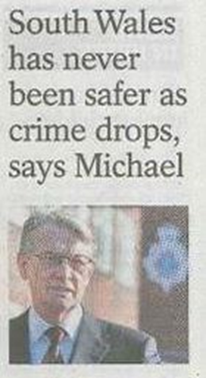
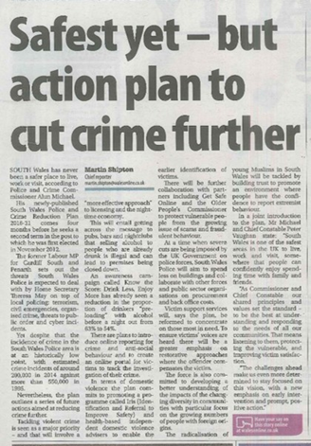

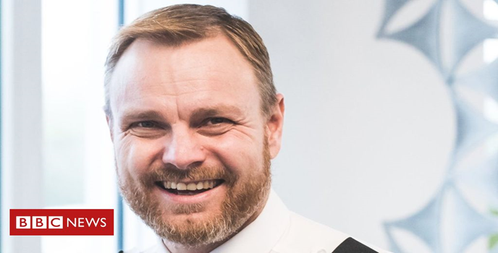
The Marketing of the Police

Slide 8
But how will this be achieved?
Priorities – South Wales Police & Crime Reduction Plan 2017-2021
To reduce and prevent crime and anti-social behaviour to keep people safe and confident in their homes and communities
To improve the way in which they connect with, involve and inform communities
To work to protect the most vulnerable within communities
To make sure that the local criminal justice system works effectively and efficiently, meeting the needs of victims and challenging offenders
To make a contribution to the strategic policing requirement and successfully police major events
To spend public money wisely to protect policing in your community
But if a police service makes promises the public expects those promises to be kept?

Slide 9
Policing Partnerships
The days of public bodies such as the police service acting unilaterally are clearly extinct
The combined impacts of grant cuts and inflation have resulted in a savings target of £58m between 2010/11 and 2019/20
Economy of scale has probably never been more important (shared services)
Police working directly with public health bodies on initiatives to prevent offending in the first place
Holistic and multi partnership model of problem solving e.g. Adverse Childhood Experiences research (ACE)
  A study conducted in California on almost 17,500 people published in 1998
  Focussed on a questionnaire of adverse childhood experiences such as abuse, neglect, witnessing violence, substance misuse or having a relative in prison.
Unsurprisingly these adverse experiences were found to have a negative impact on the individuals life chances

Slide 10
Public Perception of Policing
1982 92% of public expressed confidence in policing- 2004 decline to 47% (Bassett et al, 2004,cited in Rogers et al, 201:3)
Satisfaction rose to a national average (W&E) of 52% in 2016
https://www.ipsos.com/en-uk/public-perceptions-policing-england-and-wales-2017

Slide 11
The Future of Policing
Evidence approaches are currently vogue, prevention is better than cure and instead of separating elements of community life such as policing, health, and education. The emphasis is now on integrating them.
Increasing use of private sector, interagency work, involving communities to make the cohesive community - ‘responsibilisastion strategy’ (Garland, 2001)
Lots of strategy but it seems that Peel’s Principles remain intact – “The police are the people and the people are the police”

Slide 12

A Contemporary Issue for Policing
The War on Drugs

Slide 13
Debate about policing of drug use
Prohibitionist OR Reformist
“The best the police can hope to do is to disrupt the drugs trade” (Grieve, 1994)

Slide 14

1. Transnational Policing
Drugs entering the UK from a range of countries
Complex importation routes
International co-operation between criminal justice agencies

Slide 15
A Global Approach
Policing the global market in narcotics is the ‘model example’ of transnational policing.
Prohibition rests upon the presumption that or hope that to stem the supply can change the game in relation to drug trafficking.
However, Police activity tends to result in the punishment of the weaker ‘small’ players leaving large scale organised crime largely untouched.
In general terms, drug seizures account for only about 10% of the estimated drugs in transit.
The UN estimate of drug users in the world in 2010 was over 250 million people with the trade being worth well over £160 billion
Bowling & Sheptycki (2012)

Slide 16
Discussion Question
What issues/obstacles do you think there might be in relation to the transnational policing of the supply of drugs?

Slide 17
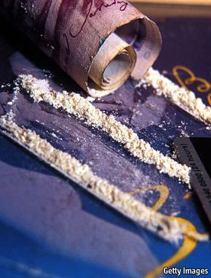
Issues with Transnational Policing of the Supply of Drugs
Very limited impact
Werb et al (2013):
“…expanding efforts at controlling the global illegal drug market through law enforcement are failing.”
Prices have fallen and purity has increased

Slide 18
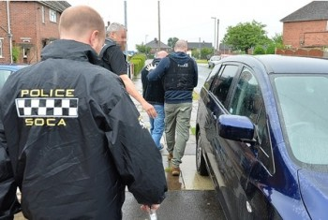
2. National Policing
Major changes in organisational structures in 2006, and again in 2013
Prior to 2006 – National Crime Squad (NCS) & National Criminal Intelligence Service (NCIS)
2006 – 2013: Serious Organised Crime Agency

Slide 19

National Crime Agency
Formed in 2013
In effect a UK version of the FBI

Slide 20
National Policing
2013 – National Crime Agency
The NCA delivers this national response through the four pillars of:
Pursue - prosecute and disrupt people engaged in serious and organised crime
Prevent - prevent people from becoming involved in serious and organised crime
Protect - increase protection against serious and organised crime
Prepare - reduce the impact of serious and organised crime where it takes place

Slide 21
Short Film on National Crime Agency
https://www.youtube.com/watch?v=Zd7AaOuUwzQ

Slide 22
Discussion Question
What issues/obstacles do you think there might be in relation to the national policing?

Slide 23
Issues with National Policing of the Supply of Drugs
SOCA (Serious Organised Crime Agency) criticised for its limited impact, excessive bureaucracy, poor performance in terms of actual arrests & asset recovery.

Slide 24
County Lines
An organised crime group (or urban gang) from an area such as London, Birmingham and Liverpool who extends their drug dealing enterprise across county boundaries is known as a running a ‘county line’.
Organised crime groups often use young people or vulnerable adults to deliver their drugs, coercing them with payment or gifts or by forcing them through intimidation and violence.

Slide 25
County Lines
Children as young as 12 years old can be targeted and recruited to travel between the urban home county and more rural locations to deliver drugs and collect cash on behalf of the dealers. This helps the urban gang members evade detection.
Human trafficking forms part of this type of crime. Dealers will often force young and vulnerable people into storing and supplying drugs, with ‘runners’ sometimes going to extreme lengths to avoid the police finding the drugs on them.

Slide 26
County Lines – Who Do They Target
Having prior experience of neglect, physical or sexual abuse;
Lack of a safe/stable home environment;
Social isolation or social difficulties;
Economic vulnerability;
Homelessness or insecure accommodation status;
Connections with other people involved in gangs;
Having a physical or learning disability;
Having substance misuse or mental health issues;
Being a ‘looked after’ child, particularly in residential care;
Resident of social housing in drug hotspot, particularly young females with children.

Slide 27
Short Film on County Lines
https://www.youtube.com/watch?v=JPXlx9C0Rxs

Slide 28
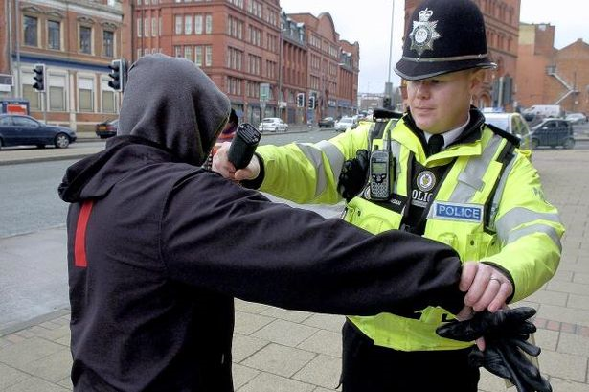
3. Local Policing
Stop & Search
Raids
Intelligence based on key informants
Use of Disruptive Street Policing
Police Visibility
Focus tends to be users or minor dealers.

Slide 29
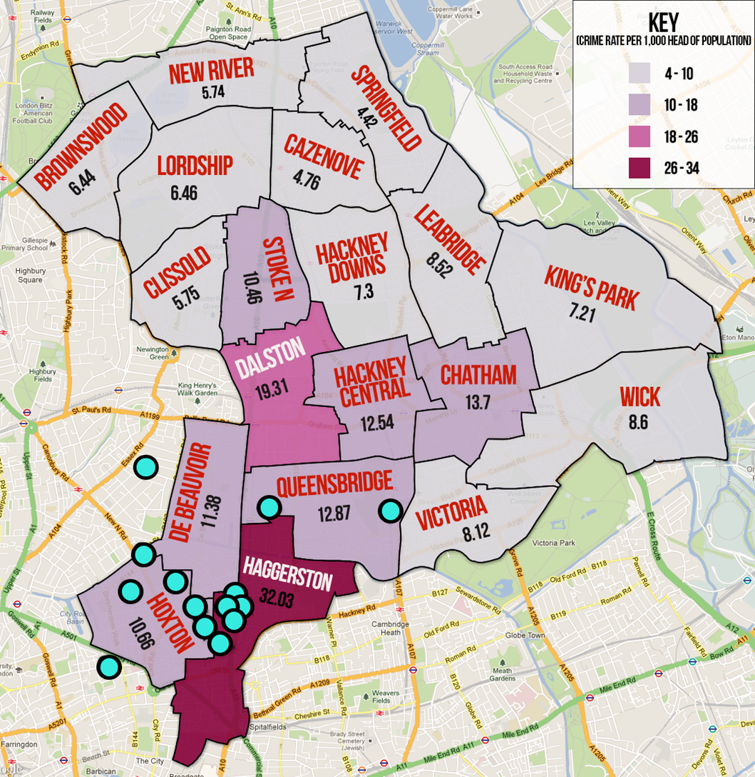

Slide 30
Discussion Question
What impact do you think local policing generally has? And, what issues might there be with local level policing in this way?

Slide 31
Local Policing
Considerable degree of discretion for frontline officers in terms of action.
There is scope here for an officer’s own opinion to effect how they implement policy.
Policy is/could effectively be deprived by officers on the ground exercising their decision.
Questions what the role of central legislation actually is.

Slide 32
Impact of Local Policing
Driving some markets underground
Impact on price?
Dependence on work partnerships e.g. probation services – social services – police etc…
Raids ineffective in isolation – must have services available

Slide 33

In Relation to County Lines how important is the EBP approach to resolving this problem?

Slide 34
General Concerns relating to the Policing of Drugs
Corruption
Methods & practices employed
Disrespect for the law & its enforcers
Forcing users & dealers underground
Displacement

Slide 35
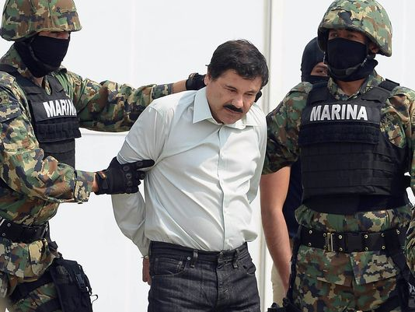
General Concerns relating to the Policing of Drugs
Mapping
Stereotyping & oversimplification of markets
Finite resources & police priorities
Mixed messages from senior police officers?

Slide 36
Drugs in UK Prisons
If the drug problem is hard to control in Prisons how difficult is it to resources and control on the outside?

Slide 37
Conclusion
Policing Drug Supply has had relatively little impact to date.
Adverse/Perverse Consequences
Prevention of purchase and sale not an achievable goal.
Solutions?
Make Drugs legal?
Arrest Dealers?
Shut down Websites?
Policy-implications – ‘war on drugs’?

Slide 38
Week 9 Complete
Any Questions?
Thank you for listening!
Good luck with your assignment!

