Slide 1


Solving the problem of profit declining within TM Lewin
Shakira Yasmin Akhter
2130089
Problem solving and decision making BMSW4004

Slide 2
Understanding the impact and nature of profit decline in TM Lewin:
Nature:
The pandemic left many businesses to face profit decline
All TM Lewin stores located in UK were effected
Impact of profit on employees
Job losses due to closure of 66 shops
Impact the profit decline on TM Lewin
Impacts the entire organisation and could lead to closure of the company

Slide 3
Understanding the cause of profit decline for TML.
To solve a problem the main cause must be identified.
What is the main cause?
A range of tools are available to determine this.
Pestel
Fishbone

Slide 4

Pestel analysis
Pestle analysis is used to understand the external factors causing profit decline

Slide 5
PESTEL Analysis
POLITICAL- During Covid-19 which meant sales decreased as everyone was in lockdown and was unable to visit and purchase stock.
ECONOMIC- Prices rising was a concern for both businesses and consumers as customers could not afford the goods and businesses could afford to invest.
SOCIAL- Staying home and ban of public events meant reduced sales
TECHNOLOGY- Remote working was put into place which meant no need to purchase in store.

Slide 6
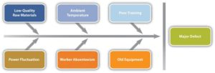
What is a fishbone analysis?
A fishbone diagram is a visual way to look at cause and effect. It is a more structured approach than some other tools available for brainstorming causes of a problem

Slide 7
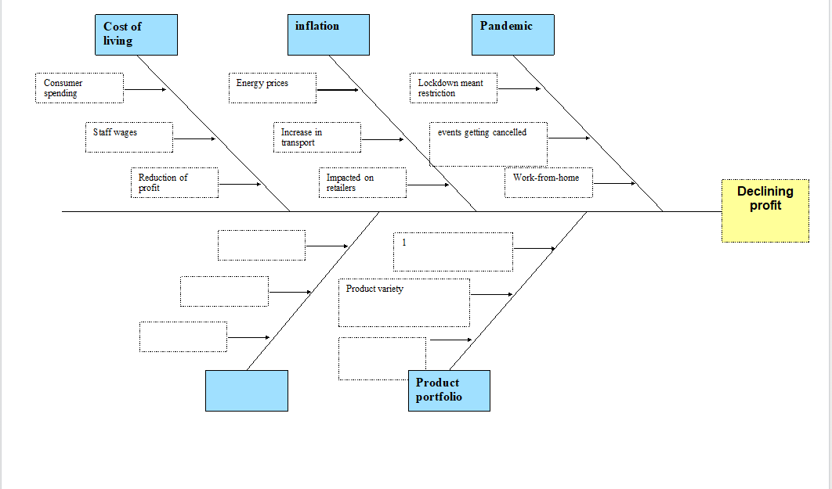
Fishbone analysis

Slide 8
Possible solutions to address profit decline
Pandemic causing stores to close down
Make an online store to allow customers to purchase
Cost of living
Ensure the prices are affordable
Discounts
Rewards
Product portfolio
Bring out a wider range of products

Slide 9




Solutions that target the main causes

Slide 10
What are the main three causes?
Lockdown restrictions
Cost of living
They could see sale rates to decline potentially undermining the continued existence of the business.

Slide 11
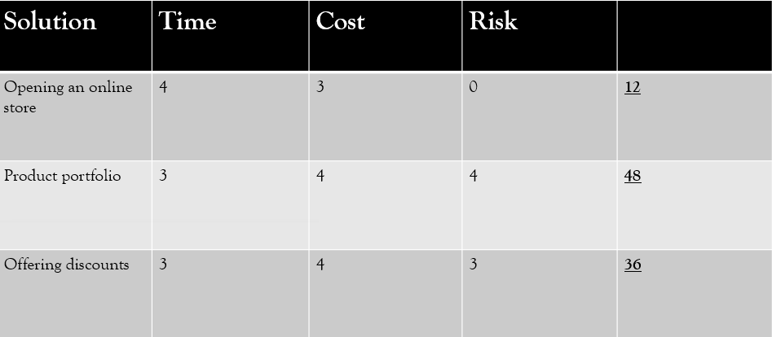
Grid Analysis

Slide 12
Conclusion
In conclusion the most effective way to stop profit decline is changing the product portfolio .
Why?
Scored the highest in the grid analysis
More convenient
Attracts more and new customers.

