Slide 1

Tehnology and collaboration
Radoslav Nikolov (2118366)
Tanweer Hussain (2123799)
Wich digital tool most comonly used for collaboration at UWTSD
Digital Skills and Research Methods.BMSW4003_BIRM
Abdi Rahman

Slide 2

Introduction and reserch metod
1 Introduction
2 Relevant existing research
3 Ethical consideration
4 Our proposed method
5 Our research timeline
6 Our hypothesis
7 Q&A
8 Referencing

Slide 3

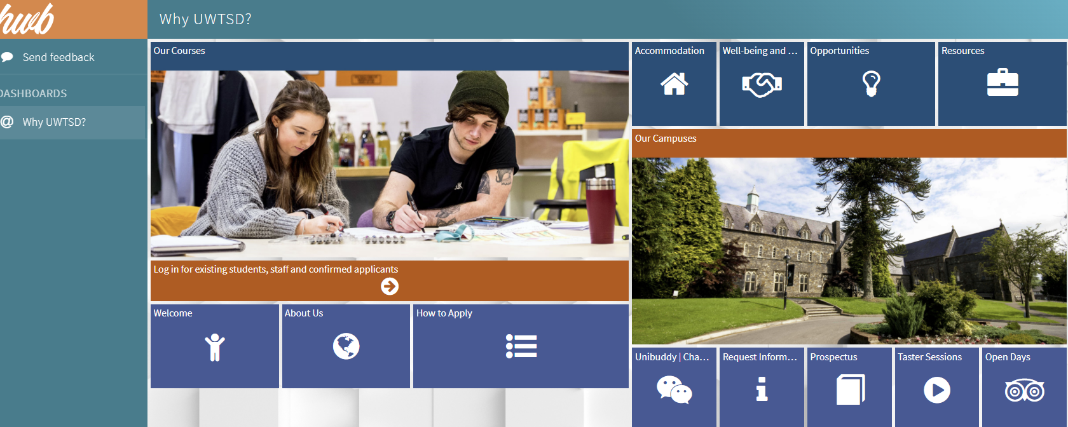
Introduction​
Hello, everyone and welcome to the application of the UWTSD.
Isn't this the best way of collaboration with technology.

Slide 4
Relevant existing research
Effective collaboration happens when
the tools needed are available and
used appropriately by the collaborators.
Collaboration is a challenging undertaking. The original example of collective pooling of resources that are then shared by a community was the shared commons (Hardin, 1968).
University-Industry Collaboration Strategies in the Digital Era is an essential research publication that provides comprehensive research on
competitive strategies for higher education institutions that will allow them to forge beneficial partnerships with industries that will have a significant impact on their success.
Highlighting a wide range of topics such as human resource management, network planning, and institutional structure

Slide 5
Ethical consideration
Integrity, fairness and open-mindedness
Respect for others
Avoidance of harm
Privacy of those taking part
Informed consent of those taking part
Voluntary nature of participation and right to withdraw

Slide 6
Our proposed method
Week ​ | ​
1​ | Gathering for info​
2​ | ​Gathering for info
3​ | ​Gathering for info
4​ | Etikal staff design question​
5​ | Submit presentation ​
6​ | Presentation proposal ​
7​ | Feedback ​
8​ | Analysis ​
9​ | Draft report​
10​ | Submit final report​

Slide 7
Our hypothesis
Ournhipotesis is Definitely the future belongs to technology they will improve and communications will certainly which when used will be much better than those that were before.
Щракнете за текст

Slide 8

Q&A

Slide 9
Referencing
Olson, J.R. (2014) Working together apart : collaboration over the internet . Gary M. Olson (ed.). [Online]. San Rafael, California (1537 Fourth Street, San Rafael, CA 94901 USA) :, Morgan & Claypool. Available from: doi:10.2200/S00542ED1V01Y201310HCI020.
Kolbaek, D. (2018) Online collaboration and communication in contemporary organizations . Ditte Kolbaek (ed.). Hershey, Pennsylvania :, IGI Global.
GuÌnay, Asunakutlu, T., & Yildiz, O. (2021). University-industry collaboration strategies in the digital era. IGI Global.
Picture 1 and 2 take from Internet

