Slide 1


Service
Portfolio
Contact
Eco-Efficiency vs. Profitability:
Food Waste & Circular Economy Efficacy in the Contemporary Hotel Sector
  Student Name: Elena Boboc
  Student Number: 2206217
  Module: Contemporary Themes in the Hotel and Hospitality Sector
  Module Code: BMIH6001
  Lead Lecturer: Dr. Ernest Wavei

Slide 2


Introduction
Balancing premium guest experiences with the ethical demands of Net-Zero targets.
Transitioning sustainability from a "marketing tool" to a "management dimension."
Technical eco-efficiency only succeeds when humanized by "Sustainability Empaths" (Sharma et al., 2022).

Slide 3

The 2026 Industry Context
  Hospitality SMEs must adopt circular models to manage resource scarcity (Bowen et al., 2024).
  Minimising "agro-industrial" food waste is now a primary driver for firm profitability.
  Integrated Smart Technology and human cooperation are no longer optional.

Slide 4


Literature Review: AI & Automation
The Smart Inventory Paradox
Precision
Automation Role
The Risk

Slide 5



Literature Review: Guest Psychology
The ‘Uncanny Valley’ of Green Tech
Trust Issues
Plate Waste
Strategic Fix

Slide 6

Research Methodology
  Framework: Systematic review of scholarly literature from 2020–2026.
  Analytical Tools: Applied PESTEL, SWOT, and 5-Why analysis for root-cause depth.
  Rigour: Cross-referenced peer-reviewed journals to ensure validated findings (Risnawati et al., 2025).

Slide 7
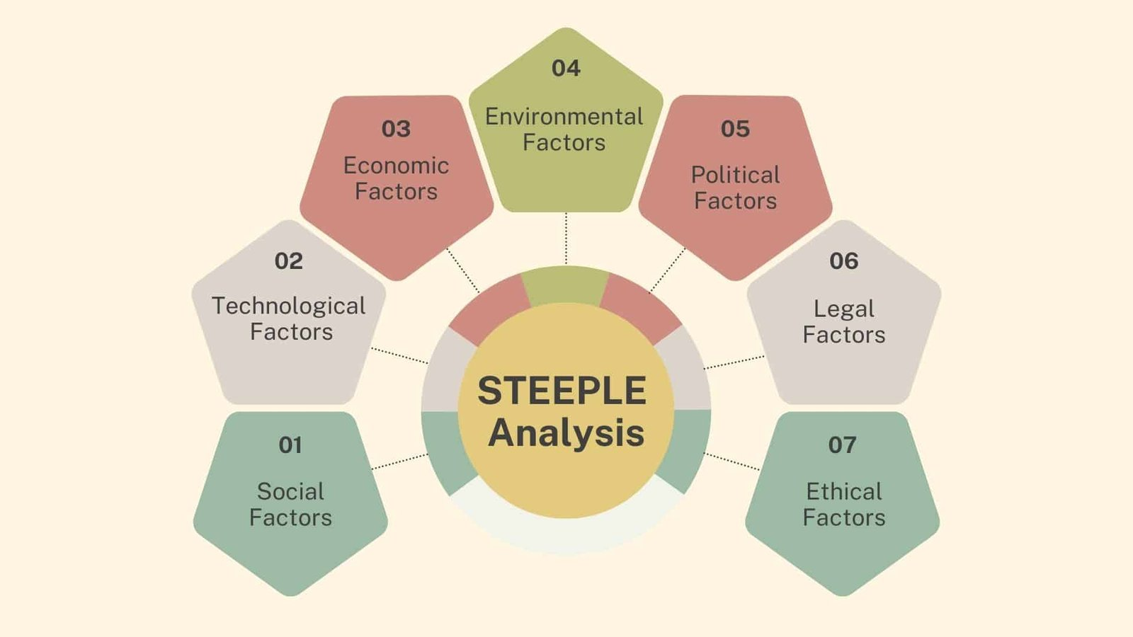


Theme Impact Analysis (STEEPLE)
About Us
Service
Portfolio
Contact
Macro-Environmental Drivers
Rise of waste-to-energy systems to reduce landfill reliance (Nubi et al., 2024)
Rigid 2026 requirements for supply chain transparency (Schaefer, 2023).
Preventing "Techno-Stress" and "Service Sabotage" among frontline staff (Zulfiqar et al., 2025).

Slide 8
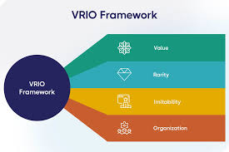

Strategic Resource (VRIO)
Is Circularity a Sustained Advantage?
Value: Eco-efficiency directly increases firm value and operational resilience (Savitri and Abdullah, 2023).
Inimitability: Deep-rooted "Green Culture" cannot be copied by software alone.
Organization: Success requires "Green Leadership" to capture frontline knowledge (Wavei et al., 2025).

Slide 9


Root Cause Analysis (5-Why)
Staff often bypass or ignore smart inventory recommendations.
Systems are often designed for "efficiency" rather than "human collaboration" (Mandić et al., 2023).
Sustainability failure is typically a management failure, not a technical one.

Slide 10
Conclusion
The Hybrid Circularity Future
Machines manage the "predictable" while humans manage the "exceptional.
Frontline employees must be treated as critical "Sustainability Managers.
Technology is the driver, but circular cooperation is the core of 2026 hospitality

Slide 11

Strategic Recommendations
A Roadmap for Efficacy
Deploy AI for "Invisible" Back-of-House carbon management (Qi, 2024).
Upskill staff into "Tech-Empowered Sustainability Empaths" (Schäpers et al., 2025).
Resolve the "Privacy Paradox" via ethical, opt-in guest data dashboards (Nira, 2025).

Slide 12
References
About Us
Service
Portfolio
Contact
  Bowen, R., Dowell, D. and Morris, W. (2024) ‘Hospitality SMEs and the circular economy: strategies and practice post-COVID, British Food Journal, 126(1), pp. 80-97.
  Deputat, M., Podolian, M., Zhupnyk, V., Terletska, K. and Gorishevskyy, P. (2024) ‘Evolution of information systems and technologies in the hospitality and tourism sector: a historical perspective’, Multidisciplinary Science Journal, 6, p. e2024097.
  Mandić, D., Panić, A. and Šain, M.Č. (2023) Automated service delivery in hotels: balancing efficiency and human interaction for optimal guest satisfaction, International Scientific Conference on Economy, Management and Information Technologies, 1(1), pp. 167-174.
  Nira, R.A. (2025) AI-Driven Hyper-Personalisation in Hospitality: Application, Present and Future Opportunities, Challenges, and Guest Trust Issues, International Journal of Research and Innovation in Social Science, 9(4), pp. 5562-5573.
  Salins, M. and Aithal, P.S. (2023) ‘Consumers’ Intention toward mitigation of plate waste behaviour in restaurants–development of conceptual model, International Journal of Management, Technology, and Social Sciences (IJMTS), 8(2), pp. 190-230.
  Savitri, E. and Nik Abdullah, N.H. (2023) The effect of eco-efficiency and good corporate governance on firm value: Profitability as a mediator, Management & Accounting Review (MAR), 22(1), pp. 379-399.
  Schäpers, P., Guntermann, T., Heinemann, H. and Mönke, F.W. (2025) Are Good Leaders Also Green Leaders? Differentiating Established and Environmental Leadership Styles, Their Antecedents, and Predictive Validity for Corporate Environmental Responsiveness, Business Ethics, the Environment & Responsibility, 34(4), pp. 2034-2047.
  Wavei, E. B., Lo, A. and Gedecho, E. K. (2025) ‘Understanding Frontline Employees’ Knowledge Management in Key Aspects of Customer Relationship Management: Insights from Contemporary Hotels, International Journal of Hospitality & Tourism Administration, pp. 1-29.
  Zulfiqar, S., Garavan, T., Huo, C., Akhtar, M.W. and Sarwar, B. (2025) ‘Leaders’ knowledge hiding and front-line employee service sabotage, The Service Industries Journal, 45(2), pp. 161-179.

