Slide 1

Nursing research project

Slide 2
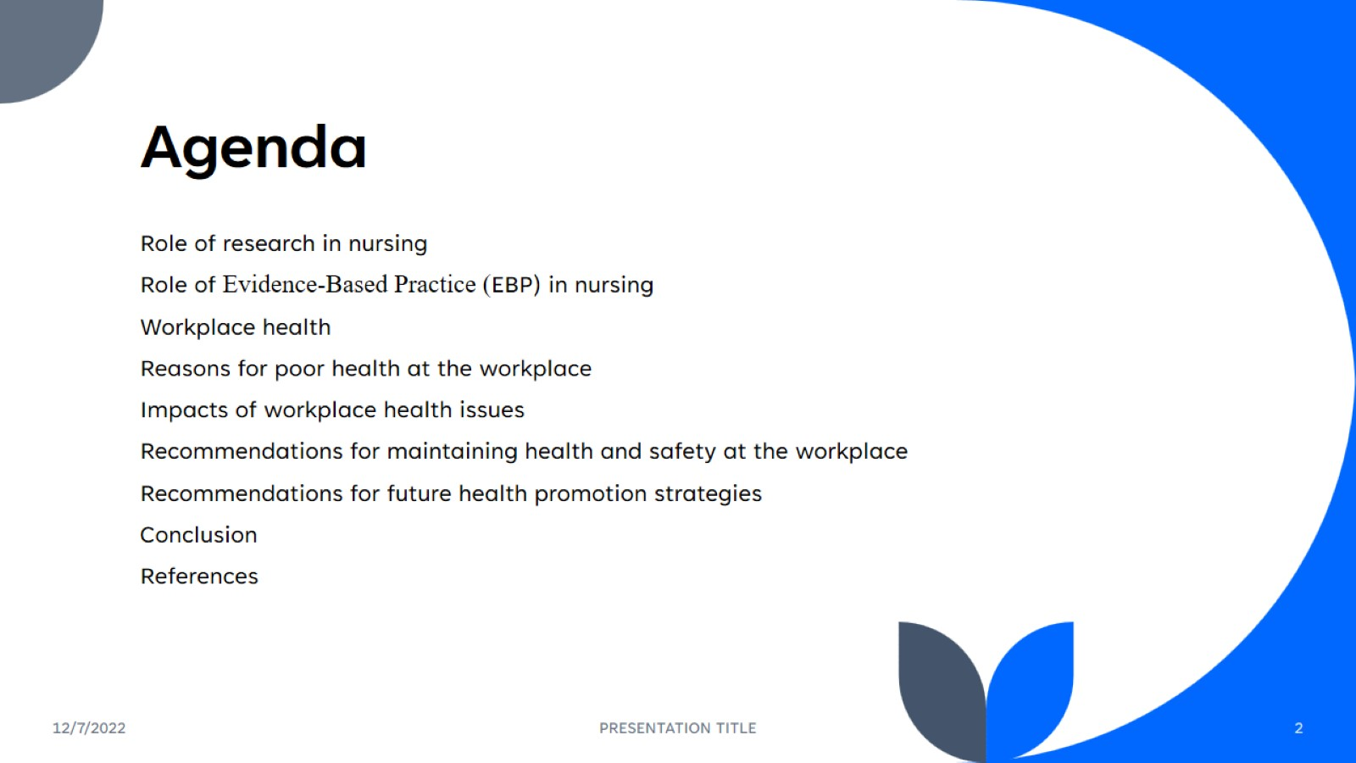
Agenda

Slide 3
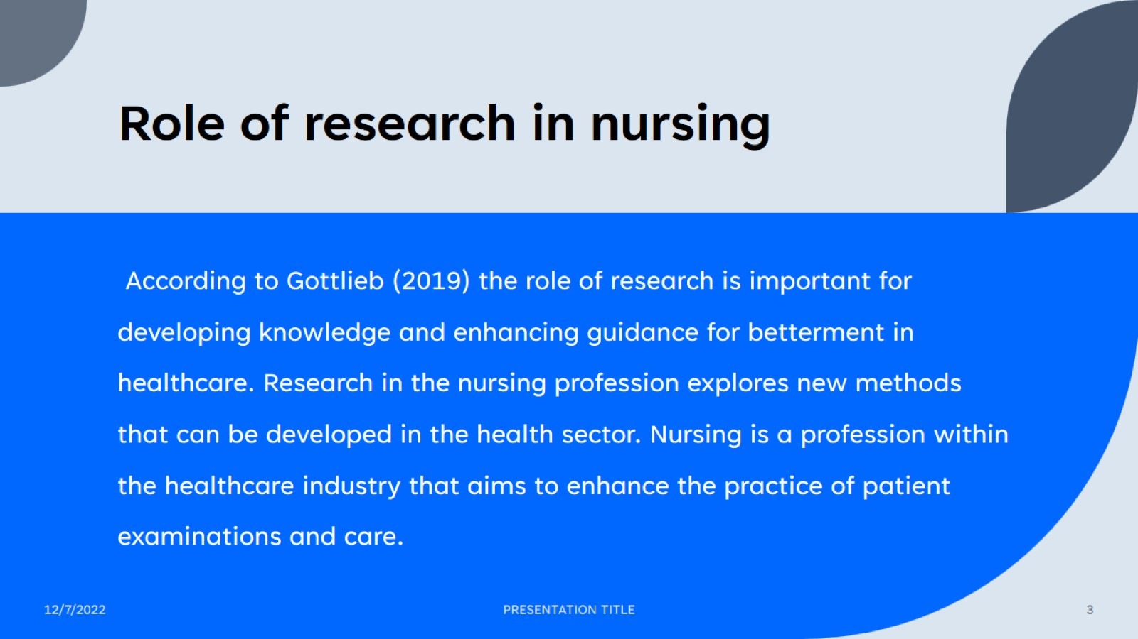
Role of research in nursing

Slide 4
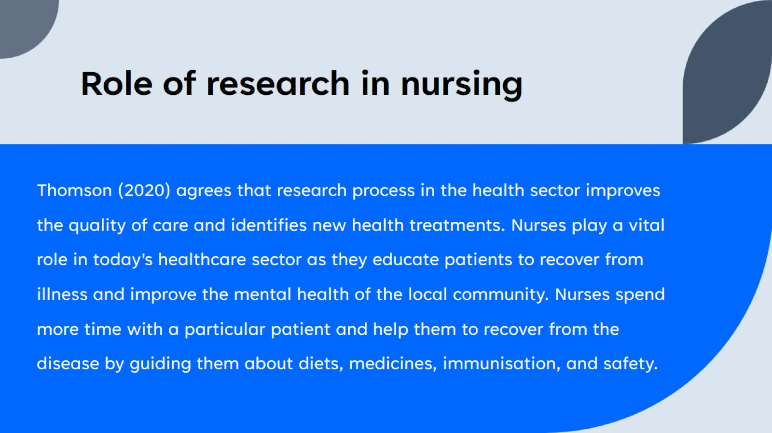
Role of research in nursing

Slide 5
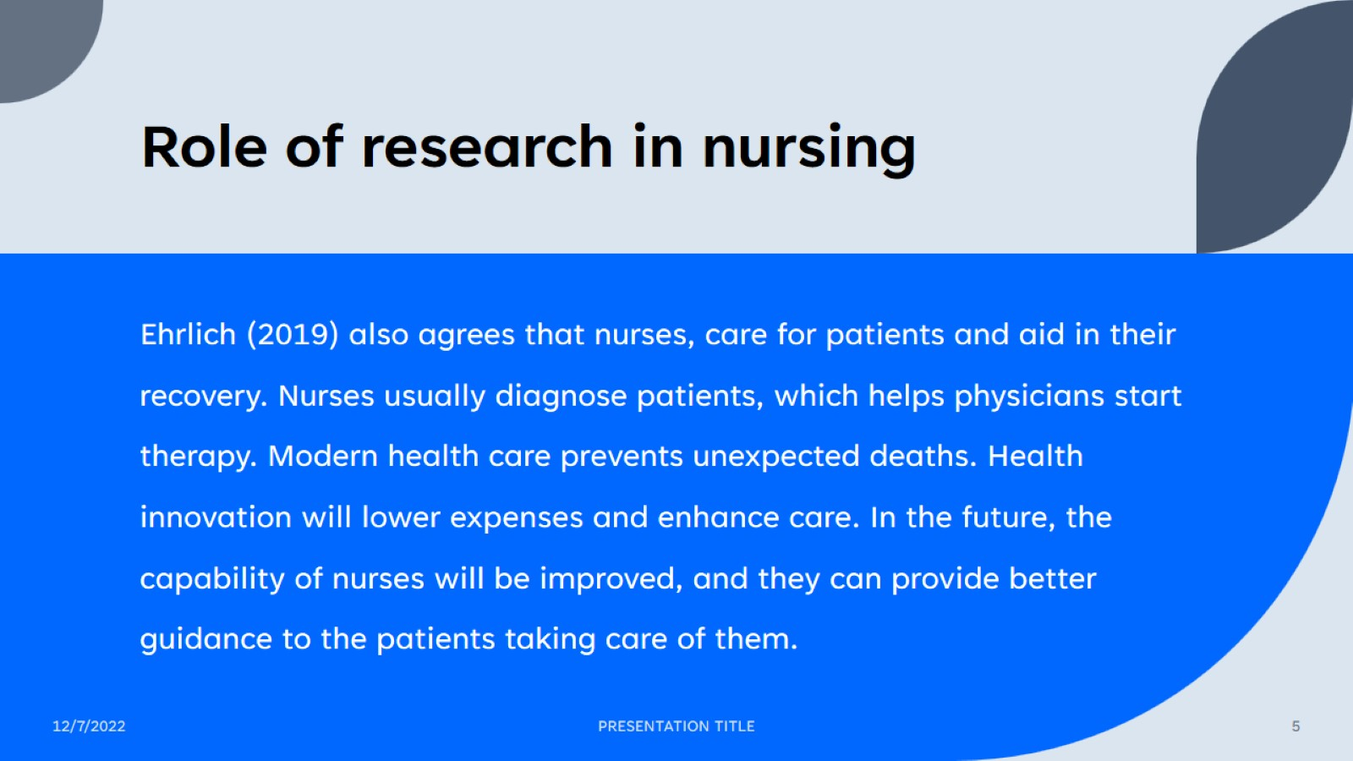
Role of research in nursing

Slide 6
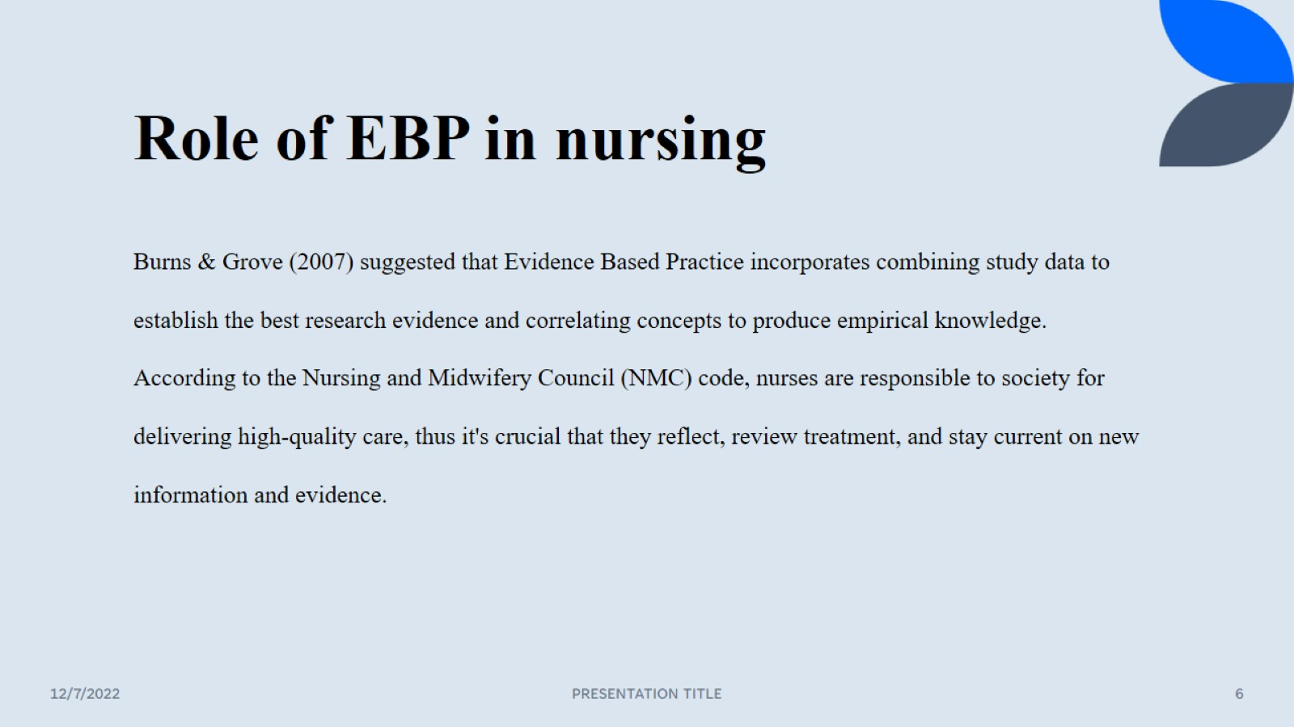
Role of EBP in nursing

Slide 7
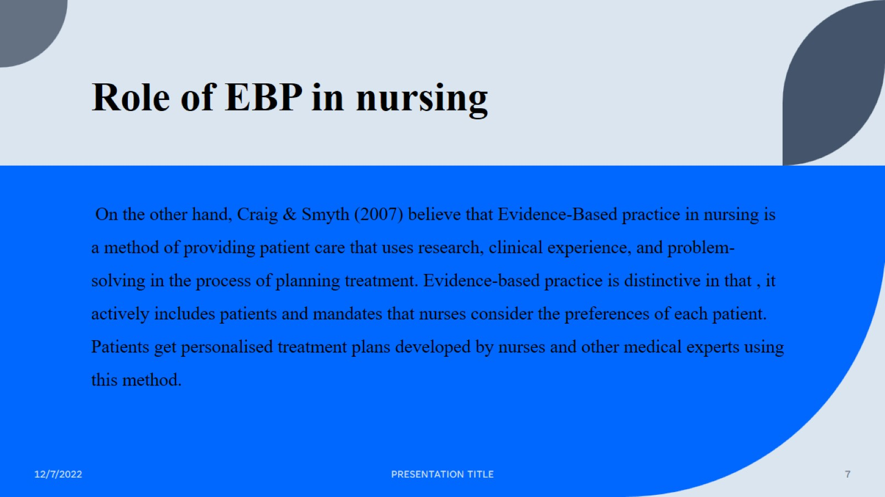
Role of EBP in nursing

Slide 8
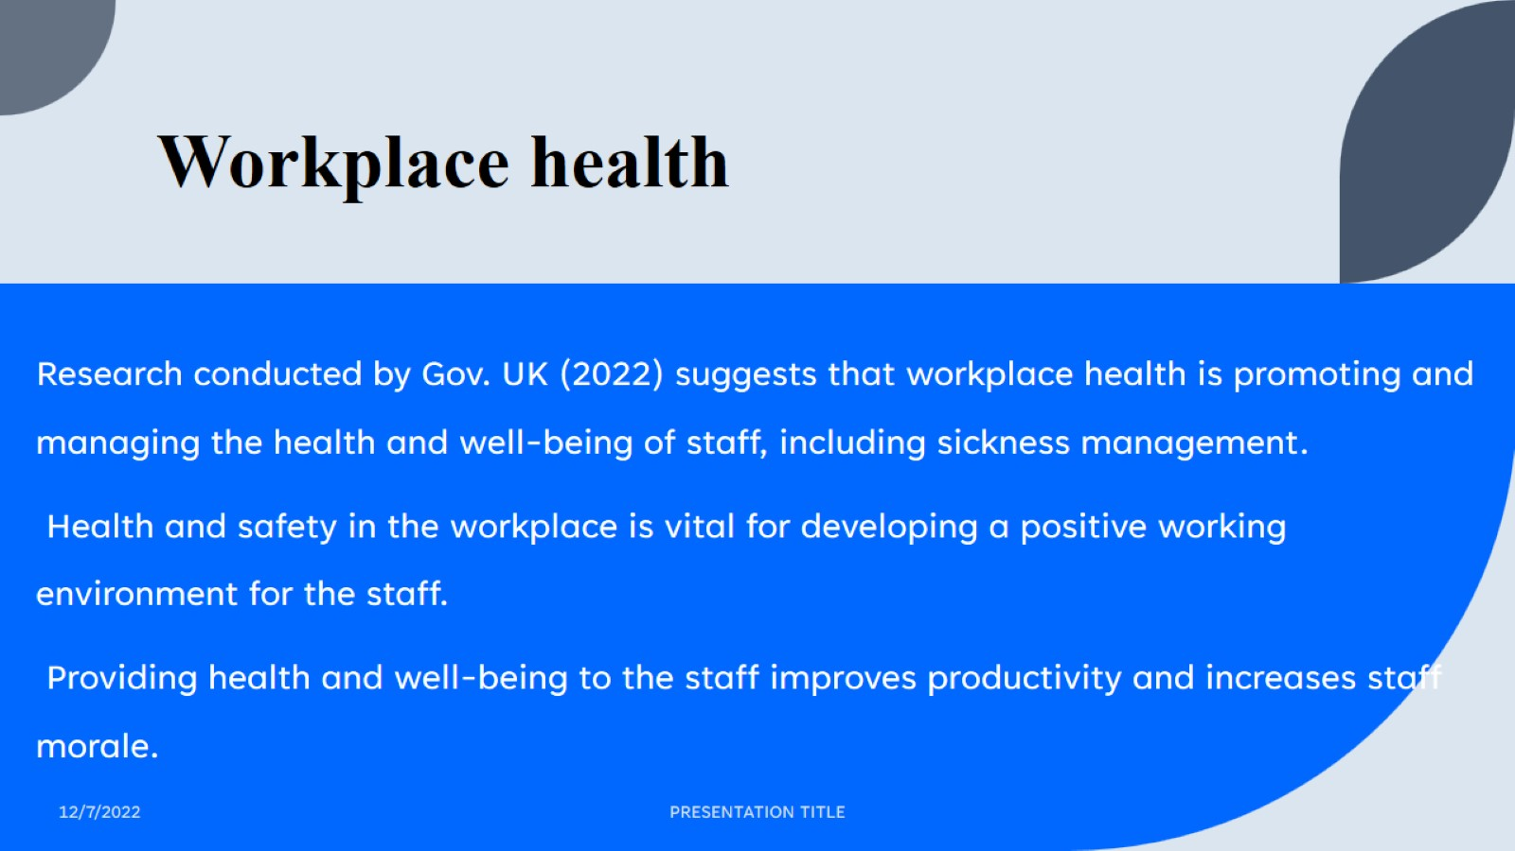
Workplace health

Slide 9
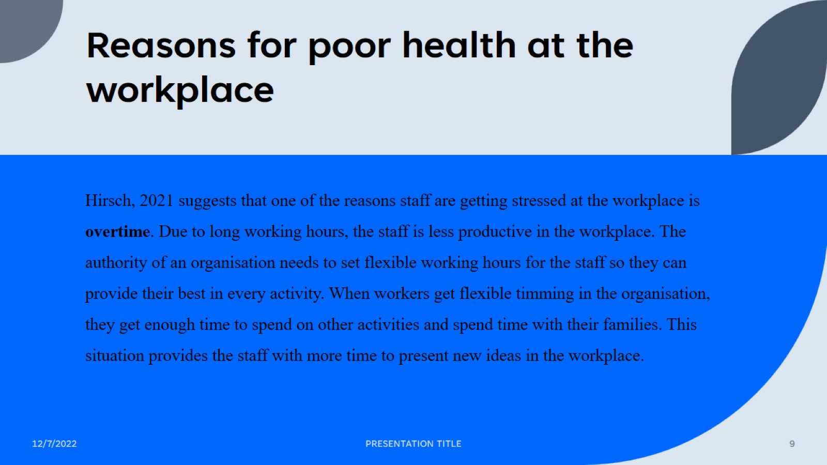
Reasons for poor health at the workplace

Slide 10

Reasons for poor health at the workplace

Slide 11
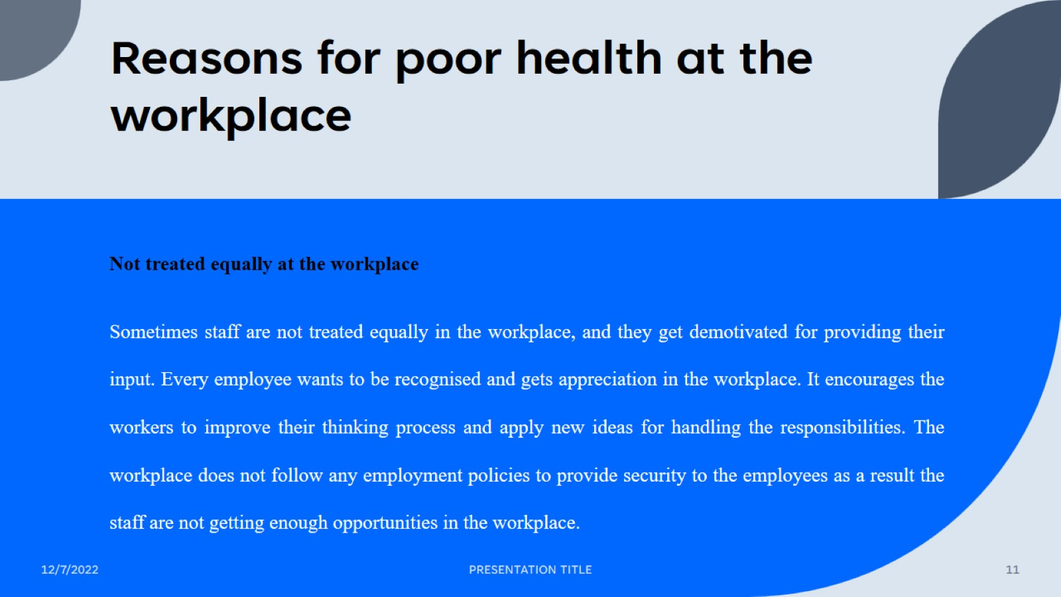
Reasons for poor health at the workplace

Slide 12

Reasons for poor health at the workplace

Slide 13
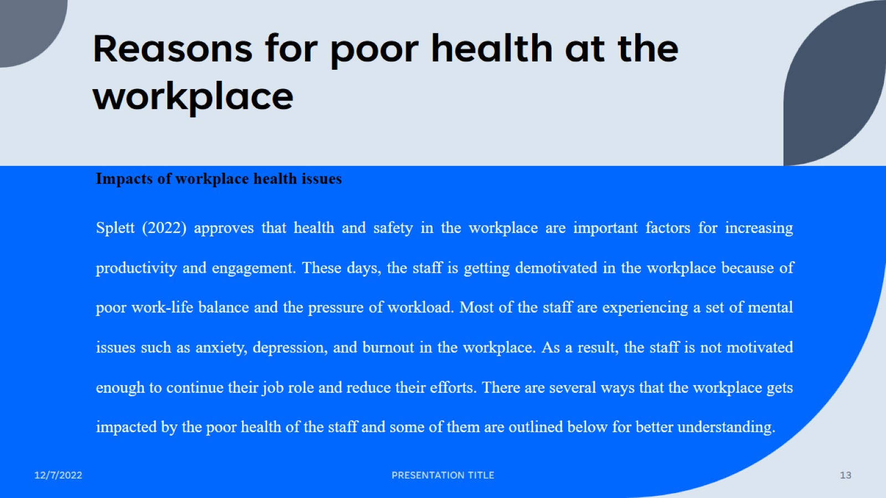
Reasons for poor health at the workplace

Slide 14
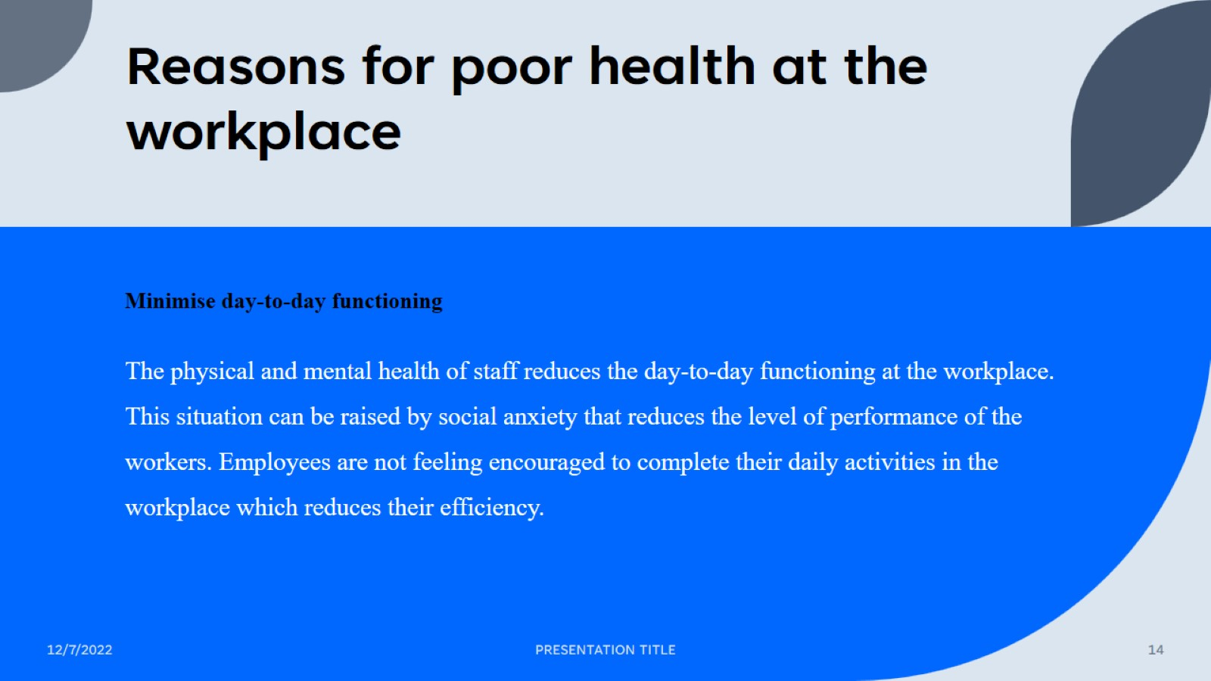
Reasons for poor health at the workplace

Slide 15
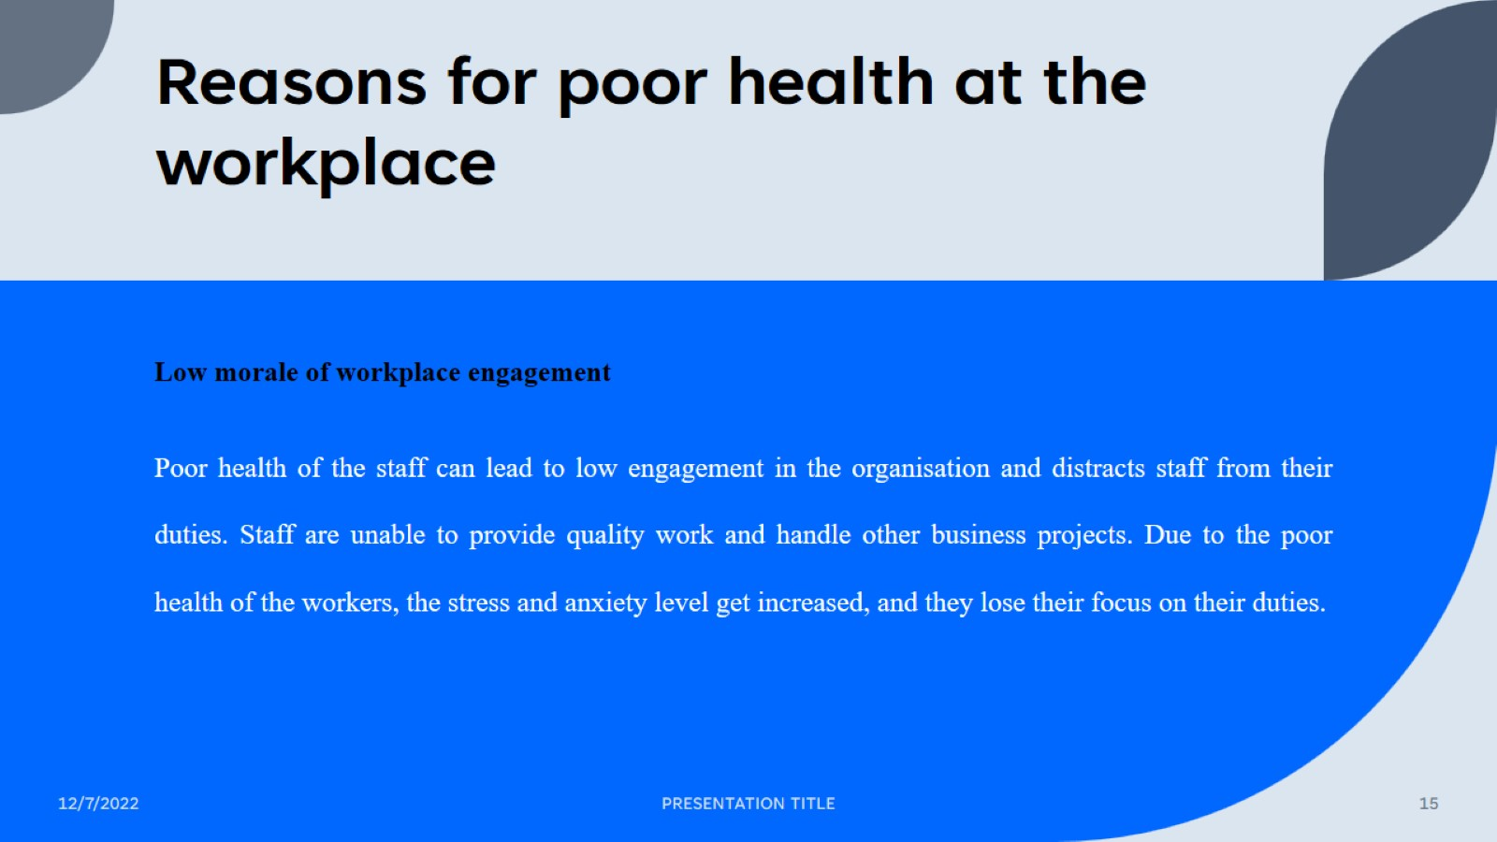
Reasons for poor health at the workplace

Slide 16
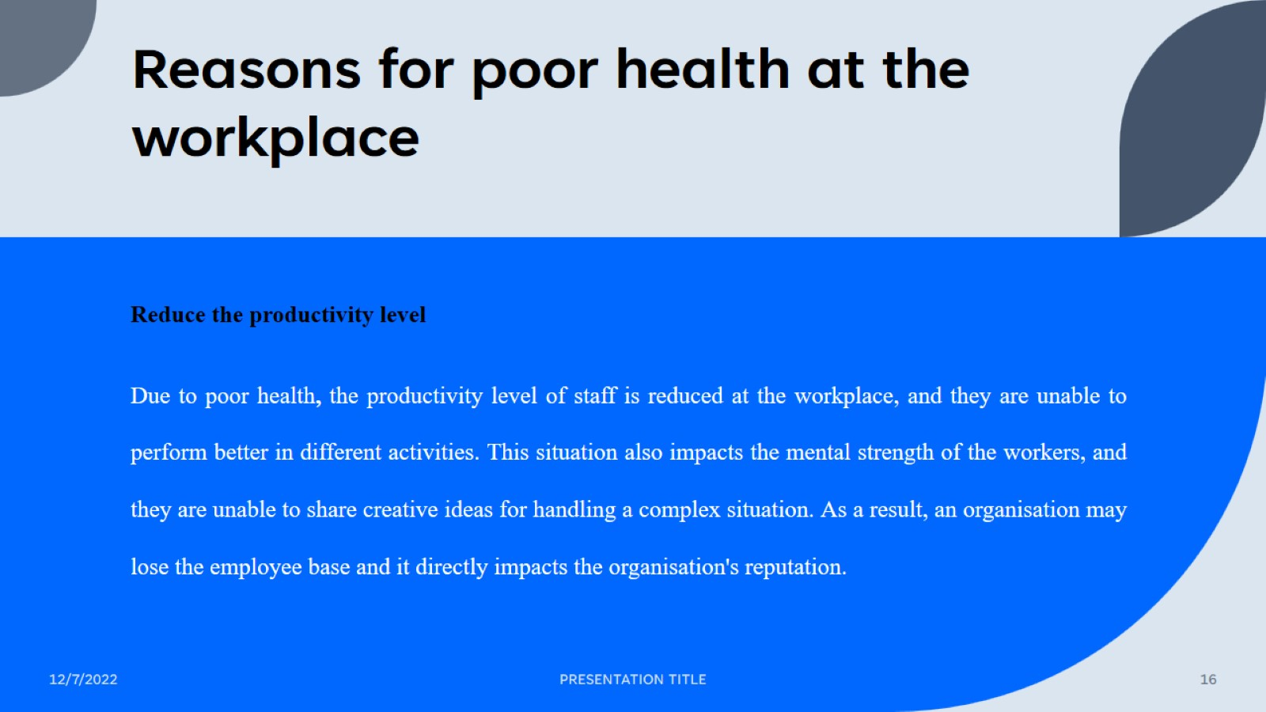
Reasons for poor health at the workplace

Slide 17
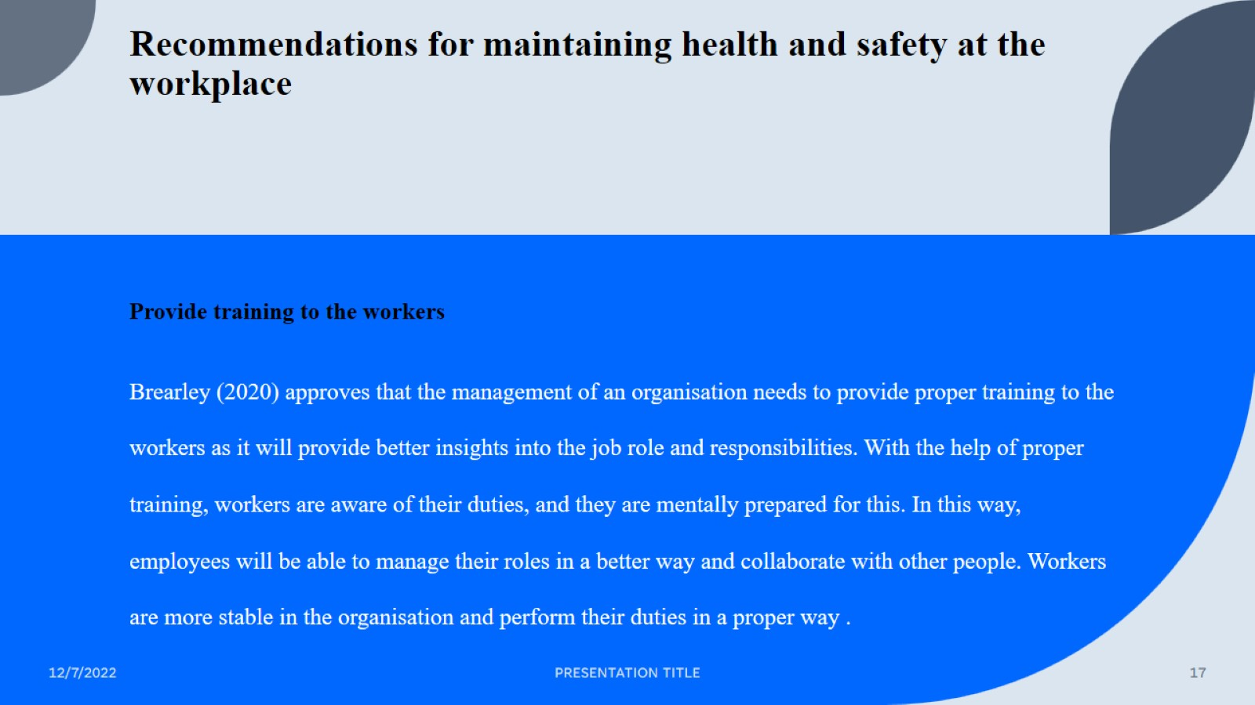
Recommendations for maintaining health and safety at the workplace

Slide 18
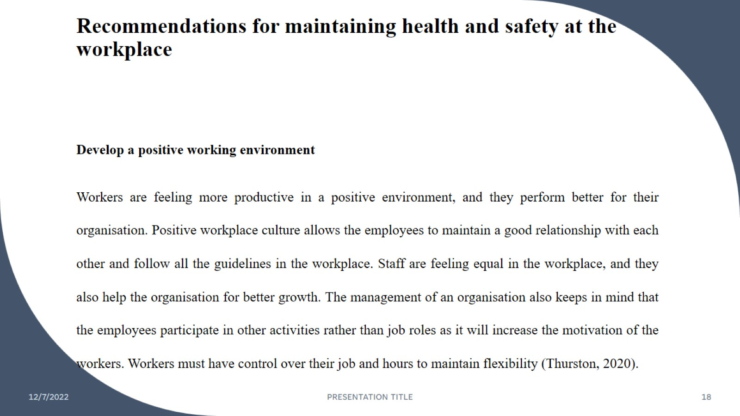
Recommendations for maintaining health and safety at the workplace

Slide 19

Recommendations for maintaining health and safety at the workplace

Slide 20

Recommendations for future health promotion strategies

Slide 21

Recommendations for future health promotion strategies

Slide 22
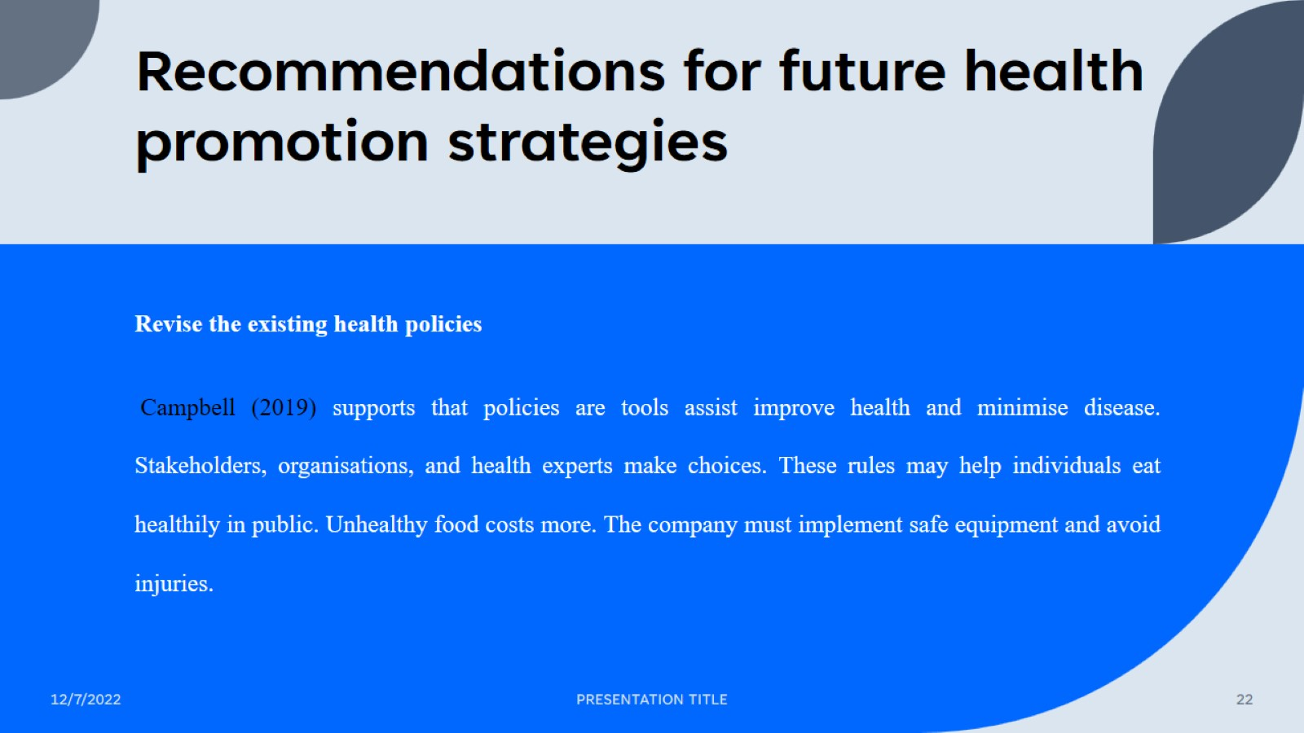
Recommendations for future health promotion strategies

Slide 23
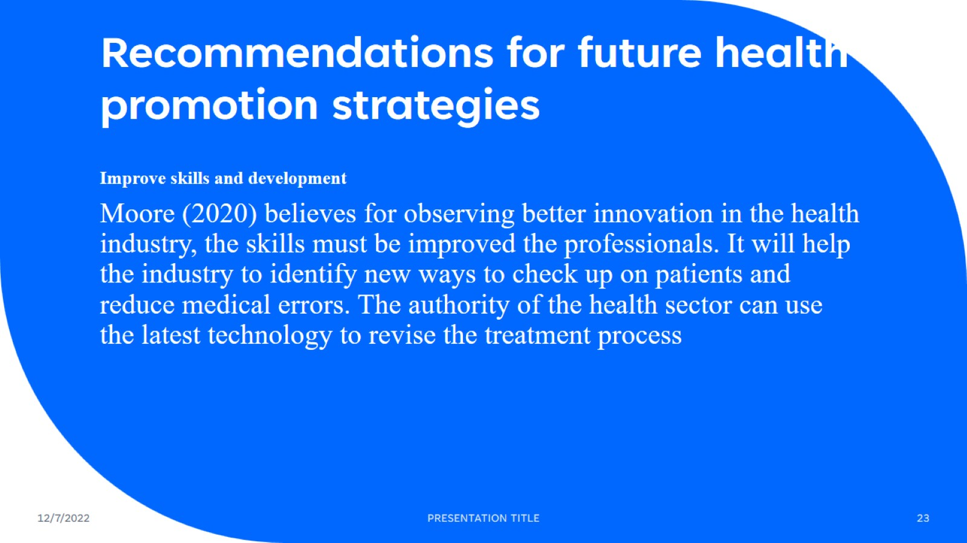
Recommendations for future health promotion strategies

Slide 24
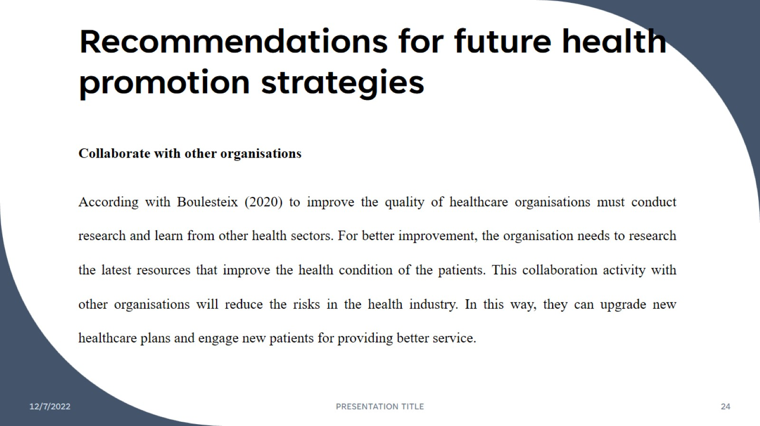
Recommendations for future health promotion strategies

Slide 25
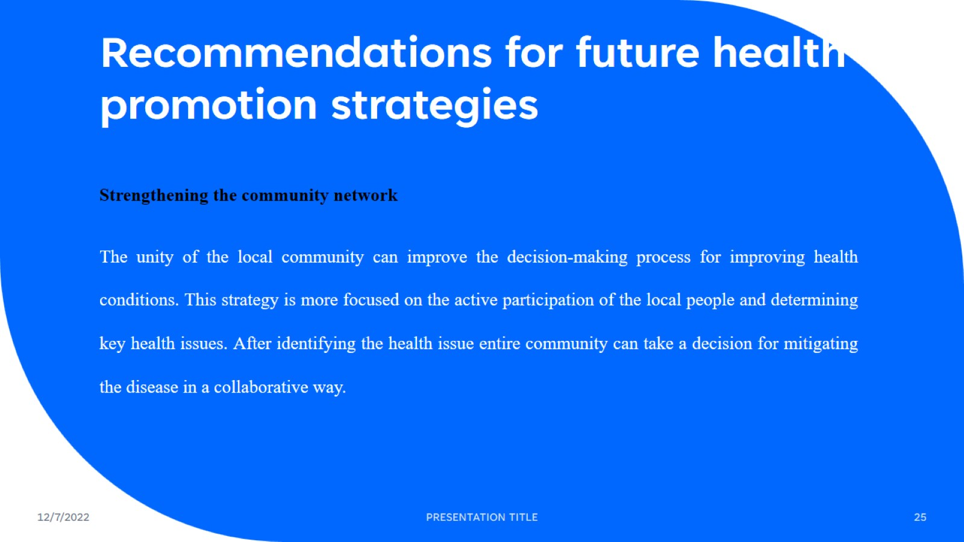
Recommendations for future health promotion strategies

Slide 26
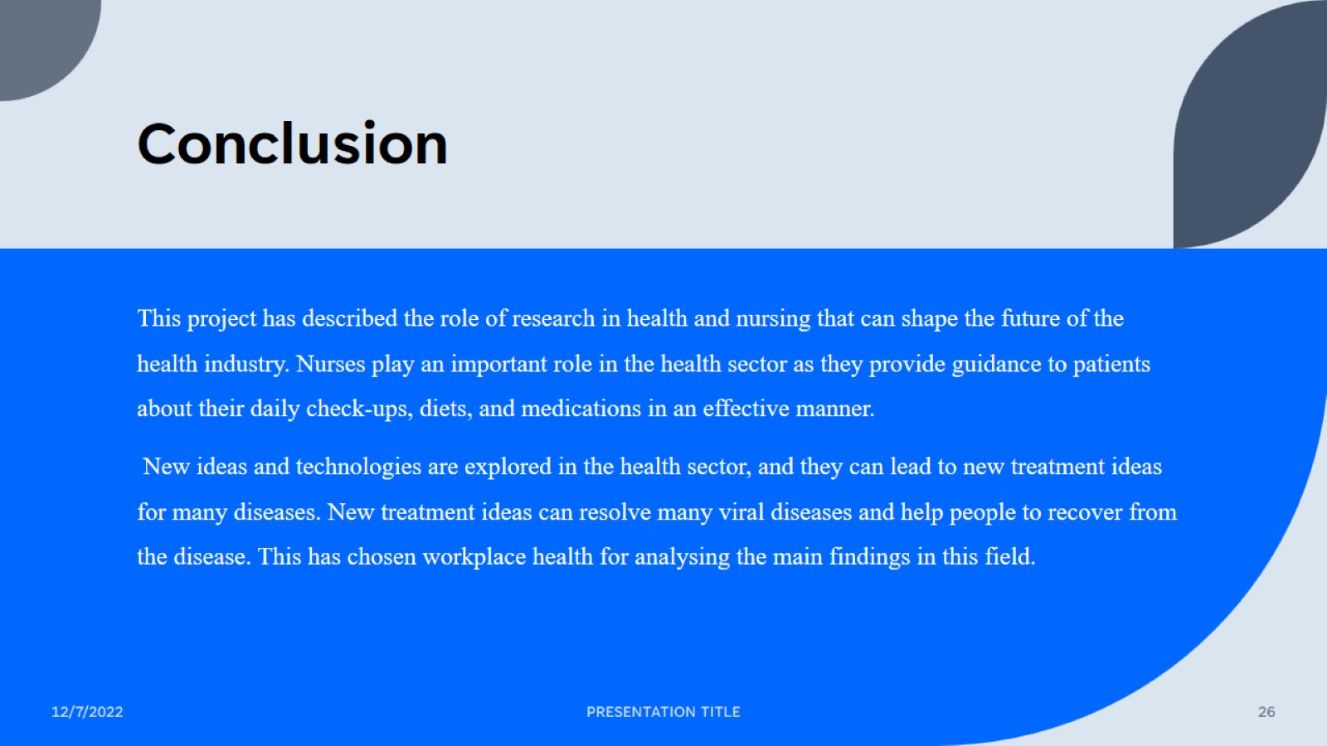
Conclusion

Slide 27
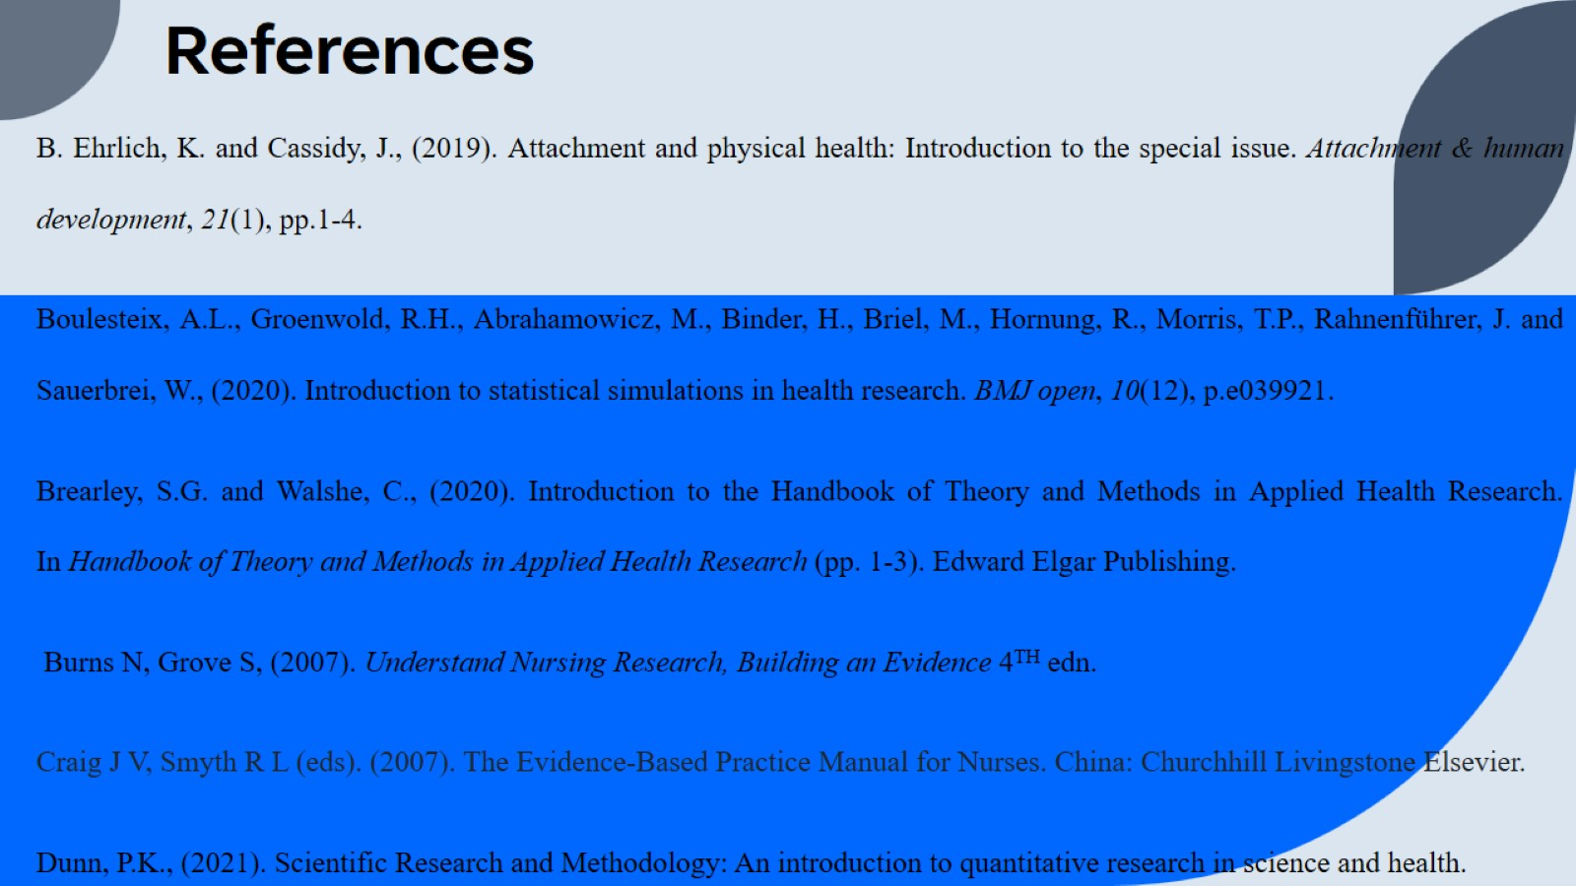
References

Slide 28
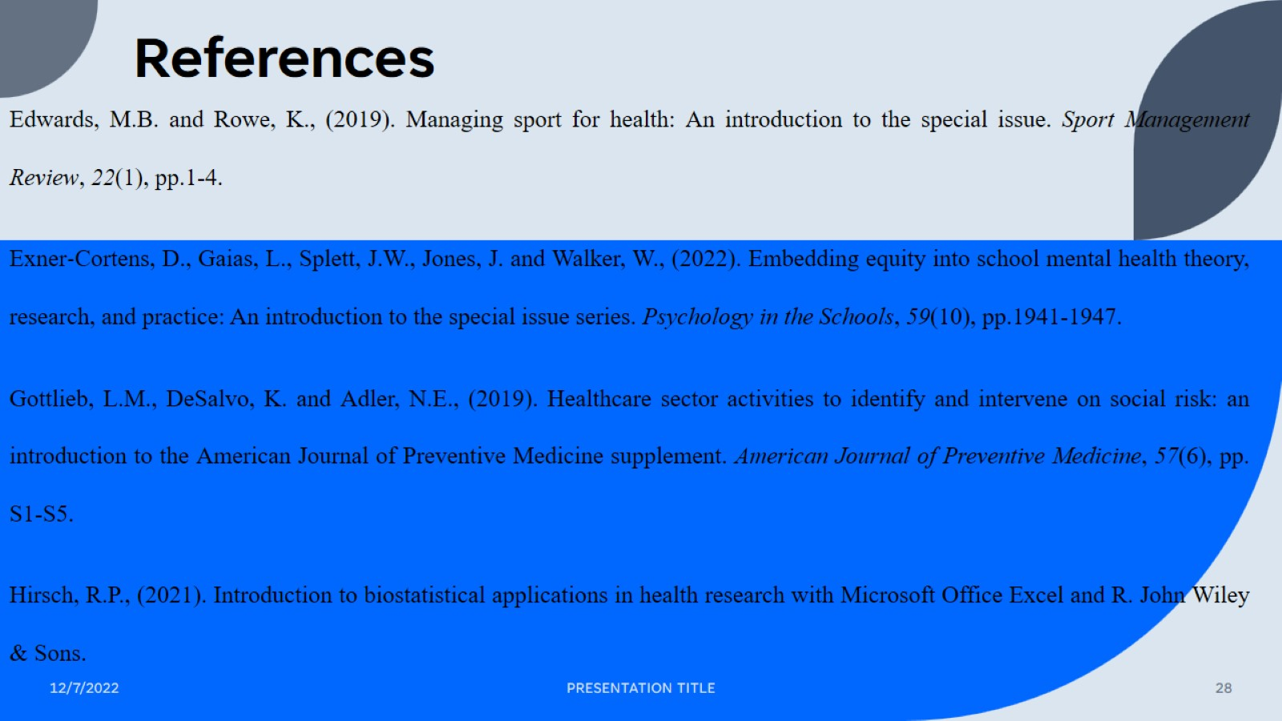
References

Slide 29
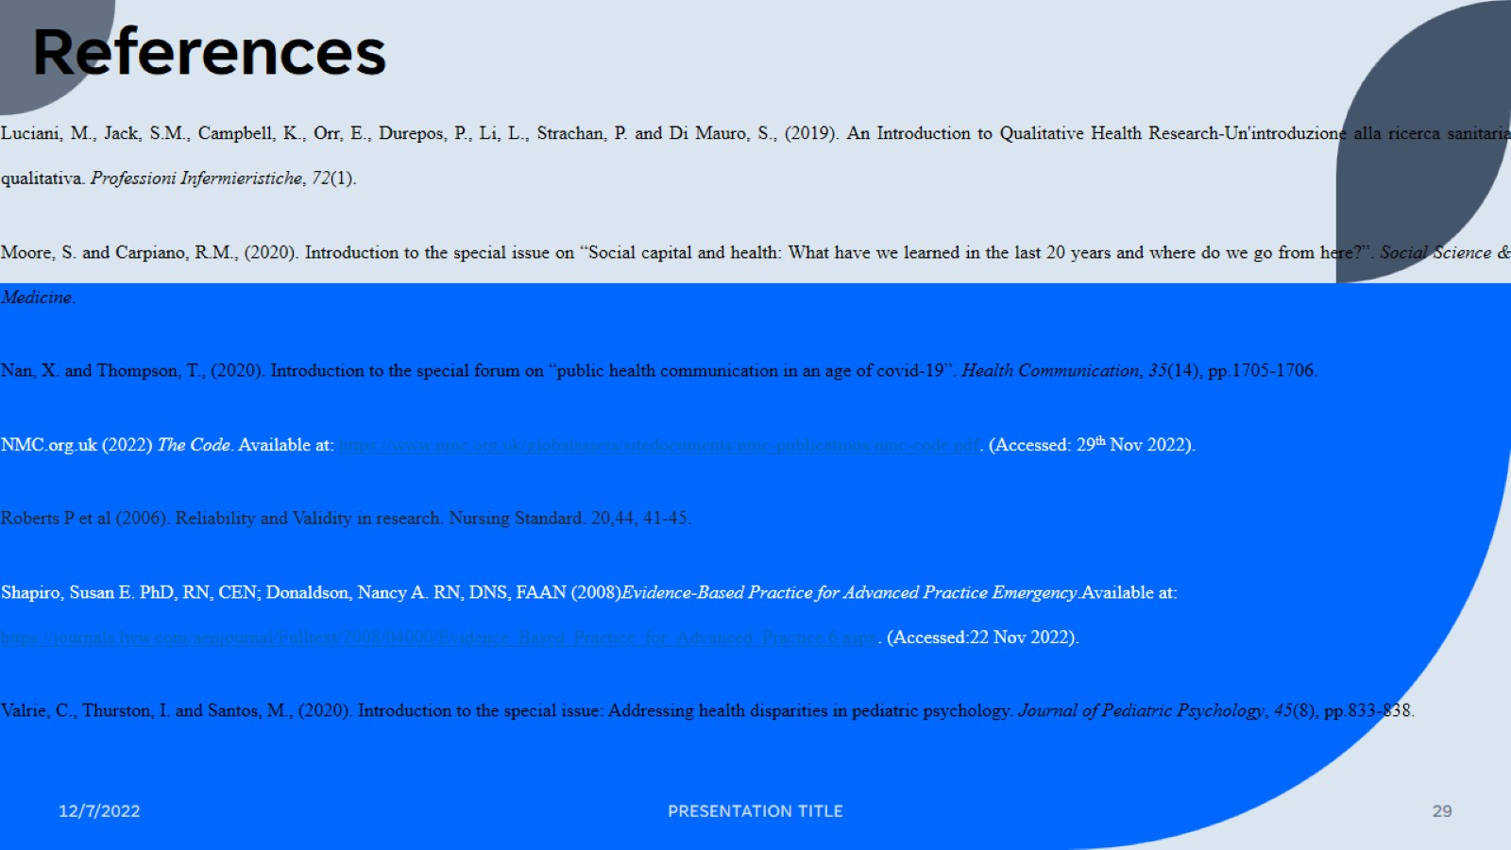
References

Slide 30

Thank you!

