Slide 1

premier inn hoteL
Nerea Juaristi
2212615

Slide 2

Introduction: Housekeeping Checklist Training
The "Housekeeping Checklist Training" focuses on maximizing the effectiveness of operations. In regarding of guest satisfaction and reputation, a carefully organized housekeeping procedure is essential in the hotel industry.
So, its necessary to focus on the essential elements of checklist with the goal of improving team performance and service quality. Examining areas such as exacting attention to detail, accurate cleaning of rooms, and efficient restocking, the objective is to strengthen abilities and maintain the highest standards(Asadi et al., 2020).
It also helps to improve knowledge and guarantee excellence in upholding the reputation of Premier Inn Hotel.

Slide 3
Main AGENDA
Aim:
To maximize operational effectiveness and develop the housekeeping staff's abilities while making sure they follow the exacting guidelines provided in the checklist.
Objective:
Increase Guest Satisfaction: Training focuses on cleaning checklist elements in an effort to enhance guest experiences and enhance the hotel's reputation.
Operational Excellence: The goal is to raise the standard of service by using industry-best practices in housekeeping and fostering operational excellence that complies with industry requirements.
Skill Refinement: The aim of skill refinement is to improve the abilities of the housekeeping crew by investigating specific issues like correct cleaning, efficient refilling, and attention to detail(Terence, 2022).
Maintain Perfect Standards: The main goal is to guarantee that the housekeeping staff works precisely and preserves the perfect standards that characterize the hotel's stellar reputation.

Slide 4
The New Checklist ABOUT CLEANING
Our team has created a new cleaning checklist to make sure the Premier Inn upholds its excellent standards throughout the entire establishment. One of this checklist's most useful features is the detailed instructions it provides for cleaning and prepping every place.
The housekeeping checklist covers everything, including cleaning the bathrooms and making the beds. This serves as a means of easing our guests' anxieties rather than just providing a list of things to do. It will always be the main point of reference and progress indicator for the group(Brotherton, 2004).
No matter how particular our customers may be, at Premier Inn, we consider ourselves successful when they all leave satisfied with their time with us.

Slide 5
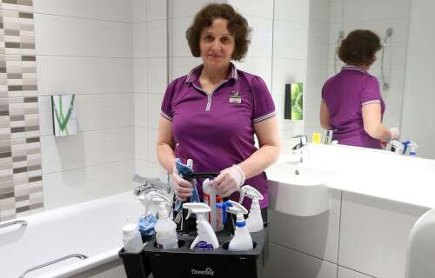
Safety and Health Standards MAINTENANCE
Our ability to preserve the values around which the brand was established will determine how successful we are going to remain. To guarantee that every visitor enjoys the same standard of quality and convenience that Premier Inn is known for, we make sure that our cleaning process strictly complies with these requirements(George, 2021).
These expectations cover the entirety of your visit, not simply the condition of the room you are sleeping in. It is essential that the highest emphasis be always given to health and safety. We place a great deal of importance on maintaining a tidy and orderly high-traffic area as well as using effective cleaning techniques (Berry, 2022).
There is nothing more important than following these rules and laws, especially when it comes to making sure that our clients and staff are safe. We can uphold our promise and establish a spotless atmosphere if everyone contributes in some small way to keeping it pleasant and pristine.

Slide 6
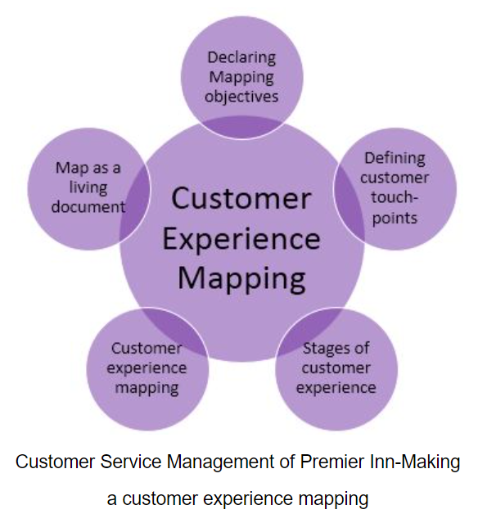
Increasing Efficiency of a TEAM
The level of consistency shown by our staff is the primary determinant of the efficiency of our cleaning operations.
The success of our plan is contingent upon the collaborative efforts of all group members, therefore emphasising the significance of each individual's contribution. According to Gandy, Hawkins, and Partridge (2019), the results of communication that is both effective and clear include an enhanced comprehension of the present matter and a decrease in the duration required to reach a resolution.
In our prioritisation, both growth and improvement are accorded equal significance. Our personnel will be continuously updated on the latest guidelines for optimal practises and security standards by active engagement in regular training sessions and seminars(Ndiuini & Baum, 2021).
The capacity of our industry to foster a climate of innovation and adaptability has been enhanced, so enabling a commensurate rise in output.

Slide 7
CLEANING Practices TO MAINTAIN STANDARD IN INDUSTRY
Using only the most effective methods is imperative if you operate in the hospitality sector and want to keep your competitive edge. The world's best hotel cleaning teams are held to extremely high standards, which may include treating each guest individually without sacrificing the hotel's overall productivity(Eid & Agag, 2020).
Every guest room in upscale hotels comes with a "finishing touch" checklist that's meant to make sure the guest's every want has been met. We will incorporate these processes in the most recent edition of the checklist.
Personalized service and the usage of eco-friendly cleaning supplies are two instances of such initiatives. Our customer service will be significantly superior than hotels in our industry if we follow these guidelines.

Slide 8
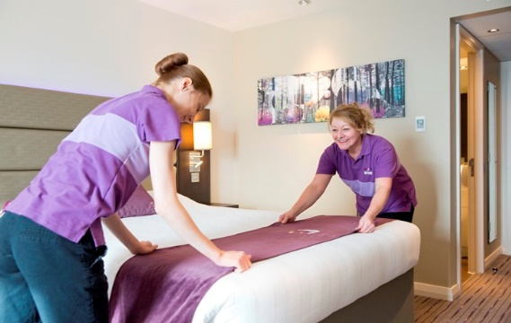
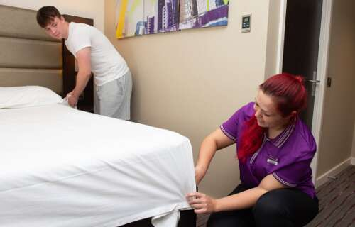
Well Organized Team
Considerable thought was given to the development of the diagrams that accompany our housekeeping guideline. In the course of these dialogues, the parameters for evaluating our continuous endeavours will be defined.
According to Lu & Tabari (2019) the meticulousness with which we consistently ensure that our beds are impeccably made and our cleaning supply carts are meticulously organised serves as a testament to our unwavering commitment to attending to even the minutest aspects.
These guidelines serve a purpose beyond mere suggestions, since their primary objective is to motivate the cleaning staff to attain the same elevated standards that we uphold.

Slide 9
Conclusion
A new cleaning checklist was introduced and the need of maintaining a consistent standard of housekeeping was emphasized during today's training.
If you wish to maintain the excellent caliber of service that guests of Premier Inn have become accustomed to getting from the company, you must remember the importance of your own job.
Everyone in the meeting today has demonstrated a very high degree of insight and participation. Premier Inn is routinely rated as one of the best hotels in the country due to your commitment to excellence and our strict standards.

Slide 10
References
Asadi, S., Pourhashemi, S.O., Nilashi, M., Abdullah, R., Samad, S., Yadegaridehkordi, E., Aljojo, N. and Razali, N.S., 2020. Investigating influence of green innovation on sustainability performance: A case on Malaysian hotel industry. Journal of cleaner production, 258, p.120860.
Berry, C.T.P., 2022. Equity research-Whitbread PLC (Doctoral dissertation, Instituto Superior de Economia e Gestão).
Brotherton, B., 2004. Critical success factors in UK budget hotel operations. International Journal of Operations & Production Management, 24(9), pp.944-969.
Buttle, F., Bowie, D., Brookes, M. and Mariussen, A., 2016. Hospitality Marketing. Taylor & Francis.
Eid, R. and Agag, G., 2020. Determinants of innovative behaviour in the hotel industry: a cross-cultural study. International Journal of Hospitality Management, 91, p.102642.
George, R., 2021. Tourism and Hospitality Marketing Principles. In Marketing Tourism and Hospitality: Concepts and Cases (pp. 3-31). Cham: Springer International Publishing.
Lu, L. and Tabari, S., 2019. Impact of Airbnb on customers' behavior in the UK hotel industry. Tourism Analysis, 24(1), pp.13-26.
Ndiuini, A. and Baum, T., 2021. Underemployment and lived experiences of migrant workers in the hotel industry: policy and industry implications. Journal of Policy Research in Tourism, Leisure and Events, 13(1), pp.36-58.
Terence, B., 2022. UK Economic Strategy Presents Opportunity for Businesses, Including Hotels, To 'Level Up'.

