Slide 1
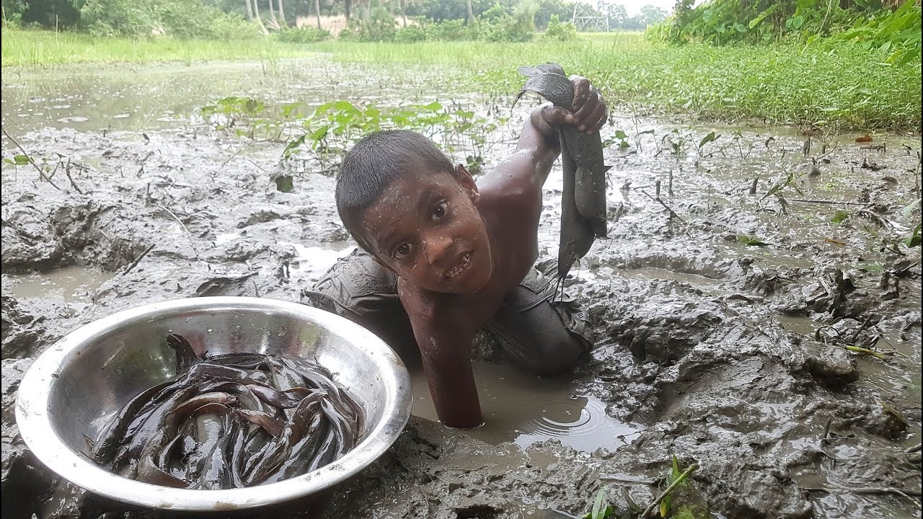
Interactions with the Environment
Exploring how people shape, and are shaped by, the environment
HPAN4005

Slide 2
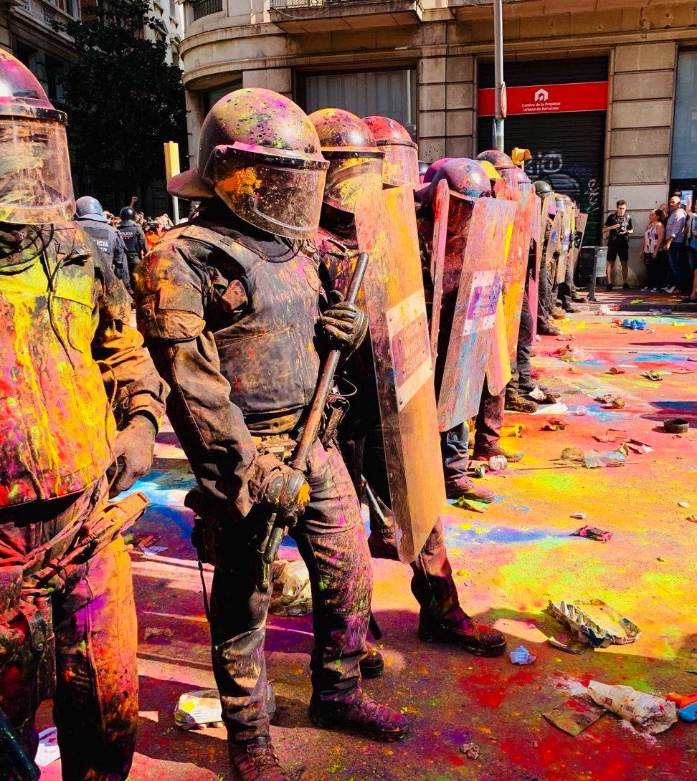
Module Focus
To use a New Materialities approach to think about humanity’s current situation and the future
To explore how people are materially connected to the rest of the world.

Slide 3

Scholarship and Theoretical Grounding of this Module
Uses an interdisciplinary approach that draws different disciplines together.
Inspiration comes from posthumanism: a move that challenges orthodox Euro-American ideas so as to create new knowledge.

Slide 4
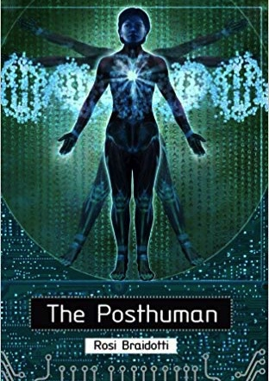
Posthumanism
Questions what ‘human’ means in light of
  Challenges to gender dichotomy (See Butler)
  New technologies (See Bradiotti and Franklin)
  Current eco situation (see Morton)
  Human exceptionalism
Posthumanism concludes we are post ‘the human’ and need to rethink about what human means.

Slide 5
Further scholarship to be aware of
More-than-human Move (see Whatmore)
Multispecies Ethnographies (See Eben Kirksey and Helmreich)
New Materialisms (see Bennett; Coole and Frost)
All of the above are concerned with ‘relationships’ and show how life forms itself relationally (ie: nothing exists in separation).
Break-out Activity:
Find a definition of each of the 3 approaches listed on this slide.
Find an example of one piece of work that uses any of these approaches.
Feedback what you have found to the class.

Slide 6
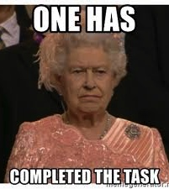
Assessments x 4
Week 1: written assignment
Week 2: annotated bibliography
Week 3: present findings, submit an academic poster
Week 4: 10 min presentation OR web repository

Slide 7
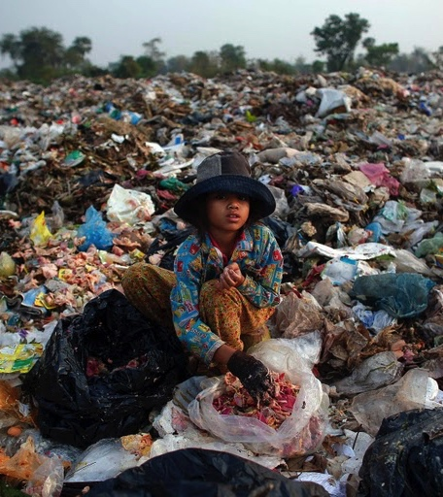
Bring in Rubbish – why?
Please bring cleaned rubbish into class each day to create your own rubbish tip.
Take an area of the room to store your rubbish for the duration of the module.
Create a rubbish/recycling diary by categorising what you bring in each day.
We will reengage with it in the last week.

Slide 8
Contextualising thoughts

Slide 9
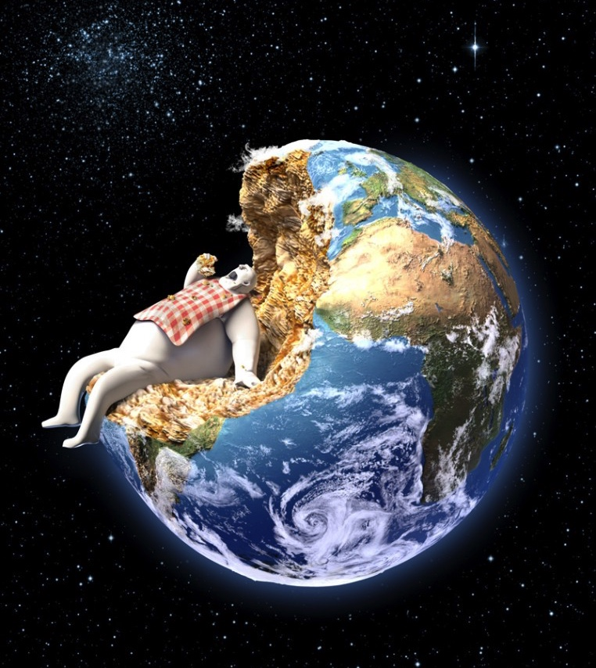
The Age of the Anthropocene
‘Some say that we have entered a new geological epoch of our own making, called the Anthropocene, in which the human footprint has reached levels akin to the impact of an ice age.’ Meybeck et al 2017: ix, Rivers of the Anthropocene CUP)

Slide 10
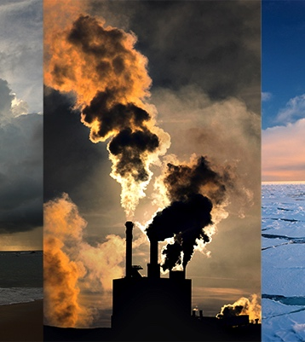
What does Climate Change even mean?
Climate Change (CC) refers to global phenomena
The notion CC has shifted from being a descriptive index to a causative agent (Hulme 2014).
This shift has given CC the power to alter social and political lives too….how so?
Notes:
‘Weather refers to atmospheric conditions that occur locally over short periods of time—from minutes to hours or days. Familiar examples include rain, snow, clouds, winds, floods or thunderstorms.
Climate, on the other hand, refers to the long-term regional or even global average of temperature, humidity and rainfall patterns over seasons, years or decades.
Global warming refers to the long-term warming of the planet since the early 20th century, and most notably since the late 1970s, due to the increase in fossil fuel emissions since the Industrial Revolution. Worldwide since 1880, the average surface temperature has gone up by about 1 °C (about 2 °F), relative to the mid-20th-century baseline (of 1951-1980). This is on top of about an additional 0.15 °C of warming from between 1750 and 1880
Climate change refers to a broad range of global phenomena created predominantly by burning fossil fuels, which add heat-trapping gases to Earth’s atmosphere. These phenomena include the increased temperature trends described by global warming, but also encompass changes such as sea level rise; ice mass loss in Greenland, Antarctica, the Arctic and mountain glaciers worldwide; shifts in flower/plant blooming; and extreme weather events.’
https://climate.nasa.gov/resources/global-warming/

Slide 11

Baer and Reuter 2015 Anth Perspectives on Climate Change
Demonstrate the need for interdisciplinarity
‘The critical anthropology of climate change is guided by an eco-social perspective and by political ecology theory’ (p2)
Uses an ‘emic’ view to focus on adaptation

Slide 12
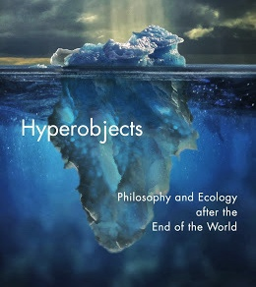
Morton’s Hyperobjects
Vast, ungraspable entities that span geography and time
Hyperobject behaviours act as warnings

Slide 13
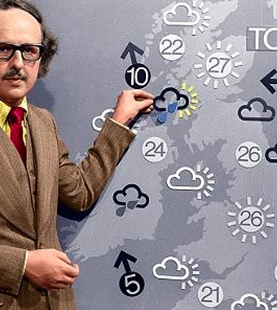
Hulme 2015 Better weather?
Summary:
‘Climate …should be understood as performing important psychological and cultural functions. Climate offers a way of navigating between the human experience of a constantly changing atmosphere with its attendant insecurities and the need to live with a sense of stability and regularity. Humans look to the idea of climate to offer an ordered container—a linguistic, sensory, or numerical repertoire—through which to tame and interpret the un- settling arbitrariness of the restless weather.’ (p238)

Slide 14
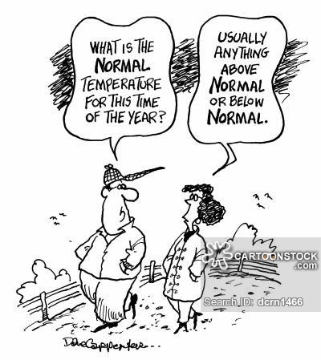
Hulme (2015) defines ‘climate’ as
‘A scientific description of an interacting physical system’ (p238) and that the ‘idea’ of a climate allows humans to live with their weather culturally
The climate ‘puts weather in its place’ (p238) and normalises patterns.

Slide 15
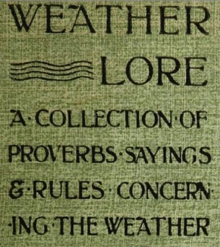
Hulme (2015): the role of scientific enquiry in the climate
The last 200 years has shown how that despite ideas of order the climate is unstable and that we struggle to harness it.
The last 50 years has shown that we are integral to its instability.

Slide 16
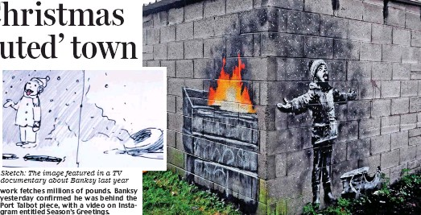
How has the atmosphere has been cultivated?
‘The atmosphere bears the imprint of considered human thought, design and action’ (Hulme 2015: 239)
  (e.g., CFCs [chlorofluorocarbons], fossil carbon dioxide, sulphate aerosols) and of land practices (e.g., methane, smoke, aerosol particulates) See example of one consequence on next slide.
New technologies to clean the atmosphere are being developed.
Banksy 2018 Port Talbot

Slide 17
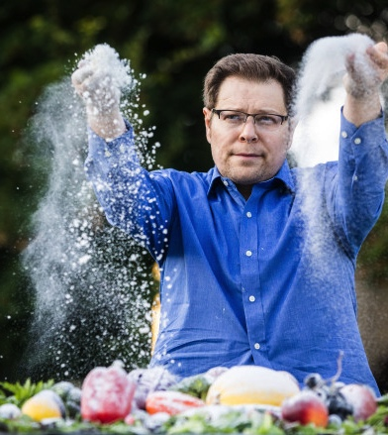
Johnson, 2018
The Great Nutrient Collapse
‘Rising CO2 revs up photosynthesis, the process that helps plants transform sunlight to food. This makes plants grow, but it also leads them to pack in more carbohydrates like glucose at the expense of other nutrients that we depend on, like protein, iron and zinc.’

Slide 18
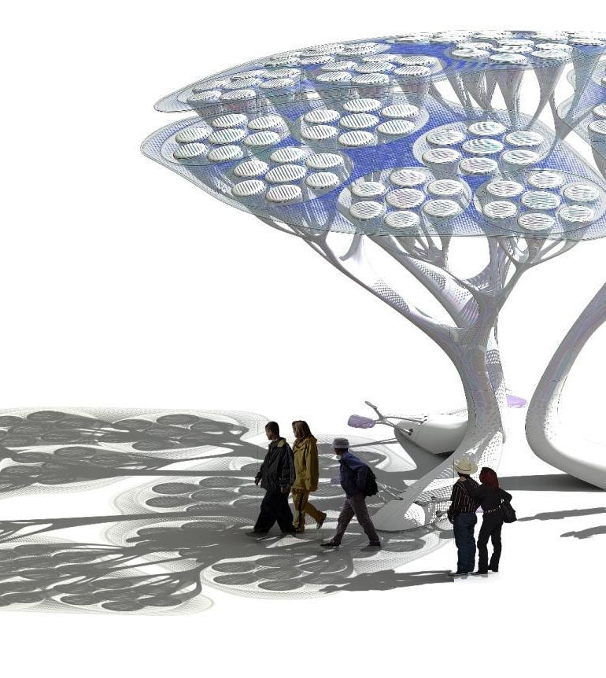
Hulme (2015) offers 2 categories of climate cultivation types
Passive cultivation
  Of the past
Active (deliberate) cultivation (2 types)
  De-cultivating (clean up) or naturalising/rewilding
  Re-cultivating (adding stuff to make it as we want it)
Carbon capture ‘trees’

Slide 19
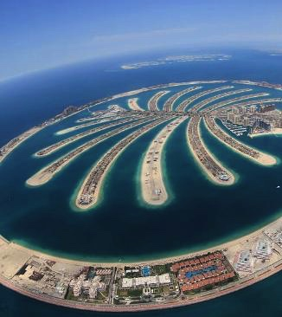
Hulme (2014) Attributing weather extremes to climate change
Extreme weather prompts calls for explanation and culpability
Where once deviant behaviour or witchcraft might have been blamed now we blame chemical changes using scientific method as the metric.
This means nature is no longer ‘natural’.
Dubai island

Slide 20
But, Hulme (2014) asks, how can we know if a weather event was caused by Climate Change?
Where can we look for the ‘fingerprints’ of the culprit?

Slide 21
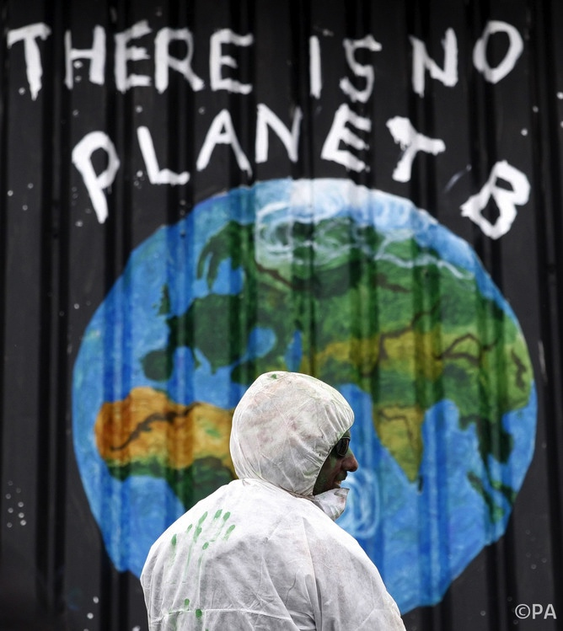
This is how
How research is now framed (what q’s are asked and how funding is allocated and by whom affects outcomes.)
Social policies
  Manufacturing
  Recycling units
Social media preoccupations
Hulme (2014) suggests that it may be of interest to be a victim of CC.
Notes:
See: https://www.oii.ox.ac.uk/news/releases/bulk-of-social-media-content-supports-climate-change-research/

Slide 22
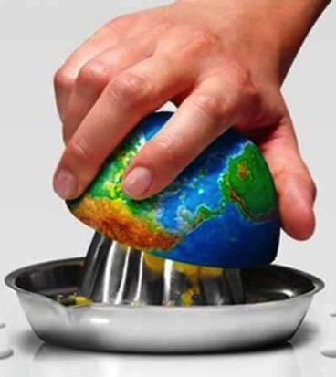
Overshoot Day Activity
‘Earth Overshoot Day marks the date when we (all of humanity) have used more from nature than our planet can renew in the entire year. In 2018, it fell on August 1.’
Measure your footprint (Global Footprint Network
  https://www.footprintcalculator.org)

