Slide 1
Overview of Independent Investigation

Slide 2
Independent Investigation
Practice at researching and writing a longer-form essay
Practice at independent research
Practice at balancing a longer assessment alongside other commitments – a (very) mini dissertation
Encourage critical thinking and analysis

Slide 3
Component 1: Plan Wed 19 Apr (10% module grade)
Students should submit a preliminary plan for their essay.
This should include:
An essay title/question
A summary of what the main topic of the essay is going to be
An explanation of what you hope to find by researching your topic
An explanation of why you chose the topic
A proposed structure (bullet points indicating paragraphs is fine)
A short statement of possible conclusions
A preliminary bibliography (not included in the word count).

Slide 4
Component 2: Essay Mon 29 May (90% module grade)
Students should submit their final essay here. Bibliographies not included in word count.
Note: the word count is expressed as a range meaning that 2500 words is the upper limit (i.e. there is no +10% 'grace' over-and-above 2500 words)

Slide 5

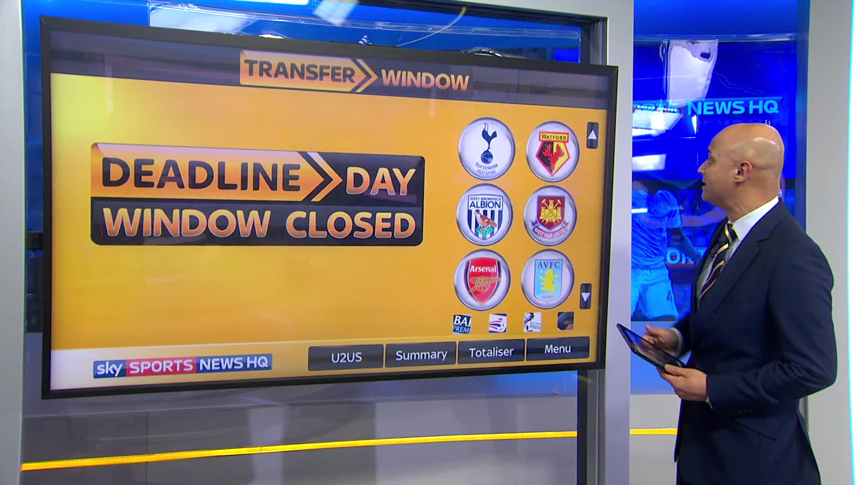
DEADLINE not a TARGET
Preceding dates have been set to fit into university term timetable … but there’s nothing to stop you starting earlier (if you have the time)
If you plan to submit earlier, just let me know

Slide 6

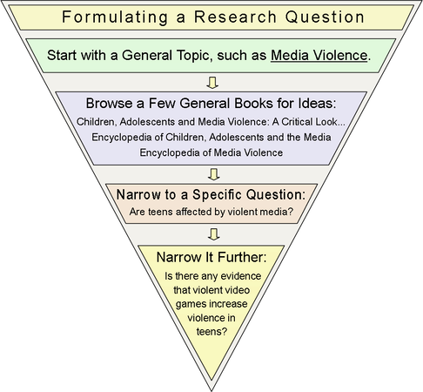

Slide 7
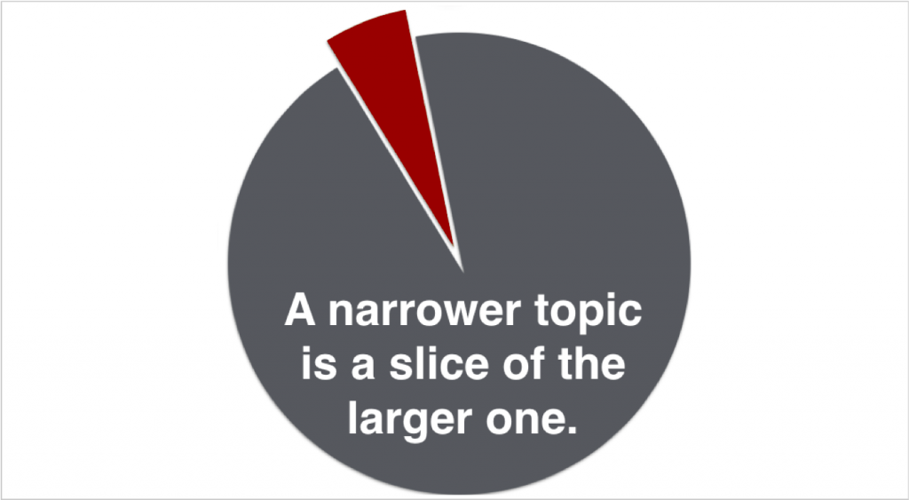
Why do we narrow topics?
Originality
Pragmatism
Focus
Depth
Detail
Nuance
Say more about the ‘big picture’ ultimately

Slide 8
Week Commencing 28 March
Start thinking of ideas:
What interests you?
Are there any interests or topics that you’ve had a hankering to read and think more about?
What has interested you most on the modules you’ve taken so far? Could these be reworked into an essay question?*
Are there any aspects of the modules you’ve taken so far that you’d like to explore further?*
* Investigation needs to be substantively different to other coursework

Slide 9
Tip: ‘Thinking “Essay”’
When studying for a module or lecture, think about how an individual topic might be converted into an essay
What primary and secondary sources are available?
What questions are asked about the topic?
What’s my opinion of the topic? Do I have an ‘angle’ on it?

Slide 10
Monday 27 March
Submit a short paragraph summarising your ideas. You should specify the general area of planned research, and the proposed ‘angle’ on it.

Slide 11
Wed 12 April
Students should submit a preliminary plan for their essay.
This should include:
An essay title/question
A summary of what the main topic of the essay is going to be
An explanation of what you hope to find by researching your topic
An explanation of why you chose the topic
A proposed structure (bullet points indicating paragraphs is fine)
A preliminary bibliography (not included in the word count).

Slide 12
Independent Investigations 2019/2020
Comparing entertainments throughout time: Roman chariot racing to formula 1
Was Aristotle’s delineation of voluntary and involuntary acts as useful to Athenian legislators as he claims in Nicomachean Ethics?
Reasons why female snooker players have not been ranked in world top 128
Childbirth and childhood in Ancient Greece
Environmental impacts of tourism in West Wales
Was Waun Mawn the original site for Stonehenge bluestone?
Lighthouse of Alexandria as a Wonder of the World
Decline of Welsh woollen industry: Cellan factory as case study

Slide 13
Independent Investigations 2019/2020
Comparing entertainments throughout time: Roman chariot racing to formula 1 – risks anachronism and spreading analysis thinly; perhaps would be best to concentrate on one particular element
Was Aristotle’s delineation of voluntary and involuntary acts as useful to Athenian legislators as he claims in Nicomachean Ethics? ‘useful’ hard to evaluate; maybe ‘to what extent did Artistole’s delineation of voluntary and involuntary acts as useful to Athenian legislators?
Why has no female snooker players ever been ranked in world top 128?
Childbirth and childhood in Ancient Egypt good idea, but need to identify ‘problem’
Environmental impacts of tourism in West Wales nice geographical precision
Was Waun Mawn the original site for Stonehenge bluestone? tight
What made the Lighthouse of Alexandria a Wonder of the World? ‘Wonder of the World’ is not really an ‘official’ label, and so is hard to fully evaluate
Decline of Welsh woollen industry: Cellan factory as case study tight

Slide 14
Narrowing Focus
Let’s try and come up with a focused question on one of the following:
First World War
Norman Britain
Animal Rights
Water
Ancient Roman Indian Ocean Trade

