Slide 1

DIGITAL FORENSIC INVESTIGATION
Suspected Theft & Attempted Sale of
AI Chip Design Patent QT-AI-2025
Forensic Toolset: Cellebrite UFED 4PC & Physical Analyzer
Devices Examined: 3 Android Smartphones (Emma, Joe, Norman)
Name: Harsh Bipinbhai Valand
Student Id: 2437861

Slide 2
CASE OVERVIEW
A Suspected Insider Data Theft
Quantum Tech's IT security team detected unauthorised access to its proprietary patent database — specifically AI chip design patent QT-AI-2025. Three seized smartphones were forensically examined to establish whether the patent was stolen and offered for sale, and to identify each party's role.
E
J
N
EMMA
JOE
NORMAN
Insider / Perpetrator
Intermediary
Buyer
Allegation
Senior engineer with access to QT-AI-2025
Located and met prospective buyers
Agreed staged handover & payment
Emma, a senior engineer, is suspected of stealing the patent and attempting to sell it to competitor NexGen Circuits through an intermediary, Joe, who located a buyer, Norman.
2

Slide 3
EVIDENCE INVENTORY
Three Devices, Three Roles
Exhibit | User | Device | Extraction | Role
1 | Emma | Huawei POT-LX1 "P Smart" (Android 10) | File System — Android ADB | Insider / Perpetrator
2 | Joe | Samsung SM-A137F Galaxy A13 (Android 14) | File System — Android Backup | Intermediary
3 | Norman | Nokia C2 2nd Edition (Android 11) | File System — Android Backup | Buyer
Chain-of-Custody & Attribution Notes
• Emma's Huawei device holds the WhatsApp thread where the owner solicits a buyer, plus the Facebook / Instagram "Peter Dover" alias.
• Joe's Samsung device carries geotagged photos matching his stated travel (Glasgow, Paris, Manchester) and a Swansea trip.
• Norman's Nokia device holds a facial photo geolocated to the same Swansea area, on a matching date.
• All extractions were re-hashed and verified in Physical Analyzer ("Extraction images are verified") confirming no tampering.
3

Slide 4
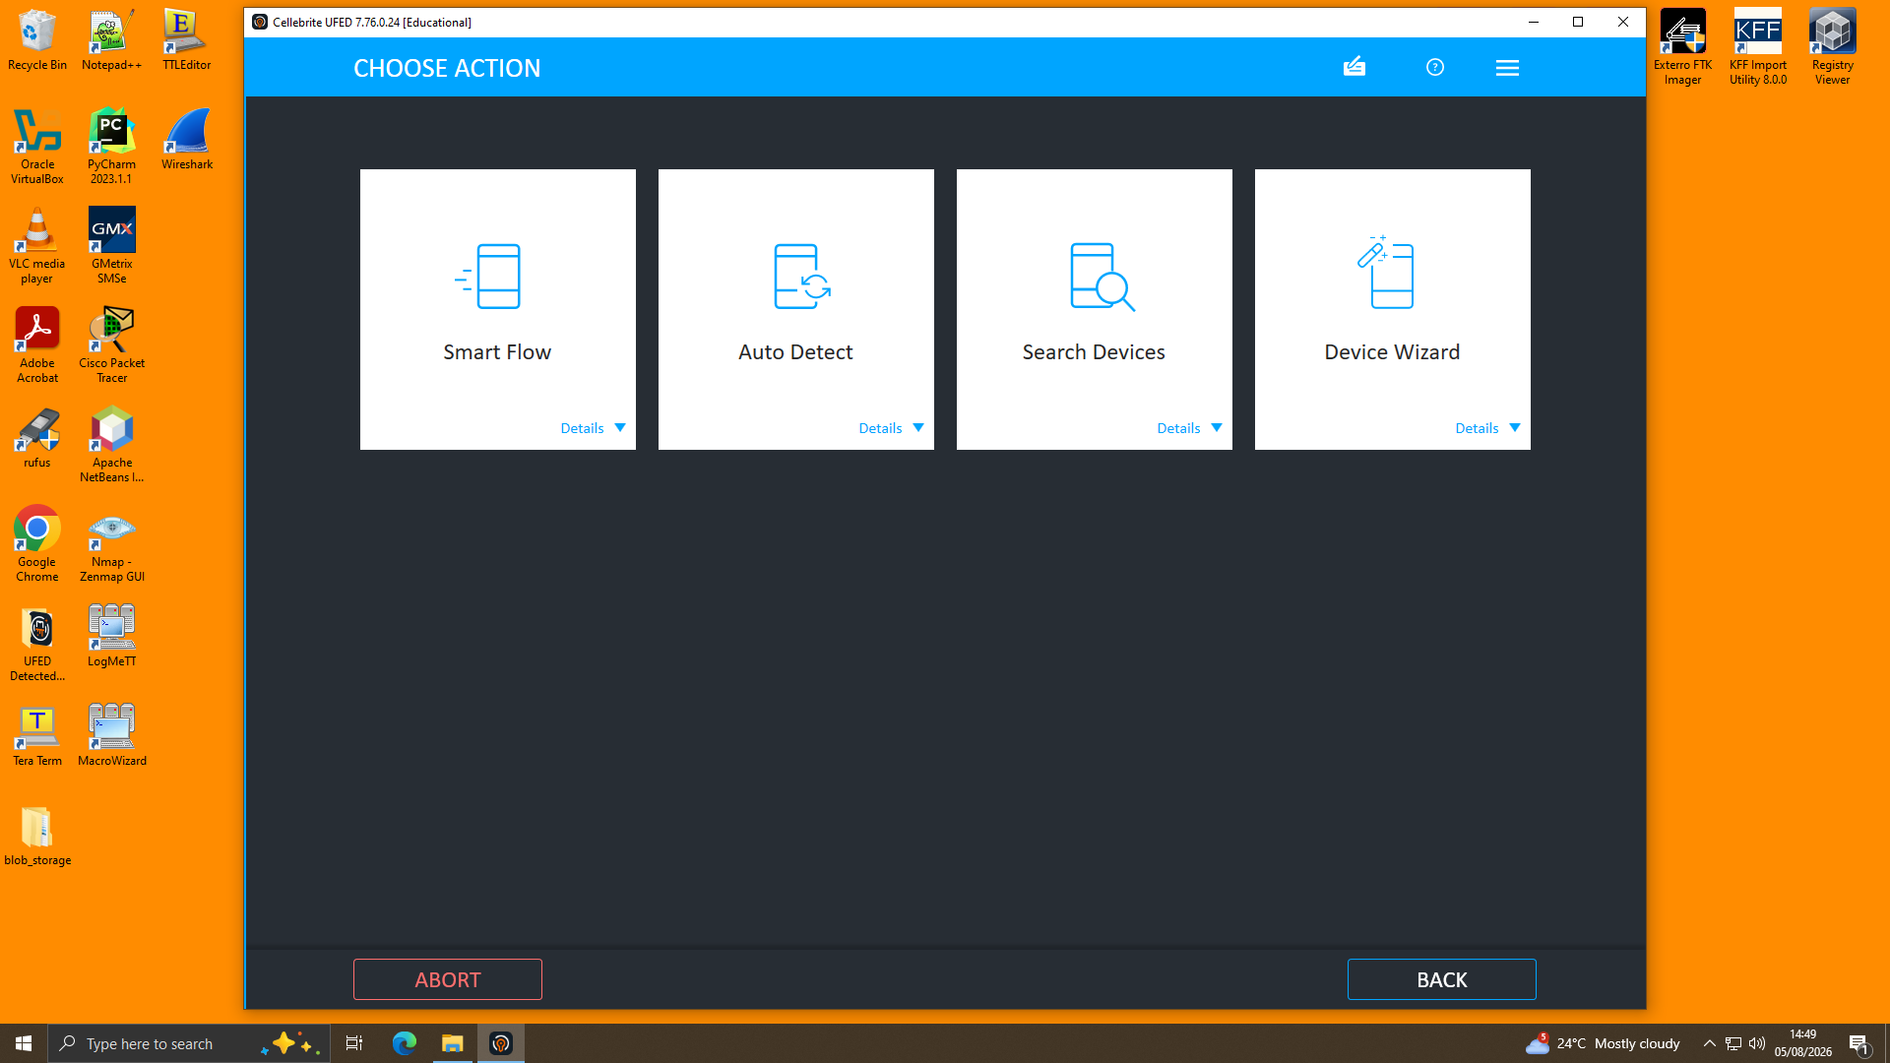
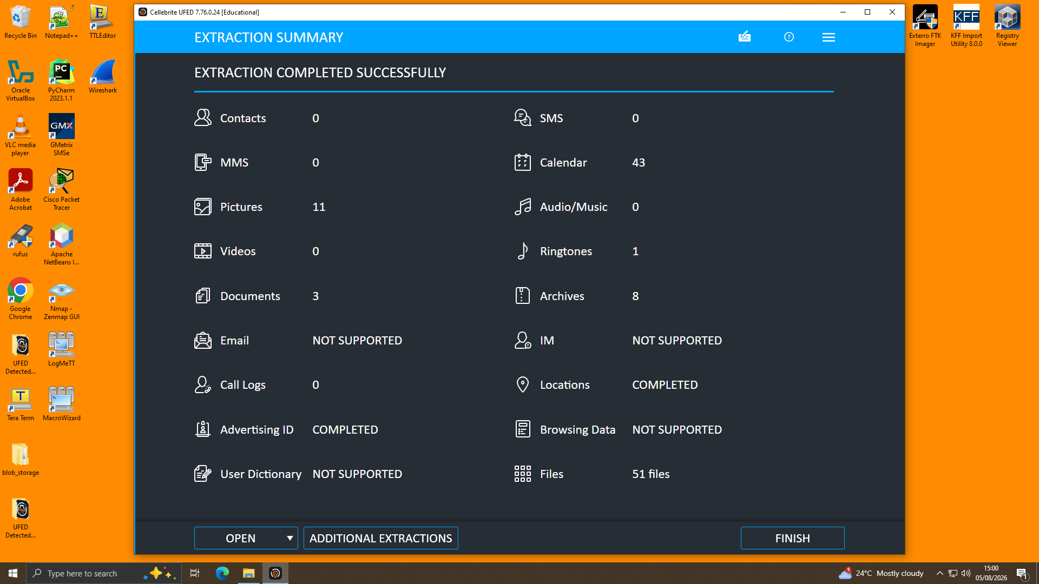
METHODOLOGY
Acquisition & Analysis Workflow
STAGE 1 — ACQUISITION
1
Connect device to Cellebrite UFED 4PC; use Auto Detect to identify model
2
Select File System extraction to preserve app databases without exploitation
3
Choose data categories: calls, contacts, chats, media, locations, files
4
Log a formal case record for chain-of-custody (examiner, evidence ID, date)
STAGE 2 — ANALYSIS
1
Open extraction in Physical Analyzer; verify re-computed image hashes
2
Decode chats (Genie parser) for WhatsApp, Facebook, Instagram threads
3
Correlate Timeline, Locations and Call Log against chat claims
UFED 4PC acquisition workflow and completed Extraction Summary
4

Slide 5
INVESTIGATION TIMELINE
21 Aug 2024 → 31 Jan 2025
21 Aug 2024
14 Oct 2024
31 Jan 2025 (AM)
Emma contacts Joe on WhatsApp
Joe travels to Paris
WhatsApp: deal terms finalised
Claims access to confidential AI product data; asks Joe to find a buyer
"Travelling back to France... to get some good deals"
"5M secured"; offshore arrangement discussed; buyer wants a demo
29 Aug 2024
20 Nov 2024
31 Jan 2025 (PM)
Joe travels to Glasgow
Joe travels to Manchester
Facebook: Peter Dover ↔ Norman Smith
Meets a prospective contact — corroborated by geotagged photos
Reports being "in final talks" with a client
Staged "blueprint" handover agreed; 48-hour window; "then we are ghosts"
5

Slide 6
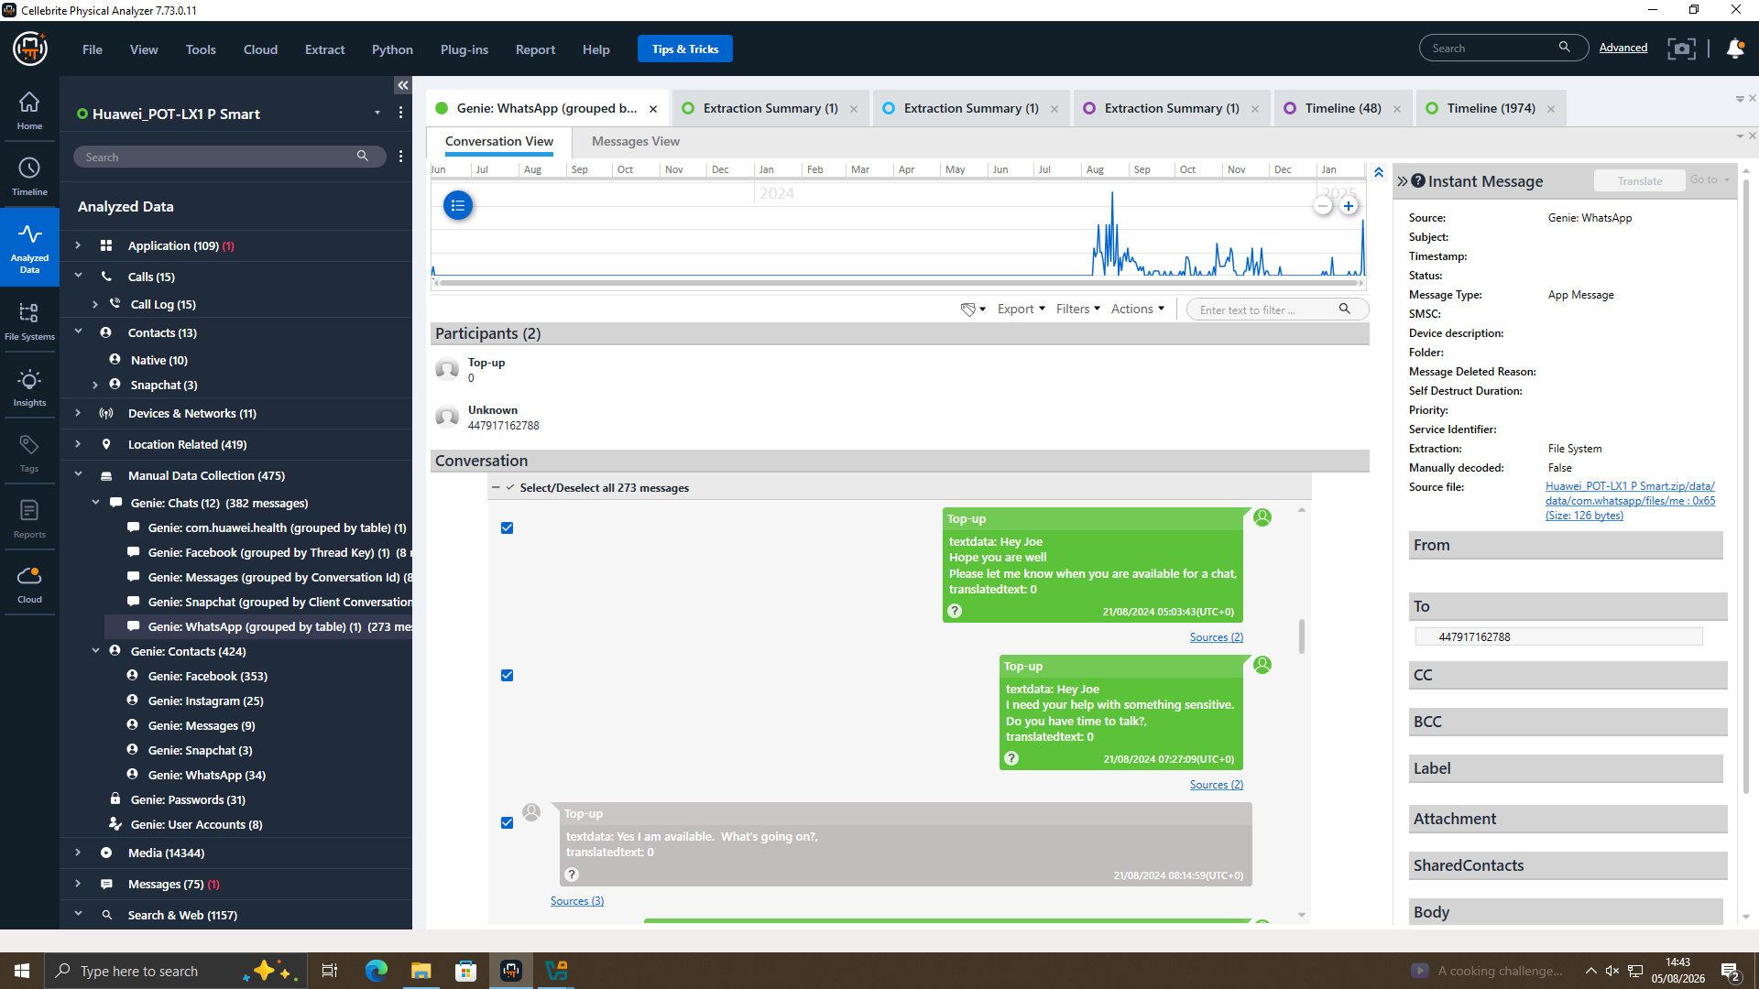
COMMUNICATION ANALYSIS · WHATSAPP
Emma Solicits a Buyer via Joe
Key admissions (21 Aug 2024)
09:58
“I have access to some highly valuable information... I'm thinking about selling it to someone interested.”
10:10
“I trust you can find the right buyer. The competition must be eager to get their hands on this tech.”
11:47
“Let's keep this under wraps. This could be huge for both of us.”
WhatsApp (Genie parser) — Exhibit 1, Emma's Huawei device
By January 2025 the buyer requests a demo sample, Emma offers a “detailed breakdown” instead, and a “5M” sum is described as “secured” via an “offshore arrangement.”
6

Slide 7
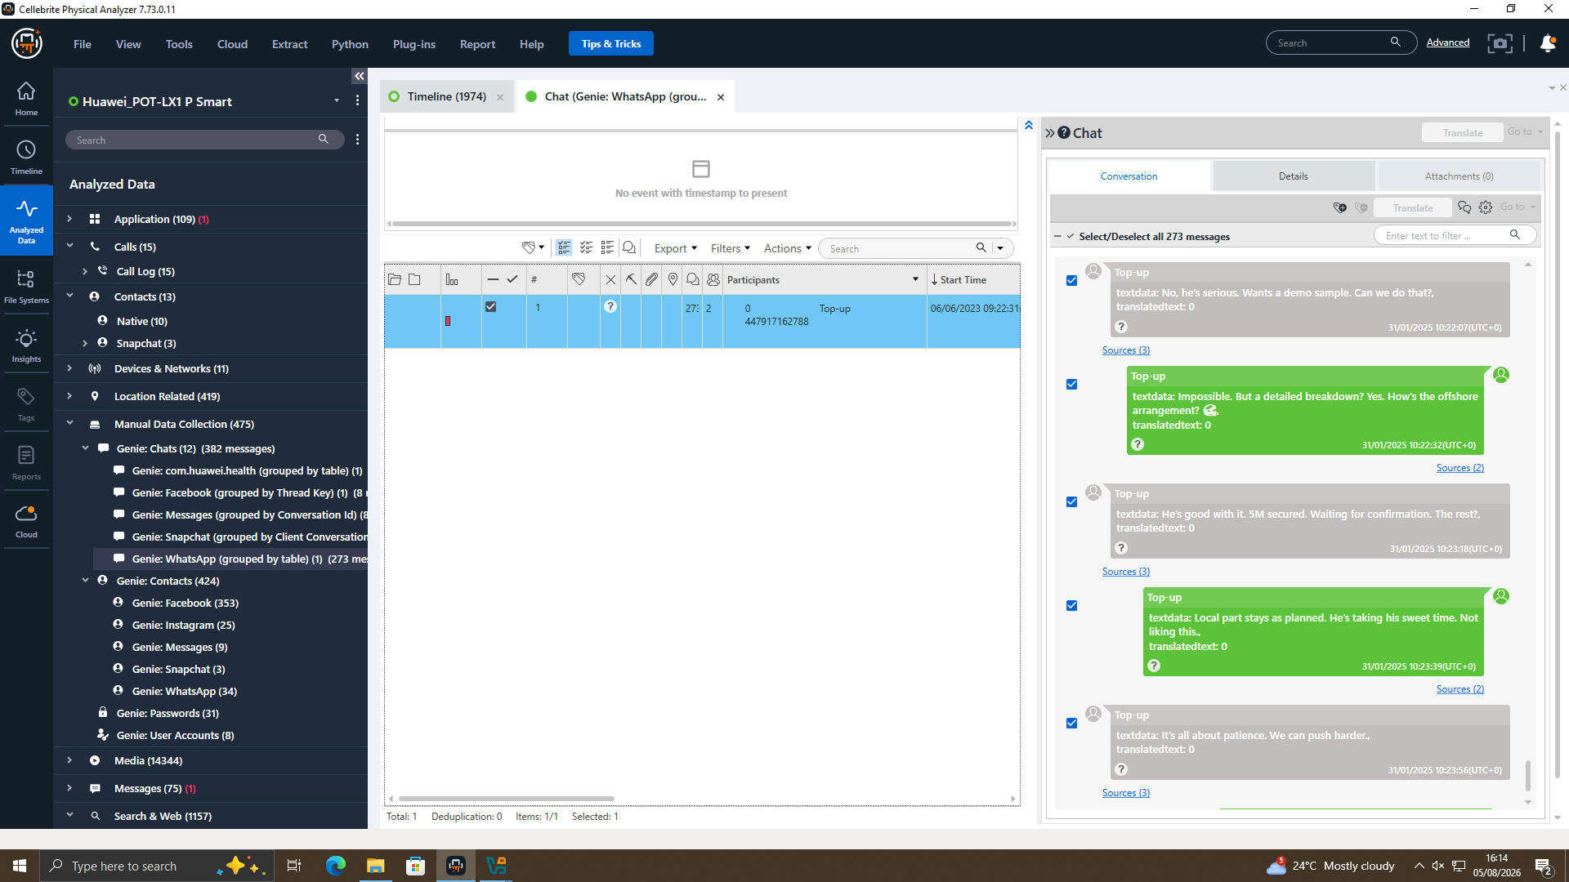
COMMUNICATION ANALYSIS · FACEBOOK MESSENGER
“Peter Dover” Negotiates the Handover
31 January 2025 — same day, minutes after the WhatsApp deal
PETER DOVER
“Joe told me u r ready to proceed. Let's keep this clean and quick.”
NORMAN SMITH
“We need the blueprint in chunks. Too risky in one go.”... “Let's start with just the head.”
PETER DOVER
“Fine. Watch ur inbox in 48 hrs. After that we are ghosts.”
Facebook Messenger — Peter Dover (Emma's alias) & Norman Smith
Terminology — “blueprint”, “head”, “no backtracking” — is consistent with a staged transfer of a technical design file; the “5M offshore” figure matches the sum discussed on WhatsApp.
7

Slide 8
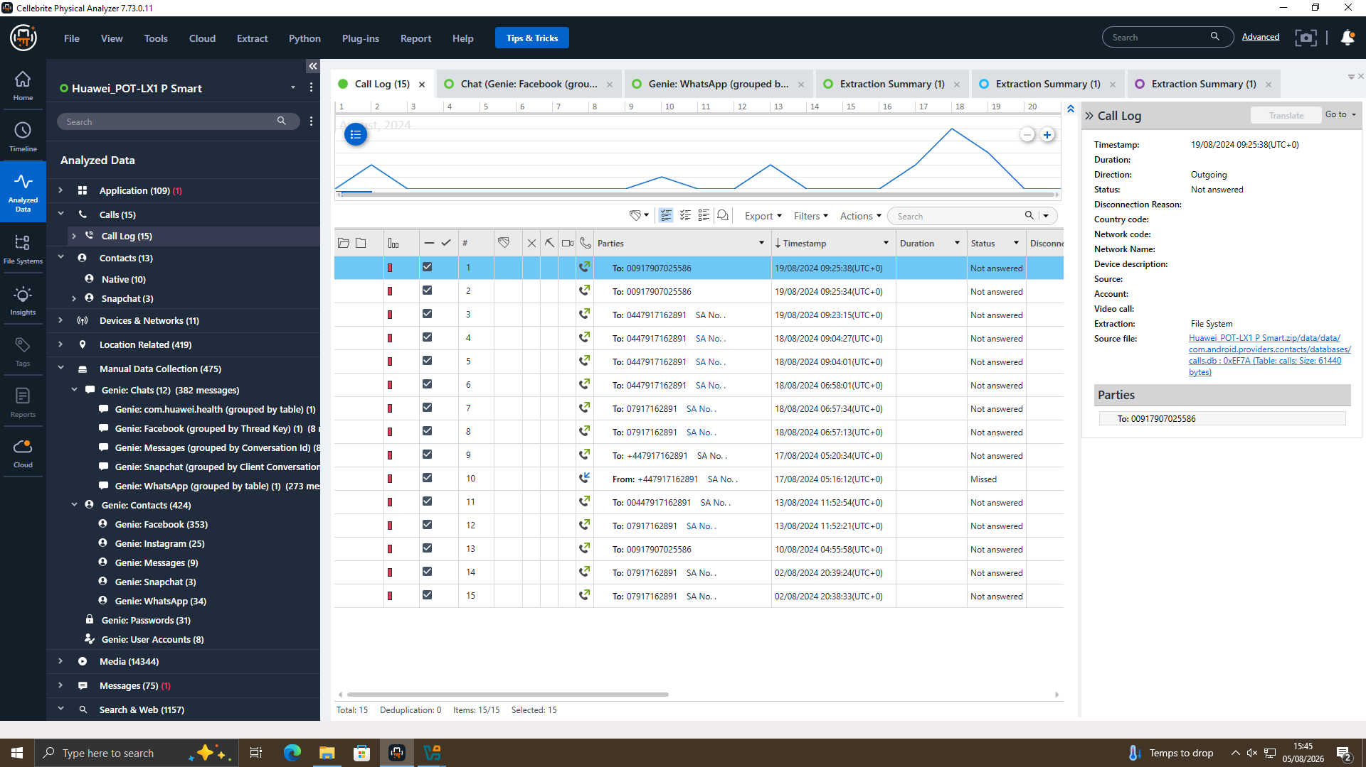
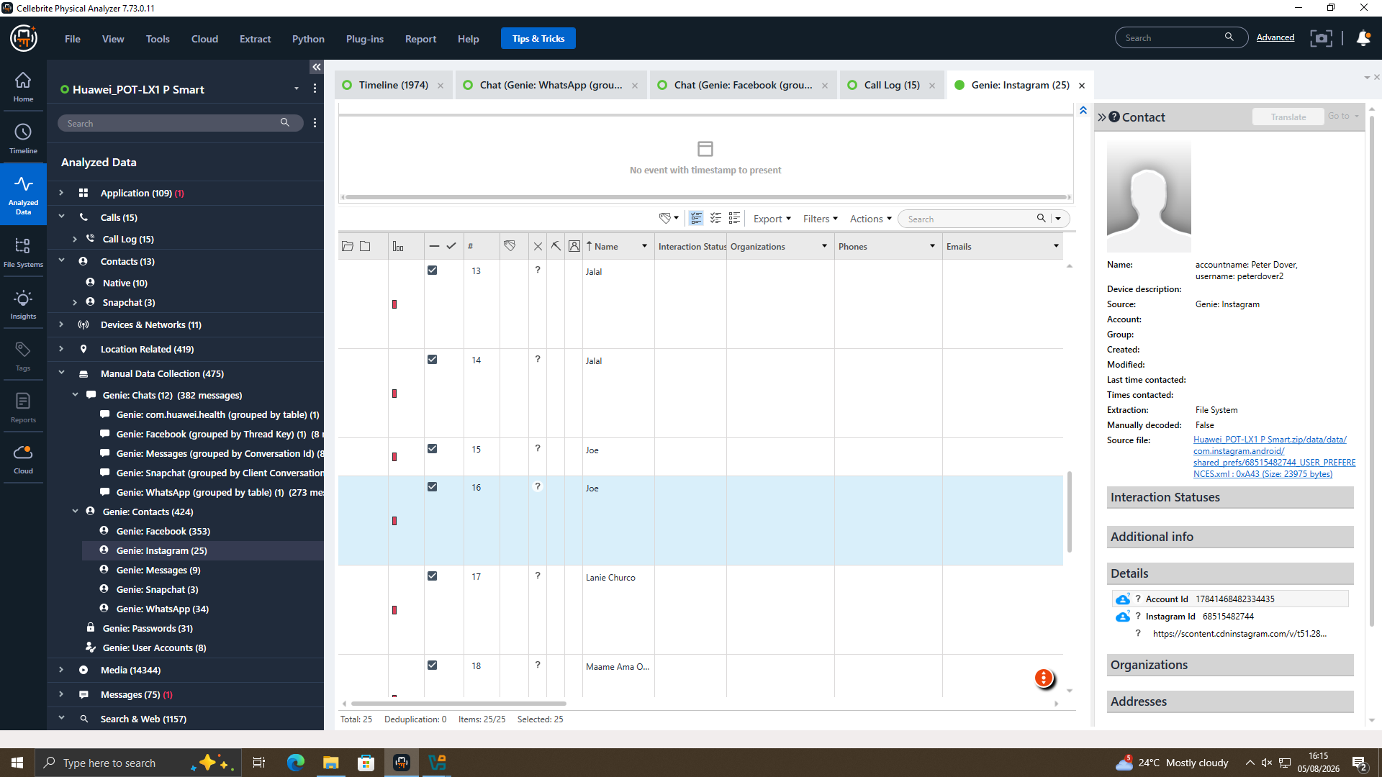
CORROBORATING ARTEFACTS
Call Log & Identity Linkage
CALL LOG — EMMA'S DEVICE
INSTAGRAM ACCOUNT DATA — EMMA'S DEVICE
15 calls (2–19 Aug 2024), mostly outgoing “Not answered”, to the number later saved as “Top-up” (Joe) — showing Emma tried voice contact before WhatsApp began.
Confirms the “peterdover2 / Peter Dover” identity resides on Emma's Huawei handset — directly linking her to the Facebook alias used to negotiate with Norman Smith.
8

Slide 9
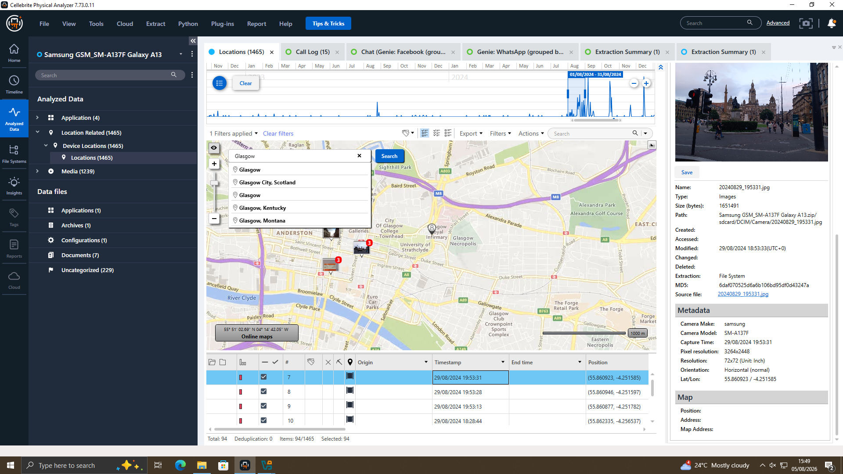
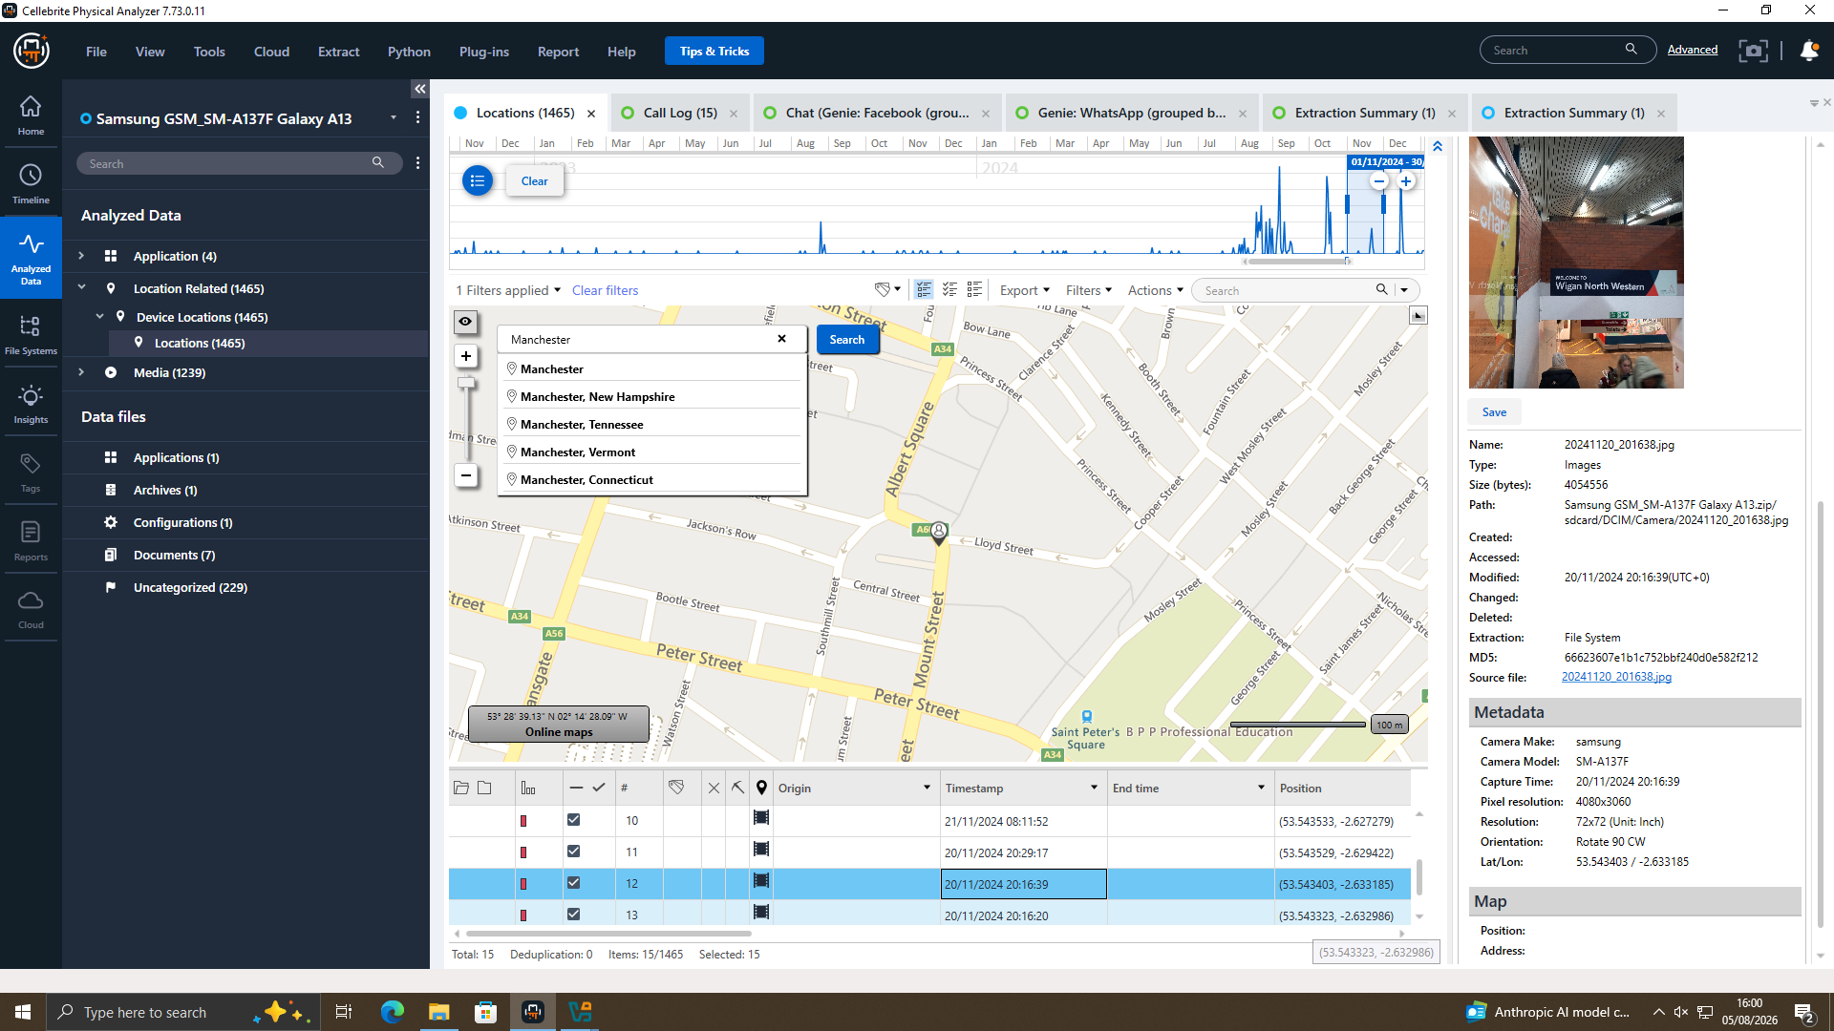
GEOLOCATION ANALYSIS
Travel Claims Corroborated by GPS
Glasgow — 29 Aug 2024, 19:53 (Joe's Samsung)
Manchester — 20 Nov 2024, 20:16 (Joe's Samsung)
Joe's geotagged photographs place him in Glasgow, Paris and Manchester on the exact dates he described in WhatsApp.
9

Slide 10
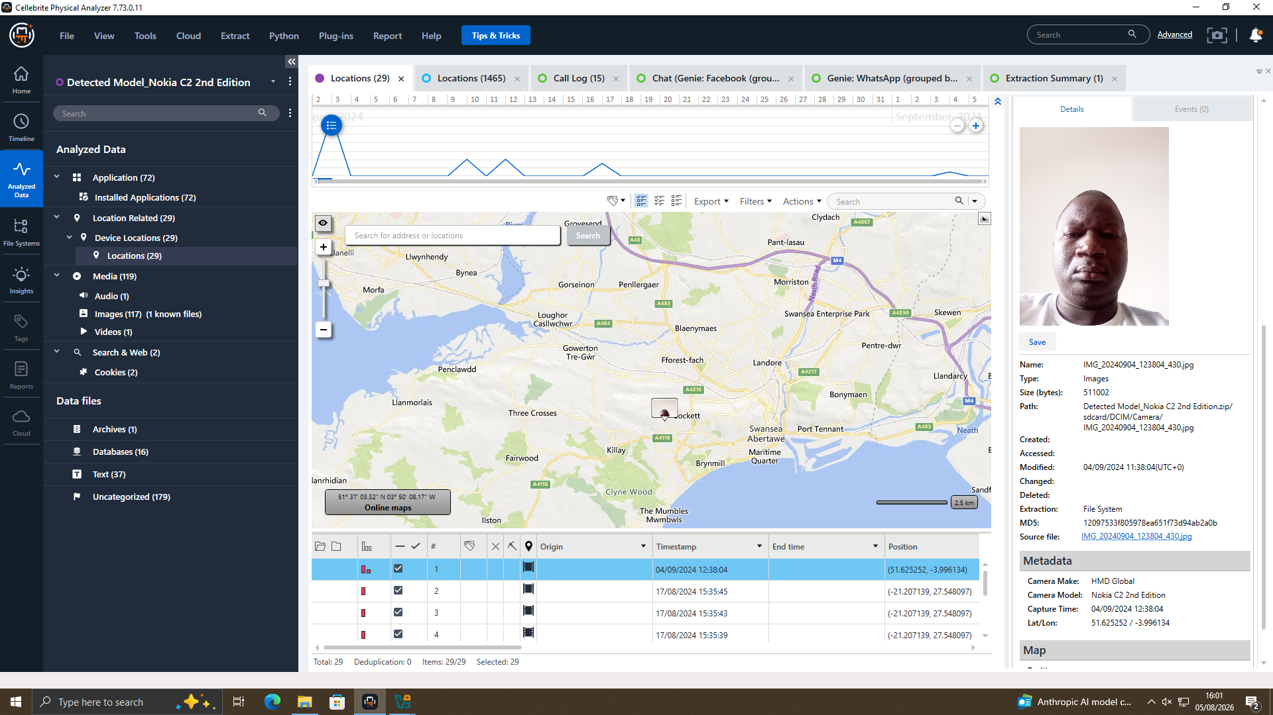
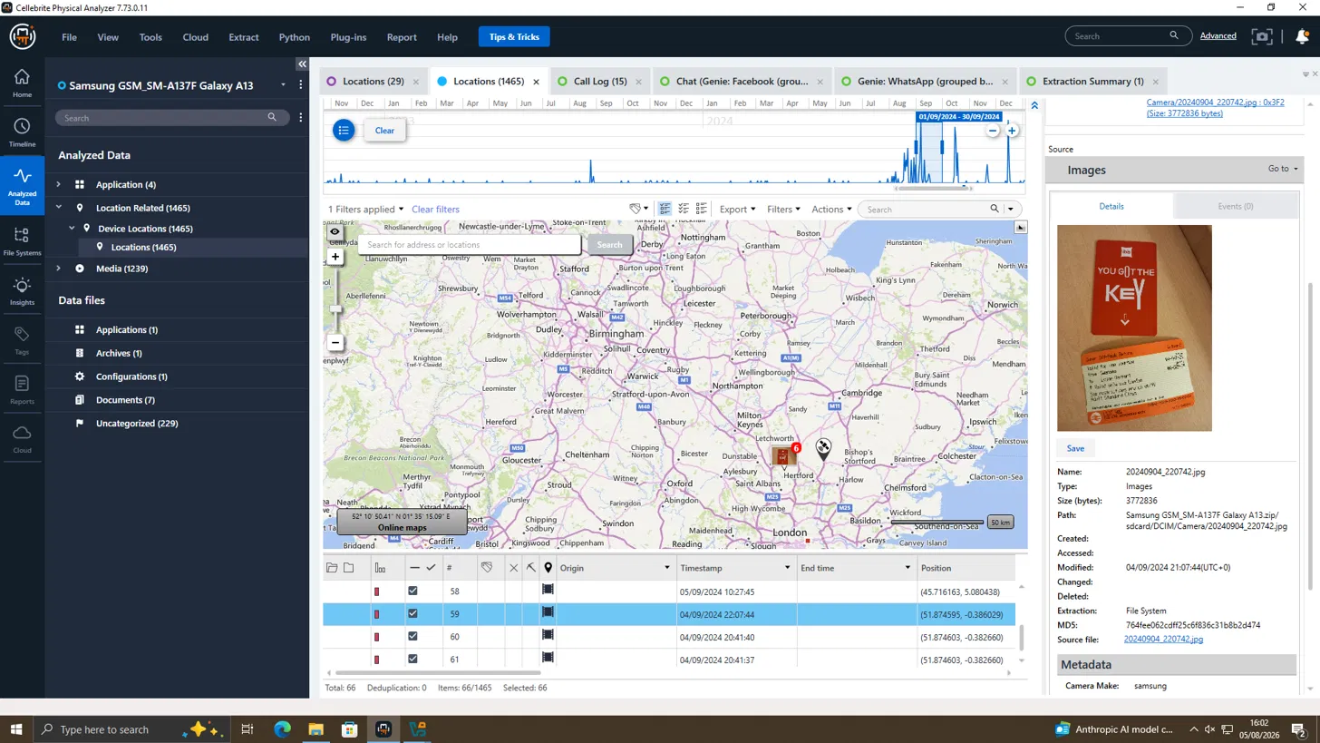
GEOLOCATION ANALYSIS
Travel Claims Corroborated by GPS
Swansea area — 4 Sep 2024 (Norman's Nokia)
Ticket for Swansea - 4 Sep 2024 (Joe’s Samsung)
Separately, matching Swansea-area travel documentation on Joe's device and a facial photograph on Norman's Nokia device — dated within days of each other — place the two men in the same location, corroborating their in-person introduction.
9

Slide 11
SUSPECT PROFILING
Roles Confirmed by the Evidence
Individual | Device | Role | Key Evidence
Emma | Huawei POT-LX1 | Perpetrator / Insider | Admits access & intent to sell on WhatsApp; “Peter Dover” alias negotiates directly with Norman
Joe | Samsung SM-A137F | Intermediary | Receives Emma's approach; geotagged travel to Glasgow, Paris, Manchester & Swansea matches buyer meetings
Norman | Nokia C2 2nd Ed. | Buyer | Negotiates staged “blueprint” handover & “5M offshore” payment as “Norman Smith” on Facebook
10

Slide 12
CONCLUSION
Evidence Supports Attempted Corporate Espionage
Emma initiated contact with Joe and admitted, in writing, to holding confidential product data and an intent to sell it.
Joe acted as intermediary, canvassing buyers across three cities — corroborated independently by geolocation data.
Emma, using the “Peter Dover” alias, negotiated final handover terms directly with buyer Norman Smith.
By 31 Jan 2025 the parties had agreed a transfer method, a “5M offshore” payment, and a 48-hour handover window.
USB and email evidence referenced in the brief was not available for review — a documented evidentiary gap.
11

