Slide 1



BMPL6015
Data Analysis Workshop
Mike Durke

Slide 2

Learning Outcomes
Explain what is meant by ‘analysis’
Define ‘coding’ in relation to data analysis
Outline the different Qualitative and Quantitative data analysis methods
Examine the differences between ‘descriptive’ and ‘analytical’ writing

Slide 3

What is ‘Analysis’?
What is analysis?
How would you define it?

Slide 4

What is ‘Analysis’?
Researchers need to process data in a systemic way – explore, examine, describe and provide a rational presentation of facts revealed.
Analysis = the scrutiny, classification or breakdown of data
Analyse = review, interrogate, assess and evaluate findings
Data means nothing unless it has been interpreted.

Slide 5
Stages of Analysing data
1. Organising date and ‘coding’
2. Analysing the data – qualitative and quantitative analysis methods
3. Interpreting & discussing the data
4. Presenting your analysis chapter
Organising & Coding
Choosing Analysis method
Interpreting/discussing data
Presentation of findings

Slide 6
Organising data and ‘coding’
Initial Evaluation – assess and reduce
‘Raw data’
Coding
To assess and reduce volume
Omit any irrelevant data
Highlight significant and relevant data
Its good practice to include all your ‘raw data’ as an Appendix
A label used to describe specific content
Process of creating and assigning codes to categorise research data
Used to identify patterns/themes

Slide 7
Inductive & Deductive Coding
Deductive Coding – uses pre-determined codes
Inductive Coding – codes emerge from data when examined
We know what we are looking for beforehand
Themes emerge from the data collected (responses)
Accessible guide to coding:
Quirkos -https://www.youtube.com/watch?v=lYzhgMZii3o

Slide 8
Qualitative & Quantitative Analysis Methods
Quantitative Analysis Method
Numbers based data or data converted into numbers
Qualitative Analysis Method
Focus on words, phrases or text

Slide 9
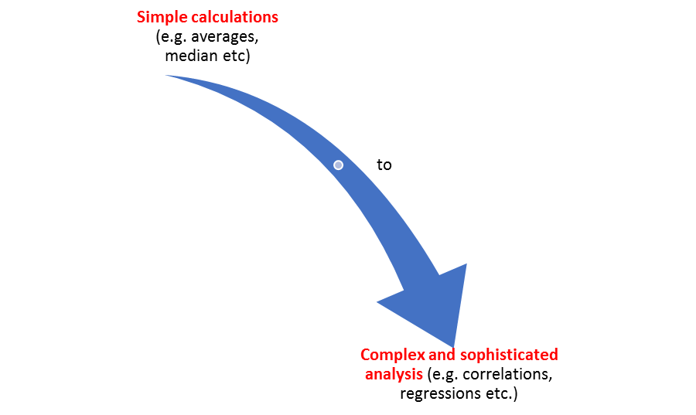
Quantitative Data Analysis
Used for 3 purposes:
Measure differences between groups
Assess relationships between variables
Used to test hypotheses
Involves use of statistics – simple to complex calculations

Slide 10
Two Categories of statistical methods:
Descriptive Statistical Method - ‘Sample’
Inferential Statistical Method – ‘population in general’
Mean – the average of a range of numbers
Median – the midpoint in a range of numbers when arranged in numerical order
Mode – the most commonly occurring number in a data set
Standard deviation – how dispersed a range of numbers are
‘Skewness’ – how symmetrical a range of numbers are
2 x Predictions that can be made
Differences between Groups
Relationship between variables
4 x Types of Inferential Stats Methods
T-Tests
ANOVA
Correlation
Regression

Slide 11
Qualitative Data Analysis Methods
Qualitative data
Not numbers, not measured using stats or maths
Concentrates on words, descriptions, concepts and ideas
Includes interview notes, documents, open-ended survey responses, images and videos

Slide 12

Types of Qualitative Analysis Methods
Content Analysis
Narrative Analysis
Discourse Analysis
Thematic Analysis
Grounded Theory
Interpretive Phenomenological Analysis (IPA)

Slide 13
Summary of Qualitative Analysis Methods
Content Analysis
Evaluates patterns within ‘content’ and can blend quantitative into primarily qualitative analysis
Narrative Analysis
Analyses how stories are told
Discourse Analysis
Analyses conversations and interactions
Thematic Analysis
Identifies Themes and patterns
Grounded Theory
Starts with a specific question and using data alone builds theory in response to the question
IPA
Understanding people’s unique experiences of phenomena

Slide 14
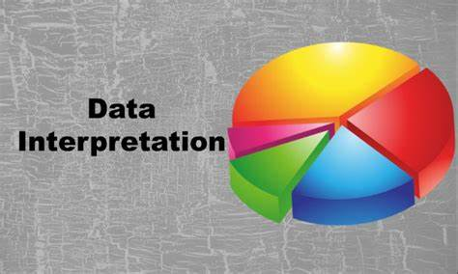
Interpreting/discussing data
Explore meaning set against your research question
Highlight any unexpected results and offer explanations
Reference other academic work – literature review
Be creative – use graphs/charts/diagrams as illustrations of points made

Slide 15
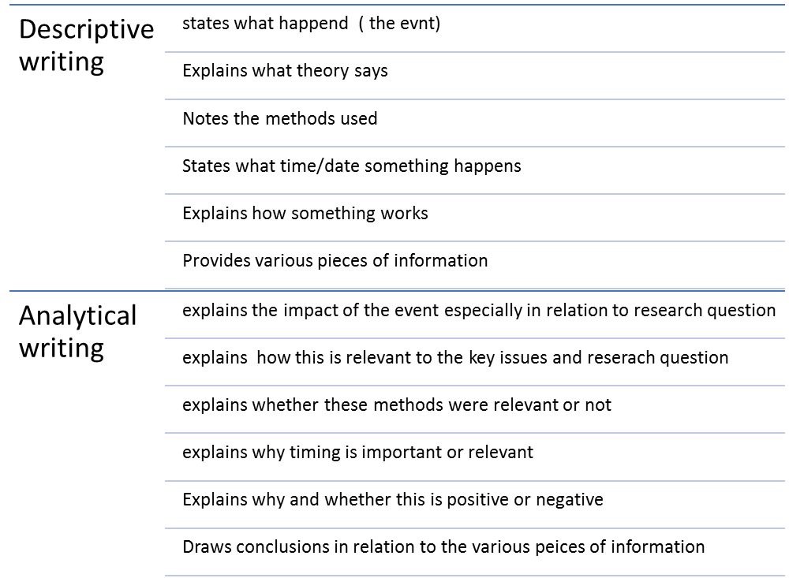
Writing up your Analysis
Aim for this

Slide 16
Presenting the Analysis Chapter
Introduction
Methodology
What you set out to do
Structure of chapter
Context of empirical research
Middle
Break down into themes/objectives
1. Describe
2. Analyse
3. Synthesise
Be creative – use graphs/charts etc.
Conclusion
Briefly summarise what chapter has highlighted and what research has discovered.
Link to the next chapter
Describe = report your empirical results
Analyse = provide an interpretation of your results
Synthesise = compare/contrast/discuss your findings against literature review and academic sources

Slide 17

Important!
Always refer your results/interpretation back to your research question and/or research objectives so that you keep focused on the relevance of your findings

Slide 18
References & Useful Resources
The following resources have been used to compile this presentation:
Saunders, M., Lewis, P., Thornhill,A., (2007) Research methods for business students. 5th Ed. Essex, Prentice Hall
Biggam.J,. (2015) Succeeding with your Master’s Dissertation. A step by step handbook. 3rd Ed. Berkshire, Open University Press.
Scribbr – online at https://www.scribbr.co.uk/thesis-dissertation/results/
GradCoach - Coding of data explained - https://www.youtube.com/watch?v=8MHkVtE_sVw
University of Glasgow - https://www.youtube.com/watch?v=YP3yAX5w6x8
Quirkos (Coding) - https://www.youtube.com/watch?v=lYzhgMZii3o
UWTSD (IMH) Dissertation Handbook, ( On Moodle)
University of Glasgow (Coding) - https://www.youtube.com/watch?v=YP3yAX5w6x8

Slide 19

Unrhyw cwestiynau/ Any Questions

