Slide 1
DS3
Digital Portfolio
+ Audio Reflection
Mirela Onel
Student ID: 2544929
Digital Skills – DS3
Portfolio based on DS1 and DS2
DS3 | 1

Slide 2
Introduction – What My Portfolio Shows
• This portfolio shows how my digital skills developed during the module.
• I selected examples from DS1 and DS2 because they show both everyday digital use and business-focused digital work.
• The examples demonstrate typing, formatting, adding images, organising information, using digital devices and saving work.
• My progress is shown by moving from describing my digital life to creating a structured business document.
DS3 | 2

Slide 3

Portfolio Item 1 – My Digital Life
DS1 example: smart technology and connected devices
• This example shows how digital technology is part of my everyday life.
• I used screenshots/images and short written explanations to present information clearly.
• Skills shown: adding images, typing, formatting and explaining digital technology.
• I learned to connect practical examples from daily life with digital-skills terminology.
DS3 | 3

Slide 4
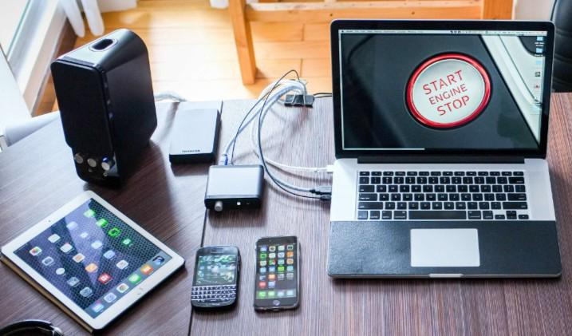
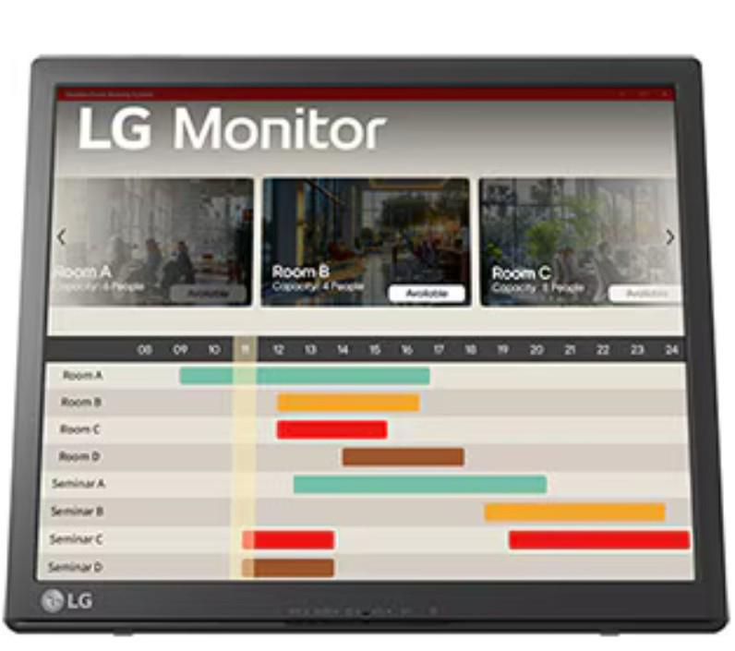
Portfolio Item 2 – Laptop, Smartphone and Digital Workspace
DS1 example: devices used for study and everyday tasks
• My laptop and monitor support studying, working and multitasking.
• My smartphone helps me access frequently used applications and notifications.
• This work shows confidence with common digital devices and file-based tasks.
• I became more aware of organisation, efficiency and online security.
DS3 | 4

Slide 5
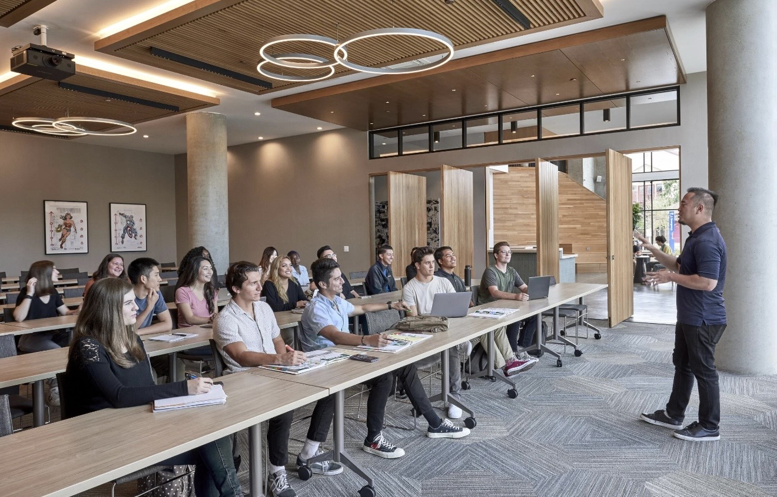
Portfolio Item 3 – Study Space Tutors
DS2 example: creating a business-focused digital document
• I created a clear document for a tutoring service called Study Space Tutors.
• I organised subjects, opening hours and prices using headings and bullet points.
• Skills shown: document formatting, information hierarchy, adding images and presenting business information.
• This task helped me understand that a business document must be easy for customers to read.
DS3 | 5

Slide 6
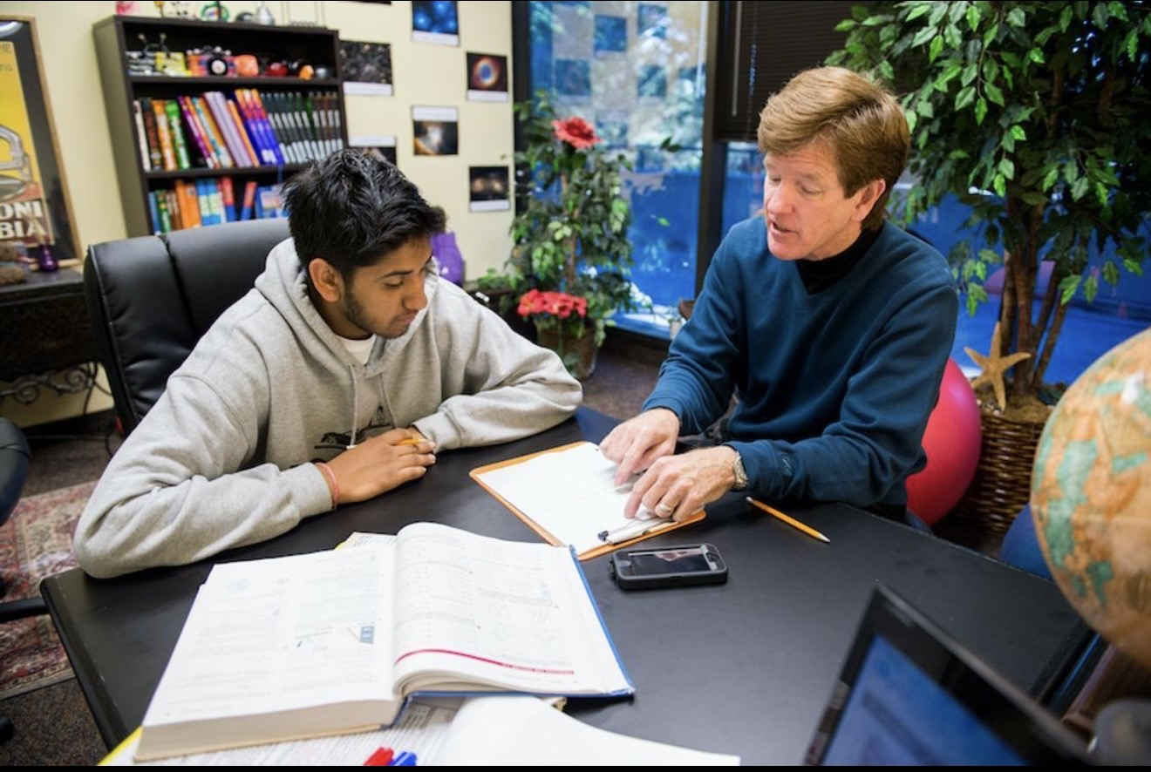
Portfolio Item 4 – Business Information and Visual Design
DS2 example: explaining the service and its benefits
• I combined an appropriate image with short information about why customers should choose the service.
• I used clear headings and simple bullet points instead of long paragraphs.
• I learned that layout, readability and visual balance affect how professional information appears.
• This example shows improvement in choosing and organising content for a specific audience.
DS3 | 6

Slide 7
Skills and Tools I Can Use Confidently
• Microsoft Word – typing, headings, bullet points, page layout and inserting images.
• Digital devices – laptop, smartphone and monitor for study, communication and multitasking.
• File organisation – saving work, locating documents and keeping assessment materials organised.
• Visual communication – selecting images that match the information being presented.
• Business communication – presenting services, prices and benefits in a simple, readable format.
• I now choose the tool according to the task: Word for structured documents and digital devices/apps for everyday tasks.
DS3 | 7

Slide 8
My Development – From Difficulty to Independence
• At the start, I found it harder to organise information and make digital work look clear and consistent.
• I also felt less confident about online security and protecting personal accounts.
• During the module, I improved my formatting, image placement and ability to organise information.
• I can now create a simple structured document, add relevant images, use headings and bullet points, and save my work independently.
• The biggest improvement is that I think more carefully about the purpose and audience of a digital document.
DS3 | 8

Slide 9
Connection to Study, Work and Real Life
• Study: I can prepare clearer coursework, organise files and present information in a logical order.
• Work: I can create simple professional documents and communicate information to customers or colleagues.
• Daily life: I can use connected devices and digital applications more efficiently.
• Business: DS2 showed me how digital presentation can make services easier to understand and more attractive to customers.
• Future development: I want to continue improving online security, document design and my confidence with more advanced digital tools.
DS3 | 9

Slide 10
Conclusion – My Digital Progress
• My portfolio demonstrates progress from everyday digital use to more organised business-focused work.
• I developed practical skills in typing, formatting, adding images, organising information and using digital devices.
• I am more confident working independently and choosing a suitable digital approach for a task.
• These skills will support my future studies, employment and daily life.
• My next goal is to build stronger skills in digital security and more advanced business software.
DS3 | 10

