Slide 1
Safeguarding in Pembrokeshire Schools: Ensuring Student Safety and Wellbeing
Karen Cook
Student No. 2213741

Slide 2
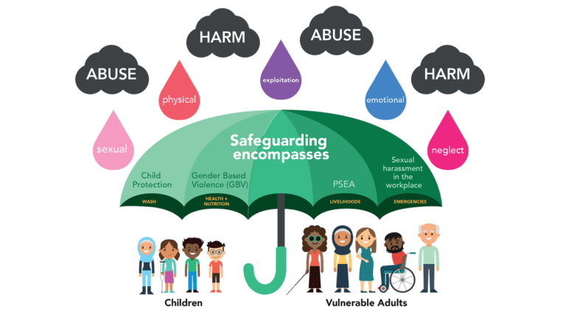
Comprehensive Safeguarding Policies
Required policies covering abuse, neglect, and other risks.
Aim to prevent harm and promote student well-being.

Slide 3
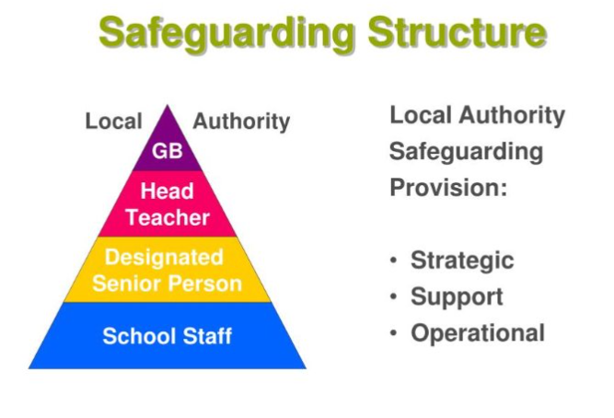
Working Together: A Coordinated Approach
Close collaboration with local authority, health services, and the police.
Ensures effective planning and response to incidents.

Slide 4

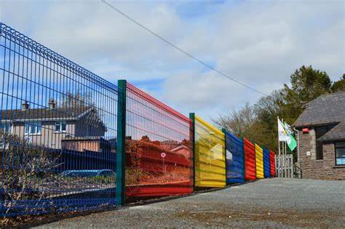
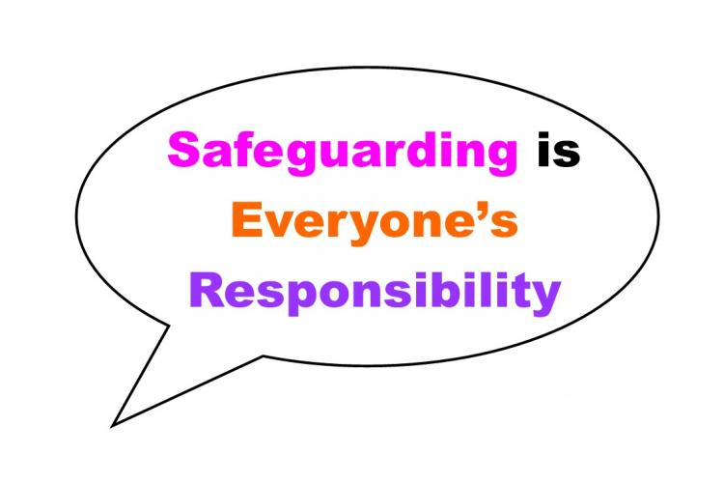
Ensuring a Secure Environment
Secure building perimeters and controlled access.
Visitor sign-in procedures and badges.
Safeguarding is everyone's business ethos.

Slide 5
Empowering Staff: Regular Training
Regular in-service training for staff on safeguarding practices.
Ensuring awareness of latest guidelines and effective responses to risks.

Slide 6

Maintaining Accountability: Oversight and Scrutiny
Pembrokeshire County Council's Schools and Learning Committee's role.
Reviews educational outcomes, school performance, and safeguarding practices.

Slide 7
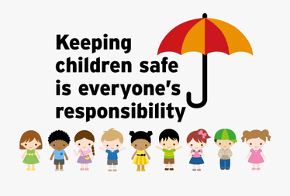
A Shared Responsibility: Community Involvement
Encouraging parent and community involvement.
Ensuring transparency and accountability.

Slide 8
Creating a Safe and Supportive Environment
Collective aim of all measures.
Supporting students to learn and thrive.

Slide 9
Referencing List
Pembrokeshire County Council. (Various dates). Safeguarding Adults and Children. (https://www.pembrokeshire.gov.uk/safeguarding-adults-and-children)
Pembrokeshire County Council. (Various dates). Corporate Safeguarding Policy. (https://www.pembrokeshire.gov.uk/safeguarding-adults-and-children/corporate-safeguarding-policy)
CYSUR - Mid and West Wales Regional Safeguarding Children Board. (Various dates). (https://cysur.wales/child-practice-reviews)
Bernard, M. (2010). Safeguarding children: A multi-agency approach.

