Slide 1
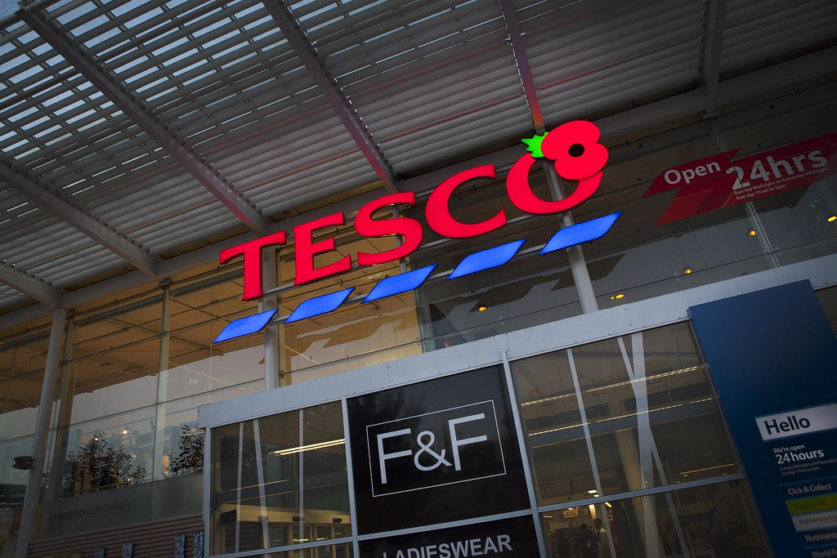
Module code: Academic Skills LCBB4006
Title: Group Presentation - Tesco
Renaldo: 2114362
Maiyara: 2113112
Stoyko: 2128919
Cristian: 2212206
Lecturer : Mr Muno Zuwirai
This Photo by Unknown Author is licensed under CC BY-SA-NC

Slide 2

Introduction
In this presentation, we will highlight the main products and services of TESCO and share our recommendations on how these products and services can be improved in order to gain additional customer satisfaction.

Slide 3
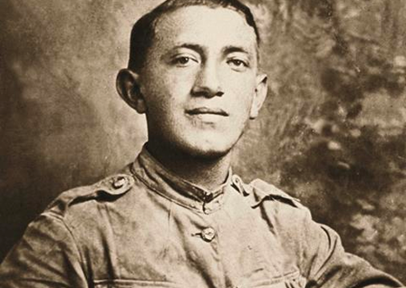
Brief History of Tesco
Tesco Origin
The story of TESCO began in 1919 when a young man by the name of Jack Cohen opened a market stall in Hackney in order to trade food items.
Tesco PCL (n.d)

Slide 4
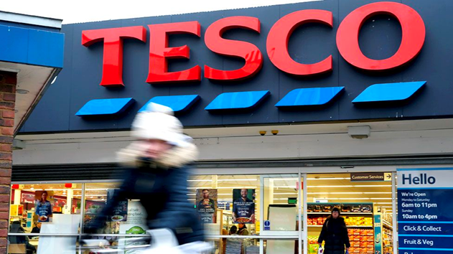
Tesco Brand is Born
●The name “TESCO” came in 1924, five years after Cohen had opened and operated his first market stalls.
The name is the result of the first three initials of one of Cohen’s suppliers (TES) and the first two letters of his last name (CO).
Ryle & Sarah (2013).

Slide 5
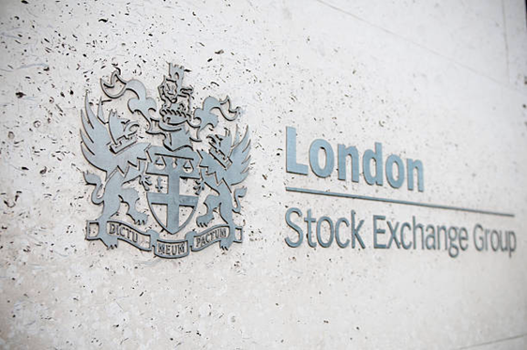
Tesco Floats on the Stock Exchange
● In 1947, Tesco was floated on the London Stock Exchange and the company has remained a publicly traded company ever since.

Slide 6
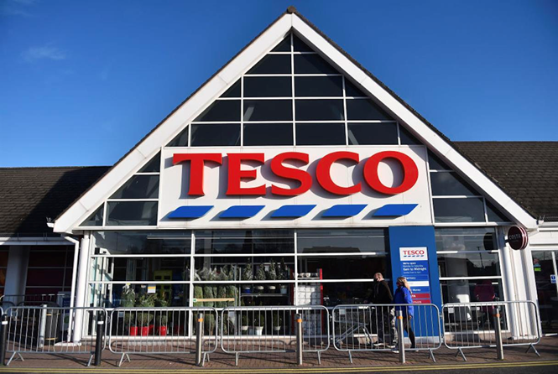
Tesco Expands
Equip with the money raised from floating the company as well as financing from banks, Tesco continued to rapidly expand. From 1955 to 1960, the company bought over 500 competing stores and rebranded them under the TESCO name.
Chen (2020)

Slide 7
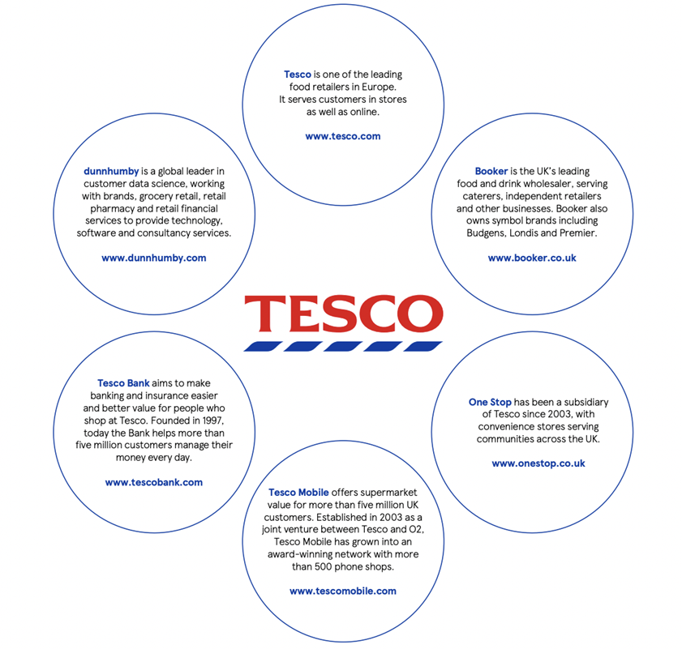
Tesco Today
Tesco Annual Report (2021)

Slide 8
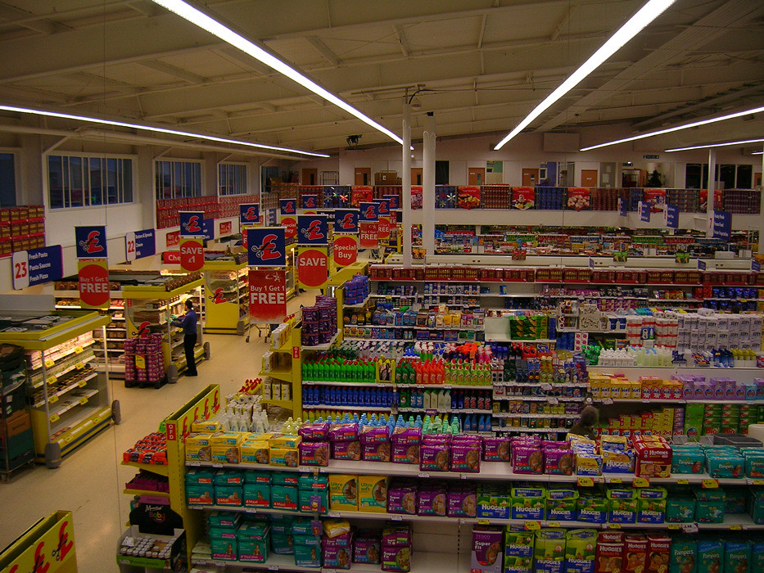
Products
This Photo by Unknown Author is licensed under CC BY-NC
Food
Electronics
Clothing
Cell Phones
Health
Books
Sports And Fitness Equipment
Party And Gifting
Home And Decor
Baby Products Etc.
Notes:
Tesco has majorly expanded since its inception and now provides a wide range of products in categories including food, electronics, health, books, apparel, home and decor, party and gifting, sports and fitness equipment, beauty, jewellery, baby products, etc. It’s quite clear that Tesco caters to various needs of consumers from across segments and is a retail giant. Tesco has its own brands for these categories, namely Tesco Loves Baby, Tesco Lotus, Tesco kipa, F&F Clothing, Tesco Value, etc.
Tesco’s stores stock over 40,000 different products.

Slide 9
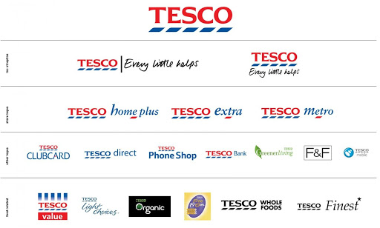
Tesco Services
Tesco Superstores
Tesco Express Shops
Tesco Metro
Tesco Bank
Tesco Phone Shop
Tesco Clubcard
Source by https://iide.co/author/aditya/
Notes:
Tesco Extra shops are larger, mainly out-of-town hypermarkets that stock nearly all of Tesco’s product ranges
Tesco Superstores are standard large supermarkets, stocking groceries and a much smaller range of non-food goods than Extra hypermarkets
Tesco Express shops are neighborhood convenience shops, stocking mainly food with and emphasis on higher -margin products
Tesco Metro shops are sized between Tesco superstores and Tesco Express shops, designed to accommodate larger weekly shops as well as top-up shopping
Includes some of the smallest shops (smaller than a Tesco Express). Stocking mainly food with and emphasis on higher-margin products

Slide 10
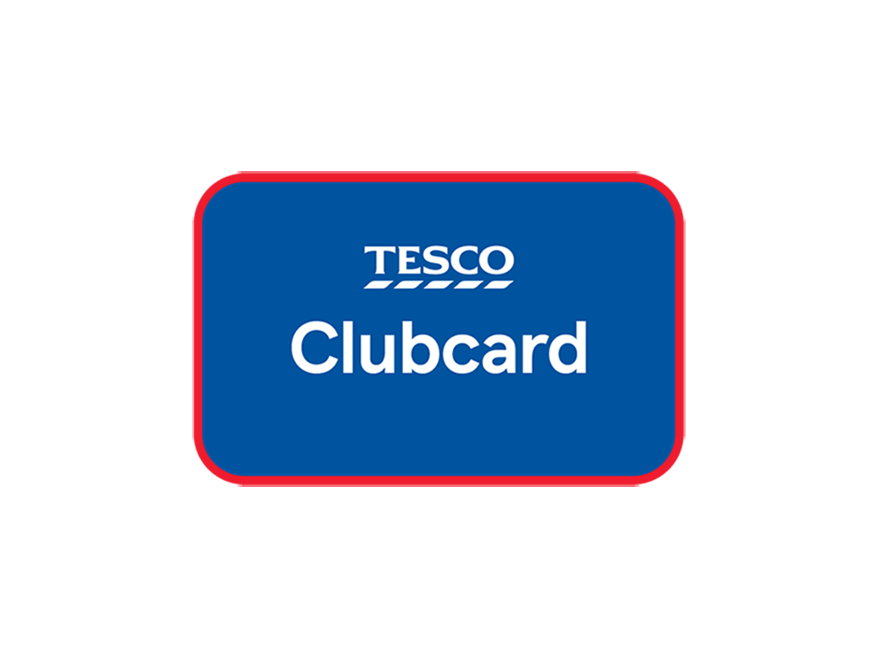
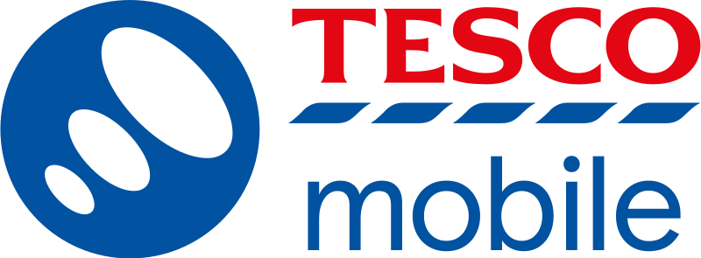

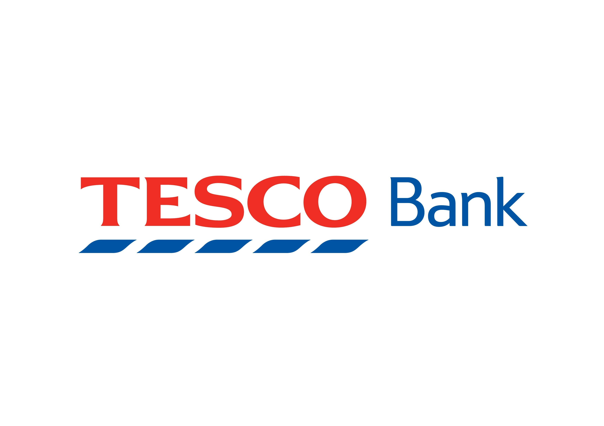
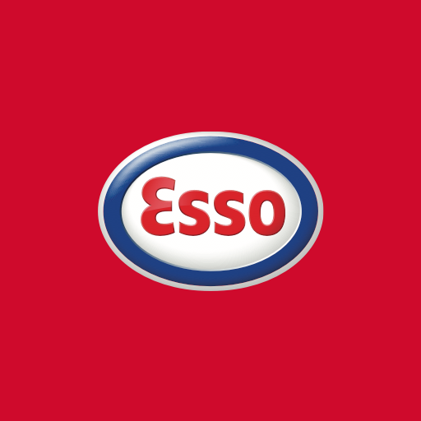
Recommended Services
Xaif (2022)
Notes:
Tesco operates a cell phone business across the United Kingdom from 2003 as a joint venture with O2 and operates as a mobile virtual network operator (MVNO) using the network of O2 .
Tesco Bank provides a range of personal accounts, including credit cards, loans, savings accounts, insurance and foreign currency exchange.
Tesco launched its customer loyalty scheme, the Tesco Clubcard, in 1995. It has been cited as pivotal development in Tesco’s progress towards becoming the UK’s largest supermarket chain.
Tesco first started selling petrol in 1974. Tesco recently diversified into biofuels offering petrol-bioethanol and diesel-biodiesel blends instead of pure petrol and diesel at its petrol stations.
In 1998, Tesco and Esso ( part of ExxonMobil ) formed a business alliance that included several petrol filling stations on lease from Esso, with Tesco operating the attached shops under its Express format. In turn, Esso operates the forecourts and sells fuel via the Tesco shop, as of 2013, there were 200 joint Tesco Express/ Esso sites in the UK.

Slide 11
STRENGTH | WEAKNESSES | OPPORTUNITIES | THREATS
Efficient supply chain network Using and having the Tesco Clubcard, customers can get points that they can redeem to claim additional perks and discounts. | Failed operations in Japan and the States. | Expanding to emerging markets such as South Korea, Indonesia, and Turkey. | Low price supermarkets. The business of the firm is affected by the introduction of supermarkets that offer very low prices and discounts.
Leading market share. Almost 27% in Great Britain. | Participating in multiple segments resulting in inefficiency. | Strategic alliances with other brands to attract more customers. | Competition from other giants like Walmart, Lidl and Aldi threatens Tesco’s market share.
Geographically diversified. Tesco has a strong global presence. | Decline in operating profits. | Capitalizing further on increased reliance on online channels. | Economic reforms and consequences of Brexit in terms of tariffs, trade barriers, import and export taxes, etc.
Tesco’s dominance in the market is more than evident. But it needs to capitalize on the available opportunities.
Xaif (2022)
Notes:
Tesco’s dominance in the market is more than evident. But it needs to capitalize on the available opportunities.
STRENGTH- Efficient supply chain network
Leading market share. Almost 27% in Great Britain.
Geographically diversified. Tesco has a strong global presence.
WEAKNESSES- Failed operations in Japan and the States.
Participating in multiple segments resulting in inefficiency.
Decline in operating profits.
OPPORTUNITIES-Expanding to emerging markets such as South Korea, Indonesia, and Turkey.
Strategic alliances with other brands to attract more customers.
Capitalizing further on increased reliance on online channels.
THREATS-Low price supermarkets. The business of the firm is affected by the introduction of supermarkets that offer very low prices and discounts.
Competition from other giants like Walmart, Lidl and Aldi threatens Tesco’s market share.
Economic reforms and consequences of Brexit in terms of tariffs, trade barriers, import and export taxes, etc.

Slide 12
Strategies
Accepting Cryptocurrency
The market for cryptocurrency is growing at a fast pace and is expected to grow from $1.2 Trillion in 2022 to $2.2 Trillions in 2025.
Over one-third of UK population would like to purchase goods or services with cryptocurrencies so that gives a clear advantage for the early adopters.
Unlike traditional currencies, cryptocurrency is not backed by any government or central bank, which makes it a great tool for protecting personal data.

Slide 13
Networking with Customers Online Marketplaces
Online marketplaces are a great alternative for Tesco to gain more customers. Especially during the covid period.
This will be a great opportunity for Tesco to increase revenue and customer satisfaction.
Notes:
There are many online marketplaces such as amazon or eBay in the world where you can find different products and services that are sold on a daily basis.
Online marketplaces are a great alternative for Tesco to gain more customers. Morrisons reported an increase of 113% in online sales in the first 14 weeks, thanks to its partnership with Amazon and its continuing association with Amazon-owned Deliveroo.
According to a study conducted by Statista.com, more than 90% of people in the UK are using online services, while only 15% use offline services.
This will be a great opportunity for Tesco to increase revenue and customer satisfaction.
Especially during the covid period

Slide 14
References
Anon, (2022). How Accepting Cryptocurrency Can Increase Your Sales. [online] Available at: https://savvycomsoftware.com/blog/how-accepting-cryptocurrency-can-increase-your-sales/#:~:text=As%20per%20research%2C%20merchants%20accepting [Accessed 14 Nov. 2022].
Chen (n.d) Inorganic Growth. Available at:https://www.investopedia.com/terms/i/inorganicgrowth.asp [Accessed 13th November 2022]
Cointelegraph. (n.d.). What can you buy with Bitcoin: A beginners guide to spending your BTC. [online] Available at:https://cointelegraph.com/bitcoin-for-beginners/what-can-you-buy-with-bitcoin-a-beginners-guide-to-spending-your-btc. [Accessed 14 Nov. 2022].

Slide 15
References
Ryle, Sarah (2013). The Making of Tesco: A story of British Shopping. Random House. [ Accessed 9th November 2022]
Stevens, B. (2021). Morrisons to expand Amazon tie-up as online sales double in first quarter. [online] Latest Retail Technology News From Across The Globe - Charged. Available at: https://www.chargedretail.co.uk/2021/05/13/morrisons-to-expand-amazon-tie-up-as-online-sales-double-in-first-quarter/[Accessed 14 Nov. 2022].
Tesco (n.d.) Tesco 2021 Annual Report. Available at: https://www.tescoplc.com/media/759057/tesco-annual-report- 2022.pdf [Accessed 10th November 2022]
Tesco PLC (n.d) Our History. Available at: https://www.tescoplc.com/about/our-history/ [ Accessed 14th November 2022]
Xaif (2022) In-depth marketing strategy of Tesco - 2022 study, IIDE. Available at: https://iide.co/case-studies/tesco-marketing-strategy/ (Accessed: October 21, 2022).

