Slide 1

Path way project 1
Teacher Name:- Diloa Bijhout
Student Name | Student ID
Abdulla Al Mamun (Team Leader) | 1606019
Mohammed Shahin | 1605776
Rohul Amin | 1606015
Community participation (Locally and Nationally)

Slide 2
Introduction
The community participation is the process that makes the people get engaged with the society and minimize the own problems. Companies implement several CSR strategy as part of the community development strategy. The community awareness needs to improve to make the people to participate with the organizational implemented strategies. There are different ways related with the community participation

Slide 3
Corporate social responsibility
According to Carroll’s (1991), corporate social responsibility is the process of company’s policy development and decision making process that fulfills stakeholder’s needs and demand. Moreover, the corporate social responsibility has four different areas these are: political, ethical, legal and philanthropic. Corporate social responsibility is ethically responsible for the societal welfare and the environmental development. For instance, Ben & Jerry’s have donated 7.5% of the pre-tax profit to the charity organizations.

Slide 4
Corporate sustainability
According to Benn, Dunphy and Griffiths (2014), corporate sustainability is the business approach that creates long term business sustainability and value created to the employees by following a green sustainable that business operate and evaluate the dimensions of social, cultural, economic and environment. This is a new emerging business concept that has developed management strategies for long term business success along the social development and develops community at large.

Slide 5
Social enterprise
According to Visser (2013), the social enterprise of the organizations is that are directly involved for the sales of the organizational goods and services with a specific purposes to develop the society. The social enterprise could be profit or non-profit organization but mainly earn profit to further use for the social programs. For instance it provides low income family job training; social enterprise provides living wages to the people. The Grameen Bank is a microfinance and community development bank founded in Bangladesh and provide small loan to local people.

Slide 6
Why is it important
The community participation benefits the local people and the same time its also benefit the organization, few of these are:
It makes the customers get satisfied and they perform repeated purchasing
The organizational brand image enhanced
Company ensure a sustainable advantage

Slide 7
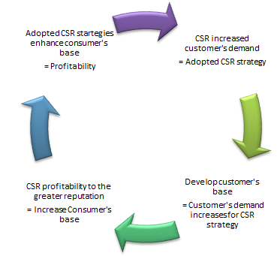
Claydon Model (2011)
The customers get engaged with the organizational strategies when their demand get satisfied. Claydon (2011) has developed a model for the customers engaged in organization. Companies get benefited with the increasing numbers of customers.

Slide 8
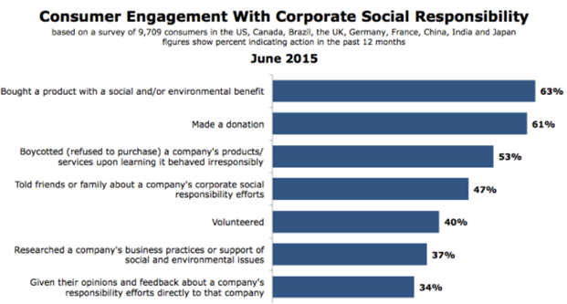
Engagement of customers with CSR strategy

Slide 9
Examine Problem
Resource Allocation: it sometime found that it gets difficult to allocate resources for the corporate social responsibility strategies as business owners found less interested to invest for charity programs or invest in a sector which is not profitable.
Communication: According to Flouris and Yilmaz (2016), appropriate communication is important for the implementation of business strategy. It found that company’s lack of ability for communicating business strategy might harm the right implementation of CSR strategy in business.

Slide 10
Discuss Solution
For the first problem for allocating resources appropriately within the organization the shareholders need to realize appropriately that allocating the resources for minimizing the waste of the organization is benefiting the organization and the operational cost of the product get reduced. Again investing for the social development programs would benefit the customers directly which would benefit the customers and they would engaged with the company.
To drive solution for the second identified problem of the implementation of CSR strategy companies needs to rightly communicate with the customers. It is important to inform the customers and enhance their awareness level so that they would perform word of mouth promotion and the business will expand.

Slide 11
Conclusion
Corporate social responsibility programs are the present requirement of the businesses and the society, as these programs provide benefits for both the companies and the customers.

Slide 12
References
Benn, S., et al Dunphy, D., Griffiths, A., (2014) Organizational Change for Corporate Sustainability: Routledge
Camilleri, M. A., (2017) Corporate Sustainability, Social Responsibility and Environmental Management: Springer
Fernando, R. A., (2015) Strategic Corporate Sustainability: 7 Imperatives for Sustainable Business: Partridge Publishing Singapore
Flouris, T. G., Yilmaz, A. K., (2016) Risk Management and Corporate Sustainability in Aviation: Routledge
Schaltegger, S., Windolph, S., Harms, D., Hörisch, J., (2014) Corporate Sustainability in International Comparison: State of Practice, Opportunities and Challenges: Springer
Visser, W., (2013) Corporate Sustainability & Responsibility: Lulu.com

Slide 13
Learning Log
Name | Activity
Mamun | The group work was very skillful and knowledgeable and I contributed to develop introduction, situate the topic and conclusion.
Shahin | I had developed the section why is it important and few theories. T found that community participation is a important and beneficial strategy for the companies. I also analyzed theories which found very effective to gain knowledge on certain issue.
Rohul Amin | I has contributes one of the important issue of community participation as I find the problems and also developed solution. I found it very effective as when problem would be identified and solution would develop them chances of gaining success of the strategies implementation enhanced.

