Slide 1
Eating Disorders: A Critical Examination of Historical and Contemporary Treatment, Provision of Care, and the Influence of Social, Cultural and Political Contexts
Student Name: Francesca Florescu
Student Number: 2332791
Module Code: BMHP6029

Slide 2

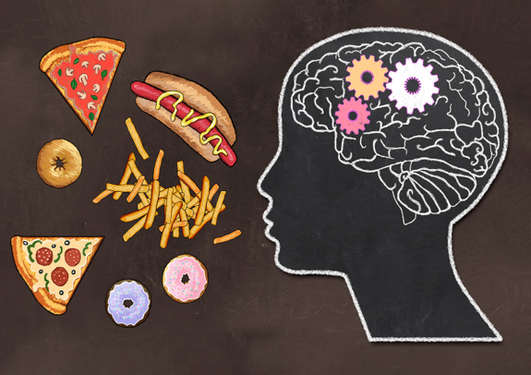
Introduction.
Historical Treatment of Eating Disorders.
Eating disorders are serious mental health conditions characterised by persistent disturbances in eating behaviours, thoughts and emotions surrounding food, body weight and body image. According to the ICD-11, eating disorders include anorexia nervosa, bulimia nervosa, binge eating disorder, avoidant/restrictive food intake disorder (ARFID) and other specified feeding or eating disorders. These illnesses affect individuals across all ages, genders and cultural backgrounds and are associated with significant physical, psychological and social consequences. If left untreated, eating disorders can result in severe medical complications and have one of the highest mortality rates of any mental health disorder. Early identification, evidence-based treatment and person-centred care are therefore essential to improve recovery outcomes and quality of life (WHO, 2024; Treasure et al., 2020).
The understanding and treatment of eating disorders have changed considerably over time. Early accounts of behaviours resembling anorexia nervosa were documented as far back as the Middle Ages, when extreme fasting was often interpreted as a sign of religious devotion rather than a mental health condition. By the late nineteenth century, clinicians began recognising anorexia nervosa as a medical disorder, although explanations frequently focused on individual weakness, hysteria or family dysfunction (Silverman, 2018).
Throughout much of the twentieth century, treatment was largely centred on restoring weight and managing physical health risks, often within institutional settings. While these approaches helped prevent severe medical complications, they frequently overlooked the psychological, social and emotional factors contributing to the disorder. The dominance of biomedical models also led to a tendency to view patients as passive recipients of care rather than active participants in recovery. Contemporary perspectives now acknowledge that eating disorders arise from a complex interaction of biological, psychological and sociocultural influences, reflecting a significant shift from earlier reductionist approaches (Keel and Forney, 2013; Treasure et al., 2020).

Slide 3




Contemporary Treatment and Provision of Care.
Today, the treatment of eating disorders has moved beyond simply restoring weight to recognising the importance of addressing the psychological, physical and social aspects of recovery. Current evidence supports a multidisciplinary approach, where psychiatrists, psychologists, dietitians, nurses and other healthcare professionals work together to provide person-centred care. This approach acknowledges that recovery is rarely linear and should be tailored to each individual’s needs, preferences and stage of illness (Treasure et al., 2020).
Psychological therapies are considered the foundation of treatment. Cognitive Behavioural Therapy for Eating Disorders (CBT-E) is widely recommended for adults with bulimia nervosa, binge eating disorder and many other eating disorders because it helps individuals identify and change unhelpful thoughts and behaviours related to food, weight and body image. For children and adolescents with anorexia nervosa, Family-Based Treatment (FBT) is regarded as the first-line intervention, as it actively involves families in supporting nutritional rehabilitation and recovery (National Institute for Health and Care Excellence (NICE), 2020).
Medical monitoring also plays a vital role, particularly for people experiencing severe malnutrition or physical complications such as electrolyte imbalances or cardiovascular problems. In some cases, hospital admission may be necessary to ensure medical stability before continuing treatment in the community. Increasingly, services are adopting recovery-oriented and trauma-informed models of care, which emphasise collaboration, respect, hope and empowering individuals to take an active role in their recovery rather than focusing solely on symptom reduction (Hay et al., 2023).
Despite these advances, access to specialist eating disorder services remains unequal. Long waiting times, limited funding and shortages of trained professionals can delay diagnosis and treatment, increasing the risk of poorer physical and mental health outcomes. These challenges highlight that while evidence-based treatments are available, equitable access to high-quality care remains an ongoing issue in many healthcare systems (World Health Organization, 2024).
Social, Cultural and Political Influences.
Eating disorders do not develop in isolation; they are shaped by a complex interaction of biological, psychological and environmental factors. Social expectations around appearance, particularly the idealisation of thinness, have long influenced body image and eating behaviours. The rise of social media has intensified these pressures by exposing individuals to carefully edited images and unrealistic beauty standards. Constant comparison with others can contribute to body dissatisfaction, low self-esteem and unhealthy dieting behaviours, particularly among adolescents and young adults (Jebeile et al., 2021).
Cultural beliefs also influence how eating disorders are recognised and treated. Historically, these disorders were viewed as conditions affecting mainly young, white women from high-income countries. However, recent research has shown that eating disorders affect people of all genders, ethnicities, ages and socioeconomic backgrounds. This misconception has contributed to underdiagnosis in men, older adults and people from culturally and linguistically diverse communities, many of whom face additional barriers to seeking help due to stigma, cultural expectations or limited access to culturally appropriate services (Treasure et al., 2020).
Political factors also play an important role in shaping the provision of care. Government investment in mental health services, healthcare policies and public health campaigns all influence how quickly individuals can access assessment and treatment. Although many countries have introduced national strategies to improve early intervention and specialist eating disorder services, demand often exceeds available resources. As a result, long waiting times and unequal access to care continue to affect recovery outcomes, particularly for people living in rural or underserved communities (World Health Organization, 2024; Hay et al., 2023).
Overall, these social, cultural and political influences demonstrate that eating disorders are not solely individual illnesses. Effective prevention and treatment require broader societal change, including reducing appearance-based pressures, improving cultural awareness and ensuring equitable access to evidence-based mental health services.

Slide 4
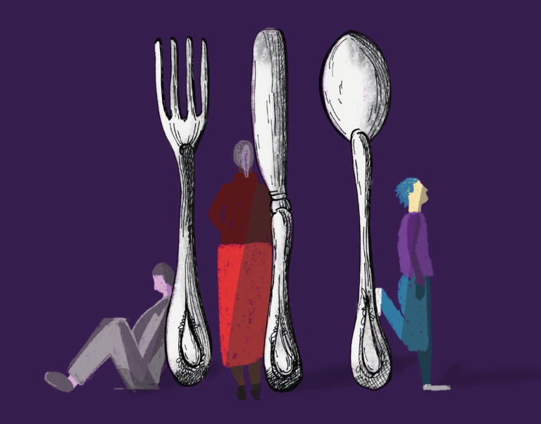
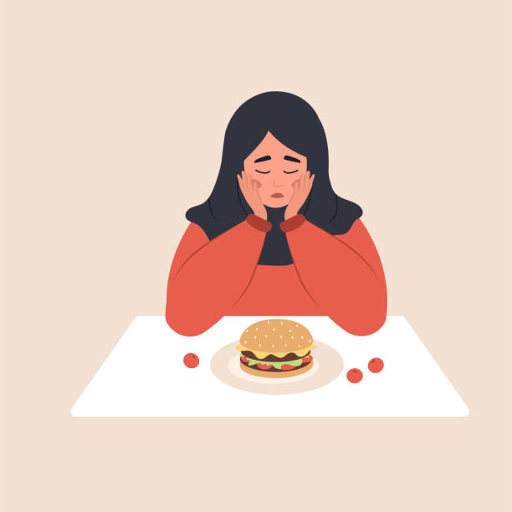
Stigma, Discrimination and Inequality.
Despite growing awareness of eating disorders, stigma remains one of the biggest barriers to early diagnosis and recovery. Many people are reluctant to seek help because they fear being judged, misunderstood or blamed for their illness. A common misconception is that eating disorders are a lifestyle choice or a result of vanity, rather than serious mental health conditions. These beliefs can lead to feelings of shame and isolation, making it more difficult for individuals to access support and engage with treatment (Ali et al., 2017).
Discrimination also affects who receives appropriate care. For many years, eating disorders were largely associated with young, thin women, meaning that men, older adults, people in larger bodies and individuals from culturally diverse backgrounds were often overlooked by healthcare professionals. This has resulted in delayed diagnosis and reduced access to specialist services for many groups. Research now shows that eating disorders affect people of all genders, ages, body sizes and cultural backgrounds, highlighting the need for more inclusive approaches to assessment and treatment (Treasure et al., 2020).
Health inequalities further contribute to poor outcomes. People living in rural or low-income communities may face long waiting times, financial barriers and limited access to specialist services. In addition, cultural differences and language barriers can make it difficult for some individuals to receive care that is respectful of their beliefs and experiences. Addressing these inequalities requires more than improving clinical treatment; it also involves challenging stigma, increasing public awareness and ensuring that mental health services are accessible, inclusive and culturally responsive for everyone (World Health Organization, 2024; Hay et al., 2023).
Reducing stigma is essential because people are more likely to seek help and remain engaged in treatment when they feel respected, understood and supported. Creating a healthcare system that values diversity and promotes equality can improve both recovery outcomes and overall quality of life for individuals living with eating disorders.
Future Directions and Conclusion.
Although significant progress has been made in understanding and treating eating disorders, there is still considerable work to do to improve outcomes for those affected. Future approaches should prioritise early intervention, as research consistently shows that prompt diagnosis and treatment are associated with better physical and psychological recovery. Increasing awareness among healthcare professionals, educators and the wider community can help individuals access support before their condition becomes more severe (Treasure et al., 2020).
Advances in technology are also creating new opportunities to improve care. Telehealth services, online psychological therapies and digital support tools have increased access to treatment, particularly for people living in rural or remote areas where specialist services may be limited. However, these approaches should complement, rather than replace, face-to-face care, as building a trusting therapeutic relationship remains an important part of recovery (Hay et al., 2023).
Looking ahead, reducing stigma and addressing inequalities should remain key priorities. Mental health services need to become more inclusive by recognising that eating disorders affect people of all genders, ages, body sizes and cultural backgrounds. Continued investment in specialist services, workforce training and public education will help ensure that everyone has equal access to timely, evidence-based care. Ultimately, improving recovery outcomes requires not only effective clinical treatment but also a society that understands eating disorders as serious mental health conditions rather than personal choices or failures (World Health Organization, 2024).
In conclusion, eating disorders are complex illnesses influenced by biological, psychological, social and cultural factors. While treatment has evolved from a narrow focus on physical symptoms to more holistic, person-centred care, ongoing challenges such as stigma, unequal access to services and misconceptions continue to affect recovery. Addressing these issues through evidence-based practice, policy improvements and greater public awareness is essential to support long-term recovery and improve the quality of life for individuals living with eating disorders.

Slide 5
References:
Ali, K., Farrer, L., Fassnacht, D.B., Gulliver, A., Bauer, S. and Griffiths, K.M. (2017) ‘Perceived barriers and facilitators towards help-seeking for eating disorders: A systematic review’, International Journal of Eating Disorders, 50(1), pp. 9–21.
American Psychiatric Association (2023) Practice Guideline for the Treatment of Patients with Eating Disorders. 4th edn. Washington, DC: American Psychiatric Association.
Bruch, H. (1973) Eating Disorders: Obesity, Anorexia Nervosa, and the Person Within. New York: Basic Books.
Hay, P., Touyz, S. and Sud, R. (2023) ‘Treatment for eating disorders: A review of evidence and future directions’, The Lancet, 402(10403), pp. 849–861.
Jebeile, H., Lister, N.B., Baur, L.A., Garnett, S.P. and Paxton, S.J. (2021) ‘Social media, body image and eating disorder risk’, Current Opinion in Pediatrics, 33(4), pp. 448–453.
Keel, P.K. and Forney, K.J. (2013) ‘Psychosocial risk factors for eating disorders’, International Journal of Eating Disorders, 46(5), pp. 433–439.
Lasègue, C. (1873) ‘On hysterical anorexia’, Medical Times and Gazette, 2, pp. 265–266.
National Institute for Health and Care Excellence (NICE) (2020) Eating disorders: Recognition and treatment (NG69). London: NICE.
Treasure, J., Duarte, T.A. and Schmidt, U. (2020) ‘Eating disorders’, The Lancet, 395(10227), pp. 899–911.
World Health Organization (2024) International Classification of Diseases 11th Revision (ICD-11): Feeding or Eating Disorders. Geneva: World Health Organization.

