Slide 1
Module Name: Operating Hotel Facilities
Module Code: BMIH4006
Component three
Student Name: Dumitru Nicolae silviu
Student ID: 2235616

Slide 2
Table of Contents
Introduction
Application of Employee Engagement Model
Principle of the Employee Engagement Model
Types of the Employee Engagement Model
Importance of the Employee Engagement Model
Benefits of the Employee Engagement Models
Examples of Employee Engagement Model in Industry Practice
Conclusion
References

Slide 3
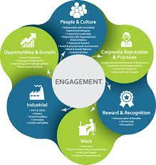
Introduction
The presentation aims to portray, the employee engagement model.
The benefits of employee engagement can be significantly seen in the work culture of Hilton Hotel, Croydon.
Employee engagement helps to increase productivity according to the checklist done previously
It helps to engage the other employees with work.
Notes:
The presentation aims to portray, the employee engagement model, principles, types, importance, benefits, and examples of the employee engagement model in the hotel industry. Along with the benefits of employee engagement in the work culture of Hiton Hotel. In an organisation, it is very important for the management team to keep the relationship between the employees. The Employee Engagement model is a framework which purposely serves to improve the organisational culture such as work culture, productivity, relationships between the employees and many more. The framework outlines the factors to engage the people with different tasks which helps to keep them motivated for work and feel more valued and respected in their workspace.

Slide 4
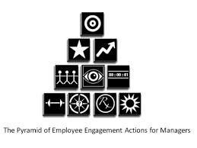
Application of Employee Engagement Model
It is a framework of several strategies to maintain a healthy workplace.
By using this strategy, an organisation can increase their overall result (Bridger, 2018).
Employees get sustainable experience in their work life.
By maintaining the employee engagement model, a company can develop their organisational culture.
It increases the work ethics among the employees.
Notes:
The Employee engagement model is a framework, which helps the organisation to maintain a healthy work culture. In the organisation, it is very important to maintain some ethics and morals in the workplace (Bridger, 2018). Employees are the main assets of the company, and by maintaining employee engagement, the company can increase the overall result. It helps to provide several facilities to the employees such as making them happy and motivated for work. Employees get a subtle experience where they are respected and valued. By maintaining the employee engagement model, a company can develop their organisational culture, and increase the work ethics among the employees. and increase the work ethics among the employees.

Slide 5
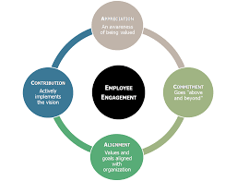
Principle of the Employee Engagement Model
Work ethics is one of the important parts of the organisation.
It has several principles of this model physical, cognitive and emotional (Cottrell, 2019).
It helps to connect with the behaviour of the employees
Employers are always hungry for motivation and energy.
In Hilton Croydon, it creates a connection between the employees and serves specific needs.
In Hilton Croydon, by using the engagement model, the management authorities can maintain the work culture in the organisational culture.
Notes:
Maintaining a work ethic is one of the important parts of making a business. There are several types of principles of the employee engagement model according to the scenario of the company. There are major 4 principles of the employee engagement model such as physical, cognitive and emotional (Cottrell, 2019). The main principle of the employee engagement model is to maintain the work culture which involves behaviour, emotion and relationship. Employers are always hungry for motivation and energy. It helps to make the overall result of the company better than expected. It creates a connection between the employees and serves specific needs. In Hilton Croydon, it creates a connection between the employees and serves specific needs. In Hilton Croydon, by using the engagement model, the management authorities can maintain the work culture in the organisational culture.

Slide 6
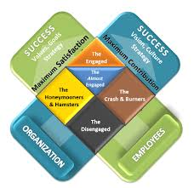
Principle of the Employee Engagement Model (Continued)
It analyses the capabilities of the employees.
It studies the mental, physical, emotional and spiritual state of the employees.
The employee engagement model refers to the employee’s emotions about work (Quick, 2020).
It helps to increase the organisation's performance.
. In Hilton Croydon, by using the engagement model, the management authorities can maintain the work culture in the organisational culture.
Notes:
Apart from those factors, the employee engagement model has some other principles such as it helps to closely analyse the capabilities of each employee by studying their mental, physical, emotional and spiritual state the employee engagement model helps to make specific strategies according to the needs of the employees and make a healthy interaction between them (Quick, 2020). The employee engagement model refers to the employee’s emotion of work. It helps them to show how much concern the organisation has about their employees. It helps to increase the organisation's performance and helps the employees to feel engaged in the work. In Hilton Croydon, by using the engagement model, the management authorities can maintain the work culture in the organisational culture. The model will help to manage the work in housekeeping cleaning significantly. It will be used in to work with full potential and by maintaining emotional intelligence in work.

Slide 7
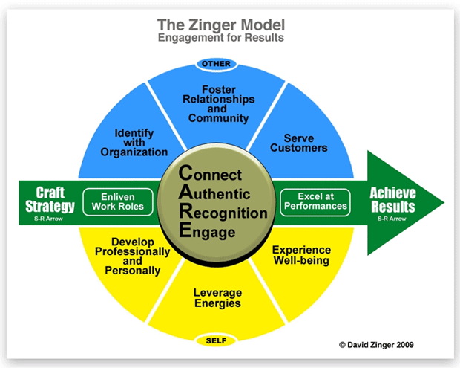
Types of the Employee Engagement Model
Employee engagement is a blueprint of the producibility of the company.
There are several types of engagement models such as the Zinger model, and many more (Ramakumar, 2021).
Zinger model targeted the behaviour of the employee
The Deloitte Model includes cultural events to attract employees.
AON Hewitt Model refers to the factors which analyse the relationship between the employees.
Notes:
Employee engagement is a blueprint for the productivity of the company. There are several types of employee engagement models which is used by companies to maintain their workforce. There are 3 major and most used employee models which help to make a better organisational culture such as the Zinger model, the Deloitte Model, and the AON Hewitt Model (Ramakumar, 2021). The Zinger model of employee engagement refers to understanding and making strategies according to the employee's needs. The Deloitte Model helps to engage the employees by holding several cultural events and challenging them to participate. AON Hewitt Model refers to the factors which analyse the relationship between the engagement drivers and create specific strategic plans for engagement. It helps an individual to make relevant strategies while working in the hospitality industry in a very efficient manner.

Slide 8

Importance of the Employee Engagement Model
It is one of the important parts of every organisation.
It is helpful to analyse the behaviour of the employee.
It uses different strategies to increase engagement (Rasool et al., 2021).
The engagement model will help an individual to grow and it is used to manage the workforce and people effectively.
In the hospitality sector, like Hilton Hotel, Croydon, it also helps to build effective communication and relationships between employees.
Notes:
Employee engagement is one of the important parts of a business because the overall performance is based on this. The employee engagement model is helpful because it creates several types of effective strategies to make a better work culture. Different types of employee engagement models have different needs in the organisation (Rasool et al., 2021). There are several aspects which can be resolved by the use of an employee engagement model, such as it makes a better workplace reduces staff turnover, increases productivity makes good relationships between the employees and makes a better workplace. In the hotel and hospitality industry, it also helps to build effective communication and relationships between employees. The engagement model will help an individual to grow and it is used to manage the workforce and people effectively.

Slide 9

Benefits of the Employee Engagement Models
It helps to analyse the potential capabilities of the employee.
It also identifies the problem in the workforce.
It helps to make a motivated and energetic employee base (Riyanto et al., 2021).
Employees can share their feelings freely on the premises.
By maintaining a better workspace for the employees, they can work freely and provide great service to the hospitality market.
Notes:
There are several benefits of the employee engagement model in the whole organisation. By using the employee engagement model, an organisation can analyse the potential of the employee and the workforce, and it also identifies the problems. The major benefit of using the employee engagement model is that it helps to boost motivation among the employees and increase overall motivation (Riyanto et al., 2021). It creates a healthy work culture in the organisation. It helps to create better employee safety and lower employee turnover. By maintaining a better workspace for the employees, they can work freely and provide a great service to the market, which will help to create customer satisfaction. In the Hilton Hotel, Croydon, during the work tenure of the housekeeping group, every team member is introduced to their other members and maintains an effective work environment to gain understanding among the employees.

Slide 10

Examples of Employee Engagement Model in Industry Practice
By training the staff in different skills, they can do the work very easily
This strategy includes training the staff, using transparent communication between them and using different types of hospitality technology.
This strategy includes training the staff, and using transparent communication between the employees.
It makes a picture of honesty and transparency (Turesky et al., 2020).
It helps the Hilton Croydon to balance the work life of the employees and trainee.
Notes:
There are several examples of employment Engagement models in different business scenarios. Several strategies will help them to input this model into the management team of the company. In hospitality, maintaining a good work culture always helps to increase the number of customers. This strategy includes training the staff, using transparent communication between them and using different types of hospitality technology. At different levels of the Hilton Hotel, it is more important to maintain effective relationships between the employees. Attending to train the employees to gain their skills helps them to create a successful work culture and providing them with a transparent space for communication helps them to express their feelings without any hesitation (Turesky et al., 2020). It helps the company to balance the work life of the employees. The engagement model will be used in order to work in a very effective manner as well as in maintaining the workplace professional. It will also help to improve team effectiveness among the teams efficiently.

Slide 11

Examples of Employee Engagement Model in Industry Practice (Continued)
Hilton Hotel, Croydon Hilton uses this model to engage their employees.
It helps to increase their productibility by 1 %
It reduces the employee turnover by 28%.
They motivate their employees to use EVP (Quick, 2020 )
In the housekeeping service of Hilton Croydon, it is more important to maintain employee engagement among the staff.
Notes:
In the world, there are several famous hotels, which use the employee engagement model one of them is the Hilton Hotel. Hilton Hotel, Croydon Hilton is one of the leading hotel and hospitality companies in the world. They empower their employees to work more and be motivated. They also share their ethics and morals with every staff. In housekeeping service, it is more important to maintain employee engagement among the staff and trainees. They also motivate their employees to adopt the new EVP in their work life (Quick, 2020). On the other hand, by using the employment engagement model, Marriott International makes several changes in their management analysis such as 11% More productivity, 16% Fewer guest problems and 28% Lower turnover. The engagement will help in the industry to produce high-quality employees. It will help an individual to work in collaboration and also help to give positive feedback effectively.

Slide 12
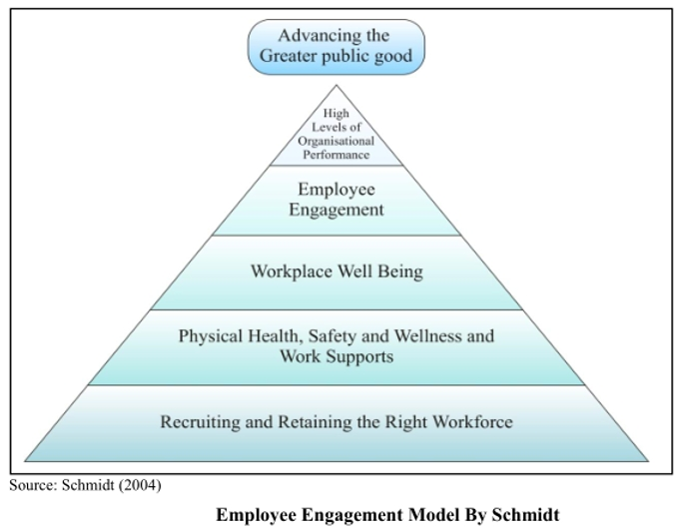
Conclusion
Employment engagement has different principles to use
And it has some significant benefits to the business such as reducing employee turnover, increasing productibility and many more
Different engagement model has different benefits
Marriott International use this model in its management system.
By using the employment engagement plan the management authorities can make effective changes in the daily operations.
Notes:
In Conclusion, the employee engagement plan is one of the leading strategies for maintaining a better work culture in the organisation. For a better work culture, it is one of the prominent parts to adapt in the management system. Employment engagement has different principles to use. And it has some significant benefits to the business such as reducing employee turnover, increasing predictability and many more. There are several types of employment engagement model which refers to a different style of managing the workload. Different engagement model has different benefits and many famous hotels and hospitality chain like Hilton Hotel, and Croydon Hilton International use this model in their management system. By using the employment engagement plan the management authorities can make effective changes in the daily work of the staff of the employees. the model will also help to enhance the work quality and give motivation in a longer period of time.

Slide 13
References
Bridger, E. 2018 Employee engagement: a practical introduction. 2nd ed. HR Fundamentals. London: CIPD and Kogan Page
Cottrell, S. 2019 The Study Skills Handbook. 5th ed. London: Red Globe Press
Quick, L. 2020 Managing Events. Real Challenges, Real Outcomes. London: SAGE Publications Ltd.
Ramakumar, K. and Priyadarshini, R.G., 2021. Employee Engagement during Organizational Crisis–with special reference to the COVID Scenario. PURUSHARTHA-A journal of Management, Ethics and Spirituality, 14(1), pp.105-115.
Rasool, S.F., Wang, M., Tang, M., Saeed, A. and Iqbal, J., 2021. How toxic workplace environment effects the employee engagement: The mediating role of organizational support and employee wellbeing. International journal of environmental research and public health, 18(5), p.2294.
Riyanto, S., Endri, E. and Herlisha, N., 2021. Effect of work motivation and job satisfaction on employee performance: Mediating role of employee engagement. Problems and Perspectives in Management, 19(3), p.162.
Turesky, E.F., Smith, C.D. and Turesky, T.K., 2020. A call to action for virtual team leaders: practitioner perspectives on trust, conflict and the need for organizational support. Organization Management Journal, 17(4/5), pp.185-206.

Slide 14


