Slide 1
LCMB7002
Financial Management
Financial performance analysis 1

Slide 2
Learning Outcomes
  By the end of this lecture, you should be able to
  Identify the major categories of ratios that can be used for analysing financial statements
  Calculate key ratios for assessing the profitability, efficiency, liquidity, and gearing of a business
  Identify the trends analysis
  Discuss the use of ratios in helping to predict financial failure

Slide 3
Introduction
Financial ratios provide a quick and relatively simple means of assessing the financial health of a business
A ratio simply relates one figure appearing in the financial statements to another figure appearing there (for example, operating profit in relation to sales revenue)
Ratios can be expressed in various forms, for example as a percentage or as a proportion

Slide 4
Purpose of Ratio Analysis
to assess a company’s financial performance
to evaluate the financial stability
to predict future performance and stability
Ratios in absolute terms may not be meaningful but allows comparisons to be made by use of benchmarks (trend, inter-firm, sector averages).

Slide 5
The Need for comparison
Just calculating the ratios will not tell us about the financial position or performance of a business
It is only when we compare these ratios with some benchmark that the information can be interpreted and evaluated.

Slide 6
Activity
Can you think of any benchmarks, or bases, that could be used to compare a ratio that you have calculated from the financial statements of your business for a particular period?

Slide 7
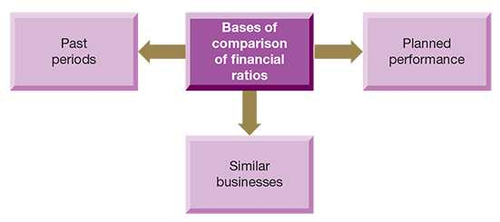

Slide 8
HOW TO INTERPRET ACCOUNTS
Read the narrative reports within the annual report
How has the business performed and what is the financial position?
  Are the statements consistent?
  Have the accounting policies changed?
  Are complex transactions disclosed in the notes?
  What are the trends and ratios?
Consider other information

Slide 9
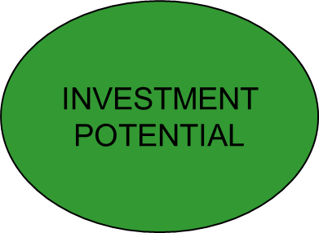
THE DIFFERENT DIMENSIONS OF A COMPANY’S FINANCIAL PERFORMANCE / HEALTH
FINANCING STRUCTURE
PROFITABILITY
LIQUIDITY / SOLVENCY / CASH
EFFICIENCY
9

Slide 10
Areas of Ratio Analysis
Profitability (i.e., Performance)
Investment
Efficiency (i.e., Working Capital)
Liquidity
Financing ratios (i.e., Gearing)

Slide 11
1. PROFITABILITY RATIOS
Used by investors, management, employees, creditors, competitors, potential investors to judge performance.
Return on capital employed (ROCE)
Return on equity (ROE)
Gross profit margin
Net profit margin

Slide 12
RETURN ON CAPITAL EMPLOYED
Relates the net profit to the level of investment used to earn it.
Profit before interest or operating profit to Capital employed
Capital employed is calculated as follows:
Total assets - Current liabilities OR
Equity+ Non-current liabilities

Slide 13
RETURN ON EQUITY
Return generated for ordinary shareholders.

Slide 14
GROSS PROFIT MARGIN
Measures profitability of sales.
Absolute values not important – depends on type of business.
Fluctuations may be due to:
Change in product mix
Change in cost or selling price
Errors
Theft of cash or stock
Stage of a products life

Slide 15
NET PROFIT MARGIN
Affected by the same things as gross profit margin and also by operating expenses.
Compares movements in gross profit margin and net profit margin.

Slide 16
2. INVESTMENT RATIOS
This ratio is used to assess the returns on shareholders’ investment. The ratio shows how a firm’s share price is valued in the stock market compared to the key indicators of the performance of the company.
Earnings per share
Price-earnings ratios

Slide 17
EARNINGS PER SHARE (EPS)
Measures the total returns for ordinary shareholders (in pence or £).

Slide 18
PRICE EARNINGS RATIO (P/E)
It measures market confidence in the future of a business.
It indicates how much the share's market value is higher than its current earnings per share.

Slide 19
3. EFFICIENCY RATIOS
Used by shareholders, competitors and creditors to assess how effectively working capital (net current assets; i.e., available resources) has been managed.
Asset Turnover (AKA Capital turnover)
Stock holding period
Debtors collection period
Creditors payment period

Slide 20
ASSET TURNOVER
Indicates how effectively the business is using total available resources.
Affected by:
Age of assets
Revaluation policy
Inflation
Recent investment
The optimum figure depends on the type of business but:
A low figure suggests ineffective management
A high figure suggests the business is overstretched

Slide 21
STOCK HOLDING PERIOD
The period for which inventories are being held in the business.
Reasons for change
Change in policy
Change in production methods
Random factors
Slow sales

Slide 22
DEBTORS’ COLLECTION PERIOD
The time taken to collect trade debts.
Reasons for change:
Offering increased credit terms
Change in customer base
Slack/improved credit control
New prompt payment discounts
Introduction of electronic invoicing

Slide 23
CREDITORS’ PAYMENT PERIOD
Time taken to pay suppliers.
Increased period may indicate liquidity problems.

Slide 24
Activity
Which of ratios should be of most value for short-term lenders?

Slide 25
4. LIQUIDITY RATIOS
Used by shareholders and creditors to assess the ability of the entity to meet its short-term financial obligations.
Current ratio (Working capital ratio)
Quick asset ratio (Acid test)

Slide 26
CURRENT RATIO
It shows the adequacy of current assets to cover current liabilities. It should be between 1:1 and 2:1
Too low indicates financial weakness
Too high indicates inefficient management
Reason for change:
Expansion
Poor stock or credit control
Repayment of finance

Slide 27
QUICK ASSET RATIO
Assesses whether the business can meet its current liabilities at short notice.

Slide 28
5. FINANCING STRUCTURE
Used by investors and lenders to examine the financing structure of a business.
Gearing ratio
Interest cover

Slide 29
GEARING RATIO
Compares the amount of finance provided by shareholders to that provided by long-term lenders.
The level depends on the type of company and the stability of profits.
Important when new finance is being raised.

Slide 30
INTEREST COVER
Assesses how well interest is covered by the profits available.
A low figure indicates problems
May decline temporarily due to new finance
4 is a safe level
Ignores the fact that cash is needed

Slide 31
TREND ANALYSIS
Key ratios can be plotted on a graph to provide a simple visual display of changes occurring over time.
It can be used to compare performance over the past years.

Slide 32
Example
The trends occurring within a business may, for example, be plotted against trends for rival businesses or for the industry as a whole for comparison purposes. An example of trend analysis is shown below;

Slide 33
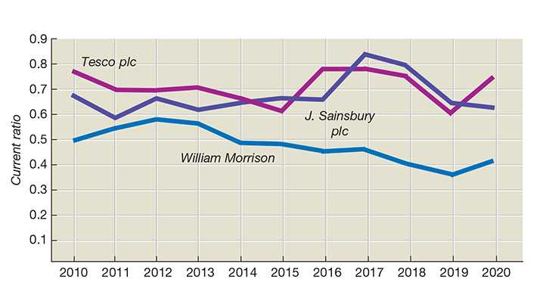

Slide 34
The graph shows the current ratio of three UK supermarket companies—Tesco plc, J. Sainsbury plc, and William Morrison—from 2010 to 2020.The current ratio measures short‑term liquidity, i.e., a company’s ability to meet short‑term obligations. A ratio above 1 is generally considered strong, while below 1 indicates tighter liquidity. All three companies consistently have current ratios below 1, suggesting reliance on efficient cash flow management rather than holding large liquid reserves. Liquidity fluctuates over time, reflecting changes in working capital management, market conditions, and strategic decisions.

Slide 35
Activity
Explain how financial ratios can be used to predict a corporate failure?

Slide 36
USING RATIOS TO PREDICT FINANCIAL FAILURE
Financial failure refers to a business being:
  Forced out of operation, or
  Severely impacted due to inability to meet financial obligations (e.g., paying suppliers, loans, wages).
This is often described as “going bust” or “going bankrupt.”
Going bust is an informal term used to describe a business that has run out of money and can no longer continue operating.“
Going bankrupt is a legal process where a business (or individual) is declared unable to pay its debts.

Slide 37
USING RATIOS TO PREDICT FINANCIAL FAILURE
Financial ratios are commonly used to predict future performance based on current or past data.
The selection and interpretation of ratios typically rely on the analyst’s judgment and opinion.
Predicting financial failure is a key concern for stakeholders connected to the business.
Overall, using financial ratios to predict failure has been broadly successful.

Slide 38
REFERENCES
Atrill, P. (2021) Financial management for decision makers [electronic resource] . 12th ed. Harlow:, Financial Times Prentice Hall.
Atrill, P. (2016) Financial management for decision makers [electronic resource] . 8th ed. Harlow:, Financial Times Prentice Hall.
Marsh, C. (2012) Financial management for non-financial managers [electronic resource] London; Philadelphia:, Kogan Page.
Weetman, P., 2013. Financial and management accounting. 6th ed. Pearson UK.

