Slide 1
MSc Plismona (AW&S) - Methodoleg
MSc Policing (O&SL) - Methodology 1.
06.11.24

Slide 2
Learning Outcomes
Explain what is meant by ‘Research Philosophy’
Understand the different terms of ‘Methodology’ & ‘Research methods’
List the 3 types of Data Collection
Describe the difference between ‘Quantitative & Qualitative data’, ‘Primary & Secondary data’, ‘Descriptive & Experimental Data’
List the different types of methods for data collection
List the 4 main methods of data analysis
How to structure your ‘methodology chapter’

Slide 3

Research and Research methods
Research is:
‘A systematic investigation to establish facts or principles’ (Collins, 2022) or
To establish new knowledge
Key element of ‘Research’ is:
  gathering data
  analysing data
  It’s METHODOLOGY
Notes:
Research is explained as a 'systemic investigation to establish facts or principles' (Collins, 2022) or to establish new information.
However, although research results in the collation of information or data, if that information is not collected systematically or methodically or is void of a clearly defined purpose, it will not be viewed as research (Saunders et al, 2015).
When evaluating the different definitions, one key element of research is the employment of accepted methods for gathering and analysing data (Saunders et al, 2015) i.e. its methodology.
The methodology used by any research is a key decision for the researcher/you and once elected to assist in meeting the aims and objectives of the research , can drive all other decisions in the research process.
As Whifflin (2021, p.11) states, 'Methodology is the fundamental assumption that guides decision making' to support researchers throughout the process'.

Slide 4
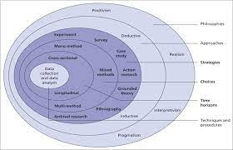
Research Philosophy
Influenced by a number of things:
  The way an individual views the world
  Practical considerations
  Person’s view of the relationship between knowledge and the process by which it is developed
Notes:
research philosophy is influenced by a number of things:
The way an individual views the world
Practical considerations
A person's view of the relationship between knowledge and the process by which it is developed.
Academics such as Saunders et al state that there are two key philosophical approaches to research which influence the way a researcher thinks and/or addresses the research process. These are known as 'Ontology' and 'Epistemology’.
We will cover this in part 2 of the Methodology lesson in a couple of weeks.
ONTOLOGY being concerned with what is reality or truth, how the world operates and how views are developed and held by others.
And EPISTEMOLOGY - relating to the nature of knowledge and how that knowledge can be gained.
Have a look back over your notes/ppt

Slide 5
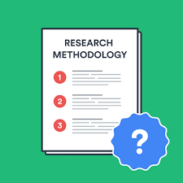
Methodology v Research methods
Methodology is:
‘ a set of systems, methods, procedures or rules that is used to conduct a structured research process for a dissertation’
‘the science of dealing with principles of procedure in research and study’
‘A system of ways of doing, teaching or studying something’
It explains what the exact activities and processes of your research is , through what methods you will be measuring the data and how you will interpret your results and outcome
Research methods are:
‘ specific procedures for collecting and analysing data.
Integral part of research design’.
Notes:
So lets begin by trying to define ‘methodology’ and ‘research methods’
What do you think they mean?
Methodology is:
a set of systems, methods, procedures or rules that is used to conduct a structured research process for a dissertation’ or ( Dissertation-help.co.uk. 2022)
‘a system of ways of doing, teaching or studying something’ ( Cambridge English Dictionary online, 2022)
It explains what the exact activities and processes of your research is , through what methods you will be measuring the data and how you will interpret your results and outcome. ( dissertation.help.co.uk, 2022)
Research methods are:
‘ specific procedures for collecting and analysing data.
Integral part of research design ( Scribbr, 2022)

Slide 6
Methodology and Methods
Methodology – overarching strategy and rationale of your research project – a study of the methods, theories and principles
Methods – specific tools and procedures data use to collect and analyse
Notes:
In summary
METHODOLOGY is the overarching strategy and rationale for your research project or dissertation – in other words a study of the methods, theories and principles of your research
METHOD/s - is/are the specific tools and/or procedures that you will use to collect your data and analyse it e.g. survey's, focus groups, interviews etc

Slide 7

Methodology
'Methodology is the fundamental assumption that guides decision making' to support researchers throughout the process’.
(Whiffin, 2021.p.11)
Notes:
Whiffin states that ….

Slide 8
Planning your research methods
Step 1 - Deciding on how you will collect data
Methods will depend on the data required to answer your research question:
Qualitative v quantitative data
Primary v secondary data
Descriptive v experimental
Notes:
Research methods are specific procedures for collecting and analysing data. Developing your research methods is an integral part of your research design. When considering your methods around how you will plan your research , two key steps to consider:
Step 1 – Deciding on how you will collect data
Step 2 - – how will you analyse the data
So firstly - Step 1 - Deciding on how you will collect data
Methods will depend on the data required to answer your research question:
Qualitative v quantitative data – will your data take the form of words or numbers?
Primary v secondary data – will you collect original data yourself or data that has already been collected by someone else?
Descriptive v experimental – will you take measurements of something as it is or will you undertake an experiment
(scribbr, 2022)

Slide 9
Planning your research methods
Step 2 – how will you analyse the data
Quantitative data – you can use statistical analysis methods to test relationships between variable
Qualitative data – you can use methods such as thematic analysis to interpret patterns and meanings in the data
Notes:
Secondly - Step 2 – how will you analyse the data
So having undertaken your interviews/questionnaires/literature reviews etc – you will have gathered a lot of information and data
What are you now going to do with it
If the data is -
Quantitative data – you can use statistical analysis methods to test relationships between variable
Qualitative data – you can use methods such as thematic analysis to interpret patterns and meanings in the data
(scribbr, 2022)
We will cover analysis in future lessons – but for now start thinking about it from even the basics of how you will organise it etc

Slide 10
3 Types of Research Methodology
Quantitative
Qualitative
Mixed methods
Notes:
There are 3 types of research methodology

Slide 11

Qualitative v Quantitative data
Qualitative data – deals with words
Quantitative – deals with numbers
Notes:
Your choice of qualitative or quantitative data collection depends on the type of knowledge you want to develop
What do we mean by ‘QUALITATIVE’ and ‘QUANTITATIVE’
In its simplest form:
Questions about ideas, experiences and meanings or to study something that can’t be described numerically, collect – QUALITATIVE data
If you want to develop a more systematic/automatic understanding of a subject, or your research involves hypothesis testing, collect – QUANTITATIVE data
So what are the pros and cons of each data method – take 5 mins to discuss with your colleague

Slide 12
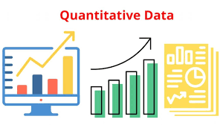
Quantitative
Answers - How many, How often , how much?
Collects quantifiable data
Uses mathematical/statistical analysis techniques
Uses numbers
Used primarily for :
  Descriptive
  Correlational
  Experimental
Research
Notes:
This methodology is interested in questions such as ‘How many?’, ‘How often?’, ‘How much?’ ( Whiffin, 2021,p.18). It is seen as a systematic investigation of the phenomena around the research that collects quantifiable data that then uses mathematical or statistical techniques to analyse the data, draw conclusions (Questionpro, 2021), identify patterns or test causal relationships and generalise results to wider populations (Bhandari, 2022)
Quantitative methodology is primarily used for ‘descriptive’ ( where a researcher seeks and overall summary of identified variables),
‘correlational’ (investigate relationships between variables) and
‘experimental’ (examine whether there is a cause and effect relationship between variables) research (Bhandari, 2022)

Slide 13
Quantitative Methodology
Advantages
Standardise data collection and generalise results
Easily reproduced
Use of large sample sizes to allow generalisation
Disadvantages
Narrow focus due to pre-determined variables
Inadequacy in explaining complex topics
Biases as a result of missing data
Lack of context
Notes:
What do you think are the advantages of using a quantitative methodology?
It usability to standardise data collection and generalise results.
Being easily reproduced by other researchers
Use of large sample sizes thereby allowing generalisation (Bhandari, 2022)
What do you think are the Disadvantages
Some academics argue
Having a narrow focus as a result of predetermined variables and measurements
Inadequacy in explaining complex research topics
Lack of context to the data due to unnatural settings or failing to consider cultural or historical matters.
Biases as a result of missing data, imprecise measurements, can all affect data quality (Bhandari, 2022).

Slide 14
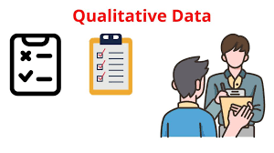
Qualitative
Seeks to investigate experiences, context , culture
Understand how people interpret problems/topic being researched
Non-numerical data
Notes:
This methodology seeks to investigate experiences, context and culture’ and to try to understand how people interpret or evaluate the problem or topic being investigated. It involves the collation of non-numerical data, such as text or audio.

Slide 15
Qualitative v Quantitative
 | Pros | Cons
Qualitative | Flexible – you can often adjust your methods as you go to develop new knowledge Can be conducted with small number of participants | Can’t be analysed statistically or generalised to broader populations Difficult to standardise research
Quantitative | Can be used to systematically describe large collections of things Generates reproducible knowledge | May require statistical training to analyse data Requires larger number of participants/sample
Notes:
Here are some others ( source Scribbr, 2022 online)
Advantages: Qualitative
Its affordable method of research
Its predictive in nature – even though experiences/perspectives of participants can vary substantially
Focuses on details of personal choice not the reasons why someone makes such choices
Uses fluid structures – it allows for inclusion of human experiences
Uses individual choices as workable data
It can be open-ended ; doesn’t rely on specific formats or questions to create successful outcomes. Allows open ended questions to gather more data
It aims to remove bias from its collected data
Requires a smaller sample size
Disadvantages
Creates subjective information points - the data can sometimes be questionable. It requires the reseaercher to connect all points to answer their research question
May involve significant amount of repetition – small sample may not always offer a complete representation of the group being studied
Can be difficult to replicate because it never involves every member of a demographic
Relies on knowledge of the researcher
Doesn’t offer statistics
Requires a significant time investment – to collect and review data
(source: ConnectUS, online www.connectusfund.org)

Slide 16
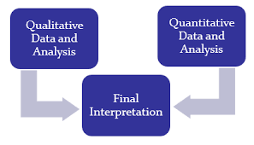
Mixed Methods Research
Mixed methods research is where you use both qualitative and quantitative data collection and analysis methods to answer your research question
Notes:
What about mixed methods approach to your research – what do you think that is ?

Slide 17
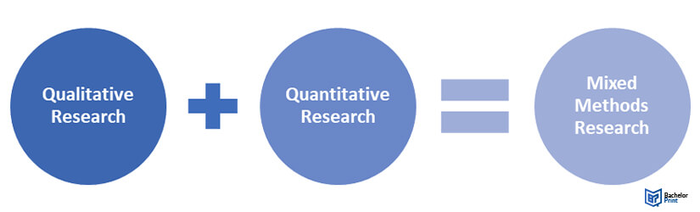
Mixed Methods
Uses both Qualitative & Quantitative methodologies
Used when answer cannot be provided by use of one methodology alone
Notes:
It is the methodology favoured when the answer to the research problem or question cannot be concluded if and when only one data collection and analysis method is adopted.
Whiffin (2021) states that ‘mixed methodologies have therefore more freedom and more techniques available’ (p.42).
However, academic sources highlight that this is not an easy option for the researcher due to the obvious ‘underpinning philosophies and theories guiding the alternative methodologies’ (Whiffin, 2021, p.42).
However, it is argued that despite the overwhelming differences, researchers will often ignore them in favour of focusing on what they consider is best for their research and ultimately what is achievable (Whiffin, 2021.p.42). In addition, it is argued that the researcher should also be aware of the relationship and complexities of integrating the two types of data into coherent and meaningful conclusions (George, 2022).

Slide 18
Mixed methods
Advantages:
Complete data set
Strength of one methodology mitigates weakness of the other
Quantitative can validate qualitative data
Disadvantages:
Create heavy workload
Challenges when two different methodologies provide different results
Notes:
some advantages such are:
It provides a means of obtaining a complete data picture by integrating the benefits of both qualitative and quantitative methods
The strengths of one methodology often mitigates the weaknesses of the other and also offers more flexibility in relation to the research design
The addition of quantitative data can in fact validate qualitative data (George, 2022)
George (2022) also highlights that the work-based researcher should be aware that the two main disadvantages of mixed methods are that:
Using the two methods can generate a heavy workload where there is a need to synthesise collated data of two different forms, and that
Challenges will arise when the two different methodologies reveal different results and ways of interpreting them . This may lead to problems when trying to establish a systematic way of interpreting them (George, 2022).

Slide 19
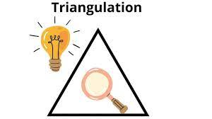
Triangulation
Strengthen validity of research conclusions and support accuracy
Triangulation of data, theory or methods
Notes:
Where the two do converge, this will strengthen the validity of the research conclusions and support its accuracy - this is referred to as ‘Triangulation’. Triangulation allows the researcher to validate their findings against those of others and may include the triangulation of data, theory or methods (Indeed, 2021).
What is important to remember is that - No one method is better than the other

Slide 20
Methods for collecting data
Qualitative v Quantitative data
Primary v Secondary data
Descriptive v experimental data
Data is the information you collect for the purpose of answering your research question
Influenced by the aims of your research
Notes:
Data is the information you collect for the purpose of answering your research question
Keep referring back to your research question to make sure that what you are doing/your chosen methods will lead you to that answer
The type of data you need depends on the aims of your research
It could be any of the following:
1. Qualitative v quantitative data
2. Primary v secondary data
3. Descriptive v experimental data

Slide 21

Primary v Secondary data
Primary data – any new or original information that you collect for the purposes of answering your research question
Secondary data – information that has already been collected by other researchers
Notes:
Question: What is the difference between PRIMARY and SECONDARY data?
PRIMARY is any original or new information that you collect for the purpose of answering your research question ( e.g. surveys, observations, experiments)
SECONDARY is information that is already out there, which has been collected by other research that has been done ( previous studies, Govt stats etc)
So what are the pros/cons of each?

Slide 22

Primary Data
What are the advantages/disadvantages of using PRIMARY data
Notes:
Open up to class

Slide 23

Secondary data
What are the advantages/disadvantages of using SECONDARY data?
Notes:
Open up to class

Slide 24
Primary v Secondary Data
 | Pros | Cons
Primary | Can be collected to answer your specific question You have control over the sample methods Up to date data | May be expensive/time consuming to collect Need to know data collection methods
Secondary | Easier and quicker to access Can collect data over a longer timescale and bigger geographical area | No control over how data was generated Requires extra processing to make sure it works for your analysis Could be too old
Notes:
Content taken from Scribbr , 2022

Slide 25
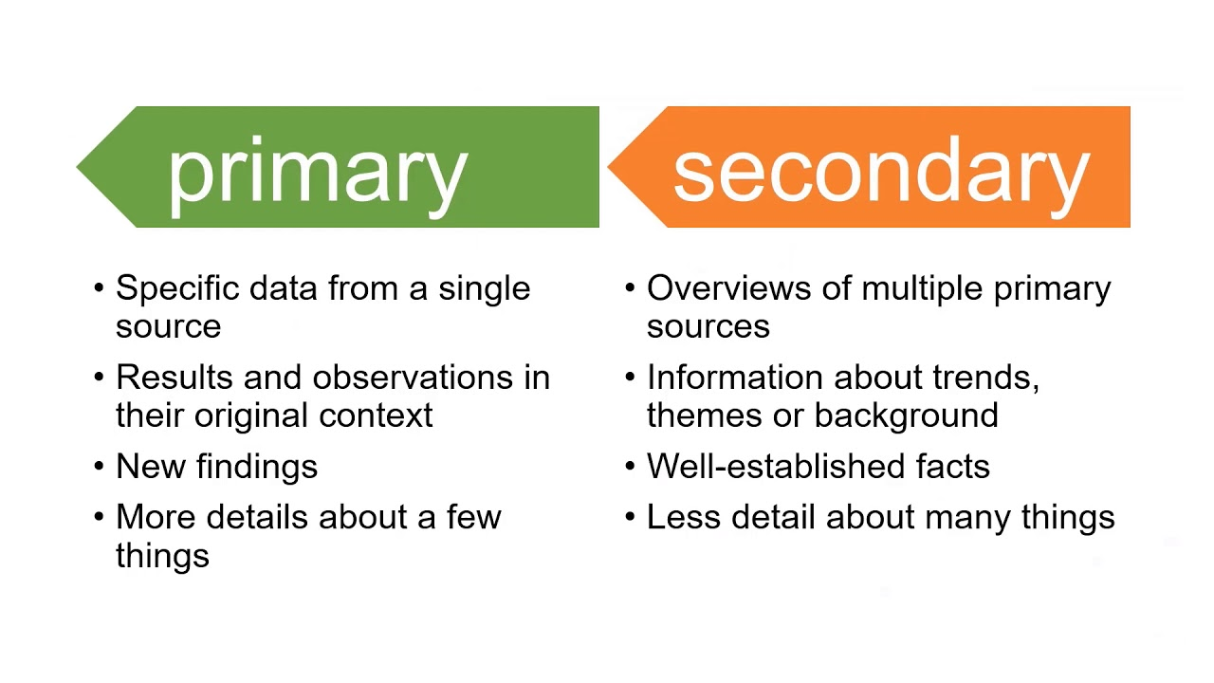
Primary v Secondary data…
Notes:
Source: QUT Library , Youtube 2020

Slide 26

Descriptive v Experimental Data
Descriptive research – you collect data about your study subject without interviewing. Validity depends on sampling method.
Experimental research – you systematically intervene in a process and measure the outcome. Validity depends on experimental design.
Notes:
Lets introduce two new types of research data
Descriptive research – you collect data about your study subject without interviewing. Validity depends on sampling method. So what you are collecting si information from observations, case studies, literature reviews etc – there is no verbal contact with participants
Experimental research – you systematically intervene in a process and measure the outcome. Validity depends on experimental design. - this si more aligned to scientific research

Slide 27
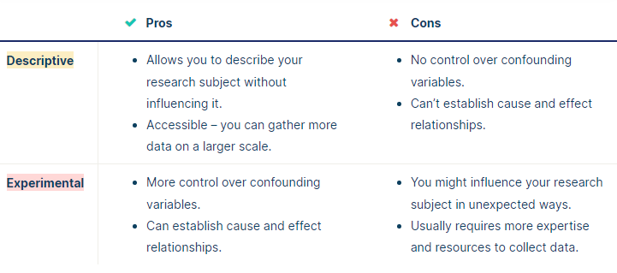
Descriptive v Experimental Data
Notes:
Source; Scribbr , online 2022
What about the advantages/disadvantages of these two

Slide 28
Research methods for collecting data
Research method | Primary or secondary? | Qualitative or quantitative? | When to use
Experiment
Survey
Interview/focus group
Observation
Literature review
Case study
Notes:
A simple exercise now to try and identify the type of data that you may look towards collecting depending on your methods
And when you might use that particular method

Slide 29
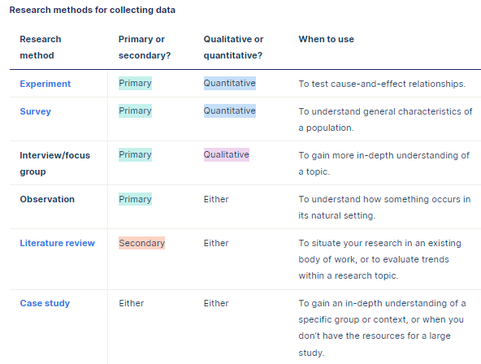
Research methods for collecting data
Notes:
Suggested answers

Slide 30

Methods for analysing data
Qualitative analysis methods – used to understand words, ideas and experiences.
  It relies upon the researcher’s judgement – reflect carefully on your choices and assumptions.
Quantitative analysis methods – uses numbers and statistics to understand frequencies, averages and connections
  As the data is collected and analysed statistically, the results are easily standardised and shared
Notes:
Having explored the data gathering methods lets now turn to the methods that ca be used for analysis
Your data analysis methods will depend on the type of data you collect and how you prepare it for analysis.
Qualitative analysis:
Data can be analysed both quantitatively and qualitatively. e,g survey responses could be analysed qualitatively by studying the meanings of responses or quantitatively by studying the frequency of responses to a question.
It relies upon the researchers judgements – so its good to reflect carefully on your choices and assumptions. It tends to be quite flexible.
Quantitative analysis:
Uses numbers and statistics to understand frequencies, averages in descriptive studies and correlations or cause and effect relationships in experiments

Slide 31
Methods for analysing data
Statistical analysis
Meta-analysis
Thematic analysis
Content analysis
Notes:
The 5 different methods for analysing data
How many have you heard of?
What do you think they mean?
We will cover these in more detail when we do the analysis lessons

Slide 32
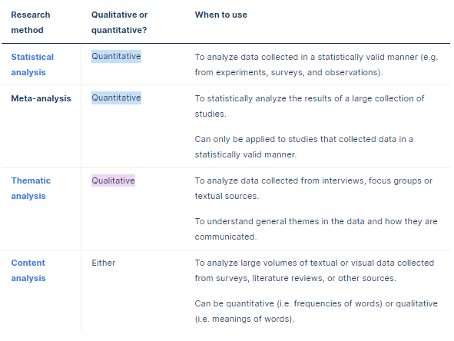
Methods for data analysis

Slide 33
Writing your Methodology Chapter
All dissertation projects need to be clear on data collection
Include this chapter if undertaking – Primary/secondary data gathering
It is the ….who, when, where, why…. of your research
Notes:
Some guidance on writing your Methodology chapter

Slide 34
What needs to be included
1.Introduction to the chapter
2. Research strategy
3. Data collection
4. Data Analysis
6. Limitations
5. Ethics
Notes:
When it come sto writing this chapter what do you think you need to cover – think of some subheadings
Lets look at what needs to be included in this chapter and how to structure it
6 areas to cover:
Introduction
Your research strategy
Data collection
Data analysis
Any limitations or problems that you encountered throughout your research

Slide 35

Introduction
Brief introduction to your subject area
Remind reader of your objectives
Explain why you are undertaking this research
  Reflection on literature review
  Gaps within the research
  New legislation
Notes:
Given the word count this subheading will not be very long
What do you think needs to be in your introduction?

Slide 36
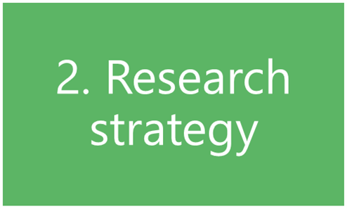
Research Strategy
What research methods have you used ( survey, questionnaire, case study etc)
Why did you choose that strategy/model?
How did you choose your sample ( size/participants)?
NB – don’t spend too much time writing about research methods in general
Notes:
Considering the next sub heading of the chapter – what would you consider writing here?

Slide 37
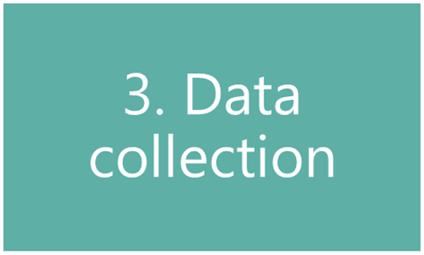
Data Collection
How will you analyse your findings?
  Quantitative = numbers
  Qualitative = focus on words
  Themes
NB – don’t talk about your findings yet!
Notes:
Next sub-heading – data collection – what do you think you need to write about here?

Slide 38
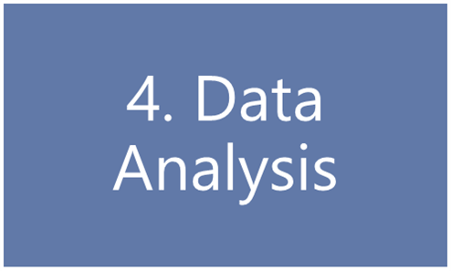
Data Analysis
How you prepared the data before analysis
Quantitative data:
  Any software used
  any statistical methods used
Qualitative data:
  Any coding or categorising of themes/ideas
Notes:
4th sub-heading – data analysis
What will you write here?

Slide 39
Ethics
Include a discussion of how you will deal/dealt with issues of a confidential or ethical nature
5.Ethics

Slide 40
Limitations
Do you foresee any limitations or problems with undertaking your research?
Any limitations to your research strategy
  Access to participants
  Limited data collection
6. Limitations
Notes:
Final sub-heading
QUESTION - What will you write here?
Give some examples
Remember that you are writing about limitations/problems in relation to your data gathering only – not general problems like time management
Questions to ask ( Biggam, 2015. p194)
What are the known criticisms of my chosen research strategy?
Is the approach to my data collection limited in any way? ( e.g. why use Questionnaires when interviews may give more meaningful info)
Is my sample population big enough – too big?
Is it valid? ( have I argued successfully that my methods are appropriate to achieving my objectives)
Is it free from bias and is it fair?
Examples:
Formulation of your research aims and objectives
Implementation of data collection method
Language barriers
Culture bias
Timing of study
Financial resources
Limited access to data
Sample size
Lack of previous research on subject
NB - You must show how you have addressed any limitations that you highlight. Avoid just producing a list – not acceptable
Also – is time management a limitation?
Time limits is a common limitation expressed by students – especially when deadlines are fast approaching – these are more to do with a lack of time management and planning on the students behalf NOT on the research itself
Leave time for your empirical work and plan for any mishaps like people not available

Slide 41
Tips for writing a strong methodology
Don’t just describe – explain how and why you applied them and demonstrate how it was conducted
Focus on your objectives and research question- show why your methods suit your objectives. Keep relating your choices back to the purpose of your research
Cite relevant sources
Write for your audience – consider how much info you need to give. Clear – structured – argues your approach.
Don’t just list details and procedures
Discuss any difficulties you encountered and how you dealt with them – include how you minimised impact as a result or changed methods.
Notes:
And finally some tips for writing a strong methodology chapter:
Don’t just describe – explain how and why you applied them and demonstrate how it was conducted
Focus on your objectives and research question- show why your methods suit your objectives. Keep relating your choices back to the purpose of your research
Cite relevant sources
Write for your audience – consider how much info you need to give. Clear – structured – argues your approach.
Don’t just list details and procedures
Discuss any difficulties you encountered and how you dealt with them – include how you minimised impact as a result or changed methods.
There has to be an element of CRITICAL EVALUATION in this chapter to get the best marks

Slide 42
Finally...
This chapter is a key chapter for the assessors because it explains the methods you have chosen, and in particular why you have chosen them
Your reasoning should be justified and supported by relevant reading from research texts.

Slide 43

No Lesson Next Week
(13.11.24)
2 Tasks to complete -
next lesson on Thursday 20 November 5.30pm

Slide 44
Task 1
Complete the Research Proposal & Ethics form
Submit Draft by Monday 25.11.24
1/1's held on 27.11.24 - agree times 5.30pm- 7.30pm
approx 1hour each

Slide 45

Task 2
Academic & InfoSkills
Moodle page
Search 'Library InfoSkills'
Self enrol:
Complete:
a. Finding & using Information
b. Referencing

Slide 46
Additional Sources
Burnett, J. (2009) Doing Your Social Science Dissertation. London: SAGE Publications.
Denscombe, M. (2012) Research proposals a practical guide. Berkshire, McGraw Hill Open University Press.
Walliman, N. (2006) Social research methods. London: SAGE.
https://www.sagepub.com/sites/default/files/upm-binaries/18533_Chapter3.pdf
Notes:
Some useful sources for you – others will be added to Moodle over the next few weeks

Slide 47

Questions/concerns?

