Slide 1
Future of Freshwater
Discussion & Self-led Tutorial

Slide 2
The Future of Water
The world’s supply of cheap and clean fresh water will likely plummet as the climate warms and populations boom. Can we find ways to conserve, cut waste, and find new sources before it’s too late?
Take notes on the insightful mitigations/plans and management practices mentioned within the short documentary The Future of Water (2018) watched in lecture.
Research into these notes you make, how these systems work, where else around the world they may have been implemented, or other water management systems.
https://www.youtube.com/watch?v=4URapRHxsmE
s.pengelly@uwtsd.ac.uk

Slide 3
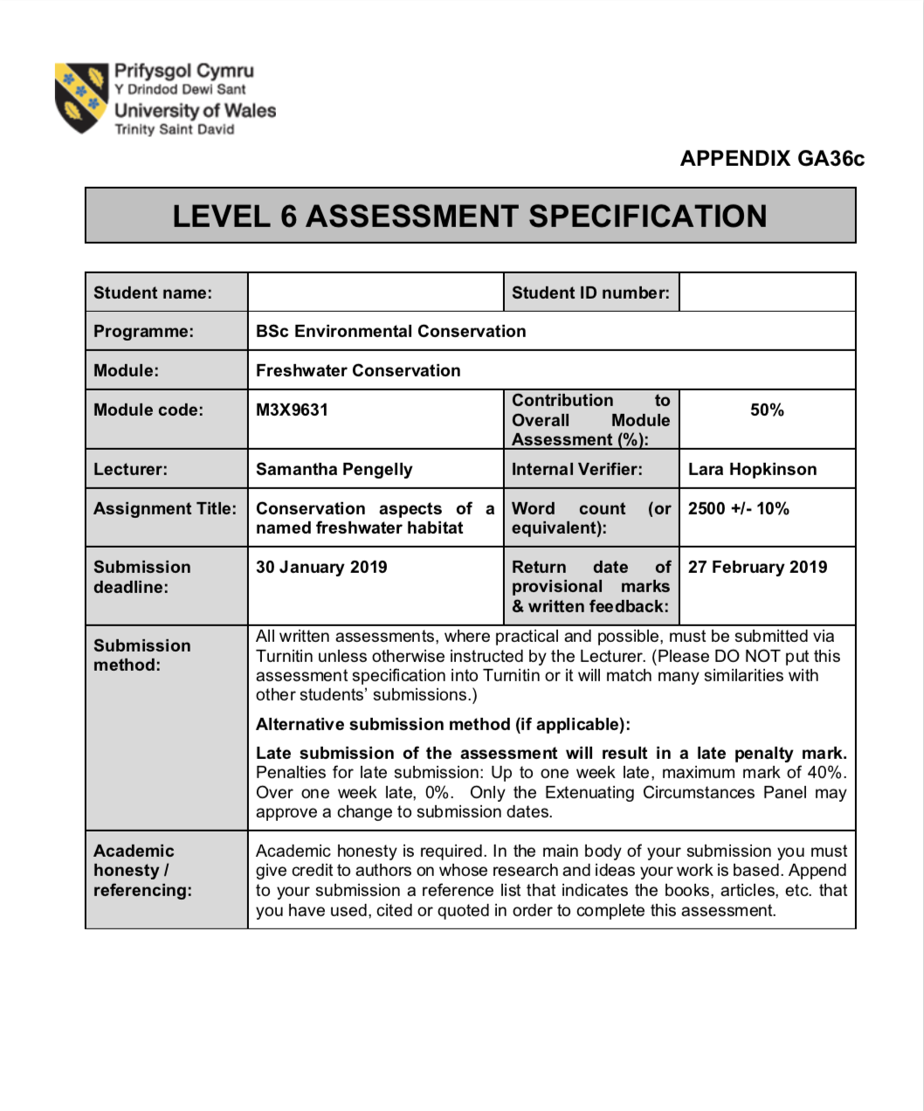
Assignment 2!
Choose a specific named freshwater body or part of it, which is sufficiently complex and significant.
It does not have to be in the UK.
13 April
(2500 word report) should include:
General overview
Past and current pollution episodes - its impact on the environment.
Ecology, scarcity and /or economic value.
Evaluation and assessment of its current status.
Description and evaluation of any relevant Management/legislation aspects.
Notes:
10/14/99
8
Also, Assignment 1 is now up on moodle as you should all probably be aware!
The main premise is to report on a body of freshwater of your choice, giving an overview, report on it’s ecology, evaluate it’s status.
It’s not due till 30 Jan, but we do need you to email either myself or Lara (I recommend Lara), to let us know your water body of choice by the end of this week (Friday 9th November).

