Slide 1
Benin Bronzes
Commemorative Head of an Oba
Lee Perkins
Student Number: 1711094
30th May 2019
Notes:
Hi my name is Lee Perkins and today I will be discussing the Benin Bronzes and in particular a Commemorative head of an Oba.
I am going to look at the origin of an Oba head and its appropriation in colonial times by the British Empire. I am going to discuss the controversies surrounding these objects, which continue to this day.

Slide 2

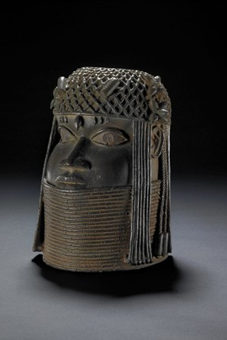

Commemorative Head of an Oba
Biography
Created: 1550-1650
Benin City, Nigeria, Edo State
Acquired: Benin Punitive Expedition in 1897
Benin Bronzes Collections
Edo State, ‘Commemorative Head of an Oba’ (The British Museum, 1550), Collection Online.
Notes:
This Commemorative head of an Oba. Oba being the traditional title for the king of Benin, is made of cast brass and iron. This life size head is a portrait and is depicted with representations of coral bead regalia in the form of a deep collar and an openwork cap. Strings of beads at sides, and a large bead in the centre of the forehead and the eyes are inlaid with iron.
It was created by the Edo people in southern Nigeria, and the British Museum date this object to be created in between 1550-1650 as Britain was coming out of the medieval period. It was acquired after the Benin Punitive Expedition in 1897 after which it was purchased by the Museum from Henry Ling Roth a famous anthropologist.
These commemorative heads of Oba’s are regarded as one of Africa's greatest treasures. There is a large collection of Benin Bronzes, including heads and plaques within the British museum and there is an on-going fight to have these items brought back to Nigeria and back to where they originate from.

Slide 3
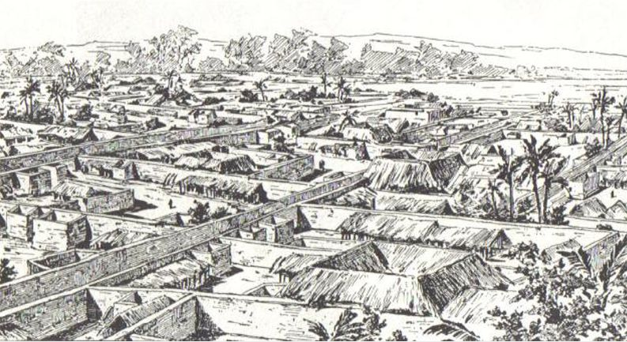
Origins
The City of Benin
  Palace highly decorated
    Oba Ovonramwen
Portuguese
  The Great City of Benin
    ‘classified Benin City as one of the most beautiful and best planned cities in the world.’ (Mawuna Koutonin)
The Punitive Expedition 1897
  The Benin Massacre
    Two British officers survived
      British retaliation
H. Ling Roth, ‘Benin City Before British Invasion in 1891. Great Benin’, Black History Month 2019 | Black History Month Celebrating the Great Black British Achievers, 1891
Notes:
The Oba head had a significant place within African culture and with the Edo people especially.
This head was not the only one created, heads like this were created between the 14th and 19th centuries and symbolised the king's rule and authority.
The heads would have sat in the palace of the Oba, and others were traditionally made in the royal foundry to commemorate a King's predecessor.
When the Portuguese first came into contact with the city in the 15th century, they were stunned to find this vast kingdom made of hundreds of interlocked cities and villages in the middle of the African jungle. They called it the Great City of Benin, they classified Benin City as one of the most beautiful and best planned cities in the world.
In November 1896, Acting Consul-General James Robert Philips set out for Benin and informed the Oba that he is coming for a friendly visit to discuss trade and peace.
Unfortunately for Phillips, he arrived during an ongoing Igue festival, and despite being warned by a small fraction of the Benin army that he should not continue as the Oba would not speak to outsiders during the festival. But Phillips decided to continued.
This decision resulted in him being killed alongside his party, with only two British officers surviving in what is now known as ‘The Benin Massacre’.
These actions led the British to call for The Punitive Expedition of Benin 1897.

Slide 4
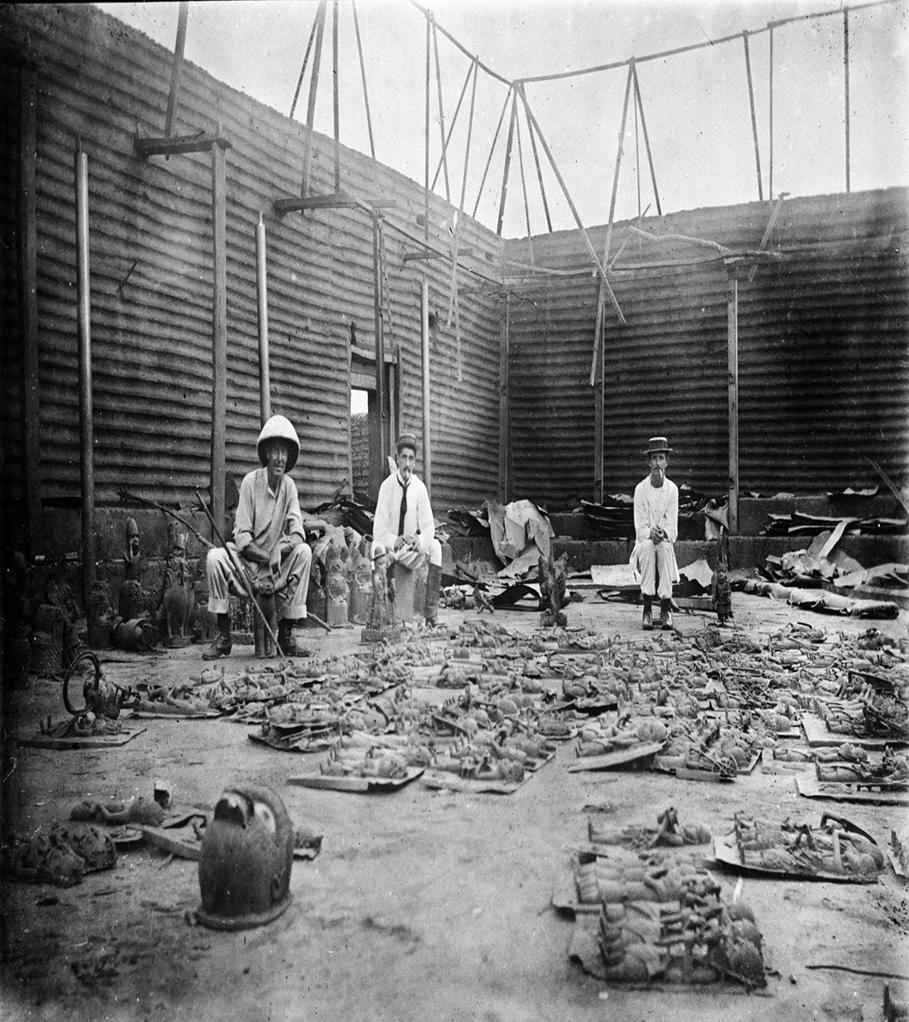
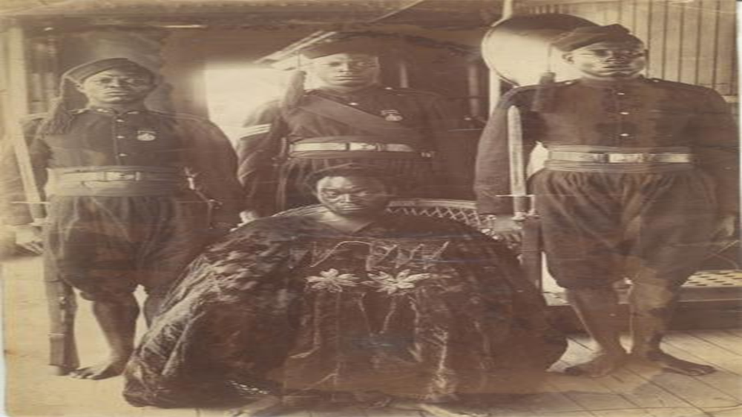
The Aftermath
Deliberate destruction
  Homes
    Religious places
      Palace
Looting
  Statues and idols
    Sold
      Displayed in museums
Oba Ovonramwen sent into exile
  Calabar, Nigeria
    Died 1914
Khanya Mtshali, ‘Old-Time Looters’, Quartz Africa,
JA Green, ‘Ovonramwen, Oba of Benin’, 1897
Notes:
The aftermath of the expedition was devastating for the great city of Benin.
The kingdom was brought to its knees, as the British slaughtered the inhabitants. Homes and religious places were torched and destroyed.
After the destruction it led way for the looting, and the British took precious artefacts and artworks including commemorative heads of the Oba’s of Benin.
A lot of the stolen goods were auctioned off to pay for the expedition.
This was just a quick gloss over of the background surrounding the Head of an Oba, which brings me to the main issues of these stolen goods and the on going effect it has had.

Slide 5
European Attitudes and Reception
Racist
  Europeans claimed the items were of white origins
    ‘outright refusal of Europeans to believe that they had been created by Africans.’ (Dr. Stephen Small. P.122)
      Leo Frobenius German ethnologist-believed Greek survivors created these works of art
The narrative entirely under British control
  Objects sit in the British Museum as trophies of Empire
    The British Museum is a powerful and imposing building and carries with it the weight of British imperialism
Notes:
When the objects arrived in Britain the general public were amazed and refused to believe that black Africans could have created them. There was a clear racist attitude from Europeans who could not believe, that Africans could make these types of art. it simply did not fit with the accepted narratives of the colonial period.
In my opinion, Dr Stephen Small puts it perfectly in his work regarding slavery and colonialism, in which he says there was an ‘outright refusal of Europeans to believe that they had been created by Africans.’
Scholars even went as far as to propose alternative origins of the heads. One example of this was one from Leo Frobenius, a German ethnologist who strongly believed the works had come from Ancient Greeks but, more importantly he believed it was from the lost city of Atlantis which had sunk off the Nigerian coast, enabling Greek survivors to create such skilled works. This is just one of many examples of the extent white European people went to, to avoid the conclusion that these had been created by Africans.
With a successful punitive expedition this really put the narrative entirely under British control, the head of the Oba and all the other looted treasures and art works were now trophies of the Empire sitting within the British Museum. The trophy house of the British Empire, even today is a powerful and imposing building but with it, it carries the weight and success of British imperialism.

Slide 6
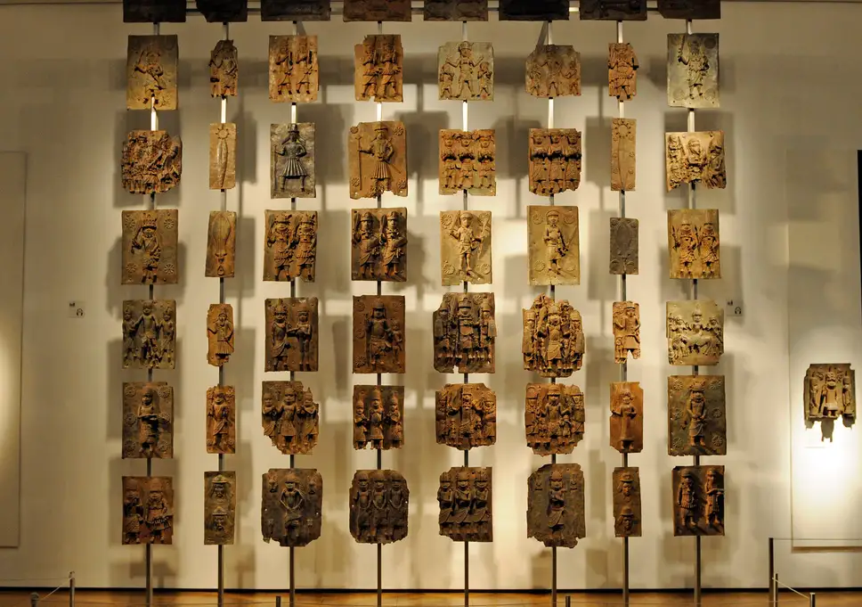
British Museum Representation
Trophy house of the Empire
  ‘The notion of western culture as inherently progressive, sophisticated and, above all, superior… remains firmly embedded in the cultural institutions of western Europe, not least in its museums.’ (G.Tawadros)
The British Museum chooses how objects are interpreted and presented
The Oba head and Bronzes are presented as works of art
Denial of cultural heritage of Benin and the symbolic significance of the objects.
Shown off as art rather than seen as a testimony
The oral history supported by material objects
  ‘These stolen items are our evidence of a glorious past truncated by a foreign force that had no respect for others history.’ (Victor Ehikhamenor)
Groucho, ‘Benin Bronzes at the British Museum’, The Independent, 2018
Notes:
The representation in the British Museum of the Oba head and the Benin Bronzes collection is problematic. In some ways the British museum at that time could be seen as the trophy house of the British empire.
Giliane Tawadros, an author of museum journals has a great description of this.. And I quote.., ‘The notion of western culture as inherently progressive, sophisticated and, above all, superior… remains firmly embedded in the cultural institutions of western Europe, not least in its museums.’
It was the western cultural way of life, that these acquired goods were to be shown off in their museums, … in their conquest show rooms.
But, with the ability to showcase items such as the Oba Head and Benin Bronzes, the British Museum chooses how these objects are interpreted and presented.
In the case of the Benin Bronzes they chose to represent them as art works rather than historical cultural objects.
This really brings about cultural appropriation as The British Empire, still to this day, is denying Benin their cultural heritage and the symbolic significance and value of these objects.
Victor Ehikhamenor is a Nigeran artist and writer, who was Born in the Edo state, has a strong view on this. I felt I needed some more background information on what I was reading so on the off chance I decided to email him and to my surprise he responded. His response clarified my understanding of the situation and in his reply, he was clear that the British Empire was responsible for cutting short their history and done so with a complete lack of respect. But he describes that African history rides on oral narrative, which are based on concrete substances and these stolen items such as the Benin Bronzes and Oba Heads are clear evidence of that.

Slide 7
Narrative of Justification
By denying cultural heritage of Benin there is a denial that Africa was already civilized
Objects were stolen but the Expedition was justified as retaliation
The narrative fed into racist views that Africans were barbaric and savage
  Sir Reginald Bacon, Benin : The City of Blood 1897
    ‘The altar was deluged in blood, the smell of which was too overpowering for many of us. This same awful smell seemed to pervade the whole compound, as if the grass had been watered with blood.’
    (Sir Reginald Bacon. P.87)
Notes:
The Justification of colonialism was at odds with a view of Africa already being civilized, but, the important thing to note is that the British narrative and European attuite towards Benin was denying their cultural heritage. Yes, the British stole the Oba head along with many other objects, but they justified it all with the expedition of retaliation for the Benin Massacre which the British empire endured.
But the British continued that their actions were just, with written works such as Sir Reginald Bacon book called Benin :The City of Blood 1897, which I quote from his book: ‘The altar was de-luged in blood, the smell of which was too overpowering for many of us. This same awful smell seemed to pervade the whole compound, as if the grass had been watered with blood.’
This again is reinforcing the idea of the British narrative towards the people of Benin. It was not only the racist views, but it was enforcing the reader to there barbaric and savage culture, and the British were there to bring civilization to them.

Slide 8
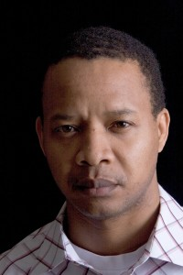

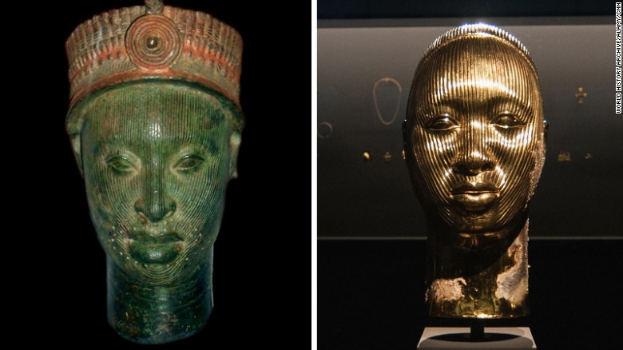
Stolen Culture
The story of the Oba head feeds into a wider discourse about cultural appropriation and colonial oppression
Art Historians vs Anthropologists
  ‘Methodological Philistinism’ (A.Gell p.40)
    Objects as art works
Fight for Reparation
  Moral Justice
    ‘The British are back for more’ (Victor Ehikhamenor)
Victor Ehikhamenor, ‘Victor Ehikhamenor’
Damien Hirst, ‘Solo Exhibitions
Damien Hirst, ‘Treasures from the Wreck of the Unbelievable’, CNN, 2017
Notes:
The story of the Oba head feeds into a wider discourse about cultural appropriation and colonial oppression. In 2017 Damien Hirst put on an exhibition in Venice called ‘treasures from the wreck of the unbelievable’ one of the art works on display was a sculpture replicating a 14th century ife bronze head. This brought an accusation of cultural appropriation and Nigerian artist Victor Ehikhamenor posted the comment ‘the British are back for more from 1897 to 2017’ on his Instagram page.
Damien Hirst responded to Victors post by saying it was a collection of works influenced by a wide range of cultures and stories from across the globe and throughout history.
The statement reads: “A reference to the Ife heads is in the text accompanying the work and in the guide to the exhibition and is integral to the concept of the work.”
So the heads for Damien Hirst are clearly art work, rather than being seen as a type of cultural symbolic heritage.
Ife was a medieval kingdom in south-west Nigeria with ancient links to the kingdom of Benin. The Benin dynasty trace their ancestral origins and the lost-wax techniques of bronze casting to the kingdom of Ife. (AFC Ryder.) British Museum has a large collection of Ife heads along with Benin Bronzes and Oba heads.
To an art historian it’s a piece of art work, but to an anthropologist its an artefact which is valuable as it sheds light on another culture and a different way of life.
In order to understand the true significance and place of these objects in life, Anthropologists such as Alfred Gell argue that we should adopt a Methodological Philistinism which is a rejection of the critical evaluation of western views of art and to understand art objects as part of social relations rather than as merely reflective or representative of them.
The oba head would have been a portrait of a past king of Benin, it would have been displayed in the palace of Benin with the heads of all the previous kings of Benin. Together they represented the royal family, legitimising the authority of the ruler and of the monarchy itself. The longevity of the intuitions of rulership is emphasised through this tradition. The heads are made of metal, they are enduring and valuable, and, the fact they are portraits emphasis the successive lifetimes of rulership going back generations. The value of the objects and the skills of there craftmanship shows the wealth and power of the kings of Benin.
The issue of the stolen culture from Benin has not been resolved and has not gone away.
The fight for reparations and moral justice is still on going and the Benin dialogue group has been set up to work with Nigerians calling for reparations.

Slide 9
Conclusion
Continual denial from the British Empire
British “justified” colonialism
Colonial appropriation
These heads and artefacts more than just art work
On-going battle for reparations
Notes:
So in conclusion there is a continual denial because the head and other African objects are still in the British Museum, and because of this the British are denying Benin their cultural heritage.
But the British justified this with the punitive raid and with this they took control of the narrative behind the objects in discussion.
But not just for the people of Benin, but for the people of Africa it is important that objects such as these are returned, and they are able to receive some sort of moral justice.
The relation of these items to empire is still on going, but as discussed, these items are clearly more than just art work to Benin and Africa, taking Alfred Gell’s approach of a methodological philistinism it is clear to see that these objects represent so much more than just art.
The battle for reparations is on going and until these items have been returned, they have been deprived of the right to have the final word on these objects, THEIR objects.

Slide 10
Bibliography
Primary Sources
Alan Maxwell Boisragon, The Benin Massacre (London: Methuen, 1897) <http://archive.org/details/beninmassacre00boisgoog> [accessed 24 May 2019]
Bacon, Reginald, Benin, the City of Blood; (London, New York, Arnold, 1897) <http://archive.org/details/cu31924028611709> [accessed 24 May 2019]
Edo State, ‘Commemorative Head of an Oba’ (The British Museum, 1550), Collection Online, On display: G25/dc6 <https://www.britishmuseum.org/research/collection_online/collection_object_details.aspx?objectId=621935&partId=1> [accessed 17 May 2019]
Granville, Reginald, Kerr ‘Old-Time Looters’, Quartz Africa, 2017 <https://qz.com/africa/1054364/the-british-museum-will-return-bronze-sculptures-looted-from-benin-nearly-two-centuries-ago/> [accessed 24 May 2019]
Green, JA, ‘Ovonramwen, Oba of Benin’, 1897 <http://revealinghistories.org.uk/colonialism-and-the-expansion-of-empires/objects/ovonramwen-oba-of-benin.html> [accessed 24 May 2019]
Secondary Sources
‘Civilisations’ Olusoga, David, Western Reactions to Benin Bronzes (BBC Two) <https://www.youtube.com/watch?v=rp8flCwvoAU> [accessed 17 May 2019]
CNN, Kieron Monks, ‘British Museum to Return Benin Bronzes to Nigeria’, CNN, 2018 <https://www.cnn.com/2018/11/26/africa/africa-uk-benin-bronze-return-intl/index.html> [accessed 24 May 2019]
Coote, Jeremy, Anthony Shelton, and Alfred Gell, Anthropology, Art, and Aesthetics (Clarendon Press, 1994), THE TECHNOLOGY OF ENCHANTMENT AND THE ENCHANTMENT OF TECHNOLOGY
Delta Movement, Edo, ‘Benin-British War’, The Benin-British Wars, 2015 <https://edodeltamovement.wordpress.com/benin-british-war/> [accessed 24 May 2019]
Ehikhamenir, Victor, ‘Benin Bronzes Presentation’, E-Mail, 23 May 2019.
Ehikhamenir, Victor, ‘The British Are Back for More 1897 to 2017’, 2017 <https://www.instagram.com/p/BT0zLHhgksJ/?igshid=w4fakt6qg2px>
Ehikhamenir, Victor, Image: Victor Ehikhamenor <http://www.victorehi.com/about-the-artist/> [accessed 24 May 2019]
Frank, Priscilla, ‘Damien Hirst Accused Of Appropriating Nigerian Art, Whitewashing History’, HuffPost UK, 2017 <https://www.huffpost.com/entry/damien-hirst-nigerian-art_n_5911b952e4b0e7021e9b1cde> [accessed 24 May 2019]
Groucho, ‘Benin Bronzes at the British Museum’, The Independent, 2018 <https://www.independent.co.uk/news/uk/home-news/benin-bronzes-british-museum-nigeria-stolen-imperialist-treasures-return-loan-elgin-marbles-looted-a8414661.html> [accessed 25 May 2019]
Hirst, Damien, ‘Solo Exhibitions - Damien Hirst’, Image, 2015 <http://damienhirst.com/biography/solo-exhibitions> [accessed 24 May 2019]
Hirst, Damien ‘Treasures from the Wreck of the Unbelievable’, CNN, 2017 <https://www.cnn.com/2017/05/10/africa/damien-hirst-appropriation-venice-biennale/index.html> [accessed 24 May 2019]

Slide 11
Bibliography
Idahosa, S. O., J. A. Onimhawo, and S. I. Ikhidero, ‘Reparation a Morale Justice for Africa: The Benin (Nigeria) in Perspective’, VESTNIK RUDN INTERNATIONAL RELATIONS, 17.2, 301–11
Institute, Joukowsky, ‘Gell’s Methodological Philistinism’, Brown University <https://www.brown.edu/Departments/Joukowsky_Institute/courses/materialworlds/1948.html> [accessed 28 May 2019]
Jones, Jonathan, ‘Spoils of War: The Art of Benin’, The Guardian, 11 September 2003, section Culture <https://www.theguardian.com/culture/2003/sep/11/2> [accessed 24 May 2019]
Koutonin, Mawuna, ‘Story of Cities #5: Benin City, the Mighty Medieval Capital Now Lost without Trace’, The Guardian, 18 March 2016, <https://www.theguardian.com/cities/2016/mar/18/story-of-cities-5-benin-city-edo-nigeria-mighty-medieval-capital-lost-without-trace> [accessed 24 May 2019]
Meiselman, Jessica, ‘Damien Hirst Show Sparks Accusations of Cultural Appropriation’, Artsy, 2017 <https://www.artsy.net/article/artsy-editorial-damien-hirst-sparks-accusations-cultural-appropriation> [accessed 24 May 2019]
Mtshali, Khanya, ‘British Museum Is in Talks to Return Bronze Artifacts Looted from Benin Kingdom 120 Years Ago’, Quartz Africa, 2017 <https://qz.com/africa/1054364/the-british-museum-will-return-bronze-sculptures-looted-from-benin-nearly-two-centuries-ago/> [accessed 24 May 2019]
Opoku, Dr. Kwame, ‘Can An English Artist Use Classical Nigerian Art Image As He Likes? Reaction To Damien Hirst’s Use/Misuse Of Ife Art Image’, Modern Ghana, 2017 <https://www.modernghana.com/news/785619/can-an-english-artist-use-classical-nigerian-art-image-as-he.html> [accessed 24 May 2019]
Rob, Abdul, ‘Black Histories: Oba Ewuare & Benin City’, Black History Month 2019 | Black History Month Celebrating the Great Black British Achievers, 2015 <https://www.blackhistorymonth.org.uk/article/section/pre-colonial-history/black-histories-oba-ewuare-benin-city/> [accessed 24 May 2019]
Roth, H. Ling, ‘Benin City Before British Invasion in 1891. Great Benin’, Black History Month 2019 | Black History Month Celebrating the Great Black British Achievers, 1891 <https://www.blackhistorymonth.org.uk/article/section/pre-colonial-history/black-histories-oba-ewuare-benin-city/> [accessed 24 May 2019]
Rotinwa, Ayodeji, ‘The Fate of Nigeria’s Benin Bronzes and the Debate Over Reclaiming African Art’, World Politics Review, 2019 <https://www.worldpoliticsreview.com/articles/27516/how-a-global-debate-over-who-owns-african-art-is-playing-out-in-nigeria> [accessed 24 May 2019]
Ryder, A. F. C., ‘A Reconsideration of the Ife-Benin Relationship’, The Journal of African History, 6.1 (1965), 25–37
Squires, Nick, and Reuters News Agency, ‘Bringing Home the Benin Bronzes: Nigeria Open to Loans Rather than a Permanent Return’, The Telegraph, 20 June 2018 <https://www.telegraph.co.uk/news/2018/06/20/bringing-home-benin-bronzes-nigeria-open-loans-rather-permanent/> [accessed 24 May 2019]
Small, Stephen (2011) "Slavery, Colonialism and Museums Representations in Great Britain: Old and New Circuits of Migration,"Human Architecture: Journal of the Sociology of Self-Knowledge: Vol. 9: Iss. 4, Article 10. Available at: http://scholarworks.umb.edu/humanarchitecture/vol9/iss4/10
Warburton, Nigel, ‘African Art in Western Museums: It’s Patrimony Not Heritage – Charlotte Joy | Aeon Ideas’, Aeon, 2019 <https://aeon.co/ideas/african-art-in-western-museums-its-patrimony-not-heritage> [accessed 24 May 2019]

