Slide 1

Introduction to developmental psychology
Week 1

Slide 2
Introduction To Developmental Psychology
Prenatal Development
And
Approaches To Developmental Psychology
In this session, we will gain an introduction to developmental psychology, its approaches and its
methodologies. We will also explore very early development, from conception through to
labour.
On successful completion of this lecture and with further reading, you will be able to:
1. Understand what developmental psychology is and why we study it.
2. Know and be able to evaluate different approaches and methodologies in developmental
psychology.

Slide 3
What Is Developmental Psychology ?
Since the 1700s, developmental psychology has theorised and grown. Some of the earliest interest in developmental psychology was rooted in the evolutionary perspective that suggested that evolution was a developmental process (Darwin, 1859).
The comparisons made between humans and animals led to investigating the differences between human adults and children. There was a focus placed upon what kinds of things happen during the course of development, when certain things happen and whether aspects of development either change or remain the same as children develop into adults.
This evolutionary perspective describes development as a continuous process by which organisms continually develop into newer forms.

Slide 4
However, it was not until the late 19th and early 20th centuries that developmental psychology
had a much more prominent position within the field of psychology.
In fact, the evolution of
developmental psychology itself is seen as occurring in three waves:
The child study
movement
  (1894-1904)
The child development movement
  (1917-1950)
Developmental
psychology
  (1960-present).

Slide 5
The current developmental psychology incorporates a plethora of theories and perspectives, and one of the most recent of these is the lifespan perspective.
This perspective assumes that:
1. The changes people display from conception through to death are developmental in
nature (Dixon & Lerner, 1992).
2. Human life and all of its variables exist at multiple levels, and those variables multi-directionally
influence one another (Dixon & Lerner, 1992).

Slide 6


Why Do We Study Developmental Psychology?
There are a number of reasons why we might be interested in developmental psychology.
Theoretical reasons include:
  • to know what knowledge is and where it comes from (i.e. epistemology),
  an interest in evolution and how human cognition and emotion evolved - does individual development mirror the development of the species?
  enriching our understanding of adult cognition and emotion.
Practical reasons include:
  • supporting children's mental and physical growth by applying research findings.
  to understand what impacts development (e.g. books and television),
  to inform educational practice,
  the diagnosis and treatment of childhood disorders.
(Photos from Powerpoint stock images, 2020).
However, there are often a number of possible interpretations of child data, and there may be disagreement as to whether a study supports a particular theory of development.
This is why critical evaluation of both theory and research is important.

Slide 7
Prenatal Development
Before we focus on postnatal development, we will first review prenatal development and two main issues in particular: the biological and psychological aspects of development at this time. Prenatal development begins at conception - when an egg has erupted from the ovary (as it will every 28 days) and is fertilised in the fallopian tubes or womb.
Hormones are released to prepare the lining of the womb for implantation of the zygote. If there are abnormalities or a faulty implantation, the zygote will be shed two weeks later with menstrual flow, with the mother never knowing she was pregnant.
Periods of development are measured in trimesters, each being three months. However, there are three other periods throughout gestation:
Zygote
(1-2 weeks)
Embryo
(3-8 weeks)
Foetus
(9-38 weeks)

Slide 8
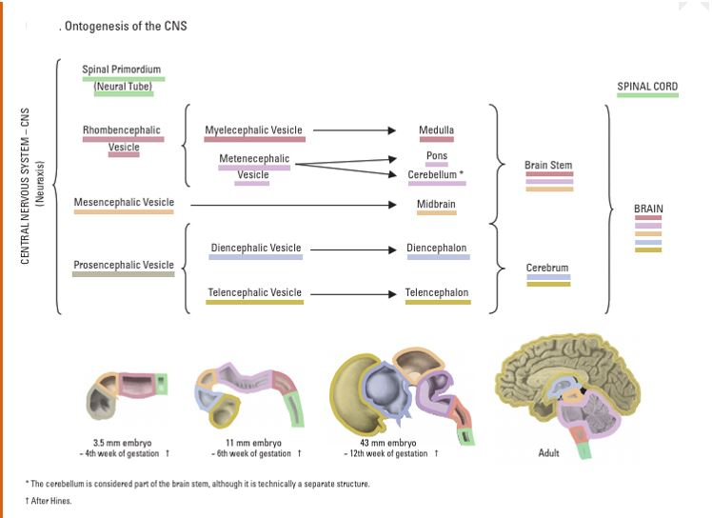
Development of the brain.
This diagram helps us to see how the central nervous system of an embryo develops and how they differing parts form the building blocks of the adult brain.
Diagram 2 Ontogenesis of the central nervous system (CNS) Woolsey et al, (2017, p10)
Notes:
This diagram is purely to attempt to demonstrate to the students how the cerebral cortex and brain stem of the adult brains begins its development very early in gestation. Please avoid any debate regarding terminations of pregnancies and ethics – it does not have relevance here.

Slide 9



Prenatal Learning
Within the womb, the unborn child begins to develop a range of skills, including touch, taste, smell and sight. Sound, however, is a particularly honed skill at this stage of life, with active listening beginning at 24 weeks, and the mother's voice is given special attention by the unborn child.
Prenatal sounds form an important developmental component in prenatal life because they provide a foundation for later learning and behaviour, for example the first communication and bonding between parent and infant.
The powerful connections between sound/music and prenatal memory/learning have been revealed in a range of research. For example, Peter Hepper (1991) discovered that prenatal exposed to TV soap opera music during pregnancy responded with focused attention to this music after birth, evidencing long-term memory. So, you could be creating the next Coronation Street fans without even realising!

Slide 10
Prenatal Environmental Influences
Sensitive periods of development relate to the particular development of an organ or structure that is sensitive to environmental agents or teratogens.
Teratogens are chemicals, illnesses or drugs that can cause malformation of an embryo and can lead to prenatal death, minor and major structural abnormalities, and physiological defects.
Drugs with molecules small enough to penetrate the placental barrier can produce a range of developmental effects on the foetus, including prematurity and breathing problems.
Harmful Teratogens

Slide 11
The Nature-Nurture Debate
For centuries, there have been arguments as to whether we are born with innate knowledge (nature) or whether we learn everything we need to know through our interactions with our environment (nurture).
In the 17th century, John Locke (1948) proposed that the child was a 'tabula rasa' - a blank slate - capable of developing in any way. This concept was a core element of behaviourism, believing that children develop through a system of stimulus, response and reinforcement (Skinner, 1953; Watson, 1913).
In contrast, Rousseau (1979) believed that children develop through a set of predictable stages that are guided by an innate timetable. This idea is present in Piagetian theories (which emphasise the idea of maturation) and nativist theories (which emphasise the idea of innate knowledge).
More recently, the ferocity of this argument has subsided and there has been acceptance of both nature and nurture. Instead, the focus is on the more complex and more interesting question of how they interact. This involves investigating what innate abilities or knowledge children have, how the environment impacts development and how the interaction between the two produces development.

Slide 12
The Course Of Acquisition
So, what does the shape of development look like? Some argue for stage-like acquisition (e.g.
Piaget), while others argue for continuous acquisition (e.g. information processing theorists).
There are four possible developmental patterns that we will explore further:
• the continuous function
• the discontinuous or step function
• the inverted-U-function
• the U-function

Slide 13
The continuous function
The continuous function describes a course of acquisition in which the child slowly develops
over time. An example of this is physical weight gain. Some theorists (e.g. information
processing theorists) argue that many cognitive abilities grow in this way.

Slide 14
Staged development
Other theorists (e.g. Piaget) argue that development occurs in stages. This is also referred to as the 'discontinuous' or 'step' function. There will be a long period of no development, followed by a sudden developmental leap or milestone. Cognitive developmentalists such as Piaget believe that cognitive development occurs in this way - sudden changes from one stage to another.

Slide 15
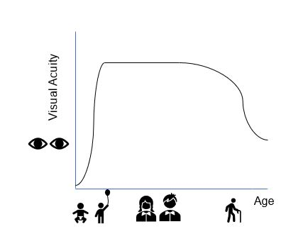
Inverted
U-Function
A third pattern is the inverted-U-function. This is a shape found more often in lifespan psychology.
Visual acuity is a good example of this. Our visual acuity (how clearly we see) gets better and better in childhood, stays constant for a while in adulthood, then starts to diminish in old age.

Slide 16

Sensitive And Critical Periods
Developmental psychologists once believed that all humans go through critical periods - regarded as a period in a person's development when an event has its greatest consequence or effect (Feldman, 2006), with significant consequences if missed or delayed.
Lorenz (1935) intervened at the critical period of newborn geese at the point of forming attachment to the first object they saw. Here is a video of man attempting to recreate Lorenz (1935) investigation.
However, it is now commonly agreed that the human brain is capable of recovering from injury or deprivation much more so than originally thought, so the term 'sensitive periods' is more commonly used. An example of this could be learning a new language.
PBS, (2013),

Slide 17
Theories Of Development
First, a theory of development will describe changes over time in on or several aspects of behaviour or psychological activity.
What are theories of development?
describe
Second, theories of development explain why children develop the way they do. They explain how changes come about.
Theories of development are frames of reference for examining behaviour that:
explain
Third, a theory must be able to make predictions that can then be tested against the data. If the predictions are upheld, the theory is supported. If not, it has to be discounted or modified.
predict
Notes:
Why Do We Need Theories
Without theories, there would be no way to make sense of the data that researchers collect.
For example, Piaget found that if you hide a teddy under a piece of cloth, infants younger than
eight months will not look for the teddy. This could mean anything! But when we start applying
theory, meaning comes in: Piaget suggested that this meant that infants under eight months
have no understanding of object permanence - the infants do not know that objects exist when
they can't see or touch them. Suddenly, the behaviour has meaning.
Theories can also tell us what new research to conduct in order to investigate the behaviour
further. If this behaviour suggests that object permanence is not present, we would predict the
infant to show other behaviours as well. Baillargeon (1987) tested this and found that infants
do have a concept of object permanence and failed Piaget's task as they cannot coordinate
remembering, reaching and grasping. This is new knowledge that wouldn't have been
investigated if Piaget's theory had not been formulated.

Slide 18
The theorist views - learning vs. innateness.
So, how much is innate and how much is environmental?
Next week we will explore an overview of:
Piaget’s theory of cognitive development
  and
Vygotsky’s theory of social constructivism.

Slide 19
References
Darwin, C. (1859). On the origin of species by means of natural selection, or the preservation of favoured races in the struggle for life. London: John Murray.
Dixon, R. A. & Lerner, R. M. (1992). A history of systems in developmental psychology. In M.H. Bornstein, & M.E. Lamb (Eds.), Developmental psychology: An advanced textbook (pp.3-58). Hillsdale, NJ: Lawrence Erlbaum Associates.
Hepper, P. G. (1991). An examination of fetal learning before and after birth. The Irish Journal of Psychology, 12(2), pp.95-107.
ITV News, (2016), Baby's brain scans show damage caused by Zika virus [video] Available at: https://www.youtube.com/watch?v=N6DajXvY15U (Accessed: 10 September 2022).
Locke, J. (1948). An essay concerning human understanding, 1690. Available at: http://pinkmonkey.com/dl/library1/book1284.pdf (Accessed: 10 September 2022).
Lorenz, K. Z. (1935). Der Kumpan in der Umwelt des Vogels. Journal fur Ornithologie, 83, pp.137-213.
PBS, (2013), Nature: Imprinting Hatchling Geese [video] Available at: https://pbsnature.tumblr.com/post/63648815137/geese-hatchlings-imprint-on-avid-bird-enthusiast (Accessed: 10 September 2022).
Rousseau, J. J. (1979). Emile, or on education (Allan Bloom, Trans.). New York, NY: Basic Books.
Skinner, B. F. (1953). Science and human behavior. New York: Macmillan
Watson, J. B. (1913). Psychology as the behaviorist views it. Psychological Review 20 pp.158-177.

