Slide 1
The Impact Of Loneliness And Social Isolation On Older Adults Over 65 in Residential Home Care in the UK
Student Name:Nadeie seaied
Student ID:2212621
Lecturer:Dr Zeno Leung
Module code:LCHS7008

Slide 2
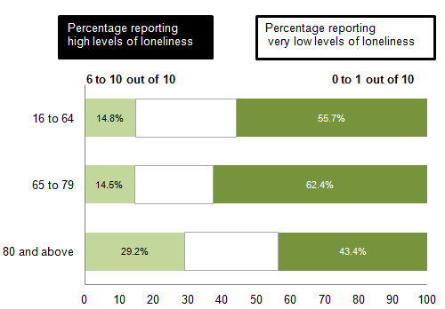
Prevalence
Over 1 million older adults in England are chronically lonely (Age UK, 2024).
Rates are especially high among those in residential care (Huang et al., 2022).
Living in a communal setting does not prevent frequent loneliness (Huang et al., 2022).
Those with mobility or cognitive issues are at highest risk (Thomas, 2015).
Staffing shortages and task-focused care limit meaningful interaction (Care Quality Commission, 2018).
Loneliness increases risks of depression, cognitive decline, and early death (Huang et al., 2022).
This is a major public health issue within social care.
Who Reported Feeling Lonely in Life By Age Group (Thomas, 2015)
Notes:
Prevalence
Social isolation and loneliness are very widespread in the cases of older adults over 65 years in residential care facilities in the UK. Age UK (2024) informs that older individuals are chronically lonely among more than a million of the elderly in England, and the rates are even higher among those in institutions because contact with family, loss of independence, and health-related restrictions is high. It is indicated that residents of care homes experience frequent loneliness, even though they live in communal settings (Huang et al., 2022). The Office for National Statistics reports that more adults aged 65 years and above feel socially isolated after having moved into care, especially those with walking problems or cognitive issues (Thomas, 2015). The Care Quality Commission (2018) outlines the fact that meaningful social interactions can be restrained by staffing issues and task-oriented care models. Loneliness has been linked with higher risks of depression, cognitive impairment, and mortality, and is an important issue affecting the social care of older adults in residential care disproportionately.

Slide 3
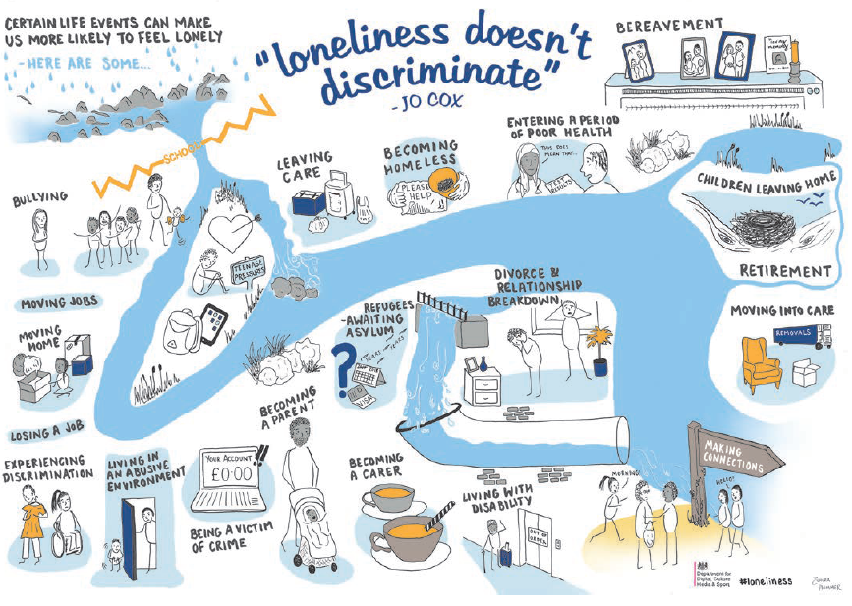
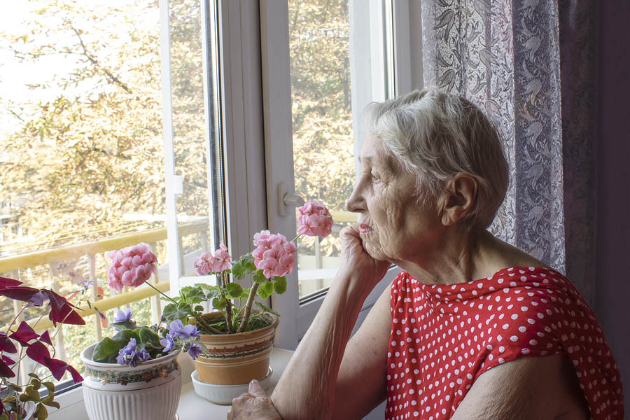
Rationale of the Research
Loneliness in UK care homes is a persistent, under-researched problem (Chepchirchir, 2024).
National policies recognize the issue but lack targeted research for this setting (HM Government, 2018).
Existing studies focus on community-dwelling seniors, not the unique care home environment (Chepchirchir, 2024).
The growing aging population will increase demand for residential care (Newmyer et al., 2022).
Loneliness directly harms mental health and increases healthcare use (Chepchirchir, 2024).
This research aims to fill a specific gap in evidence.
Goal is to inform tailored, sustainable interventions for resident well-being.
Notes:
Rationale of the Research
The study is needed because the effect of loneliness and social isolation on older adults in residential care homes in the UK has been a persistent issue that has not been adequately addressed. Although the national policies like the UK Loneliness Strategy recognise older adults as vulnerable groups, not many studies are dedicated specifically to the residents of institutional care older than 65 years of age (HM Government, 2018). Current research tends to investigate community-based older adults without focusing on specific social, environmental, and organisational determinants of loneliness in care homes (Chepchirchir, 2024). As the population of the UK aged is likely to grow drastically, older people seeking residential care are likely to contribute to this growth, worsening the problem (Newmyer et al., 2022). The issue of loneliness is acute; it is connected with worse mental well-being, more frequent visits to healthcare services and worse quality of life. The study is innovative due to its specific focus on residential care and the intention to produce evidence to guide customised, sustainable interventions to enhance the psychosocial well-being of older residents.

Slide 4
Research Question, Aim and Objectives
Research Question
What is the impact of loneliness and social isolation on adults aged over 65 living in residential care homes in the UK?
Research Aim
To explore the effects of loneliness and social isolation on the mental, emotional, and social well-being of older adults in UK residential care homes.
Research Objectives
To examine the prevalence and key contributing factors of loneliness among care home residents aged over 65.
To analyse the psychological and social impacts of loneliness and social isolation on older adults in residential care.
To identify potential care-based strategies that could reduce loneliness and enhance social engagement within care homes.
Notes:
Research Question, Aim and Objectives
Research Question
What is the impact of loneliness and social isolation on adults aged over 65 living in residential care homes in the UK?
Research Aim
To explore the effects of loneliness and social isolation on the mental, emotional, and social well-being of older adults in UK residential care homes.
Research Objectives
To examine the prevalence and key contributing factors of loneliness among care home residents aged over 65.
To analyse the psychological and social impacts of loneliness and social isolation on older adults in residential care.
To identify potential care-based strategies that could reduce loneliness and enhance social engagement within care homes.

Slide 5
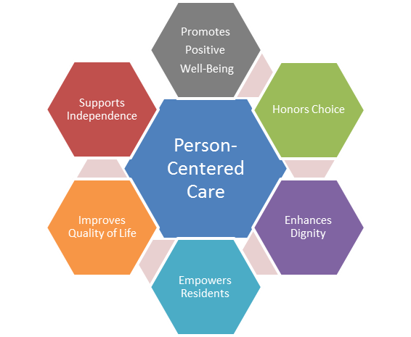

Research Impact
Will inform the creation of more person-centered care strategies.
Provides evidence to care home providers and professionals on effective interventions.
Can improve activity planning, staff training, and social interaction models.
Provides information for the creation of creative, fact-based concepts to enhance inhabitants' general well-being (Fazio et al., 2018).
Evidence can strengthen national policies on aging and mental health in care settings.
Notes:
Research Impact
This study will contribute to the understanding of the impacts of loneliness and social isolation on older adults residing in residential care, which will be used to design more people-centred care strategies. Results will educate care home providers and health and social care professionals on useful approaches to foster social involvement and emotional welfare. The study has the potential to help improve service levels to help improve activity planning, staff training, and resident interaction models, which can lead to improved quality of care (Spilsbury et al., 2024). The evidence can be used by policymakers to reinforce the national ageing and mental health approaches, especially in long-term care institutions.

Slide 6
References
Age UK (2024). AGE UK’S NEW REPORT SHOWS ‘YOU ARE NOT ALONE IN FEELING LONELY’. [online] Age UK. Available at: https://www.ageuk.org.uk/latest-press/articles/age-uks-new-report-shows-you-are-not-alone-in-feeling-lonely/ [Accessed 3 Feb. 2026].
Chepchirchir, L. (2024). Loneliness Among the Elderly in Nursing Care Homes: A Scoping Review.
CQC (2018). Beyond Barriers: How Older People Move between Health and Social Care in England. [online] Available at: https://www.cqc.org.uk/sites/default/files/20180702_beyond_barriers.pdf [Accessed 3 Feb. 2026].
Gill, A.S. and Sullivan, S.S. (2025). Resonances of Feeling Alone: A Systematic Review Unveiling Older Persons' Loneliness and Its Mechanisms in Residential Care Facilities. Journal of advanced nursing.
HM Government (2018). A Connected Society a Strategy for Tackling Loneliness - Laying the Foundations for Change. [online] Available at: https://assets.publishing.service.gov.uk/media/5fb66cf98fa8f54aafb3c333/6.4882_DCMS_Loneliness_Strategy_web_Update_V2.pdf [Accessed 3 Feb. 2026].
Huang, P.H., Wang, S.Y., Hu, S.H. and Chuang, Y.H., (2022). Older residents' perceptions of loneliness in long‐term care facilities: A qualitative study. International Journal of Mental Health Nursing, 31(3), pp.601-610.
Newmyer, L., Verdery, A.M., Wang, H. and Margolis, R., (2022). Population aging, demographic metabolism, and the rising tide of late middle age to older adult loneliness around the world. Population and Development Review, 48(3), pp.829-862.
Spilsbury, K., Charlwood, A., Thompson, C., Haunch, K., Valizade, D., Devi, R., Jackson, C., Alldred, D.P., Alldred, D., Arthur, A. and Brown, L., (2024). Relationship between staff and quality of care in care homes: StaRQ mixed methods study. Health and social care delivery research, 12(8), pp.1-139.
Thomas, J. (2015). Measuring National Well-being: Insights into Loneliness, Older People and Well-being, 2015. [online] www.ons.gov.uk. Available at: https://www.ons.gov.uk/peoplepopulationandcommunity/wellbeing/articles/measuringnationalwellbeing/2015-10-01 [Accessed 3 Feb. 2026].
Notes:
References
Age UK (2024). AGE UK’S NEW REPORT SHOWS ‘YOU ARE NOT ALONE IN FEELING LONELY’. [online] Age UK. Available at: https://www.ageuk.org.uk/latest-press/articles/age-uks-new-report-shows-you-are-not-alone-in-feeling-lonely/ [Accessed 3 Feb. 2026].
Chepchirchir, L. (2024). Loneliness Among the Elderly in Nursing Care Homes: A Scoping Review.
CQC (2018). Beyond Barriers: How Older People Move between Health and Social Care in England. [online] Available at: https://www.cqc.org.uk/sites/default/files/20180702_beyond_barriers.pdf [Accessed 3 Feb. 2026].
Gill, A.S. and Sullivan, S.S. (2025). Resonances of Feeling Alone: A Systematic Review Unveiling Older Persons' Loneliness and Its Mechanisms in Residential Care Facilities. Journal of advanced nursing.
HM Government (2018). A Connected Society a Strategy for Tackling Loneliness - Laying the Foundations for Change. [online] Available at: https://assets.publishing.service.gov.uk/media/5fb66cf98fa8f54aafb3c333/6.4882_DCMS_Loneliness_Strategy_web_Update_V2.pdf [Accessed 3 Feb. 2026].
Huang, P.H., Wang, S.Y., Hu, S.H. and Chuang, Y.H., (2022). Older residents' perceptions of loneliness in long‐term care facilities: A qualitative study. International Journal of Mental Health Nursing, 31(3), pp.601-610.
Newmyer, L., Verdery, A.M., Wang, H. and Margolis, R., (2022). Population aging, demographic metabolism, and the rising tide of late middle age to older adult loneliness around the world. Population and Development Review, 48(3), pp.829-862.
Spilsbury, K., Charlwood, A., Thompson, C., Haunch, K., Valizade, D., Devi, R., Jackson, C., Alldred, D.P., Alldred, D., Arthur, A. and Brown, L., (2024). Relationship between staff and quality of care in care homes: StaRQ mixed methods study. Health and social care delivery research, 12(8), pp.1-139.
Thomas, J. (2015). Measuring National Well-being: Insights into Loneliness, Older People and Well-being, 2015. [online] www.ons.gov.uk. Available at: https://www.ons.gov.uk/peoplepopulationandcommunity/wellbeing/articles/measuringnationalwellbeing/2015-10-01 [Accessed 3 Feb. 2026].

