Slide 1
Managing Business Ethics
Dr Caroline Jawad
2018

Slide 2
Reminder
12 November 1-2-1 tutorials
19 November Reading session plus watching a film ☺
https://www.channel4.com/programmes/deepwater-horizon

Slide 4
https://www.bbc.co.uk/iplayer/episode/b0bqlrls/breakfast-05112018

Slide 5
Overview
Time to discuss the nature and evolution of business ethics management
Codes of ethics
Current theory and practice regarding the management of stakeholder relationships
The development of social, ethical, and environmental accounting, auditing and reporting tools
Different ways of organising for the management of business ethics, and critically assess the role of organization culture and leadership
Extent to which developments discussed in this lecture represent genuine commitment to business ethics or sophisticated public relations

Slide 6
What is business ethics management?
Business ethics management is the direct attempt to formally or informally manage ethical issues or problems through specific policies, practices and programmes

Slide 8

Typical components of business ethics management
Mission or values statements
Codes of ethics
Reporting/advice channels
Risk analysis and management
Ethics managers, officers and committees
Ethics consultants
Ethics education and training
Stakeholder consultation, dialogue and partnership programs
Auditing, accounting and reporting

Slide 9
Evolution of business ethics management
Few, if any, businesses likely to use all tools and some do not use any
Escalating adoption of most if not all components (US and UK surveys)
Change in emphasis concerning the purpose of business ethics management
  Previously primarily focused on managing employee behaviour
  Increasing attention to management of broader social responsibilities

Slide 10
Introducing regulation

Slide 11
Have you ever heard ..
Look, I am not to be trusted. Don’t do business with me.
Don’t do business with us.

Slide 12
Bernie Madoff said
“In today’s regulatory environment, it’s virtually impossible to violate rules.”

Slide 13
Madoff Was Sentenced to 150 Years In Prison

Slide 15
Ponzi
A well-respected financier, Madoff convinced thousands of investors to hand over their savings, falsely promising consistent profits in return. He was caught in December 2008 and charged with 11 counts of fraud, money laundering, perjury, and theft.
Conned his investors out of $65 billion and went undetected for decades

Slide 16
Madoff used a so-called Ponzi scheme, which lures investors in by guaranteeing unusually high returns. The name originated with Charles Ponzi, who promised 50% returns on investments in only 90 days.
Ponzi schemes are run by a central operator, who uses the money from new, incoming investors to pay off the promised returns to older ones. This makes the operation seem profitable and legitimate, even though no actual profit is being made. Meanwhile, the person behind the scheme pockets the extra money or uses it to expand the operation.

Slide 17
To avoid having too many investors reclaim their "profits," Ponzi schemes encourage them to stay in the game and earn even more money. The "investing strategies" used are vague and/or secretive, which schemers claim is to protect their business. Then all they need to do is tell investors how much they are making periodically, without actually providing any real returns.
Ponzi schemes aren't usually very sustainable. The setup eventually falls apart after: (1) The operator takes the remaining investment money and runs. (2) New investors become harder to find, meaning the flow of cash dies out. (3) Too many current investors begin to pull out and request their returns.

Slide 18
In Madoff's case, things began to deteriorate after clients requested a total of $7 billion back in returns. Unfortunately for Madoff, he only had $200 million to $300 million left to give.
Another reason Madoff managed to fly under the radar for so long (despite multiple reports to the SEC about suspicions of a Ponzi scheme), is because Madoff was a well-versed and active member of the financial industry. He started his own market maker firm in 1960 and helped launch the Nasdaq stock market. He sat on the board of National Association of Securities Dealers and advised the Securities and Exchange Commission on trading securities. It was easy to believe this 70-year-old industry veteran knew exactly what he was doing.

Slide 19
Madoff really cheated clients out of $65 billion. That's hardly any consolation for his thousands of investors, the full list of whom can be found with WSJ here.
The 150-year sentence, more symbolic than literal, was followed by other convictions related to Madoff's scheme. In March this year, five of Madoff's employees were found guilty for their part in the Ponzi scheme. Most recently, Madoff's accountant and lawyer is also facing up to 30 years in prison for his role.
There are several other notable Ponzi schemes in history, including Allen Stanford's which stole $8 billion and Tom Petters' that cheated investors out of $3.7 billion. But as far as scale goes, Madoff wins by a landslide.

Slide 20
A CEO said
“We are the good guys. We are on the side of angels.” and “We are doing God’s work here.”?

Slide 21
Jeffrey Skilling CEO, Enron

Slide 23
What company had a 64-page award-winning code of ethics?

Slide 24
Enron – the fall of a Wall Street Darling
7th largest corporation in the US.
Valued at over $70b.
1997 started losing money and accumulating debt.
Did not admit losses and decided to hide losses through ‘accounting tricks’ because they did not want stock price to go down.
2001 media started to wonder if Enron was over-valued.

Slide 25
Continued
Media speculation put pressure on stock prices which fell from $90.75 to 12 cents.
2001 December filed for bankruptcy.
20,000 jobs lost.
$2b pension fund lost.
Executives arrested, some imprisoned.
Countless examples and mainly in the financial industry, especially after the 2008 global recession.

Slide 28
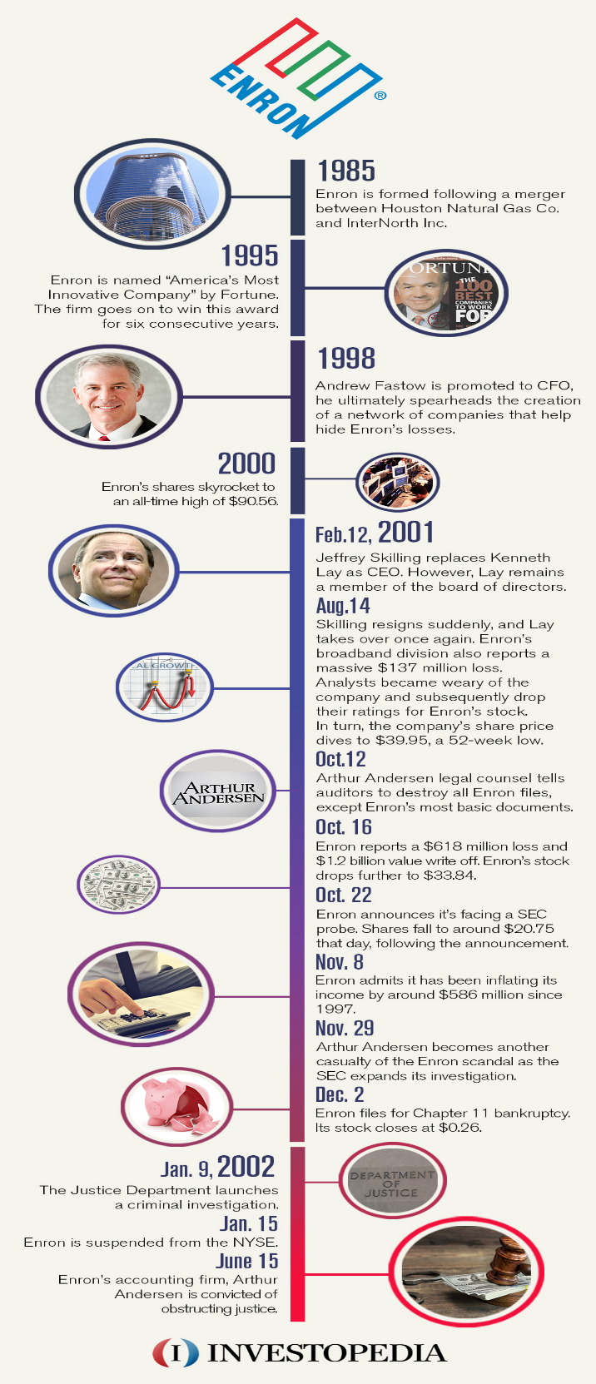
Notes:
https://www.investopedia.com/updates/enron-scandal-summary/

Slide 29
Anarchy or not ?
The capacity to follow rules and regulations is far more advanced in humans than in any other species (Baumeister, 2005).
Without this vital capacity, modern society would cease to function in any meaningful form.
Adherence to social regulations (eg norms, morals and laws) is especially important, having benefits for individuals and society.
When individuals comply, there is a safer, healthier, generally more desirable result.

Slide 30
However …
Human life is saturated with rules.
What about business ?
When businesses comply, there is a safer, healthier, generally more desirable result.

Slide 31
Self-regulation
The darling of the industry

Slide 32
Self-regulation to be the best kind of control
In their election document, the country's Catholic bishops – who are not known for their support of free market economics – pointed out:
  "A society that is held together just by compliance to rules is inherently fragile, open to further abuses which will be met by a further expansion of regulation.”
Notes:
http://www.bloomsburyacademic.com/view/NetNeutrality_9781849662192/chapter-ba-9781849662192-chapter-0007.xml

Slide 33
Principles and trends
The state cant do it all ....................
Markets ... it was assumed ... could be kept in check largely by a minimalist state and corporate self-regulation.
More connected to all stakeholders involved.

Slide 34
Continued
“Softer”, voluntary approaches to business regulation – promoted to improve company performance relating to social and sustainable development and human rights.
Designed by business interests and NGOs.
Superior in relation to legal “harder” approaches involving state actors.
Notes:
“softer”, voluntary approaches to business regulation being promoted in an attempt to improve aspects of company performance that relate to social and sustainable development and human rights. Such approaches are often designed by business interests and non-governmental organizations (NGOs), and couched in a discourse that proclaims their superiority in relation to legalistic, “harder” approaches involving state actors.

Slide 35
Continued
Greater levels of democracy/participation
  From hierarchical to decentralized regulation
  From external to internal self-regulation
  Greater stakeholder involvement
  Greater integration with everyday exchange

Slide 36
Historical Trends in Regulation
Early industrialism: separation between state and markets. Focus on production.
Fordist & state-socialist industrialism:
  More concern with consumption / demand.
  Need for more planning: political-economic intervention.
Today: even greater involvement of consciousness & planning is necessary
  Post-Fordist globalization: avoidance or disguising of conscious planning.

Slide 37
Regulation
Liberalisation = trend towards markets and prices for co-ordination and away from hierarchies.
Growing self-regulation and co-regulation (albeit under the “shadow of hierarchy” – Scharpf 1994 – legislative and executive decisions in order to deal effectively with the problems they are supposed to solve)
Internet.

Slide 38
Palfrey’s 4 phases of internet regulation (2010)
1960s-2000 ‘Open Internet’ - separate space ‘cyberspace’ - governments ignored online activities or regulation was minimal.
2000-2005 ‘Access Denied’ - governments and others determined that some online activities should be blocked/managed - certain acts of speech and online organisations needed to be regulated.
2005-2010 ‘Access Controlled’ governments utilised regulatory approaches/mechanisms that function like filters and act as variable controls.
‘Access Contested’ - reaction against some of these controls.

Slide 39
Regulation
Regulations dominate all aspects of our private and organisational lives and we have to work with regulatory environments and the policies that shape future rules, laws and regulatory institutions.
The world is constantly changing and organisations need to understand regulatory frameworks in order to formulate and implement strategies.

Slide 40
A Definition of Regulation
“Refers to the various instruments (both formal legal instruments and such informal tools as ‘guidance’) used by government to control some aspect of the behaviour of a private economic actor. Regulation can also include rules issued by non-governmental bodies (e.g. self-regulatory bodies) to which governments may have delegated regulatory powers. All regulations are supported by the explicit threat of punishment for non-compliance.” OECD, 2001.

Slide 41
Types of regulations
Economic (Structural) Regulation
  remedies for market failure, centrally-planning an economy, BoE.
Social (Conduct) Regulation
  rules aimed at restricting behaviors that directly threaten public health, safety welfare or well being.
Administrative Regulation
  rules and regulations made by government agencies or commissions which derive their authority from the state.
  Concentrate on regulations relating to protecting consumers.

Slide 42
Why might we regulate?

Slide 43
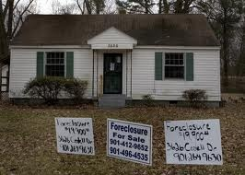
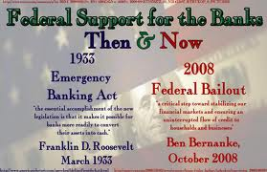
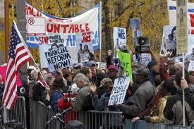
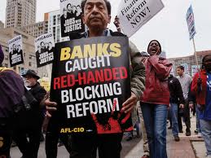
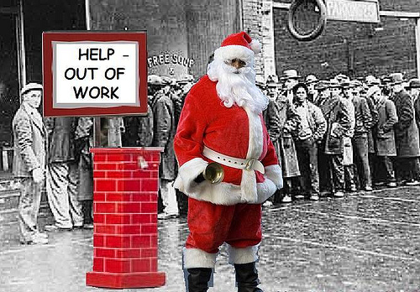
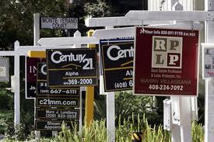

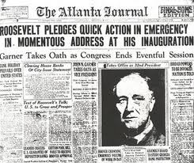

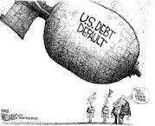




Slide 44
The Great Depression
The Treaty of Versailles made the United States very rich.
UK and France gave large amounts of money to the U.S., and Germany had to pay a great amount of money for the damage they had done in WW1.
This wealth that began the stock market crash.
Notes:
An important reason for the Great Depression was the Treaty of Versailles.^{[4]} The Treaty of Versailles made the United States very rich. Britain and France both gave large amounts of money to the U.S., and Germany had to pay a great amount of money for the damage they had done in World War I. However, it was this wealth that began the stock market crash.

Slide 45
The Bull Market
For five years prior to 1929, rising prices typified the stock market.
During this period, American investors enjoyed an enormous "bull market."
(The opposite, a market characterized by falling prices, is called a "bear market").

Slide 46
Why Americans invested in the stock market
Rising stock dividends.
Increase in personal savings. Fordism.
Relatively easy money policy.
Companies invested their over-production profits in new production.
No stock market regulation.
Psychology of consumption.
Notes:
Americans invested in the stock market for six reasons during the 1920s:
1. Rising stock dividends.
New investors entering the market, many who viewed it as an easy way to get rich quick, helped inflate stock prices. Economic historians, however, estimate that a relatively small number of Americans--about 4 million--had investments in the market at any one time. Yet, the constant influx of new investors coming in and old investors moving out ensured that new money was always floating around.
2. Increase in personal savings.
Higher wages meant that even average Americans now had surplus money to put into savings or invest in the stock market.
3. Relatively easy money policy.
At this time, banks made money more readily available at lower interest rates to more and more people. Although economists debate the actual influence of this phenomenon on the stock market, it's conceivable that many people took out loans not only to buy cars, but also to buy stock.
4. Companies invested their over-production profits in new production.
From 1925 on, industry was over-producing. In anticipation of eventually selling the surplus, business leaders funneled their profits right back into industry. They invested in factories and new machinery, and hired more workers, which, in turn, fueled even greater overproduction. This increased production gave the companies an aura of financial soundness, which encouraged Americans to buy more stock.
5. Lack of stock market regulation.
At this time, there were no effective legal guidelines on buying and selling stock. Free from such limitations, corporations began printing up more and more common stock. Many investors in the stock market practiced "buying on margin," that is, buying stock on credit. Confident that a given stock's value would rise, an investor put a down payment on the stock, expecting in a few months to pay off the balance of their initial investment while reaping a hefty profit. This investment strategy turned the stock market into a speculative pyramid game, in which most of the money invested in the market didn't actually exist.
6. Psychology of consumption.
The Psychology of Consumption fed the optimism of investors and gave them unquestioning faith in prosperity. When the Crash did come, it was even more devastating because of this unquestioned faith.

Slide 47
The Crash
Black Thursday 24 October 1929.
Black Tuesday 29 October 1929.
13 November 1929.
$14,000,000.00 in 1929 – relative value 9 March 2018 $2,590,000,000,000.00 = £2.5trillion
Notes:
In September of 1929, stock prices began to fluctuate, but market analysts dismissed this as temporary. What many of these analysts did not realize--or refused to admit--however, was that stock prices were totally out of proportion to actual profits.
October 24, 1929 as "Black Thursday." On this day, people began dumping their stocks as quickly as they could. October 29, 1929, "Black Tuesday," was the beginning of the Great Crash.
"Black Tuesday" was the single most devastating financial day in the history of the New York Stock Exchange. Within the first few hours the stock market was open, prices collapsed and wiped out all the financial gains of the previous year. Since most Americans viewed the stock market as the chief indicator of the health of the American economy, the Great Crash shattered public confidence. Between October 29 and November 13, the day when stock prices hit their lowest point, over $30 billion disappeared from the American economy. This amount was comparable to the total amount of money that the federal government had spent to fight the First World War.

Slide 48
US Financial Crisis
Great Depression
4 decades of growth
Banks were tightly regulated – unable to speculate on investments with consumer savings

Slide 50
Neoliberalism
Neoliberalism • Ideological - a set of ideas about the “best” relationship between the economy and government. • Political - social and economic reforms that put the ideas of neoliberalism into practice. • Historical - an era characterized by the dominance of neoliberal political projects (roll-back and roll-out).
Neoliberal Ideas • The economy will prosper if left alone, and a prosperous economy is good for the people. • Individuals bear responsibility for their poverty, and governments should not foster “dependence” on social programs. • Economic rationales should be applied to social programs: competition, cost-beneﬁts analysis, measurable outcomes.

Slide 51
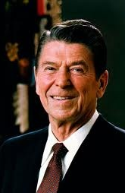
Ronald Reagan
Started 30 year period of deregulation
Banks (Savings & Loans) could speculate with savings
Criminal activity

Slide 52
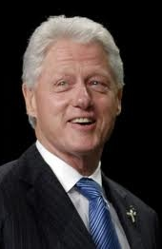
Bill Clinton
Deregulation continued
Consolidation and mergers
Banks like monopoly power

Slide 53
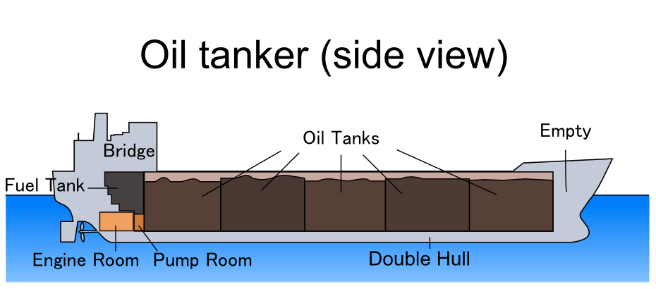
Oil Tankers .....
Notes:
After the Great Depression, banks became like oil tankers – each tanks carefully separated from each other – safety reasons – good for balance, easier to manage – and captain did not want all the oil to slosh around together
But deregulations changed this
In the 1990s – the $1billion dollar fines started coming in for the banks – and they said they wouldnt do it again –
COOKING THE BOOKS, LAUNDERING MONEY – CITIBANK funneled $100m of drug money out of Mexico

Slide 54
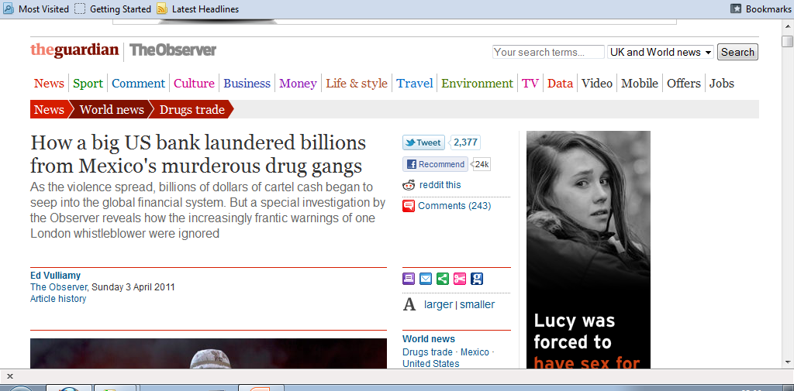

Slide 55
Criminality – distinctive
Fannie Mae lied to investors that its value was 10 times its real value (2007/8) (returned to profitability in 2012).
UBS fined $780m for fraud (tax evasion probe UBS had an estimated 19,000 U.S. customers with undisclosed Swiss accounts).
AIG paid $1.64b to settle with regulators (to resolve allegations that it used deceptive accounting practices to mislead investors and regulators)
Deregulation and Information Age made industry unstable.
Notes:
http://us.history.wisc.edu/hist102/lectures/lecture18.html
“Fannie Mae and Freddie Mac executives told the world that their subprime exposure was substantially smaller than it really was.
Swiss banking giant UBS has agreed to pay $780 and identify certain US clients in a deal to resolve criminal fraud charges that it assisted rich Americans to evade taxes.
American International Group announced Thursday a $1.6 billion settlement to resolve regulators' charges that it used fraudulent accounting techniques to artificially bolster results and rigged bids for commercial insurance.

Slide 56
Continued
Derivatives – 1990’s $50trillion market
https://www.youtube.com/watch?v=gCHiLLgO55o
Loans – in the old days – home buyers – pay mortgage – to lenders
New system – lenders sold debt to investment banks – lenders are not on the hook
More and more loans were pumped out

Slide 57
Continued
Home buyers – lenders – investment banks – investors
https://www.youtube.com/watch?v=mFIKx-hWlZw
https://www.youtube.com/watch?v=0WBi-ts4M5E
Investment banks preferred higher interest rates (sub prime loans)
Anyone could get a mortgage
Bubble created
Traders became wealthy Lehman Bros salary $485m
Notes:
Lehman Brothers – PONZI scheme
Greenspan did not believe in regulatoin – would not change his mind
Instant global communication – helped the finance industry

Slide 58
Continued
Investment banks – borrowed more money to buy loans –LEVERAGE
Leverage - The amount of debt used to finance a firm's assets. A firm with significantly more debt than equity is considered to be highly leveraged.

Slide 59
Derivatives
Highly risky investment
Example – insurance
In insurance, you can only insure something you own. The derivatives
universe essentially enables anybody to actually insure that house.
Notes:
Using derivatives, bankers could gamble on virtually anything. They could
bet on the rise or fall of oil prices, the bankruptcy of a company; even the weather. By
the late 1990s, derivatives were a 50-trillion-dollar unregulated market.
In insurance, you can only insure something you own. Let's say you
and I own property; I own a house. I can only insure that house once. The derivatives
universe essentially enables anybody to actually insure that house. So you could insure
that; somebody else could do that. So 50 people might insure my house.
So what happens is, if my house burns down, now the number of losses in the system
becomes proportionately larger.

Slide 60
Continued
Bank traders
Type A personalities
Cocaine
Prostitutes
Notes:
Type A people – competitive – work obsessed - Type A
personalities know everything in the world. These people are risk-takers; they're impulsive. It's part of their behavior, it's part of their personality.

Slide 61
Are u type a or ......
http://psychologytoday.psychtests.com/cgi-bin/tests/transfer_ap.cgi?partner=yahoo&part=1&test=type_a_r&ret=Anxiety&AMT=9.95&item=Type%20A%20Personality%20Test%20-%20R

Slide 62
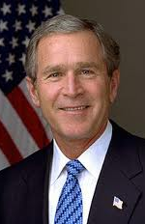
Continued
$700b bailout
Recession
World went tumbling down
GM and Chrysler went bankrupt
Banks bigger , more consolidated, little competition
Notes:
There are fewer competitors, and a lot of smaller banks have been
taken over by big ones. JP Morgan today is even bigger than it was before.
JP Morgan took over first Bear Stearns and then WAMU; Bank of
America took over Countrywide and Merrill Lynch; Wells Fargo took over Wachovia.
After the crisis, the financial industry, including the Financial Services
Roundtable, worked harder than ever to fight reform. The financial sector employs 3,000
lobbyists, more than five for each member of Congress.

Slide 63
Concluding...
Inequality of wealth higher in US than in any other country
Americans borrow to finance cars, homes, education
Little reform – is it a Wall Street government
Has the financial industry turned its back on society?

Slide 64
How much regulation?
should occur as long as the marginal benefits equal the marginal costs of intervention, but the data problems involved are enormous.
‘Competition where possible, regulation where necessary’. A political Judgement?
It should look to improve allocative, productive and dynamic economic efficiency.
Does this always require the state?
  Property Rights and Public Choice views
How about self-regulation?

Slide 65
Principles of good regulation
Independence
Accountability
Transparency
Clarity
Speed
Appeals Procedure
Simplicity
Periodic Review
Consistency
Commitment
Fairness
Targeted

Slide 66
Some potential benefits of good regulation
Overall Consumer Gains

Slide 67
Self Regulation
Where business/industry monitors its own behaviour – often through an agreed code of practice. e.g.
  PCC – Press Complaints Commission
  Portman Group – alcoholic drinks industry
  FSA – Financial Services Authority
  BMA – British Medical Association

Slide 68
Self-regulation and the state
‘Co-operative’: co-operation between regulator and regulated on the operation of statutory regulation;
‘Delegated’: the delegation of the implementation of statutory duties by a public authority to self-regulatory bodies;

Slide 69
Continued
‘Devolved’: the devolution of statutory powers to self-regulatory bodies, often thought of as ‘statutory self-regulation’, ie, the specification of self-regulatory schemes in statute;
‘Facilitated’: self-regulation explicitly supported by the state in some way but where the scheme itself is not backed by statute;

Slide 70
Continued
‘Tacit’: close to ‘pure’ self-regulation – self-regulation with little explicit state support, but its implicit role can be influential.

Slide 71
Advantages of self-regulation over legislation
knowledge and expertise of all parties used more effectively;
flexible and adaptable;
lower regulatory burden on business;
more commitment, pride and loyalty within a profession or industry;
lower costs to the state;
the market can work better.

Slide 72
Advantages of self-regulation over no regulation
Overcome market or conduct failures and prevent harms to, for example, the consumer and the environment;
Improve corporate governance and reporting, address issues such as corporate social responsibility and ethical trading.

Slide 73
Decline in self-regulation
Increasingly complex, globalised economy
Increasing risk aversion
Need to regulate to promote competition
Although in some areas like environmental/employee working conditions/international banking ??? – self-regulation has increased
Notes:
There are many reasons for the decline of self-regulation including an increasingly complex and globalised economy and society, increasing risk aversion and the need to regulate to promote competition. Social and economic change, however, have not always resulted in less self-regulation. In some areas self-regulation has increased (eg, voluntary agreements are becoming more significant in environmental regulation) and self-regulation at the transnational level has increased significantly (eg, in international banking, employee working conditions and the internet).6

Slide 74
Continued
Weaknesses
  Collusion and anti-competitive behaviour
  Not in public interest
  Little participation
  Little accountability
  Soft – unable to achieve objectives
Notes:
The decline in self-regulation can also be connected to its weaknesses. One of the most important weaknesses is that self-regulation might lead to collusion and anti-competitive behaviour.7 Another weakness is the possibility of ‘regulatory capture’ which involves the control of regulation by parties not pursuing the public interest. Processes of self-regulation might be closed with little participation by outside interests and little accountability through democratic political processes. Another disadvantage is that not all members of a sectoral self-regulatory scheme may subscribe to regulatory standards and the public may be unaware of this (Baldwin and Cave, 1999, p128). Self-regulation also has the perception of being ‘soft’ and may not achieve its objectives.8 The experience of local loop unbundling in telecommunications in Britain can be perceived as an example of the failure of self-regulation. In 2000 there was controversy over the lack of access to the local loop - Oftel’s initial light touch strategy and the hope of negotiated industry agreements failed and it was pressurised to take a more pro-active role.9

Slide 75
Continued
Deregulation and self-regulation = aversion to the state
Fear self-regulation will lack legitimacy, prove unfair, elusive and inefficient
Notes:
This late 20th century decline in self-regulation is, however, somewhat paradoxical in that it coincides with the era of ‘deregulation’ and liberalisation. Although they are not identical, there is a congruence between deregulation and self-regulation: they both represent an aversion to state intervention which became dominant in the late 20th century. An expectation therefore is that they would coexist and rise and fall in unison. The ‘new wave’ of self-regulation might be a response to this paradox but the weaknesses of self-regulation mean that care is required in the transition. It has been recognised, for example, ‘that a more effective route to compliance lies through more proactive stimulation of the self-regulatory capacities of companies’ but there are ‘dangers that flow from excessive trust … [which] will not lead corporations to act in a wholly public spirited manner’ (Baldwin, 2004, p381). There is a ‘fear that regulatory processes, as a result, will lack legitimacy and prove unfair, exclusive and inefficient’ (ibid).

Slide 77
Northern Rock
http://news.bbc.co.uk/1/hi/business/7007076.stm

Slide 78
Codes
Complementary to government legislation
1990s proliferation of codes of conduct and an increased emphasis on CSR
Emphasis on monetarist economic policies and increased integration of international markets, privatization of state assets, trade liberalization
Notes:
The 1990s saw a proliferation of corporate codes of conduct and an increased emphasis on corporate responsibility. This was a result of economic developments in the 1980s, which saw a major shift away from the social democratic and Keynesian interventionism of the postwar period in the North, and from import substituting industrialization and statism in the South. The emphasis on monetarist economic policies and increased integration of international markets for goods and finance, the massive privatization of state assets and, in developing countries, the shift to trade liberalization and export promotion, all served to redefine the economic role of the state.

Slide 79
Continued
Capitalism has always required the establishment of certain .rules of the game. in order to avoid being subject to the ‘law of the jungle’
Codes of conduct can also be used as a means of heading off more draconian measures that might be applied to business

Slide 80
Social Responsibility
Some people question whether business has the expertise needed to assess and make decisions about social problems
Many people believe that social problems are the responsibility of government agencies and officials

Slide 81
Types of Codes
L'etang (1992)
codes of ethics which comprise a fairly short set of ethical principles expressed in the imperative mode
codes of conduct which are more specific, practical documents and govern client relationships
codes of practice which are technical documents that define required standards for the members of a profession
Notes:
L'etang (1992) differentiates between three different types of codes: codes of ethics which comprise a fairly short set of ethical principles expressed in the imperative mode; codes of conduct which are more specific, practical documents and govern client relationships, and; codes of practice which are technical documents that define required standards for the members of a profession.
Self-regulatory codes of conduct are used to control the promotional practices of the pharmaceutical industry, but the effectiveness of these codes in controlling pharmaceutical representatives' presentations has not been examined. This is a matter of concern because pharmaceutical representatives have more influence than any other promotional media on prescribing practices. The authors developed a method for monitoring the oral presentations of pharmaceutical representatives when promoting products to medical practitioners. Sixteen audio-recordings, detailing 64 medicines, were obtained; 38 of the 64 products were prescription-only medicines. Information on indications and on dosage and administration was commonly provided, but information on other areas of drug knowledge, particularly product risk, was minimal. Thirteen presentations contained at least one inaccuracy when compared with Australian Approved Product Information. Presentations did not always comply with current guidelines in the Code of Conduct. The Code provides only limited standards for pharmaceutical representatives' presentations, and no active monitoring system is in place to ensure adherence to the code. There is an urgent need for policy development on the role of pharmaceutical representatives, their standards of practice, and regulation of their activities to ensure they contribute to the appropriate use of medicines.
http://www.ncbi.nlm.nih.gov/pubmed/9595344

Slide 82
Motivation for “code of ethics”
Historical
  professional associations use mechanism to establish status as a profession
  regulate their membership
  convince public that associate deserves to be self-regulated
Self-regulation
  consistent with the tradition of limited government
  costs in terms of time, energy and resources

Slide 83
Motivations for Adopting Codes
1. Stakeholder Regulation
Using codes as a way of guiding or controlling employee and/ or other stakeholder behaviour as it relates to day-to-day operational concerns and/or stakeholder groups
  formalise values, philosophies or commitments as a way of encouraging buy-in to the code and protecting the corporation from rogue employees by using the code as part of the employment contract.
Some codes are championed by senior executives who feel a personal commitment to do the right and formalise this in the corporate ethic using a code
Notes:
Stakeholder Regulation
Stakeholder regulation motives are based on using codes as a way of guiding or controlling employee and/ or other stakeholder (such as supplier) behaviour as it relates to day-to-day operational concerns and/or stakeholder groups (Aaronson and Reeves, 2002; Kolk, van Tulder and Welters, 1999; Rezaee, Elmore and Szendi 2001). This includes the desire of corporations to formalise their values, philosophies or commitments as a way of encouraging buy-in to the code and protecting the corporation from rogue employees by using the code as part of the employment contract. This group also includes third party codes written by a wide variety of stakeholder groups such as NGOs, governments, business associations etc., so as to guide or influence the behaviour of the corporation (Kolk, van Tulder and Welters, 1999). Not all of the motives for self-regulation focus on influencing the behaviour of others or
protecting the corporation. Some codes are championed by senior executives who feel a personal commitment to do the right thing (Gibson, 2000; Thompson, 2002) and formalise this in the corporate ethic using a code.

Slide 84
2. Stakeholder Communication
Communicating elements of corporate philosophy, activities and performance to stakeholders.
Motivations
  to ensure a continued societal license to operate where codes are used to formalise this commitment
  to create trust, legitimacy and credibility of corporations with its stakeholder groups
  to communicate their intentions or activities towards operating in an ethical and socially acceptable manner, while still maintaining their ability to be profitable.
Public opinion of the corporation
Notes:
Stakeholder Communication
These deal specifically with communicating elements of corporate philosophy, activities and performance to both internal and external stakeholders, but where the code is not intended to regulate all the groups to which it communicates. Motivations in this group include a desire by corporations to ensure a continued societal license to operate (White, 1999; Kagan, Gunningham and Thornton 2003) where codes are used to formalise this commitment, to create trust, legitimacy and credibility of corporations with its stakeholder groups (Sethi, 2002), and
to communicate their intentions or activities towards operating in an ethical and socially acceptable manner, while still maintaining their ability to be profitable. Here corporations emphasise how products are made based on corporate philosophies and operating practices, which in turn can positively affect public opinion of the corporation (Wotruba, 1997; Rezaee, Elmore and Szendi 2001).

Slide 85
3. Competitive Advantage
  to help create a market advantage for the corporation
  to help win contracts with discerning corporations or governments
  to exclude new competitors to the market and/ or access to new markets or to attract potential investors
  to help differentiate products in the marketplace as they inform the public about the corporation’s quality and modes of production
  to improve relationships with customers
  and other stakeholders
Notes:
Competitive Advantage
Motivations in this category are based on corporations using codes to help create a market advantage for the corporation. This includes corporations using codes to protect or enhance their already existing reputation within
the marketplace (Gibson, 2000; Diller, 1999; Brereton, 2002) by articulating a triple bottom line approach to production. This puts them in a position of leader or innovator either in their own industry or with regard to CSR issues. Some codes are created to help win contracts with discerning corporations or governments, (Ruhnka and Boerstler, 1998) to exclude new competitors to the market and/ or access to new markets, (Gibson, 2000; Wotruba, 1997) or to attract potential investors. Codes can also be used to help differentiate products in the marketplace as they inform the public about the corporation’s quality and modes of production. Therefore, the codes are created to provide information about the corporation with the hope these commitments will be rewarded by customers and other stakeholders when purchasing. (Lenox and Nash, 2003) Code creation is also motivated by a desire to improve relationships with customers (Diller, 1999) and other stakeholders.

Slide 86
4. Mitigation of Risks or Threats
Avoiding government legislation, intervention, or pressure and reducing or preventing negative public attention are the most commonly noted motivations for corporations in adopting codes
Other threats or risks to mitigate include pressure from other corporations in the same industry or industry, pressure from the public resulting from government
Failure to regulate and pre-empting consumer boycotts or remedy through the legal system
Codes are also used to prove due diligence in court proceedings as a defence against legal sanction or to reduce legal penalties or to indicate appropriate internal control systems in place to secure bank loans and reduce insurance premiums
Notes:
Mitigation of Risks or Threats
The last major group of motivations, mitigation of risks or threats, seems to have the most emphasis in the literature. Avoiding government legislation, intervention, or pressure and reducing or preventing negative
public attention are the most commonly noted motivations for corporations in adopting codes. (McInnes, 1996; Diller, 1999; Brereton, 2002; Truss, 1998; Aaronson and Reeves, 2002; Wotruba, 1997; Gibson, 2000; van Tulder and Kolk, 2001; Lenox and Nash, 2003; Cragg, 2005) Other threats or risks to mitigate include pressure from other corporations in the same industry or industry associations (Lenox and Nash, 2003), pressure from the public resulting from government failure to regulate (McInnes, 1996) and pre-empting consumer boycotts or remedy through the legal system. (Diller, 1999) Codes are also used to prove due diligence in court proceedings as a defence against legal sanction or to reduce legal penalties (Carroll and McGregor-Lowndes, 2001) or to indicate appropriate internal control systems in place to secure bank loans and reduce insurance premiums. (Brereton, 2002; Lenox and Nash, 2003; Thompson, 2002)

Slide 87
CSR Literature
Codes of conduct are variably described and defined but have common elements,
  self-regulatory or voluntary in nature
  used to influence behaviour of a specified group or groups
  and/or to define intentions/ actions on a certain group of issues or to a certain group of individuals, sometimes from a market-based perspective
  (Kolk, van Tulder and Welters, 1999; Kaptein and Wempe, 2002; United States Council for International Business, 2000; ILO, n.d.a; ILO, n.d.b; Forcese, 1997; Alexander, 1997; Dickerson and Hagan, 1998; OECD, 2001; Diller,1999).

Slide 88
US Council for International Business (2004)
codes are defined as "commitments voluntarily made by companies, associations, or other organisations that put forth standards and principles of business conduct in the marketplace, and are thus primarily market-driven" (2000: 2)
Notes:
In the vast majority of literature written on codes, there is an assumption (often implicit) that codes are created to encourage and/or ensure corporations act more responsibly. In the CSR and code literature, this assumption can be found in many works such as Diller (1999), Forcese (1997), Alexander (1997), and the ILO (n.d.a. and n.d.b.), where "code" is defined without any indication of the content or commitments to be made, however the body of
literature focuses on particular areas of importance with regard to CSR issues. For example, the United States Council for International Business (2004) website corporate responsibility section has a "position/statement document" on codes of conduct, where codes are defined as "commitments voluntarily made by companies, associations, or other organisations that put forth standards and principles of business conduct in the marketplace, and are thus primarily market-driven" (2000: 2). The definition does not describe content, or the nature of the
voluntary commitments to be made by the code. These pages also provide a summary of initiatives such as the US Model Business Principles, UN Global Compact, UN Guidelines for Corporate Social Responsibility and the ILO Tripartite Declaration of Principles, Concerning Multinational Enterprises and Social Policy, whose purpose is to encourage greater social and environmental responsibility by corporations. There are no statements that explicitly suggest or question the assumption that codes are to be used for reasons other than to promote CSR
Commitments.

Slide 89
Codes of practice
Mandatory codes are legislated and imposed by governments
Co-regulatory codes are intended to develop a shared understanding between parties (i.e. government, community and industry) and, while often voluntary, may be legislated
Self-regulatory codes have been developed with the intent that they are enforced by industry
Notes:
http://www.csrinternational.org/wp-content/uploads/Visser_Age_of_Responsibility_Paper_2011.pdf
http://www.unrisd.org/unrisd/website/document.nsf/0/e3b3e78bab9a886f80256b5e00344278/$FILE/jenkins.pdf
In some states the development and implementation of codes of practice is required by legislation. However, administration of the content and management of the codes is the responsibility of industry.
• The NT Code of Practice has classified the required harm minimisation measures into nine categories. These are: the provision of information, interaction with customers and community, training and skills development, exclusion of problem gamblers, physical environment, minors, financial transactions, advertising and promotions and privacy
policies.
• The NT Code has a three-phase model for review that covers (1) implementation, (2) cultural shift and (3) sustainability.
• Resource constraints, affecting both governments and individual venues affect the implementation and enforcement of the codes. Consequently, this varies from state to state and venue to venue. Despite community
input in the development of some codes, reviews in some states (i.e. Qld & SA) have found that communities are rarely aware of the codes in practice.
Mandatory codes are legislated and imposed by governments to ensure industry (operators and venues) abide to the specific standards and practices of the code with penalties applicable for non-compliance
Co-regulatory (or voluntary codes) are intended to develop a shared understanding between parties (government, community and industry) for specific practices, policies and standards. These codes usually do not have penalties applied, but may be legislated.
Self-regulatory codes have been developed and enforced by industry itself.

Slide 90
Responsible Gambling Code of Practice
http://www.gamcaretradeservices.com/data/files/v5_nov_2010_gamcare_code.pdf
http://www.gamcaretradeservices.com/pages/certified_remote_companies.html

Slide 91
Motivations for RG Code
The introduction of these codes of practice and programs stem from a range of motivations within the gambling industry
  ethical concerns
  a desire to improve their public profile
  a concern to pre-empt the introduction of prescriptive government regulation.

Slide 92
Codes vary in terms of responsible gambling
whether or not they are made mandatory by governments
the forms of gambling to which they apply
how they were developed (whether by the gambling industry alone or with governments and community sector organisations)
their scope (for example, some focus on advertising or self-exclusion practices
whereas others cover a broader range of practices) the specific measures they include

Slide 93
Breadth and depth of codes of practice and programs
http://www.pc.gov.au/__data/assets/pdf_file/0010/95698/15-chapter12.pdf
p7
Notes:
Codes of practice and programs — some examples
The voluntary Queensland Responsible Gambling Code of Practice, introduced in 2002, was developed by the Queensland gambling industry, the State Government and the Queensland community. The Code ‘represents a voluntary, whole-of-industry commitment to best practice in the provision of responsible gambling’ (Queensland
Responsible Gambling Advisory Committee, sub. 235, p. 13). It contains ‘responsible gambling practices’ relating to: the provision of information; the interaction with customers and the community; exclusion; the physical environment; financial transactions; and advertising and promotions.
In South Australia, individual Advertising and Responsible Gambling Codes of Practice have mandatorily applied since 2004 to the casino, lotteries, TAB, licensed racing clubs and gaming machine venues (hotels and clubs). The gaming machine venue Advertising Code of Practice covers such matters as electronic media blackouts, the advertising of prises, the sounds of gaming in radio and TV advertisements, and interior and exterior advertising. The gaming machine venue Responsible Gambling Code of Practice covers such matters as the screening of the sights and sounds of gambling, customer information and signage, coin availability, alcohol and gambling, inducements, self-exclusion and staff and training (South Australian Government, sub. 225, pp. 35–6).
The BetSafe Program, developed in 1998 by a gambling counsellor and funded by
industry members, provides over 40 New South Wales and ACT clubs with: staff training in responsible gambling; problem gambling counselling; a self-exclusion program, and information, publications, signage, and policies and procedures (BetSafe, sub. 93, pp. 1–3). Specific BetSafe policies and procedures cover such matters as unattended children, underage gambling, financial transactions, legal and compliance information, complementary food and drinks, payment of jackpots and winnings, helping problem gamblers, dealing with third party complaints, exclusion
procedures and training policy.
The ACT Clubsafe Program, a joint initiative of ClubsACT and Lifeline Canberra commenced in 2001 and now applies to 26 clubs in the ACT, which operate over 90 per cent of gaming machines. Under the program, clubs contribute funding to Lifeline, which provides access to counselling for club patrons. The ACT Clubstart Program,
an initiative of ClubsACT in 2007, among other things, provides training in the responsible service of gambling and alcohol to participants (ClubsACT, sub. DR337, pp. 8–9).
Crown Casino in Melbourne voluntarily operates an on-site Responsible Gaming Support Centre, 24 hours a day seven days a week, that provides a variety of services to assist patrons and their families including responsible gaming information, counselling and referral to other service providers. Trained Responsible Gaming
Liaison Officers, a chaplain and two registered psychologists staff the Centre (Australasian Casino Association, sub. 214, attachment — Allen Consulting Group 2009b, p. 61).

Slide 94
Benefits of industry self-regulation
various voluntary initiatives have subsequently mandated
some have gone beyond minimum mandated requirements or have reflected best practice
many have involved collaboration with community and governments
quicker to implement and amend, more flexible and more reflective of leads to greater ownership
Notes:
there are numerous and various initiatives introduced, or funded, voluntarily by the industries, some of which governments have subsequently mandated
some have gone beyond minimum mandated requirements or have reflected best practice
many have involved collabouration with community sector organisations and governments
compared with government regulation, self-regulation is quicker to implement and amend, more flexible and more reflective of diversity in local conditions facing venues, and leads to greater ownership by venues

Slide 95
Deficiencies with voluntary codes of practice and programs
Voluntary measures tend to be at the ‘soft’ end of the harm minimisation spectrum
the lack of effective monitoring and enforcement
inconsistent and/or low compliance by operators with voluntary codes of practice and programs
Notes:
However, despite their benefits in terms of their flexibility, there are three interrelated deficiencies with voluntary codes of practice and programs as a means of addressing gambling harms.
The first deficiency relates to the types of harm minimisation measures that voluntary codes of practice and programs include. Voluntary measures tend to be at the ‘soft’ end of the harm minimisation spectrum — that is, they appear to involve the provision of information or warnings, or the introduction of documentation or
reporting systems, or the identification of venue liaison contacts, or merely restate government regulation (for example, Hing and Dickerson 2002). Such measures are unlikely to reduce gambling revenues significantly for a venue.
The second deficiency is the lack of effective monitoring and enforcement. There is very little evidence of industry associations or governments publicly reporting the extent of venue compliance with voluntary codes of practice and programs, or penalising venues for breaches. For example, McMillen noted that governments
have different ways of monitoring the compliance of industries with codes of practice, with none commissioning an independent compliance audit. Furthermore, she noted that there is little public information on compliance or on consumer experiences of codes (sub. 223, p. 32). This is an important deficiency in that effective monitoring and enforcement has the potential to countervail the commercial incentive of venues not to vigorously pursue effective harm minimisation measures.
Linked to these two deficiencies is the third — namely, inconsistent and/or low compliance by venues with voluntary codes of practice and programs. Poor compliance was a concern for some participants in respect of both voluntary and mandatory codes of practice and programs (box 12.6).

Slide 96
Compliance is better where codes are mandatory
Weak incentives facing venues
Specific measures included in the codes and
Programs
Poor monitoring and enforcement
Lack of ownership over a code externally imposed
Notes:
Some studies suggest that venue compliance is better where codes are mandatory
Already noted are the inherently weak incentives facing venues, the specific measures included in the codes and
programs, and poor monitoring and enforcement. An additional reason for poor compliance is that venues may ‘lack ownership’ over a particular code or program that is externally imposed — they may not have been consulted in its development, or they genuinely believe that it does not reflect their particular circumstances.
A mandatory/systematic approach addresses the following issues: the potential conflict of interest that gambling venues face — actions to increase revenue as opposed to harm reduction; and research has indicated that c
compliance and commitment to voluntary requirements is generally low. (sub. 247, p. 46)
in the absence of strong incentives facing gambling venues to effectively address gambling harms, it would be inappropriate for governments and the community at large to depend solely on voluntary codes of practice and programs for harm minimisation. Indeed, as noted by Clubs Australia, no jurisdiction appears to rely sole upon voluntary measures to address gambling harms (sub. DR359, p. 53).
This is not to say that such industry self-regulation does not have a role within gambling regulatory regimes. Voluntary codes of practice and programs are a source of useful guidance and direction for individual venues. By their nature, they can be flexible instruments, easily altered to accommodate changing business practices, technologies and consumer demands.
However, there will be certain types of measures that will need to be made mandatory by governments — whether through so-called ‘mandatory codes of practice’, venue licensing conditions or legislation — if harm minimisation is to be effectively achieved.

Slide 97
Regulatory spectrum
No intervention
No formal government action.
Incentive based structures
Classic regulation
Prescriptive state regulation. Regulations prescribe particular conduct.
Information and Education
Self regulation
Enables better informed choices. Can change attitudes - ‘hearts and minds’.
Codes negotiated and enforced within an industry. Those with statutory backing or significant government involvement are co-regulation.
The encouragement of particular types of behaviour. Financial instruments, eg, price caps, taxes often used.
Notes:
Regulatory spectrum No intervention Information and education Self-regulation Classic regulation Incentive based structures No formal government action. Enables better informed choices. Can change attitudes - ‘hearts and minds’. The encouragement of particular types of behaviour. Financial instruments, eg, price caps, taxes often used. Prescriptive state regulation. Regulations prescribe particular conduct. Codes negotiated and enforced within an industry. Those with statutory backing or significant government involvement are co-regulation.

Slide 98
Self-regulation spectrum
Legal codes
Unilateral codes of conduct
Official codes and guidance
Recognised codes
Trade association codes
Negotiated codes
Unilateral sector codes
Customer charters
Notes:
At the pure self-regulatory end of the spectrum ‘unilateral codes of conduct’, according the NCC, are when an individual business ‘decides to adopt and implement specific policies which amount to some form of self-restraint on its conduct towards its customers.’ The objectives of this often have a mix of private and public interest. They can provide a competitive advantage, deflect the concerns of government, or pursue goals of social responsibility.
One step along the spectrum ‘customer charters’ adopted by an individual business involve a ‘formal exercise covering all aspects of its dealings with customers, though still stopping short of collective participation of other companies’. It is a ‘formal public commitment to combine compliance with legal obligations with customer service initiatives’.
A ‘unilateral sectoral code’ is a ‘code of practice or similar set of rules unilaterally adopted by a trade or profession, without any consultation or discussion with the outside world’. While the NCC notes that this ‘has all the characteristics of “genuine” self-regulation – entirely voluntary, self imposed and collective’ in practice it is ‘almost extinct’. It is close to classic self-regulation of the professions but it is ‘more or less unthinkable’ that a professional organisation would operate in such an isolated way today.
‘Negotiated codes’ are more common in the modern world and are ‘codes of self-regulation which have been negotiated, or at least discussed (either formally or informally) between an industry body on the one hand, and government and consumer organisations on the other. They also include schemes in which the other organisations are involved in the administration of the codes.
‘Trade association codes’ approved by the OFT are a variant of negotiated codes including the codes developed by the trade association in consultation with and approved by the OFT. These are becoming more significant as the OFT has a duty to promote good consumer practice and an important way in which it does this is by encouraging and approving codes of practice.
‘Recognised codes’ are ‘codes which have some form of statutory foundation or recognition’. It includes legislation which empowers the Law Society and the General Medical Council to make ‘practice rules’ for solicitors and doctors.
‘Official codes and guidance’ refer to ‘a government department or regulatory agency issuing a code of guidance (often elabourating on statutory provision), which has had self-regulatory input’. The enforcement of such codes is through civil or criminal action in the courts.
The final category, ‘legal codes’, is ‘perhaps not true self-regulation at all, but business interests are likely to have a strong influence in negotiating the content’. They are imposed by government or public authority under statute but do not have the full force of law ie, they often explain or supplement legislation but are not a substitute.
Co-regulation is not specifically defined in this spectrum by the NCC but they see it in general as self-regulation which is ‘underpinned by legal regulation’. They quote the Australian government’s document on codes of conduct (DIST, 1998) which defines co-regulation as ‘a process where industry develops and administers a code and the government provides the ability to enforce it through legislative backing’.

Slide 99
Regulatory spectrum
No regulation
Co regulation
Legislation
Self regulation
Quasi regulation
Notes:
The category ‘no regulation’ is seen as important by the Australian government as it ‘supports a fair and informed marketplace where consumers’ interests are protected without excessive regulation’. Although the government will regulate when necessary in the public interest, it generally favours the ‘minimum effective regulation to achieve the desired outcomes’. Self-regulation and less interventionary approaches are therefore considered before stronger and more direct regulation.
Self-regulation is taken to be where ‘business sets its own standards of conduct and enforces those standards without any government involvement either in drafting the standards, promoting the standards or in enforcing the standards’. ‘Pure self-regulation’ would include voluntary codes. Self-regulation is often used ‘to correct a bad public image, to forestall legislation or to give an industry a competitive advantage’.
The next step along the spectrum is ‘quasi regulation’ which refers ‘to those situations where industry adopts or uses codes of conduct in which government involvement extends to matters such as drafting its provisions or endorsing a code, but the enforcement of the code is left to the industry’. A key difference between quasi regulation and self-regulation is that government involvement in the former implies that legislation may be introduced if industry does not satisfactorily comply with the code.
Co-regulation is when ‘industry develops and administers a code and government provides the ability to enforce the code by giving it legislative backing in some way’. The category ‘legislation’ is seen to be appropriate when less interventionary are found to be inadequate in solving a problem, or in areas where there is a clear and important public interest, such as safety.

Slide 100
Reference
http://www.bath.ac.uk/management/cri/pubpdf/Research_Reports/17_Bartle_Vass.pdf
p36

Slide 101
A thought
CSR has failed. The argument is simple and compelling; a doctor judges his/her success by whether the patient is getting better/healthier or worse/sicker. Similarly, we should judge the success of CSR by whether our communities are getting better or worse. And while at the micro level, in terms of specific CSR policies and practices we can show many improvements, at the macro level, almost every indicator shows our social, environmental and ethical health is in decline.

