Slide 1
Professional Development Within Health and Social Care (LCHS4009)
Student name: Marie France Aurelie Bodo Bodo
Student ID: 2426167
Lecturer: Amitave Banik
Title: Critical Thinking in Health and Social Care
Notes:
This presentation analyses Jenny’s situation using attachment theory. Jenny is a 16‑year‑old who has been caring for her mother for the past five years following the death of her father.
The presentation will outline attachment theory, explain its key concepts, apply it to Jenny’s experiences, and propose strategies to support her well-being.
Biological and environmental influences will also be discussed, and the strengths and limitations of the theory will be evaluated.

Slide 2
Use of AI Acknowledgement
I confirm that I have not used any AI tools in the research and creation of this assignment. I confirm that I have not presented any AI generated materials as my own work. I confirm I have copies of my drafts, notes, and other resources I used, which I may be asked to provide in evidence.

Slide 3
Introduction
Critical thinking is a core professional skill within health and social care, enabling practitioners to analyse information, evaluate evidence, and make informed decisions in complex situations. In environments where patient outcomes depend on accurate judgement and timely intervention, the ability to think critically ensures safe, effective, and person-centred care. This presentation explores the concept of critical thinking, its importance in professional practice, and its application through a recognised model within real-world healthcare settings.
Notes:
Jenny has taken on the role of a young carer since her father’s death. Young carers often perform responsibilities normally expected from adults, including household management and emotional support.
Research suggests that young carers may experience increased stress, reduced social opportunities, and difficulties balancing school and caregiving responsibilities (Cassidy & Shaver, 2016).
Understanding how these experiences influence Jenny’s psychological development is important for designing appropriate support strategies.

Slide 4
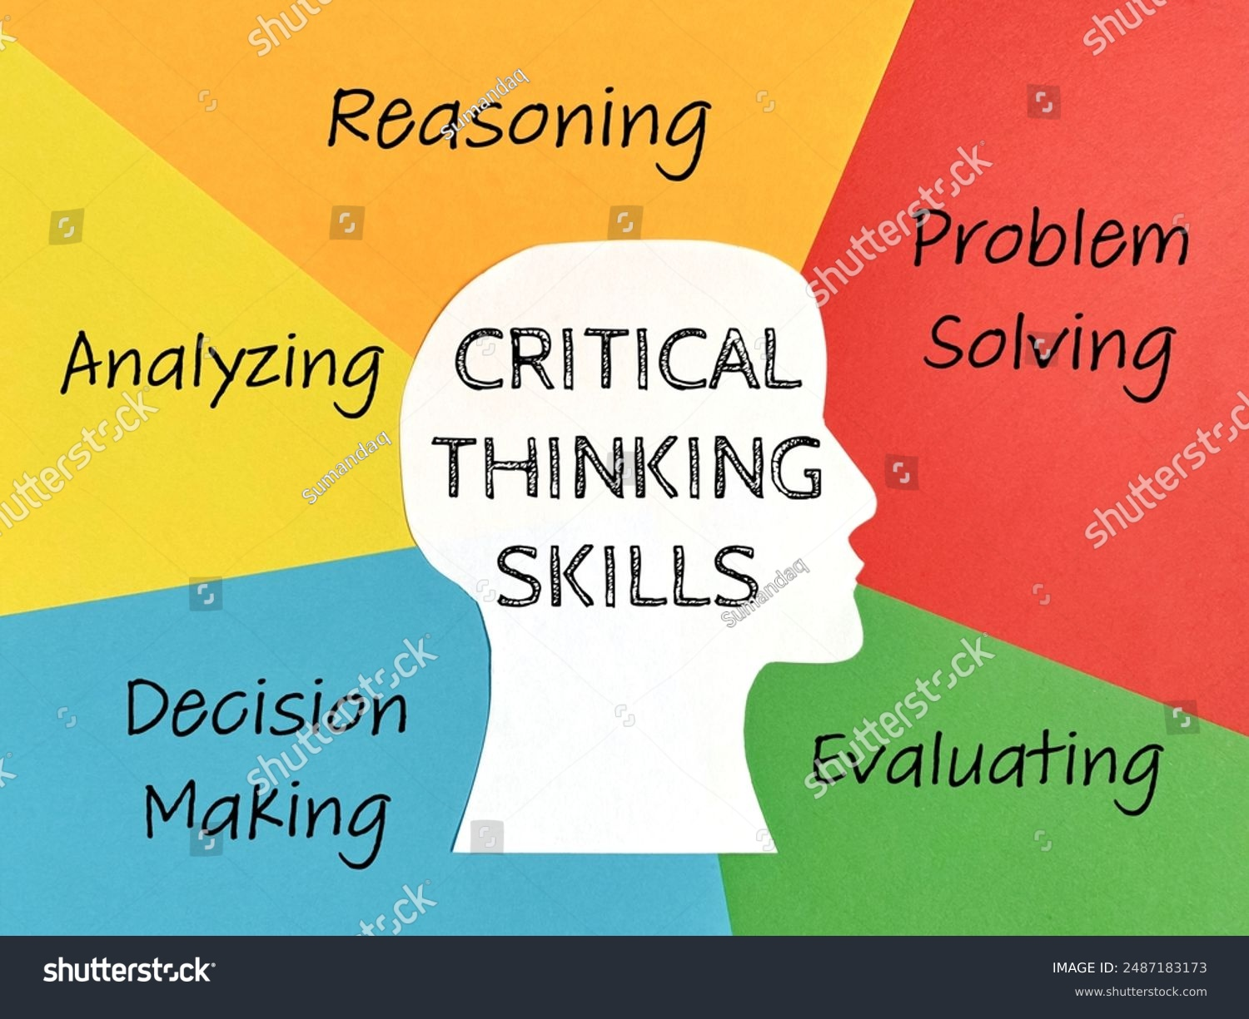
What is Critical Thinking?
Critical thinking is the ability to analyse, evaluate, and interpret information objectively. Moreover, Critical thinking involves purposeful, self-regulatory judgement (Facione, 1990).
Involves questioning assumptions and avoiding bias and Supports evidence-based decision-making
Finally, it includes skills such as reasoning, reflection, and problem analysis and essential for dealing with uncertainty and complex patient needs.
Notes:
Bowlby (1969) proposed that children are biologically predisposed to form attachments with caregivers because these relationships support survival and emotional security.
These early interactions shape internal expectations about how relationships function.
Attachment theory is useful in health and social care because it helps professionals understand how family relationships and life events can influence emotional development and well-being (Cassidy & Shaver, 2016).

Slide 5
Importance in Professional Practice
Critical thinking, accordingly to Papathanasiou et al. (2014) is essential for safe and effective nursing practice. Also, critical thinking can:
Improves clinical decision-making and reduces errors
Enhances patient safety and quality of care
Supports evidence-based practice
Enables professionals to respond effectively to complex or unexpected situations
Encourages accountability and professional judgement
Notes:
Attachment theory suggests that children develop internal working models based on their experiences with caregivers (Bowlby, 1969).
If caregivers are responsive and supportive, children develop a sense of security and confidence.
These internal models influence emotional regulation, social interactions, and coping strategies throughout life (Cassidy & Shaver, 2016).

Slide 6
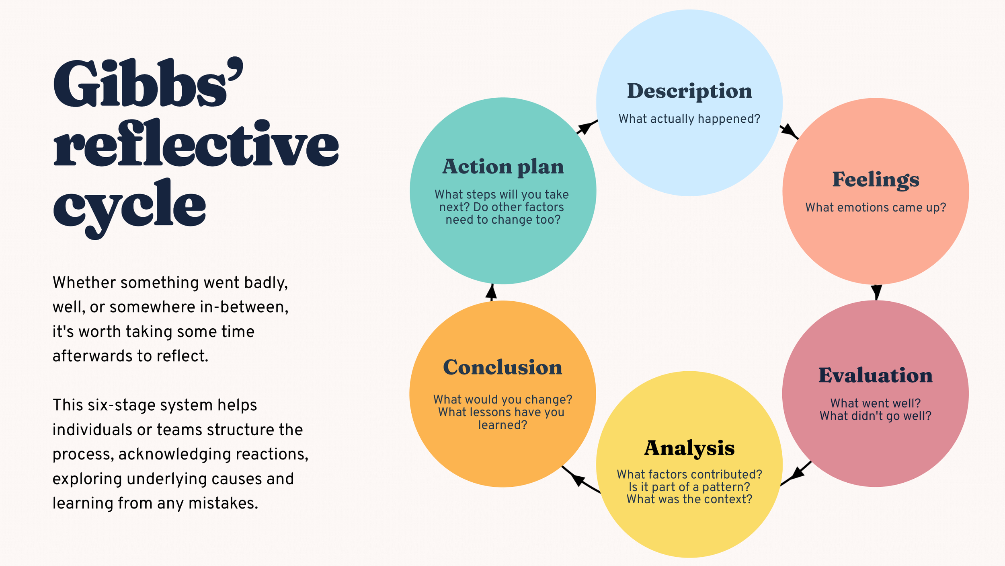
Model – Gibbs’ Reflective Cycle (1988)
The Gibbs’ reflective model encourages practitioners to learn from experience and improve future practice. (Gibbs, 1988).
Notes:
Ainsworth et al. (1978) developed the Strange Situation experiment, which identified different patterns of attachment behaviour in children.
These patterns reflect how children respond to separation from caregivers and how they seek comfort when distressed.
Although attachment patterns form early in life, later experiences and supportive relationships can influence emotional development and resilience.

Slide 7
Application of the Model
Applying this model in the health and social care setting will:
Helps practitioners break down clinical situations logically
Encourages deeper understanding of decisions made
Promotes continuous professional development
Supports identification of what went well and what could improve
Links theory to practice through structured reflection
Notes:
Attachment theory helps explain how Jenny’s experiences may affect her emotional wellbeing.
The loss of a parent can disrupt feelings of security and stability (Bowlby, 1980).
In addition, caring responsibilities may limit Jenny’s ability to focus on her own developmental needs, such as forming peer relationships and exploring independence.
These pressures may increase stress, anxiety, and emotional fatigue.

Slide 8
Practical Example (Health and Social Care Setting)
A healthcare assistant observes that a patient’s condition is deteriorating (e.g., increased confusion and abnormal vital signs).
Using critical thinking:
practitioner questions whether this is normal or a sign of deterioration
Reviews observations and compares with baseline data
Communicates concerns to a nurse or senior staff member
Takes appropriate action based on evidence and observation
Using Gibbs’ Cycle: Reflects on the situation afterwards by analysing the decision-making process and identifies improvements for future responses.
Notes:
Biological factors also influence psychological development. Prolonged stress can activate the body’s stress response system, potentially affecting emotional regulation and mental health (Shonkoff & Garner, 2012).
Young carers may experience fatigue and stress due to balancing school, home responsibilities, and emotional demands

Slide 9
Relevance to Future Career
Critical thinking will support safe decision-making in clinical practice
Essential for handling high-pressure situations
Improves ability to work independently and within multidisciplinary teams
Enhances professional confidence and competence
Required for career progression in health and social care roles
Notes:
Environmental influences such as family circumstances, social support, and educational environments also shape development.
Young carers may face social isolation or reduced opportunities for peer interaction.
However, supportive relationships and community services can reduce stress and improve resilience (Cassidy & Shaver, 2016).

Slide 10
Conclusion
Critical thinking is a vital skill that underpins safe, effective, and professional practice in health and social care. By enabling practitioners to analyse situations, evaluate evidence, and make informed decisions, it directly contributes to improved patient outcomes. The use of models such as Gibbs’ Reflective Cycle further strengthens this skill by encouraging structured reflection and continuous learning. Developing strong critical thinking abilities is therefore essential for both current practice and future professional growth.
Notes:
A whole‑family approach is often recommended when supporting young carers.
Assessing Jenny’s needs can ensure she receives appropriate support.
Reducing her caregiving burden and strengthening family relationships may improve her emotional well-being.
Peer support groups and school adjustments can also help Jenny balance education with her responsibilities.

Slide 11
References
Facione, P.A. (1990) Critical Thinking: A Statement of Expert Consensus for Purposes of Educational Assessment and Instruction. California: The Delphi Report.
Gibbs, G. (1988) Learning by Doing: A Guide to Teaching and Learning Methods. Oxford: Oxford Polytechnic.
Papathanasiou, I.V., Kleisiaris, C.F., Fradelos, E.C., Kakou, K. and Kourkouta, L. (2014) ‘Critical thinking: The development of an essential skill for nursing students’, Acta Informatica Medica, 22(4), pp. 283–286.

