Slide 1
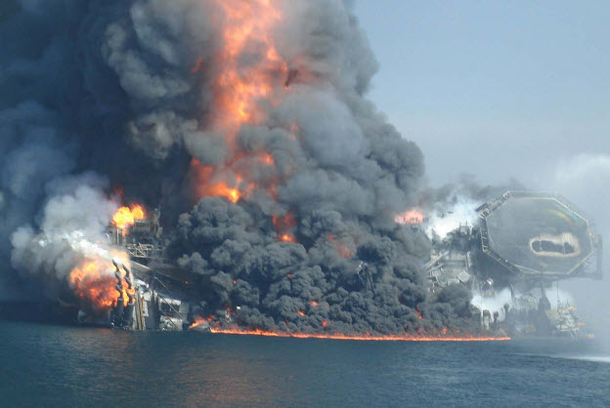
BP DEEPWATER HORIZON
STEVE GRIFFITHS AND DR CAROLINE JAWAD
2020
Notes:
What happened? There was a large explosion and fire; the rig burned and sank after three days; and oil flowed for 87 days. Sadly, the families heard the news first from media reports and secondly and later from BP, who did not at the time have an active crisis management plan. The deaths are 10% of the workforce: 1 would be unacceptable: it is a tragedy that the bodies of the eleven men were never recovered from the site. The rescued workers were forced to sign “silence” waivers before they landed ashore and went to hospital for treatment or saw their families.

Slide 2
2010: Explosion, fire, rig sank 36 hours later
11 deaths and 17 serious injuries out of 126 workers
Notes:
What happened? There was a large explosion and fire; the rig burned and sank after three days; and oil flowed for 87 days. Sadly, the families heard the news first from media reports and secondly and later from BP, who did not at the time have an active crisis management plan. The deaths are 10% of the workforce: 1 would be unacceptable: it is a tragedy that the bodies of the eleven men were never recovered from the site. The rescued workers were forced to sign “silence” waivers before they landed ashore and went to hospital for treatment or saw their families.

Slide 3

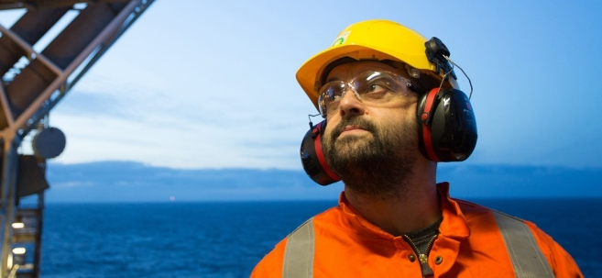
BP Safety Policies
“Everything we do depends on the safety of our operations, our workforce and the communities around us”.
“We strive to create and maintain a safe operating culture, putting safety front and centre of everything we do”

Slide 4

Immediate aftermath…
Human cost of deaths and injuries
Environmental impact: pollution of natural resources, sea and wildlife – seabirds and fish, plants
Capping of well and clean up of rig area
Economic impact Loss of businesses in Gulf of Mexico, fishing, tourism
www.npr.org
Notes:
Who was responsible for the explosion, fire, deaths and injuries? In a multi layered operation this was not initially clear. If this wasn't clear, no wonder there were delays and problems with taking responsibility for compensation for deaths and injuries, clean up operations and capping the well, and dealing with the environmental impact. The first mention on BP’s website said there was a fire and they would support Halliburton in their work, two days later. The situation was compounded by no national regulations, state regulations and self-regulations only. Only the Clean Water Act applied nationally.

Slide 5
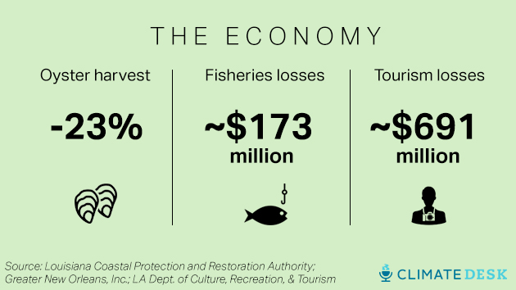
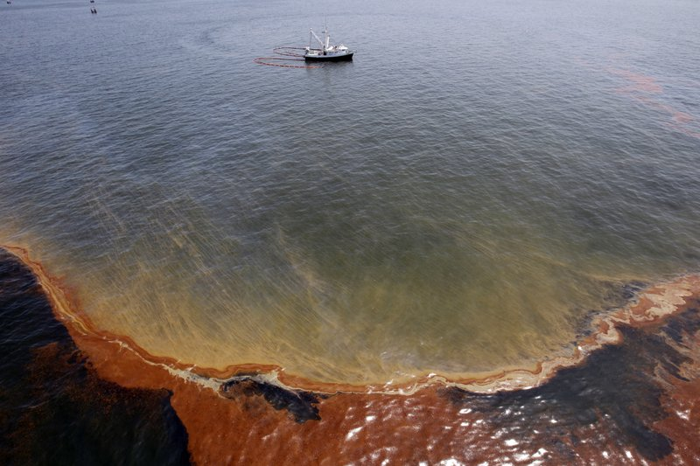
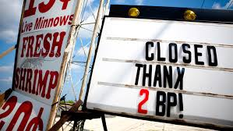
The resulting effect on the area…

Slide 6
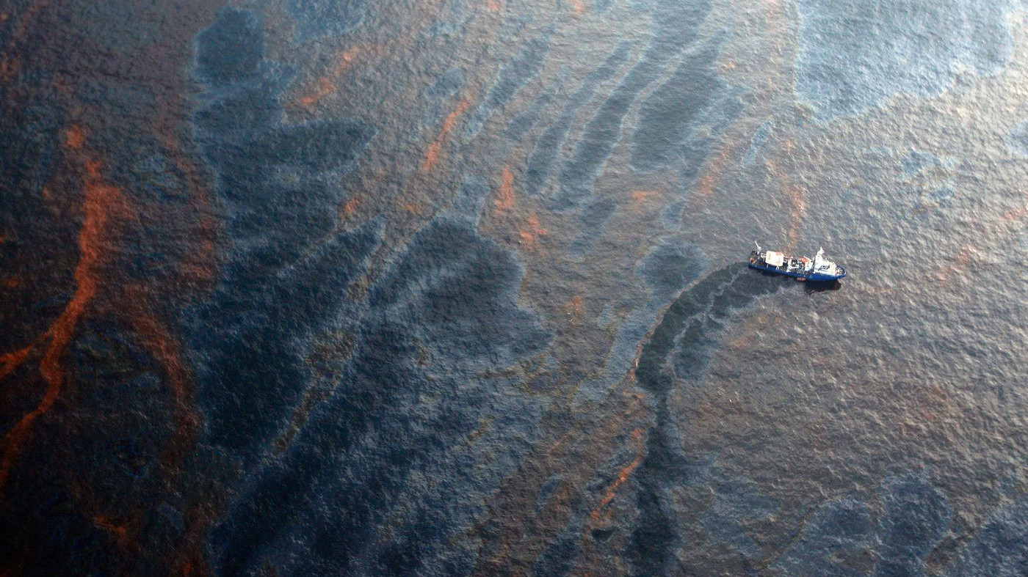

Slide 7
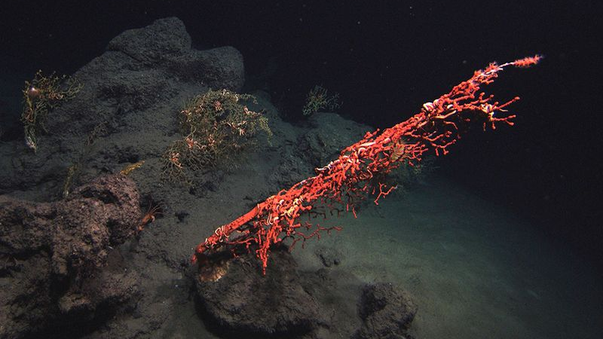

Slide 8
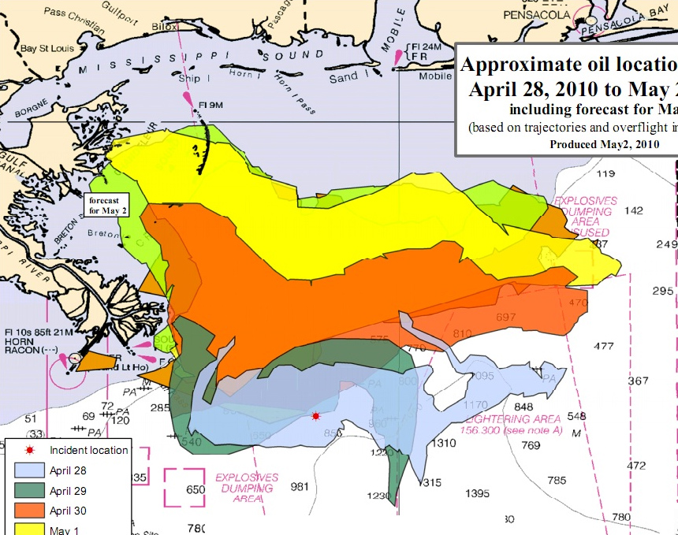
BP Accident Report September 2010
Report looked at factual evidence and process of what happened
Did not look at ethical issues around what went wrong
Blamed multiple failures by different organisations , eight key factors identified
Notes:
Issued six months after the explosion, BP’s report looked primarily at the technological failures which led to the explosion; it also stated the Transocean rig crew did not recognise the pressure test failure and the influx of gas, until it was too late. There was no mention of the power loss which led to the geopositioning of the dynamically positioned rig being lost; this was a major factor in the well losing oil and not being capped. Further explanations of these failures and BP’s response will be analysed in the report.

Slide 9
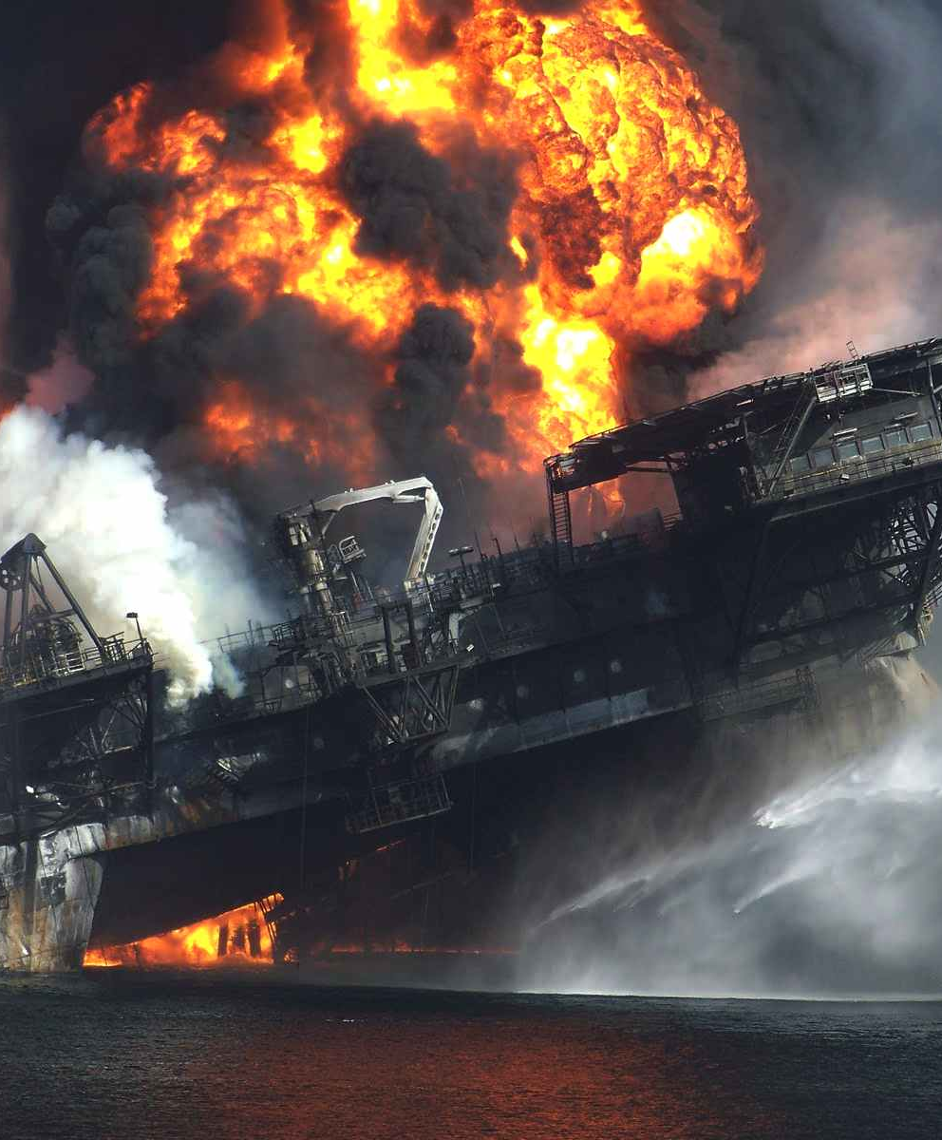
Deepwater Horizon Study Group
“This disaster was preventable had existing progressive guidelines and practices been followed. This catastrophic failure appears to have resulted from multiple violations of the laws of public resource development, and its proper regulatory oversight.”
The blowout and oil spill on the Deepwater Horizon in the Gulf of Mexico was caused by a flawed well plan that did not include enough cement between the 7-inch production casing and the 9 7/8-inch protection casing.
Notes:
Amongst many other groups issuing reports are the Deepwater Horizon Study Group, a world wide collaborative partnership of 55 experts from the Centre for Catastrophic Risk Management with expertise in petrochemicals, testing, offshore drilling, offshore risk and deepwater working; they concluded that whilst one failure alone in the process would not have led to the catastrophe, the combination of factors which led to the explosion was preventable and should not have happened.

Slide 10
Media coverage of these varied in stance
Wall Street Journal: concerned with value of companies
The Guardian: focused on environmental and human cost
Financial Times: focused on the share prices
Local press (NOLA, Picayune Times): Updates on legal cases, fundraisers, clean up operations
Scientific American: long term environmental impacts

Slide 11

Emotive coverage on social media https://www.emaze.com/@AFCZFOOT/Oil-Spill

Slide 12

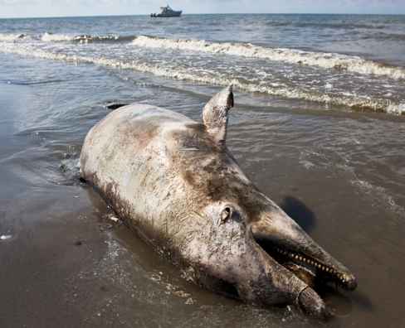

Slide 13
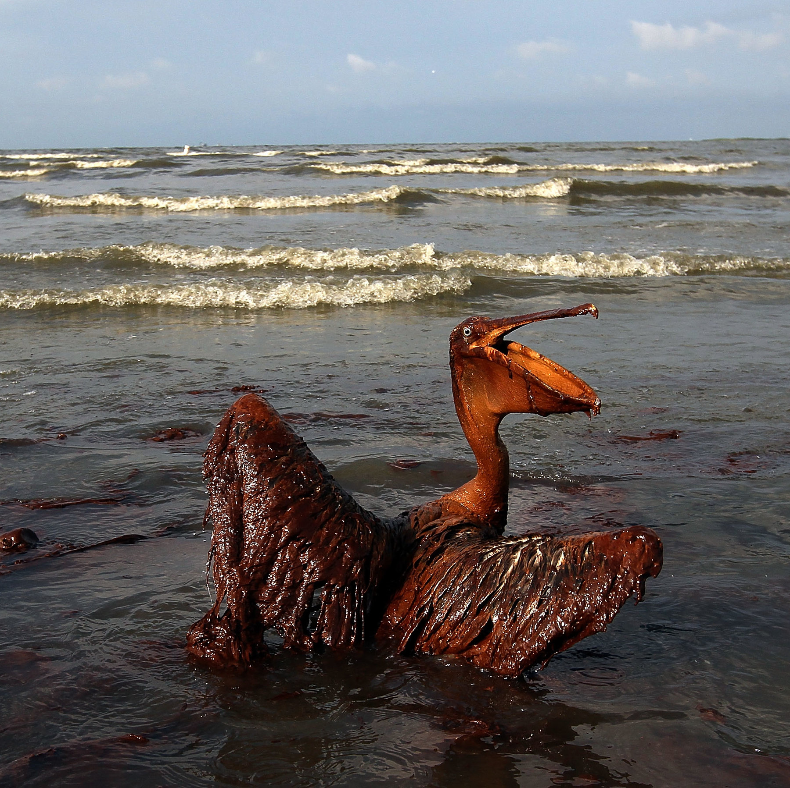
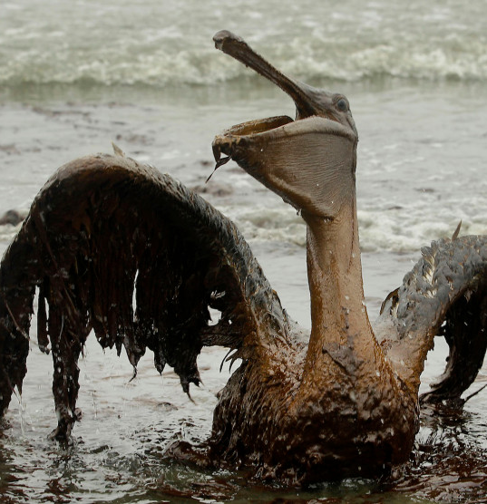

Slide 14
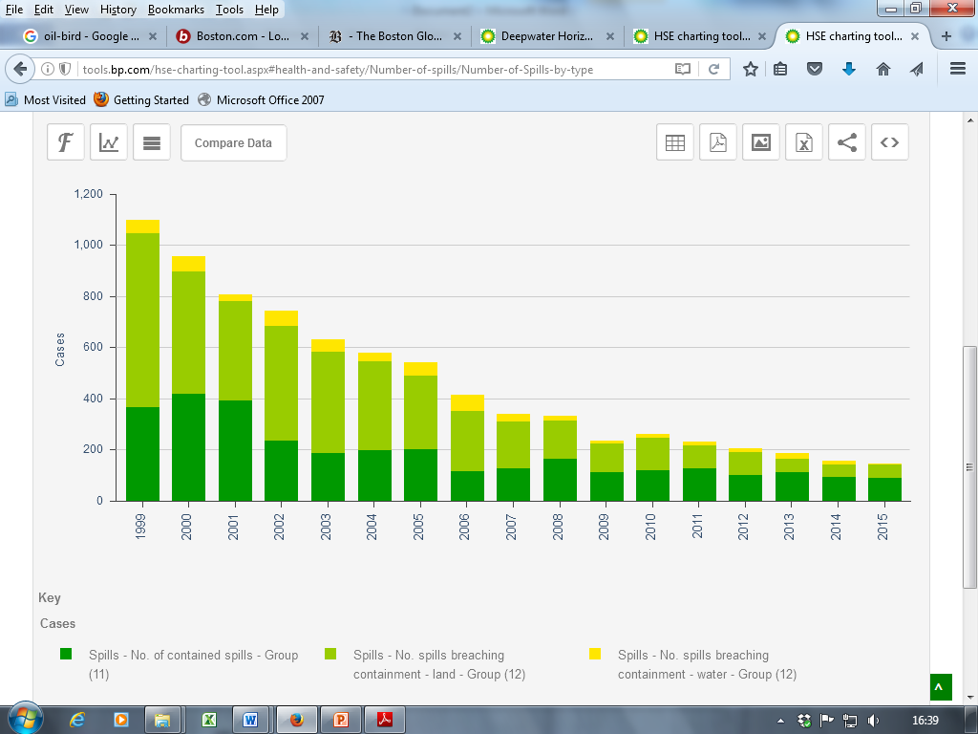
In the greater picture…
Notes:
BP publish data for environmental, health and safety, greenhouse gases. Their webpage allows anyone to view figures and appears to be transparent and accessible. The results allow a user to build comparison between the data, but onscreen are limited to two elements. The data does show a fairly consistent fall in spills and fatalities since 1999 but for an event such as happened where deaths occur, this remains an area to be addressed. The amount of oil spilled does not correlate to the number of spills, as media reports show, with a lesser number of spills with a larger volume. If you try to add the volume to the number to compare, there is a data error message! If compared separately the scale on the graphs is different and creates an impression that the volume is less.

Slide 15
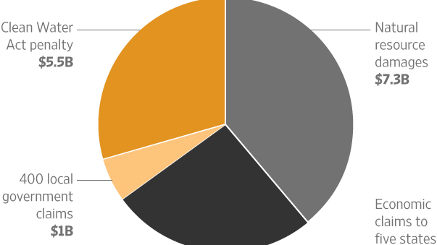

Slide 16
FRIEDMAN AND BP DEEPWATER HORIZON
Friedman a company should not have any "social responsibility" to the public or society because the only concern for the management is to increase profits for itself and for its shareholders.
Notes:
The stockholder theory by Milton Friedman is a normative business ethics theory related to the corporate social responsibility of a company. It is a theory about the corporation and its moral purpose and responsibilities of the company (Martin and Mertens, 2013). The theory describes businesses as a mere arrangements by which a group of people mainly the stockholders, offer capital to another group, the managers which the managers use to achieve specified aims set by the stockholders in response stockholders receive an ownership interest for bearing the associated risks.” It is just a contractual agreement in which both the parties the stockholders & the managers have entered voluntarily. The agreement describes the responsibilities and obligations to the both contractual partners. Executives requires to acts as agents in part of the stockholders. They have been empowered to manage the money advanced by the stockholders. Not in all cases the purpose of the business necessarily needs to earn profit for the stockholders, other goals are also common, but the main concern of the stockholder theory of Milton Friedman is profit-maximization (Martin and Mertens, 2013).
In his stockholder theory Milton Friedman allowed Executives to spend their personal funds anyway they see worthy of for any charitable funds or project that they think will socially beneficial. Friedman appreciated them as a private citizen, but when functioning as an executive for corporations they are acting as an agent of the stockholders and are bound not to use business resources except for the purposes they are authorized for by the stockholders (Martin and Mertens, 2013).
Milton Friedman took the shareholder approach to the social responsibility. In This approach Milton Friedman tried to show the shareholders as the economic engine of the company and the only group to which the company must be socially responsible. As discussed earlier, the goal of the firm according to Milton Friedman’s’ stockholders theory is to maximize profits and return a portion of those profits to shareholders as a reward for the risk they took by investing in the firm (Senge, 2008).
Milton Friedman in his theory of stockholder advocates that the shareholders should be given the authority to decide what social initiatives they need to take part rather than making the decision by their appointed executive, who they are appointed for business purpose.
Friedman also urged that a company should not have any "social responsibility" to the public or society because the only concern for the management is to increase profits for itself and for its shareholders and that the shareholders will be in full authority to make decision regarding social responsibility (Stern, 2007).
In this theory Milton Friedman states that companies concern for the community rather than for profits, would leads them to totalitarianism.
In his book, Friedman wrote "There is one and only one social responsibility of business to use its resources and engage in activities designed to increase its profits so long as it stays within the rules of the game, which is to say, engages in open and free competition without deception or fraud."
Many argued with the stockholder theory offered by Milton Friedman saying it inconsistent with the concept of corporate social responsibility which they said comes at the cost of the stakeholder. Following example can be considered as a logical point by the opponent of the Milton Friedman stockholder theory (Senge, 2008). If a company donating to help victim got hurt in a natural disaster like cyclone, in any way which is may not be considered as an action in the best interest of the shareholder. Not considering the scenario Friedman would suggest that shareholders themselves be given the authority to decide how much and to whom they want to donate. Some other argue that goods & services provided to the society at any crisis moment build further allegiance between customer & the corporation and meet the stockholder theory's requirement through a different mechanism (Senge, 2008).
So far The Friedman doctrine deemed to be controversial. In her book Naomi Klein's a left-wing social activist book she criticizes the theory, saying that most of citizens become sufferer with huge wealth in the hand of corporate elites (Senge, 2008).

Slide 17
Restrictions on the limitations on profit maximisation
Rules of the game - open and free competition without deception or fraud - a set of side-constraints on profit-maximization
  Social norms
  Ethical customs
  Law in the society that the business functions within

Slide 18
And so
‘No question’ that BP is responsible not only for its neglect of safeguards that could have prevented the spill, but also for the incompetent, secretive, coercive, and litigious manner in which it has handled the spill’s aftermath (Stolyarov, 2010).

Slide 19
BP
BP admitted to “photoshopping” official photos that they had posted on their website to illustrate efforts to respond to the disaster as well as to ease the public relations stranglehold on the company and its workers (Hough, 2019).

Slide 20
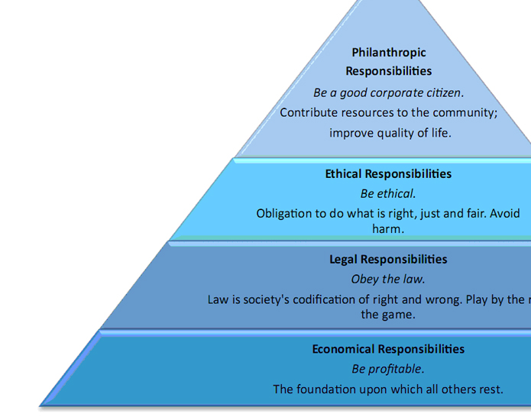
Corporate Social Responsibility
Peter Mather, BP Head of UK "We balance our responsibilities to our employees, shareholders and the communities in which we operate.“
“We strive to be… a responsible corporate citizen”
Notes:
Yet compared with this, BP are a founder member of the World Bank Development Partnership and operate to an apparently philanthropic level of CSR, funding life skills and partnership working in South America, and health and literacy in Indonesia. In the UK they partner the National Opera House, the British Museum, and the National Portrait Gallery giving £7.5m over 5 years. Actors in the Royal Shakespeare Company made a high profile objection in the autumn when Mark Rylance said BP are not philanthropic and not ethical, and withdrew from acting with the RSC whilst BP sponsorship was in place. In Carroll’s pyramid, whilst all elements are valid, BP appear to be philanthropic although using Petrick and Quinn’s model, with irresponsible responsiveness.

Slide 21
Freeman and BP
Freeman’s ideas suggested that considering the needs of stakeholders is essential to a firm’s long-term success and not a benevolent additional ‘add-on.

Slide 22
BP stakeholders and communications channels
Employees & families | Internal media communications; meetings, surveys,
Sub-contractors | Contracts, meetings, media communications
Customers and suppliers | meetings, contracts, media communications
Media | Press releases, conferences, interviews and social media
Shareholders | Annual and financial reports, meetings,
Government, National and Local (State) | Advocacy and lobbying; consultation meetings
Industry | Collaborative projects
NGOs and INGOs | CSR and associated communications
Local communities | Consultations and meetings, communications by media and social media
Notes:
There is a wide variety of stakeholders, both internal and external: communications means vary for all groups: communications through regular reports and meetings occur, CSR with a wide range of outreach projects is given prominence, a new code of conduct was published 2014. The primary objective is to remain profit maximising, but there is an increasing message in the communications relating to citizenship and sustainability, and green energy. Whilst the outward face is ethical and open towards employees, media reports suggest otherwise: a Taylorist attitude to production management.

Slide 23
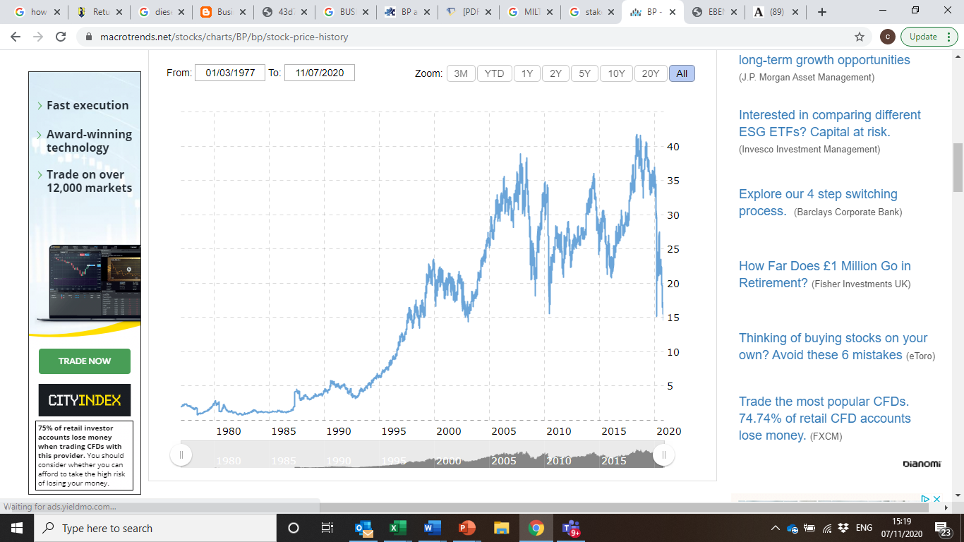

Slide 24
Impact on stakeholders
Deepwater Horizon damaged organisation reputation and incur direct costs which deeply affect shareholder value.
Developing a strong corporate image is important for BP if it is to reach its long-term goals.
BP executives have the paradoxical challenge of balancing the needs of shareholders with imperative CSR related expenditure.

Slide 25
Deontology
Deontology is commonly understood as rights or duty-based ethics. This means that the consequences of an action are not considered in the decision-making process.
Kant stated that everyone has an innate moral sense, and that this sense should be coupled with reason to develop a “categorical imperative” that allows us to make decisions based on good will and a sense of duty, without regard for the consequences of our actions (Dombrowski, 2000, p. 47–48). Kant also points out two guiding principles concerning duty-based ethical reasoning: that we should treat decisions as if they would become universal laws, to be abided by everyone, everywhere, regardless of the consequences (Geirsson & Holmgren, 2010, p. 157) and that we should always treat human beings (including ourselves) as ends, never as means to an end (Geirsson & Holmgren, 2010, p. 161).
Notes:
Deontology is commonly understood as rights or duty-based ethics. This means that the consequences of an action are not considered in the decision-making process. Kant stated that everyone has an innate moral sense, and that this sense should be coupled with reason to develop a “categorical imperative” that allows us to make decisions based on good will and a sense of duty, without regard for the consequences of our actions (Dombrowski, 2000, p. 47–48). Kant also points out two guiding principles concerning duty-based ethical reasoning: that we should treat decisions as if they would become universal laws, to be abided by everyone, everywhere, regardless of the consequences (Geirsson & Holmgren, 2010, p. 157) and that we should always treat human beings (including ourselves) as ends, never as means to an end (Geirsson & Holmgren, 2010, p. 161). One approach to deontological ethics that is appropriate in considering BP’s actions is rights-based theory. Rights-based theory holds that an agent (the person/thing performing an action) has the duty to “respect the moral rights of all morally considerable recipients (the person/thing with moral standing receiving the action)” (Kernohan, 2012, p. 85) when making decisions. Moral standing, of course, depends on the situation in cases of environmental impact and the rights of animals. However, fellow human beings have moral standing, unless decision makers are operating under an ethical egoism lens. Kernohan describes this lens of ethical theory as, “[…] the theory that people should always act in their own self-interest, that they are morally obligated to do what is best for themselves” (p. 41). Under ethical egoism, an actor or moral agent acts in his or her own self-interest above all els

Slide 26
BP and Deontology
Deontological ethics considering BP’s actions is that the person/thing performing an action has the duty to “respect the moral rights of all morally considerable recipients” (Kernohan, 2012, p. 85) when making decisions.
Morally perhaps in the situation in cases of environmental impact and the rights of animals.
In which case, the case study is not ethical in a deontological doctrine.

Slide 27
And
Under a deontological lens, BP would likely be accused of acting unethically in releasing manipulated photos as means to ease the media and the public’s inquiry into their clean up and response efforts in the wake of the oil spill.
Also difficult to argue that they believe that their actions should be or could be considered universal law, and therefore morally right.
BP also acted unethically in consideration of Kant’s second guiding principle: that recipients of actions should be treated as ends rather than means to an end.

Slide 28
Teleology
Teleology is the consequences of an action or decision constitute whether the action or decision was good or bad.
Utilitarianism is that a decision is right or good if it creates the “maximum aggregate amount of utility.”
In which case, the case study may be ethical in a teleological doctrine.
If the end of an action can be considered good and right regardless of the nature of the means required to achieve such an end, then BP may have acted ethically. However, this conclusion is still problematic in that there is no way to truly and accurately deem such an objective good or right.
Is the end money ?
Notes:
Consequentialist ethical theory almost exactly opposes that of deontology. Actors operating under consequentialism believe that the consequences of an action or decision constitute whether the action or decision was good or bad. Kernohan (2012) writes that subjective consequentialism, or utilitarianism, “claim[s] that the intrinsic value which we ought to maximize pertains to the actual mental states of recipients” (p. 57) and that a decision is right or good if it creates the “maximum aggregate amount of utility.” This becomes problematic when decision makers attempt to define what constitutes utility. To solve some of these issues, utilitarianism is split into two subcategories, but even these subcategories are somewhat problematic. One subcategory of utilitarianism is preference-satisfaction utilitarianism, which values actions that satisfy “desires and wants” of recipients (p. 57). When compared to Kant’s two guiding principles, there is a stark difference between deontology and consequentialism: not only would the actor not act as if his/her actions would become universal law (because every consequence, and therefore every decision, would undoubtedly vary), but the consequentialist lens dictates that the ends justify the means. In other words, it does not matter how you reach a “good” objective, because any means of reaching that objective are ethically acceptable.

Slide 29
The way forward: legal, governance, technical, environmental and human
Changes to national and state regulation
Changes to company codes and response protocols
Changes to guidance on whistleblowing
Technical changes to ensure no procedure can be overridden
Better tests on technical items at depth and pressure

Slide 30
State of Alabama Oil and Gas Laws and Regulations
http://www.gsa.state.al.us/ogb/ogb.html [online] accessed 27 November 2016
BBC News Mark Rylance 'snubs' RSC in BP sponsorship row
http://www.bbc.co.uk/news/entertainment-arts-37501105 [online] accessed 21 November 2016
BP Sustainability Section: Safety Policies http://www.bp.com/en/global/corporate/sustainability/safety/safer-drilling.html [online] accessed 20 November 2016
Campbell, R & Kitson, A (2008) The Ethical Organisation 2nd Edn Basingstoke: Palgrave McMillan
Deepwater Horizon Study Group Final Report
http://ccrm.berkeley.edu/pdfs_papers/bea_pdfs/dhsgfinalreport-march2011-tag.pdf [online] accessed 20 November 2016
National Geographic http://news.nationalgeographic.com/2015/04/150420-bp-gulf-oil-spill-safety-five-years-later/ [online] accessed 30 November 2016
Rigzone (Oil and Gas Industry online resource)
http://www.rigzone.com/news/oil_gas/a/146875/Deepwater_Horizon_Movie_Recounts_Several_Safety_Missteps [online] accessed 30 November 2016
Wall Street Journal Halliburton to Pay Alabama http://www.wsj.com/articles/halliburton-to-settle-deepwater-horizon-claims-for-1-1-billion-1409664524 [online] accessed 22 November 2016
Bibliography and References
Notes:
References include academic sources (books and journals) for theory; websites for legislation and regulation, organisation reports and policies; online news reports. Some webpages have been removed although the links come up when searched for possibly due to legal issues. That ends the presentation, thank you.

