Slide 1
Remote sensing and imaging
Lecture 1
Introduction
Prof. Nik Whitehead

Slide 2
Teaching Sessions
The teaching sessions for this class will be:
  Monday 9-11 (IQ004)
  Monday 2-4 (IQ108)
  Tuesday 9-11 (IQ004)
  Thursday 9-11 (IQ004) except for Thursday September 27th
  Friday 11-3 (IQ108)
The weeks for these classes are:
  September 24th – 28th
  October 2nd – 6th
  November 6th – 10th
  November 13th – 17th

Slide 3
aims
This module provides students with a comprehensive and systematic understanding of the capabilities and technologies of modern remote sensing and imaging systems. The student’s technical skills will be developed to allow them to select appropriate systems for given case studies, to identify any operational issues that might negatively affect an operations project, and to identify workable solutions to these problems.

Slide 4
Learning outcomes
At the end of the module students should be able to:
Demonstrate a sound understanding of the capabilities of modern remote sensing and imaging systems;
Demonstrate a sound understanding of the technologies underlying modern remote sensing and imaging systems;
Critically discuss the operational issues encountered by users of modern remote sensing and imaging systems;
Evaluate, select and apply appropriate technologies and techniques to meet the requirements of an operations project.

Slide 5
assessment
Two assessments
Assessment 1 (Assignment – 70%)
  The assignment will consist of a one practical-based report on the building and evaluation of small scale engineering project. This type of assessment allow topics to be studied to a greater depth and gives students’ time for reflection. Coursework (1 x 2500 words equivalent).
Assessment 2 (Examination – 30%):
  The examination will be used to assess the student’s understanding of the underlying theory, and their ability to apply that knowledge appropriately.

Slide 6
Indicative content
Lenses and optics suitable for optical, lidar and radar systems
IR/UV signatures, stealth
Aerial vs. Satellite imaging; advantages and disadvantages
Advanced image analysis diagnostic techniques (such as cross and auto correlation) through the use of appropriate software application
Imaging technologies; accuracy, resolution and distortion
Real-time data acquisition; high-speed digital video, video tracking
Applications of remote sensing and imaging

Slide 7
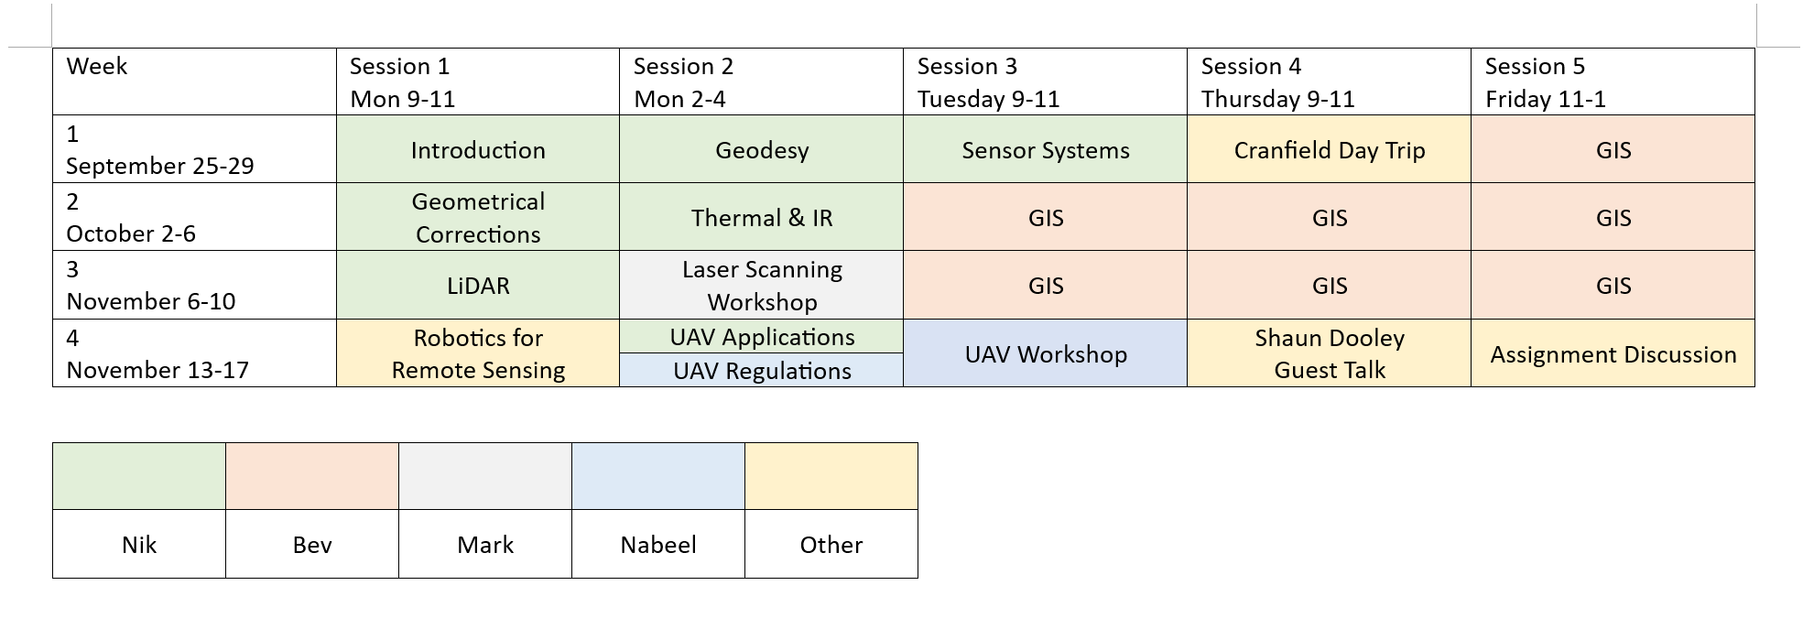
Organisation
No extra software is needed for the majority of this module, but the GIS section will use QGIS (an Open Source Geographical Information System - https://www.qgis.org/en/site/

Slide 8
Summary
Topics covered
  Historical background
  Remote sensing process
This background provides a context for the next section, which will look at imaging systems

Slide 9
Introduction
Human beings are very effective image processing machines
  A picture paints a thousand words ☺
This module will focus on a specific subset of images
  Overhead perspective from aircraft and satellites
  Unfamiliar scales and resolutions
  Use of multiple regions of the electromagnetic spectrum

Slide 10
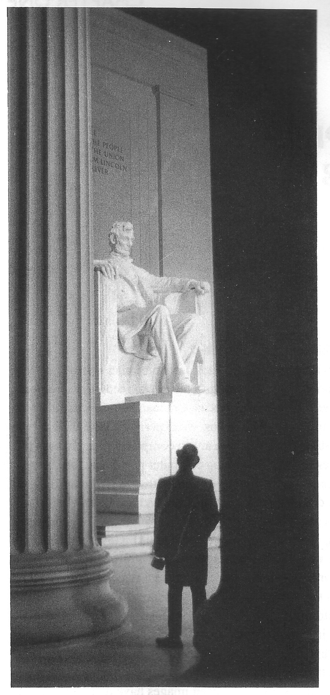
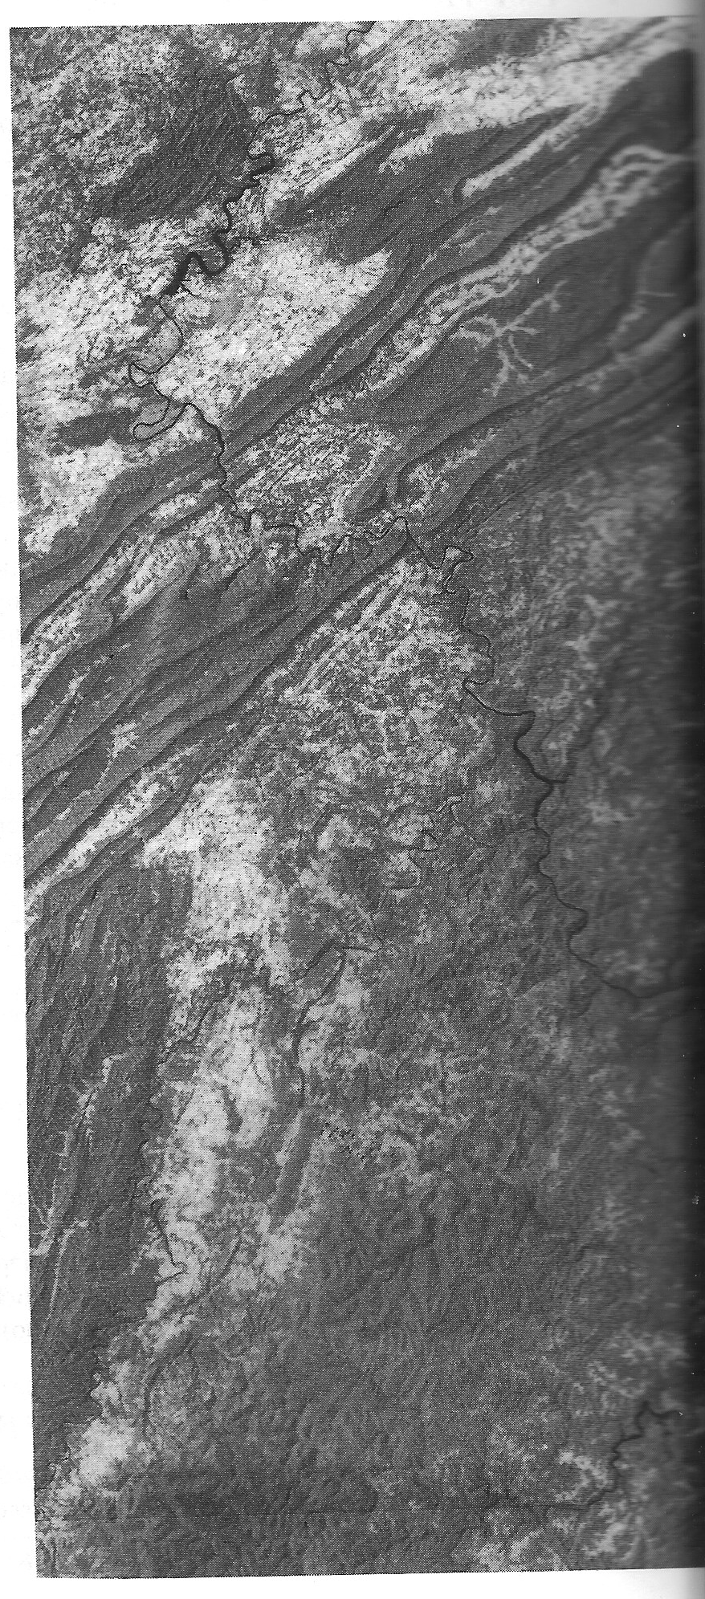
Visual Interpretation of images
Both images are shown using a limited spectral range but we can still extract information from them
  Relative positions
  Relief
  Detail
With extra contextural knowledge a much deeper understanding of the image is possible

Slide 11
Definition
Remote sensing has been defined as:
  … [T]he acquisition of physical data of an object without touch or contact
  …[T]he observation of a target by a device separated from it by some distance
  …[R]econnaissance at a distance
For the purposes of this module we will define remote sensing as
  The practice of deriving information about the earth’s land and water surfaces using images acquired from an overhead perpective, using electromagnetic radiation in one of more regions of the electromagnetic spectrum, reflected or emitted from the earth’s surface

Slide 12
Brief history
1800 – Herschel discovers infrared light
1839 – Development of photography by Daguerre
1850-1860 – Photography from balloons
1909 – Photography from aircraft
1914-18 – Aerial reconnaissance
1920-1930 – Further development of aerial photography and photometry
1939-1945 – Non-visible portions of EMS used for aerial reconnaissance; specialised training for personnel involved in the acquisition and interpretation of aerial images
1954 – First flights of U2 spy plane

Slide 13
Brief history
1956 – Colwell’s work on plant disease detection with IR photography
1960-1970 – First use of term ‘remote sensing’; TIROS weather satellite; Skylab remote sensing observations from space
1964 – Operational debut of the SR-71
1972 – Launch of Landsat 1
1970-1980 – Advanced in digital image processing; introduction of CCD sensors
1980-1990 – New generation of Landsat satellites and sensors; development of hyperspectral sensors
1990s – Global remote sensing systems
2001 – First release of Google Earth as Keyhole

Slide 14
Exercise
Remotely sensed images are not the same as maps
  List ways in which these differ
  List advantages and disadvantages for each
  List some tasks for which one is more useful than the other

Slide 15
Remote sensing process
What kind of information do we need to perform effective remote sensing?
Physical features
  Geology, forestry, soil science, urban planning…
Sensor data
  Pictorial images, data arrays
Extracted information
  Context is essential
Applications
  Depends on the field of study – same data, different uses
  Land use, geology, hydrology, vegetation, soils, military, GIS…
Physical Features
Sensor Data
Extracted Information
Applications

Slide 16
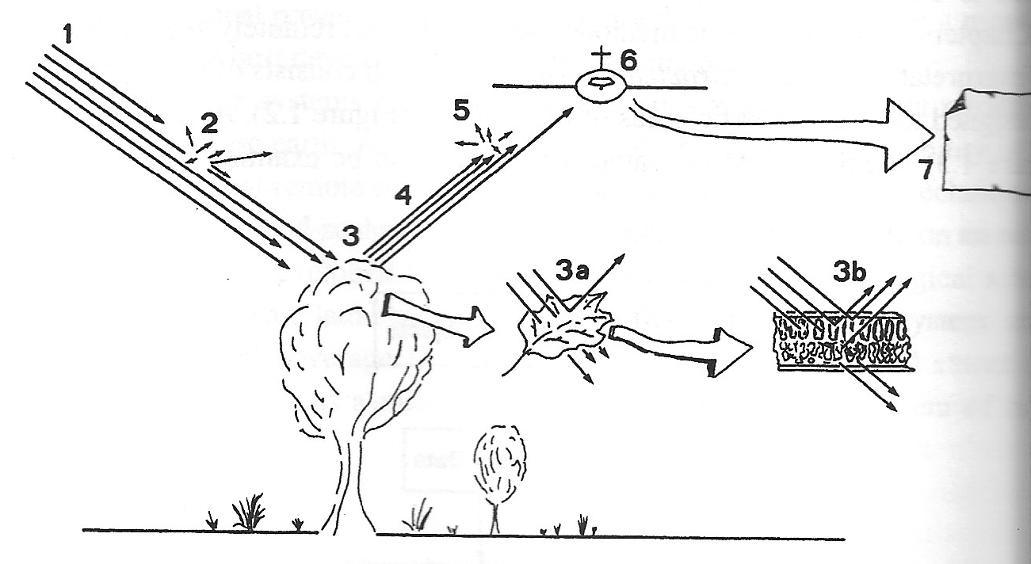
Remote sensing process
1: Light is emitted by the sun (broad spectrum)
2: Light is scattered by dust and water in the atmosphere
3: Light is reflected by a tree
  3a: Most reflection is done by the leaves
  3b: The reflected colour depends on the leaf composition

Slide 17
Remote sensing process
4: Reflected light travels back towards the sensors
5: Some light gets scattered by dust and water
6: Reflected light is picked up by the sensors
7; Reflected light is converted into digital form for storage and further processing

Slide 18
Remote Sensing Process
In order to correctly interpret the data collected, we must understand the effects that each of these elements have on the images produced
Physical Features
  Broad spectrum of radiation (red, green, blue plus UV& IR)
  The solar energy must pass through the atmosphere before reaching the reflector and is attenuated by scattering
  Blue light is scattered more than green or red light
  The nature of the reflecting surface changes the light – trees absorb red and blue light but reflect green and IR light
  Energy reaching the camera lens will have been further attenuated by scattering before reaching the detector

Slide 19
Remote Sensing Process
In order to correctly interpret the data collected, we must understand the effects that each of these elements have on the images produced
Sensor Data
  Energy recorded by a camera lens is very different to the sunlight that enters the atmosphere
  Some of the blue light will have been scattered by the atmosphere and will not have been reflected by the earth’s surface
  Blue, green, red and IR will be present in very different proportions to those intercepted by the canopy
  The detector will display these different types of radiation in different colours, which may or may not be their actual colours (IR has to be shifted to the human visual spectrum)

Slide 20
Remote Sensing Process
In order to correctly interpret the data collected, we must understand the effects that each of these elements have on the images produced
Extracted Information
  Data is converted into information through the process of image interpretation or image analysis
  A skilled individual or trained computer system studies the image to identify, for example, timber types and forest damage
  This requires a lot of implicit knowledge – knowing that certain trees lose their leaves in winter, for example
  This knowledge can be geographically limited – crop types grown in the UK are not necessarily grown in Ukraine

Slide 21
Remote Sensing Process
In order to correctly interpret the data collected, we must understand the effects that each of these elements have on the images produced
Applications
  Applying remote sensing data to practical problems normally requires links to political, topographical, geological or hydrological data
  This is now normally done within the context of a Geographical Information System or GIS, e.g. Google Maps/Google Earth
  This allows the analysis of relationships between different kinds of data that have been matched to each other using geocodes, allowing layers of information to be stacked on top of each other

Slide 22
Exercise
Given a satellite shot of Swansea, what sort of implicit knowledge might be needed to analyse it?
https://www.google.co.uk/maps/@51.6255141,-3.9655064,5374m/data=!3m1!1e3

Slide 23
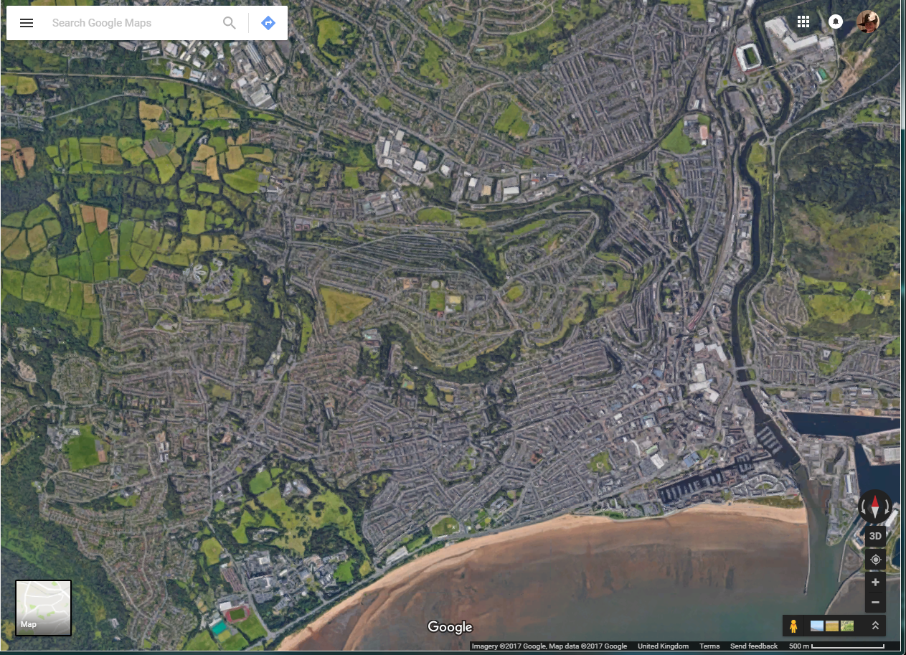

Slide 24
Key Concepts
There are several key concepts and technical terms that need to be defined and discussed before we go into detail on the tools and techniques of remote sensing
Spectral Differentiation
  Remote sensing depends upon observed spectral differences in the energy reflected or emitted by targets
  Multispectral remote sensing considers the different responses at different wavelengths to define a ‘spectral signature’ for a target feature
  This spectral signature may change over time but still be useful to identify an object
    Corn has a different spectral signature when it is planted to when it is ripe, but it is still possible to differentiate it from the spectral signature of wheat

Slide 25
Key Concepts
There are several key concepts and technical terms that need to be defined and discussed before we go into detail on the tools and techniques of remote sensing
Radiometric Differentiation
  Identifying objects on a remotely sensed image depends on differences in brightness of features in the image
  There must be enough contrast in brightness and the remote sensing instrument must be capable of recording this contrast
  The sensitivity of the recording system in therefore important
  The inherent contrast between features and their backgrounds are also very important
    Think of the differences between photographs taken in full daylight, at dusk, or at night

Slide 26
Key Concepts
There are several key concepts and technical terms that need to be defined and discussed before we go into detail on the tools and techniques of remote sensing
Spatial Differentiation
  The minimum area that can be separately recorded determines the spatial detail – the resolution – of the image
  This is influenced by both the lens system and the sensor used (film or CCD)
  Zoom in enough to an image and it will appear pixelated – the size of the individual pixels defines the resolution of the image, e.g. 1m
  High-resolution imagery is generally taken from aircraft while low-resolution images are taken by satellites
  Some landscapes vary greatly in their spatial complexity – parts can be clearly represented at coarse levels of details but other parts may require high resolution

Slide 27
Key Concepts
There are several key concepts and technical terms that need to be defined and discussed before we go into detail on the tools and techniques of remote sensing
Geometric Transformation
  Every remotely sensed image represents a landscape in a specific geometrical relationship to the camera taking the image
  This is influenced by instrument design, operating conditions, terrain relief, instrument motion etc.
  Changes in perspective warp the image from the ideal flat ‘map’ view that we would like, and therefore we have to perform a variety of geometric transformations to overlay the image onto the map
  This is extremely important when trying to measure sizes and distances based upon remotely sensed images

Slide 28
Exercise
Satellite imaging provides many advantages over aircraft-borne sensors
List as many advantages as you can
What are the disadvantages

Slide 29
Coming soon
Next session: Geodesy
Homework: Read chapters 1 and 2 of Introduction to Remote Sensing by Campbell

