Slide 1


Knowledge and Information Management Skills for the Workplace
Study Case eBay and Deliveroo
Ricardo Alexandre
2025546
Knowledge and Information Management Skills for the Workplace
BMSW5106
Lecturer: Dr Oluwaseun Adegbite
November 7th, 2022

Slide 2


Table of Contents
Introduction
SWOT Analysis into eBay and Deliveroo
Critical evaluation of both organisations
Contributing system and micro environment
Recommendations
Conclusion
references
Similarities and Differences on both organisations
Notes:
Experiences and information are combined to create knowledge.

Slide 3
Introduction
In this presentation, we will analyse eBay's KMS and Deliveroo's KMS.
A discussion of the implementation of knowledge management systems by individual organisations will be presented.
In the conclusion, outline the key areas in which the Knowledge Management System needs to be improved. Two types of knowledge.
Swot analyses have been conducted on both companies.
Notes:
KM provides benefits to individuals, communities and organizations. For the individual, KM: Helps people do their jobs and save time through better decision making and problem solving. Builds a sense of community bonds within the organization. Enables organizations to better stay ahead of the competition. Develops a professional code of ethics that members can adhere to.

Slide 4
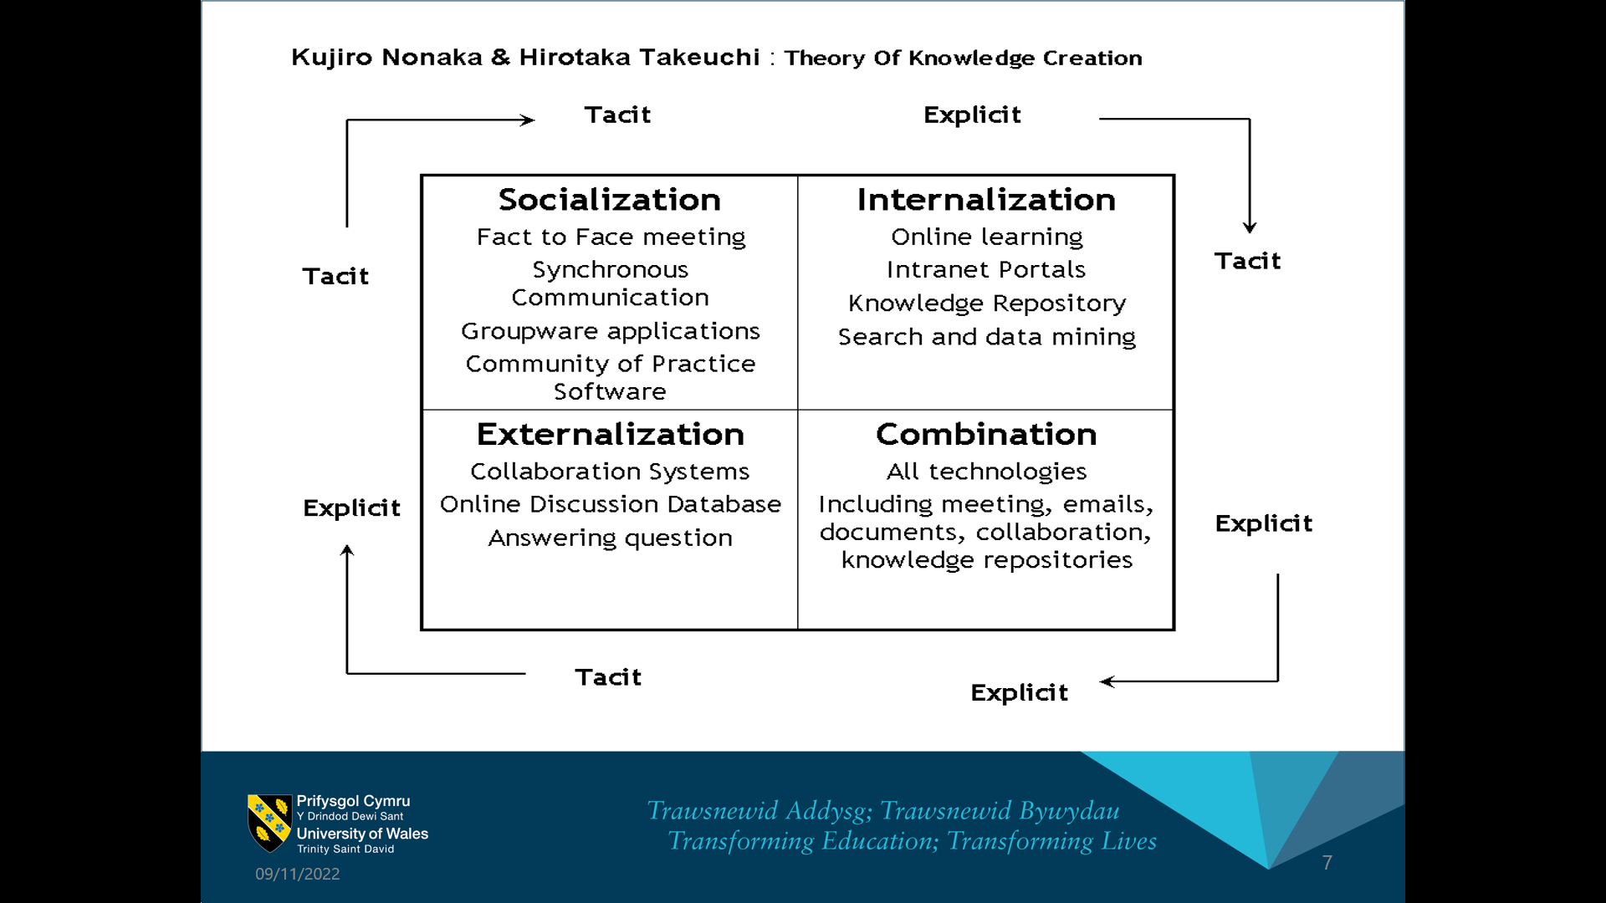
Two types There are two types of knowledge
Knowledge | Explicit | Tacit
It is possess: | Easily captured and | Beliefs Values
Experiences | Stored within documents | Difficult to elicit
Information | form of manuals, documents, procedures and database files. | To describe and record moments and we action.
Source: Demarest (1997).
Notes:
Tacit knowledge can be formed through a few different.
Factors such as:
perceptions,
beliefs,
values,
intuition and experience.
It is often stored in the form of manuals, documents, procedures and database files, which are written in a systematic
The way to ensure consistency and comprehensibility.

Slide 5
SWOT Analysis into eBay and Deliveroo
It is a critical tool for identifying such as:
Advantage and disadvantage
Internal
Strengths | Weaknesses,
Strong Product | Continuous Losses
External
Opportunities | Threats
Effective Marketing Update Website | Rise of Strong Competitors
Source: Leigh (2009).

Slide 6
Similarities and Differences on both organisations
Similarities
Differences
Orders online
Payment online
Delivery to door
Different suppliers
eBay:
Delivery groceries
Different platform of products
International products
Deliveroo:
Delivery food
Ordering local community
Local service
Source: Baker El-Ebiary et al. (2021), Galati et al. (2020).

Slide 7
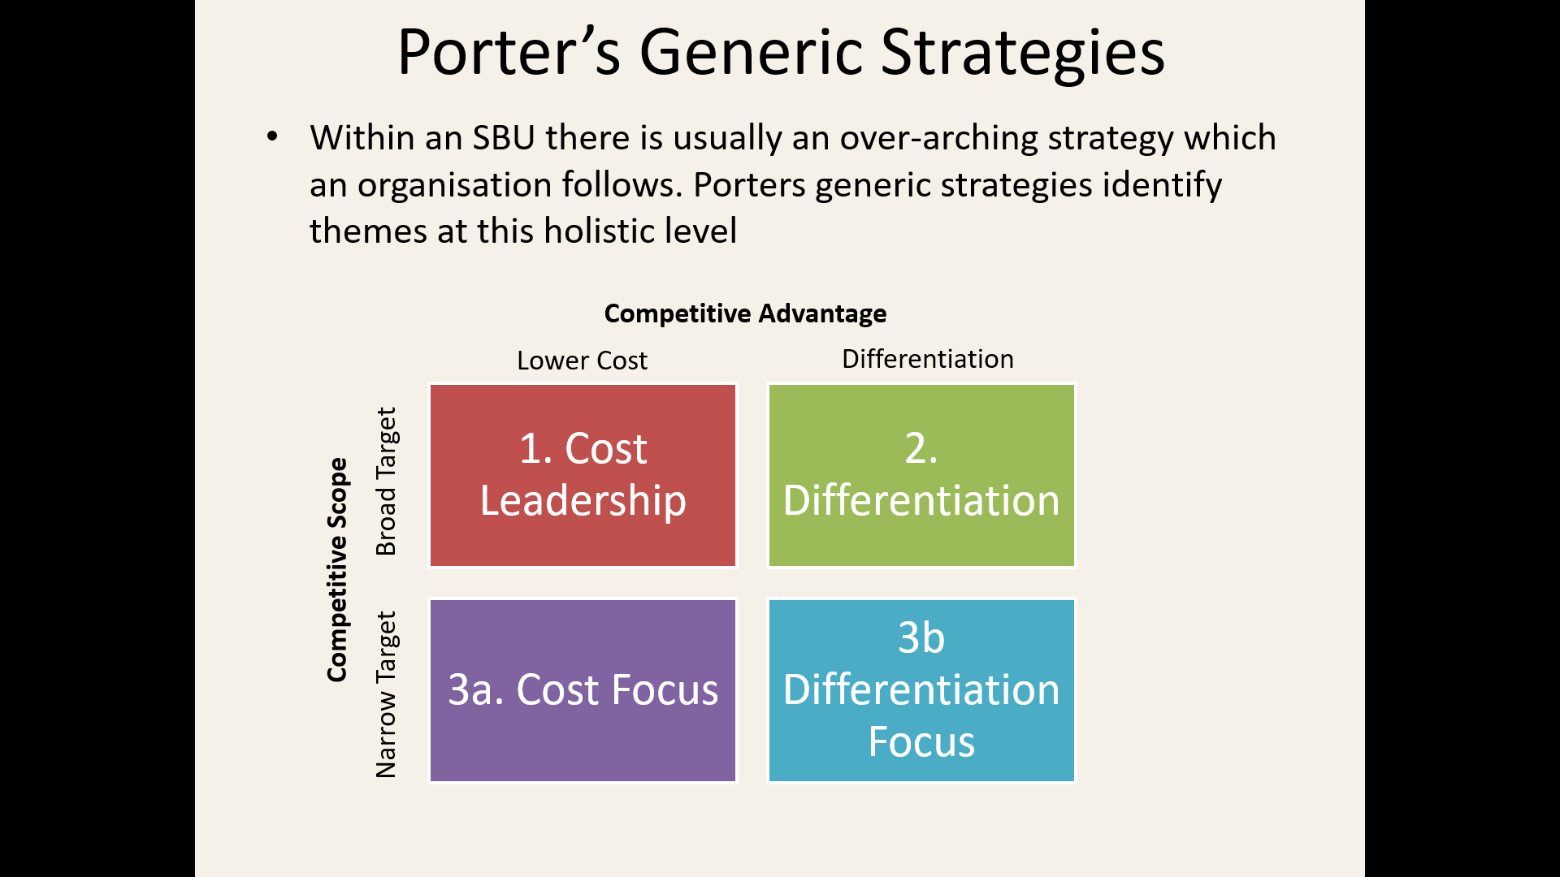
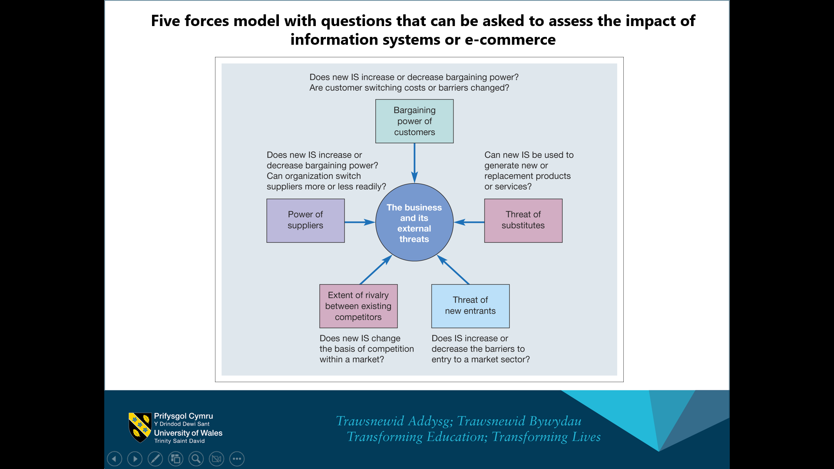
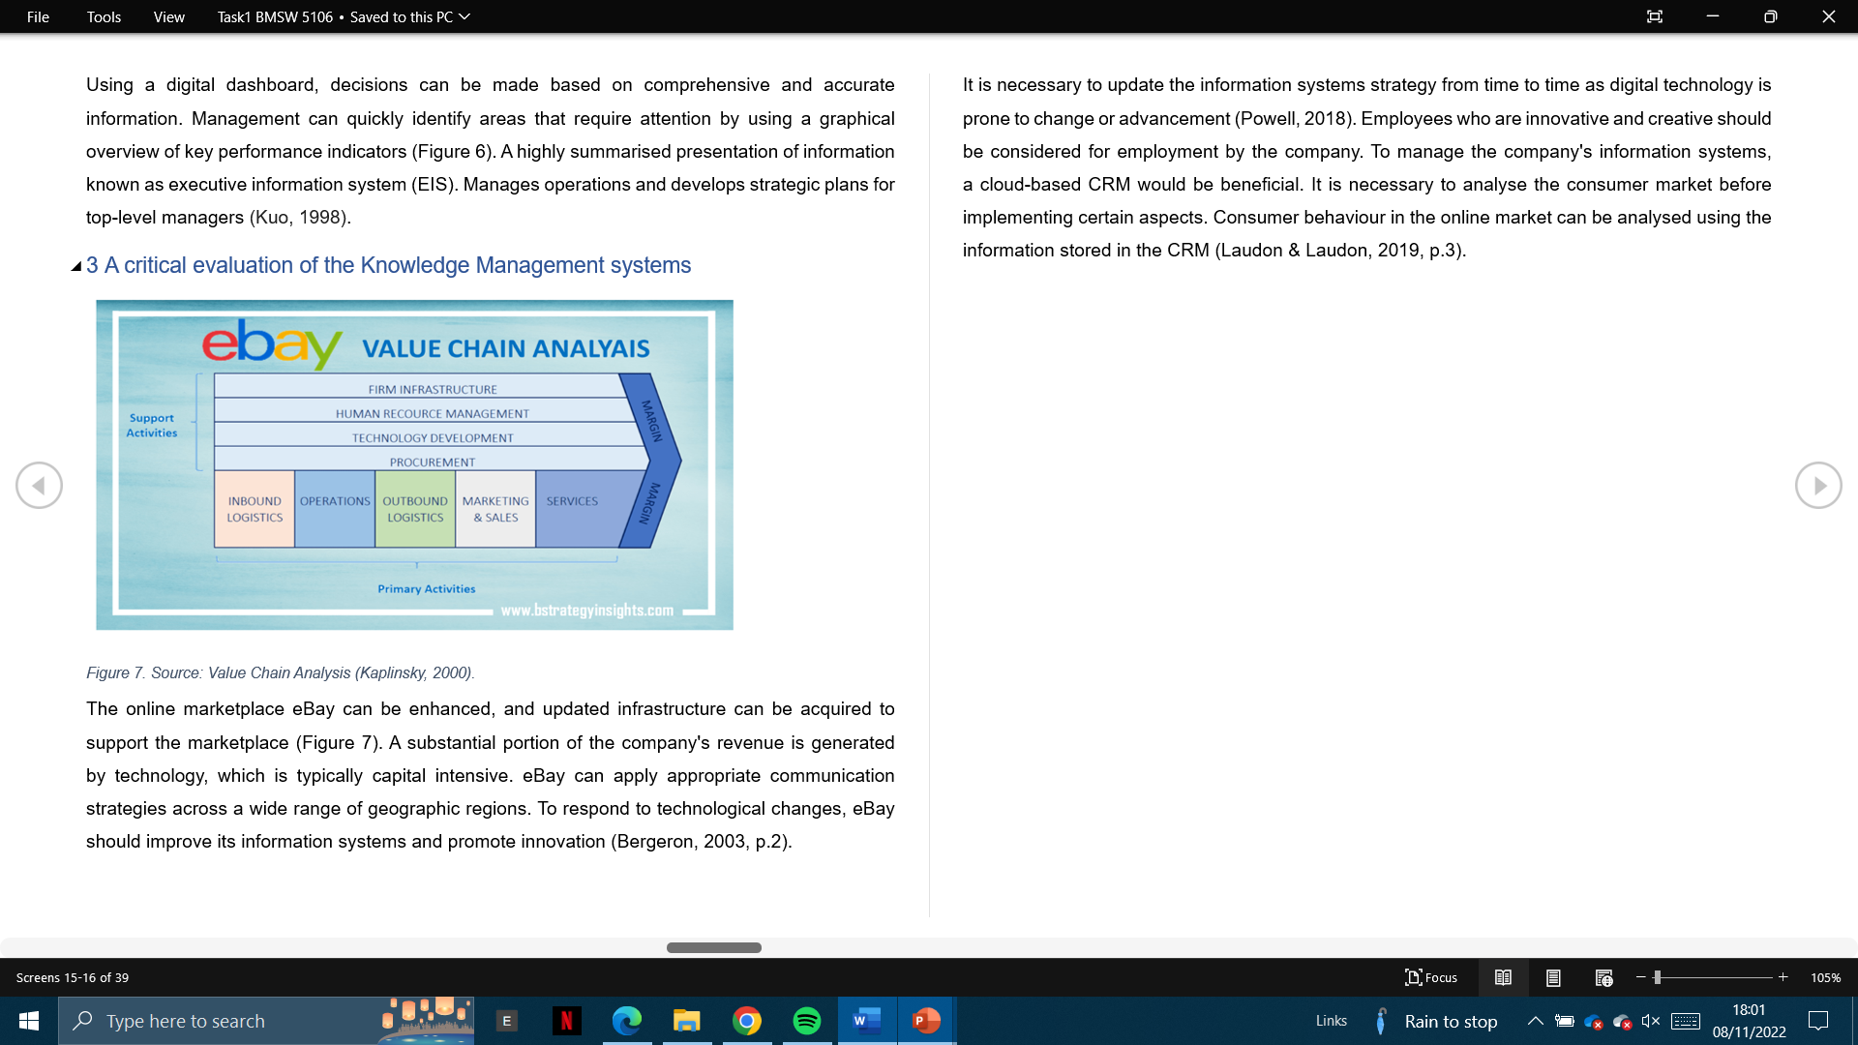
Critical evaluation of both organisations
Deliveroo:
Viability of the Marketplace.
eBay:
Online shopping worldwide.
Source: Porter (1985) , Kim et al. (2004), Porter (1980).
Notes:
A business information system is a group of interrelated components that work collectively to carry out input, processing, output, storage and control actions in order to convert data into information products that can be used to support forecasting, planning, control, coordination, decision making and operational activities in an organisation.
eBay Inc. is among the major players in the global e-commerce industry. The company's success represents strategic effectiveness in solving challenges in the online business environment. Some of the major challenges are identified in this Five Forces Analysis of eBay's online trading platform business. Michael E. Porter's Five Forces analysis model is an external analysis tool that identifies competitive forces and their intensities linked to business performance.

Slide 8
Contributing system and micro environment
Givers and receivers of knowledge
Giving knowledge requires the interest of the giver
By merging the gained knowledge with the acquired experience, the receiver becomes a giver
Functional Taxonomy and CBIS and APIs
Source: Mentzas (1994), Chen et al. (2012),

Slide 9
Recommendation
Knowledge Acquisition | Knowledge Retention | Knowledge Transfer
Creativity- Update website Voyage Estimating Decision Support System (DSS) | Stores CPU Executive Support System- (ESS) | Sharing-Services Transaction Processing System (TPS) Payroll (TPS)
Innovation- New Technology Enterprise System Package (ERP) Functional Taxonomy and CBIS | Protect Database Management Information System (MIS) Information System (IS) Relational database management system (RDBMS) | Exchange- Feedback Understanding Customer Experience (Demarest,1997). .
Competitive forces and their intensities associated with business performance can be identified by the Five Forces analysis model (Porter,1980).
Knowledge Management Life Cycle.
Source: Easterby-Smith & Lyles (2011), Bender et al. (2022), Payne et al. (1993).
Notes:
Back-office departments should reduce their expenses to preserve the service provided by the front offices. Employees who are innovative and creative are essential to the company's competitive advantage. The funding for eBay's information systems should be increased.
Company operations can be improved more effectively so that they are structurally superior to the competition. To meet the customer's needs, the company should provide a user-friendly and adaptive user interface. It is imperative that they continuously monitor the quality of food they provide as well as their quality of service.

Slide 10
Conclusion
eBay is one of the most popular online marketplaces in the United States and sharing deliver service with another's supplier as Amazon.
Deliveroo provides food delivery services online. Using an eCommerce value chain, a company can improve operational efficiencies and give the most value to its customers without incurring large capital expenditures.
Source: Baker El-Ebiary et al. (2021), Galati et al. (2020).
Notes:
What is knowledge management and why it’s important?
Organisations can foster a culture that helps people understand that sharing their knowledge makes them more relevant, not less.
What is Knowledge?
An individual's knowledge is a combination of their experiences and information.

Slide 11
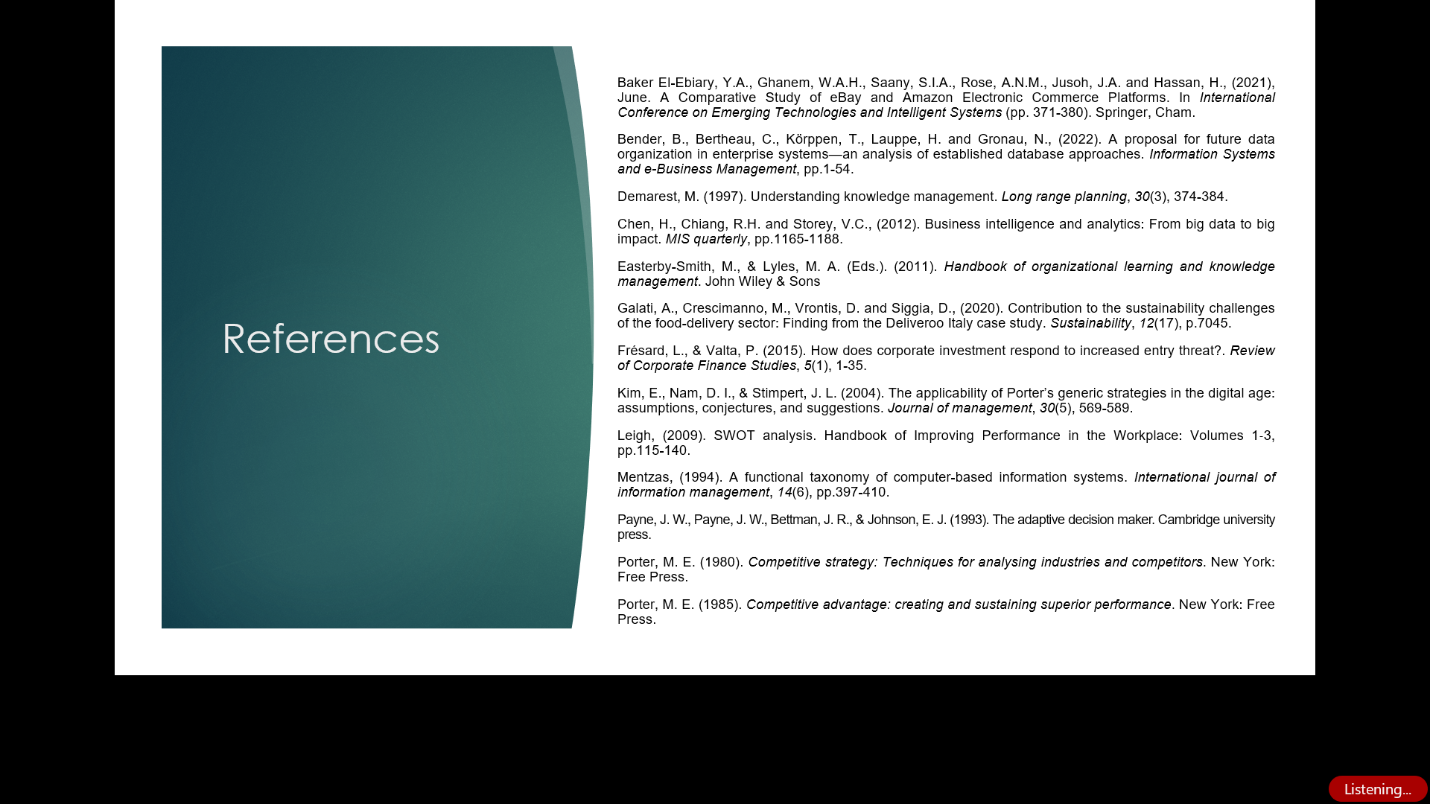
References

Slide 12
The end
Thanks for watching!
See you soon.

