Slide 1
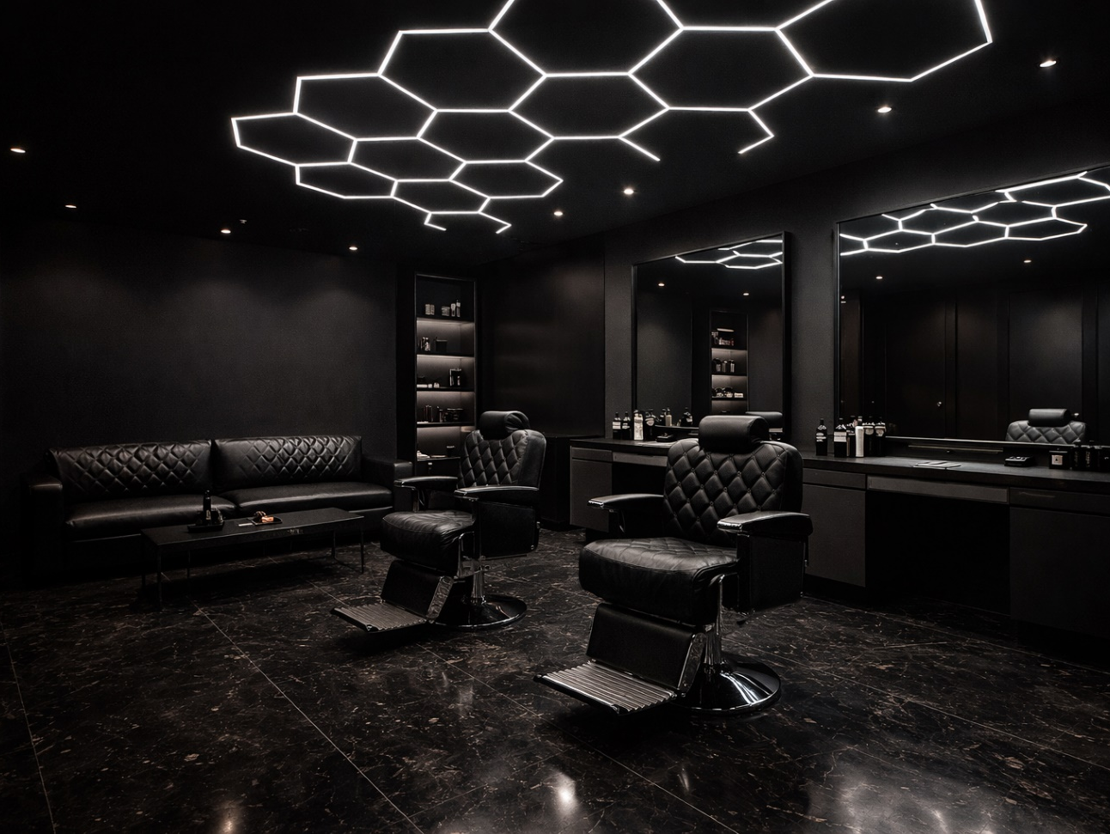

Premium Barber Shop – Nuneaton
Business Plan Presentation
Corneliu-Bogdan Dan
Student ID: 2310378
Entrepreneurship – LCBB5013
Lecturer: Fouziya Farheen
Source: AI-generated image created using ChatGPT (OpenAI, 2026).

Slide 2
Business Opportunity
UK men’s grooming market valued at £3–4 billion and growing steadily as male grooming spending increases (Mintel, 2023).
Haircuts represent a high-frequency service — most male customers require grooming every 2–4 weeks, creating predictable recurring revenue.
The barbering industry is dominated by independent SMEs, creating opportunities for new entrants with strong branding and service quality (ONS, 2023).
Market gap in Nuneaton for a barber shop positioned between budget barbers and luxury salons.
Opportunity to build a mid-premium barber brand delivering professional service, modern styling and consistent customer experience at competitive prices.

Slide 3
Business Concept
Appointment-based barber shop located in Nuneaton town centre, targeting working professionals and appearance-conscious men.
Provides modern haircuts, beard grooming and traditional hot towel shaves delivered in a professional environment.
Operates with a digital booking system to minimise waiting times and improve customer convenience.
Positioned as a mid-premium barber shop, offering higher service quality than budget barbers while remaining affordable.
Competitive strategy based on service differentiation rather than price competition (Porter, 1985).

Slide 4
Unique Selling Point
Premium grooming experience at accessible prices, delivering strong value for customers and a luxury experience.
Differentiation through service quality, including precision barbering and professional standards.
Appointment-based system designed to minimise waiting times and improve convenience.
Personalised grooming consultations enhancing customer satisfaction and service relevance.
High hygiene standards and comfortable environment supporting professionalism and trust.
Customer-experience-focused strategy aimed at building loyalty and repeat visits.
Strategic mid-premium positioning between low-cost barbers and high-end salons to target an underserved market segment.

Slide 5


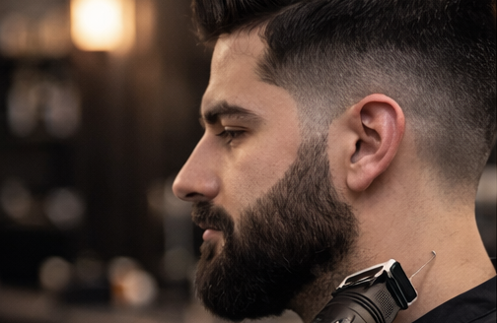
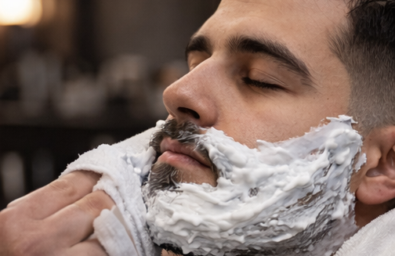
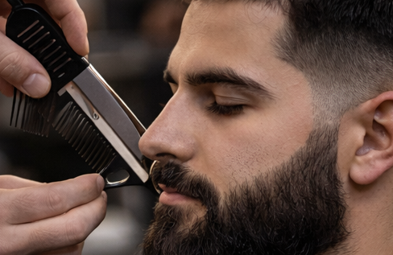
Products and Services
Core Grooming Services
Precision Haircuts (£18–£25)
Modern and classic styles including skin fades, tapers, textured crops and scissor cuts tailored to face shape.
Beard Grooming (£10–£15)
Professional beard trimming, shaping and line-ups using precision clippers and razors.
Traditional Hot Towel Shave (£15)
Luxury shaving service with hot towels, premium shaving creams and straight-razor finish.
Style Consultation
Personalized grooming advice to help clients maintain their hairstyle and beard between visits.
Retail Products
Premium Pomades and Styling Creams – for hold, texture and shine.
Beard Oils and Balms – moisturize the skin and promote healthy beard growth.
Hair Texture Powder – adds volume and long-lasting natural hold.
Retail products provide additional revenue streams and reinforce brand identity (Kotler & Keller, 2022).
Source: AI-generated image created using ChatGPT (OpenAI, 2026).

Slide 6
Local Market Insight
Local barber shops in Nuneaton typically charge £10–£15 per haircut, indicating strong price-based competition in the town centre.
Direct competitors include established local barbers such as Dandy Barbers, Hairy Monkey Barbers, and The BarberBlok, which provide traditional men’s haircuts and grooming services in the area.
Many of these competitors operate primarily as walk-in barbers, creating inconsistent waiting times and limiting service scheduling.
Indirect competitors include hair salons such as Glam Factory and other unisex hairdressers that also provide men’s haircuts.
Competition is high and switching costs are low, allowing customers to easily change barber providers.
A market gap exists between low-cost barbers and high-end salons, creating an opportunity for a mid-premium barber shop focused on service quality and experience.

Slide 7
Short and Long-Term Goal
Establish a recognised mid-premium barber brand in Nuneaton known for high service quality and professional standards.
Build a loyal and repeat customer base supported by appointment systems and strong customer relationships.
Achieve sustainable profitability through stable revenue growth and efficient operations.
Expand service capacity by increasing the number of barbers as demand grows.
Strengthen brand reputation through customer experience, reviews and social media presence.
Evaluate future expansion opportunities, including additional locations in nearby towns such as Bedworth or Hinckley.

Slide 8
Target Market
Demographic
Men aged 18–45 with moderate disposable income
Occupation
Students, young professionals, and skilled tradespeople who maintain a neat appearance for work or social image
Location
Nuneaton town centre catchment, including Bedworth and Hinckley residents working or studying in the area
Behaviour
Regular grooming habits, typically booking haircuts every 2–4 weeks
Prefer reliable appointments, minimal waiting times, and consistent service quality
Psychographic
Appearance-conscious customers who value professional presentation and convenience over the cheapest price

Slide 9
Competitive Advantage
Improved Competitive Advantage
Mid-premium pricing (£18–£22) positioned between low-cost barbers (£10–£15) and premium salons.
Appointment-based system improving time efficiency and eliminating long walk-in queues.
Consistent service quality through standardised haircut procedures and consultations.
Enhanced customer experience via professional environment, hygiene standards, and modern interior design.
Customer retention strategy using digital booking, reviews, and repeat-visit behaviour (Grant, 2022).

Slide 10
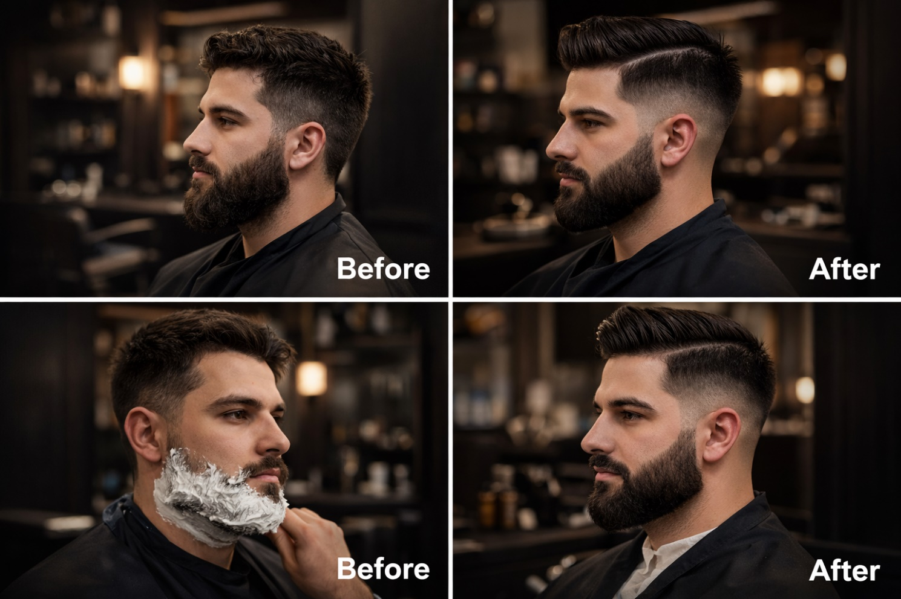
Marketing Strategy
4Ps of Marketing
Product
Precision haircuts, skin fades and beard grooming
Traditional hot towel shaves
Retail grooming products (pomades, beard oils)
Price
Mid-premium pricing strategy
Haircuts approximately £18–£22
Place
Town centre location in Nuneaton
Online booking for easy access and convenience
Promotion
Instagram and TikTok haircut content
Google reviews and local SEO
Referral incentives and loyalty programmes
(Chaffey and Ellis-Chadwick, 2019).
Source: AI-generated image created using ChatGPT (OpenAI, 2026).

Slide 11
Legal Structure
Structure
Private Limited Company (Ltd) registered with Companies House.
The business operates as a separate legal entity from its owner.
Why this structure?
Limited liability protection safeguards the owner’s personal assets.
Higher credibility with suppliers, lenders and customers.
Better growth potential, allowing future expansion or additional investors.
Clear separation between personal and business finances.
Legal and Regulatory Requirements
Register the company with Companies House and submit annual accounts.
Register for Corporation Tax with HMRC.
Obtain public liability insurance and employer’s liability insurance .
Comply with health and hygiene regulations for personal care services.
Follow employment law requirements for staff contracts, wages and workplace safety.

Slide 12
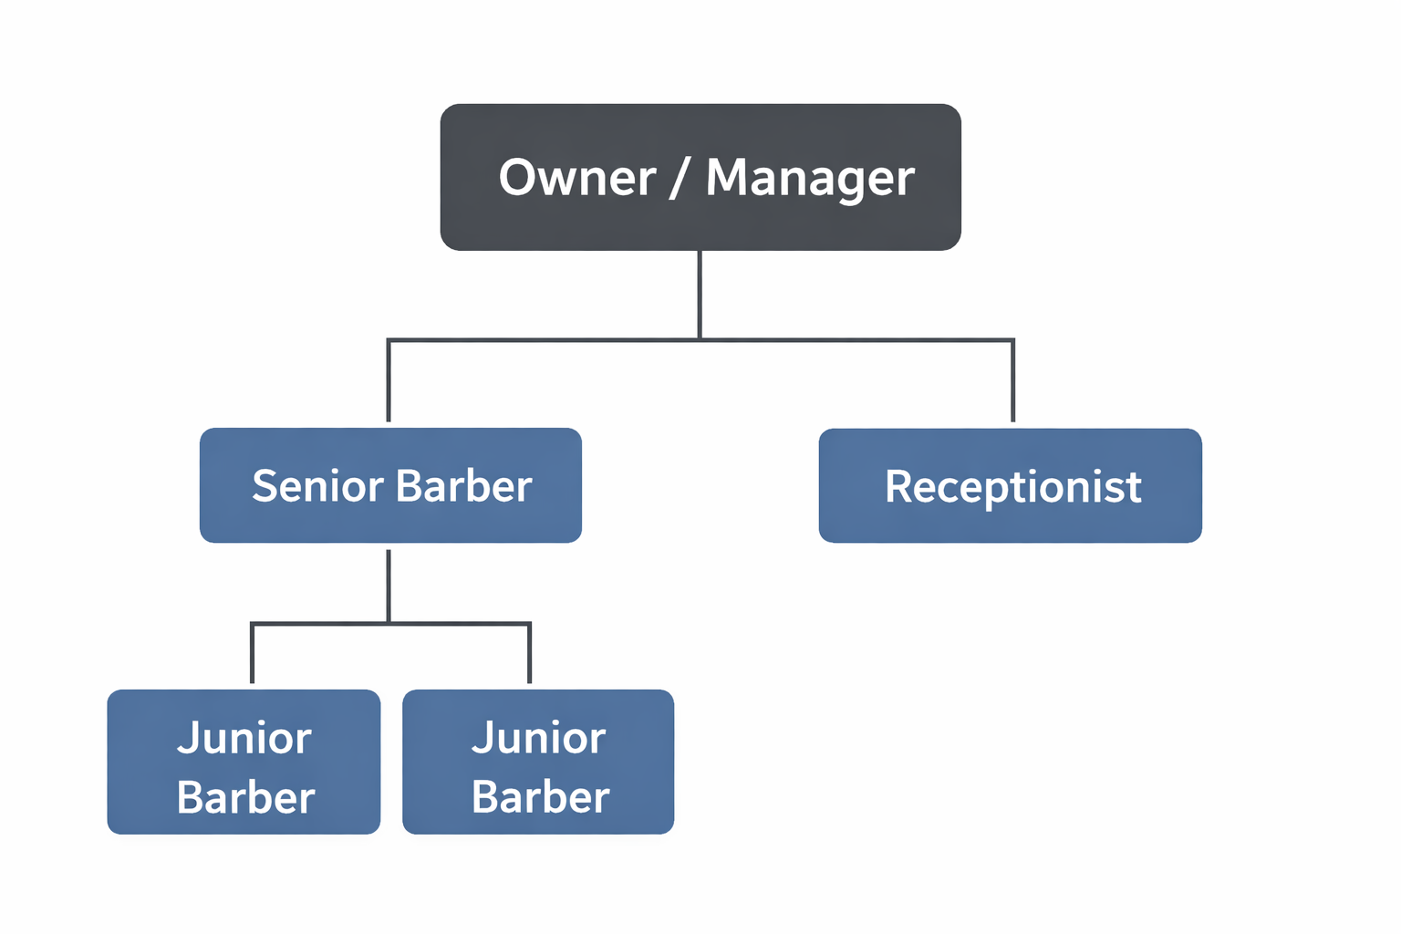
Management Structure
Main Responsibilities
Owner / Manager: financial control, marketing strategy, supplier management
Senior Barber: deliver advanced haircuts and maintain service standards
Junior Barber: provide haircuts and assist with daily shop operations
Receptionist: manage bookings, payments, and customer enquiries
Focus on Building the Brand
Post before-and-after haircut content on Instagram and TikTok
Encourage Google reviews to improve local search visibility
Maintain professional shop environment and consistent service quality to build a reputation for excellence

Slide 13
Market Analysis
Swot
Pestle
Strengths
Mid-premium positioning between low-cost barbers (£10–£15) and high-end salons
Appointment-based model improving efficiency and customer convenience
Professional environment and consistent service quality
Weaknesses
New business with limited brand recognition
Initial investment required for equipment and interior fit-out
Opportunities
Growing demand for male grooming and modern hairstyles
Social media marketing and Google reviews increasing local visibility
Threats
High number of low-price barber shops in the local market
Economic pressures reducing discretionary spending
Political: Compliance with local council licensing and hygiene regulations
Economic: Inflation and cost-of-living pressures affecting consumer spending
Social: Increasing importance of appearance and professional grooming
Technological: Digital booking platforms and social media promotion
Legal: Employment law, public liability insurance and health standards
Environmental: Opportunity to use eco-friendly products and sustainable practices

Slide 14
Growth Potential
Increase service capacity by expanding from 2 to 4 barbers, enabling the shop to serve 30–40 customers per day.
Launch private-label grooming products (pomade, beard oil, styling cream) to increase average revenue per customer.
Expand to a second location in nearby towns such as Bedworth or Hinckley once the Nuneaton shop reaches stable profitability.
Scale through repeat customers, with haircuts typically required every 2–4 weeks, ensuring predictable demand and steady revenue growth.

Slide 15
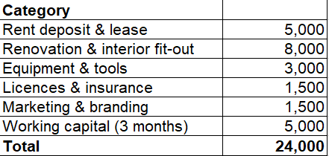
Start-Up Investment and Funding
Estimated start-up investment: £24,000
Funding sources
Owner investment – £12,000
Start-up loan – £12,000
Total capital – £24,000
Main start-up costs
Equipment and barber tools
Shop renovation and interior design
Licences, insurance and marketing
Structured financial planning improves start-up survival (Finch, 2016)

Slide 16
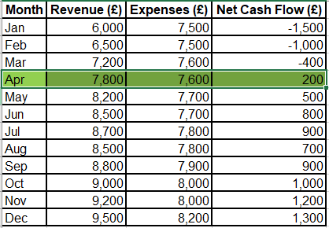
Break-Even Analysis
Average service price: £20
Daily break-even calculation:
15 customers × £20 = £300 daily revenue
Monthly estimate (26 working days):
£300 × 26 = £7,800 per month
Break-even target: ~15 customers per day (Finch, 2016)

Slide 17
Conclusion
Growing demand for high-quality male grooming services in the local market
Clear brand positioning as a mid-premium barber focused on service quality rather than price competition
Customer experience and consistent haircut quality as the key drivers of loyalty and repeat visits
Strong potential to build a recognized local brand through reputation, reviews, and social media visibility
Sustainable growth supported by repeat customers and realistic financial targets

Slide 18
References
Burns, P. (2020) Entrepreneurship and Small Business: Start-up, Growth and Maturity. 5th edn. London: Palgrave Macmillan.
Chaffey, D. and Ellis-Chadwick, F. (2019) Digital Marketing: Strategy, Implementation and Practice. 7th edn. Harlow: Pearson.
Finch, B. (2016) The Small Business Start-Up Workbook: A Step-by-Step Guide to Starting the Business You’ve Dreamed Of. 6th edn. London: Kogan Page.
Grant, R. (2022) Contemporary Strategy Analysis. 11th edn. Oxford: Wiley.
Kotler, P. and Keller, K. (2022) Marketing Management. 16th edn. Harlow: Pearson.
Mintel (2023) UK Hair and Beauty Market Report. Available at: https://www.mintel.com (Accessed: 8 February 2026).
Office for National Statistics (ONS) (2023) Business population estimates for the UK and regions. Available at: https://www.ons.gov.uk (Accessed: 8 February 2026).
OpenAI (2026) ChatGPT. Available at: https://chat.openai.com (Accessed: 13 March 2026).
Porter, M.E. (1985) Competitive Advantage: Creating and Sustaining Superior Performance. New York: Free Press.

