Slide 1
MBA
Financial Management
Sources of finance

Slide 2
Learning outcomes
Identify the main sources of finance available to a business
Understand why businesses need finance
Explain the factors affecting the choice of finance

Slide 3
Why do businesses need finance?
Business set-up
Day-to-day trading [working capital management]
Business growth

Slide 4
What factors affect the choice of finance?
Type of business
Size of the business
Stage of business development
Current financial position
Availability of security to guarantee loans
Market conditions
The terms of the finance
Level of gearing and existing interest commitments

Slide 5
Most businesses have a combination of both equity and debt
Debt
Equity

Slide 6
Difference between Equity and Debt
Equity finance means selling a stake, or shares, in your business.
Equity represents ownership in a company
Debt finance, in its simplest terms, is an arrangement between borrower and lender
Debt must be repaid with interest

Slide 7
Main ways to raise finance
Internal
Retained Profits
Sale of assets
Sale and leaseback
Depreciation
External
Bank Overdraft
Loans
Bonds
Debentures
Ordinary shares
Preference shares
Venture Capital
Factoring
Warrants
Informal

Slide 8
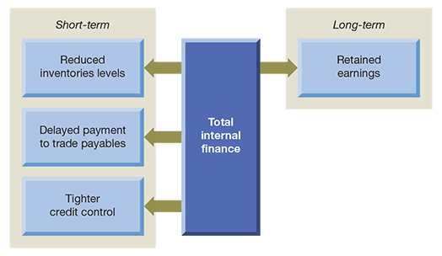
Short and long-term internal sources of finance

Slide 9
Internal sources finance
Capital
Retained
profits
Sale of owned assets
Sale and leaseback of owned assets
Depreciation

Slide 10
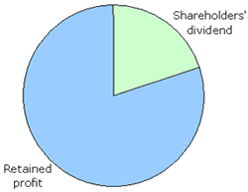
Retained profits
Retained profit is the profit kept in the company rather than paid out to shareholders as a dividend. Retained profit is widely regarded as the most important long-term source of finance for a business
It involves a decision by the directors of how much dividend to pay out to shareholders and how much to retain for the future growth of the business
The directors are not obliged to pay any dividend

Slide 11
Activity (5mins)
Are retained earnings a free source of finance for the business? Explain.
Discuss in a group of five (5)

Slide 12
Sale of assets
Businesses can raise finance by selling off unwanted or unused fixed assets
For example, land, surplus or obsolete equipment
However, not all businesses will have spare assets

Slide 13
Sale and lease-back
Business sells tangible assets and then leases them back from the new owner
Business acquires an immediate and substantial capital sum
Disadvantages?

Slide 14
Depreciation 1
Depreciation of tangible assets (Amortisation of intangible assets) is the charge made against profits to reflect the wearing-out, obsolescence, diminishing utility, or outdated technology of am organisation’s assets.
The annual charges for these assets are recorded in the income statement as an expense, and effectively reduces the profit available for distribution, and so retains the amount within the business.
This amount, so retained, both increases the cash available for working capital, and also for longer-term investment
Therefore, in some ways depreciation can be considered as similar to retained profits as a source of internal income

Slide 15
Depreciation 2
However, when new assets are acquired or older assets are disposed of, adjustments are made to the income statement to reflect either the gain or loss on disposals, or maybe overall increases in the annual charge for new acquisitions
Amortisation, is effectively a depreciation charge for intangible assets, for example brand valuation, goodwill, licences, and registered patents
Although firms decide on the method, type, and amounts of charge to make, there are a number of technical accounting issues legal restraints, and taxation implications that companies have to address, not least of which are where different national regulatory frameworks are involved

Slide 16
Sources of external finance
Capital
Debt
Equity
Bank loans and overdrafts
Bonds and debentures
Factoring and invoicing
Leases
Warrants and similar contracts
Ordinary shares
Preference shares
Venture capital
Commercial paper
Informal
(Suppliers, moneylenders, family, and cooperatives)
Informal (Suppliers, family, cooperatives)

Slide 17
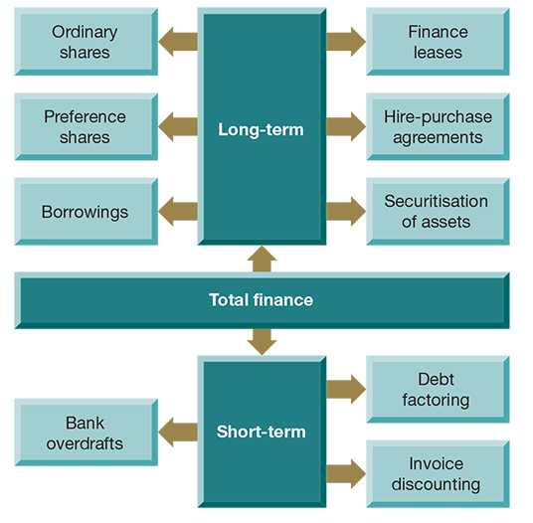
Short and long-term external sources of finance

Slide 18
Bank borrowing- overdraft versus bank loan
Bank overdraft
Bank loan
These are a form of loan, whereby the business is allowed to draw out more money from the bank than they have in their account. Bank overdrafts usually have an upper limit and the amount overdrawn can usually be called in at any time.
A bank loan is a fixed amount for a fixed term with regular fixed repayments. The loan may be secured on the company’s assets. . Regular repayments of both the capital and the interest will be expected.

Slide 19
Share capital - 1
Involves a business issuing and selling new shares on the stock market
Commonly used to raise large sums of capital for expansion
Ordinary and Preference shares issued

Slide 20
ACTIVITY 2
10 minutes
In a group of five, discuss the differences between ordinary shareholders and preference shareholders

Slide 21
Share capital - 2
 | Ordinary shares | Preference shares
Dividends | Dividends vary according to profits and what the board of directors decide to pay. Dividends do not have to be paid | Dividends are fixed. For example, a £1, 7% preference share would yield £1 x 1.07 = £1.07
Voting rights | Normally carry voting rights of one vote per share | Normally have no voting rights
Market price | Market prices will rise and fall according to investors’ perceptions, which is often the subject of supply and demand | Market prices usually stable, showing little variation over time

Slide 22
Share capital - 3
Ordinary shares | Preference shares
More risky for the shareholder because… Dividends vary Dividends cannot be paid until all preference dividends are paid Equity shareholders are the last to be paid in the event of the company going into liquidation | Less risky for the shareholder because… Dividends are predictable Dividends are paid before ordinary shareholders receive any In the event of liquidation, preference shareholders rank above ordinary shareholders

Slide 23
Share capital - 4
Ordinary Shares are usually regarded as being EQUITY capital
Preference Shares are usually regarded as being DEBT capital
This has implications for ratio analysis

Slide 24
Bonds - 1
Bonds are issued by firms, national governments, and local governments to raise finance on both national and international markets
Unlike debentures, bonds are a form of unsecured borrowing
They are traded on specific bond markets, in a similar way to shares that are traded on stock markets
They can short-term (under 12 months maturity), medium-term (1-3 years, or), long-term ( over 3 years

Slide 25
Bonds - 2
Bonds vary considerably in terms of the coupon payment, interest rate, maturity date, and yield (rate of return)
Here is a sample of Pearson plc’s issued bonds from 2003
9.5% Sterling Bonds 2004 £108m
6.125% Eurobonds 2007 £343m
7% Global Dollar Bonds 2011 £278m

Slide 26
Debentures - 1
These are long-term loans, similar to bonds, that are not secured against assets, although are often related to specific projects of infrastructure, high-profile construction, or similar ventures. They have a fixed rate of interest and are repayable at a fixed date
For example, 10% debentures 2016
Debenture holders have the right to receive interest payments before any dividend is paid to shareholders

Slide 27
Debentures - 2
Debenture holders are commonly used in relation to the financing of sports or leisure venues. In addition to receiving interest, holders usually receive privileges such as tickets or the use of facilities. The following popular venues are largely funded by debentures
Millennium Stadium
Wembley Stadium
Wimbledon
Twickenham Stadium
Lord’s Cricket Ground
Royal Albert Hall

Slide 28
Venture capital
The main sources of venture capital in the UK are…
Venture capital firms [managed by professional investors]
Business angels [private investors]

Slide 29
Trade credit
A working capital method of raising finance
Goods are purchased from suppliers on credit terms. By delaying payment, the business is able to use the finance for other purposes in the short-term.

Slide 30
Debt factoring
Debt factoring is a service offered by financial institutions (known as ‘factors’), many of which are subsidiaries of commercial banks.
It involves the factor taking over the trade receivables collection for a business.

Slide 31
Debt factoring - 1
Another working capital source of finance
This is where the firm passes on its trade debtors to a debt factoring company.
The debt factoring company will collect the debt and charge a fee (up to 20%). This speeds up the receipt of cash.

Slide 32
Debt factoring - 2
Supplier
Customer
Original invoice
80%
Invoice value
New invoice
Factor
Payment less discount
Full payment

Slide 33
Hire purchase (HP)
The acquisition of assets is a major commitment for a business. Rather than paying for the asset outright, it can often make sense for businesses to acquire them using HP
Typically, a hire purchase agreement allows the purchaser sole use of an asset for a period of time, after which they have the right to buy them, often for a small or nominal amount.

Slide 34
Securitisation
involves bundling together illiquid financial or physical assets of the same type so as to provide financial backing for an issue of bonds. ‘Illiquid’ in this sense means not readily able to be sold. This financing method was first used by US banks, which bundled together residential mortgage loans to provide asset backing for bonds issued to investors.

Slide 35
Leasing - 1
This is where the company has use and control over the asset in exchange for regular payment, and at first sight leasing appears to be the same as HP. This is not the case, as the company never owns the asset
Why would a business consider leasing assets?

Slide 36
Leasing - 2
Three main types of leasing…
Finance leasing
Operating leasing
Contract Hire

Slide 37

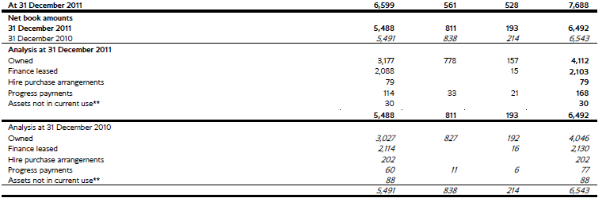
Leasing example
Example
Many airline businesses use hire purchase and finance leasing as a means of acquiring new aircraft. The financial statements for British Airways plc for 2010/11 show that nearly 40% of the asset values of the aircraft fleet has been acquired through these methods

Slide 38
Mortgage
This is a long-term loan from either a bank or other financial institution, usually provided to buy premises or land
Normally, the land or property is used as security on the loan.

Slide 39
Grants
Business may be able to obtain grants, which are non-repayable, from the government, local authorities or other agencies and funding bodies. Usually, grants would be awarded only in quite specific circumstances and may have strict conditions attached.
www.businesslink.gov.uk
www.is4profit.com
www.bizhelp24.com
www.smallbusiness.co.uk

Slide 40
References
Weetman, P (2013) Financial and Management Accounting, 6th edition, Pearson Education pp. 162-3
Atrill, P. and McLaney, E.J., 20. Accounting and Finance for Non-specialists. Pearson Education.

