Slide 1
Personal and Professional development.
By Simon Buckingham (1704912)

Slide 2

Introduction
Not feeling good enough
Autism
Therapy
Parents
Relationships
Young Simon

Slide 3

Not feeling good enough
Lifelong issue
All different areas of life – e.g relationships, education..
Linked with self saboteur and imposter syndrome
Therapy and self reflection

Slide 4
Autism
Felt different e.g didn’t fit in with in groups, didn’t have the same interest as peers
Over the last twelve months I’ve been through a self discovery
My fiancée noticed my patterns and habits e.g food, sensory sensitivities and social struggles
Helped me gain a better understanding

Slide 5
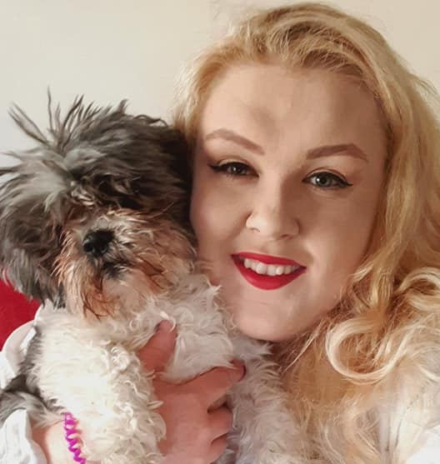


Lucy & Mildred
One of the things I’ve struggled most with is the concept of love

Slide 6
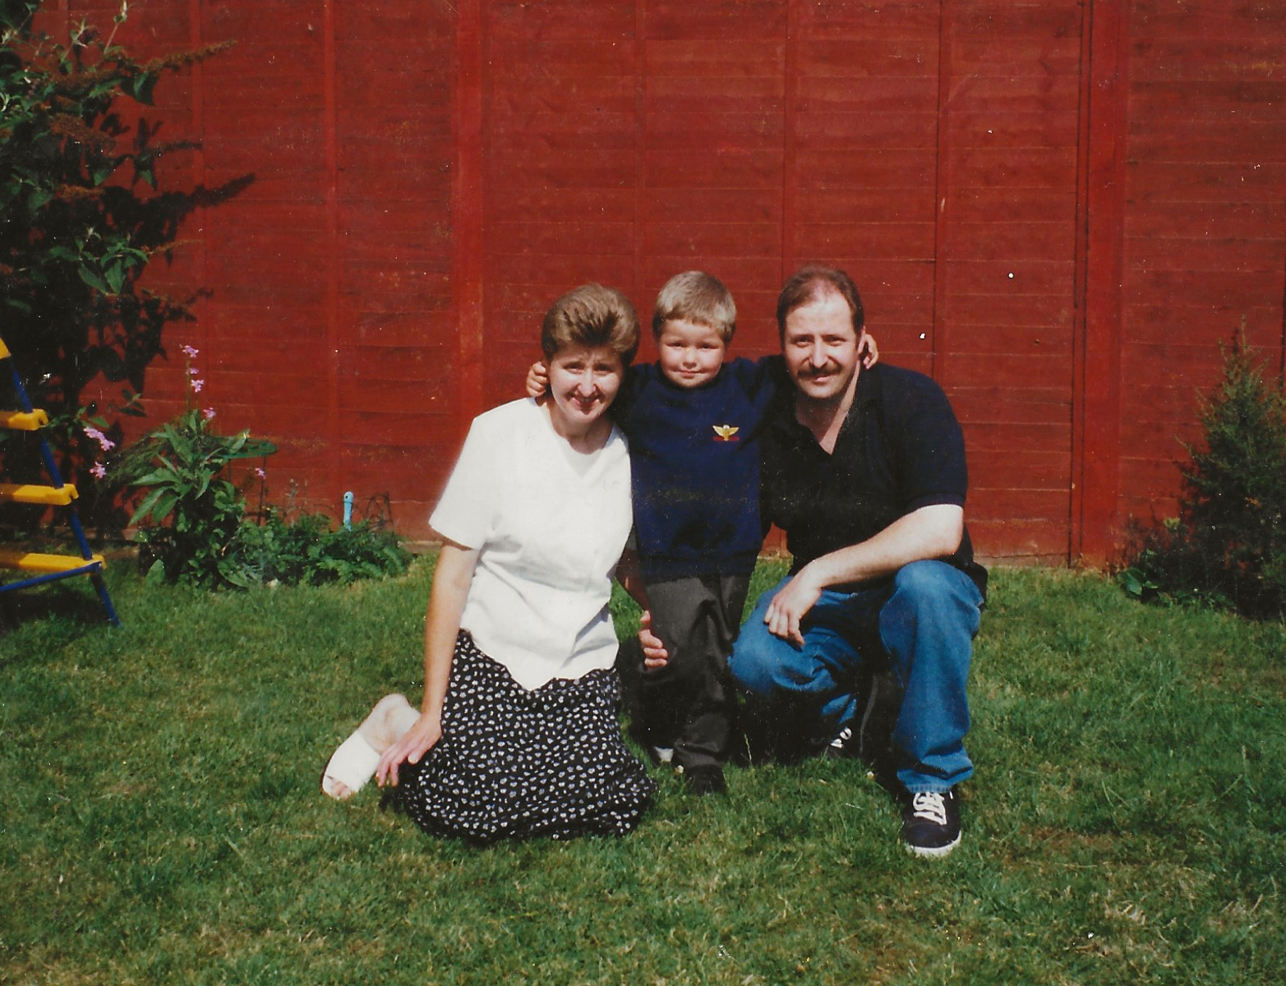
Parents
Never felt fully understood or accepted by parents
Under the impression I’d be fully accepted and loved unconditionally by my parents
Saw them as more than just people, making it hard to accept their faults
Stripped away labels, seeing them as human not superhuman

Slide 7
Therapy
Lost myself during this course
Thought I had to play the role of a therapist instead of being myself, a therapist
Felt like I don’t deserve the title, like I haven’t had to work hard
This stems from the fact that it’s so natural to me having been my mothers ‘therapist’ from a young age
Degree will not have ‘you are good enough’ on the front of it

Slide 8
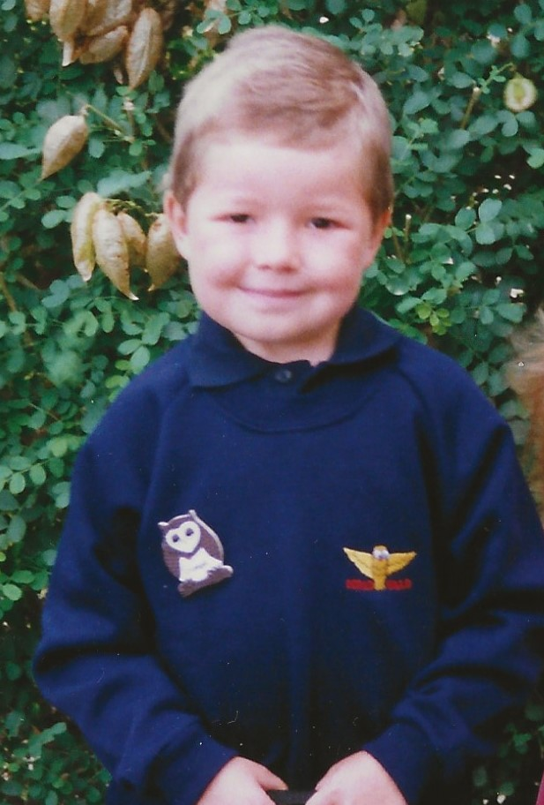
Young Simon
This has all lead me to begin to accept that I was always good enough
That version of me did not feel good enough
I am good enough

