Slide 1
Is there a moral obligation to help alleviate poverty?
Regan Edwards 2305133

Slide 2
Introduction
"Extreme poverty, as defined by the World Bank, means not having enough income to meet the most basic human needs for adequate food, water, shelter, clothing, sanitation, health care or education." (Practical Ethics, Rich and Poor, Page 191, Peter Singer)
Relative Poverty "In industrialised countries, people are poor by comparison to others in their society
Affluency “defining characteristic is a significant amount of income above the level necessary to provide for the most basic human needs of oneself and one’s dependents.” (Practical Ethics, Rich and Poor, Page 193 Peter Singer)

Slide 3
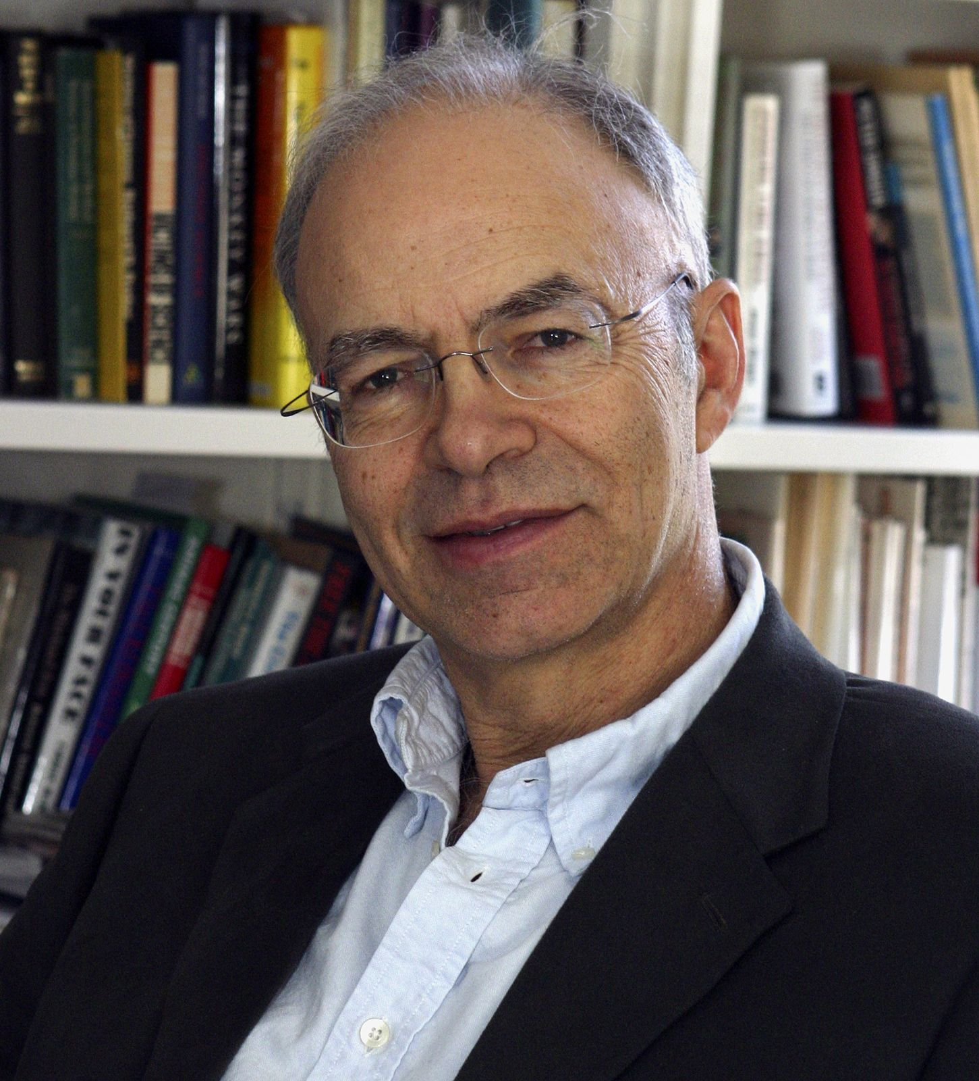
Peter Singer's Moral Equivalent To Murder
The affluent have wealth that they could transfer to the extremely poor, without threatening their own basic well-fare.
This implies that poverty could be alleviated if those who are affluent were willing to give their excess wealth to those in poverty.
Affluent people are letting people in poverty die by choosing not to do things like voluntary work for organisations dedicated to helping those in poverty, and refusing to give their excess wealth to those in poverty.
Peter Singer points out that letting someone die is "not intrinsically different from killing someone", thus "we are all murderers" (Practical Ethics, Rich and Poor, Page 194, Peter Singer)
Image of Peter Singer

Slide 4
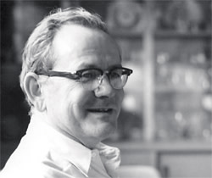
Garret Hardin's Lifeboat Ethics
Garret Hardin divides the world into two categories, these are rich countries and poor countries, two thirds of them are desperately poor and only one third are comparatively rich, with the United States being the wealthiest of all.
Hardin states "Metaphorically each rich nation can be seen as a lifeboat full of comparatively rich people. In the ocean outside each lifeboat swim the poor of the world, who would like to get in, or at least to share some of the wealth. What should the lifeboat passengers do?" (Lifeboat Ethics: the Case Against Helping the Poor, Page 1)
“which 10 do we let in? How do we choose? Do we pick the best 10, ‘first come, first served’? And what do we say to the 90 excluded?” (Lifeboat Ethics: the Case Against Helping the Poor, Page 1)
Image of Garret Hardin

Slide 5
The Lifeboat Example And Luck
“Some say they feel guilty about their good luck. My reply is simple: ‘Get out and yield your place to others” (Lifeboat Ethics: the Case Against Helping the Poor, Page 2)

Slide 6
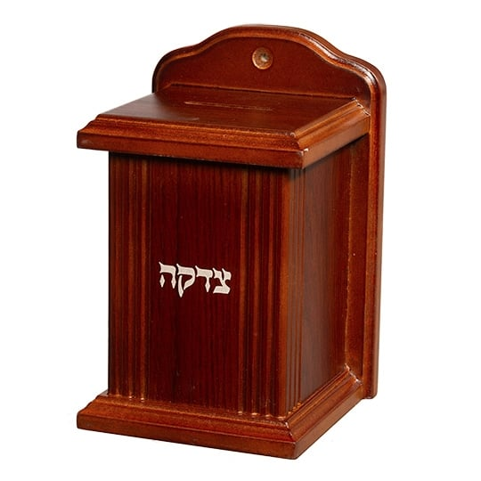
Tzedakah (A Third Way?)
There are some cultures and religions that see actions such as help to alleviate poverty as a good act that is a part of our duties.
One example of this is the concept of tzedakah in Judaism. Tzedakah literally means justice, righteous, and charity. (Tzedakah, The Movement for Reform Judaism)
It could be seen as an injustice that some people live in affluency when others live without even having their basic needs met, due to this some Jews may choose to give their tzedakah donation to a charity that helps those in poverty.
Tzedakah Box

Slide 7
Conclusion
In conclusion there is no moral obligation to help alleviate poverty, but there is an obligation of justice to help alleviate poverty

Slide 8
Ref
Britannica, Peter Singer Image, (2025) <https://cdn.britannica.com/36/97036-050-6344EA93/Peter-Singer-2004.jpg>
Financial Times, Garret Hardin Image, (2013) <https://images.ft.com/v3/image/raw/http%3A%2F%2Fcom.ft.imagepublish.upp-prod-eu.s3.amazonaws.com%2F69e3740a-105d-11e3-a258-00144feabdc0?source=next-article&fit=scale-down&quality=highest&width=700&dpr=1>
Garret Hardin, 'Life Boat Ethics: The Case Against Helping the Poor', Psychology Today, (1974)
Judaica Web Store, Tzedakah, (2025) <https://www.judaicawebstore.co.uk/media/catalog/product/cache/2924dcbf4775c7dc730d6a3aa7c3ac8d/w/o/wooden_tzedakah_box.jpg>
Menachem Poser, What is Tzedakah:15 Facts about Charity Every Jew should Know, (2024) <https://www.chabad.org/library/article_cdo/aid/4203668/jewish/What-Is-Tzedakah.htm>
Singer, Peter, Practical Ethics, 3rd edn (Cambridge: Cambridge University Press, 2011)
The Movement For Reform Judaism, Tzedakah, (2016) <https://www.reformjudaism.org.uk/tzedakah/>

