Slide 1
CARDIOVASCULAR DISEASE: DIAGNOSIS, MANAGEMENT, AND PERSONALISED CARE IN THE UK
Name: Adnankhan Firojkhan Sindhi
Student ID: 2528923 module : Community Care and Management of Longer-term Conditions (LCHS7003)
Lecturer : Muhammed Khan
Date : 16/04/2026
Level 7 Academic presentation

Slide 2
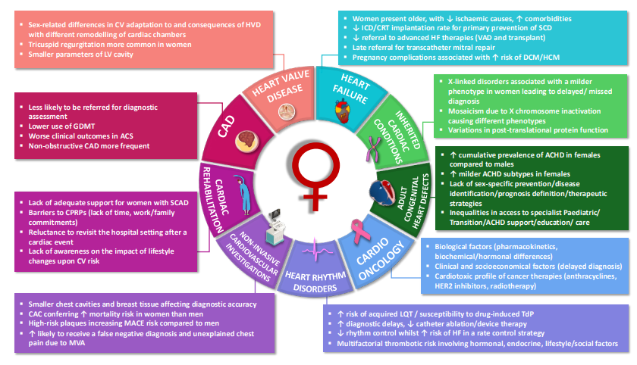
INTRODUCTION
Group of vessel and heart disorders causing major mortality among the world.
About 7.6 million cases in the UK and 17.9 million deaths in the world (WHO, 2026).
WHO characterises CVDs as heart and blood vessel diseases that result in mortality worldwide.
Figure: 1
Key contributors to sex differences in various subareas of cardiovascular disease, Tayal et al. 2024
Notes:
Some of the conditions under cardiovascular diseases include coronary artery disease, heart failure, and stroke. They rightly cannot be considered the leading causes of mortality in the world, emerging as a major factor in death to the tune of almost 18 million yearly. More than 7.6 million individuals in the UK are living with CVDs suggesting that it places a huge burden on the NHS. WHO defines cardiovascular diseases as disorders of the heart and vessels (coronary diseases, cerebrovascular diseases and rheumatic diseases) globally.

Slide 3
SYMPTOMS AND AETIOLOGY
Chest pain, fatigue, palpitations, breathlessness, and dizziness are the common symptoms of CVDs (Govender et al. 2022).
It is caused by smoking, diabetes, hypertension and atherosclerosis.
Genetics, lifestyle and ageing accelerate enhances risks of these diseases.
Notes:
Cardiovascular diseases frequently develop as partners of chest pain, dyspnea, and fatigue, although specifics of the manifestations depend on a disease. The risk factors are hypertension, diabetes, smoking, and obesity that hasten atherosclerosis. Poor lifestyle habits including poor diet and lack of exercise are a major contributing factor. Risk is further increased by genetic predisposition and ageing, and therefore prevention strategies are necessary to reduce disease burden and increase the results of long-term outcomes.

Slide 4
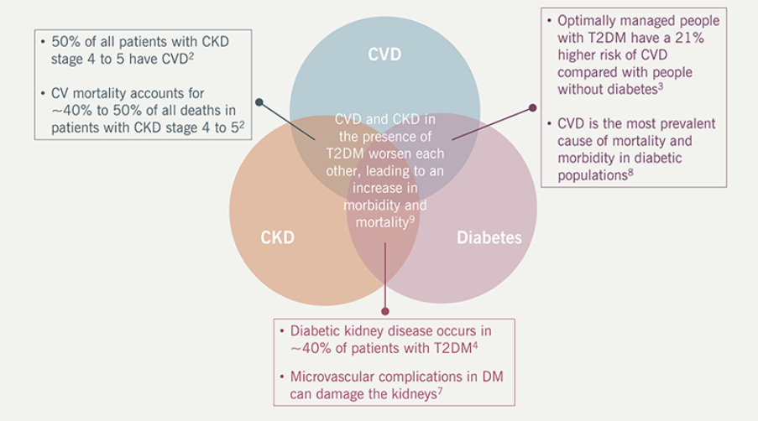
PREVALENCE (UK AND GLOBAL)
About 7.6 million individuals with CVD and 25% of deaths in the UK noticed (NHS, 2026).
Around 32% of mortality and 17.9 million deaths per year is shown in the world (WHO, 2026).
Prevalence increases due to lifestyle and ageing factors among individuals (Kundu and Kundu, 2022).
Figure: 2
Contingencies of CVRM states, Bjcardio, 2024
Notes:
CVDs are the leading cause of mortality in the UK where more than 7.6 million people are infected. One out of four premature deaths in the country is attributed to them. Worldwide, CVDs lead to 17.9 million annual deaths, which constitute 32 per cent of all deaths. The burden is constantly increasing as population ages, urbanises as well as lifestyle risks, like obesity and lack of physical activity.

Slide 5
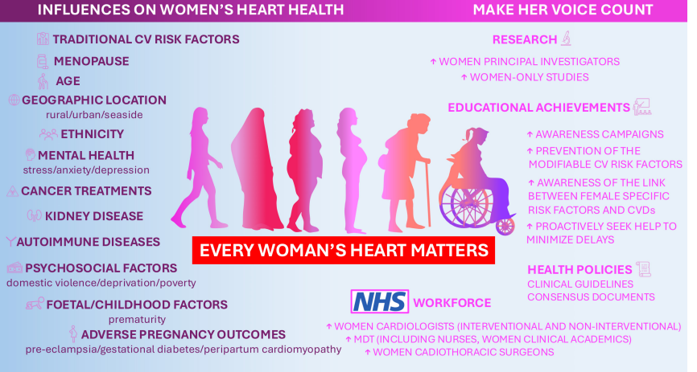
ECONOMIC AND SOCIAL BURDEN
NHS spends about £9 billion CVD care per year (NHS, 2026).
Families face economic, emotional and social strains due to this disease.
Informal caregiving and productivity loss enhances costs (Fakeye et al., 2023).
Figure: 2
Determinants of heart health in women and how to address sex disparities in cardiovascular care
, Tayal et al. 2024
Notes:
Cardiovascular diseases impose the social and financial burden for the family of patients. The NHS spends about £9 billion per year on management and treatment. Losses of productivity from disability and premature deaths are substantial beyond the direct healthcare costs. Families experience economical and emotional stress with information carers and women delivering unpaid support. Its dual influences shed light on the needs of effective management and prevention strategies for decreasing long-term costs.

Slide 6
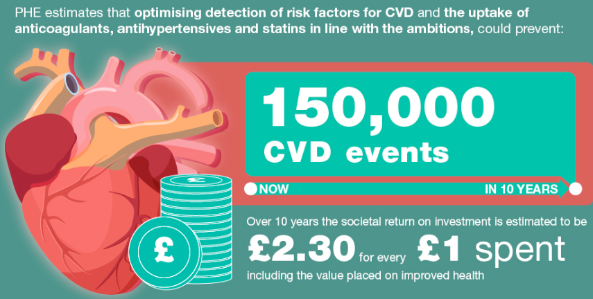
DIAGNOSIS AND INITIAL ASSESSMENT
NICE guidelines ensure standardised diagnostic pathways in healthcare (Eldred‐Evans et al. 2023).
Cholesterol, glucose, troponin blood tests can be helpful to address CVDs (Nazir et al. 2025).
Echocardiogram, ECG, physical exam and clinical history are the initial assessment for patients of CVDs (Di Costanzo et al. 2024).
Figure: 2
Infographic of cardiovascular disease costs to NHS as well as society, GOV.UK, 2026
Notes:
Diagnosis of CVDs included in the blood tests, echocardiography, ECG, physical examination and clinical history. Guidelines of NICE ensure standardised pathways to enable the effective deception and timely interventions to develop patient outcomes.

Slide 7
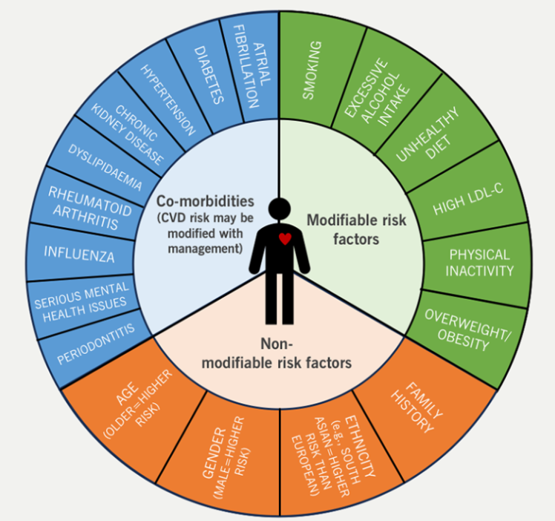
MANAGEMENT (UK GUIDANCE)
Integrated, evidence-based CVD management is informed by NICE frameworks and NHS Long Term Plan.
NHS long term plan focuses on the integration and prevention of this disease (Collins et al., 2022).
Multidisciplinary teams provide co-productive and personalised care for patients (Mc Laughlin et al., 2022).
Figure: 2
The risk factors of CVD are either non-modifiable or modifiable, Bjcardio, 2024
Notes:
Both NICE and NHS Long Term Plan have involved systematic outlines, which will guarantee prevention, integration, and co-productive care to patients of cardiovascular diseases. Multidisciplinary teams provide personalised care that supports self-management, peer support and community programmes to decrease long term costs.

Slide 8
COMPREHENSIVE MODEL OF PERSONALISED CARE MODELS
Self-management, care planning, and shared decision-making are the main components of the Comprehensive Model of Personalised Care (Petersson et al., 2022).
Peer programmes, community support and Social prescribing helps in increasing care for patients (Yadav et al. 2024).
Integrated services and empowered patients are the main goals of CVD patient care (Al‐Chalabi et al., 2025).
Peer programmes and group learning, digital tools, and social prescribing are all classified as self- management support.
Notes:
Giving patients the power to self-monitor and self-manage their conditions via education, peer support and digital monitoring, NHS personalised care model enhances patient self-management and long-term outcomes.

Slide 9
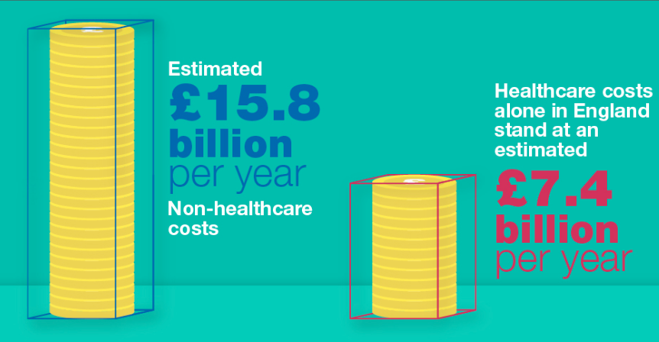
TREATMENT OPTIONS
Cardiac rehabilitation and lifestyle interventions develop outcomes of patients.
“Coronary artery bypass graft (CABG)” and angioplasty are the surgical way of CVD treatment (Ibrahim et al. 2025).
Anticoagulants, antihypertensives and strains are the pharmacological way of CVD treatment in the healthcare sector (Narkhede et al.,2024).
Figure: 2
Infographic of cardiovascular disease costs to NHS as well as society, GOV.UK, 2026
Notes:
CVD treatment combines lifestyle changes, drugs, surgery. Strains, anticoagulants and antihypertensives help to maintain risks and restore flow such as rehabilitation, smoking cessation, exercise and diet help to develop long are outcomes and recovery of patients.

Slide 10
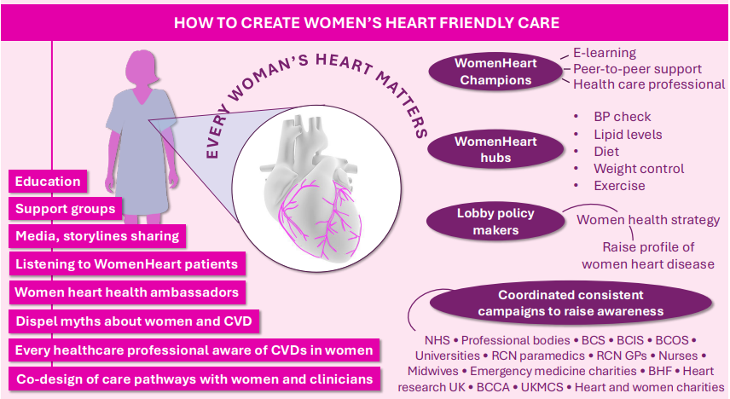
COMORBIDITIES
Chronic kidney, obesity and diabetes can create depression (Vadakkiniath, 2023).
Shared risk factors of the diseases worsen mortality and prognosis.
Integrated psychological support and management are important for care services of this disease.
Figure: 3
How to create women’s heart friendly care, Tayal et al. 2024
Notes:
Cardiovascular diseases co-exist with chronic conditions like chronic kidney diseases, diabetes and obesity that share common risk factors such as poor lifestyle habits and hypertension. Depression is prevalent and affects adherence and recovery of patients. These comorbidities complicate treatment and elevate mortality risks. Psychological support and multidisciplinary management are important for addressing mental and physical health requirements effectively.

Slide 11
PREVENTION
The primary prevention is cessation of smoking, exercises and healthy diet.
Control on cholesterol, BP and screening are the secondary prevention for CVDs (López Ferreruela et al. 2024).
Community programs and public campaigns can decrease incidence.
Notes:
Prevention of CVDs needs primary and secondary strategies in the healthcare sector, primary prevention focuses on lifestyle changes like physical activity, balanced diet, and avoiding tobacco. Secondary prevention involves screening, cholesterol control and blood pressure monitoring for detecting risks early. Public health campaigns such as Change4Life and NHS Heart Age Test increases awareness. Peer support and community initiatives programmes increase prevention and population health outcomes.

Slide 12
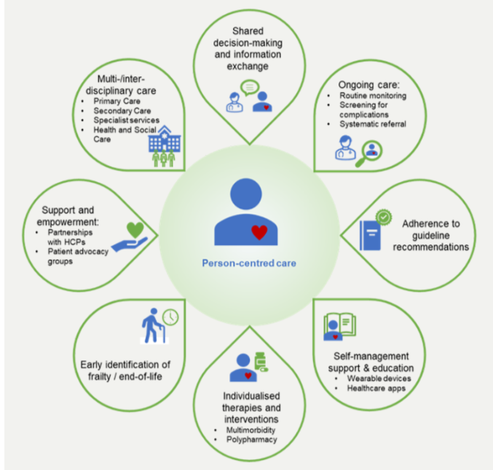
SKILLS, VALUES AND BEHAVIOURS
Teamwork, accountability, cultural sensitivity and empathy are needed in co-productional care in various patient environments.
Respectful and cleared communication due to patient centred dialogue can create empathy (Garling and Stewart, 2024).
Staffs need to be sensitive to the individuals from diverse backgrounds.
Compassion, integrity and accountability are the professional values for the healthcare sector (Marshman et al., 2024).
Figure: 2
The most important elements of holistic and integrated patient care with CVD
, Bjcardio, 2024
Notes:
Professionals partner with patients, maximize the utilization of empathy, integrity, and teamwork to offer personalised and co-productive cardiovascular care. Cultural competency is important in the diverse populations that ensure equitable care for patients. Teamwork among multidisciplinary teams increases outcomes. Professional values like accountability and integrity focuses on practices that enable co-productivity and holistic care that supports long term management and patient’s health.

Slide 13
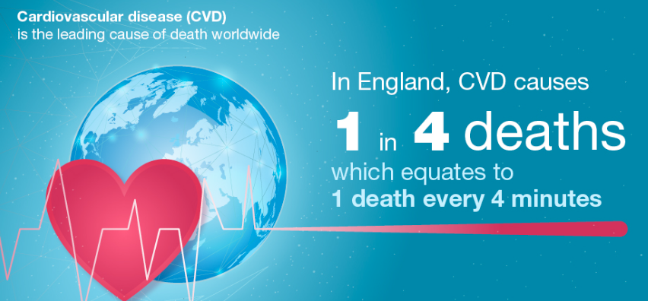
EPIDEMIOLOGY
About 7.6 million people live with CVD in the UK (BHF, 2026).
Approximately 17.9 million deaths per year are caused due to this disease (Fowler et al. 2022).
Around 25% of all deaths in the UK are due to cardiovascular diseases (BHF, 2026).
The mortality rate is about 32% across the world (WHF, 2023).
Figure: 2
Infographic of Reason why we should invest in cardiovascular disease prevention
, GOV.UK, 2026
Notes:
CVD is the leading cause of death in the UK and globe. About 7.6 million people lived with CVD in the UK while 17.9 million died in the world. These shed light on the urgent requirements for prevention, effective management strategies and early detection for decreasing global burden.

Slide 14
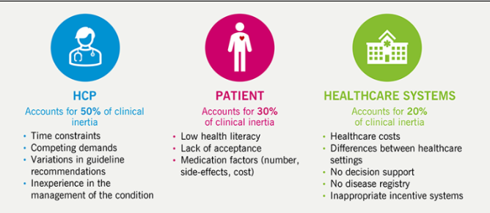
RECOMMENDATIONS
Application of the comprehensive model of Personalised Care (Talaat, 2025).
Relate management along with NICE guidance and NHS Long Term Plan (Albarqouni et al. 2022).
Increase strength of patient empowerment and shared decision making (Wexelman et al., 2025).
Promotion of rapid lifestyle and education modification (Alsaidan, 2025).
Integrate community based support and multidisciplinary systems (Machado et al. 2025).
Figure: 2
The origins of therapeutic inertia may be traced to three different sources: HCPs, patients and healthcare systems, Bjcardio, 2024
Notes:
Effective management of CVDs needs alignment with the personalised care principles and health policies in the UK. Implementation of Comprehensive Model of Personalised Care enhances shared decision making and self management. Integration of community based support and multidisciplinary team’s increases rapid care. Empowering the patients by lifestyle modification and education develops adherence and outcomes with the support of NHS goals for prevention, sustainable long term health development and equity.

Slide 15
References
Albarqouni, L., Ringsten, M., Montori, V., Jørgensen, K.J., Bulbeck, H. and Johansson, M., (2022). Evaluation of evidence supporting NICE recommendations to change people's lifestyle in clinical practice: cross sectional survey. BMJ medicine, 1(1), p.e000130. doi: 10.1136/bmjmed-2022-000130
Al‐Chalabi, S., Sinha, S. and Kalra, P.A., (2025). Enhancing clinical service design for multimorbidity management: A comprehensive approach to joined‐up care for diabetes, chronic kidney disease, and heart failure. Diabetic Medicine, 42(2), p.e15403. https://doi.org/10.1111/dme.15403
Alsaidan, A.A., (2025) . Cardiovascular disease management and prevention in Saudi Arabia: strategies, risk factors, and targeted interventions. International Journal of Clinical Practice, 2025(1), p.7233591. https://doi.org/10.1155/ijcp/7233591
BHF, (2026). Consensus statement on cardiovascular disease. Available at: https://www.bhf.org.uk/what-we-do/policy-and-public-affairs/hearts-need-more/bhf-consensus-statement-on-cvd [Accessed on: 3th April 2026]
BHF, (2026). UK Cardiovascular Disease Factsheet. Available at: https://www.bhf.org.uk/-/media/files/for-professionals/research/heart-statistics/bhf-cvd-statistics-uk-factsheet-jan26.pdf?rev=26534e1487094dbd806277891baef112 [Accessed on: 3th April 2026]
Collins, B., Bandosz, P., Guzman-Castillo, M., Pearson-Stuttard, J., Stoye, G., McCauley, J., Ahmadi-Abhari, S., Araghi, M., Shipley, M.J., Capewell, S. and French, E., (2022). What will the cardiovascular disease slowdown cost? Modelling the impact of CVD trends on dementia, disability, and economic costs in England and Wales from 2020–2029. PLoS One, 17(6), p.e0268766. https://doi.org/10.1371/journal.pone.0268766
Di Costanzo, A., Spaccarotella, C.A.M., Esposito, G. and Indolfi, C., (2024). An artificial intelligence analysis of electrocardiograms for the clinical diagnosis of cardiovascular diseases: a narrative review. Journal of clinical medicine, 13(4), p.1033. https://doi.org/10.3390/jcm13041033
Eldred‐Evans, D., Connor, M.J., Bertoncelli Tanaka, M., Bass, E., Reddy, D., Walters, U., Stroman, L., Espinosa, E., Das, R., Khosla, N. and Tam, H., (2023). The rapid assessment for prostate imaging and diagnosis (RAPID) prostate cancer diagnostic pathway. BJU international, 131(4), pp.461-470. https://doi.org/10.1111/bju.15899
Fakeye, M.B.K., Samuel, L.J., Drabo, E.F., Bandeen-Roche, K. and Wolff, J.L., (2023). Caregiving-related work productivity loss among employed family and other unpaid caregivers of older adults. Value in Health, 26(5), pp.712-720. https://doi.org/10.1016/j.jval.2022.06.014
Fowler, A.J., Wahedally, M.H., Abbott, T.E., Smuk, M., Prowle, J.R., Pearse, R.M. and Cromwell, D.A., (2022). Death after surgery among patients with chronic disease: prospective study of routinely collected data in the English NHS. British Journal of Anaesthesia, 128(2), pp.333-342. https://doi.org/10.1016/j.bja.2021.11.011
Garling, K.A. and Stewart, M.P., (2024). A new framework for elevating and updating clinical language: RAISED patient-centric communication. JAPhA Practice Innovations, 1(1), p.100001. https://doi.org/10.1016/j.japhpi.2023.100001
Govender, I., Nashed, K.K., Rangiah, S., Okeke, S. and Maphasha, O.M., (2022). Palpitations: Evaluation and management by primary care practitioners. South African Family Practice, 64(1), p.5449. https://doi.org/10.4102/safp.v64i1.5449
Ibrahim, D., Elkhidir, I.H., Mohammed, Z., Abdalla, D.A., Mohammed, O.A., Hemmeda, L., Alrawa, S., Ahmed, M., Abdalla, R., Batran, A. and Abdalla, Z., (2025). The role of CBT in enhancing health outcomes in coronary artery bypass graft patients: a systematic review. BMC psychiatry, 25(1), p.22. https://doi.org/10.1186/s12888-024-06457-w
Kundu, J. and Kundu, S., (2022). Cardiovascular disease (CVD) and its associated risk factors among older adults in India: Evidence from LASI Wave 1. Clinical Epidemiology and Global Health, 13, p.100937. https://doi.org/10.1016/j.cegh.2021.100937
Tayal, U., Pompei, G., Wilkinson, I., Adamson, D., Sinha, A., Hildick-Smith, D., Cubbon, R., Garbi, M., Ingram, T.E., Colebourn, C.L. and Camm, C.F., 2024. Advancing the access to cardiovascular diagnosis and treatment among women with cardiovascular disease: a joint British Cardiovascular Societies’ consensus document. Heart, 110(22), pp.e3-e15. https://heart.bmj.com/content/heartjnl/110/22/e3.full.pdf
Bjcardio, 2024. Embedding innovation in clinical practice to improve patient care across cardiovascular disease https://bjcardio.co.uk/2024/08/embedding-innovation-in-clinical-practice-to-improve-patient-care-across-cardiovascular-disease/
GOV.UK, 2026. Health matters: preventing cardiovascular disease https://www.gov.uk/government/publications/health-matters-preventing-cardiovascular-disease/health-matters-preventing-cardiovascular-disease

