Slide 1
Building A Game Scene Dynamically
Lecture 3: Indie Game Development (IGD)
Dr Kemi Ademoye

Slide 2
Today’s Lecture
Building a Game Scene Layout Dynamically using
  ASCII Art & XML
  Prefabs

Slide 3
Object Oriented Development Review
What is a class?
What is the difference between a class and an object?
What is a Field?
What is a Property?
What is a method?
What is the role of a constructor?

Slide 4
Defining the Game World
The game world levels are defined using ASCII art in an XML document.
Using XML allows you to add other properties to the game world.
For example, the XML on the next page includes
  The room (or level) number
  The type of floor and wall materials
You then need to find some way of getting the XML into programmable objects.
  You can use Deserialisation.

Slide 5
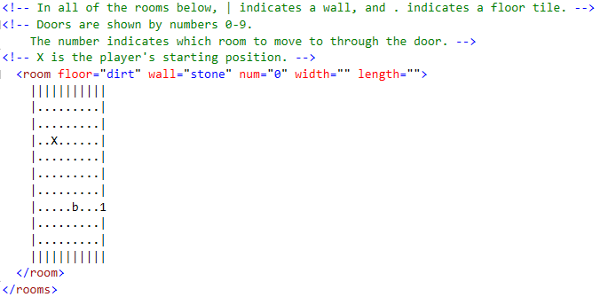
Example XML ASCII Art

Slide 6
Serialisation and Deserialisation
Serialisation
  The process of translating data structures or object state into a stream of bytes in order to store the object or transmit it to memory, a database or file.
  The main purpose is to save the state of an object so it can be recreated later.
  Useful for data exchange.
Deserialisation
  The reverse process
  The process of reading a data source
  and constructing an object from it.
Object
Bytes
Database
Memory
File

Slide 7
Deserialising the XML
First you need to define classes representing the programmable object(s) your XML gets converted to.
The classes will contain properties that map to the XML elements and attributes.
You create a normal class and add markers to each property to indicate what it maps to in the XML.
To add the markers and to indicate that this class will be used in XML de/serialisation, you have to import the following libraries into your classes:
    using System.Xml;
    using System.Xml.Serialization;

Slide 8
Deserialising the XML
Using the example XML shown earlier as an example, you will need the following:
  A Room class with the following properties:
    Floor: maps to the XML attribute floor="dirt"
    Wall: maps to the XML attribute wall="stone"
    Num: maps to the XML attribute num="0"
    Layout: maps to the ASCII ART (the XML room element value) <room>|||||||||||…</room>
    Etc.
  A Rooms class with one property
    Collection: maps to the collection of different <room></room> elements available in the XML.

Slide 9
Deserialising the XML
Once the classes have been defined, you can use them to deserialise the XML into objects.
You:
  Create a XmlSerialiser object of the type of object you want to load the XML into.
  Use a MemoryStream object to load the XML into memory.
  Use an XmlReader to read the XML quickly
  Use the XmlSerializer.Deserialize method to convert the XML read by the XmlReader to the required object structure.
Once the deserialization is done, you can use the objects to build the layout dynamically.
Notes:
See the following links:
MemoryStream Class: https://msdn.microsoft.com/en-us/library/system.io.memorystream(v=vs.110).aspx
XmlReader Class: https://msdn.microsoft.com/en-us/library/system.xml.xmlreader(v=vs.110).aspx
XmlSerialiser.Deserialize method: https://msdn.microsoft.com/en-us/library/cca2d5s9(v=vs.110).aspx

Slide 10
Creating the Layout
The game world layout will be built tile by tile (brick by brick) in code.
  This means looping through each of the map code characters.
Each tile will be added dynamically from a prefab game object.
  The challenge is positioning the tiles correctly and changing the tile texture if it is wall or floor tile.

Slide 11
Instantiating a Prefab
To instantiate a prefab (add a new instance to the game) in code, you use either:
First, you add a public GameObject variable to your script.
  Use the variable to set the prefab from the Inspector.
Then in code, use either of these two methods:
  Instantiate(PrefabType) as GameObject;
  GameObject.Instantiate(PrefabType);
Where PrefabType is the name of the prefab variable created in the first step.
Transform (position, rotate, scale) the prefab as needed.

Slide 12
Setting a Prefab Material in Code
You can also set a prefab’s material in code when you instantiate it.
You need to use the GetComponent<Type>() method to get the Renderer component attached to the prefab.
Then set the retrieved renderer material’s mainTexture to a texture material.
For example:
    GetComponent<Renderer>().material.mainTexture = TextureMaterial.Texture

Slide 13
Lab Exercise
Download Instructions from Moodle

