Slide 1
VerdeMode Studio
“Style with Purpose”
Prepared by: Andrei-Stefanita Stoica
Module: Business and Web Management (ACCA5019)
Lecturer: Suneth Fernando

Slide 2
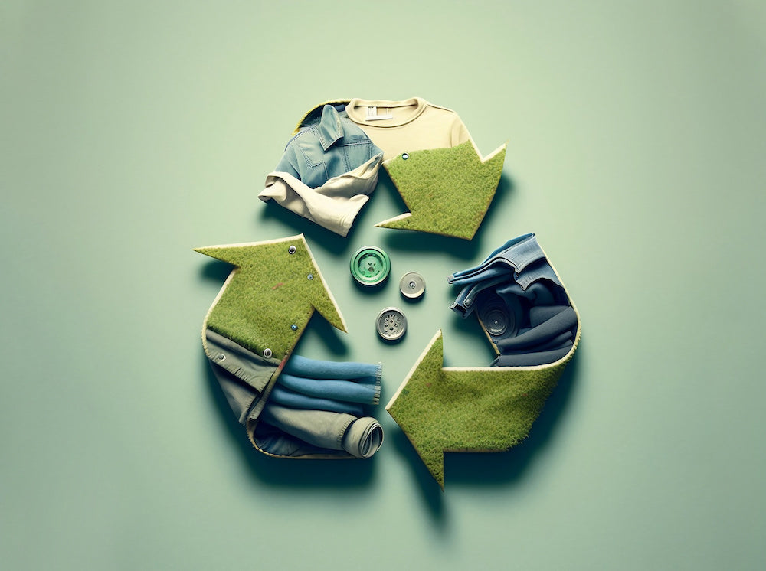
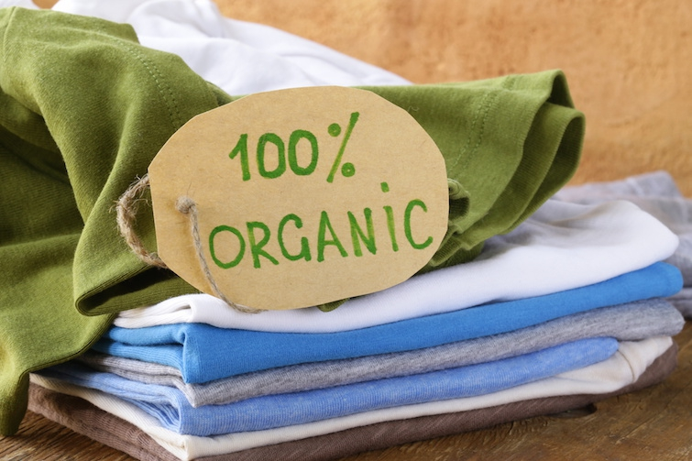
About VerdeMode Studio
VerdeMode’s core fundamentals revolve around sustainable fashion
Fashion should be stylish
Vision
Inspire consumer choices
Mission
Timeless fashion

Slide 3
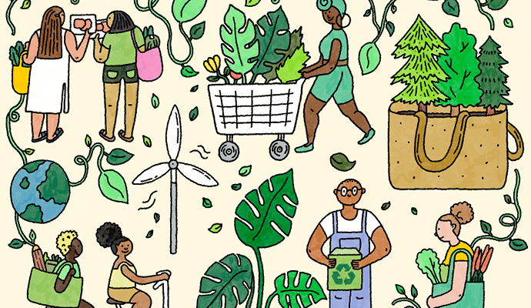

Target Audience
Primary Customers
Customer Interests
Age: 20-45
Urban professionals
University students
Creative individuals
Environmentally conscious shoppers
Sustainable living
Ethical Fashion
Minimalist lifestyle
High-quality clothing
Eco-friendly products

Slide 4
Brand Identity
Brand Values
Brand Personality
Brand Colors
Sustainability
Transparency
Quality
Innovation
Ethical Production
Modern
Elegant
Honest
Responsible
Inspirational
Forest Green
Sage Green
White
Beige
Earth Brown

Slide 5
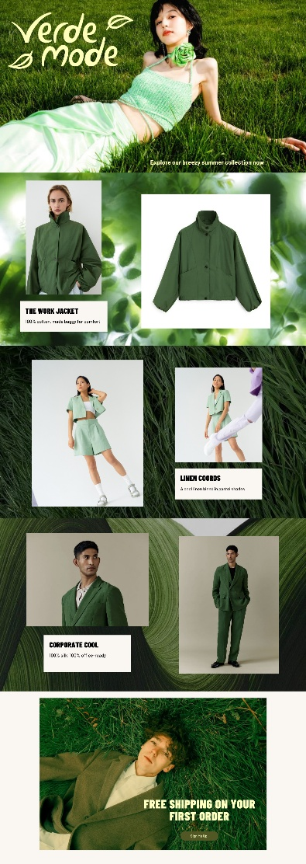


Logo Design and Template Promotion Slides
per basic tee (life-cycle); ranges by SKU; methodology in verifiable docs

Slide 6
Brand Story
All successful brands need a strong powerful message wrapped up in an appealing story
Suggested Story Template
VerdeMode Studio was founded with one simple belief…:
Inspired by nature and modern minimalist design..
Every piece is carefully produced…
Instead of encouraging fast fashion…
By choosing VerdeMode, customers are investing…
Together, we can reshape the future of fashion…

Slide 7
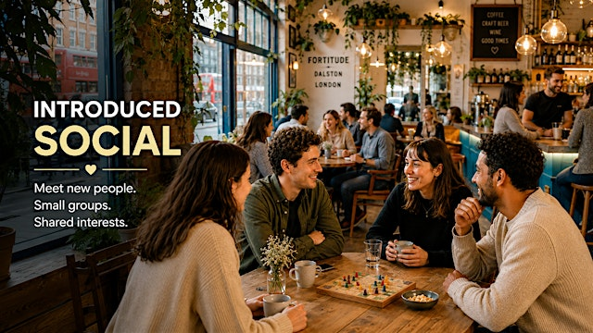
Marketing Strategy
Increase
Brand awareness
Boost website traffic
Hold online sales
Customer engagement
IRL events
Brand loyalty
Build an online and offline community around sustainable fashion

Slide 8






Social Media and Content Strategies
Instagram
Pinterest
TikTok
Website Blog
Email Marketing
Video Content
Daily outfit inspiration
Product Launches
Behind-the-scenes videos
Customer photos
Reels
Sustainable wardrobe ideas
Fashion mood boards
Eco-friendly lifestyle tips
Seasonal collections
Outfit transformations
“Day in our studio”
Sustainable fashion tips
Packaging process
Customer reviews
Why slow fashion matters
How ethical clothing protects the environment
10 ways to build a capsule wardrobe
Sustainable fashion trends
New arrivals
Exclusive discounts
Sustainability news
Fashion advice
Manufacturing process
Material sourcing
Styling guides
Customer Stories
Impact of sustainable clothes on the environment

Slide 9



Search Engine Optimization (SEO)
Keyword Strategy, use words like:
Sustainable fashion
Eco-friendly clothing
Ethical fashion
Organic cotton clothing
Minimalist fashion
On-Page SEO
Optimized page titles
Meta descriptions
Image ALT text
Fast loading website
Mobile-friendly design
Off-Page SEO
Fashion bloggers
Backlinks
Social media sharing
Online directories
Customer reviews

Slide 10




Cloud Computing
Cloud computing allows VerdeMode to run services over the internet
Benefits
Examples
24/7 web hosting
Data storage
Collaboration
Scalability
Backup
Google Drive
Microsoft OneDrive
Amazon Web Services
Microsoft Azure

Slide 11








Security Measures (Protecting the Website)
SSL Certificate
Strong Password Policy
Secure Payment Gateway
Regular Software Update
Firewall
Anti-Malware Software
Daily Backups
Privacy Compliance

Slide 12

Expected Benefits
Implementing these online strategies will help VerdeMode Studio:
Increase brand awareness
Build customer trust
Improve search engine rankings
Boost online sales
Create long-term customer loyalty
Strengthen its reputation as a sustainable fashion brand

Slide 13

Conclusion
VerdeMode Studio has the opportunity to become a recognized sustainable fashion brand
By combining:
A consistent brand identity
Effective digital marketing
Cloud technology
Strong cybersecurity
The company can successfully connect with environmentally conscious consumers while supporting long-term business growth

Slide 14





Thanks!
Do you have any questions?

