Slide 1
Introduction to Physiology (BMHP5023)
Week 4 Session 2: The Respiratory System
Breathing, the lungs and gas exchange, made simple

Slide 2




What we will cover today
The structure of the lungs
The main parts and what they look like
The journey of air
From the nose all the way down to the air sacs
How breathing and gas exchange work
How oxygen gets in and carbon dioxide gets out
Lungs and heart as a team
How the respiratory and cardiovascular systems link

Slide 3
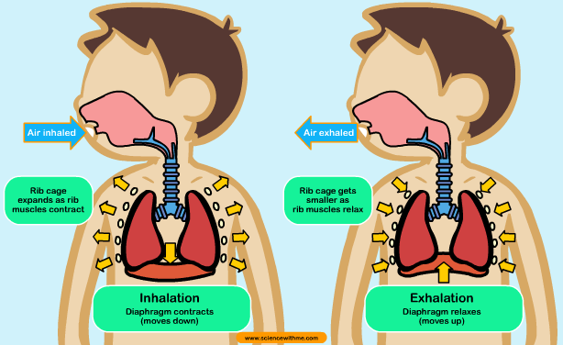


What is the respiratory system for?
Breathe in oxygen (O2)
The gas our cells need to make energy
Breathe out carbon dioxide (CO2)
The waste gas our cells make
In simple terms: the lungs put oxygen INTO the blood and take carbon dioxide OUT of it. The heart then carries the oxygen around the body.

Slide 4
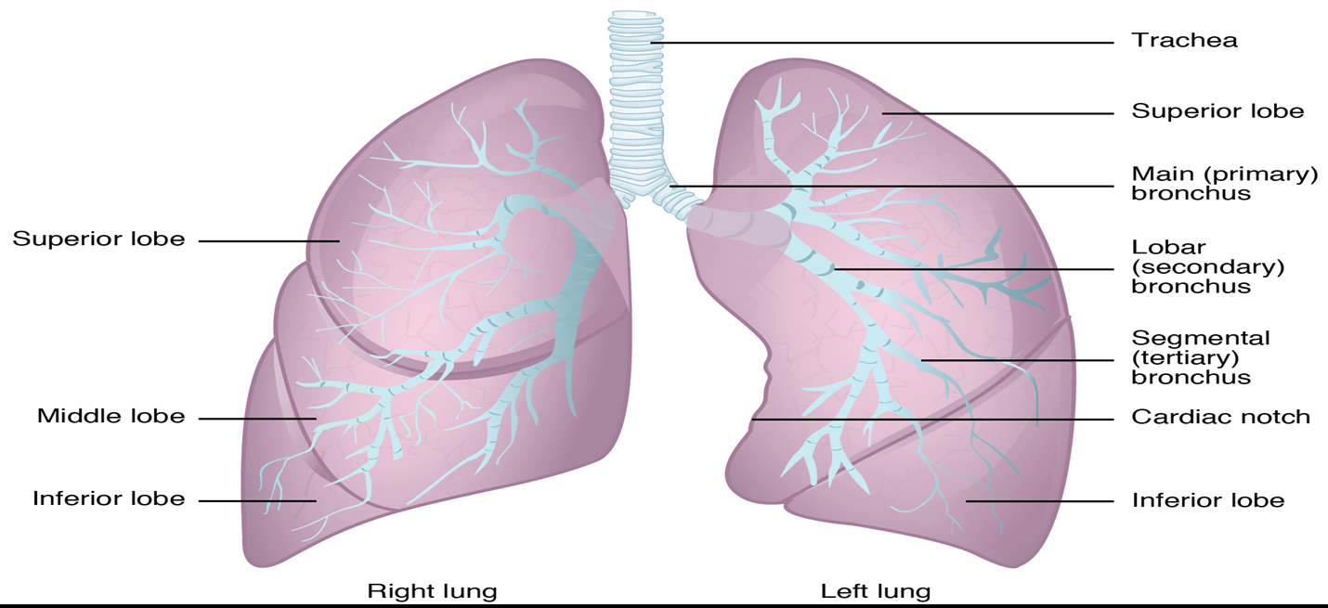
The lungs from the outside
Right lung
3 lobes (top, middle, bottom). Shorter and wider.
Left lung
2 lobes, plus the cardiac notch: a dip that makes room for the heart.
Lobe
A section of a lung. 'Superior' = top, 'inferior' = bottom.

Slide 5
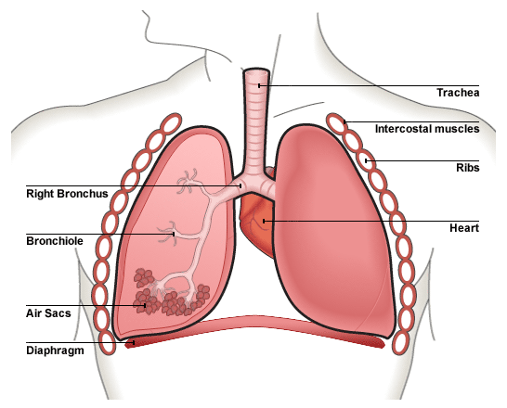
Key facts about the lungs
Two lungs, shaped like cones, inside the chest
Joined to the windpipe (trachea) by two tubes called bronchi
The diaphragm is a dome-shaped muscle underneath the lungs
Right lung: shorter and wider
Left lung: smaller, with a cardiac notch for the heart
In simple terms: two spongy bags of air in the chest, sitting on a muscle (the diaphragm), with the heart tucked in on the left.

Slide 6
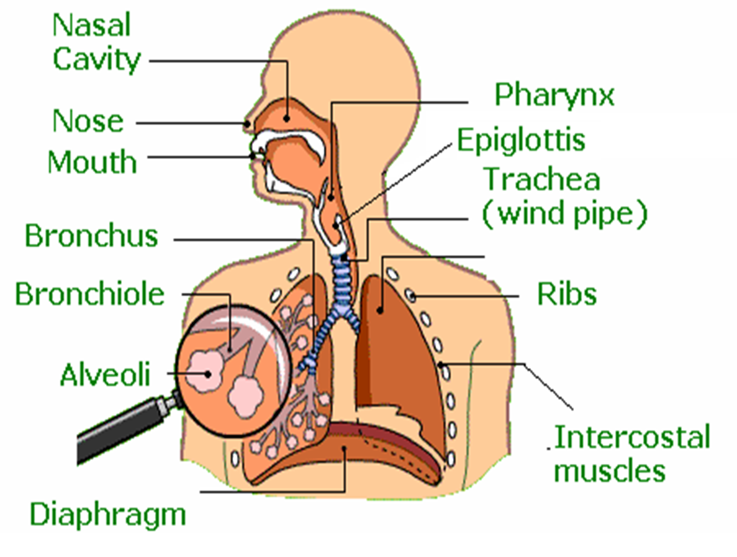
The main parts of the respiratory system
Upper airway
Nose, mouth, nasal cavity, pharynx (throat), epiglottis
Airway tubes
Trachea (windpipe), bronchus, bronchiole
Air sacs
Alveoli: where oxygen enters the blood
Breathing muscles
Diaphragm and intercostal muscles, protected by the ribs

Slide 7

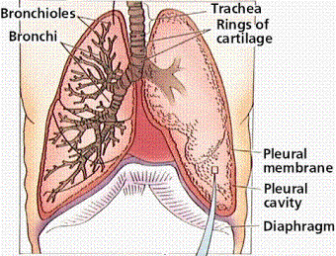
The airway is like an upside-down tree
Trachea
Bronchi
Bronchioles
Alveoli
= Trunk
= Branches
= Twigs
= Leaves
The windpipe: one wide tube held open by rings of cartilage
Two thick tubes, one into each lung
Smaller and smaller tubes spreading through the lung
Tiny air sacs, like bunches of grapes, where gas exchange happens
In simple terms: air goes down the trunk, into the branches and twigs, and ends in the leaves (the alveoli).

Slide 8
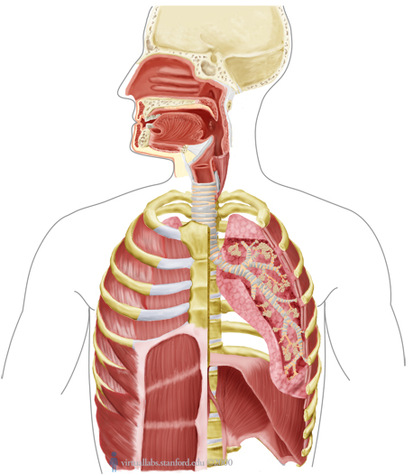
The journey of air, step by step
1
Nose / mouth Air comes in
2
Nasal cavity Air is warmed, moistened and cleaned
3
Larynx The voice box, in the throat
4
Epiglottis A flap that stops food going down the windpipe
5
Trachea The windpipe
6
Bronchi Two tubes, one into each lung
7
Bronchioles Smaller and smaller tubes
8
Alveoli Tiny air sacs: oxygen passes into the blood

Slide 9
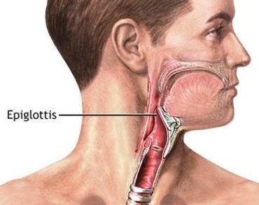


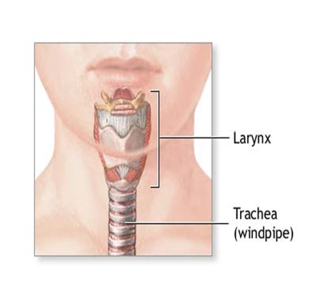

From the nose to the windpipe
Nasal cavity
Warms, moistens and cleans the air
Pharynx and larynx
Pharynx = the throat (air and food). Larynx = the voice box
Epiglottis
A lid that closes when we swallow, so food does not go down the windpipe
Trachea
The windpipe: a flexible tube held open by rings of cartilage

Slide 10
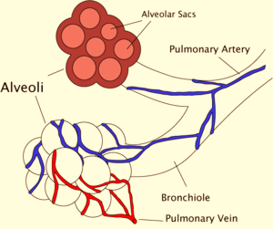

Alveoli: where air meets blood
Blue capillaries
Bring oxygen-poor blood from the heart to the alveoli
Red capillaries
Take oxygen-rich blood back to the heart
300 to 500 million
alveoli in an adult's lungs
In simple terms: blue arrives empty, red leaves full of oxygen.

Slide 11
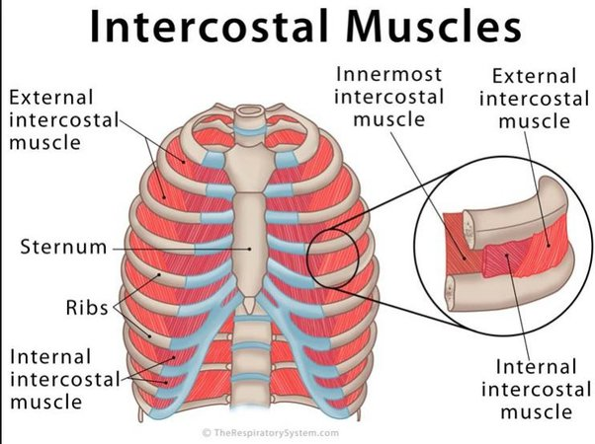

The breathing muscles
Diaphragm
A dome-shaped sheet of muscle under the lungs. The main breathing muscle.
Intercostal muscles
Muscles between the ribs. They lift the rib cage so the chest gets bigger.
In simple terms: the lungs cannot move on their own. The diaphragm and rib muscles do the work.

Slide 12
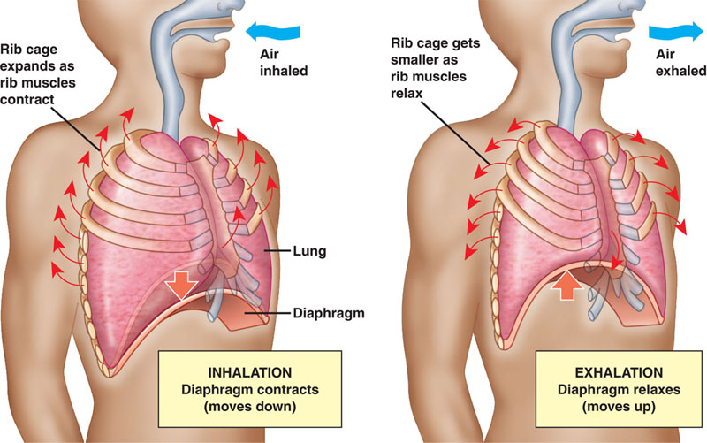
Breathing in and breathing out
Breathing in
Diaphragm contracts and moves down
Ribs move up and out
Chest gets bigger: air rushes in
Breathing out
Diaphragm relaxes and moves up
Ribs move down and in
Chest gets smaller: air is pushed out
In simple terms: bigger chest = air in, smaller chest = air out. It works like a pair of bellows.

Slide 13


Why do we need oxygen?
We breathe in oxygen
Oxygen enters the blood
Cells use it to make energy
Energy powers our muscles and organs
In simple terms: oxygen is the fuel that lets cells turn food into energy. Carbon dioxide is the exhaust fumes, which we breathe out.

Slide 14
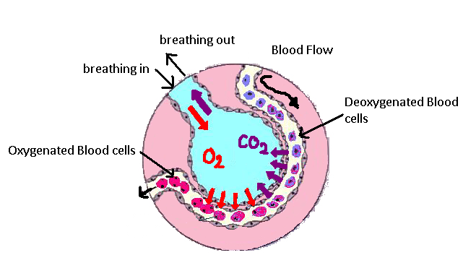
What is gas exchange?
Gas exchange is oxygen and carbon dioxide swapping places between the air in the lungs and the blood.
Diffusion: things spread from where there is a lot to where there is little (high to low).
Oxygen: alveoli into blood
Lots in the lungs, little in the blood
In simple terms: like perfume spreading across a room.
Carbon dioxide: blood into alveoli
Then breathed out

Slide 15
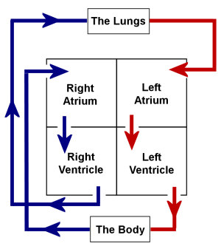
Teamwork: the lungs and the heart
Lungs
Oxygen enters the blood
Pulmonary veins
Carry oxygen-rich blood to the heart
Left side of heart
Pumps it around the body
Body cells
Use the oxygen and make CO2
Right side of heart
Sends oxygen-poor blood back to the lungs
...and back to the lungs again
In simple terms: the lungs LOAD the oxygen; the heart DELIVERS it. Neither system works without the other.

Slide 16
Case study 1: Mrs Evans and the cup of tea
Group discussion: 15 minutes

Slide 17

Case study 1: meet Mrs Evans
15 minutes
The situation
You visit Mrs Evans at lunchtime. Since her stroke, she finds swallowing harder. Today she is slumped down in her armchair, drinking a cup of tea.
As she drinks, she starts coughing and spluttering, and her voice sounds 'wet' and gurgly afterwards.
Her daughter mentions that her mum has had a few chest infections since the stroke.
Mrs Evans, 81
Lives: at home with daily carer visits
Health: had a stroke six months ago
Care plan: sit upright to eat and drink

Slide 18
Case study 1: discuss in your group
15 minutes
1
Which part of the throat normally stops food and drink from going down the windpipe? What might be going wrong for Mrs Evans?
2
If some tea goes the wrong way, trace where it could end up, from the throat down to the smallest part of the lungs.
3
Why could this lead to a chest infection such as pneumonia? What would that do to gas exchange?
4
What should you do now, and how could her care help prevent this happening again?
5 min Read and talk it through
7 min Answer the questions
3 min Feed back to the class

Slide 19

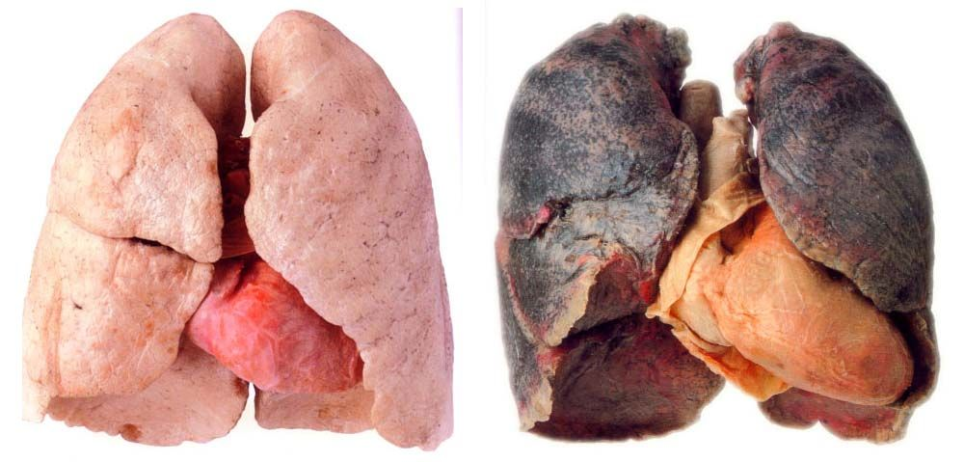
Lung diseases: asthma and COPD
Asthma
A long-term condition of the airways
The airways swell and narrow
Symptoms: breathlessness, tight chest, coughing and wheezing
COPD
Chronic obstructive pulmonary disease
A group of lung conditions that cause breathing difficulties
Smoking is the main cause
In simple terms: chronic = long-lasting; obstructive = the airways are partly blocked. Left: a healthy lung next to a smoker's lung.

Slide 20
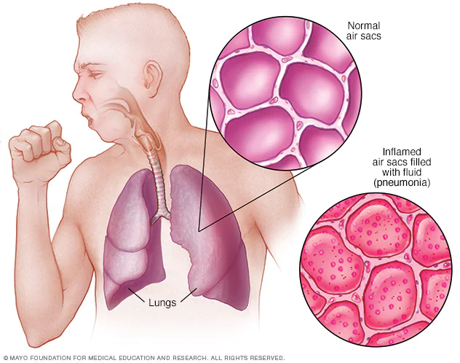
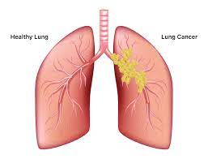
Lung diseases: pneumonia and lung cancer
Pneumonia
Lung cancer
An infection that inflames the air sacs
The sacs fill with fluid or pus
Causes cough with phlegm, fever, chills and breathlessness
Primary: the cancer starts in the lungs
Secondary: it spreads to the lungs from elsewhere in the body

Slide 21
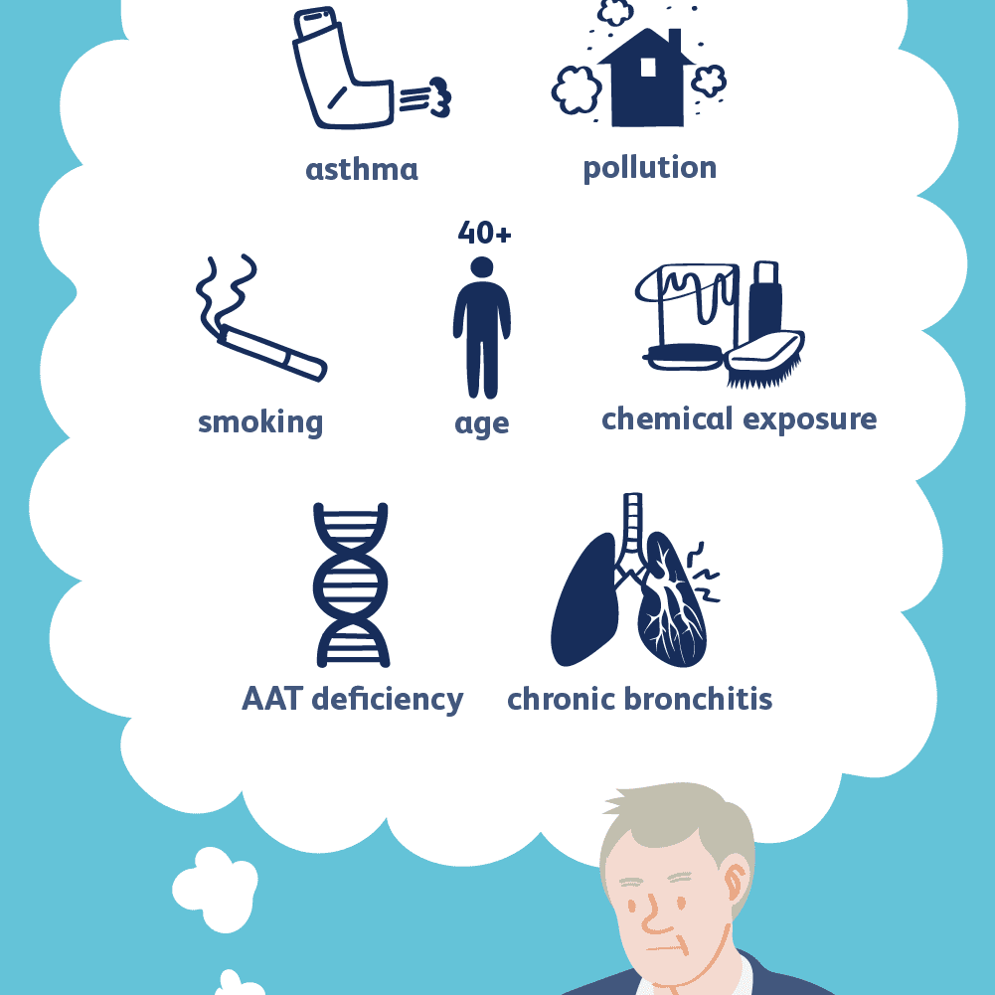


What causes respiratory diseases?
Smoking
The biggest preventable cause
Pollution and chemicals
Outdoor air pollution; dust, fumes and chemicals at work or home
Age (40+)
Risk rises as we get older
Genes (AAT deficiency)
An inherited condition that leaves the lungs less protected
Other lung conditions
Asthma and chronic bronchitis

Slide 22


Role of the care professional: advice to give
Do not smoke
Avoid indoor pollutants
Limit outdoor air pollution
Prevent infection
Have regular check-ups
Exercise
Further reading: Department of Health (2012) An Outcomes Strategy for COPD and Asthma: NHS Companion Document.

Slide 23
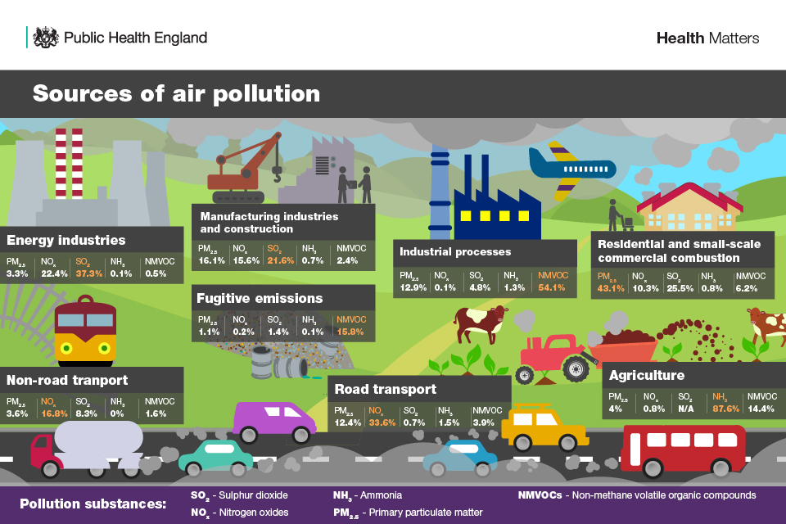
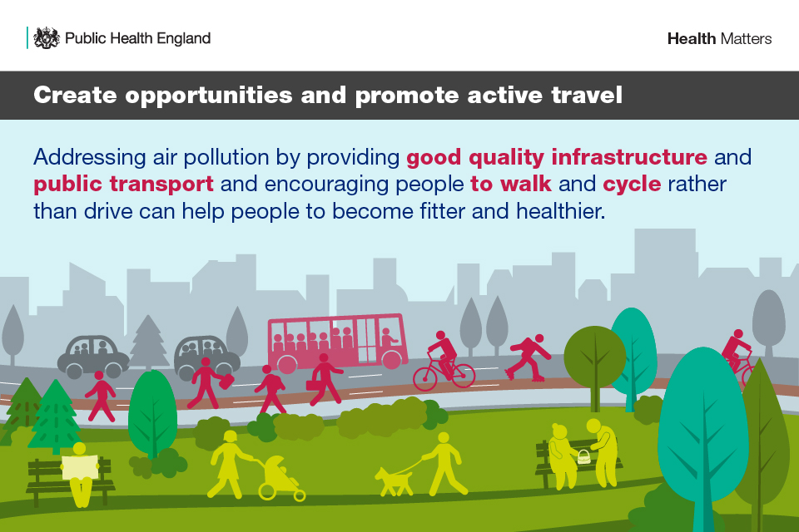
UK strategies: tackling air pollution
Where pollution comes from: energy, industry, transport, farming and homes
One solution: make walking, cycling and public transport easier than driving
Source: Public Health England (2018) Health matters: air pollution. GOV.UK.

Slide 24


Care: monitoring, planning and routines
Pulmonary rehab
A programme of exercise and education for people with lung disease or breathlessness
Finding people who need it
GP practices check their COPD lists for patients never referred to rehab
Better use of inhalers
Where suitable, switch to dry powder inhalers: better for the environment
In simple terms: help people breathe better, find those who are missing out, and review their medicines.
Source: NHS (2019) The NHS Long Term Plan: respiratory disease.

Slide 25






Ethics in respiratory care
Be honest and trustworthy
Act with integrity and objectivity
Keep learning
Stay up to date in your practice
Work within your role
Only do what you are trained to do
Protect rights and privacy
Keep patient data confidential
Treat everyone fairly
Never discriminate
Follow the law
UK law, data protection and your professional code
Source: adapted from NHS Providers (2023).

Slide 26


Health promotion for healthy lungs
Do not smoke
Avoid smoke, dust and chemicals
Eat a healthy diet
Keep a healthy weight
Stay active and exercise
Reduce exposure to pollution
Avoid infections
Breathe deeply
Source: Healthline (2023).

Slide 27
Case study 2: Mr Hughes and his breathing
Group discussion: 15 minutes

Slide 28
Case study 2: meet Mr Hughes
15 minutes
The situation
Mr Hughes has COPD. He gets breathless walking to the shops and coughs up phlegm most mornings. He has had two chest infections this winter.
He uses his blue reliever inhaler many times a day. He was offered pulmonary rehabilitation last year but did not go: "What's the point? Exercise just makes me out of breath."
You are a health and social care worker visiting him at home.
Mr Hughes, 66
Work history: 35 years in a dusty factory
Lifestyle: has smoked since he was 16
Home: a damp flat next to a busy main road

Slide 29
Case study 2: discuss in your group
15 minutes
1
What is COPD? Explain in simple words what is happening in Mr Hughes's lungs and why he gets breathless.
2
Which causes of respiratory disease can you spot in his story? Think about the causes slide.
3
What advice and support could you give him? Include pulmonary rehab, inhalers, infection and his home.
4
Mr Hughes feels it is pointless. How would you talk to him, and what ethical principles should guide you?
5 min Read and talk it through
7 min Answer the questions
3 min Feed back to the class

Slide 30

Videos to watch
The respiratory system
https://www.youtube.com/watch?v=hc1YtXc_84A
Pulmonary (lung) diseases
https://www.youtube.com/watch?v=-oHlcuS7AeU

Slide 31
In-class activity
Label the lungs
Name the lobes, the bronchi, the trachea and the cardiac notch
Follow the air
Put the parts in order, from the nose to the alveoli
Explain breathing
Use the diagram to explain breathing in and out, and gas exchange
Use your workbook for Week 4 Session 2. We will go through the answers together.

Slide 32
Check your understanding
What is the main purpose of the respiratory system?
How is the left lung different from the right?
1
2
Put the airway in order, from nose to alveoli.
What do the red and blue capillaries around the alveoli show?
3
4
What happens to the diaphragm when we breathe in?
What is gas exchange, and how does diffusion help?
5
6

Slide 33
Key words in plain English
Trachea | The windpipe
Bronchi / bronchioles | Large / small air tubes inside the lungs
Alveoli | Tiny air sacs where oxygen enters the blood
Pharynx / larynx | The throat / the voice box
Epiglottis | A flap that stops food going down the windpipe
Diaphragm | The dome-shaped breathing muscle under the lungs
Intercostal muscles | Muscles between the ribs
Gas exchange | Oxygen and carbon dioxide swapping places
Diffusion | Spreading from a lot to a little
Pulmonary | To do with the lungs

Slide 34
References
Department of Health (2012) An Outcomes Strategy for COPD and Asthma: NHS Companion Document. Available at: https://assets.publishing.service.gov.uk/government/uploads/system/uploads/attachment_data/file/216531/dh_134001.pdf
Healthline (2023) Ways to keep your lungs healthy. Available at: https://www.healthline.com/health/understanding-idiopathic-pulmonary-fibrosis/ways-to-keep-your-lungs-healthy-and-whole
NHS (2019) The NHS Long Term Plan: respiratory disease. Available at: https://www.longtermplan.nhs.uk/online-version/chapter-3-further-progress-on-care-quality-and-outcomes/better-care-for-major-health-conditions/respiratory-disease/
NHS Providers (2023) Ethical considerations. Available at: https://nhsproviders.org
OpenStax (2013) Anatomy and Physiology. Available at: https://opentextbc.ca/anatomyandphysiology/
Public Health England (2018) Health matters: air pollution. Available at: https://www.gov.uk/government/publications/health-matters-air-pollution/health-matters-air-pollution

Slide 35
Any questions?
Next week: the digestive and urinary systems

