Slide 1
Module Code:ACCA6022
Module Name:Switching, Routing and Wireless
Lesson 3
Title: Dynamic routing

Slide 2
Lesson Aims
Routing information Protocol
Dynamic Routing
Practical tasks on Dynamic Routing (RIP

Slide 3
Function of Router
A router is a switching device for networks, which is able to route network packets, based on their addresses, to other networks or devices.

Slide 4
Static and Dynamic Routing
A static routing table is created, maintained, and updated by a network administrator, manually. A static route to every network must be configured on every router for full connectivity.
A dynamic routing table is created, maintained, and updated by a routing protocol running on the router

Slide 5
Static Routing
Static Routing is the process in which static routes are manually added to the routing table through the direct configuration.
Router(config)#ip route [destination_network][subnet_mask][next-hop_address or exitinterface]. ip route is used to create a static route

Slide 6
Advantage of Static Routing
Static routing provides some advantages over dynamic routing, including: Static routes are not advertised over the network, resulting in better security. Static routes use less bandwidth than dynamic routing protocols, as routers do not exchange routes

Slide 7
Dynamic routing RIP
RIP uses a distance vector algorithm to decide which path to put a packet on to get to its destination. Each RIP router maintains a routing table, which is a list of all the destinations the router knows how to reach. Each router broadcasts its entire routing table to its closest neighbors every 30 seconds.

Slide 8
What is difference between RIP and OSPF?
The main difference between OSPF and RIP is that RIP only keeps track of the closest router for each destination address, while OSPF keeps track of a complete topological database of all connections in the local network.

Slide 9
Uses of RIP protocol
RIP, like all routing protocols, is designed to disseminate network information pertinent to routers. At the most basic level, routers need to know what networks are reachable and how far away they are. RIP does this, and it's still widely used toda

Slide 10
Disadvantages of RIP
This is one of the biggest disadvantages of RIP. Bandwidth utilization in RIP is very high as it broadcasts its updates every 30 seconds. RIP supports only 15 hop count so a maximum of 16 routers can be configured in RIP.

Slide 11
Advantages of OSPF over RIP
OSPF routing protocol has complete knowledge of network topology, allowing routers to calculate routes based on incoming requests. OSPF protocol has no limitations in hop count, unlike RIP protocol that has only 15 hops at most. So OSPF converges faster than RIP and has better load balancing

Slide 12
Configuring RIP requires the following steps:
Step 1 Enable the RIP routing process, which places you in router configuration mode via the Router#router rip command.
Step 2 Specify those networks that should be advertised using RIP via the Router(config-router)#network [network-number] command

Slide 13
Example of Commands
Router>enable
Router#
Router#configure terminal
Router(config)#interface FastEthernet0/0
Router(config-if)# ip address 192.168.12.2 255.255.255.0
Router(config-if)# no shutdown
Router>enable
Router#
Router#configure terminal
Router(config)#interface Serial0/0/0
Router(config-if)# ip address 192.168.12.2 255.255.255.0
Router(config-if)# no shutdown

Slide 14
Example of Commands
Router#config t
Enter configuration commands, one per line. End with CNTL/Z.
Router(config)#router rip
Router(config-router)#network 192.168.40.0
Router(config-router)#network 192.168.30.0
Router(config-router)#network 192.168.50.0
Router(config-router)#

Slide 15
Practical task 1 using RIP
How many Networks are there?
Set up IP address for this network
Configure Router using RIP Protocol using CLI Mode
Ping

Slide 16
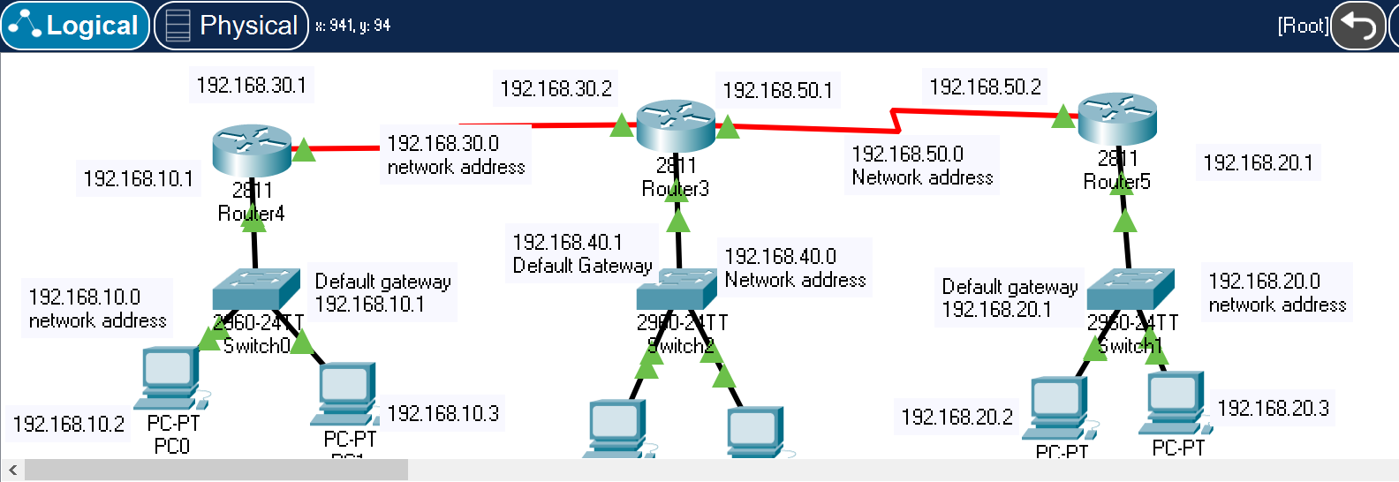
Practical Task 1 Using RIP

Slide 17
References
Andrew S Tanenbaum, David J. Wetherall ( 2013) Computer Networks, Pearson
Anttalainen, Tarmo(2003), Introduction to Telecommunications Network Engineering.
https://web-b-ebscohost-com.ezproxy.uwtsd.ac.uk/ehost/ebookviewer/ebook/bmxlYmtfXzg3NzM0X19BTg2?sid=2327383a-5654-4205-9324-0a82e27ed6e0@pdc-v-sessmgr02&vid=5&format=EB&rid=7
Todd Lammle (2016), CCNA Routing and Switching Complete Study Guide: Exam 100-105, Exam 200-105, Exam 200-125 Sybex

