Slide 1

Cosmologies
New thoughts 4 November
2024

Slide 2
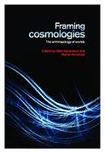
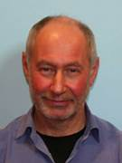
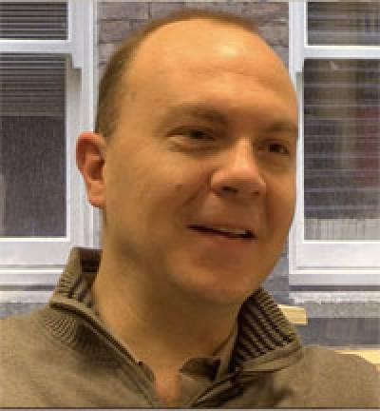
New reading
Abramson, Allen and Martin Holbraad, ‘Contemporary Cosmologies, Critical Reimaginings’, Religion and Society: Advances in Research, Vol. 3 (2012), pp. 35-50.
You can contact them via academia.edu and ask for a PDF (say we recommended you)
Abramson, Allen and Martin Holbraad (eds), Framing Cosmologies: the Anthropology of Worlds, Manchester: Manchester University Press, 2014).
E book via University library
Try chapter 1

Slide 3
Abramson and Holbraad are critical of traditional anthropologists’ views of cosmologies which are
That non-western ‘indigenous’ people had cosmologies, as in constructed but imaginary views of the universe, whereas westerners have science
Anthropologists stopped looking for non-western cosmologies in the 1960s
Instead (as we do in the Sophia Centre), they argue that
‘Western’ cultures have constructed cosmologies and
(b) the examination of cosmologies is important and ongoing

Slide 4
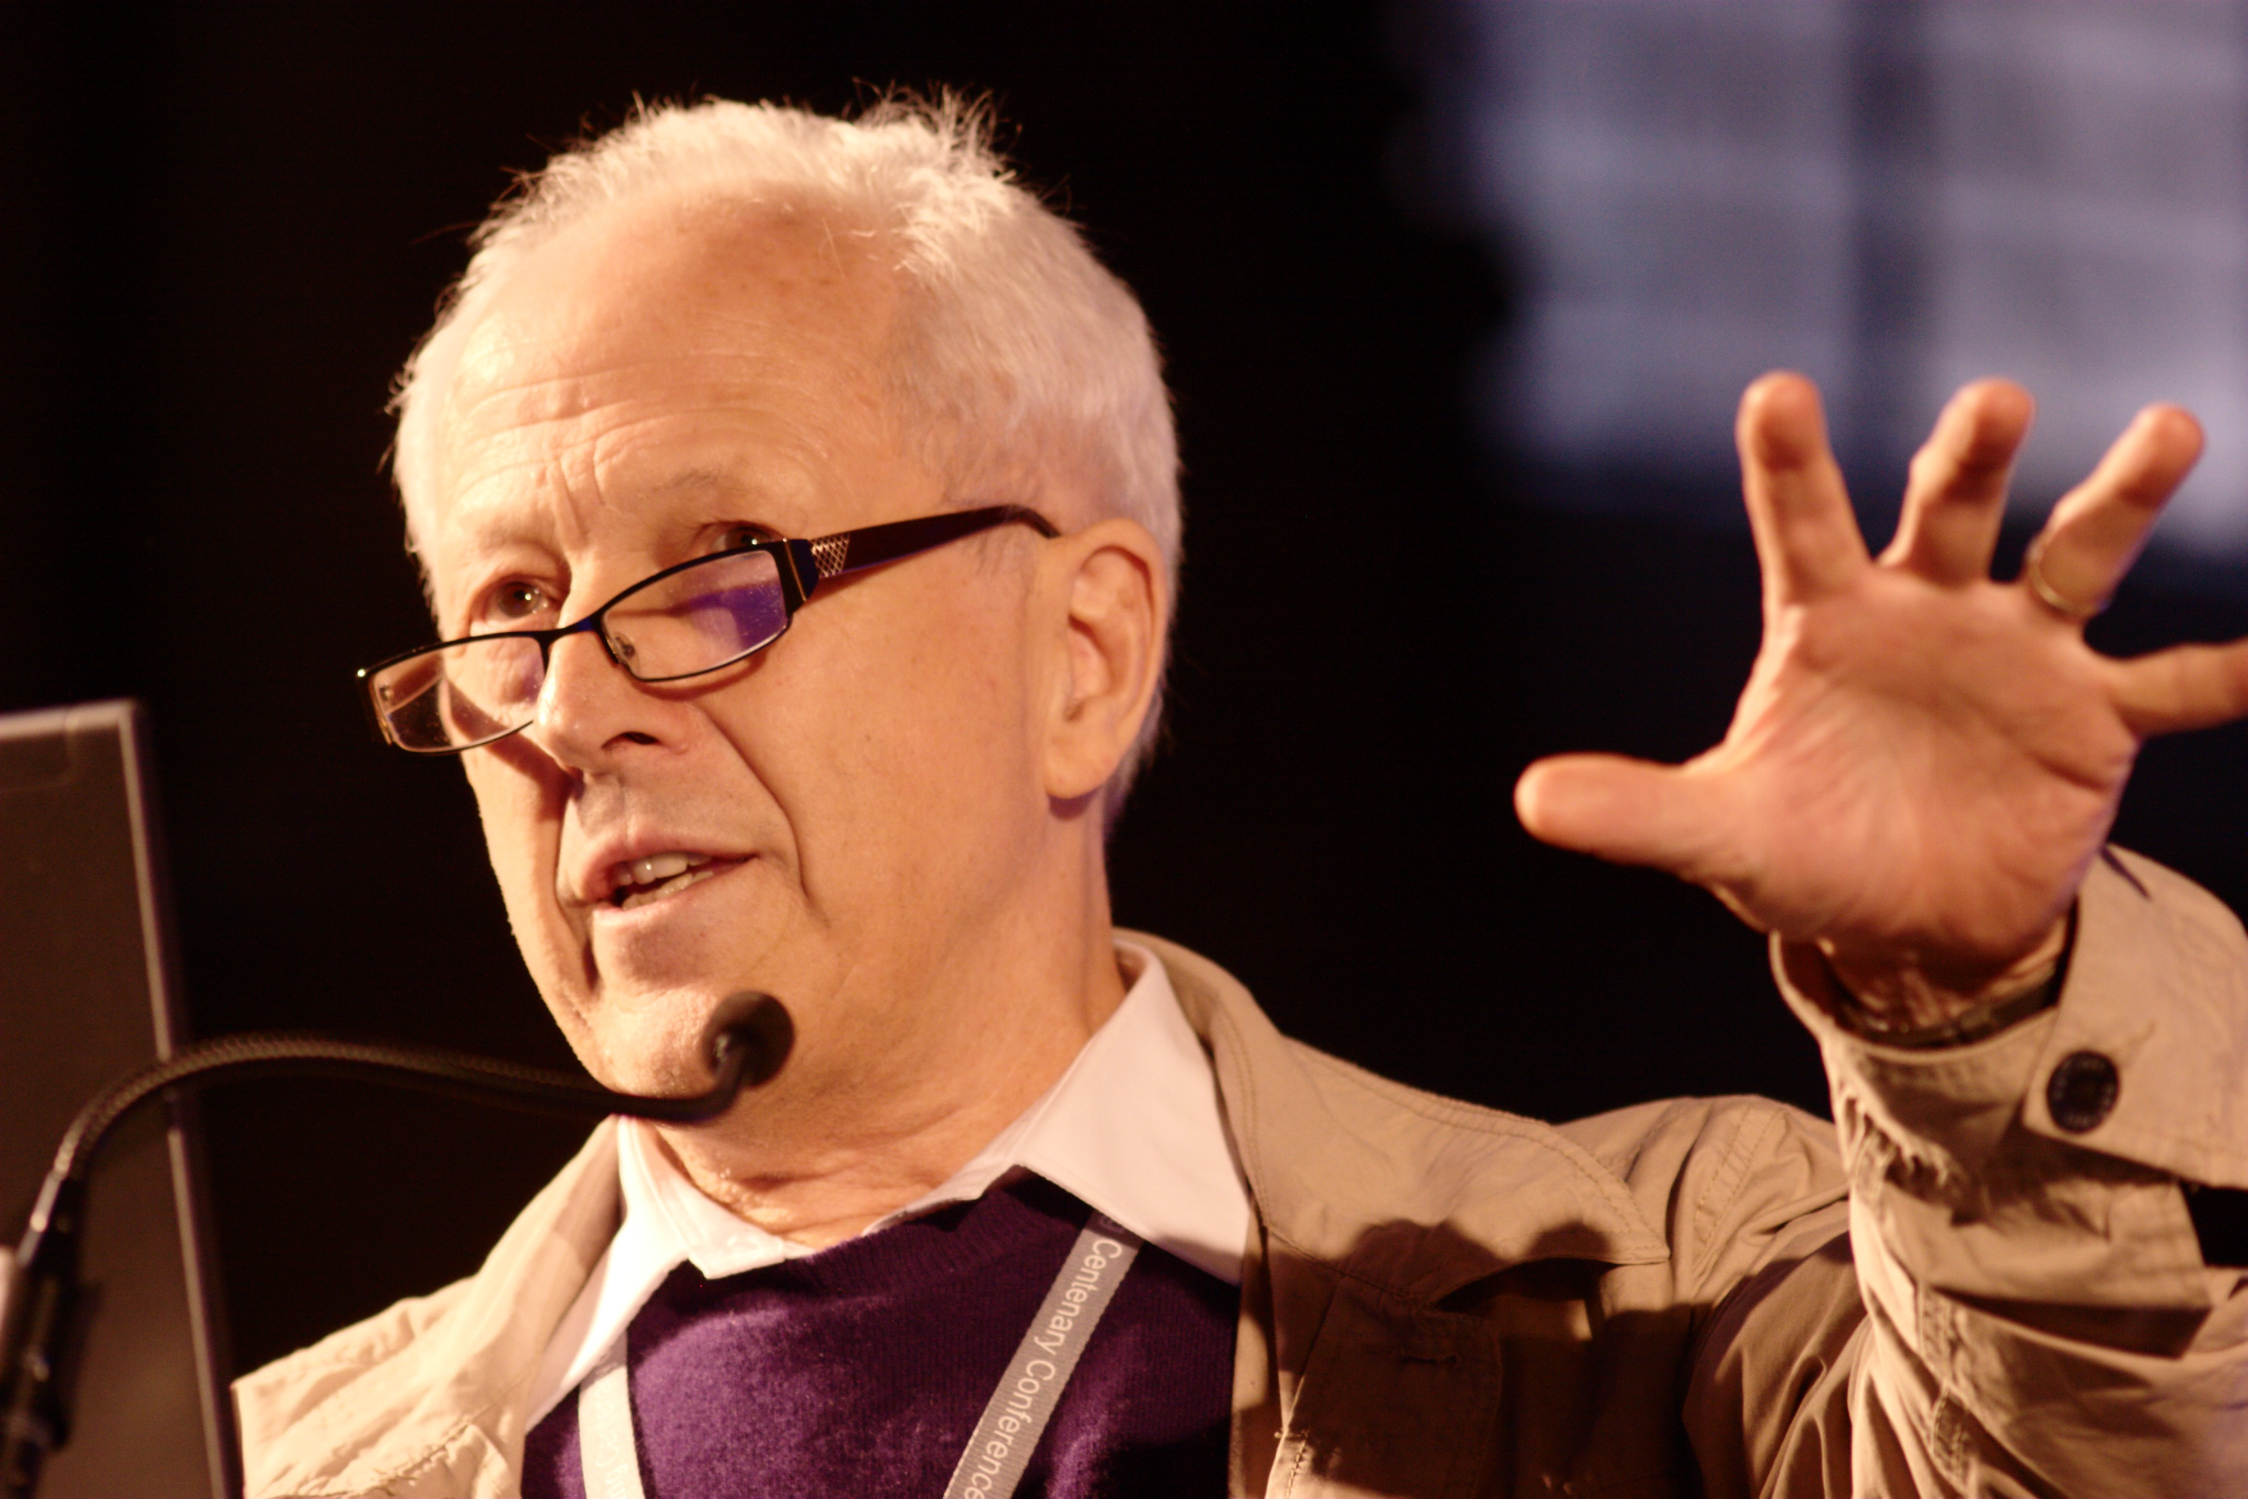
And
Ellis, George, ‘Issues in the Philosophy of Cosmology’, in Jeremy Butterfield and John Earman (eds), Philosophy of Physics (Elsevier: Amsterdam, 2006), pp. 1183-1285
Online 5 February 2008, https://arxiv.org/pdf/astro-ph/0602280.pdf
Ellis’s main concern is with ways of framing contemporary scientific cosmology, ie, astrophysics.
He separates ‘mathamticising’ cosmology from ‘human’ cosmology (ie Abramson and Holbraad’s focus), but in the western tradition traces them both to Plato.

Slide 5
Personal cosmologies
We have multiple ‘human’ cosmologies as a result of our membership of nationalities, ethnicities, genders, religions (or not), and families traced through the past and in the present - and our unique personalities.
We might see the world as difficult, easy, united, fragmented, and our place in it as?

Slide 6
Worldview
A worldview is ‘a [wo]man’s idea of the universe. It is that organization of ideas which answers to a man the questions: Where am I? Among what do I move? What are my relations to these things?’
Robert Redfield, ‘The Primitive World View’, Proceedings of the American Philosophical Society, vol. 96, (1952), p. 30.
Do you have a personal cosmology?
What view of the cosmos makes sense to you?

