Slide 1
Ffion Limited
Ratio Analysis
M5X01922_LON
Lecturer Dale Clarke
Erol Asan
1814997
1814997@student.uwtsd.ac.uk
November 2019

Slide 2
According to (Gitman and Zutter, 2015) a firm's performance can be quantified through methods of calculations, known as financial ratios.
(Greninger, 1996) stipulates that financial ratios have been utilized for 50 years, making them a large part of how the market has set benchmarks
The main point of ratio analysis is that it merely points to areas of concern and not actually provides conclusive proof of the existence of a problem. That makes the interpretation of the numbers the actual tool for decisions

Slide 3
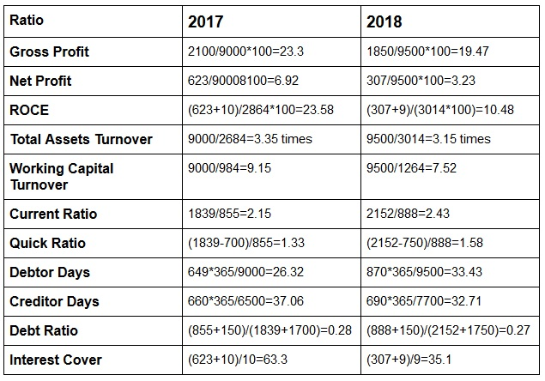
Financial Analysis
Below, are the 11 ratios selected for analysis, split for contrast into 2 columns, representing 2017, and 2018.

Slide 4
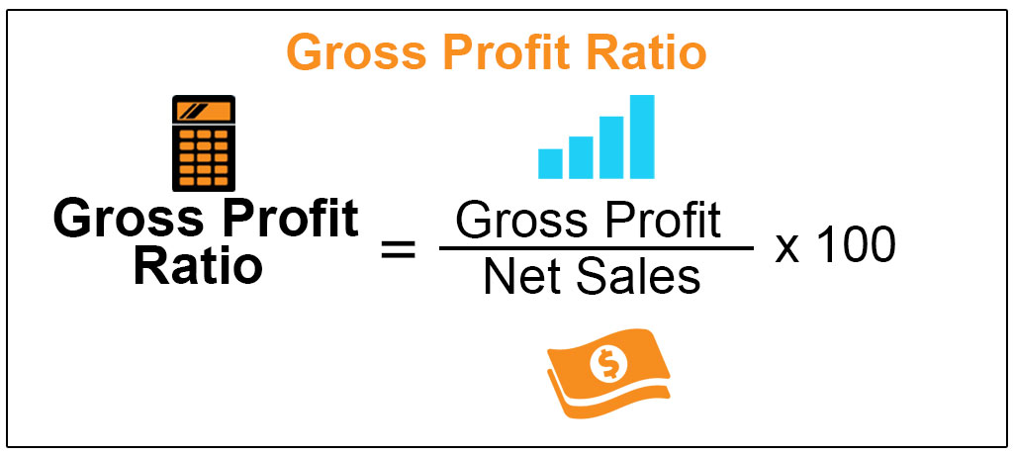

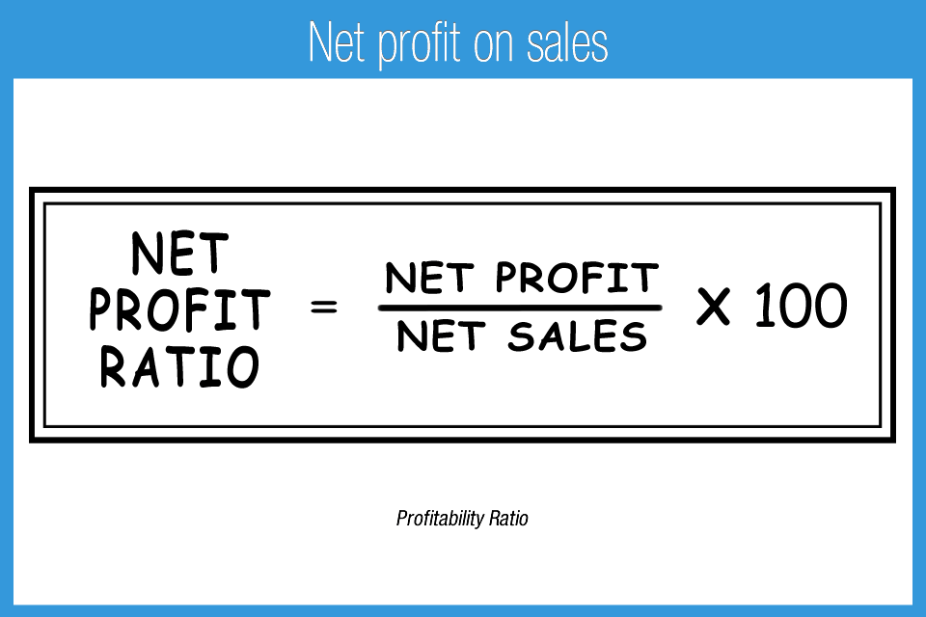
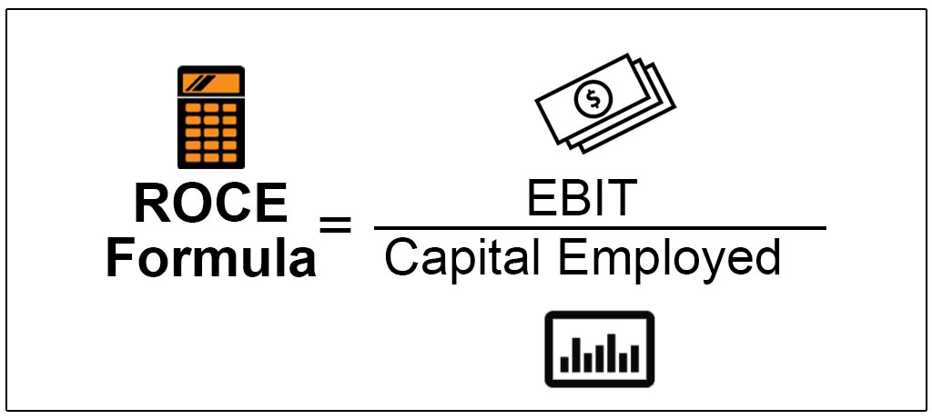
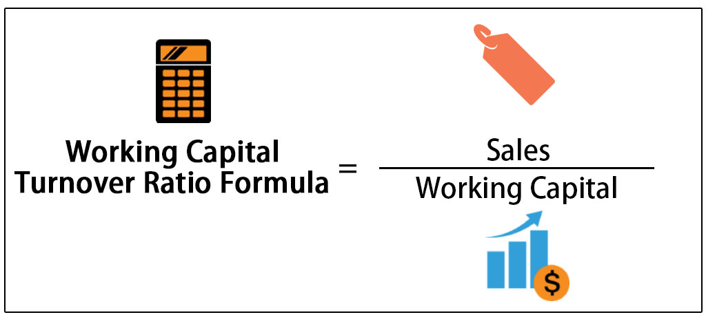
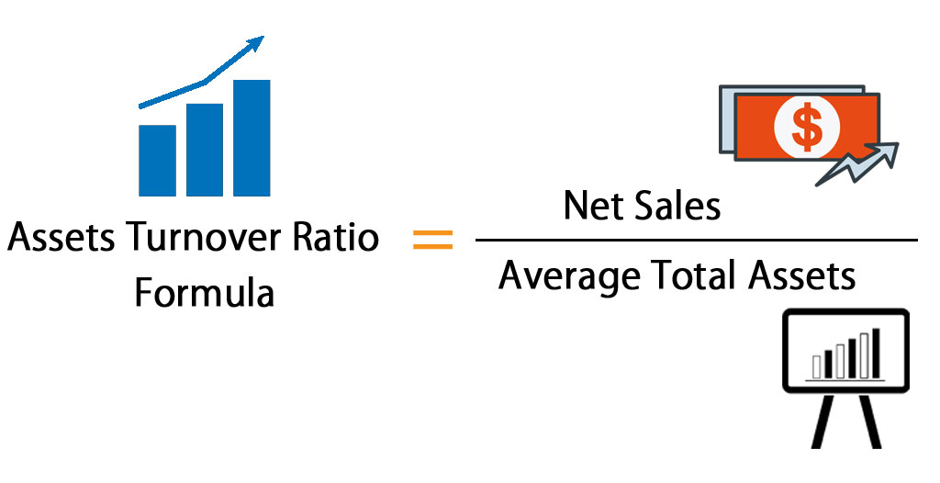
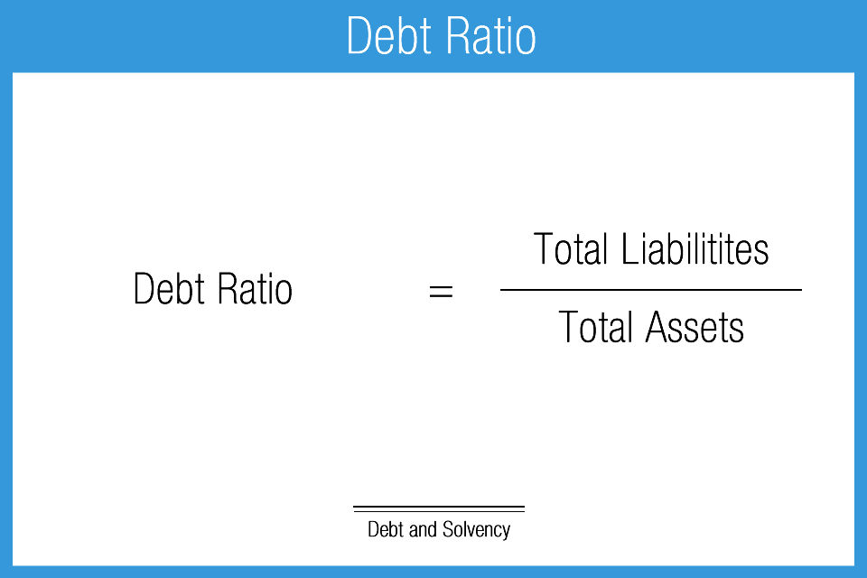

A business's most important aspect is generating profit.
Comparing gross profits ratios for Ffion Limited shows a drop of close to 4%
the benchmark being around 30%
.(Atrill and MacLaney, 2001) state that the oscillation could have something to do with sales, costs and pricing, and in the hotel industry , occupancy can be determined by internal as well as external factors, thus oscillations occur regularly.
The Net profit ratio, is directly linked with the Gross profit ratio.
New strategies might be required for a more efficient structure

Slide 5

Gearing
(Bragg, 2019), ‘’Gearing is about how a company boroughs against its own equity levels’’.

Slide 6


Slide 7
Proposed plan to achieve better results for the following year:
Examine sales history, for price adjustments.
Obtain loans from banks to promote growth and attract
even more guests.
Consolidate loans already taken out.
Asset management.
Improve debt collection, negotiate contracts ,add
penalty fees for past due bills that have been credited.

Slide 8
Conclusion
After analysing specific ratios generated from internal financial records, this report has come to the following conclusions:
The Gross Profit and Net Profit have gone down, overall
profits have decreased in 2018.
Liquidity ratios show that despite lower profits, the company
in 2018 has the ability to cover its debts at a superior level
than it had in 2017.
The gearing ratios show that the possibility of taking out
loans with a reduced interest rate have made the company
seem more stable for creditors.
The efficiency with which assets are handled seems to be
a problem.
The company isn't appearing to be aggressive in taking
out more loans to promote growth, it is consolidating itself
as stable to banks, and not being a risk at all.
Debt collection is not as efficient as it was in 2017.

Slide 9
Bibliography
Accountingtools.com. (2015). Gearing Ratio - AccountingTools. [online] Available at: http://www.accountingtools.com/gearing-ratio [Accessed 20 Nov. 2019].
Atrill, P. and MacLaney, E. (2001). Accounting and finance for non-specialists. Harlow: Financial Times/Prentice Hall.
Atrill, P and Mclaney, E (2011) Accounting and Finance for non-specialists, (7th ED.), Essex:Pearson Education Limited.
Biery, M. (2015). Can A Company Pay Its Bills? Which Industries Have Strong Liquidity Ratios?. [online] Forbes. Available at: http://www.forbes.com/sites/sageworks/2014/12/07/can-a-company-pay-its-bills-which-industries-have-strong-liquidity-ratios/#54c76f9e24e0 [Accessed 20 Nov 2019].
Bragg, S. (2019). Net profit ratio — AccountingTools. [online] AccountingTools. Available at: https://www.accountingtools.com/articles/2017/5/5/net-profit-ratio [Accessed 22 Nov. 2019].
Chadwick, L (2001) Essential Financial Accounting. Essex: Pearson Education Limited.
Demonstratingvalue.org. (2019). Financial Ratio Analysis | Demonstrating Value. [online] Available at: https://www.demonstratingvalue.org/resources/financial-ratio-analysis [Accessed 20 Nov. 2019].
Edward, D. and Wilkinson, J. (2019). Return on Capital Employed (ROCE) Definition | ROCE Formula. [online] The Strategic CFO. Available at: https://strategiccfo.com/roce/ [Accessed 22 Nov. 2019].
Gitman, L. and Zutter, C. (2015). Principles of managerial finance. 10th ed. Harlow: Pearson Education Limited, p.50.
Glakas, S. (2011). 15 Financial Ratios Every Investor Should Use | Investing Answers. [online] Investinganswers.com. Available at: http://www.investinganswers.com/education/ratio-analysis/15-financial-ratios-every-investor-should-use-3011 [Accessed 20 Nov 2019].
GOV.UK. (2019). Accounts and tax returns for private limited companies. [online] Available at: https://www.gov.uk/prepare-file-annual-accounts-for-limited-company [Accessed 22 Nov. 2019].
Greninger, S. (1996). . Ratios and benchmarks for measuring the financial well-being of families and individuals. Financial Services Review, (5).
Hussain, S. and Warner, S. (2017). Finance book - understand the numbers even if you're not a finance professional. 1st ed. FT Publishing International.
Investopedia. (2019). Why Profitability Ratios Matter. [online] Available at: https://www.investopedia.com/terms/p/profitabilityratios.asp [Accessed 20 Nov. 2019].
Owen, C (1998) Accounting for hospitality, Tourism and Leisure. Essex: Pearson Limited.
Madura, J. (2009). International Financial Management. 10th ed. Example Product Manufacturer.

