Slide 1


Cyber Awareness Game - Emerging Trends (ACCB6019)

Slide 2

Meet the team
Skyler Schenke
Content Lead
Rehan Joseph
Research Lead
Ben Jones
Project Coordination + Content
Jake Whitehouse
Developer/Tester
Kawam de Oliveira
Developer
Will Foot
UI Design, Developer

Slide 3

Phishing Is Evolving. Awareness Must Too.
Phishing is more than suspicious emails. Attackers use impersonation, urgency and convincing messages to trick
people into trusting them [1].
Convincing messages
Fake emails can look like genuine messages from
trusted organisations.
Human manipulation
Urgency, fear and curiosity pressure people into
acting quickly.
One wrong click
A mistake can expose accounts, passwords or
sensitive information.
A learning gap
Knowing phishing exists does not always mean
knowing how to recognise it.

Slide 4
Meet CyberSense
Not just "Is it phishing?" - "Can you prove why?"
﻿﻿Investigate: Click and examine suspicious parts of an email.
﻿﻿Learn: Discover why clues are suspicious through immediate explanations.
﻿﻿Experience: See simulated consequences and practise how to respond.
﻿﻿Improve: Earn points, unlock levels and receive personalised feedback.
Our difference
CyberSense turns phishing awareness from a simple quiz into an interactive learning experience that
develops real-world decision-making skills.
Notes:
(Will)
CyberSense is a web based game that aims to help people to identify phishing emails.
It will feature emails crafted to look like real-world phishing emails, as well as other genuine real-world emails.
There will also be an in-game guidebook providing information on common phishing techniques to help players spot phishing emails.
The player will then select the email, determine whether it is genuine or malicious, and provide a reason for their decision.
At the end of the game the player will receive a report highlighting the areas of the emails that were markers of a malicious email and a score that they will have the option to post to a leaderboard.
This experience should help people to reliably identify phishing emails in a fun and engaging manner.

Slide 5
Other Ideas
Phishing Email Simulation
Using the user's email address to register for a service that periodically
sends simulated phishing emails, allowing users to practise identifying
potential threats.
1
Educational Phishing Game
Developing an educational game aimed at secondary school students
to help them recognise phishing attempts and understand the risks
associated with phishing emails and attacks.
2

Slide 6
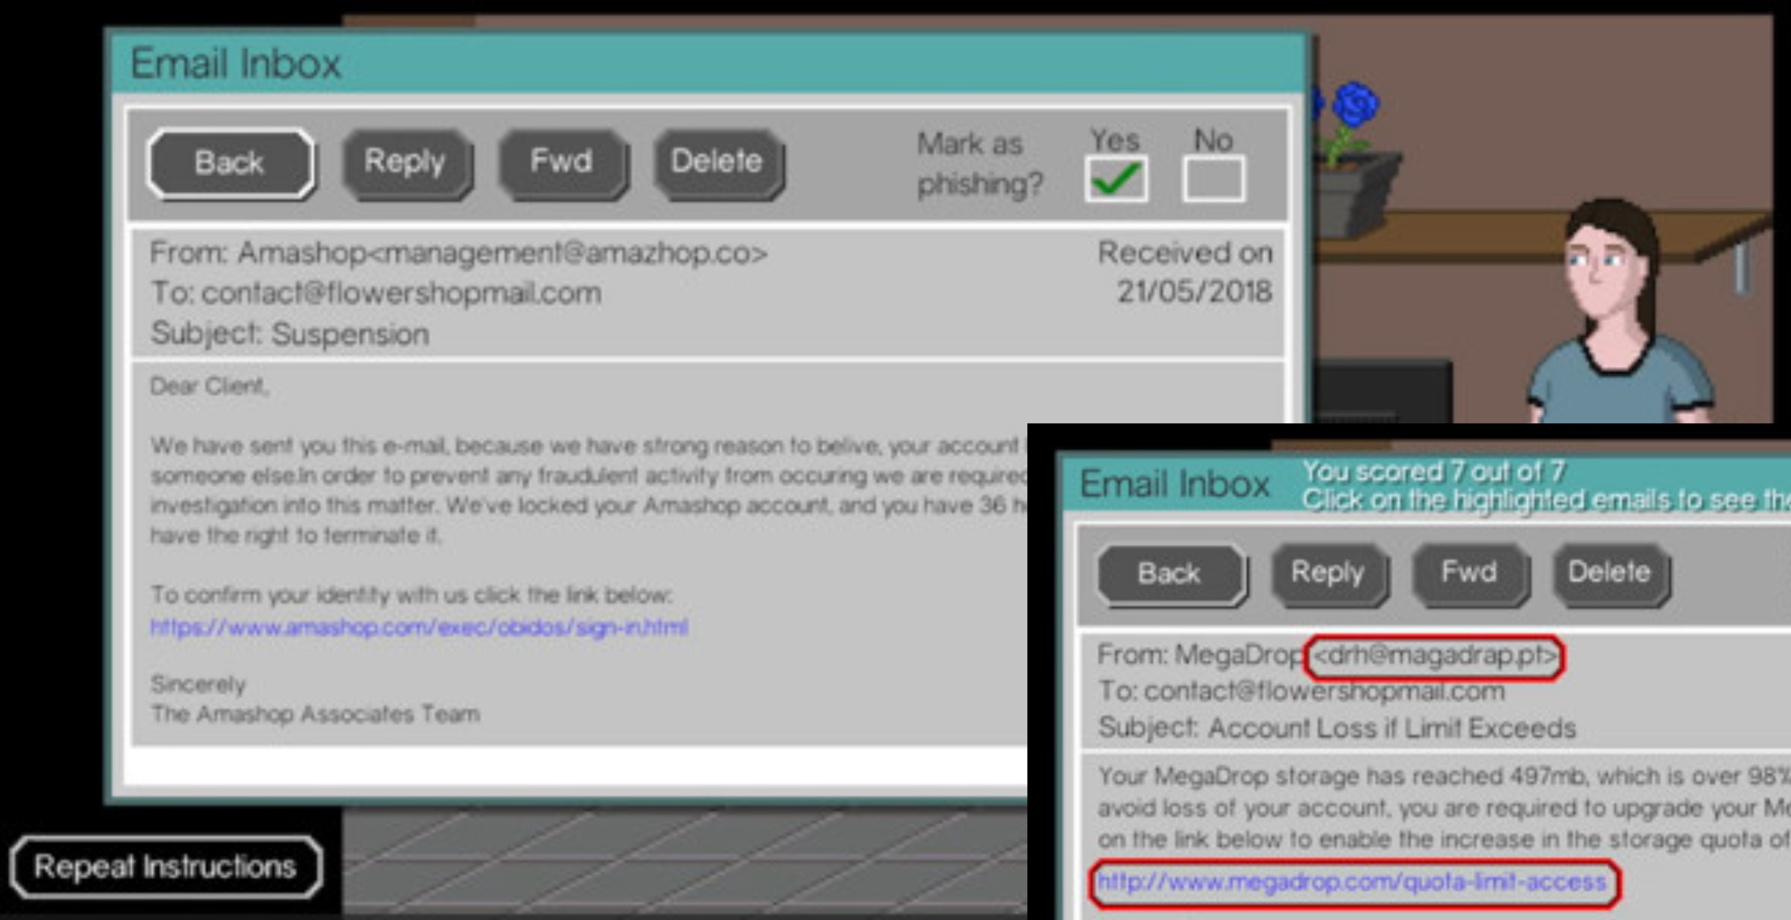
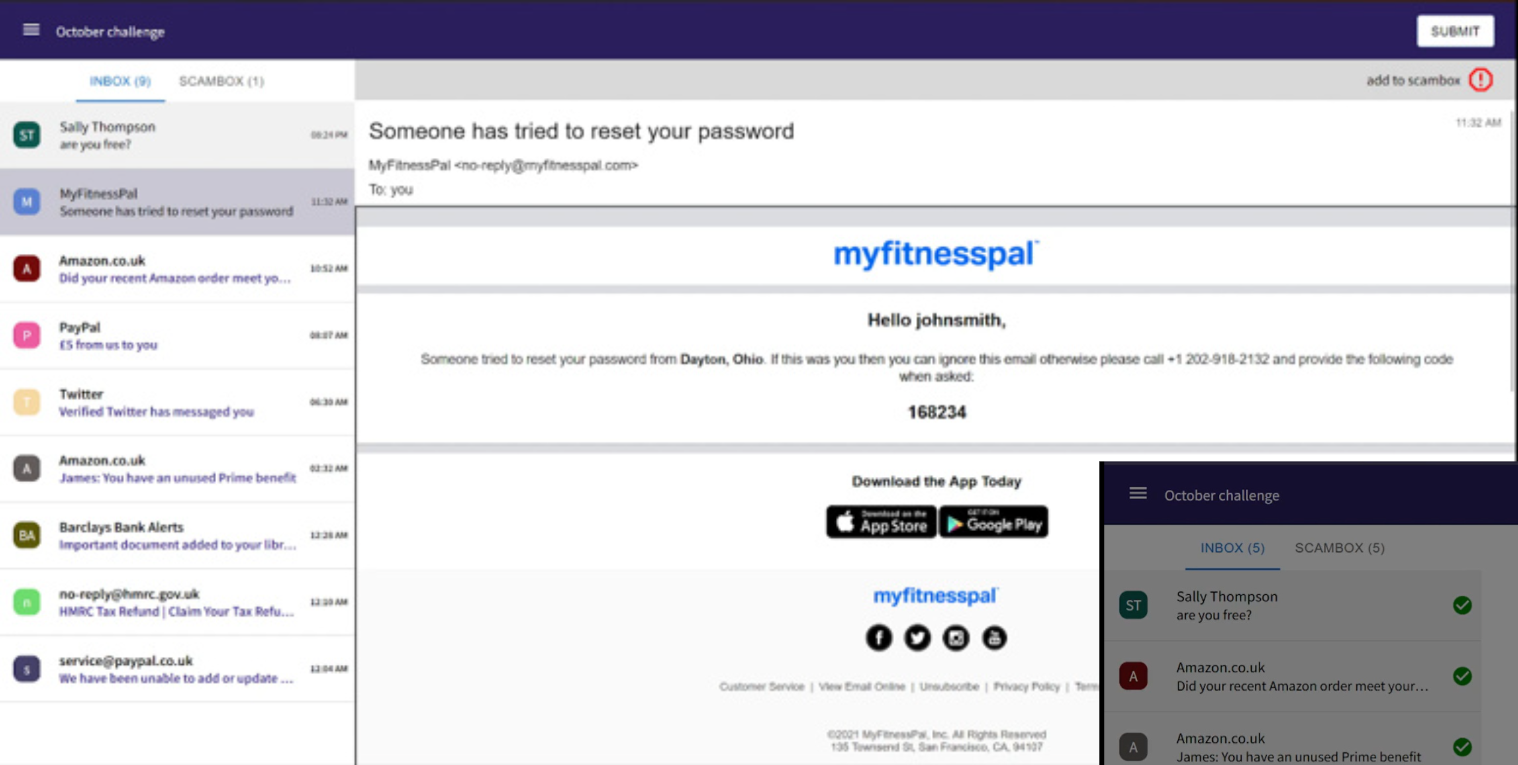
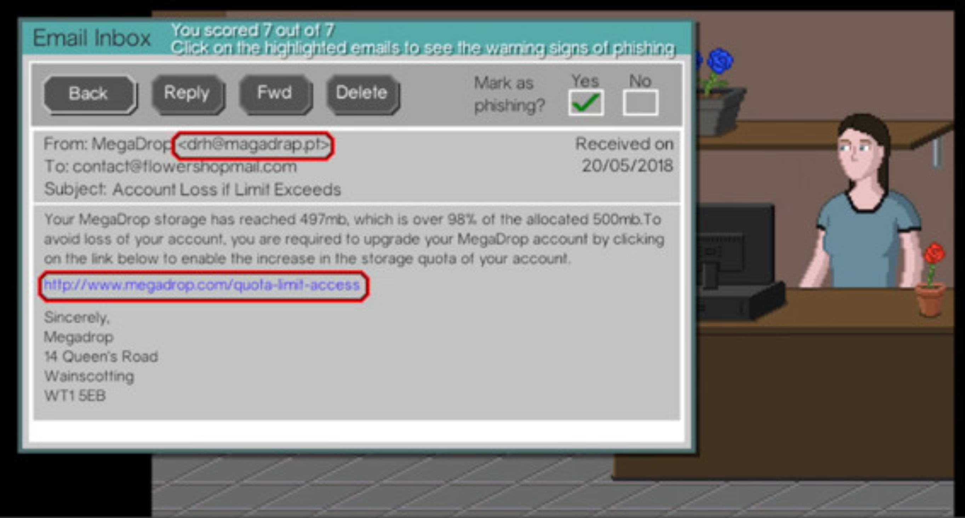
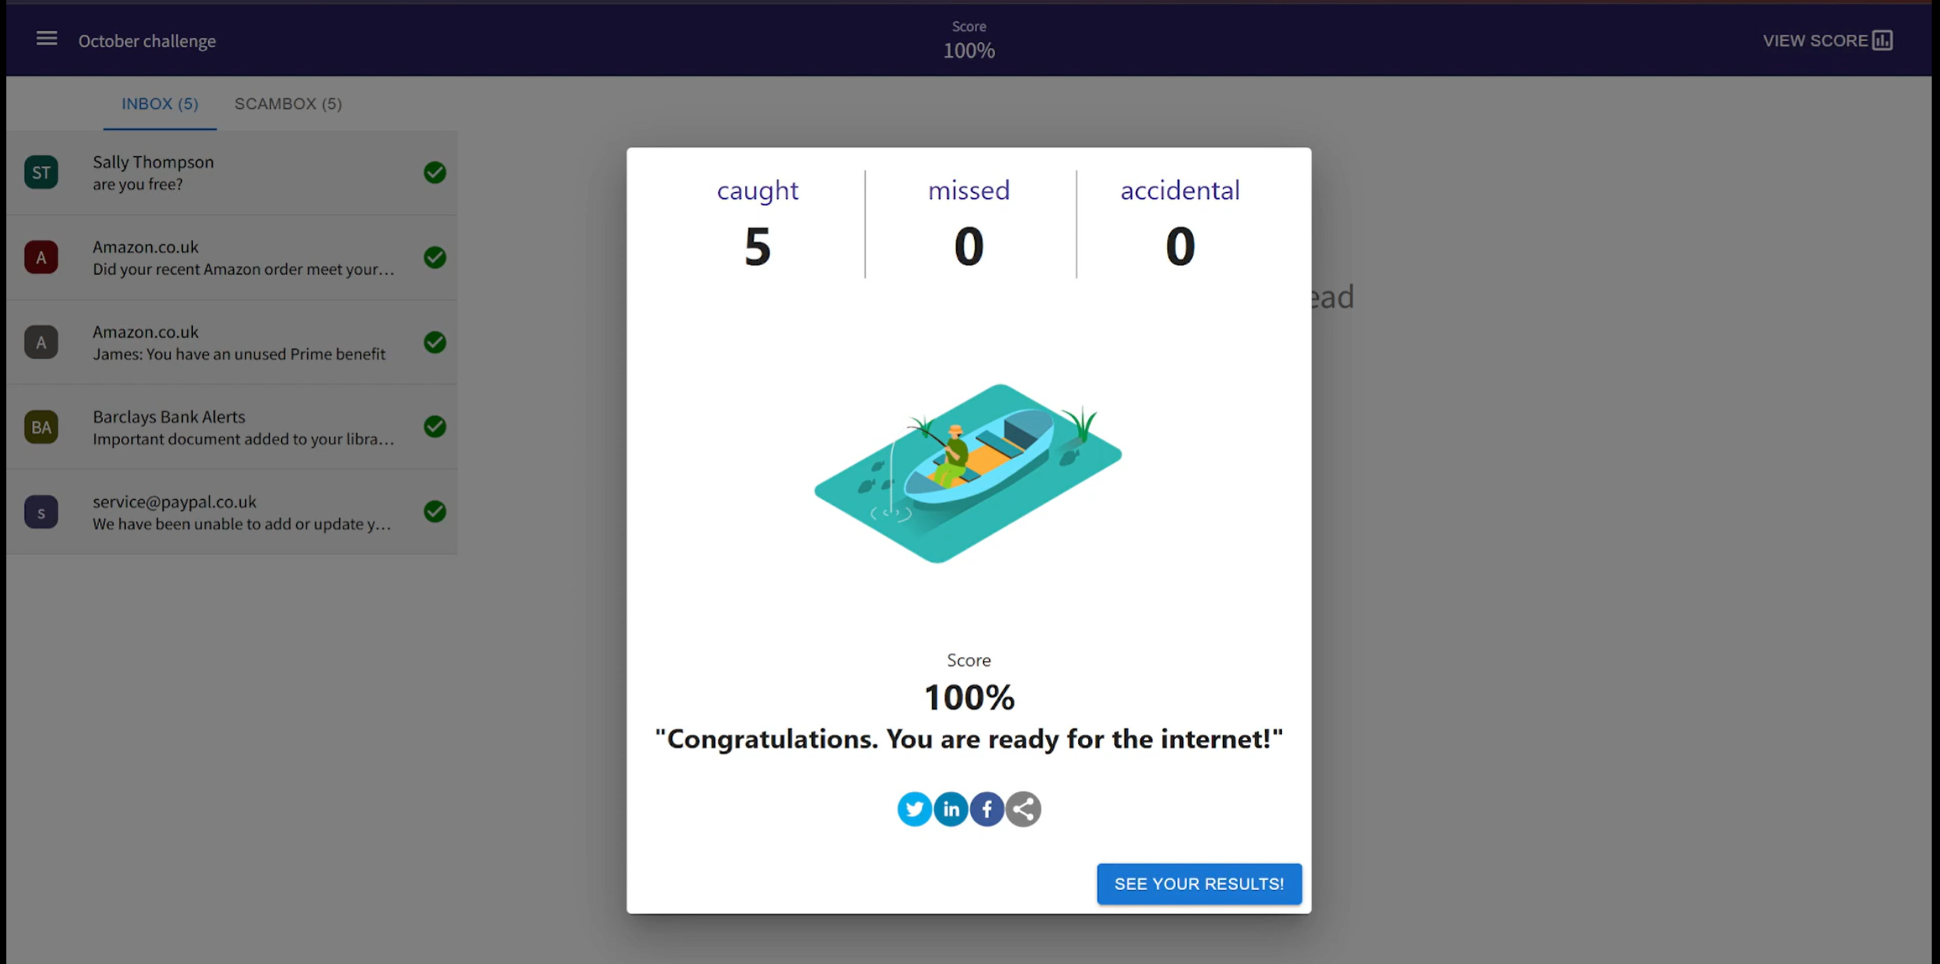

Similar Designs
Phishing - Cyber Games UK
Phish Me If You Can
Figure 1. Cyber Trust - Phishing Email
Simulation [2]
Figure 3. PhishMeIfYouCan - Email Challenge [3]
Figure 2. Cyber Trust - Phishing Warning Signs [2]
Figure 4. PhishMeIfYouCan - Game Results [3]
﻿﻿Simulates a real-world environment.
﻿﻿Provides examples of phishing emails.
Highlights the warning signs of phishing emails.
Uses real-world brands in the examples
Examples are high quality
Updated monthly.
Pros
Pros
﻿﻿Limited pool of examples.
﻿﻿Only available on PC screens.
﻿﻿Layout issues on the webpage.
Could highlight the areas of the email that identify it as a phishing email.
Cons
Cons

Slide 7
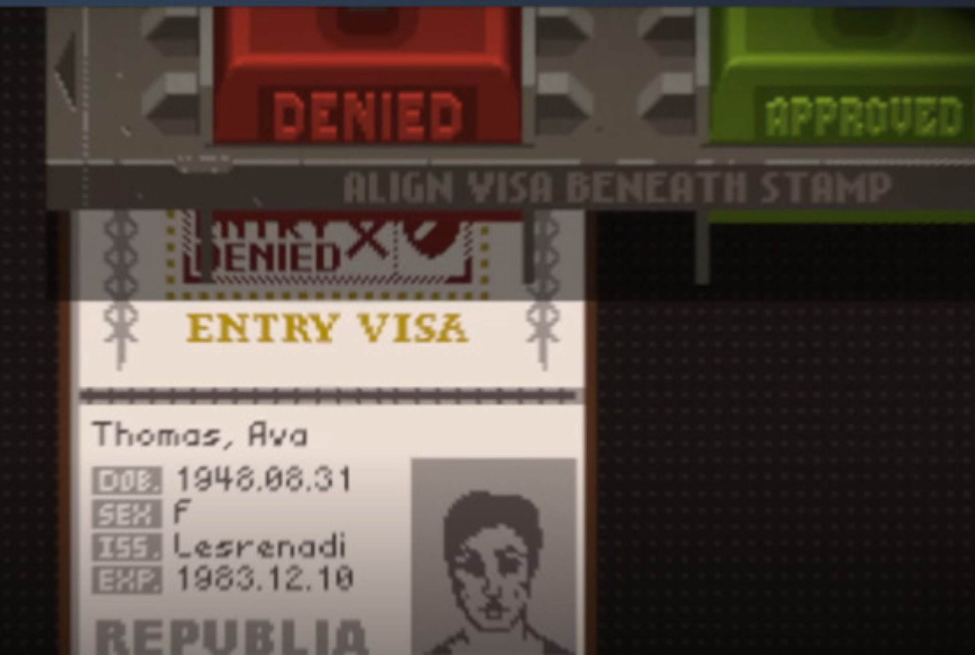
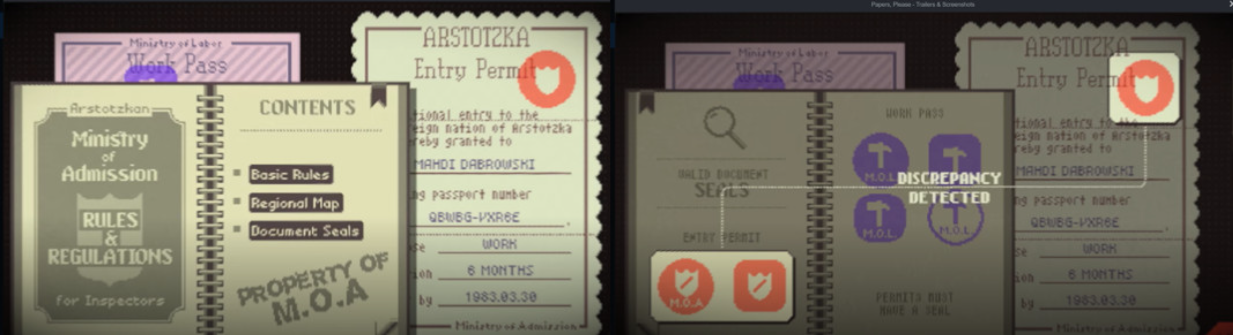
Game Mechanics Inspiration
Papers Please Game
﻿﻿Approving and Denying Emails.
﻿﻿Guide to help identify phishing emails.
﻿﻿Consequences to player actions.
﻿﻿Rules that change as the game progresses.
Figure 6. Papers, Please - Document Verification Game[4]
Arrival
1
Decision
3
Passport Check
2
Figure 5. Papers, Please – Document Verification Game [4]

Slide 8
Next Steps
Review Presentation
Feedback
4
Create a Game Design
Document (GDD)
1
2
Finalise requirement
5
Build a minimum viable
product (MVP)
3
Choose technologies
6
Iterate and expand

Slide 9
Any Questions?

Slide 10
References
[1] National Cyber Security Centre, “Phishing scams: How to spot and report them.” Accessed: Oct. 12, 2026. [Online]. Available: https://www.ncsc.gov.uk/collection/phishing-scams
[2] The Cyber Trust, “Phishing,” Cyber Games UK. Accessed: Oct. 12, 2026. [Online]. Available: https://cybergamesuk.com/phishing
[3] “PhishMeIfYouCan | The Game.” Accessed: Oct. 12, 2026. [Online]. Available: https://play.phishmeifyoucan.com/
[4] L. Pope, “Papers, Please,” Steam, Aug. 8, 2013. Accessed: Oct. 12, 2026. [Online]. Available: https://store.steampowered.com/app/239030/Papers_Please/

Slide 11
Thank you!

