Slide 1

Psychology for Health and Social Care (BMHP4003_BIRM)

Slide 2
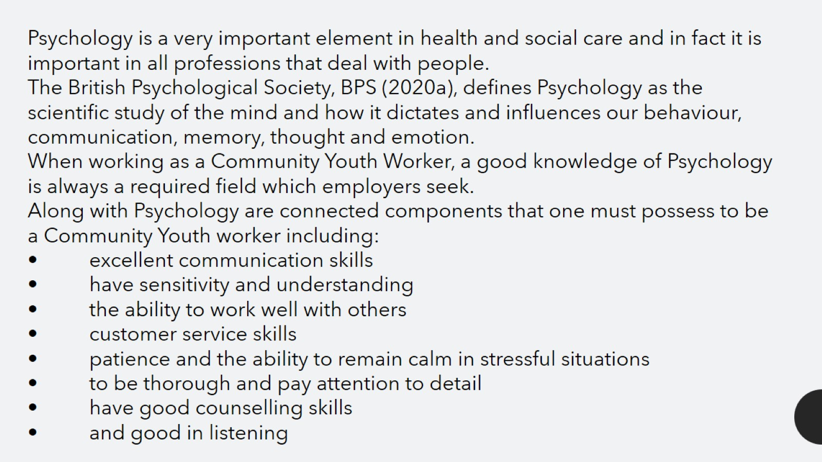

Slide 3


Slide 4
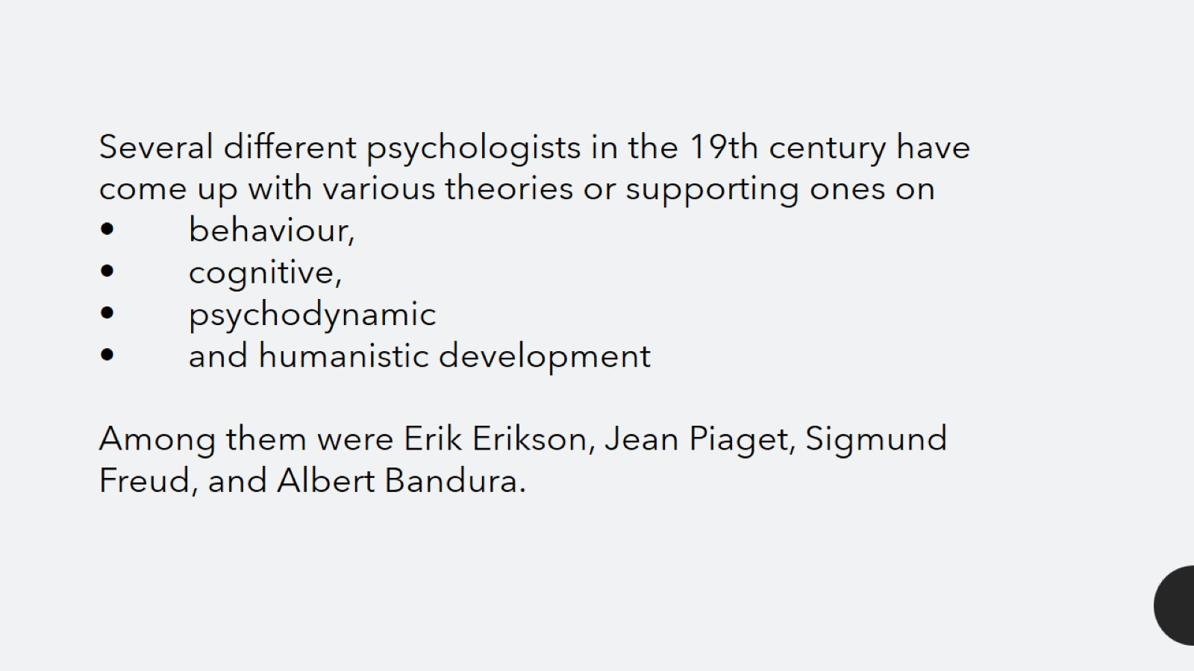

Slide 5


Slide 6
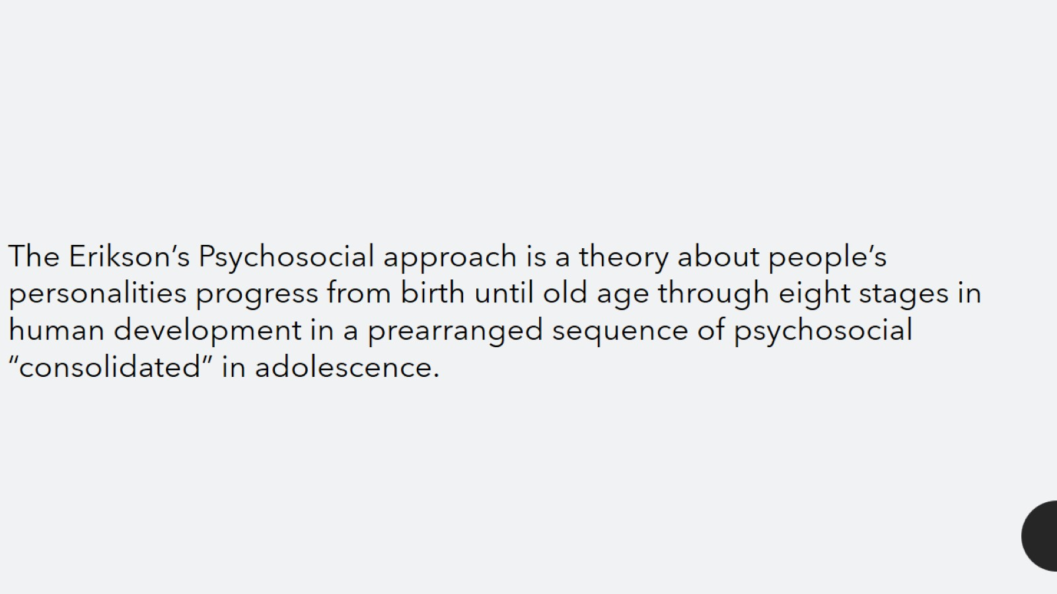

Slide 7
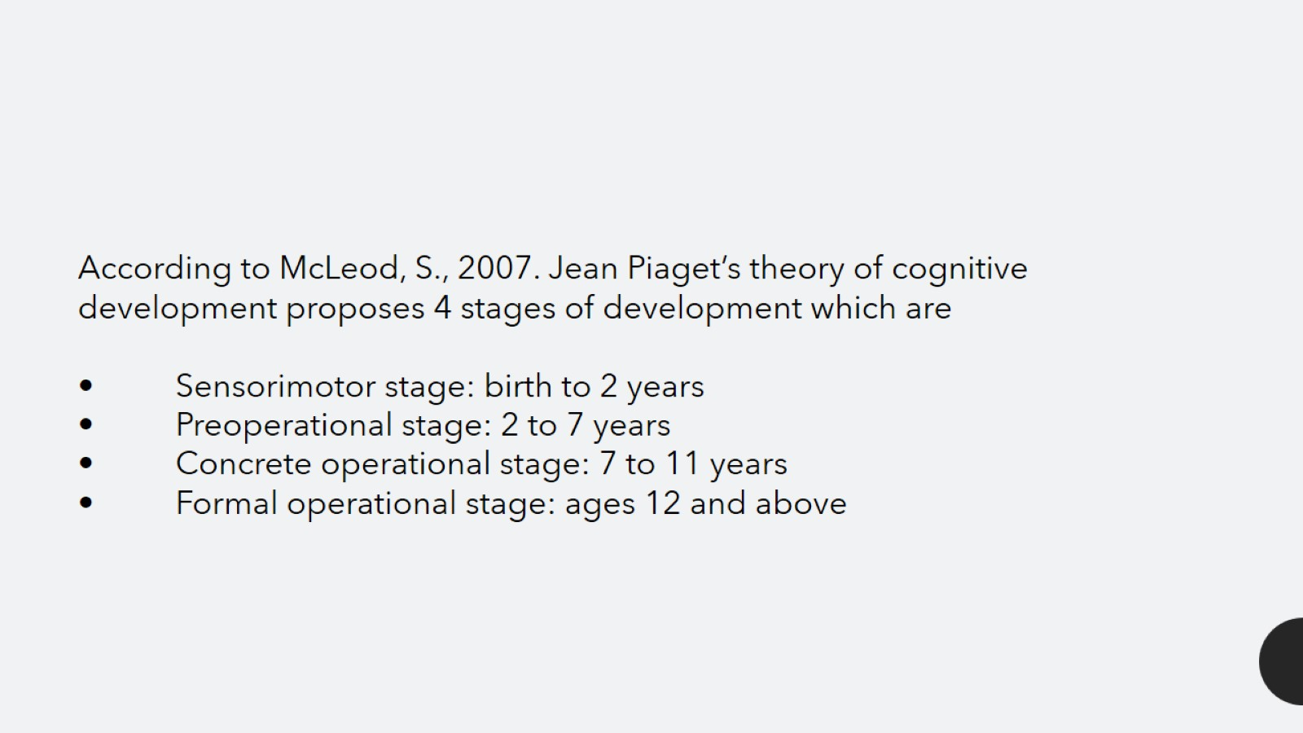

Slide 8
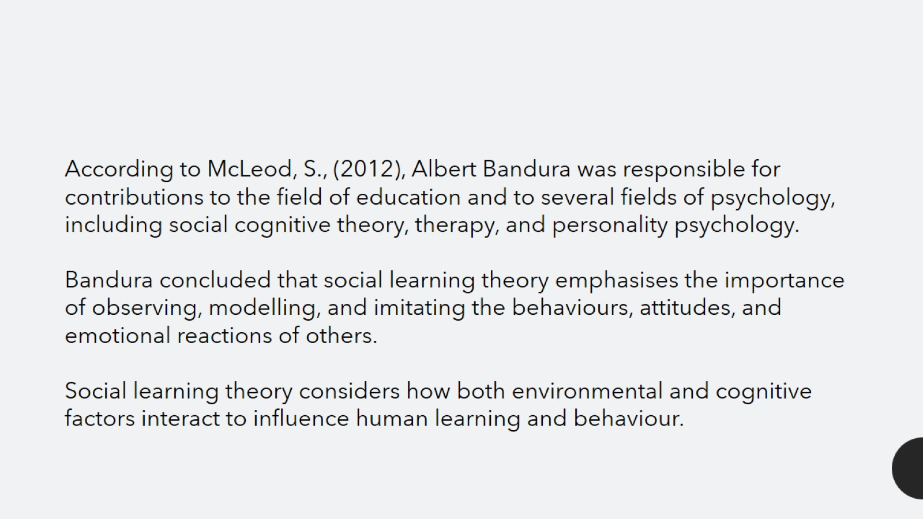

Slide 9
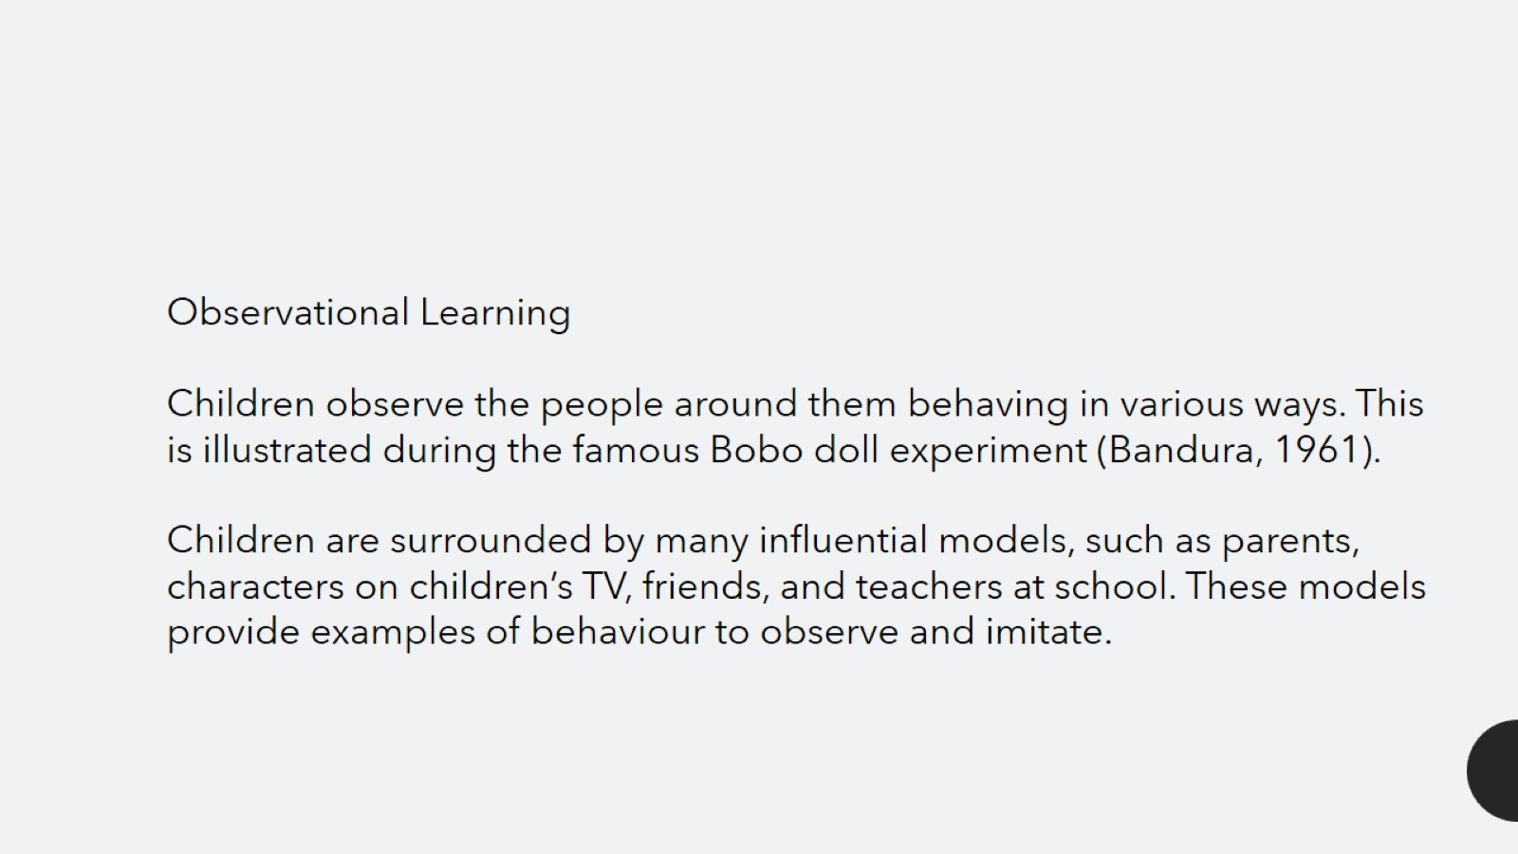

Slide 10
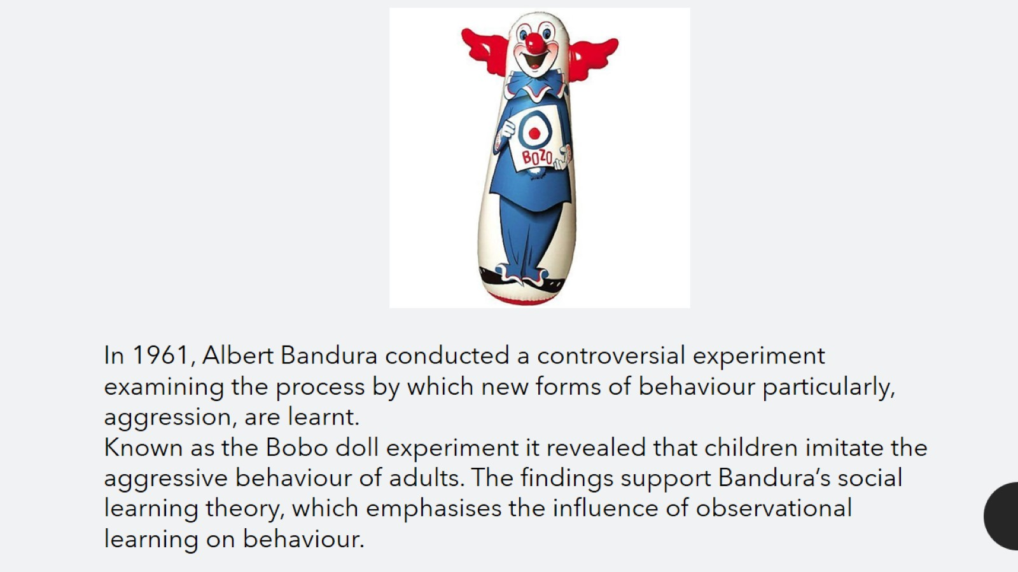

Slide 11


Slide 12


Slide 13


Slide 14


