Slide 1
https://youtu.be/yk1hONLSuAs

Slide 2
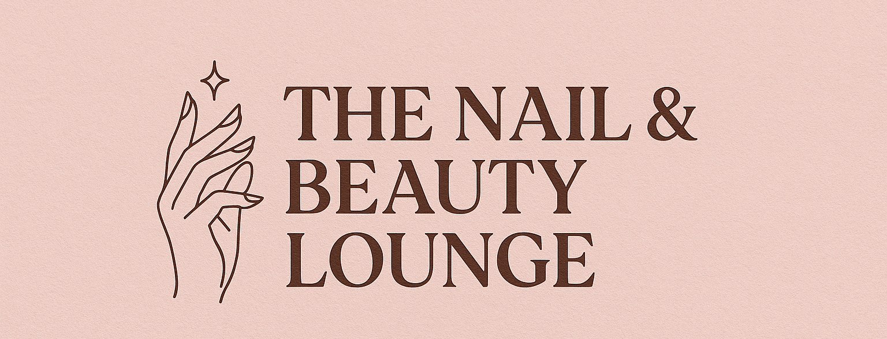
Digital Skills for Personal and Professional Growth
The Nail and Beauty Lounge

Slide 3

Introduction
Purpose: Explain the process for Tasks 1-3 for The Nail & Beauty Lounge.
Focus: Transform market research into a website, marketing materials, and video advertisement.
Target Audience: Price-conscious adults seeking beauty services.
Includes reflection on learning and skills development.
Showcases research-to-business application.

Slide 4

Market Research Questionnaire Design
Created a 14-question survey using Google Forms (Kim and Jin, 2022).
Questions: Age, service preferences, booking methods, etc.
Format: Mix of multiple-choice and open-ended for quantitative/qualitative data.
Distributed to classmates and local community.
Collected 26 responses for analysis.

Slide 5
Data Analysis and Key Findings
Analyzed 26 responses, focusing on 4 key questions (Park and Lee, 2022).
Q6: 61.5% prefer gel/acrylic nails – guides service focus.
Q7: 80.8% spend £20-£50 – emphasizes affordability.
Q9: 52% value skilled staff – highlights expertise in branding.
Q12: 76% use Facebook – directs marketing efforts.

Slide 6
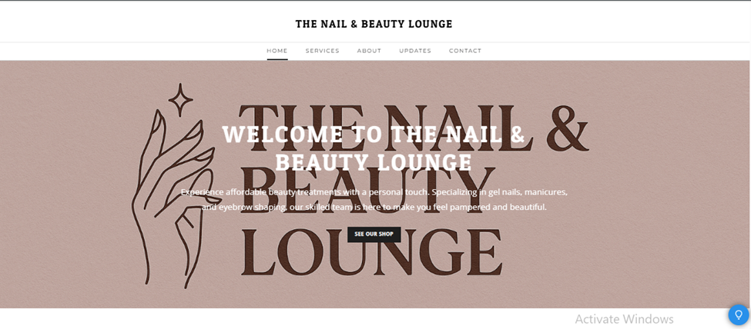
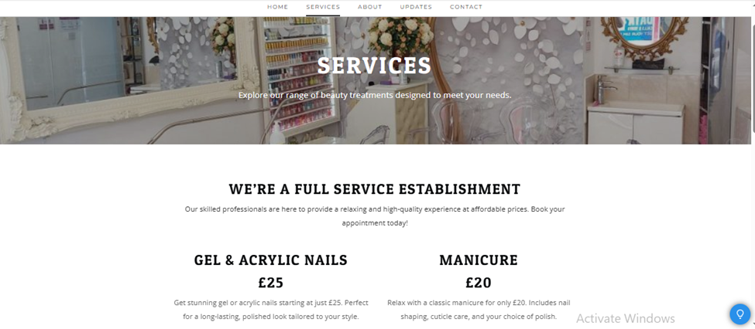
Website Design and Application of Insights

Slide 7
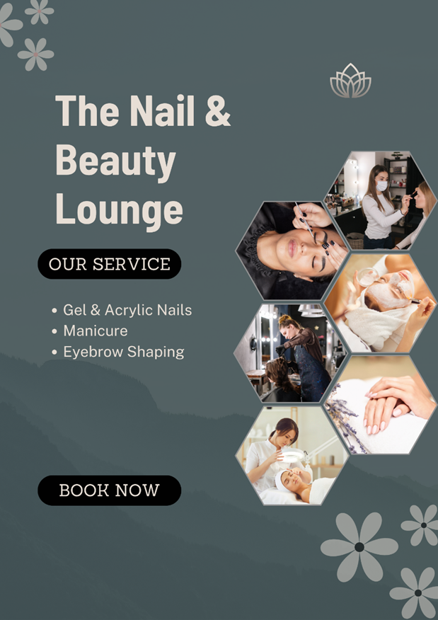
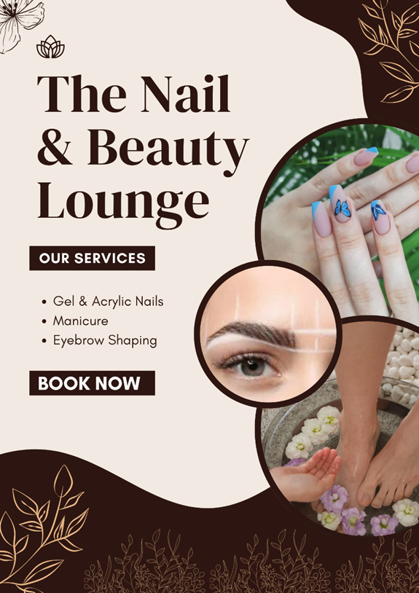
Marketing Materials Design

Slide 8
Video Advertisement and Brand Message
Created a 2-minute video ad, uploaded to YouTube (Park et al., 2021).
Content: Shows gel nail service, £25 price (Q7: 80.8%), friendly atmosphere (Q9: 52%).
Starts with my introduction, followed by salon visuals.
Brand Message: “Affordable Beauty with a Personal Touch.”

Slide 9
Reflection on Learning and Skills
Learned: Importance of market research in business strategy (Soltanifar et al., 2021).
New Skills: Google Forms, Weebly, CANVA, video editing, SEO, audience segmentation.
Improved: Digital literacy and confidence in applying research insights.
To Develop: Time management for balancing tasks.
Impact: Equipped for future digital projects.

Slide 10
Conclusion
Summary: Research informed website, marketing, and video for The Nail & Beauty Lounge.
Key Takeaway: Digital skills transformed data into business solutions.

Slide 11
References
Kim, N.-R. and Jin, Y.-M. (2022) ‘Effect of Hair Salon Selection Criteria on Consumer Behavior and Satisfaction’, Journal of the Korean Society of Cosmetology, 28(1), pp.1–9. doi:10.52660/jksc.2022.28.1.1.
Park, H.-A. and Lee, I.-H. (2022) ‘The Effect of Clean Beauty Cosmetics on Consumer’s Engagement on Consumer Norms and Consumption Behavior’, Journal of the Korean Society of Cosmetology, 28(1), pp.153–164. doi:10.52660/jksc.2022.28.1.153.
Park, Y.-R., Yun, Y.-D. and Chon, H.-J. (2021) ‘The Effect of the Convenience of Beauty Service on the Value Consumption’, Journal of the Korean Society of Cosmetology, 27(3), pp.667–674. doi:10.52660/jksc.2021.27.3.667.
Ros, Rahman, A., Haque, R. and Isa (2023) ‘Marketing Mix Influence on Consumer Buying Behavior: A Case Study on the Cosmetics Industry’, International Journal of Professional Business Review, 8(5), p.39. doi:10.5281/zenodo.8956967.
Soltanifar, M., Hughes, M. and Göcke, L. (2021) Digital Entrepreneurship: Impact on Business and Society. Springer. doi:10.1007/978-3-030-53914-6.
Yang, S.-Y. and Jin, Y.-M. (2023) ‘The Effect of Convenience and Value Consumption of Beauty Service on Satisfaction and Revisit’, Journal of the Korean Society of Cosmetology, 29(2), pp.430–439. doi:10.52660/JKSC.2023.29.2.430.

