Slide 1

The role and importance of quality service, hospitality and guest services in the hospitality industry
Name: Alina Bud
Student ID number: 2213954
Module title: Hospitality and Guest Service Management BMIH4003
Lecturer’s name: Charlotte Joyner

Slide 2
Table of content
Introduction
Hospitality at St. Regis
The role and function of guest services
Importance of hospitality
Conclusion
Reference list

Slide 3
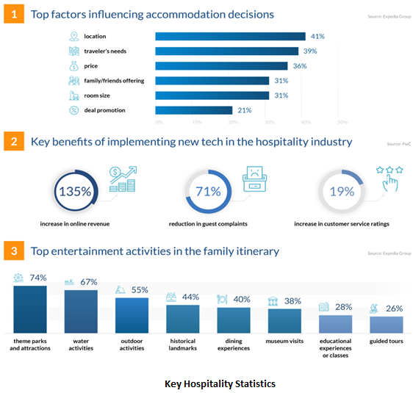
Introduction
The hospitality industry has progressed over the years, each sector of it are constantly changing.
The purpose of hospitality it is guest satisfaction which leads to loyalty and brings profit to the company.
(Finances Online 2023, Walker 2021)

Slide 4
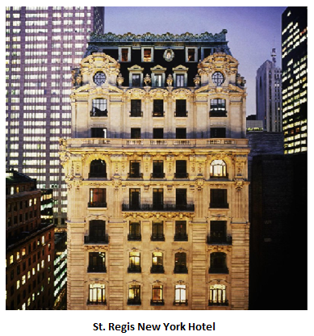
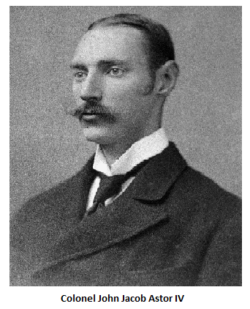
Hospitality at St. Regis
St. Regis it is a 5-star full service luxury hotel, brand owned by Marriot International.
First hotel of St. Regis was built in New York, by Colonel John Jacob Astor IV in 1904, which combines his vision of luxury and technology.
Today, almost 50 hotels are open worldwide, in the most attractive locations, respecting local heritage and bringing signature rituals.
(Cornell Hotel and Restaurant Administration Quarterly,1991 and Turner, 2022)

Slide 5
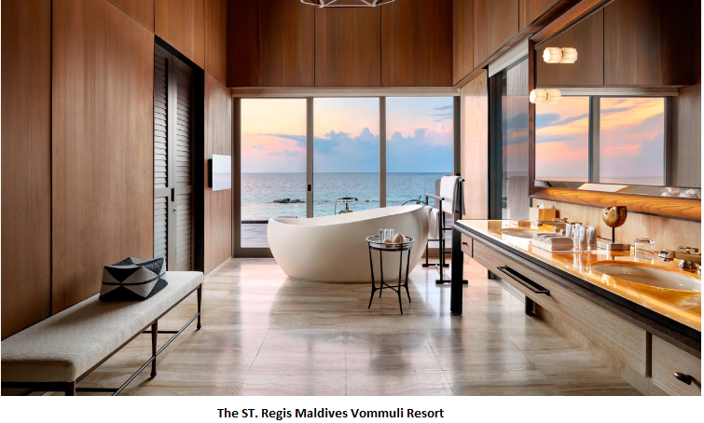
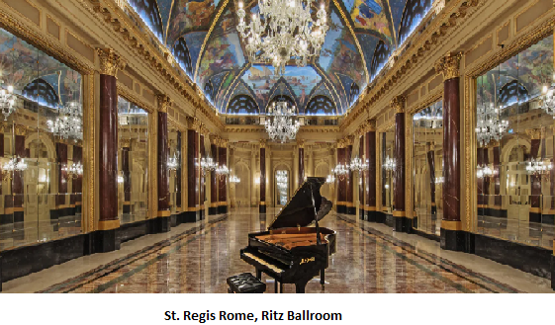
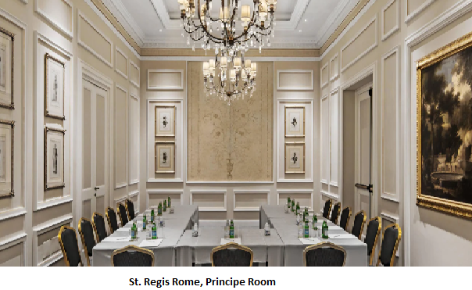
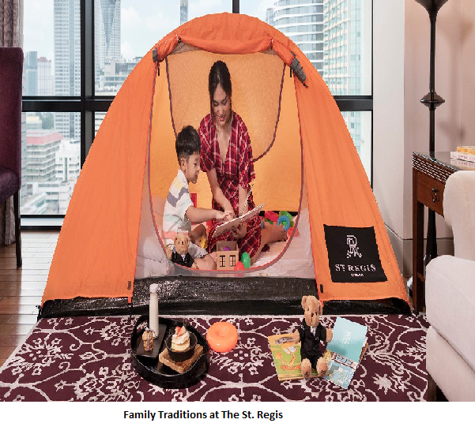
Hospitality at
St. Regis
St. Regis it is targeting upscale travellers:
- Family holiday –Children’s Club , In-Suite Glamping;
Special occasion travellers – venues for weddings and celebrations;
Business – meeting rooms and business centres;
Leisure – fitness centre, spa, swimming pool;
Other facilities that St. Regis offer are gyms, lounges, restaurants, guest rooms.
(Mowery 2022, Global Data 2014 and Luxury Travel Advisor, 2018)

Slide 6
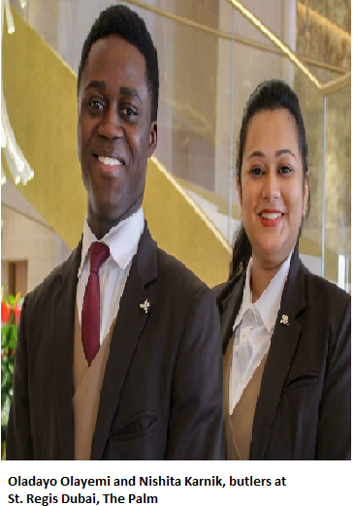
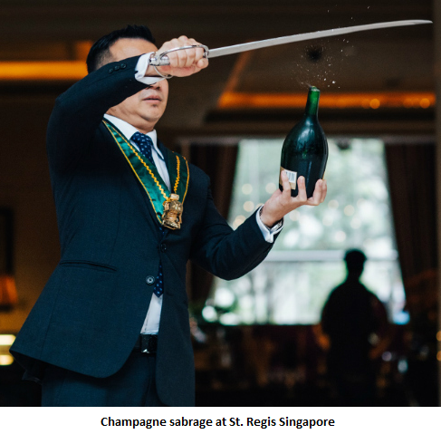
Hospitality at St. Regis
Butler service – the butlers receive the same training as butlers at Buckingham Palace, service available 24 hours.
Signature Rituals
- Bloody Mary;
Evening Rituals;
Afternoon Tea;
Midnight Supper
The House of Celebration - define special occasions across all cultures and seasons.
(Mann 1993, Marriott 2022 and St. Regis, 2023)

Slide 7
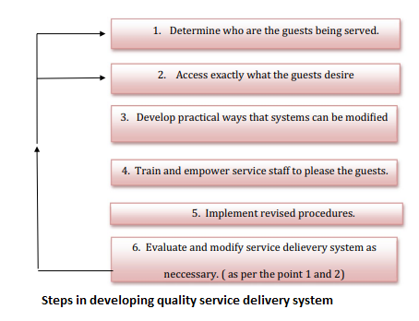
The role and function of guest services
A quality and highly personalized service can be the way to make the guest return and thus become loyal to the brand, the success of the brand could be measured this way.
To achieve guest satisfaction, it is not only the customer important but an engaged employee who come in direct contact with the guest can make a difference.
(Özdemir, Çolak and Shmilli, 2019 and Tepeci, 1999)

Slide 8
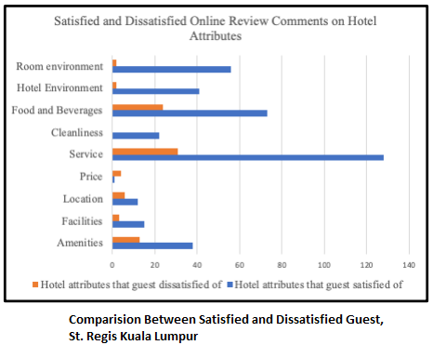
The role and function of guest services
The service at St. Regis goes far beyond elegant rooms and luxury design, through contactless check-in, luggage carts the staff wear gloves, are greeting the guest, open doors, unpack or pack luggage, call for taxi.
For example St Regis offer complimentary entrance tickets for 2 adults and 2 children to the Kuala Lumpur Bird Park, which is just 500 min from the hotel, can be seen as an wow effect.
(Awang Razli, 2022)

Slide 9
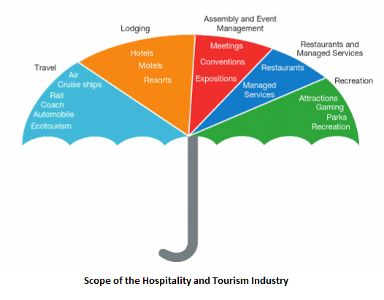
Importance of hospitality
The hospitality industry is one of the most complex industries that can offer different professions in various positions.
Hospitality involves employees, by preparing and delivering products and services to the guests but guest opinion is important to help businesses improve and grow.
(Walker and Walker, 2013)

Slide 10
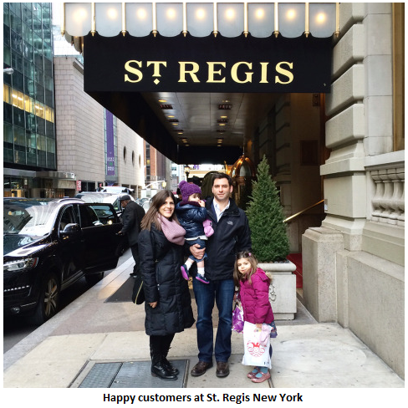
Conclusion
The luxury hotels are offering customers with similar standard of product and services. Therefore, a hotel like St. Regis whose hotels are in most desired locations and respect the personality of each place, is trying to tell own story by signature rituals. All these combined with authentic service and modernism can make guest loyal to the brand, leading to the success of the company.
(Kester, 2021)

Slide 11
References
Awang Razli, I. (2022) ‘An ethnographic examination of TripAdvisor reviews: A case study of the ST. Regis Hotel Kuala Lumpur’, BIMP-EAGA Journal for Sustainable Tourism Development, 11(1), pp. 69-84. Available at: AN ETNOGRAPHY EXAMINATION OF TRIPADVISOR REVIEWS: A CASE STUDY OF THE ST REGIS HOTEL KUALA LUMPUR | BIMP-EAGA Journal for Sustainable Tourism Development (ums.edu.my) (Accessed: 1st of February 2023).
Cornell Hotel and Restaurant Administration Quarterly (1991) NYC Hotels Show the Reasons Why, 32(4), pp. 24. Available at: NYC Hotels Show the Reasons Why - ABI/INFORM Collection - ProQuest (Accessed: 24th of January 2023)
D'aveni, R. (2010) ‘How to escape the differentiation proliferation trap’ Strategy & Leadership, 38(3), pp. 44-49. Available at: How to escape the differentiation proliferation trap - ProQuest (Accessed: 25th of January 2023).
Finances Online (2023) ‘109 Hospitality Statistics you must know: 2023 Data Analysis & Market Share’ Available at: 109 Hospitality Statistics You Must Know: 2023 Data Analysis & Market Share - Financesonline.com (Accessed: 25th of January 2023).
Global Data (2014) St. Regis Hotels & Resorts - Company Capsule Available at: St. Regis Hotels & Resorts - Company Capsule - ABI/INFORM Collection - ProQuest (Accessed: 27th of January 2023).
Luxury Travel Advisor (2018) ‘The St. Regis Mexico City Announces Family-Friendly Experiences’ Available at: The St. Regis Mexico City Announces Family-Friendly Experiences | Luxury Travel Advisor (Accessed: 2nd of February 2023).
Mann, I.S. (1993) ‘Marketing to the affluent: A look at their expectations and.’, Cornell Hotel and Restaurant Administration Quarterly, 34(5), pp. 54. Available at: Marketing to the affluent: A look at their expectations and - ABI/INFORM Collection - ProQuest (Accessed: 1st of February 2023).
Marriott (2022) ‘St. Regis Hotels & Resorts Introduces The House of Celebration’ Available at: St. Regis Hotels & Resorts Introduces The House of Celebration (hospitalitynet.org) (Accessed: 1st of February 2023).
Marriott (2023) ‘Meetings’ Available at: Meeting Space & Event Venue in Rome (marriott.co.uk) (Accessed: 7th of February 2023).

Slide 12
References
Mowery, L. (2022) ‘The Gilded Age For Modern Travelers: What It’s Like To Stay At The St. Regis New York’ Available at: The Gilded Age For Modern Travelers: What It’s Like To Stay At The St. Regis New York (forbes.com) (Accessed: 1st of February 2023).
Özdemir, A.İ., Çolak, A. and Shmilli, J. (2019) ‘Business process management in hotels: with a focus on delivering quality guest service’, Quality and Quantity, 53(5), pp. 2305-2322. Available at: Business process management in hotels: with a focus on delivering quality guest service - ABI/INFORM Collection - ProQuest (Accessed: 25th of January 2023).
St. Regis (2023) Available at: Experience 5-star Luxury | St. Regis Hotels & Resorts (marriott.com) (Accessed: 25th ^{of} January 2023).
Turner, M (2022) ‘London to Get First St. Regis Hotel in 2023’, Available at: London to Get First St. Regis Hotel in 2023 | Luxury Travel Advisor (Accessed: 24th of January 2023)
Walker, J. (2021) Introduction to Hospitality, Global Edition, Pearson Education, Limited, 2021. ProQuest Ebook Central Available at: ProQuest Ebook Central - Book Details (Accessed: 27th of January 2023).
Walker, J., and Walker (2013) Introduction to Hospitality Management: Pearson New International Edition PDF EBook, Pearson Education Limited, Available at: ProQuest Ebook Central - Reader (Accessed: 2nd of February 2023).
Tepeci, M. (1999), ‘Increasing brand loyalty in the hospitality industry’, International Journal of Contemporary Hospitality Management, Vol. 11 No. 5, pp. 223-230. Available at: Increasing brand loyalty in the hospitality industry | Emerald Insight (Accessed: 2nd February 2023).
Kester, J. (2021) ‘St. Regis to double its resorts and update iconic service’ Available at: St. Regis To Double Its Resorts And Update Iconic Service (forbes.com) (Accessed: 2nd February 2023).

Slide 13
Thank you for your attention!

