Slide 1
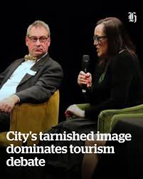
TELI
Week 9

Slide 2
Assignment 2 – deadline 13 January 2026
Industry Debate Presentation (5 minute each person )
Presentation Requirements: As an individual in your team you will have 5 minutes to lay your case of either FOR or Against one of the key discussions. Each member will look at either positive or negative situations to do with social, economic and environmental aspects
Task
As part of a team you are required to debate one of the following key industry debates with the sub-categories that have been highlighted to be discussed (to be agreed in class with your lecturer).
You will be expected to gather research both academic and industry evidence either FOR or Against One of the following ( agreed in class by lecturer) :
Wales Tourism Levy
Cardiff Airport
Kilvey Hill Skyline Development

Slide 3
Evaluative discussion
Good / bad
Effective/ineffective
Helpful/harmful
Sustainable / not sustainable
Words:
Successful
Effective
Educational
Informative
An evaluative discussion in a debate involves critically assessing the strength, validity, and overall quality of arguments presented by all sides. The goal is to determine which side's position is more convincing based on specific criteria, rather than just exchanging ideas or reaching a consensus.

Slide 4
Key Components of Argument Evaluation in a Debate
Debates are typically evaluated on three main components (often called the "Three Ms"): Matter, Method, and Manner:
Matter (Content): This refers to the substance of the arguments—what is being said. Evaluators assess the relevance, credibility, and depth of the evidence and reasoning provided.
Evaluation Criteria:
Relevance: Do the claims and evidence directly address the debate motion?
Evidence: Is the argument supported by facts, data, examples, or authoritative sources?
Logic: Is the reasoning sound and free from logical fallacies (e.g., straw man, red herring)?
Depth: Does the argument explore underlying complexities rather than just skimming the surface?

Slide 5
Method (Structure and Responsiveness):
This involves the organization of the speech and the team's engagement with the opposition's points. A good method makes the arguments easy to follow and demonstrates a strong understanding of the debate's dynamics.
  Evaluation Criteria:
    Structure: Is the argument clearly outlined with a logical flow from premises to conclusion?
    Rebuttal: How effectively were the opposing team's main points identified and countered?
    Signposting: Did the speaker clearly indicate where they were in their speech (e.g., "My first point is...")?

Slide 6
Manner (Style and Persuasion):
This refers to the speaker's presentation skills, including their tone, body language, and ability to engage the audience. A convincing delivery can enhance the impact of the content.Evaluation Criteria:
  Clarity: Is the speaker's voice clear, and their language appropriate?
  Confidence: Does the speaker appear confident and in control of the room?
  Engagement: Do they maintain eye contact and use gestures effectively to emphasize points?

Slide 7
The Evaluative Process
To conduct an effective evaluative discussion, participants or appointed judges should:
Define the criteria: Clearly establish the standards by which the arguments will be measured.
Take thorough notes: Document the specific claims, reasons, evidence, and rebuttals presented by each side.
Analyze and question: Go beyond description to actively analyze the information. Question the assumptions, validity, and implications of each argument.
Compare and contrast: Assess the relative merit of arguments from both sides on a point-by-point basis to determine which team "wins" each argument.
Form a reasoned judgment: Based on the evaluation of all criteria, articulate a final decision on which side was more persuasive, providing an analysis to explain the reasoning

Slide 8
What Is the Wales Visitor Levy?
It's a small additional charge on overnight stays at visitor accommodations in Wales.
Local councils in Wales can choose whether to introduce the levy in their area.
The money raised is intended to be reinvested locally — into tourism infrastructure like toilets, footpaths, beaches, visitor centres, and other visitor-related facilities.
The Welsh Revenue Authority (WRA) will collect and manage the levy.
As part of the law, there will also be a national register for all visitor accommodation providers in Wales.
This register is mandatory from autumn 2026, regardless of whether the levy is applied in that area.

Slide 9
How much will the tourism levy cost?
Type of Accommodation | Charge per person, per night
Campsites / hostels / shared rooms | £0.75 (75p)
All other visitor accommodation (e.g. hotels, B&Bs, holiday lets) | £1.30 per person per night GOV.WALES+1
https://www.gov.uk/government/news/levy-on-overnight-trips-will-help-mayors-invest-in-local-growth

Slide 10
Who Is Exempt from Paying the Levy?
Some exemptions are built into the system:
Under-18s staying in hostels or campsites are exempt. GOV.WALES+1
Stays longer than 31 nights aren’t charged the levy.
If someone is staying in their sole or main residence, or in emergency / temporary housing arranged by a local council, they don’t have to pay.
There are provisions for disabled people who need a carer: carers may get a refund in some cases.

Slide 11
When Will This Come into Force?
The Visitor Accommodation (Register and Levy) Act received Royal Assent on 18 September 2025.
The earliest date a local council can introduce the levy is 1 April 2027.
But it’s not mandatory – councils must consult with their communities before implementing it.

Slide 12
How Much Revenue Is Expected / What’s the Impact?
If all local authorities in Wales adopt the levy, it could raise £33 million a year.
The funds raised must be used transparently – councils are expected to report annually on how the money is spent to improve tourism infrastructure.

Slide 13
Why Introduce This Levy?
The Welsh Government’s rationale includes:
Promoting sustainable tourism — making sure tourism doesn’t overwhelm communities and infrastructure.
Generating additional local funding to maintain and improve visitor services.
Getting better data on accommodation use via the national register, which helps with planning and policy.
Supporting local amenities and cultural assets, including Welsh-language initiatives

Slide 14
Pros / cons
There are a few concerns raised by critics:
Some in the tourism industry worry it might discourage visitors or make Wales less competitive.
Small accommodation providers (like Airbnb hosts) may face administrative burden.
There’s debate on whether the money will actually deliver value for visitors or communities

Slide 15
UK Tourism – Attractions
Key statistics regarding tourism attractions in the UK:
Top Attractions:
  The British Museum remains the most visited free attraction in the UK, welcoming approximately 5.8 million visitors in 2023, a significant 42% increase from 2022.
  The Tower of London holds the top spot for paid attractions, with 2.8 million visitors in 2023, showing a 38% increase compared to 2021.

Slide 16
Overall Trends:
In 2023, England's attractions reported an 11% increase in visitor numbers year-on-year, primarily driven by an 80% surge in international visits and increased school trips.
Museums, art galleries, and places of worship saw the largest year-on-year growth, at 20% and 19%, respectively.
Regional Highlights:
London dominates UK tourism, with 15.6 million international visitors in 2022, spending approximately £14.2 billion in the capital. Popular sites include the London Eye, Buckingham Palace, and the National Gallery.
VisitEngland Annual Attractions Survey (2023)

Slide 17
Tourism Wales
Visitor Numbers: In 2023, approximately 42% of Welsh tourism attractions reported increased visitor numbers compared to the previous year, indicating a recovery in certain areas.
Employment Impact: Tourism continues to be a significant contributor to the Welsh economy, accounting for 11.8% of total employment (159,000 jobs) in 2022. The hospitality sector represents the majority of this employment, with 77% of tourism-related roles tied to food and beverage services, followed by accommodation for visitors (1.9%)
In regions like Pembrokeshire and Anglesey, over 20% of local employment is directly tied to tourism industries, showcasing the significance of tourism to these economies
Attractions in Wales are a core driver of tourism demand, with iconic sites and natural landmarks contributing to the influx of domestic and international visitors
Welsh Government's tourism statistics

Slide 18
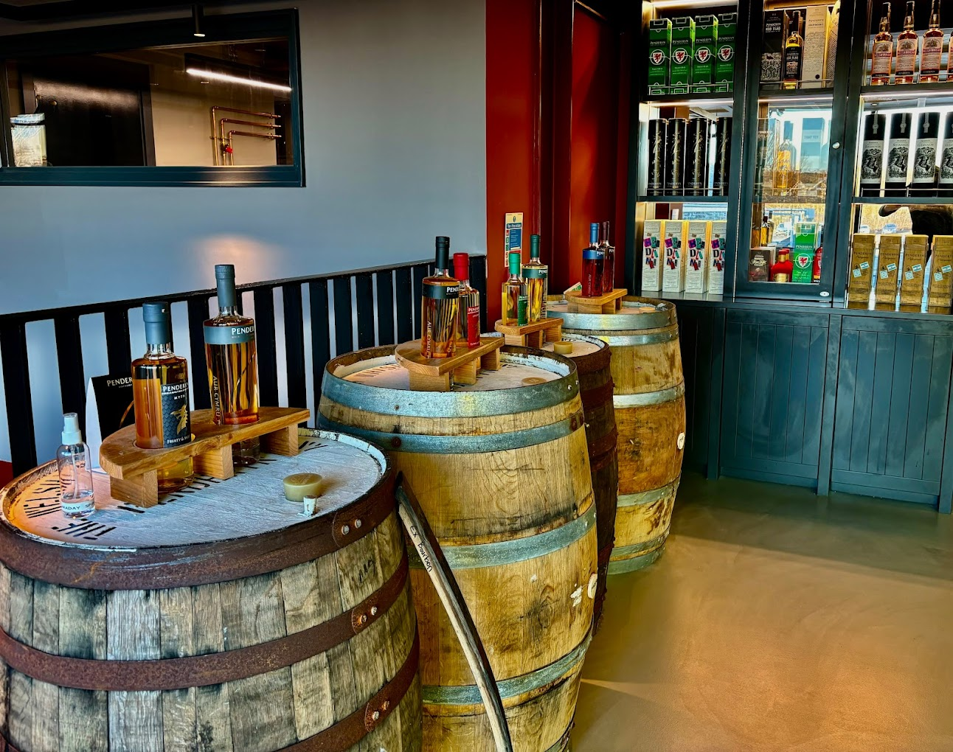
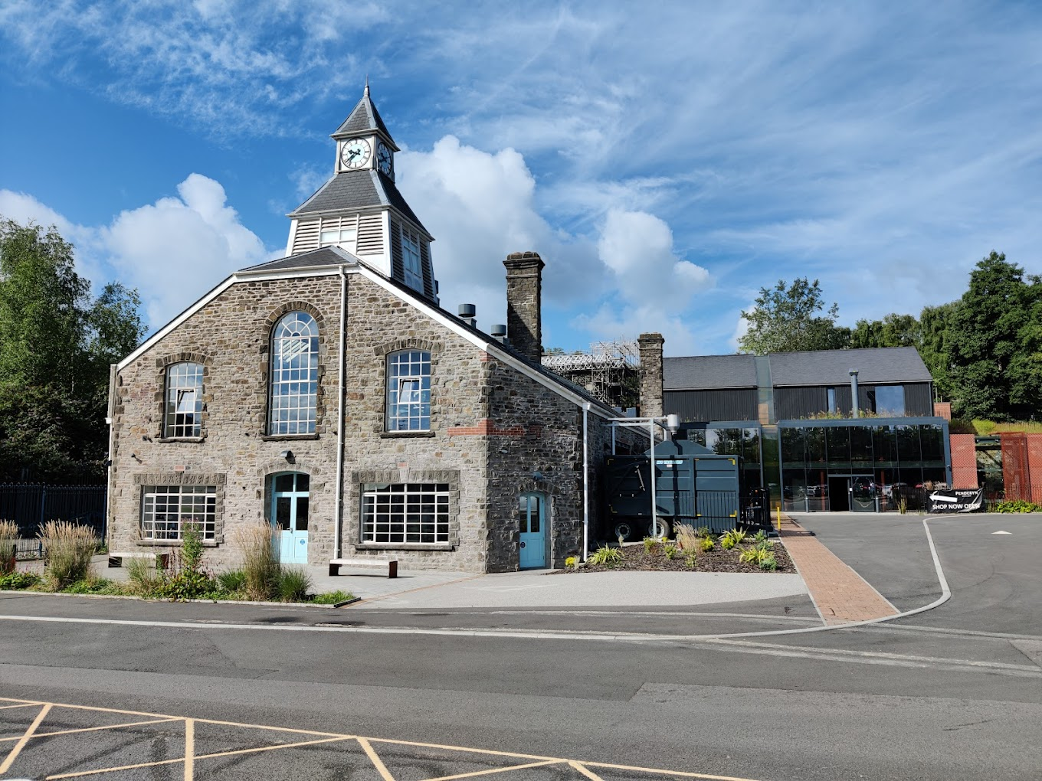
PENDERYN DISTILLIARY – SWANSEA

Slide 19
Heritage and Identity
Heritage is deeply associated with constructing and legitimising collective constructs of identity ranging from class, gender, ethnicity to nationalisation. (GRAHAM et al 2000)
MacDonald says that Heritage sites / attractions are material testimony of identity. (MacDonald 2006).
Heritage sites / attractions create “symbolic meanings and national embodiments” (Park 2015, P93)

Slide 20
Heritage and Identity
Heritage portrayal and interpretation assists nationals to realise their essential elements of their own unique cultures and history. (Park 2014)
Potential to reinforce identities and encourage national pride, in the way that they often communicate histories past and present.

Slide 21
Heritage and Identity
CAVEATS!
NB: Outcomes are very much dependant on the way in which a heritage / history is depicted! (Positive or Negative Interpretation / Biased Accounts / ‘Rose Tinted’ Past / Commercialised Focus????).
Views and opinions of heritage interpretation can be very subjective!

Slide 22
Heritage and Identity
What is crucial for any heritage portrayal / interpretation for IDENTITY, is that it is ‘authentic’ and holds ‘genuine meaning’ to a community and locality.
“The popularity of heritage tourism , particularly within domestic settings relates to the fact that its images and symbols encountered and experienced during visits reveal a past that is “OURS”….. and communally enduring” (Park 2010, p29).
Bell 2003, argues that this relates to ‘shared memories’ (Community Solidarity)

Slide 23
Heritage and Identity
Heritage sites therefore can hold much significance to a ‘Community’ / Group….. , it is therefore VITAL that accounts of a past are genuine.
Heritage needs to be as AUTHENTIC as possible! Both for formal / informal education – (Wider Tourists), but also to ensure ‘connectivity’ with locals (Sense of Pride / Identity….)

Slide 24
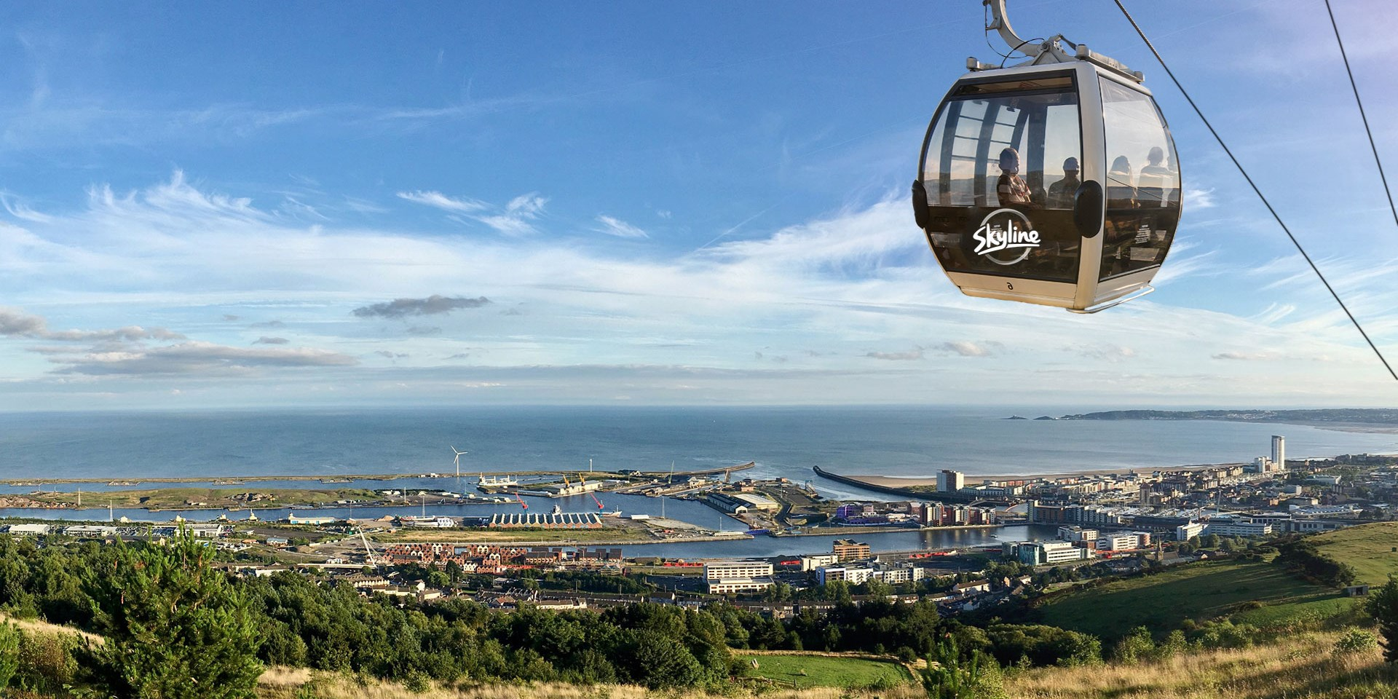
Kilvey Hill Skyline Development
Location: Kilvey Hill, St Thomas area, Swansea. Height ~193 m with panoramic views across Swansea Bay and the city.
Skyline Enterprises, operator of similar attractions worldwide (New Zealand, Canada, South Korea, Singapore).
Swansea would be its first European destination.
Create a family-friendly outdoor leisure destination combining adventure activities, food and beverage amenities, and enhanced access to the hill.

Slide 25
Proposed attractions & facilities
Gondola/cable car connecting Landore Park & Ride to the Kilvey Hill summit.
Gravity-powered luge runs with return chairlift.
Zipline (~1 km loop) and sky swing (~50 m tall).
Hillside walking routes and mountain biking trails, with new beginner-level additions.
Food and drink venues, viewing terraces, picnic zones, and a children’s play area.
Enhanced biodiversity initiatives such as tree planting and habitat restoration for “net-positive” environmental impact.

Slide 26
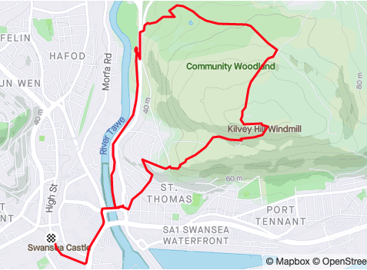
What’s been approved & where things stand
In March 2025, the planning committee of Swansea Council approved the project by seven votes to two (with one abstention).
Some preparatory work is already underway: land has been disposed / transferred to the developer, and initial ecological work (such as relocating reptiles ahead of construction) has begun.
The project is expected to create jobs: around 100 permanent jobs in the first year of operation, plus hundreds of construction-phase jobs.
Economic projections estimate the new attraction could bring roughly £84 million in added value over 15 years to the Swansea economy, with an anticipated ~450,000 visitors per year once open

Slide 27
Expected benefits
Public investment: Welsh Government support of ~£4 million, plus ongoing council discussions on additional funding (previously earmarked up to £8 million)
Type | Forecast impact
Visitor footfall | ~450 000+ visitors per year. swanseastandard.com+1
Jobs | ~100 permanent jobs + hundreds of construction roles. Home+2swanseastandard.com+2
Economic value | Expected £80 – 84 million net local economic benefit over 10–15 years. Home+2swanseastandard.com+2

Slide 28
summary
The Kilvey Hill Skyline development is a major leisure and tourism initiative intended to position Swansea as a more dynamic and accessible destination, linking adventure tourism with sustainable development goals.
While endorsed by local authorities and potentially transformative economically, it continues to spark debate involving environmental, cultural, and community considerations.

Slide 29
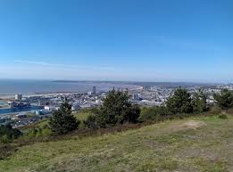
Pros
1. Economic boost for Swansea
Expected to attract 450,000+ visitors per year.
Projected £80m+ economic value over the first decade.
Positions Swansea as a major adventure-tourism destination.
2. Job creation
Around 100 permanent jobs once open.
Hundreds of construction jobs during the build phase.
Wider supply-chain opportunities for local businesses.
3. Environmental enhancement commitments
Habitat restoraion and tree planting planned.
Aim for “net-positive” biodiversity over time.

Slide 30
Cons
1. Impact on natural landscape
Visual impact from:
  gondola towers,
  new buildings,
  zipline/luge infrastructure.
Some feel the hill’s natural, tranquil character will change.
2. Environmental concerns
Noise and footfall could disturb wildlife.
Risk of habitat fragmentation despite mitigation plans.
Works such as tree felling for routes and pylons remain controversial.
3. Community concerns
Some locals fear:
  increased traffic around Landore,
  parking issues,
  higher congestion during peak tourist seasons.
4. Long-term commercial risk
Financial sustainability depends on:
  high visitor numbers,
  good weather conditions,
  tourism demand staying strong.
If forecasts fall short, public investment risks criticism.

Slide 31
Cohen, and Plog’s Tourism Typologies
Cohen and Plog are two key theorists who developed influential tourism typologies that help us understand tourist behaviour, motivations, and preferences.
Cohen’s Tourism Typology : Cohen (1972) categorised tourists based on their degree of familiarity and novelty-seeking behaviour during travel.
He identifies four main types of tourists:
The Organized Mass Tourist
  Characteristics: Highly dependent on packaged tours, itineraries, and group travel. They prefer structured, predictable, and familiar experiences (e.g., sightseeing tours with guides).
  Behaviour: Seek comfort, safety, and minimal personal effort. : Example: Cruise ship tourists or visitors on package holidays.
The Individual Mass Tourist
  Characteristics: Slightly more independent but still rely on pre-arranged services like organized transport and accommodation.
  Behaviour: While they explore individually, they often stick to mainstream tourist destinations and activities. : Example: Tourists using pre-planned tours but having some free time for personal exploration.

Slide 32
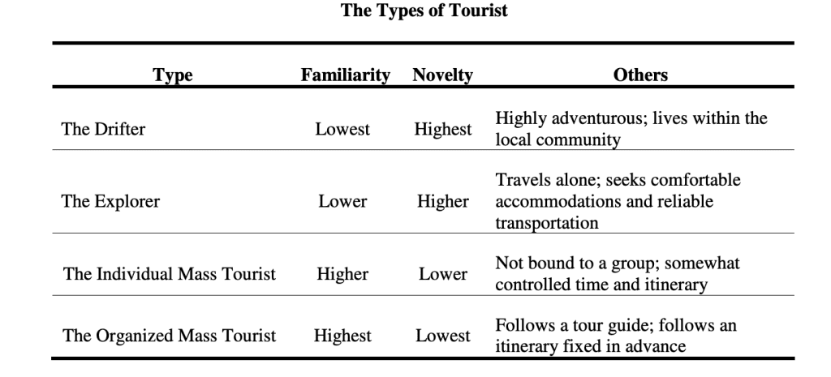
Cohen Typology
The Explorer
  Characteristics: More adventurous and independent. They seek novelty and unique cultural experiences but still want certain comforts (e.g., hotels or travel insurance).
  Behaviour: Visit off-the-beaten-track locations but often return to familiar comforts :Example: Backpackers who explore local culture but use tourist infrastructure like hostels.
The Drifter
  Characteristics: Fully independent and seek total immersion in local cultures. They avoid mainstream tourism and prefer novelty and spontaneity.
  Behaviour: They reject structured tours, stay in local homes or inexpensive lodgings, and may travel with little pre-planning : Example: Long-term travellers living among locals.
Cohen’s typology emphasises the continuum between familiarity and novelty, offering a broad understanding of tourist behaviour and motivations.

Slide 33
Plog’s Tourism Typology
Plog (1974) created a psychographic model based on tourist personalities and their preference for certain destinations.
He divides tourists into three main types along a spectrum:
Allocentrics (Venturers)
  Characteristics: Adventurous, independent, and novelty-seeking.
  Behaviour: Prefer undiscovered or less commercialized destinations. Allocentrics enjoy challenging experiences, cultural immersion, and off-the-beaten-track travel : Example: Tourists who travel to remote or developing countries.
Mid-Centrics
  Characteristics: Represent the majority of travelers and fall in between the two extremes.
  Behaviour: They enjoy moderately developed destinations with some comforts but still seek novelty and exploration : Example: Tourists visiting popular yet still culturally significant destinations like Thailand or Italy.

Slide 34
Plog Typology
Psychocentrics (Dependables)
  Characteristics: Cautious, conservative, and comfort-seeking.
  Behaviour: Prefer highly developed, familiar, and predictable destinations with organized tours and facilities : Example: Visitors to all-inclusive resorts in Spain or Florida.
Plog’s model also aligns destinations with the preferences of these tourists. For example:
New, exotic destinations attract allocentrics.
As a destination becomes popular, mid-centrics follow.
Finally, when a destination is highly commercialized, psychocentrics dominate.
Plog’s model highlights how tourist preferences impact destination development and life cycles.

Slide 35
Comparison/ relevance of Cohen and Plog
Cohen focuses on tourist behaviour and their quest for novelty or familiarity.
Plog focuses on tourist personalities and aligns them with destination preferences.
Both theories remain widely used in tourism studies to analyse markets, tailor marketing strategies, and predict trends.
Cohen’s and Plog’s models provide foundational frameworks for understanding tourist behavior and segmentation.
Modern tourism studies note that tourists' motivations and behaviors are dynamic. For instance, even allocentric travelers may engage in psychocentric travel depending on life circumstances like age, health, or budget constraints

Slide 36

Niche tourism
https://www.trendhunter.com/slideshow/niche-tourism
https://tourismteacher.com/humix/video/6688e708f4a501558eb5d4a929dad33f661c22598a20cb89f0aecaa3c3f2a90f

Slide 37
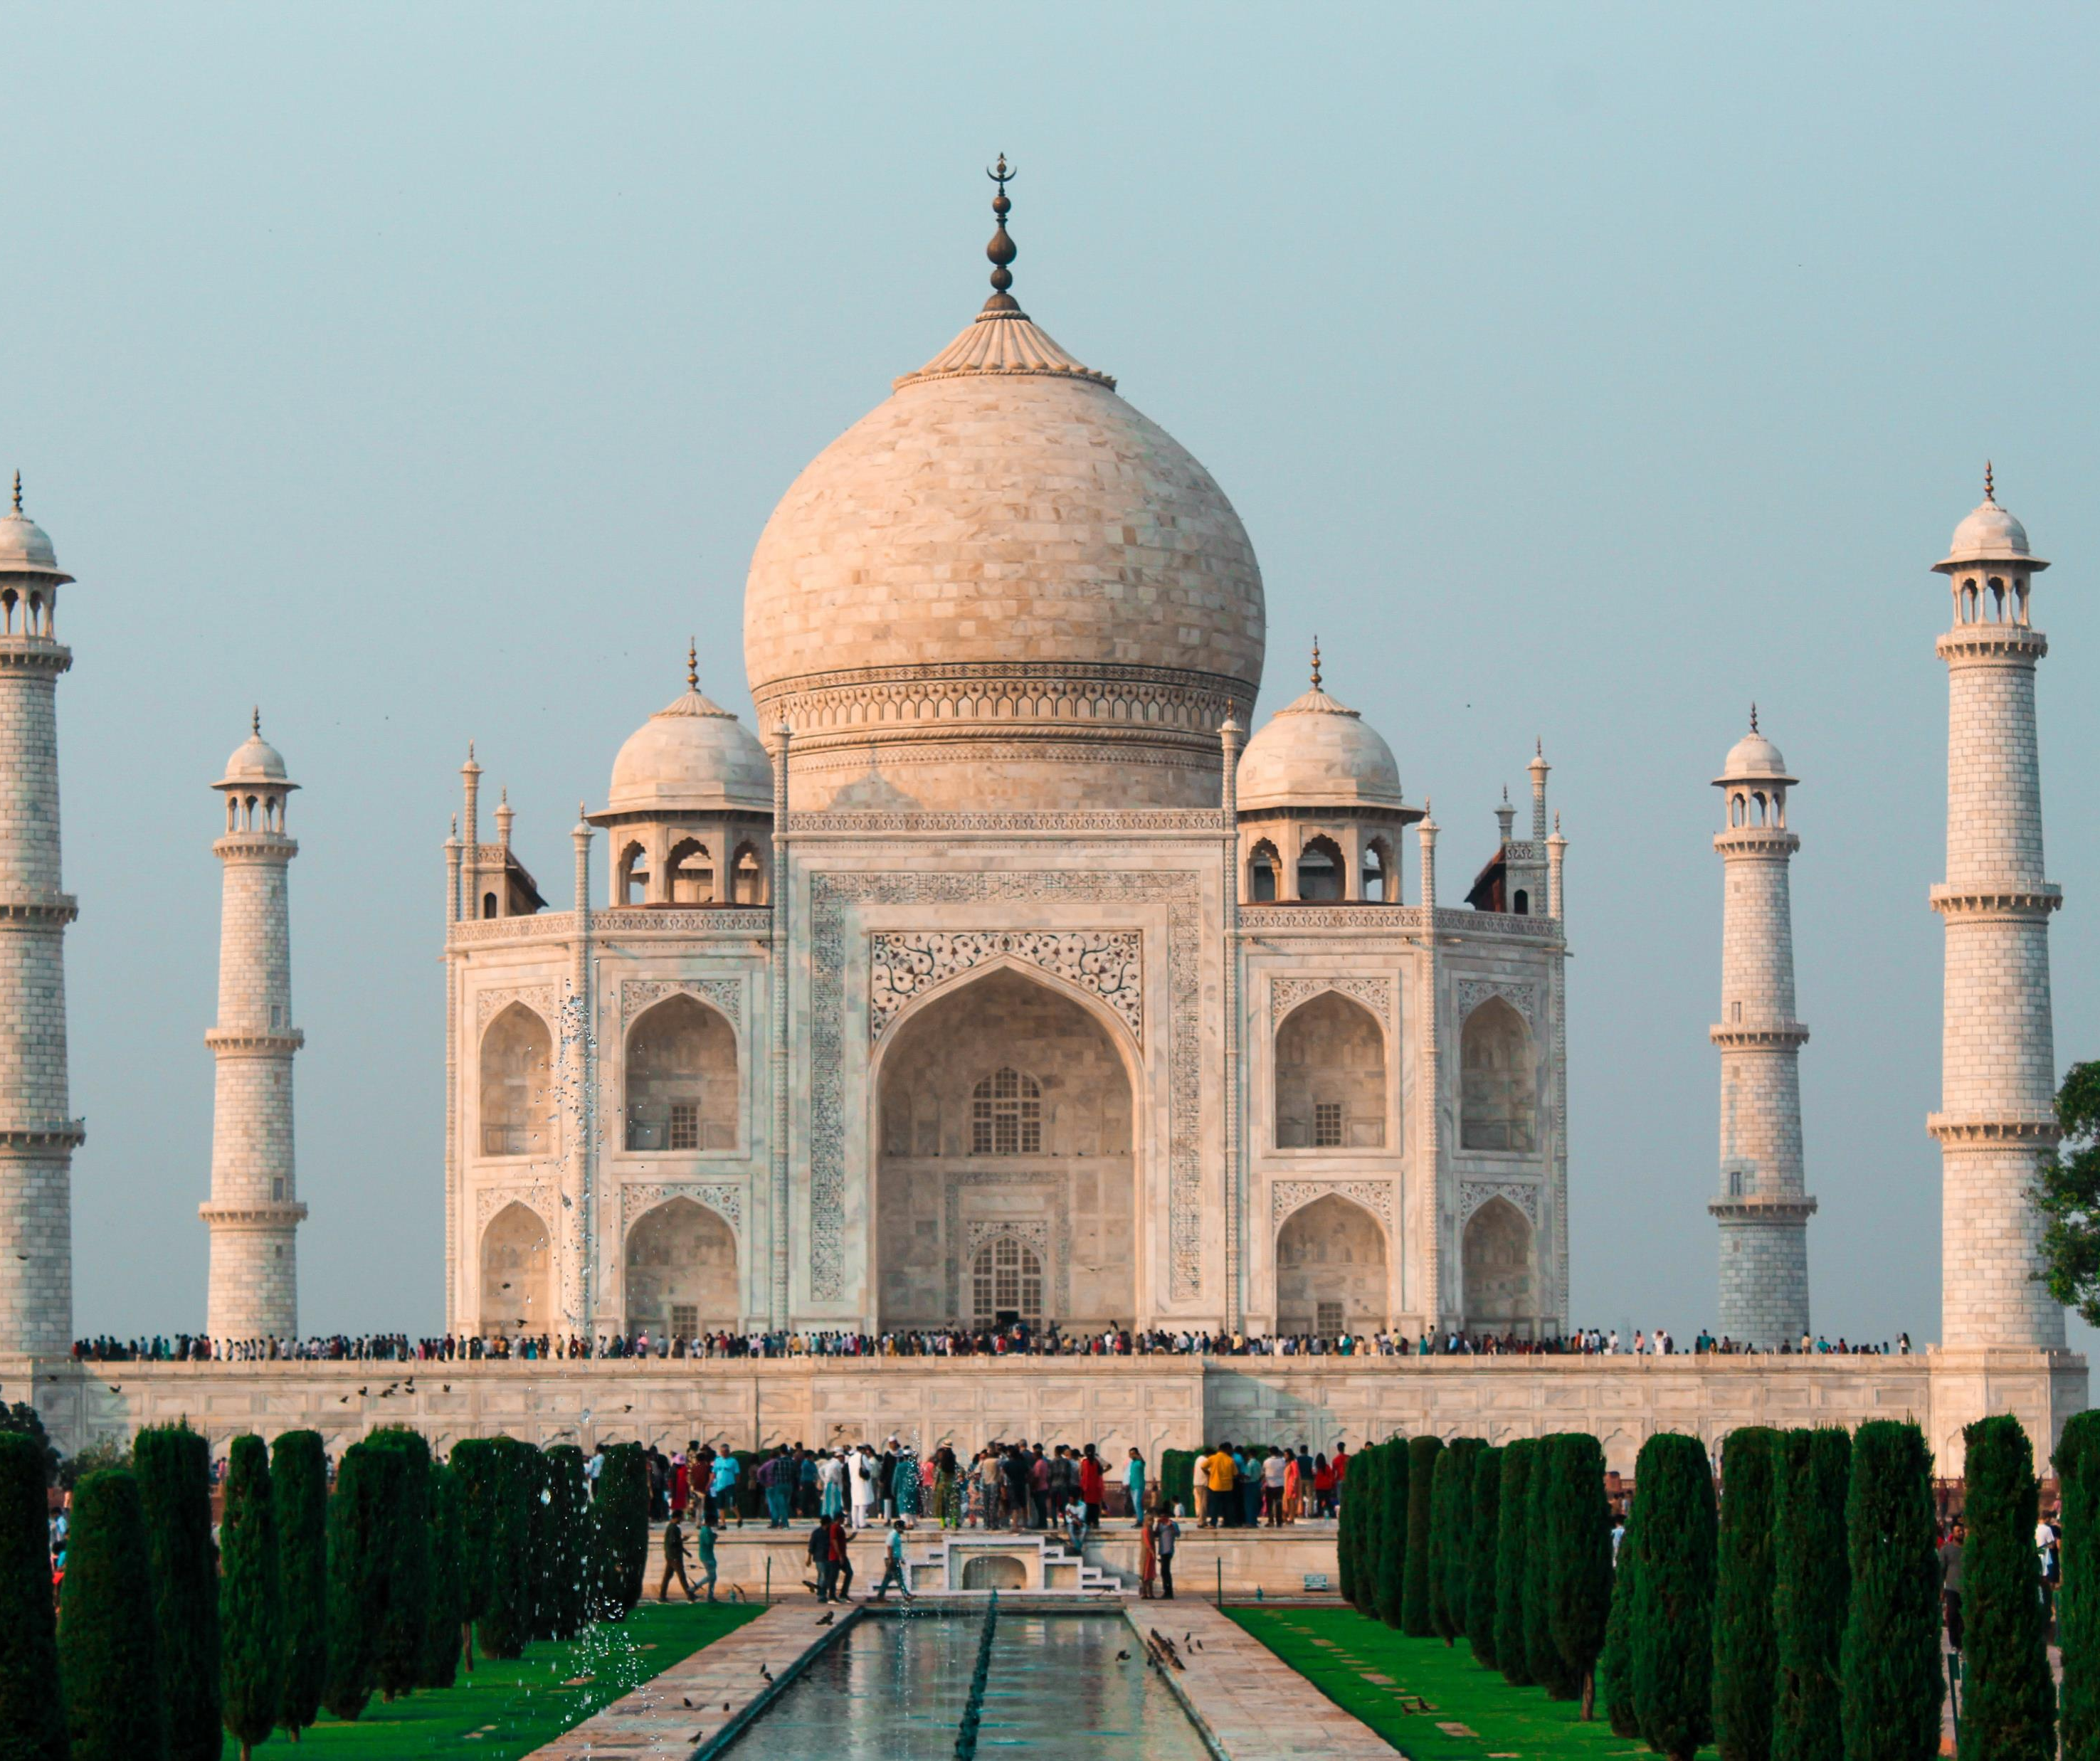
Heritage and Cultural Tourism:
Essentially directed towards history and culture, this type of tourism is more traditional and occurs typically in urban areas with a distinct area of interest, such as museums and theatres.
This aspect of tourism also brings diverse traditions of native communities through witnessing of rituals, customs, and their values and way of living.
Owing to its diversity, India is symbolized by its heritage value. All the captivating monuments and heritage sites in the country depict their story while keeping the visitors fascinated.

Slide 38

Wellness and Spiritual Tourism:
Some tourists tend to select their destination to relax and indulge in reflexology and special massages.
People visit destinations like Hawaii or Costa Rica for various reasons, owing to their islands and unique retreat centres, for an unwinding getaway.
For Spiritual Tourism, the travellers are looking to explore temples, meditation and yoga at different destinations, or some for pilgrimage. India, owing to its rich legacy and being the birthplace of Hinduism and Buddhism and home to thousands of monasteries and ancient temples, tops the list of such destinations.
Art Tourism: when people travel to a destination to engage in activities related to art such as museums, special events related to art, dance and book festivals, etc. For some, art tourism is a subdivision under Cultural Tourism, but because of its growing vastness, it has become a niche aspect of travelling.

Slide 39
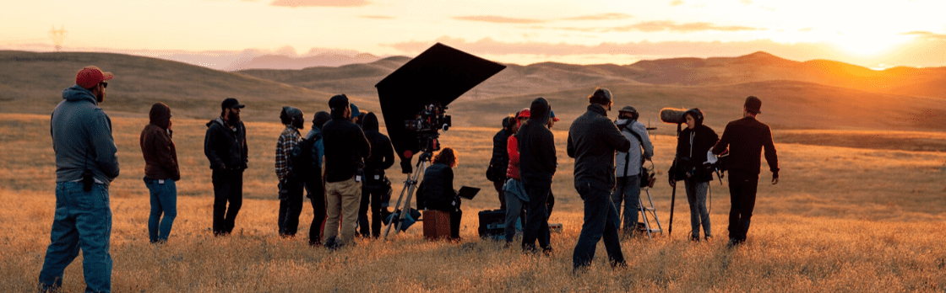

Niche tourism
Film Tourism: As a recently emerged niche in the tourism industry, Film Tourism is a thriving marvel worldwide. People have indeed started showing their interest in destinations which became famous due to their appearance in cinemas and television series.
Culinary Tourism: One of the most interesting and latest niches emerging in the tourism industry is around the gastronomical delights that the travellers are looking for.

Slide 40

Advantages & disadvantages for Industry
Advantages of niche marketing:
Higher ROI.
Better customer loyalty.
Less competition.
Disadvantages of niche marketing:
Smaller market.
A higher ROI isn't guaranteed.
The smaller market makes growth difficult as there is not a large customer demand.

Slide 41

New ways to do business
Opening a world of possibilities for travellers, tour operators, and travel brands by pioneering solutions for discovering and booking things to do.
unique, immersive travel experiences that drive bookings and deepen customer relationships.
https://www.holibob.tech/

Slide 42
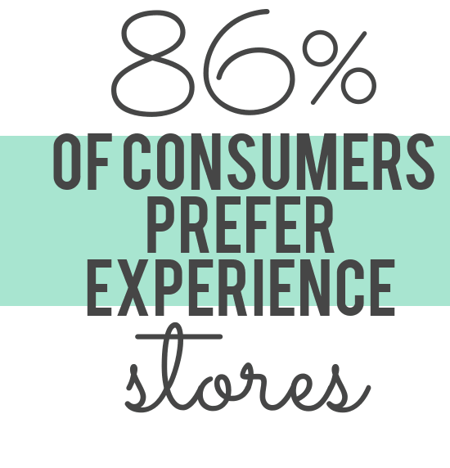
Enterprise trends
Large companies such as Booking Holdings, TUI Group, and Expedia are investing in niche tourism experiences and holidays to try and diversify their product ranges. The movement from two of the world’s largest OTAs follows changing trends within the travel industry, with many Millennials and Gen Z tourists seeking more meaningful and fulfilling tourist experiences. The rise of the experience economy has also had a significant impact.
The sharing economy is positively impacting niche tourism, and some tourists are now moving away from traditional hotels. Hotels provide a standardized service, which can vary in quality depending on the service rating of the property. Ultimately, the consumer has a level of expectation, such as the check-in process, facilities, aesthetics, and services.
However, this standardized type of service can sometimes lack character, innovation, and authenticity. For example, the guest experience in reputable budget hotel chain Motel One will be similar whether they stay at a hotel in Prague in the Czech Republic, or Manchester in the UK. Both hotels have a similar feel and look, breakfast options are identical, and both contain similar facilities such as the ‘Gin Bar’ and contemporarylounge lounge.

Slide 43
Conclusion
Understand the current niche tourism trends within the travel landscape today and how these will escalate in the near future.
Assess how travel and tourism companies such as tour operators, OTAs and DMO’s are utilizing niche tourism to drive revenues.
Acknowledge the potential pitfalls of using niche tourism by understanding the social, cultural, and environmental effects on the destination.
Discover recommendations that for businesses involved in niche tourism

Slide 44
References
Ali-Knight, J. The role of niche tourism products in destination development. (Thesis). Edinburgh Napier University. Retrieved from http://researchrepository.napier.ac.uk/id/eprint/5376
https://www.interglobe.com/niche-tourism-unlocking-new-travel-experiences
McCabe, S. (2014) The Routledge Handbook of Tourism Marketing. New York: Routledge, Taylor &amp; Francis Group.
Richards, G. (2021) “Rethinking niche tourism: The example of backpacking,” Croatian Regional Development Journal, 2(1), pp. 1–10. Available at: https://doi.org/10.2478/crdj-2021-0004.

