Slide 1

Public Health Policy Presentation
Module code BMHP5013
Lecturer DR Besty Jose
Group 2
Fizza Chohan 1807415
Shameela Rani 1713646
Tabita Lincan 1713949
Mohammed Hussain 1809052

Slide 2
Overview of Covid-19
COVID-19 is a new strain of coronavirus that has not been previously identified in humans. The COVID-19 is the cause of an outbreak of respiratory illness first detected in Wuhan, Hubei province, China (World Health Organisation, 2020 ).
Most people infected with the COVID-19 virus will experience mild to moderate respiratory illness and recover without requiring special treatment. Older people, and those with underlying medical problems like cardiovascular disease, diabetes, chronic respiratory disease, and cancer are more likely to develop serious illness (WHO, 2020a).
The virus that causes COVID-19 most commonly spreads between people who are in close contact with one another (within about 6 feet, or 2 arm lengths).It spreads through respiratory droplets or small particles, such as those in aerosols, produced when an infected person coughs, sneezes, sings, talks, or breathes (Centers for Disease Control and Prevention , 2020).

Slide 3
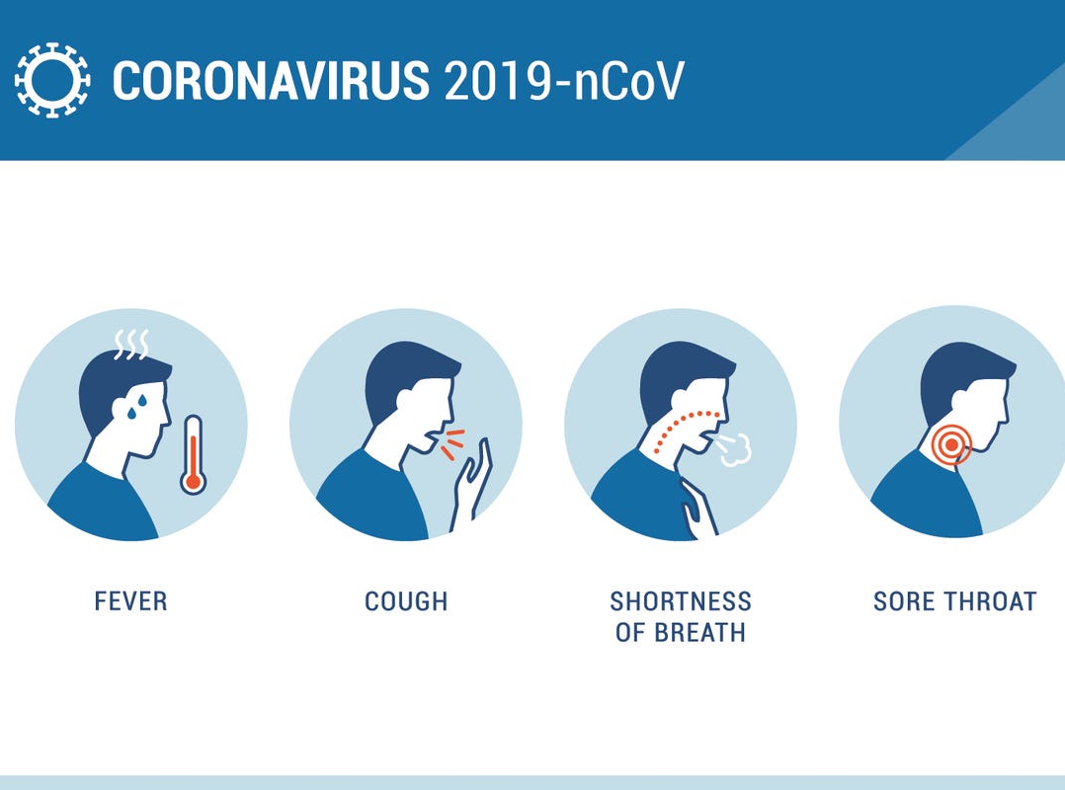
Symptoms of Covid-19
Reported illnesses have ranged from mild symptoms to severe illness and death for confirmed coronavirus disease 2019 (COVID-19) cases ( NHS , 2020).
Symptoms may appear 2-14 days after exposure:
Cough
Fever
Headache
New loss of taste or smell
Repeated shaking with chills
Sore throat
Shortness of breath
Muscle pain ( NHS, 2020).

Slide 4

Our Target Group
Our chosen target group is the Elderly. We will be looking at Adults over the age of 50 plus.
Advanced age itself is a pre-disposing factor to ‬physical and mental health issues With rapid strides in medical care and increasing average lifespans, the elderly also comprises ‬a significantly ‭‬large proportion of ‬the population (Gov UK, 2020a).
The presence of comorbid conditions makes them ‭ ‬more ‭ ‬susceptible ‭ ‬to ‭ ‬new ‭ ‬infections ‬and ‭ ‬the accompanying psychological distress ‭ (Medicine and public Health, 2020).
Elderly are more at risk due to health problems, particularly if they are taking regular medications (British Geriatrics Society, 2020).

Slide 5
Impact of Covid-19 on the Elderly
The COVID-19 disease has hit older adults harder than other age groups (WHO, 2020b).
Older adults are more likely to already have underlying conditions such as cardiovascular disease, diabetes, or respiratory illness — comorbidities that we now know raise the risk of severe COVID-19 and COVID-19-related death. In addition, a likely weaker immune system makes it harder for older adults to fight off infection (Gov UK , 2020).
As a result, the impact on older adults is notable. According to World Health Organization (WHO) data from April 2020, more than 95% of COVID-19 deaths were among people over 60 years of age, and more than half of all deaths occurred in people of 80 years-plus (WHO, 2020c).

Slide 6
Social isolation among older adults is a “serious public health concern” because of their heightened risk of cardiovascular, autoimmune, neurocognitive, and mental health problems.
Santini and colleagues recently demonstrated that social disconnection puts older adults at greater risk of depression and anxiety ( Santini, 2020).
Self-isolation will disproportionately affect elderly individuals whose only social contact is out of the home, such as at daycare venues, community center's, and places of worship.
Those who do not have close family or friends and rely on the support of voluntary services or social care, could be placed at additional risk, along with those who are already lonely, isolated, or secluded ( The Lancet, 2020).
Impact of covid 19 on the Elderly

Slide 7
Purpose of our presentation
Understand the impacts / effects Covid-19 has on our specific target group
To recognise the agencies involved regarding our chosen target group,
What action they took and put in place
Also what polices are related to our target group
Did the policies help our chosen target group
Are there any gaps that are missing
How we can help or recommend ways to help our chosen target group affected by Covid-19
Carry out a mini project on how to help and improve our target group who are affected by Covid-19

Slide 8
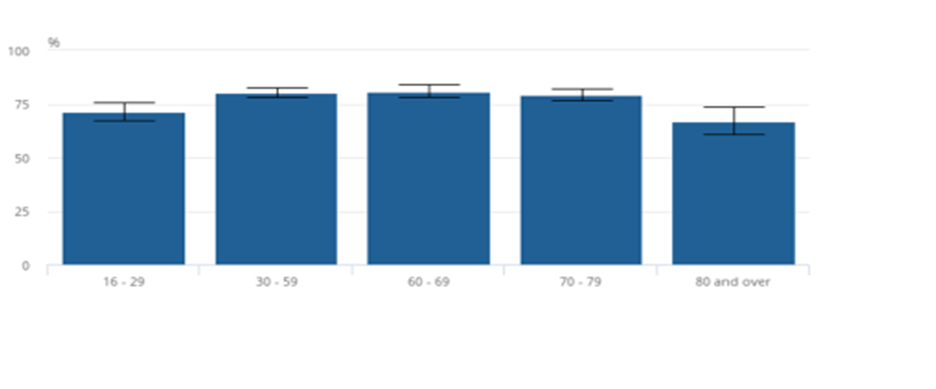
The Effect Of Coronavirus On Older People
80 and over were less worried about the effect the coronavirus was having on their lives (Office for National Statistics, 2020).
(Office for National Statistics, 2020).
(Office for National Statistics, 2020).

Slide 9
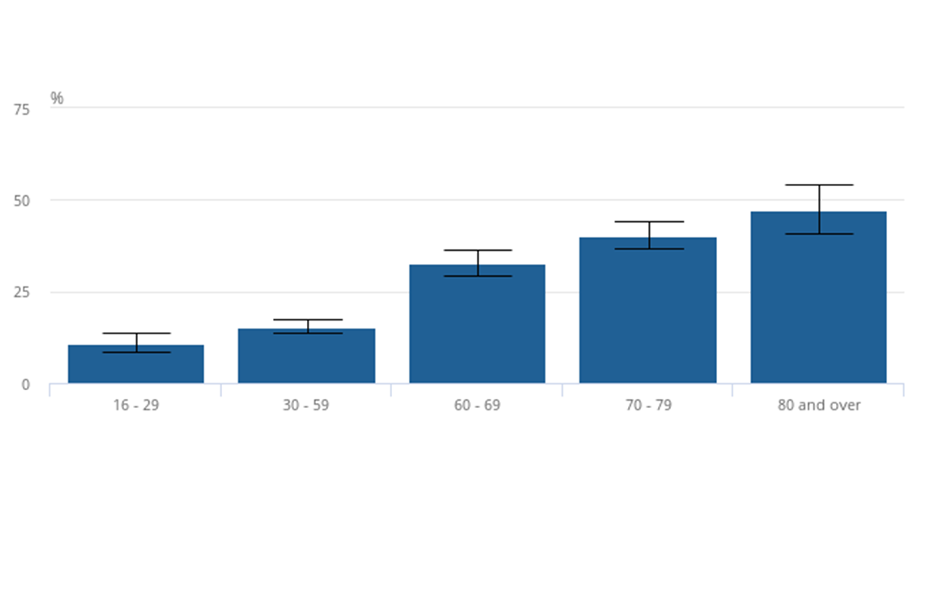
Effect on coronavirus on older people
Individuals aged 60 years and over were also more likely to have a limiting age-old illness, with those aged 80 years and over the most likely.
In older age groups have also reported having worse general health overall than younger people and were less likely than those under 60 years to report very good general health, with those over 70 years the least likely (Office for National Statistics, 2020).
(Office for National Statistics, 2020).

Slide 10
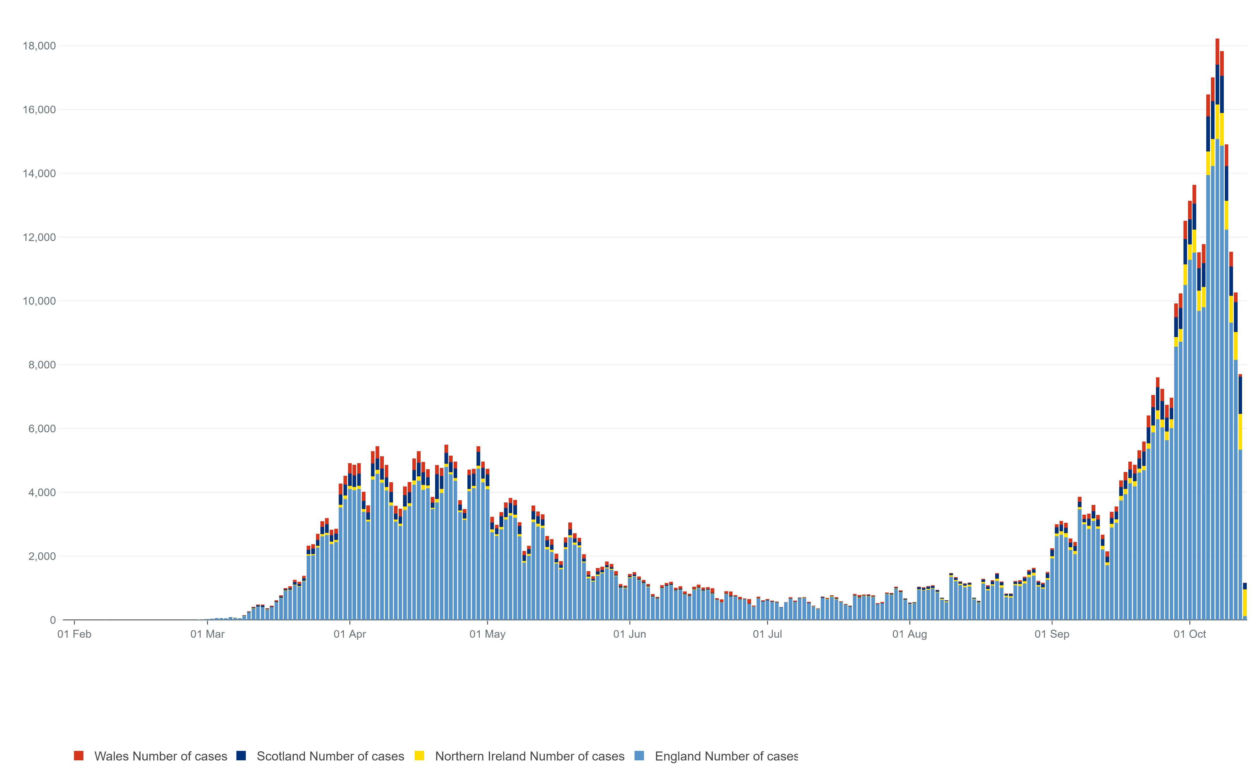
Geographical Distribution Of Covid-19 In UK
Since January 31st, 2020 there were two first cases of coronavirus in the UK.
Cases increased from March and again September.
Since 8th October cases that are confirmed is 561,815.
Confirmed Death rates 42,592 in the UK.
(Statista, 2020).
(Gov UK,2020).

Slide 11
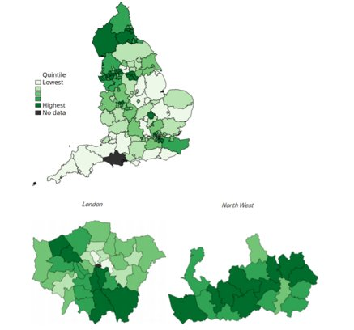
Incidence Rates To Control Covid-19 in the UK
The UK has largely been affected.
Since 9th June 289,140 confirmed cases of COVID-19.
40,883 confirmed deaths.
36,521 deaths have been in England.
To be clear death rates, cases, from Covid-19 painted incomplete picture.
Number of Cases per 10,000
(The geography of the COVID-19 crisis in England, 2020).
(The geography of the COVID-19 crisis in England, 2020).

Slide 12
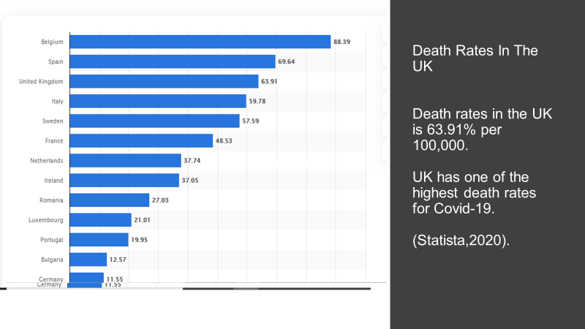

Slide 13
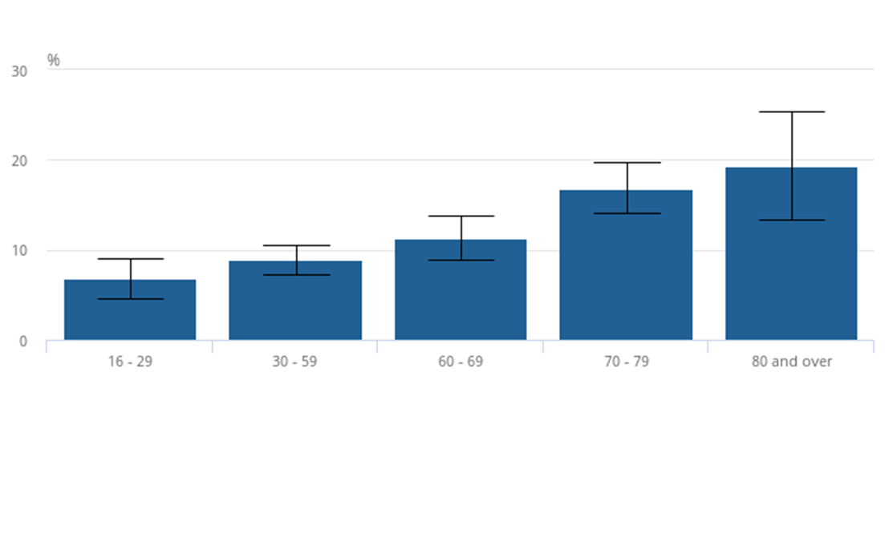
Health Conditions on the elderly
42% of those aged 70 years and over reported having a health condition, a somewhat small amount of older people who were worried about the effect that the coronavirus was having on their life, stated that their health was being affected compared with other worries, 8.5% of those aged over 70 years, a smaller amount than those aged under 70 years (12.9%). They were also less likely to say their mental health had been affected (Office for National Statistics, 2020).
(Office for National Statistics, 2020).
(Office for National Statistics, 2020).

Slide 14
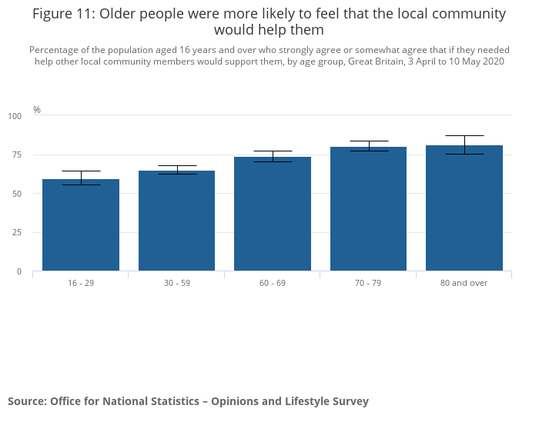
Helping The Community During Pandemic (Covid-19)
There was only two cases confirmed in January in the general population.
Older people were more at risk of dyeing (Kingsfund, 2020).
Positive cases in the elderly 368,504 (BBC, 2020).
Death rate is 10 times higher in older people (BBC, 2020).
Over 26,500 deaths in care homes (Kingsfund, 2020).
Covid-19 positive cases in general population 654,644 (Gov UK, 2020).
Death in general population 57,690 (Gov UK, 2020).
The majority of people of all ages agreed that if they needed help other local community members would helped them during the coronavirus (COVID-19) pandemic (Office for National Statistics, 2020).
Research from Office for National Statistics.
(Office for National Statistics, 2020).

Slide 15
Causes of Covid-19
One of the causes can be pneumonia
Can cause server acute respiratory syndrome (SARS)
Coronaviruses are family of viruses
Can cause illnesses like the common cold
(Mayo Clinic, 2020).

Slide 16
Spreads
The disease spreads from person to person through small droplets from the nose or mouth which are spread when a person with COVID-19 coughs or exhales. These droplets land on objects and surfaces around the person. Other people then catch COVID-19 by touching these objects or surfaces, then touching their eyes, nose or mouth. Therefore hand-washing is so critical. People can also catch COVID-19 if they breathe in droplets from a person with COVID-19 who coughs out or exhales droplets (NHS England, 2020).
Touching unclean surfaces
Shaking hands
Kissing
(Mayo Clinic, 2020).

Slide 17
Trends
Fast growth of coronavirus (WHO, 2020).
Variations in infection mutation (Toyoshima, et al. 2020).
Catching up testing to examine people (Hunter, 2020).
Curfew regulations to control spreading (Barr, 2020).
Reduction in Gross domestic product (GDP) rate (Office for National Statistics, 2020).
Global oil has been dropped to the lowest level in the last 18 years (BBC, 2020).
Loss of millions of jobs.

Slide 18
Main measures to control Covid-19
Highest rate of spreading of virus infection in UK.​
High death rate.​
Improper record of being affected by the coronavirus.​
Rapid Tests.​
Lockdown for any nonessential store.​
Evacuation for Wuhan.​
Medical equipment supply to health centers (WHO,2020). ​

Slide 19
Conspiracy Theories
Fake News about Coronavirus spreading over social media​ (Poliyico, 2020).
Misconception of 5G radiation spreading Coronavirus (Lea, 2020).
Facebook warned thousands of false news makers ​​ (Poliyico, 2020).

Slide 20
Policies regarding Covid-19
Almost one million of elderly people rely on adult social care (The Kings Fund, 2019).
The Government developed new legislation to fight and prevent the spread of Covid-19 (Kraemer, 2020).
The aim of this legislations is to safeguard and protect individuals relying on adult social care
Slowdown the spread of the virus
Support the country through coronavirus (Gov UK, 2020).

Slide 21
Coronavirus Act 2020
Coronavirus Act 2020 has been established by the Government to help the country with the difficulties as a result of Covid-19 pandemic
Enables the Government to support the organisations that contribute to the welfare of the public
The aim of the Act is to give the Government powers that are desirable in a pandemic.
Some of this powers relate to the ‘high demand and reduced capacity’ that the virus will cause within adult social care
More service users becoming ill and less staff to care for them
Also, there will be less staff to occupy critical roles
(Gov UK, 2020).

Slide 22
Coronavirus Act Objectives
The Act has three main objectives
1.To enable the Government to slow the spread of Covid-19
2.To reduce the pressure on NHS and other public bodies resources
3.To control staff shortage (The Institute for Government, 2020).

Slide 23
Coronavirus Act 2020
Impact on elderly
Delays in care
Impact on choice and well-being (British institute of Human Rights, 2020).
Limitations
Limitation from having a person-centred care plan to suit their needs, every individual has different needs, different medical problems therefore they need a care plan to fulfil their personal needs (Jayanetti, 2020).
Limiting their right of choice which means they must accept the care and support provided without having the freedom to choose what is best for them (British Institute of Human Rights, 2020).

Slide 24
Deprivation of liberty: while no one can doubt the urgency created by coronavirus ,the powers given by the Act to the authorities to impose restrictions such as quarantine and self-isolation, are a major concern wherever these powers will create a violation of the Human Rights (Pugh, 2020).
Recommendations:
Care providers should be able to work together with family and service users and do their best to fulfil the needs of service user, give the service user the choice of their own care and to get involved in their care, until a social worker or any other accredited professional will be able to put in place a person centred approached care plan (National Health Service, 2020).

Slide 25
Covid-19:action plan for adult social care
It is a plan created to protect adult social care users during pandemic
The main objectives of this policy are not just to help individuals with various needs but to give them the chance to a good and healthy lifestyle (Gov UK, 2020).
This plan consist of four pillars:
Monitoring the growth of the infection
Provide assistance to workforce
Promoting independence, provide end of life care and support, and provide care using person-centred approach
Collaborating closely with local authorities and care organisations (Social Care Institute for Excellence, 2020).

Slide 26
Covid-19: action plan for adult social care
Impact and Limitations on elderly
This Act is covering the needs and support of elderly and the carers therefore if the legislation is followed, elderly people will be able to receive the support they need and they will be able to continue living in safe manner.
Accredited training will be provided to new and existing carers therefore this will have a positive impact on the service users, as they will be able to get physical and emotional support
Government is attracting the workforce by giving them certain benefits such as free DBS Check, free training to improve the staff number
(Gov UK, 2020).

Slide 27
Covid-19: action plan for adult social care
Social impact-restrictions of visiting under social distancing measure, service users that live in nursing home will not be able to see their families and friends this means that their relationships will be affected (Armitage and Nellums, 2020). Also, the risk of abuse and neglect is increasing (Gardner, States and Bagley, 2020).
Emotional impact: not being able to have a social life, can have negative impact on the service users mental health and affect them emotionally making them vulnerable, exposed to anxiety, depression and loneliness ( Santini et al. 2020).

Slide 28
Recommendations
To help elderly people maintaining social life and to reduce the emotional impact that coronavirus has on them, the care providers should make it possible for them to meet family and friends within the Government guidance. This can be done by allowing service users to meet their loved ones in open space, for example the garden of the residential home, wearing masks and maintaining safe distance
Another suggestion is involving testing facilities in care homes
Promoting physical activities and social well being should be done by increasing home-based opportunities and access to online leisure services (Son et al.2020).
To prevent abuse and neglect of service users or residents, supervision of premises and nursing homes should be a priority (Gardner, States and Bagley,2020).

Slide 29
Agencies of public health
There some agencies that have been continuously striving to improve the public health of people globally, nationally and locally.
The following agencies are recognised to have had an influence in the communities for the promotion of good health.

Slide 30
World Health Organisation (WHO)
WHO focuses on health issues globally and are a part of the united nations.
WHO have over 60 years of experience dealing with and trying to improve issues regarding various diseases and issues such as childhood immunizations, the eradication of smallpox, maternal morbidity rates, the eradication of polio, AIDS and also family planning (WHO, 2020e).

Slide 31
Who aims to respond to pandemic of COVID-19
Health Cluster teams and partners are responding to the COVID-19 pandemic worldwide within the framework of the Global Humanitarian Response Plan, towards the following strategic priorities:
Contain the spread of the COVID-19 pandemic and decrease morbidity and mortality.
Decrease the deterioration of human assets and rights, social cohesion and livelihoods.
Protect, assist and advocate for refugees, internally displaced people, migrants and host communities particularly vulnerable to the pandemic (WHO, 2020f)

Slide 32
How the aims will be achieved
Coordinates with national authorities, partners and international actors to implement COVID-19 response actions targeting the most vulnerable people and hard-to-reach communities;
Raises public awareness on COVID-19 risks and mitigation measures to protect communities and health workers;
Promotes global guidance on COVID-19 and supports its operational adaptation for low-capacity & humanitarian settings;
Maintains access to other essential health services by adapting service delivery approaches, providing essential supplies and training health workers and national/local partners;
Supports the development of a multi-sectoral response to COVID-19, supporting other Health Clusters and Sectors to mainstream public health measures in their response;
Captures operational practice and learning to inform the evolving COVID-19 response (WHO, 2020g)

Slide 33
How WHO helped the Elderly during the Pandemic
Many guidance's have been published to help the elderly during the pandemic.
COVID-19 is changing older people’s daily routines, the care and support they receive, their ability to stay socially connected and how they are perceived. Older people are being challenged by requirements to spend more time at home, lack of physical contact with other family members, friends and colleagues, temporary cessation of employment and other activities; and anxiety and fear of illness and death – their own and others. It is therefore important that we create opportunities to foster healthy ageing during the pandemic.
WHO, together with partners, is providing guidance and advice during the COVID-19 pandemic for older people and their households, health- and social care workers and local authorities and community groups. (WHO, 2020h)

Slide 34
Limitations for WHO’s response in Covid-19
Health and Human Services Secretary Alex Azar says the World Health Organization failed in its response to the COVID-19 pandemic – and that it "cost many lives," delivering a sharp criticism of the WHO at the organization's annual meeting.
"We must be frank about one of the primary reasons this outbreak spun out of control: There was a failure by this organization to obtain the information that the world needed. And that failure cost many lives," Azar said at the World Health Assembly, reiterating President Trump's complaints about the WHO (NPR.org, 2020).

Slide 35
Limitations for WHO’s response in Covid-19
WHO failed to heed warning signs of a looming pandemic, and that its response, particularly a bungled approach to testing, is a key reason why the infection and death rates are so high, the U.S. leads the world in confirmed infections and deaths from COVID-19 (NPR.org, 2020b)

Slide 36
Public Health England (PHE)
Public Health England is responsible for improving the health and reducing the disparities between the health status of various groups by enhancing good and quality lifestyle that would improve the health of the entire populace.
More so, Public Health England also helps in advising government and also supports local government actions, the NHS and the public responsible for the protection of the nation from public health hazards (Gov UK, 2018).

Slide 37
Public Health England
(2016) classifies the nine
areas of Public Health
Practice in the UK
Surveillance and assessment of the health and well-being status of the entire populace,
Proper assessment of the evidence of effectiveness of health and treatment of illnesses and diseases,
Development and application of policy and intervention strategy,
Strategic leadership and joint activities in working for health,
Improvement of health,
Health protection,
Health and social service quality,
Public health intelligence, and
Public health in academia (Gov UK, 2018).

Slide 38
PHE response to COVID-19
Testing and tracing
Self isolation and treating symptoms
Advice for people at higher risk
Guidelines on social distancing and changes to everyday life (Gov UK, 2018).

Slide 39
Limitations
By 11 March, Italy had taken firm public health action and was in full lockdown, followed closely by Spain and France. The UK’s Scientific Advisory Group for Emergencies (SAGE) rejected lockdown, believing that the population would not accept it.
Interim Chief Executive, PHE, Michael Brodie said:
A technical issue was identified overnight on Friday 2 October in the data load process that transfers COVID-19 positive lab results into reporting dashboards. After rapid investigation, we have identified that 15,841 cases between 25 September and 2 October were not included in the reported daily COVID-19 cases. The majority of these cases occurred in most recent days (Gov UK, 2018).

Slide 40
PHE STATEMENT
Date (recorded – flow though into following day’s published numbers) | Expected reported date for GOV.UK | Cases that were not included on the expected data
24/09/2020 | 25/09/2020 | 957
25/09/2020 | 26/09/2020 | 744
26/09/2020 | 27/09/2020 | 757
27/09/2020 | 28/09/2020 | 0
28/09/2020 ( Gov UK,2020). | 29/09/2020 | 1415
29/09/2020 | 30/10/2020 | 3049
30/10/2020 | 01/10/2020 | 4133
01/10/2020 | 02/10/2020 | 4786
The delayed reporting are all positive cases identified via Pillar 2 testing between 24 September and 1 Oct
(Gov UK, 2020).

Slide 41
Recommendations
Review of policies and procedures
As the pandemic is worldwide, all countries need to get together and make a constructive decision that relates to all to stop the spread of COVID 19.
To have a quicker and effective response to an outbreak of a pandemic.

Slide 42

Conclusion
Statics state there was 654,644 positive cases in the UK (Gov UK, 2020). ​
368,504 of the positive cases were in the elderly (BBC, 2020).​
57,690 deaths were confirmed due to Covid-19 in the UK (Gov UK, 2020). ​
There were over 26,500 deaths in the elderly in care homes (Kingsfund, 2020)​.
The elderly were at greater risk of dying due to Covid-19 (Kings fund, 2020).​
​

Slide 43
Conclusion
According to (WHO) there was a fast growth of coronavirus (Who, 2020). ​
Curfew regulations were put into place to stop the spread (Barr, 2020). ​
Cases increased from March and slowed down in August, and started to rise again in September (Statista, 2020).​
Government put policies in place to safeguard people and help slow down the spread of the virus ​
There were gaps that were apparent, more testing should be made available and help for those who were vulnerable and the elderly. ​
A small-scale community project could help the elderly to improve their wellbeing and to help with the impact covid-19 has had on them ​
​

Slide 44
References
Armitage, R. and Nellums, L.B. (2020) COVID-19 and the consequences of isolating the elderly. The Lancet Public Health, 5(5).
Son, J.S., Nimrod, G., West, S.T., Janke, M.C., Liechty, T. and Naar, J.J. (2020) Promoting Older Adults’ Physical Activity and Social Well-Being during COVID-19. Leisure Sciences, pp.1–8.
Kraemer, D. (2020) What is in emergency coronavirus legislation? BBC News. [Online] 25 Mar. Available at: https://www.bbc.co.uk/news/uk-politics-52004116 (Accessed 25 Sep. 2020)
Gardner, W., States, D. and Bagley, N. (2020). The Coronavirus and the Risks to the Elderly in Long-Term Care. Journal of Aging & Social Policy, 32(4-5),pp.310-315.
Gov UK (2020) Guidance. Coronavirus Act Analysis [Online] Available at: https://www.gov.uk/government/publications/coronavirus-act-analysis (Accessed:25th September 2020).
Gov UK. (2020) COVID-19: our action plan for adult social care [Online] Available at: https://www.gov.uk/government/publications/coronavirus-covid-19-adult-social-care-action-plan/covid-19-our-action-plan-for-adult-social-care?wp-linkindex=1 (Accessed:30th September 2020).
Social Care Institute for Excellence (2020) Coronavirus (Covid-19) advice for social care. Coronavirus (Covid-19) infection control for care providers [Online] Available at: https://www.scie.org.uk/care-providers/coronavirus-covid-19/infection-control/quick-guide (Accessed:4th October 2020).

Slide 45
#
National Health Service (2020) My Covid-19 Advanced Care Plan. Guidance and template in the context of coronavirus (Covid-19) [Online] Available
at:https://www.england.nhs.uk/coronavirus/wp-content/uploads/sites/52/2020/04/C0485-appendix-acp-template-110520.pdf (Accessed:9th October 2020).
Pugh,J.(2020) The United Kingdom’s Coronavirus Act, deprivations of liberty, and the right to liberty and security of the person. . Journal of Law and the Biosciences, 7(1),PP.1-14.
The Kings Fund (2019) Key facts and figures about adult social care [Online] available at: https://www.kingsfund.org.uk/audio-video/key-facts-figures-adult-social-care (Accessed:25th September 2020).
British Institute of Human Rights (2020) Human Rights Implications of the Coronavirus Bill: The risk of making vulnerable adults and children even more vulnerable [Online] Available at: https://www.bihr.org.uk/coronavirusbill-20march (Accessed 29 Sep. 2020).
The Institute for Government (2020) Working to make government more effective. Coronavirus Act 2020 [Online] Available at :https://www.instituteforgovernment.org.uk/explainers/coronavirus-act (Accessed:25th September 2020).
Santini, Z.I., Jose, P.E., York Cornwell, E., Koyanagi, A., Nielsen, L., Hinrichsen, C., Meilstrup, C., Madsen, K.R. and Koushede, V. (2020) Social disconnectedness, perceived isolation, and symptoms of depression and anxiety among older Americans (NSHAP): a longitudinal mediation analysis. The Lancet Public Health, 5(1), pp.e62–e70.
Jayanetti,C. (2020) Warning raised over Coronavirus bill impact on elderly and disabled [Online] Available at: https://www.politics.co.uk/comment-analysis/2020/03/23/warning-raised-over-coronavirus-bill-impact-on-elderly-and-d (Accessed 9 Oct. 2020).

Slide 46
REFERENCES
Toyoshima,Y. Nemoto,K.Matsumoto,S.Nakamura,Y. Kiyotani, K. (2020). SARS-CoV-2 genomic variations associated with mortality rate of COVID-19. Journal of Human Genetics, 65, pp.569-575. https://doi.org/10.1038/s10038-020-0771-5
Hunter, P.(2020).Why the UK failed to get Coronavirus testing up to speed. The Guardian. Available at: https://www.theguardian.com/commentisfree/2020/apr/01/why-uk-coronavirus-testing-work-catchup. Accessed on: (2nd October,2020).
Barr, S.(2020). Coronavirus: What will A 10pm curfew for pubs and restaurants in England actually look like? Independent. Available at: https://www.independent.co.uk/life-style/coronavirus-pubs-restaurants-curfew-10pm-england-boris-johnson-b527096.html
Office for National Statistics. (2020).GDP monthly estimate UK: June 2020.Available at: https://www.ons.gov.uk/economy/grossdomesticproductgdp/bulletins/gdpmonthlyestimateuk/june2020. Accessed on: (3rd October, 2020).
BBC NEWS, (2020).Coronavirus: Oil price collapses to lowest level for 18 years. Available at: https://www.bbc.co.uk/news/business-52089127. Accessed on: (27th September, 2020).

Slide 47
References
Who.int. 2020. WHO,Vaccination Greatly Reduces Disease, Disability, Death And Inequity Worldwide. (online) Available at: https://www.who.int/bulletin/volumes/86/2/07-040089/en(Accessed 13 October 2020).
Who.int. 2020. Older People And COVID-19. (online) Available at: https://www.who.int/teams/social-determinants-of-health/covid-19,(Accessed 13 October 2020).
World Health Organization. 2020. COVID-19 Response. (online) Available at: https://www.who.int/health-cluster/news-and-events/news/COVID19/en, (Accessed 13 October 2020).
GOV.UK. 2020. Health Profile For England: 2018. (online0 Available at: https://www.gov.uk/government/publications/health-profile-for-england-2018, (Accessed 13 October 2020).
GOV.UK. 2020. PHE Statement On Delayed Reporting Of COVID-19 Cases. (online) Available at: https://www.gov.uk/government/news/phe-statement-on-delayed-reporting-of-covid-19-cases,(Accessed 13 October 2020).

Slide 48
REFERENCES
Politico, (2020). Facebook to tells millions of users they,ve seen fake news about COVID-19. Available at: https://www.politico.eu/article/facebook-avaaz-covid19-coronavirus-misinformation-fake-news/. Accessed on: (5th October,2020).
World Health Organiztion, (2020). Available at: https://www.who.int/foodsafety/publications/foodborne_disease/Section_5.pdf. Accessed on: 8th October, 2020).
Lea, R. (2020). ZME Science, (Myth Busted: Debunking the Alleged 5G/Coronavirus Connection. Available at: https://www.zmescience.com/science/debunking-5g-coronavirus-connection-0523543/. Accessed on: 7th October, 2020).
The geography of the COVID-19 crisis in England. (2020). Available at: https://www.ifs.org.uk/uploads/The-Geography-of-the-COVID19-crisis-in-England-final.pdf. Accessed on: 27th September, 2020).

Slide 49
REFERENCES
Office for National Statistics,(2020). Coronavirus and the social impacts on older people in Great Britain: 3 April to 10 May 2020. Available at: https://www.ons.gov.uk/peoplepopulationandcommunity/birthsdeathsandmarriages/ageing/articles/coronavirusandthesocialimpactsonolderpeopleingreatbritain/3aprilto10may2020 . (Accessed on: 29th September 2020).
Mayo Clinic, (2020). Coronavirus disease 2019 (COVID 19). Available at: https://www.mayoclinic.org/diseases-conditions/coronavirus/symptoms-cause/syc-20479963. Accessed on: 1st October 2020).
Middle east respiratory syndrome (MERS) (Mayo Clinic,2020). Available at: https://www.emeesykidney.nhs.uk/128-coronavirus-advice/228-how-is-covid-19-spread#:~:text=The%20disease%20can%20spread%20from,%2C%20nose%20or%20mouth. (Accessed
On: 27th September 2020).
Statista, 2020, UK: coronavirus cases | Statista . Available at: https://www.statista.com/statistics/1101958/cumulative-coronavirus-cases-in-the-uk/. (Accessed on: 30th September 2020).​
Statista, (2020). UK Incidence of coronavirus (COVID-19) deaths in the European Economic Area and the United Kingdom as of October 9, 2020, by country. Available at: https://www.statista.com/statistics/1111779/coronavirus-death-rate-europe-by-country/. (Accessed on: 10th October,2020).
World Health Organization, (2020).WHO Coronavirus Disease (COVID-19) Dashboard. Available at: https://covid19.who.int/?gclid=Cj0KQjw2or8BRCNARIsAC_ppyYPtq2aVfJ94s{_8X1zPbNTj9Ozr5ccxEXu7NdlhDU3wMRYrvN8LZUkaApg9EALw_wcB. (Accessed on: 2nd October, 2020).

Slide 50
The Institute for Government (2020) Working to make government more effective. Coronavirus Act 2020 [Online] Available at :https://www.instituteforgovernment.org.uk/explainers/coronavirus-act (Accessed:25th September 2020).
Santini, Z.I., Jose, P.E., York Cornwell, E., Koyanagi, A., Nielsen, L., Hinrichsen, C., Meilstrup, C., Madsen, K.R. and Koushede, V. (2020) Social disconnectedness, perceived isolation, and symptoms of depression and anxiety among older Americans (NSHAP): a longitudinal mediation analysis. The Lancet Public Health, 5(1), pp.e62–e70.
Jayanetti,C. (2020) Warning raised over Coronavirus bill impact on elderly and disabled [Online] Available at: https://www.politics.co.uk/comment-analysis/2020/03/23/warning-raised-over-coronavirus-bill-impact-on-elderly-and-d (Accessed 9 Oct. 2020).
GOV.UK. (2020) COVID-19: Effects on the Elderly Available at: https://www.gov.uk/government/publications/coronavirus-covid-19-adult-social-care-action-plan/covid-19-our-action-plan-for-adult-social-care?wp-linkindex=1 (Accessed:27th September 2020).
World Health Organization, (2020).WHO Coronavirus Disease (COVID-19) Dashboard. Available at: https://covid19.who.int/?gclid=Cj0KQjw2or8BRCNARIsAC_ppyYPtq2aVfJ94s{_8X1zPbNTj9Ozr5ccxEXu7NdlhDU3wMRYrvN8LZUkaApg9EALw_wcB. (Accessed on: 4th October, 2020).
Santini, Z.I., Jose, P.E., York Cornwell, E., Koyanagi, A., Nielsen, L., Hinrichsen, C., Meilstrup, C., Madsen, K.R. and Koushede, V. (2020) Social disconnectedness, perceived isolation, and symptoms of depression and anxiety among older Americans (NSHAP): a longitudinal mediation analysis. The Lancet Public Health, 5(1), pp.E256.

Slide 51
NHS, (2020). Main symptoms of coronavirus. Available at :https://www.nhs.uk/conditions/coronavirus-covid-19/symptoms.(Accessed on 29th September 2020).
Centers for Disease control and Prevention, (2020). How does the Virus Spread. Available at :https://www.cdc.gov/coronavirus/2019-ncov/faq.html. (Accessed on 29th September 2020).
British Geriatrics Society, (2020). Cornoavirusand older people. Avaliable at :https://www.bgs.org.uk/resources/resource-series/coronavirus-and-older-people.(Accessed on 1st October 2020).
Npr.org. 2020. NPR Choice Page. [online] Available at: <https://www.npr.org/sections/coronavirus-live-updates/2020/05/18/858151841/azar-accuses-who-of-failure-that-cost-many-lives-in-covid-19-pandemic?t=160219934109&t=1602586989269> [Accessed 15 October 2020].

