Slide 1



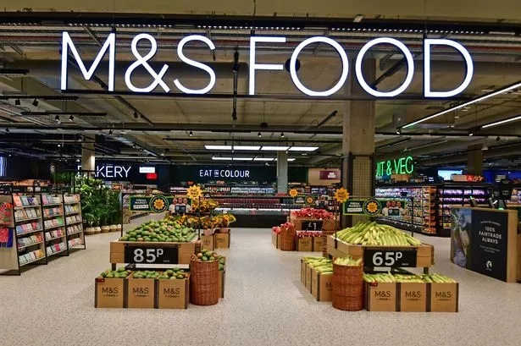
DIGITAL AND SOCIAL MEDIA MARKETING
M&S FOOD
Module name: Building a Sustainable Marketing Relationship (BMSW5007_CARD)
Lecturer name: Gwyneth Jones
University of Wales Trinity Saint David
Presented by:
Cristina Limbau (2410885)
04.12.2025

Slide 2



Contents
1.Introduction
2. Defining Digital Marketing
3. Defining Social Media Marketing
4. The Role of Digital & Social Media in CRM
5. How M&S Food Uses Digital Marketing
6. How M&S Food Uses Social Media Marketing
7. Building Customer Relationships Through Digital & Social Media
8.Enhancing Customer Experience
9. Impact on Organisational Performance
10. SWOT Analysis: M&S Food’s Digital & Social Media Strategy
11. Recommendations
12. Conclusion
13. Reference List

Slide 3

  Introduction
  This presentation examines how digital and social media marketing support Customer Relationship Management at M&S Food, focusing on how these tools strengthen customer engagement and loyalty in a competitive grocery environment.
  Digital and social platforms now shape how retailers communicate with customers, offering opportunities for personalisation, interaction and rapid response that traditional marketing alone cannot provide.
  M&S Food increasingly uses digital channels such as the Sparks app, email marketing and social platforms to engage customers in more tailored ways, supporting stronger and more sustainable customer relationships.
  The aim of this presentation is to evaluate how effectively M&S Food applies digital and social media marketing to build relationships, enhance the customer experience and contribute to overall organisational performance.

Slide 4

2. Defining Digital Marketing
WHAT DIGITAL MARKETING MEANS
Digital marketing refers to the use of online channels such as websites, mobile apps, email, search engines and digital content to attract, engage and retain customers, offering more targeted and measurable communication than traditional methods (Chaffey & Ellis-Chadwick, 2022).
DIGITAL MARKETING WITHIN CRM
Within Customer Relationship Management, digital marketing plays a key role because it allows organisations to gather customer data, personalise communication and deliver relevant interactions that strengthen long-term customer relationships (Puthussery, 2020).
WHY IT MATTERS FOR M&S FOOD
For M&S Food, digital marketing supports tailored Sparks rewards, personalised email offers and consistent communication across digital touchpoints, helping the organisation better understand customer behaviour and build stronger loyalty.

Slide 5

3. Defining Social Media Marketing
What Social Media Marketing Means
Social media marketing involves using platforms such as Instagram, TikTok, Facebook and YouTube to communicate with customers, share content and build ongoing relationships in highly interactive digital spaces (Evans, Bratton & McKee, 2021)
SOCIAL MEDIA MARKETING WITHIN CRM
Within CRM, social media enables two-way communication, allowing customers to comment, react and participate in conversations, which strengthens emotional engagement and influences customer behaviour (Wibowo et al., 2021).
WHY IT MATTERS FOR M&S FOOD
Social media is essential for M&S Food because it helps the brand showcase products, create storytelling content and respond directly to customer feedback, supporting loyalty and enhancing the customer experience.

Slide 6
4. The Role of Digital & Social Media in CRM
STRENGTHENING CUSTOMER UNDERSTANDING
DIGITAL AND SOCIAL MEDIA CHANNELS ALLOW ORGANISATIONS TO COLLECT BEHAVIOURAL DATA, HELPING THEM UNDERSTAND CUSTOMER PREFERENCES, SHOPPING PATTERNS AND ENGAGEMENT LEVELS MORE ACCURATELY (CHAFFEY & ELLIS-CHADWICK, 2022).
SUPPORTING PERSONALISED COMMUNICATION
These platforms enable targeted messages, personalised offers and tailored content, which improve relevance and make customers feel recognised and valued
ENHANCING ENGAGEMENT AND LOYALTY
Social media interactions, personalised digital experiences and ongoing communication encourage repeat visits and deepen emotional loyalty, influencing long-term behaviour ( Antczak, 2024).

Slide 7

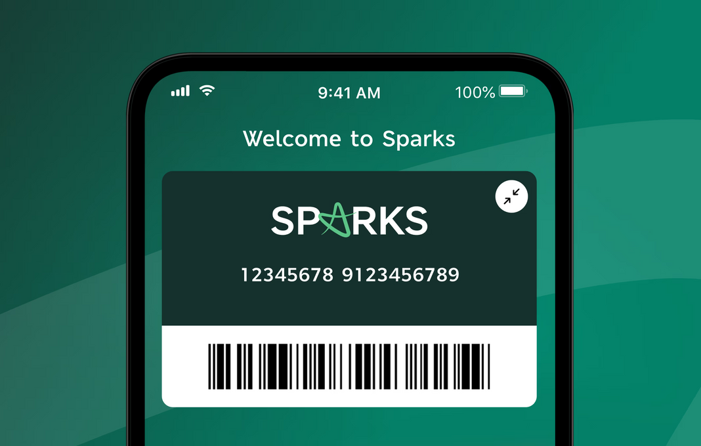
5. How M&S Food Uses Digital Marketing
5.1 Personalised Sparks Rewards and Offers
M&S Food uses digital data from the Sparks loyalty programme to deliver personalised offers, tailored discounts and product recommendations, helping the brand create more relevant customer interactions and strengthen loyalty.
(Marks&Spencer, 2025a)

Slide 8
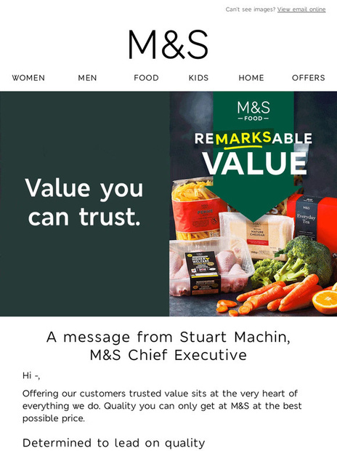
5.2 Targeted Email and App-Based Communication
The M&S app and email campaigns provide customers with personalised updates, exclusive offers and reminders based on individual shopping behaviour, increasing convenience and encouraging ongoing engagement.
(Marks&Spencer, 2025a)

Slide 9
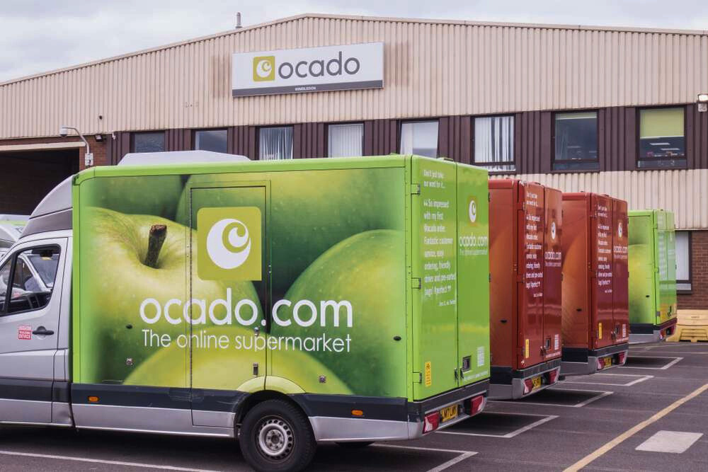
5.3 Enhanced Online Shopping Experience
Digital features such as online browsing, shopping through Ocado, and personalised product suggestions help M&S Food provide a smoother and more customer-centred online experience that supports repeat visits.
(Marks&Spencer, 2025a)

Slide 10
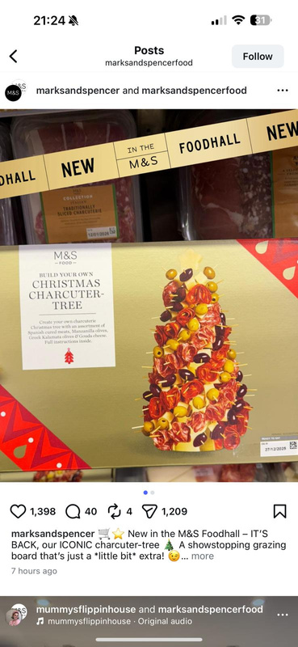

6. How M&S Food Uses Social Media Marketing
6.1 Showcasing Products and Food Quality
M&S Food uses Instagram, TikTok and Facebook to highlight new ranges, seasonal products and high-quality food imagery, helping the brand communicate value and inspire customers through visually engaging content.
(Marks&Spencer, 2025b)

Slide 11
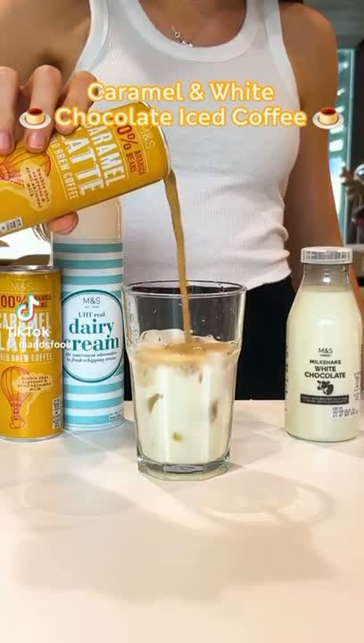
6.2 Creating Engaging and Shareable Content
Short-form videos, behind-the-scenes clips and recipe-based reels encourage customers to interact with posts, increasing reach and supporting emotional engagement with the brand (Virdi, 2025).
(Marks&Spencer, 2025c)

Slide 12


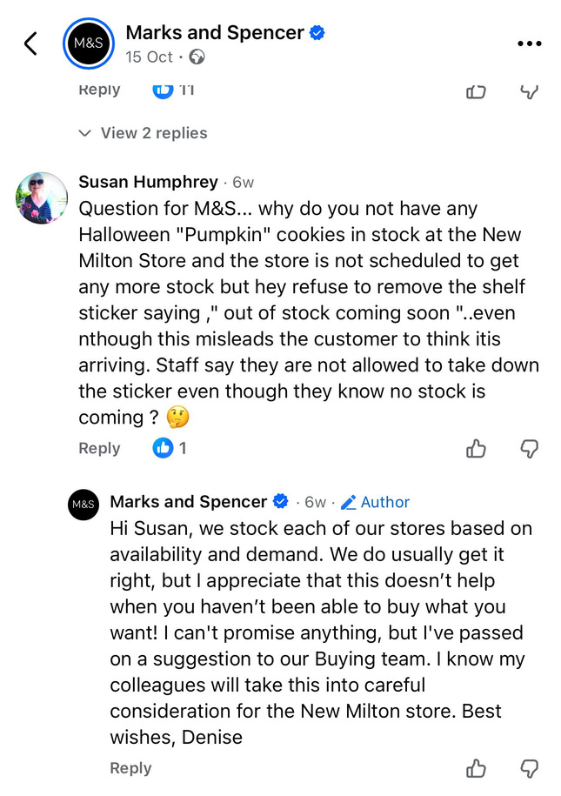

6.3 Building Community Through Two-Way Interaction
M&S responds to comments, reposts customer content and encourages participation, using social platforms to build a sense of community and strengthen customer relationships in line with CRM principles.
(Marks&Spencer, 2025a)

Slide 13

7. How Digital & Social Media Build Customer Relationships at M&S Food
Strengthening Personalisation Through Customer Data
Digital platforms such as the Sparks app enable M&S Food to tailor offers, recommendations and communication to individual customer preferences, reinforcing a sense of personal recognition that supports loyalty (Chaffey & Ellis-Chadwick, 2022).
Enhancing Emotional Engagement Through Social Content
M&S Food’s social media storytelling, seasonal campaigns and recipe-based content foster emotional connection and brand attachment, helping customers feel connected to the M&S Food experience (Virdi, 2025; Evans, Bratton & McKee, 2021).
Building Trust Through Transparency and Consistent Messaging
Regular updates, behind-the-scenes videos and responsible sourcing messages communicate transparency and authenticity, which are essential for trust-building within CRM relationships (Puthussery, 2020).

Slide 14



8. Enhancing Customer Experience Through Digital & Social Media
  Improving Convenience Through Digital Touchpoints
The M&S app, Sparks programme and online shopping via Ocado simplify the customer journey by offering easy navigation, digital receipts and personalised product suggestions, making the shopping experience more convenient and efficient (Chaffey & Ellis-Chadwick, 2022).
  Creating Interactive and Engaging Customer Journeys
Short videos, recipe content and interactive posts on social media platforms provide inspiration, entertainment and opportunities for customers to engage with the brand beyond traditional shopping experiences (Evans, Bratton & McKee, 2021).
  Supporting Seamless Shopping Experience Across Platforms
Digital tools link in-store and online behaviour, allowing M&S to offer tailored offers, consistent messaging and a connected experience across multiple platforms, which strengthens customer satisfaction and long-term loyalty (Puthussery, 2020).

Slide 15


9. How Digital & Social Media Support Organisational Performance
Increasing Brand Visibility and Reach
M&S Food’s social media campaigns, short-form videos and seasonal content help the brand reach wider audiences, driving higher visibility and improving its competitive position in a crowded grocery market (Virdi, 2025).
Boosting Customer Engagement and Repeat Purchases
Digital tools such as Sparks, personalised notifications and interactive posts encourage customers to return more frequently, improving engagement levels and supporting stronger customer loyalty (Wibowo et al., 2021).
Supporting Sales Growth Through Online Platforms
Online shopping through Ocado, personalised offers and targeted digital promotions contribute to increased conversions and higher sales, demonstrating the financial value of M&S Food’s digital strategy (Antczak, 2024).

Slide 16

10. SWOT Analysis: M&S Food’s Digital & Social Media Strategy
Strengths
Weaknesses
Opportunities
Threats
M&S Food benefits from a strong brand reputation, high-quality digital content and a structured social media strategy that increases engagement and supports emotional loyalty.
Premium pricing reduces accessibility on digital platforms, and the Sparks programme may encourage short-term, deal-driven behaviour rather than deep emotional loyalty
There is significant potential to expand innovative digital content, adopt AI-driven personalisation and increase the accessibility of online services to attract broader customer groups (Chaffey & Ellis-Chadwick, 2022)
Competitors offering lower prices and stronger online ecosystems pose a challenge, while rapidly changing digital behaviours require constant innovation to avoid losing relevance (Wibowo et al., 2021).

Slide 17

11. Recommendations for Strengthening M&S Food’s Digital & Social Media Strategy
  Enhance Value-Focused Digital Offers
M&S Food should introduce more value-based bundles and personalised price incentives through Sparks to reduce price sensitivity and support deeper loyalty among cost-conscious customers (Antczak, 2024).
  Expand Creative Short-Form Content
Investing in more recipe videos, behind-the-scenes clips and influencer-led collaborations would help the brand maintain viral reach and strengthen emotional engagement across TikTok and Instagram (Virdi, 2025; Evans, Bratton & McKee, 2021).
  Strengthen Connected Customer Experiences Across Platforms
Improving the link between in-store and online behaviour—such as store-specific offers, digital wayfinding or app-based shopping support—would create a more seamless and consistent customer journey (Chaffey & Ellis-Chadwick, 2022).
  Develop Advanced Personalisation Using AI
Introducing AI-driven recommendations and predictive analytics would allow M&S Food to tailor content, offers and product suggestions more accurately, improving relevance and strengthening long-term customer relationships (Puthussery, 2020).

Slide 18

12. Conclusion
Digital and Social Media as Key Drivers of CRM Success
M&S Food’s use of digital tools and social platforms plays a central role in strengthening customer relationships by supporting personalisation, emotional engagement and consistent communication.
Positive Impact on Engagement, Loyalty and Performance
Digital strategies such as Sparks personalisation, engaging social content and online convenience have enhanced customer experience, increased repeat interactions and supported stronger organisational performance.
Need for Continued Innovation and Customer-Centric Growth
To sustain competitive advantage, M&S Food must continue investing in value-led offers, creative content, connected customer experiences and advanced personalisation to maintain relevance in a rapidly evolving digital environment.

Slide 19
13. Reference List
  Antczak, B.O. (2024) ‘The influence of digital marketing and social media marketing on consumer buying behavior’, Journal of Modern Science, 56(2), pp. 310–335. doi: 10.13166/jms/189429.
  Chaffey, D. and Ellis-Chadwick, F. (2022) Digital Marketing. 8th edn. Harlow: Pearson.
  Evans, D., Bratton, S. and McKee, J. (2021) Social Media Marketing. A G Printing & Publishing. Available at: https://books.google.co.uk/books?hl=en&lr=&id=7lgkEAAAQBAJ&oi=fnd&pg=PR6 (Accessed: 3 December 2025).
  Marks & Spencer (2025a) Facebook post: M&S Food promotional content. Available at: https://www.facebook.com/share/1AMmdH6PER/?mibextid=wwXIfr (Accessed: 3 December 2025).
  Marks & Spencer (2025b) Instagram post: M&S Food content and updates. Available at: https://www.instagram.com/marksandspencerfood?igsh=MWVwdTl3ODFsYzU1eg== (Accessed: 3 December 2025).
  Marks & Spencer (2025c) TikTok channel: M&S Food videos and campaigns. Available at: https://www.tiktok.com/@mandsfood?_r=1&_t=ZN-91vMC8Iq2Io (Accessed: 3 December 2025).
  Puthussery, A. (2020) Digital Marketing: An Overview. Notion Press. Available at: https://books.google.co.uk/books?id=wFjTDwAAQBAJ (Accessed: 3 December 2025).
  Virdi, A. (2025) ‘M&S on why its “vast” social media structure drives virality’, Marketing Week, 8 September. Available at: https://www.marketingweek.com/ms-social-media-tv-marketing-virality/ (Accessed: 3 December 2025).
  Wibowo, A., Chen, S.-C., Wiangin, U., Ma, Y. and Ruangkanjanases, A. (2021) ‘Customer Behavior as an Outcome of Social Media Marketing’, Sustainability, 13(1), 189. Available at: https://www.mdpi.com/2071-1050/13/1/189 (Accessed: 3 December 2025).

Slide 20

THANK YOU FOR ATTENTION!
M&S FOOD

