Slide 1
Module Name : Signals and System
Module Code : ACDA4009
Topic : Revision 1
Lecture : 11

Slide 2
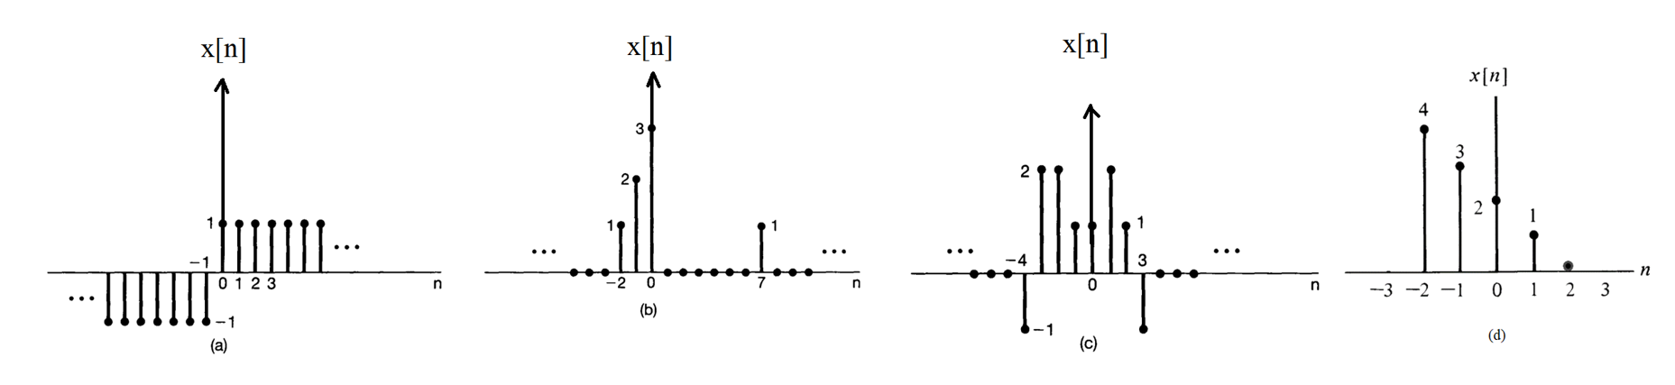
Revision 1
Exercise 1
ACDA4009 – Signals and System

Slide 3
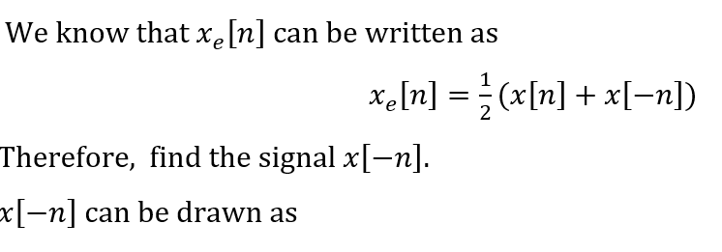
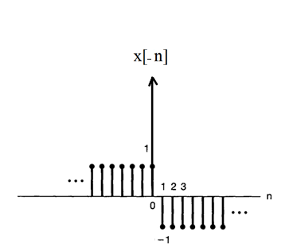
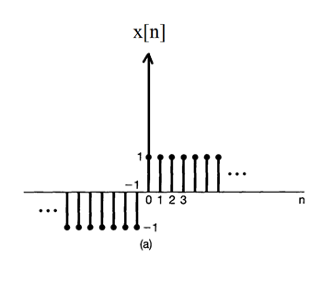
Revision 1
(a)
ACDA4009 – Signals and System

Slide 4
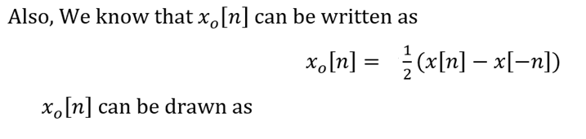
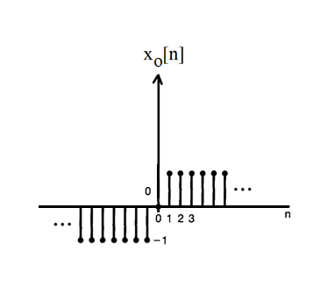
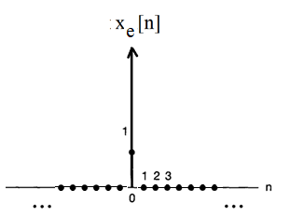
Revision 1
ACDA4009 – Signals and System

Slide 5
Revision 1
ACDA4009 – Signals and System

Slide 6
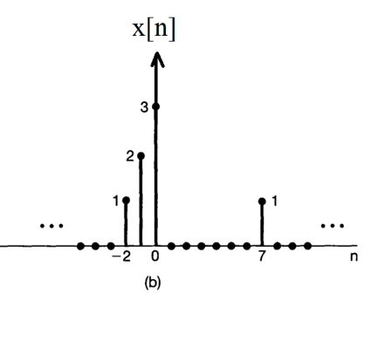
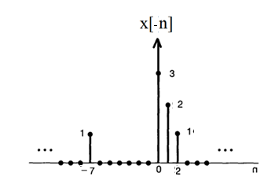
Revision 1
(b)
ACDA4009 – Signals and System

Slide 7
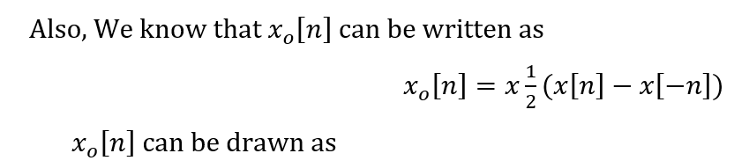
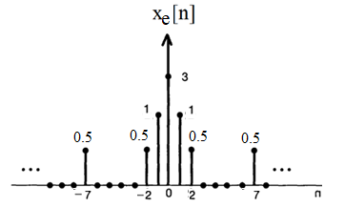
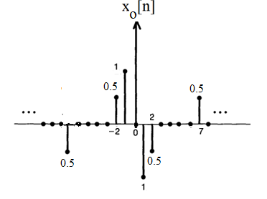
Revision 1
ACDA4009 – Signals and System

Slide 8
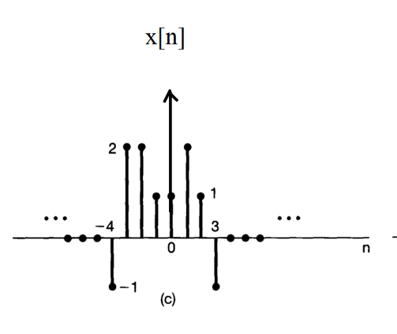
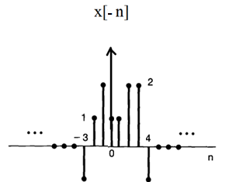
Revision 1
(c)
ACDA4009 – Signals and System

Slide 9
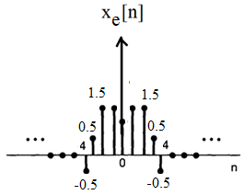
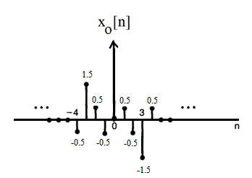
Revision 1
ACDA4009 – Signals and System

Slide 10
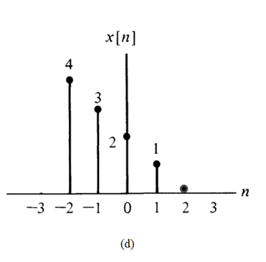
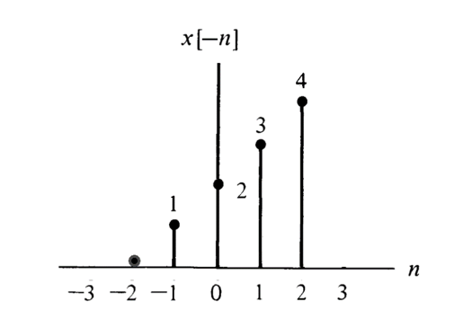
Revision 1
(d)
ACDA4009 – Signals and System

Slide 11
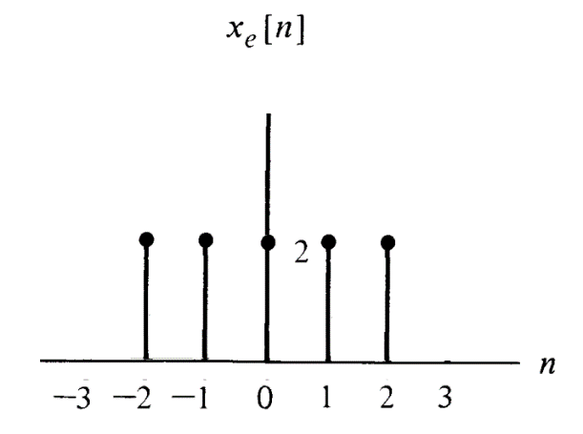
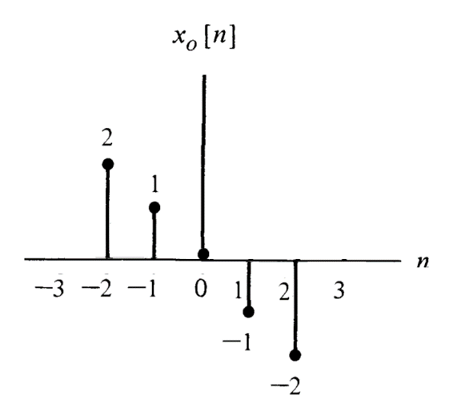
Revision 1
ACDA4009 – Signals and System

Slide 12
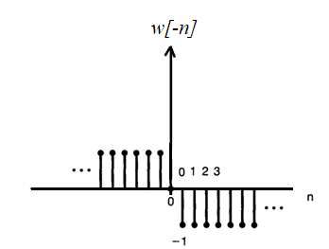
Revision 1
Exercise 2
a.
ACDA4009 – Signals and System

Slide 13
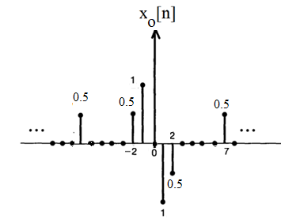
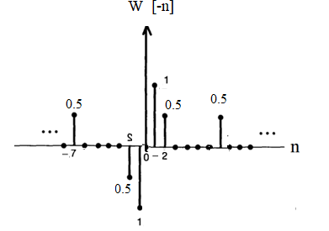
Revision 1
Exercise 2
b.
ACDA4009 – Signals and System

Slide 14
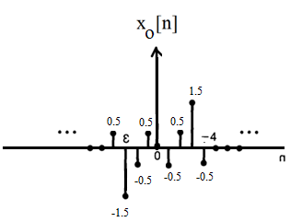
Revision 1
Exercise 2
c.
ACDA4009 – Signals and System

Slide 15

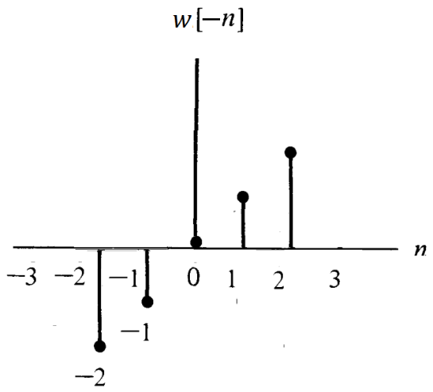
Revision 1
Exercise 2
d.
ACDA4009 – Signals and System

Slide 16
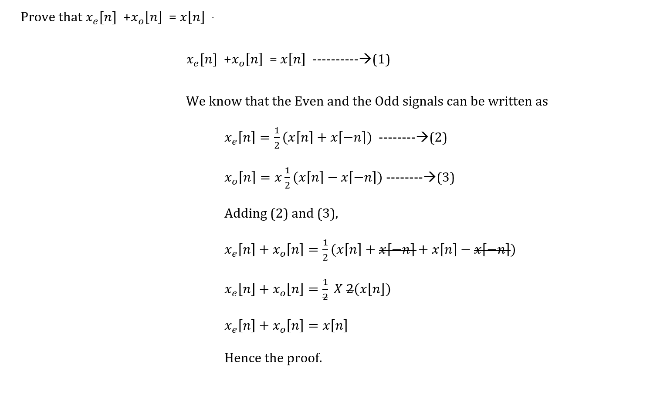
Revision 1
Exercise 3
ACDA4009 – Signals and System

Slide 17
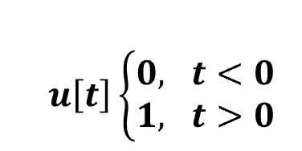

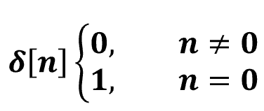

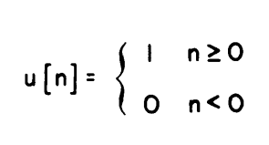
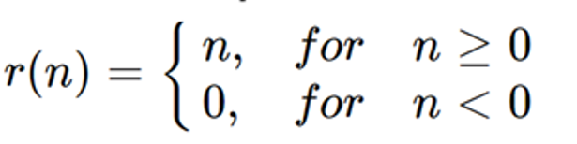
Revision 1
Exercise 4
Identify the Signal and provide the name of the function below and illustrate its graphical representations.
(a) (d)
(b) (e)
(c) (f)
ACDA4009 – Signals and System

Slide 18
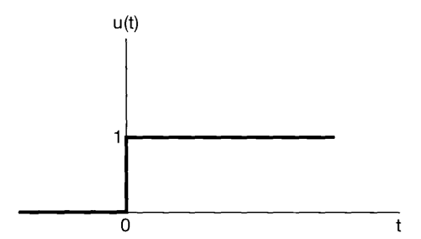
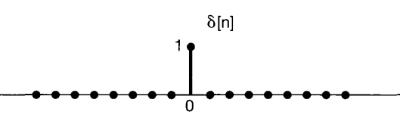
Revision 1
Exercise 4
(a)
Signal: Continuous time signal
Function : Unit Step Function
Graphical representations.
(b)
Signal: Discrete Time Signal
Function : Unit impulse Function
Graphical representations.
ACDA4009 – Signals and System

Slide 19
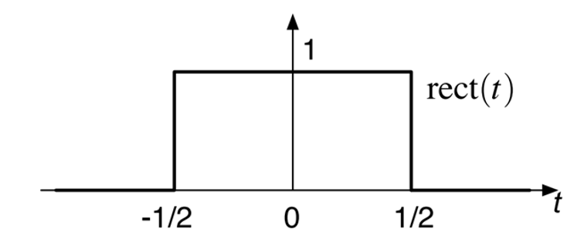
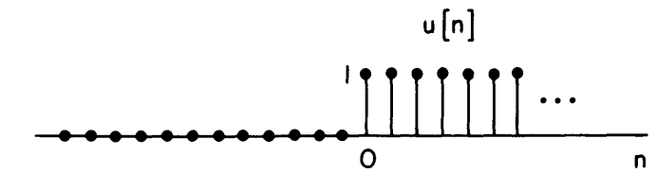
Revision 1
Exercise 4
(c)
Signal: Discrete Time Signal
Function : Unit Step Function
Graphical representations.
(d)
Signal :Continuous time signal
Function : Unit Rectangular Signal
Graphical representations.
ACDA4009 – Signals and System

Slide 20
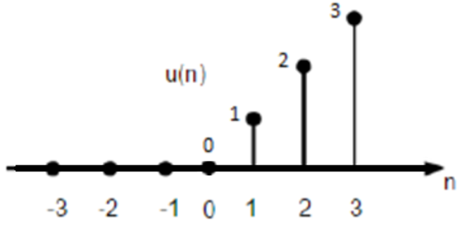
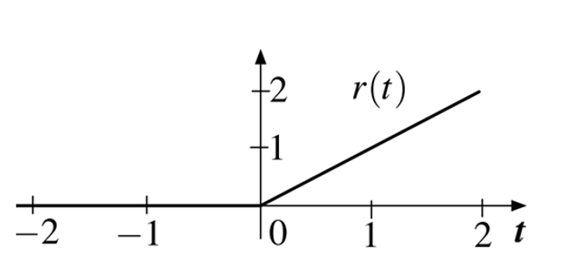
Revision 1
Exercise 4
(e)
Signal: Continuous time signal
Function : Unit Ramp Signal
Graphical representations.
(f)
Signal: Discrete Time Signal
Function : Unit Ramp Signal
Graphical representations.
ACDA4009 – Signals and System

Slide 21
Revision 1
Exercise 5
Generate a rectangular pulse for x(t) with unit amplitude and a duration of 2-time units.
Generate a triangular pulse for c(t) with the amplitude of 3 and a duration of 4-time units.
Plot a rectangular pulse x(t) for unit amplitude and unit duration.
ACDA4009 – Signals and System

Slide 22
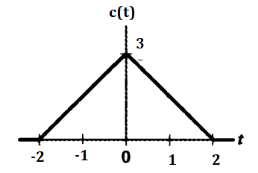
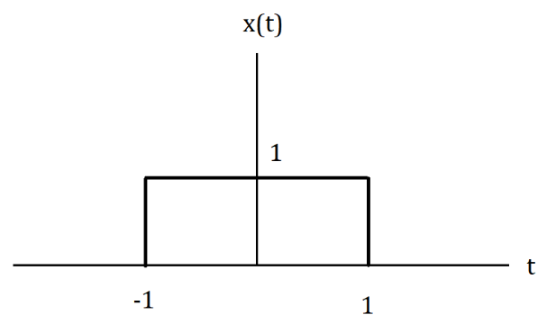
Revision 1
Exercise 5
(i) Generate a rectangular pulse for x(t) with unit amplitude and a duration of 2-time units.
(ii) Generate a triangular pulse for c(t) with the amplitude of 3 and a duration of 4-time units.
ACDA4009 – Signals and System

Slide 23
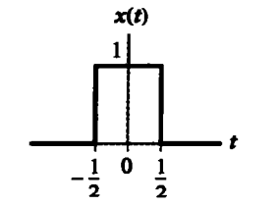
Revision 1
Exercise 5
(iii) Plot a rectangular pulse x(t) for unit amplitude and unit duration.
ACDA4009 – Signals and System

Slide 24
Revision 1
Exercise 6
Consider the rectangular pulse below
Illustrate the time shift and time variant representation for rectangular function y(t)=x(2t+3)
ACDA4009 – Signals and System

Slide 25
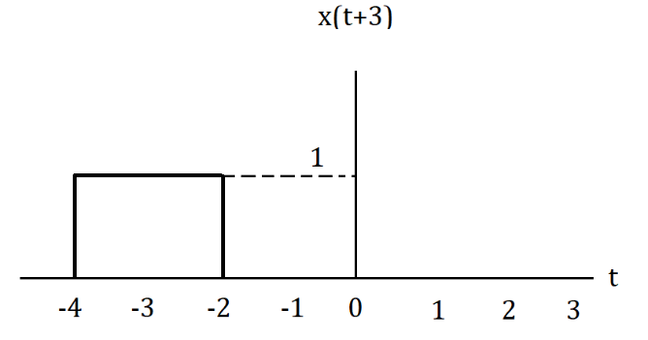
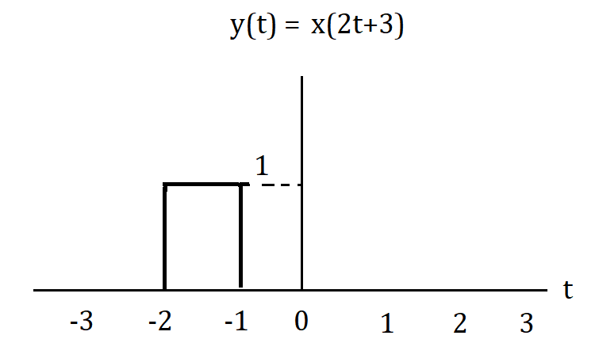
Revision 1
Exercise 6
y(t)=x(2t+3)
Time Shift Time Variant
ACDA4009 – Signals and System

Slide 26
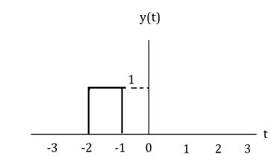
Revision 1
Exercise 7
Consider the rectangular pulse below
Illustrate the time shift and time variant representation for rectangular function u(t) = y(2t+2)
ACDA4009 – Signals and System

Slide 27
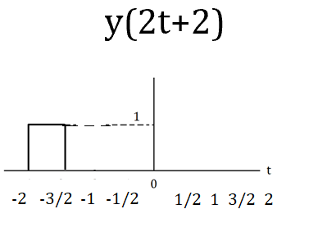
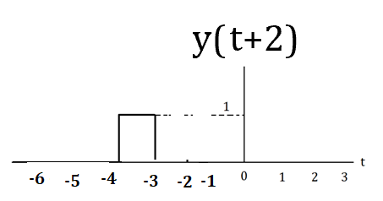
Revision 1
Exercise 7
u(t) = y(2t+2)
Time Shift Time Variant
ACDA4009 – Signals and System

Slide 28
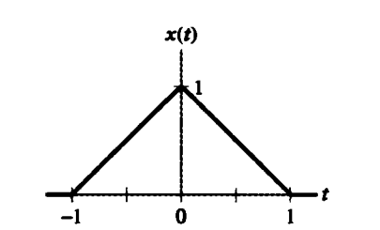
Revision 1
Exercise 8
For the triangular pulse x(t) shown below, sketch the time scaling for each of the following derived from x(t)
x(3t)
x(3t+2)
x(3t)+x(3t+2)
ACDA4009 – Signals and System

Slide 29
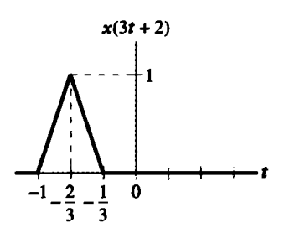
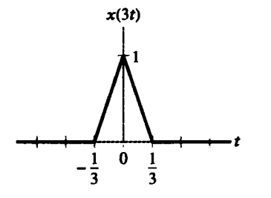
Revision 1
Exercise 8
x(3t) (b) x(3t+2)
ACDA4009 – Signals and System

Slide 30
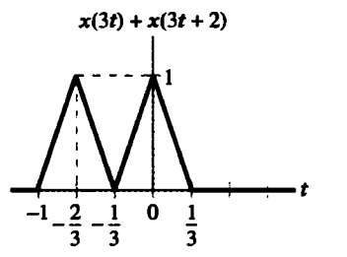
Revision 1
Exercise 8
(c) x(3t)+x(3t+2)
ACDA4009 – Signals and System

Slide 31
Thank You

