Slide 1
What is Thematic Analysis
Thematic Analysis is a widely used qualitative psychology tool in analysing interview, focus group or diary based data.
“Thematic analysis is a method for identifying, analysing, and reporting patterns (themes) within data”. (Braun and Clarke, 2006)
It is a method of processing and analysing the data in rich detail , interpreting various aspects of the research topic (Boyatzis, 1998).
Despite being widely used, its methodology can be considered unclear (supporters might call this flexible) – and more recently researchers have adopted a hybrid approach of thematic analysis, combing it with other qualitative method of analysis.

Slide 2
Introduction to Thematic Analysis.
The term Thematic Analysis has had many different meanings in Psychology.
Whilst it has been a popular method there has been some confusion regarding its methodology.
However, largely through the work of Braun and Clarke (2006), Thematic Analysis is considered a robust methodology and widely recognised in psychology, social sciences and health sciences.
  “Accessible, systematic and rigorous approach to coding and theme development” (Howitt, 2010, cited in Clark, Braun and Hayfield, 2015 p 223).

Slide 3
Thematic Analysis (Braun and Clarke 2013).
◆ TA research is conducted within a qualitative paradigm.
1) REJECTION of the possibility of discovering universal meaning.
  Meaning is understood to the context in which it is produced.
2) ACTIVE role of the researcher
  Embracing research subjectivity.
3) Organic approach to coding and theme development. Unique to the perspectives of the researcher
  Fluid, Flexible and Responsive to the researchers evolving engagement with the data.

Slide 4
A key difference between TA and other forms of Qualitative Analysis.
It is a method rather than a methodology.
Methodology = Theoretically informed Framework.
  Alongside guidelines for analysis, there is also guiding theoretical assumptions for particular kinds of research questions.
Method = Theoretically independent tools for analysing data.
  When you use TA, you have to decided the theoretical assumptions, what your research question will be and the type of data you collect.
    Much more flexible.

Slide 5
The Key Steps in Qualitative Research.
1. Choosing a topic/research question
2. Constructing an interview schedule
3. Locating participants
4. Conducting an interview or interviews
5. Transcribing the interview material
6. Analysis of data
7. Writing Up

Slide 6
Conducting Analysis.
Thematic Analysis involves searching for themes in interview or other qualitative data.
Themes are: “recurrent ideas or topics which can be detected in the material which is being analysed, and which come up on more than one in a particular set of data.” (Hayes 2000:173)

Slide 7
Thematic Analysis (Clarke et al 2015).
Familiarisation – reading and re-reading the transcripts.
Coding – is the first step in the process of identifying patterns in the data because it groups together similar data fragments.
“Searching for themes” – the research cluster together codes to create a credible mapping of key patterns in the data.
Reviewing the themes – the researcher check whether the ‘candidate’ theme exhibit a good ‘fit’ with the coded and the entire data set, and each has a clear, distinct ‘essence’ or central organising concept.
Defining and naming the themes – writing theme definitions and selecting a theme name or label.
Writing the Report – produce a narrative (organising framework) showing the analytical journey.

Slide 8
Phase 1 - Familiarisation
Ask yourself questions are you read for the first few times. Example questions include:
  Why are they making sense of things in THIS way? (and not another way).
  What assumptions underpin this account?
  What type of world view does this account rely on?
  How would I feel in the situation?
  What implications does this account have?
Make notes as you go.
Record observations and Insights
Try to read in a curious and questioning way.
Make notes on your OVERALL observations on the data set.

Slide 9
Phase 2 – Coding.
What is Coding…..
“Coding is the first step in the process of identifying patterns in the data because it groups together similar data fragments”
“A systematic process of identifying and labelling relevant features of the data (in relation to the research question)”.
(Clarke, Braun and Hayfield, 2015 p 230)

Slide 10
Phase 2 – Coding.
Coding facilitates deep engagement with the data and the production of an analysis that goes beyond the immediate or obvious.
Most data will have a mixture of both semantic and latent codes.
Semantic codes identify the explicit and surface meanings of the data.
  The researcher does not look beyond what the participant said or wrote.
Latent codes capture underlying ideas, patterns, and assumptions
  This requires a more interpretative and conceptual orientation to the data.

Slide 11
How do you record your codes.
Ultimately up to you.
Writing down on the wide margins?
Using a separate MS Word document?
Using specialist software (such as Nvivo)?
Close reading through a data item.
When you note something of potential relevance you code it.
Short phrase – captures the key aspect you see as important.
  Can use your own words or words from the data.
  Try to avoid one word codes – as need to have analytical relevance.

Slide 12
Coding
Work through the data – if you see something of interest – you need to decide if an existing code captures it or whether a new code is required.
TA coding is flexible and organic – you can tweak old codes as you work through the data.
Data excerpts can be coded more than once.
Coding should be over rather than under inclusive.
  If in doubt – CODE IT.
Two rounds of coding for each data set is recommended – e.g. when you have completed the coding, read the excerpt again with a fine tooth comb and see if there are tweaks to the coding.
No number or ideal number of codes.

Slide 13
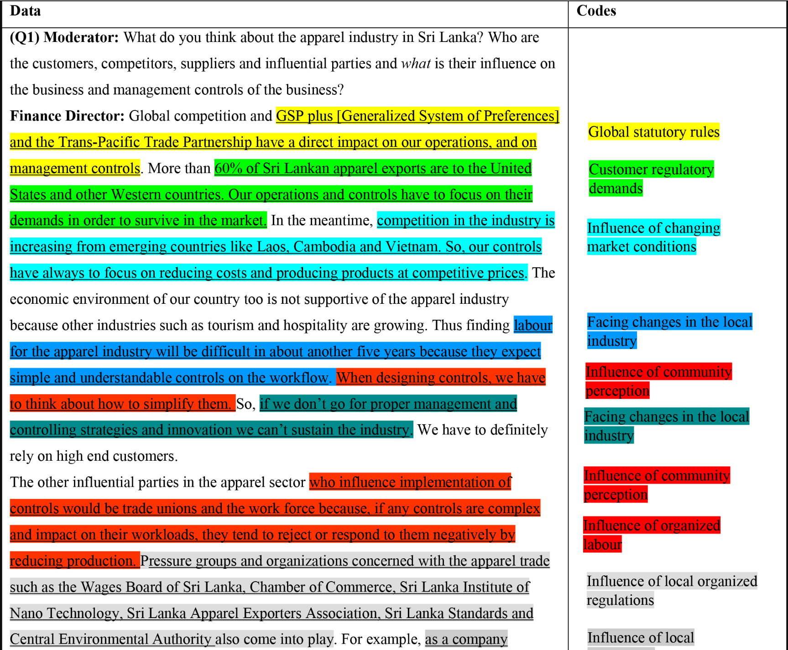
Example of Coding on a transcript.

Slide 14
Phase 3 – Searching for Themes
Not looking for something that already exists.
Aim to create a plausible and coherent thematic mapping of the data.
You may “promote” a complex code to a theme or cluster similar codes to a theme.
A theme should identify both a coherent aspect of the data and tells you something about it relevance to the research question.
The theme should represent analytical work.
Drawing thematic maps or tables – see write up PowerPoint.
Searching for Themes ends when you are only making minor adjustments to the participants themes and feel confident that your themes capture the DATA CODING and answers your research question.

Slide 15
Phase 4 – Reviewing your themes.
Review the themes in 2 ways.
Do the themes “work” in relation to the codes made (in Phase 2).
Re-read all the data involved in the codes.
Asking if the theme is a good fit for the codes involved.
If not you need to revise your themes.
Once satisfied – read the entire data for a final check for fit.
  Themes and Analysis must address your research question and reflect the data content.

Slide 16
Phase 5 – Defining and naming themes.
Once satisfied that you have searched, identified and reviewed themes you begin the process of elaborating each theme.
Theme Definitions
  Short explanations of the essence of the theme – its scope, coverage and boundaries.
Helps with the Analytical Narrative (see the write up material).
Try to capture the essence of the themes with the name.

Slide 17
Phase 6 – Writing up.

