Slide 1
Introduction to Module
Psychology for Health and Social Care
BMHP4003

Slide 2
Contents
Brief Overview
Level of Study
Aims of Module
Assessments
Submission Dates
Reading List
Moodle
Brief introduction to the history of psychology.

Slide 3
Brief Overview
Duration – 10 weeks of teaching sessions
Throughout semester 3
20 Credits
Let’s view the Moodle page for this module together.
Psychology Moodle Page

Slide 4
Aims of Module
The aim of this module is to develop understanding of the psychological factors which influence human behaviour throughout the lifespan and how these apply to health and social care settings.

Slide 5
Learning Outcomes
Upon the successful completion of this module, the student should be able to:
• Understand theories of lifespan development
• Analyse how psychological theories are applied to health and social care practice
• Examine social and biological determinants of human behaviour displayed in health and social care contexts

Slide 6
Lesson Content
This module is designed to develop students’ awareness and understanding of:
Life stages: infancy; early childhood; later childhood; adolescence; adulthood; late adulthood; final stages of life and death.
Theories of lifespan development: stage versus open-ended theories; continuity versus discontinuity; static versus dynamic theories; idiographic versus nomothetic perspectives on personality.

Slide 7
Lesson Content
Theories: behavioural, cognitive, psychodynamic and humanistic.
Theorists: Freud; Erikson; Maslow; Rogers; Piaget; other theorists as appropriate
The examination of theoretical perspectives of group and individual behaviour, such as human conditioning.
The consideration of behavioural psychology perspectives in terms of the health and social care environment/workplace.

Slide 8
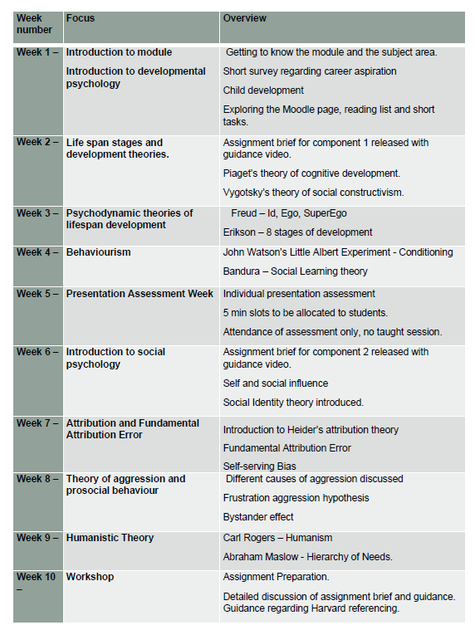
Overview of module
This is available as a pdf on the Moodle page.
Notes:
Access the overview online from the Moodle page.

Slide 9
Assessments – Full brief released wk2
Assessment Component 1 – 50%
Presentation (5mins) with annotated bibliography (1000words)
Presentation week – week 5.
Submission of annotated bibliography – end of week 5

Slide 10
Assessments – Full brief released wk2
Assessment Component 2 – 50%
Written Assignment - 1500 words
Case study.
Submission date - End of week 11 – TBC

Slide 11
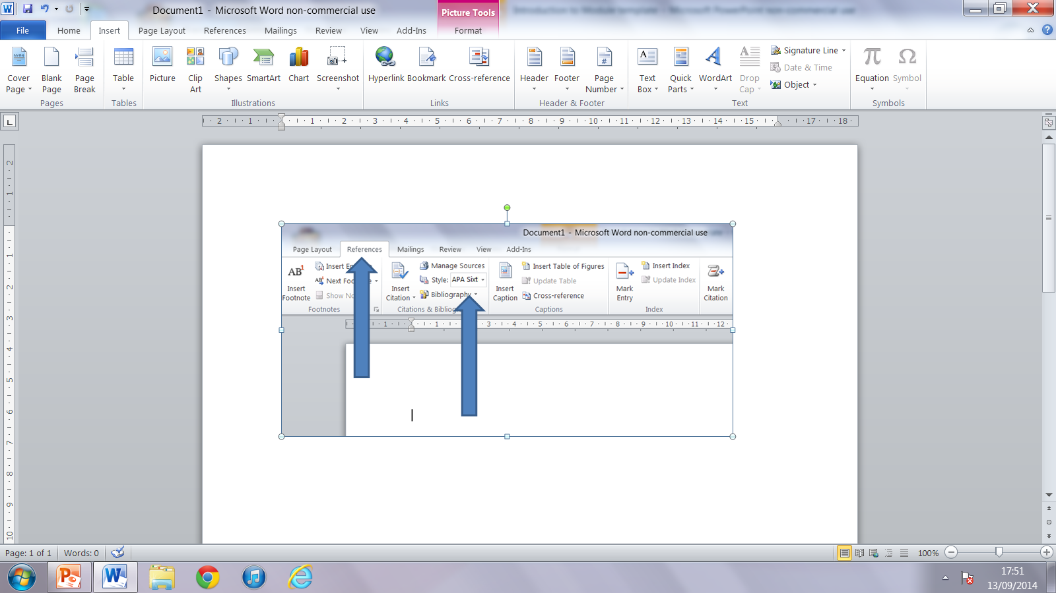
Referencing
Makes up at least 20% of your grade
Best to input
manually
You can utilise
MS Word referencing
Your referencing system is HARVARD 2008

Slide 12
Reading Lists
On the Moodle page for this module, you will find the link to the reading list for this module.
Let’s visit this together now.
The Leganto Reading list

Slide 13
Journals and Websites
Journals:
The Psychologist
British Psychological Society
Occupational Psychology
Work and Stress
Personnel Psychology
Journal of Managerial Psychology
Journal of Personality and Social Psychology
Useful Websites:
www.bps.org.uk
www.nhs.uk
www.nice.org.uk
https://www.ons.gov.uk/

Slide 14
You Will Need …
Attendance
Commitment
Participation in class tasks.
Time management
READING READING READING
Support – use academic skills and academic writing support.

Slide 15

What is Psychology?
Definition
“Psychology is the scientific study of the mind and how it dictates and influences our behaviour, from communication and memory to thought and emotion.
It's about understanding what makes people tick and how this understanding can help us address many of the problems and issues in society today.”
(BPS, 2020a, paragraph 1 and 2)

Slide 16

Origin of Psychology
Gross (2015) describes that the term psychology originates from two Greek words:
ψυχή - Psych – meaning mind, soul or spirit
and
λόγος, Logos – meaning knowledge, discourse or study.

Slide 17
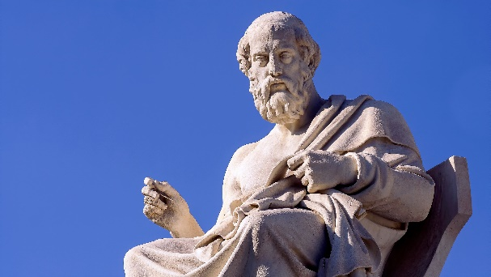
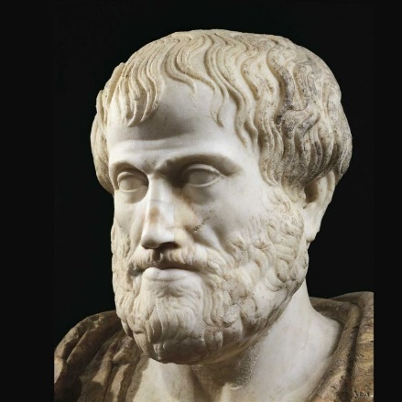
The evolution of psychology
The Influence of Aristotle and Plato
They treated behaviour as something that is logical and analytical, rather than mystical.
Plato was a nativist - he believed that certain kinds of knowledge are innate,
Aristotle was an empiricist - he believed that all knowledge was acquired through experience.
This difference can be seen in the nature versus nurture debate that continues today.
Notes:
Many of the issues that interest modern psychologists have their roots in philosophical debate from hundreds of years ago. Although the modern discipline of psychology is considered only about 140 years old, we can see that early views and beliefs of human behaviour are linked to psychology today.
The Influence of Aristotle and Plato
Very early medical doctors, physiologists and philosophers were interested in the physical workings of the human body.
Ancient Greek philosophers studied the differences between the mind and the soul and how past experience contributes to behaviour from around 600 BC.
Many of the basic ideas that we investigate in modern psychology may be traced back to two Greek philosophers: Aristotle and Plato.
They treated behaviour as something that is logical and analytical, rather than mystical. Plato was a nativist - he believed that certain kinds of knowledge are innate, whereas Aristotle was an empiricist - he believed that all knowledge was acquired through experience. This difference can be seen in the nature versus nurture debate that continues today.

Slide 18




Galen's Four Temperaments
The Roman philosopher Galen devised a model of personality types based on the ancient Greek theory of humourism, which attempted to explain how the human body worked.
The original medical model was based on the four basic elements of earth, fire, air and water. These elements had qualities that could be ascribed to four fluids in the body. Galen connected these fluids, or 'humours', to emotions or behaviours, known as 'temperaments’.
Galen's four temperaments were:
sanguine: warm-hearted, cheerful, optimistic and confident
phlegmatic: slow, quiet, shy, rational and consistent
choleric: fiery, energetic and passionate
melancholic: sad, fearful, depressed, poetic and artistic (Lester.,1990)
Notes:
He proposed that if one of these humours develops disproportionately, the related personality type begins to dominate. For example, a sanguine person has too much blood and although is warm-hearted, cheerful, optimistic and confident, could also become selfish. Galen believed that some people are born predisposed to certain temperaments but can be 'cured' through diet and exercise and, in more severe cases, through purging and bloodletting. The example of the sanguine person being too selfish could be 'cured' by cutting down on meat or by releasing some of their blood. These principles were popular in medicine until the Renaissance, and the idea that many physical and mental illnesses are connected forms the basis of many modern treatments

Slide 19
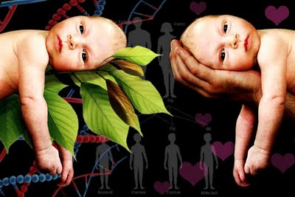
Developments During the Scientific Revolution
The arrival of the 19th century witnessed a scientific revolution through academia and scholarship. Francis Galton (1822-1911) was the first scientist to identify ‘nature’ and ‘nurture’ as two separate influences on personality. He proposed that the effects of both ‘nature’ and ‘nurture’ could be measured and compared and used his own family tree and home environment as the basis of his research.
This idea was in contrast with that of John Locke, who in 1690 proposed that the mind of every child is a blank slate (or ‘tabula rasa’). It also conflicts with Darwin, who in 1859 suggested that all human development is the result of adaptation to the environment.
(Rosales, 2010)

Slide 20
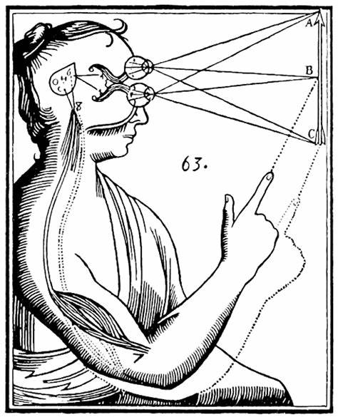
Making Links Between Mind and Body
In 17th-century France, Rene Descartes (1596-1650) was concerned with the link between the external physical world and the internal subjective experience. He concluded that body and mind are fundamentally different things, suggesting that the mind influenced the body through the pineal gland - an idea that became known as 'dualism’.
You can read more about Descartes at https://plato.stanford.edu/entries/descartes-works/ (Stanford Encyclopedia of Philosophy, 2014).

Slide 21
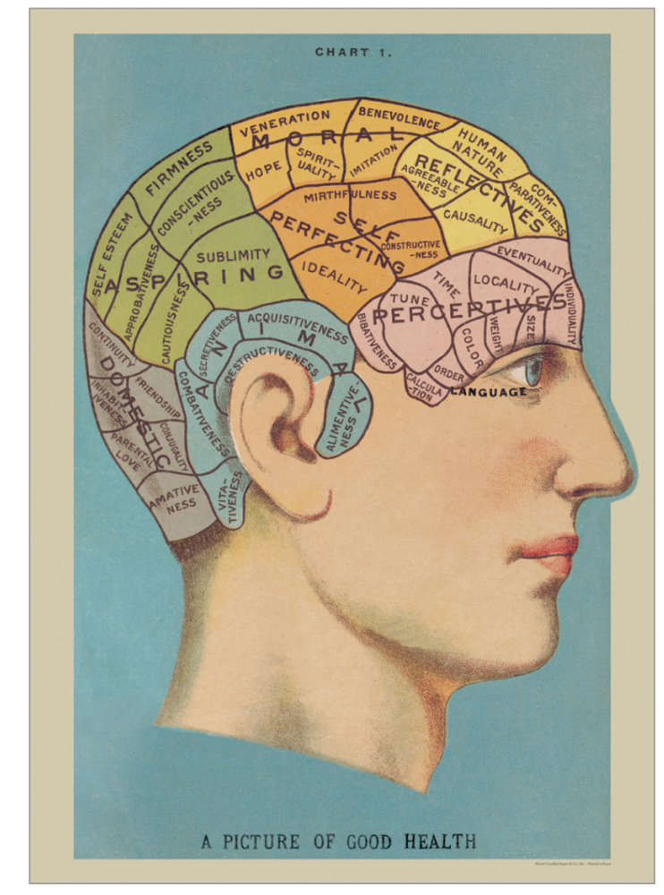
The Growth of Craniometry and Phrenology
Not everyone at this time agreed with Descartes and his theory that the mind and body were separate.
Thomas Hobbes (1588-1679) argued that the mind and body were not separate entities at all but that the mind is what the brain does. This view was later expanded by scientists such as Franz Joseph Gall (1758-1828), who believed that the mind and brain were linked but only by size.
Through examining the brains of people who had died, he found that mental ability was linked to brain size. He theorised that different areas of the brain were linked to different abilities and characteristics and that these areas could be felt through the skull. This led to a very popular movement called 'phrenology' - each human capacity was mapped onto a particular area of the brain.
Notes:
If this is something that interests you, here are a couple of magazine articles about phrenology that we recommend you read:
The Shape of Your Head and the Shape of Your Mind (Janik, 2014)
Facing a Bumpy History (Scherlinder Morse, 1997)
You might like to spend some time considering the similarities between 18th- and 19th-century advances in craniometry and physiognomy and current work in neuroscience. For example, Pierre Flourens (1794-1867) first discovered the association between different brain areas and functions such as balance and motor coordination. You may have also heard of Paul Broca (1824-1880), who was responsible for important discoveries about language function.

Slide 22
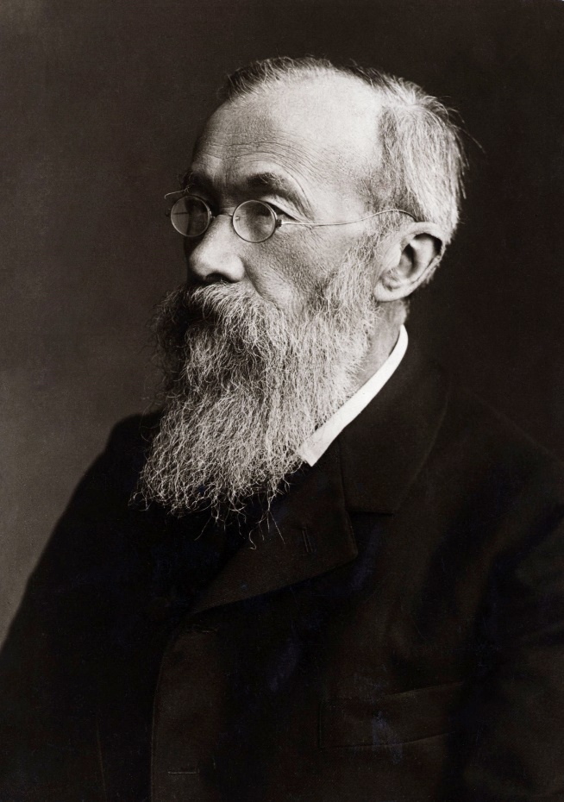
Developments During the Scientific Revolution
Gross (2015) outlines the emergence of psychology as a separate discipline from philosophy, a scientific discipline, began in 1879 when a Wilhelm Wundt opened the very first psychology laboratory.
His aim was to investigate the mind through introspection.
Notes:
The ‘controlled conditions’ were vital in beginning to create experiments that could be replicated leading to observations that could be compared between samples/participants. If the conditions were different for every participant it would be impossible to make any conclusions about what was causing any particular response. Wundt’s controlled conditions included – using the same physical surroundings, the same stimulus and the same verbal instructions. This emphasis on control as the investigator of mental processes rather than simply observing life as it happened, shifted psychology from being largely subjective to being objective and measurable, in turn this created a separation between psychology as a science and philosophy.

Slide 23
Activity – 30 mins
Complete the Moodle Quiz (week1)– History of psychology.
Password – quiz

Slide 24
Break until…
Please access the Moodle page and reading list.

Slide 25
References
BPS., (2020a) The British Psychological Society, What is psychology? Available at:
https://www.bps.org.uk/public/what-is-psychology (Accessed: 12 September 2020).
BPS, (2020b) The different areas of psychology are.. Available at: https://careers.bps.org.uk/ (Accessed: 10 September 2022).
Gross, R, D., (2015), Psychology: The Science of Mind and Behaviour 7th edn, Hodder Education Group, EBSCO Publishing : eBook Collection (EBSCOhost)
Eysenck, M, W., (2017), Simply Psychology, Taylor & Francis Group: ProQuest Ebook Central
Rosales, J., (2010), Nature vs Nurture - The Debate, Available at: http://jose-psychology.blogspot.com/2010/08/nature-vs-nurture-debate.html, (Accessed: 10 September 2022).
Lester, D. (1990) ‘Galen’s Four Temperaments and Four-Factor Theories of Personality: A Comment on “Toward a Four-Factor Theory of Temperament and/or Personality.”’, Journal of Personality Assessment, 54(1/2), pp. 423–426. doi: 10.1207/s15327752jpa5401&2_40
Carlson, N, R., Buskist, W., (2013), Psychology : UEL, Pearson Education UK, 2013. ProQuest Ebook Central,
Stanford Encyclopedia of Philosophy (2014). Descartes' life and works. Available at: https://plato.stanford.edu/entries/descartes-works. (Accessed: 9 September 2022).
The Times, (2020) Travel Expert Available at: https://www.thetimes.co.uk/expert-traveller/destinations/greece/best-islands-in-greece (Accessed: 10 September 2022).
Willow and Stone (2020), Wrap – Phrenology Head Chart Available at: https://www.willowandstone.co.uk/stationery-prints/ (Accessed: 10 September 2022).

