Slide 1
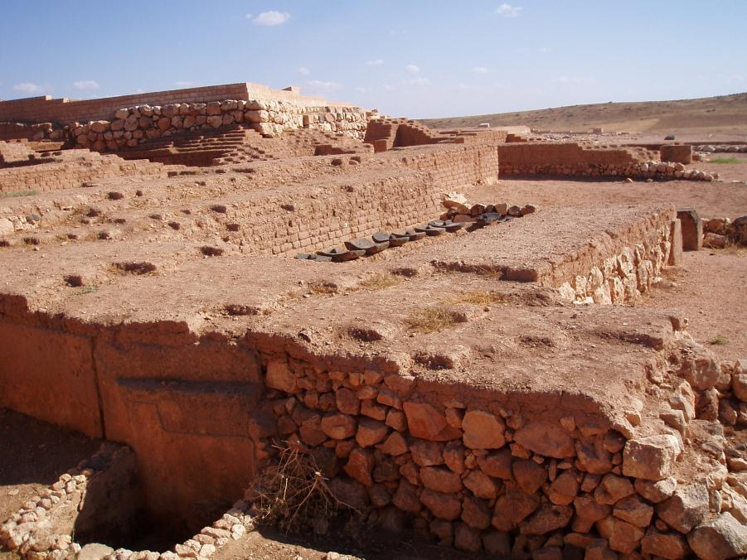
Pharaohs, Phoenicians and Peoples of the Sea
The First Towns in the East

Slide 2
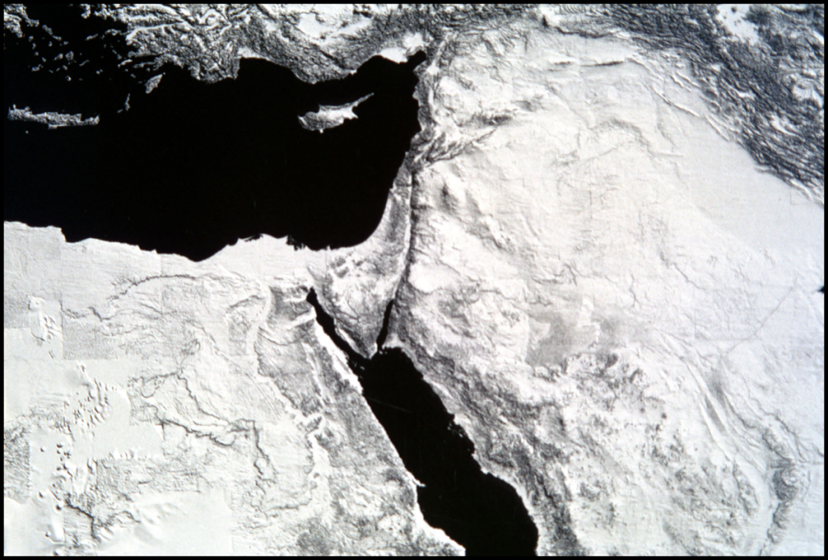
Defining the Region
Levant: Ancient Near East
Ancient Canaan
Coast of Syro-Palestine
  Syria
  Lebanon
  Palestine

Slide 3
Chronology
Southern Levant / Palestine:
  EB I c.3500-3100: Egyptian colonies
  EB II c.3100-2700 BC: first urban period (Albright 1935)
Western Syria:
  2600-2000 BC = “urban Revolution”
  Fortified cities with satellite communities
  Monumental building projects
  Writing

Slide 4
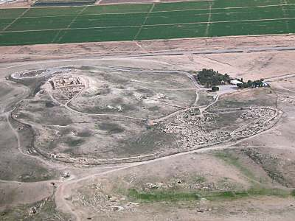
Urbanisation
What do we mean by urbanisation?
How do we define a town?
Where do towns first develop?
  And why?
Arad

Slide 5
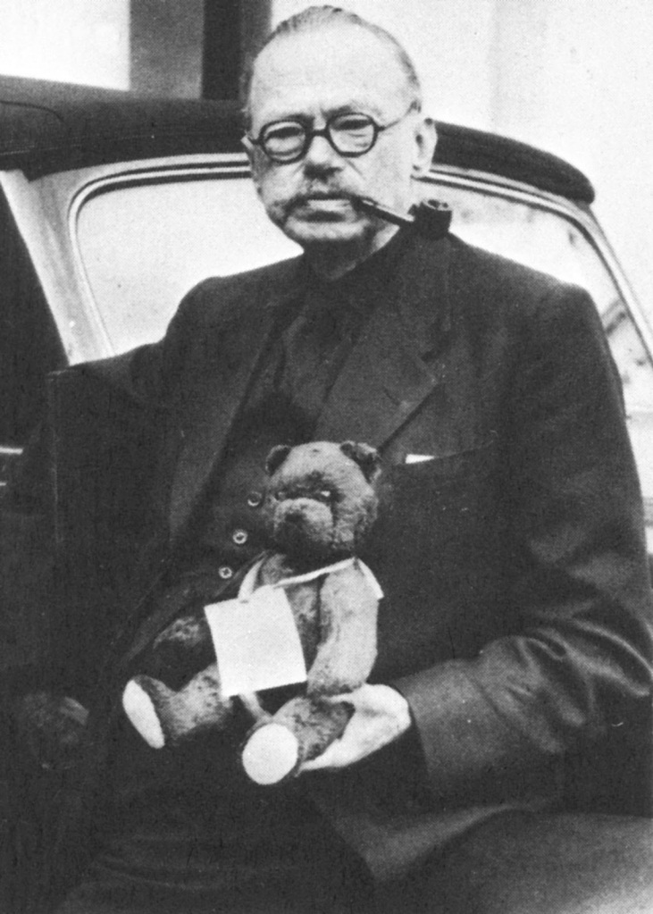
Childe’s Urban Revolution
Transformation of small, non-literate village communities into large, socially complex, urban societies
Childe applied concepts & theories from the social sciences to interpret archaeological finds
Developed model of urban revolution
  With ten separate criteria

Slide 6
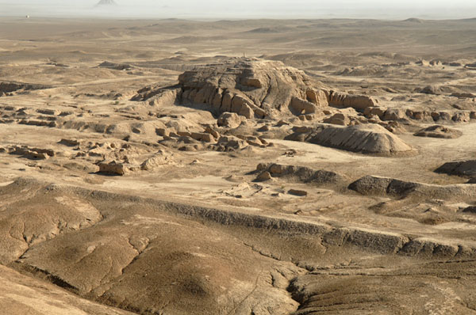
Childe’s Urban Revolution
Large population & large settlements (towns)
Full-time (craft) specialization & division of labour
Production of an agricultural surplus to support state & specialists
Monumental public architecture
A ruling class
Uruk

Slide 7
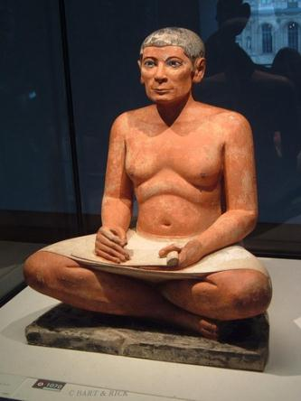
Childe’s Urban Revolution
Writing:
  Bureaucratic system of government
Exact & predictive sciences
  Arithmetic, geometry, astronomy, calendars
Sophisticated art styles
Long-distance trade (for luxuries)
The state
  Attached specialist craftsmen

Slide 8
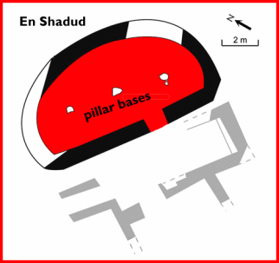
Southern Levant
EB I: contemporary with Late Dynastic & Proto Dynastic Egypt
Joffe: slow process of increasing social complexity
  control over copper resources
Small settlements (1 ha):
  villages with oval & curvilinear houses, eg. Yiftahel, En Shadud
Joffe: semi-sedentary pastoral communities

Slide 9
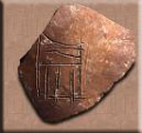
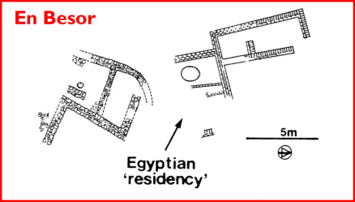
Egyptian Colonies EB I
Trade: cosmetic palettes, copper, wine
Egyptian residences, eg. En Besor &Tell Sakan
Serekh: at numerous sites (Tell Sakan, Arad)
Locally made Egyptian pottery (eg. el-‘Arieni)

Slide 10

EB II c. 3100-2700 BC
Expansion of settlement & larger sites (from 6-10 hectares up to 20-25 hectares)
First urban period in southern Levant
Characterised by emergence of city states?
  major tell sites are fortified
  a distinctive leap in socio-political organisation
  higher level of inter-site competition & intra-site organisation, all within context of an urban society
Arad

Slide 11
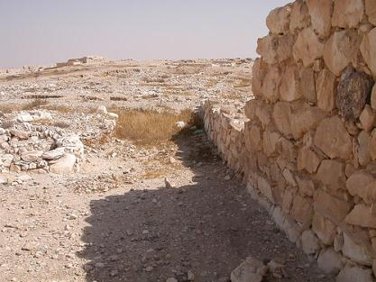
Fortifications
Arad: stone circuit wall 2.5m wide traced over 1100m
  11 (semi)-circular towers, two gates & two postern gates
‘Ai: stone wall 4-5m thick
Jericho: mudbrick wall with structural cavities built on sloping earth glacis
  Semi-circular towers & gates protected by external tower
Arad

Slide 12
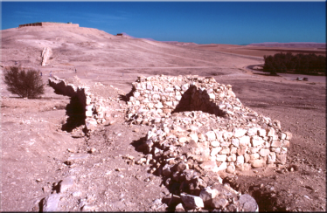
Fortifications
Create bounded spaces enclosing specialised activity areas
Control of access
Represent mobilisation of labour on a massive scale (communal projects):
  Centralised control?
Power & identity of a town
How effective were the walls for protection?
  Symbolic message in competition between sites
Arad

Slide 13
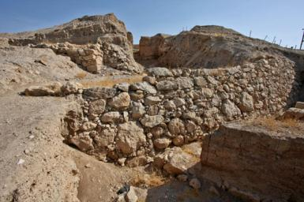
Fortifications
Control over internal population
Define a new social, political & symbolic landscape
Ability of emergent elite to plan, organise & administer construction projects
Centralisation of economic activities within the urban environment?
Jericho

Slide 14
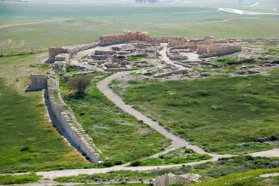
Inside the Towns
Any evidence for centralised organisation, & planning ?
Organised into compounds or insulae
Arad & ‘Ai: houses built in alignment with the fortifications
Some very large well built structures:
  Public buildings?
  Homes of elite, “patrician” families?
Arad

Slide 15
EB II c. 3100-2700 BC
Are these towns?
Why do towns develop in the southern Levant at beginning of third millennium BC?
“the outcome of a long process of social evolution, resulting in the emergence of complex society” (Gophna 1998: 273).
Joffe: state formation/urbanisation grew up following the withdrawal of Egyptian presence & end of direct overland trade with Egypt

Slide 16

Syria: 2600-2000 BC
Urban communities found throughout region:
  Fortified cities with satellite communities
Hierarchical political organisation
Monumental building projects
Lavish funerary display
Writing
Ebla

Slide 17
Settlement Hierarchy
Large towns: agriculturally dependent on hinterland
  Satellite settlements: smaller towns, villages, farmsteads
Development of settlement hierarchy
Some towns/cities are massive:
  Mari = 250 ha

Slide 18
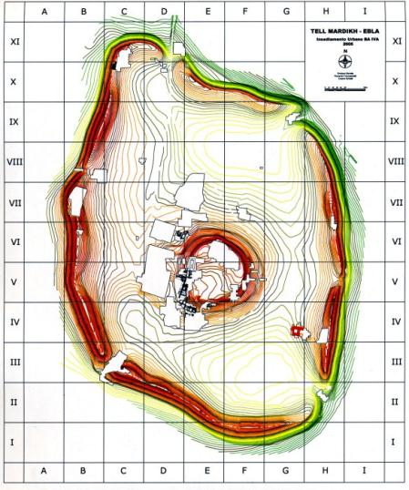
Fortifications
Increasing wealth & territorial expansion of towns: defensive
Textual evidence for military aggression
Citadel cities:
  Upper town walled
  Second wall surrounding lower town: with towers, fortified gates, buttresses, rampart & glacis
Ebla

Slide 19
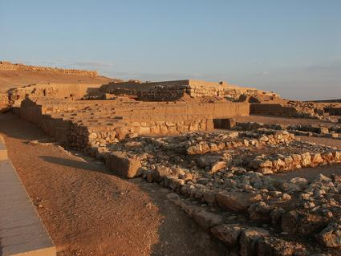
Central Buildings
Two types of central building develop in Syria:
  Religious structures: temples
  Secular buildings: palaces
Palaces: grander architecture, central location, more complex arrangement of rooms
  Elite residences?
  Individuals responsible for their construction had control over resources
  Economic role?
Ebla

Slide 20
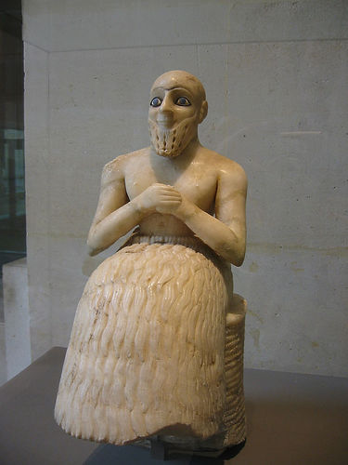
Central Buildings
Monumental sacred complexes segregated from domestic areas
  Institutionalised control of religious practices
  Economic & political role?

Slide 21
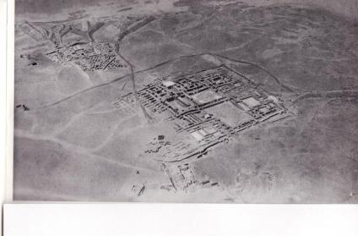
Central Buildings
Mari: Temple to Ishtar
  Built over earlier “royal” tombs
  3 construction phases
  final phase : rectangular cella & brick-pillared courtyard to north
  Foundation deposits: bronze peg & uninscribed stone tablets
  Benches with bowls
  100+ votive statues inscribed with names of individuals
Mari

Slide 22
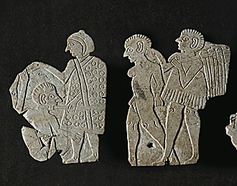
Craft Specialisation
Movement of craft specialisation away from the household
Wheelmade pottery:
  Mass-produced
  Elaborate forms
Bronzes
Attached specialists:
  Standard of Ebla

Slide 23
Summary
Significant changes in settlement organisation in Levant during 3rd millennium BC
Appearance of fortified central places in the landscape – dramatic modification of landscape & peoples’ experience of space
Significant evidence for mobilisation of labour
Elaborate architecture within the cities: early examples of palaces & temples
Craft specialisation: Syria
Are these settlements urban centres?

