Slide 1
LCBB4016
Global Business Environment
Week 2 – Introduction to the Academic and InfoSkills Programme

Slide 2
Academic and InfoSkills programme
The Academic and InfoSkills programme is designed to help you develop key academic, research, and information management skills essential for success in your studies.
It provides online learning modules that guide you on:
Finding and using reliable academic sources
Referencing correctly
Understanding academic integrity and avoiding plagiarism
Becoming an independent, confident researcher
Completing these modules will enhance your academic performance and support your assignments, reports, and dissertations.

Slide 3
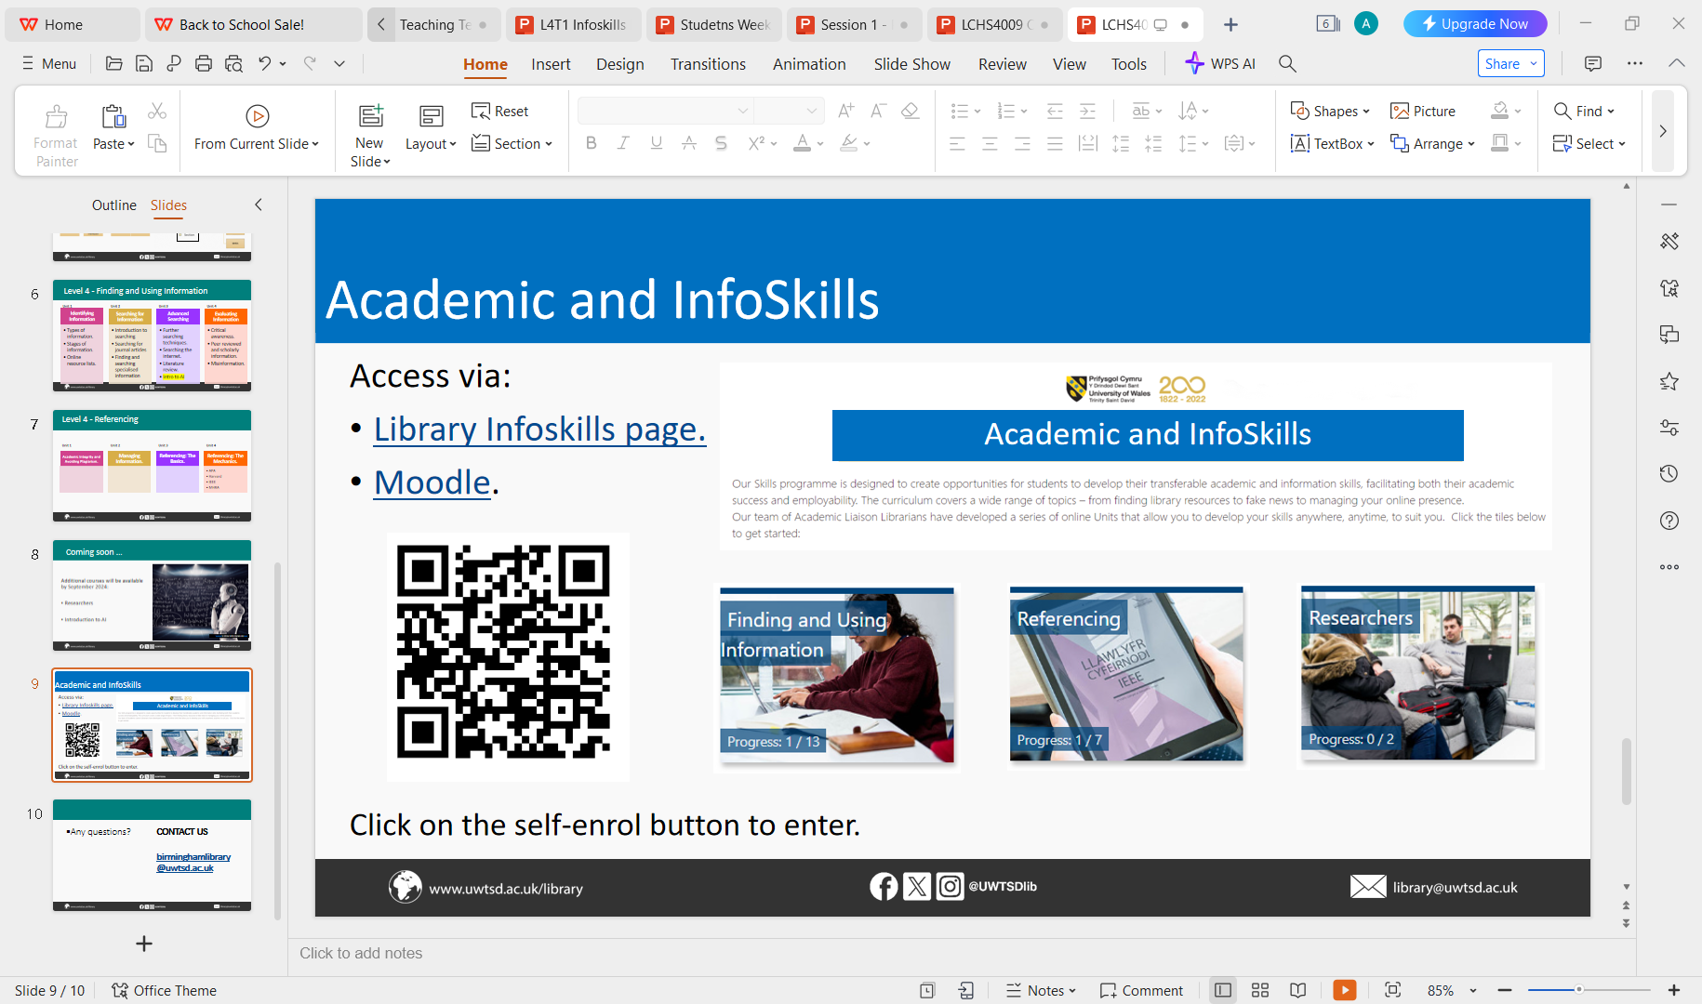
Course: Library Infoskills | Home

Slide 4
Applying What You’ve Learned
Check the content carefully and identify which sections are most relevant to your module.
Open your current assignment brief and review how the InfoSkills content - such as referencing, academic integrity, and finding reliable sources - can be applied to complete your assignments effectively.
Discuss with your classmates and tutor how these skills can strengthen your academic writing and improve the quality of your submissions.
Complete Units 1 and 2 of “Finding and Using Information” before attending next week’s session

